Slide 1
Talk: Graph embeddings as building blocks for decentralized learning.
FeatureCloud: Providing the worldwide first technological solution to ensure full patient data control
Bernd Malle Medical University Graz
Monthly FC Seminar 11/02/2020

Slide 2
WP4 – Status: Progress to date
Our original thought was to tackle graphs in a traditional way
assume a global (connected) graph
distribute it optimally or not via partitioning (KL, MCMF, RW, …)
This idea came from an experimental mindset, where we assumed having a certain dataset which we could compute globally
then split the data & compare with distributed results
Reality however will actually determine datasets and their locality (distribution for us. Also, graph types will never be ”text-book pure”
Also, in modern network representation learning approaches (RW-based / GCNs) strict graph classes are rarely (never) mentioned
Quick experiments: graph (sim) recommenders / w|d2v|ft embeddings
Conclusion: The formulation of our original work packages and tasks changed rather significantly towards GRL & node / graph embeddings…

Slide 3
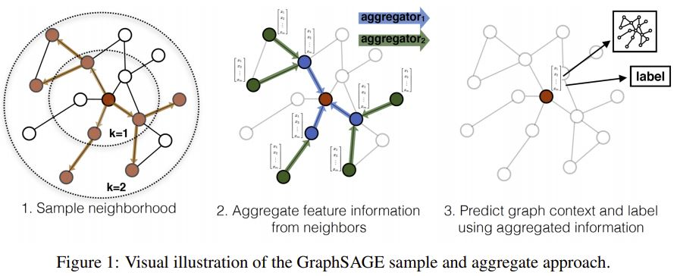
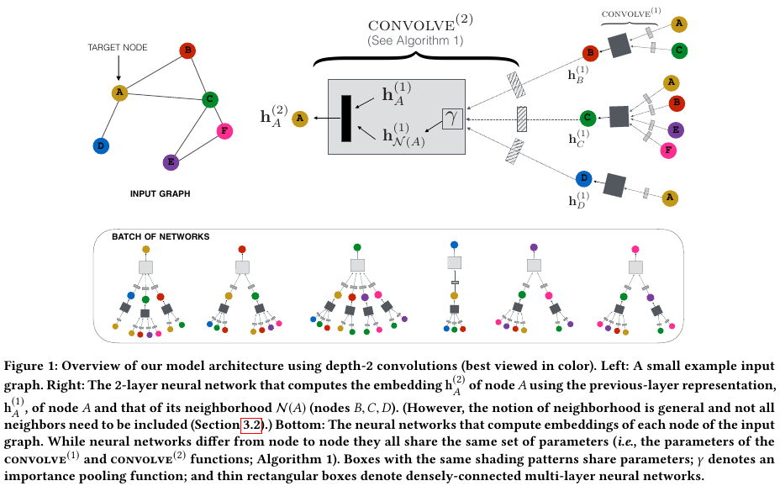
WP4 – Schematic overview of neighbourhood aggregation (GraphSAGE)
Supervised – or – unsupervised
Rex Ying, Ruining He, Kaifeng Chen, Pong Eksombatchai, William L. Hamilton, and Jure Leskovec. Graph convolutional neural networks for web-scale recommender systems. Proceedings of the ACM SIGKDD International Conference on Knowledge Discovery and Data Mining, pages 974–983, 2018. doi: 10.1145/3219819.3219890.
W. L. Hamilton, R. Ying, J. Leskovec, Inductive representation learning on large graphs, Advances in Neural Information Processing Systems 2017- Decem (Nips) (2017) 1025–1035. arXiv:1706.02216.
Sample a neighbourhood for each node
The sampling strategy can be flexible
Learn aggregation weight matrices
Aggregators can be simple (mean) or more complex
LSTMs performed really well, but we don’t know why

