Slide 1


Tutorial – MiniProject iML for k-anonymity
Bernd Malle
The Name of the Event (Workshop/Symposium) 06.03.2016
Interactive Machine Learning
for improving
K-anonymity
b.malle@hci-kdd.org
Notes:
Version ok (checked 17.12.2016)

Slide 2
Overview / Contents
What is Machine Learning?
What is interactive Machine Learning?
What is k-anonymity?
Privacy in the 21st century…?
Influence on k-anonymity on ML performance
Can we improve this via iML
Structure of experiments in AK-HCI

Slide 3
What is Machine Learning
Definition by Tom Mitchell:
“A computer program is said to learn from experience E with respect to some class of tasks T and performance measure P if its performance at tasks in T, as measured by P, improves with experience E.”
Algorithm “A” => In real world it’s a pipeline
Task T => Prediction, Clustering, Classification, DimRed
Performance P => TP, FP, Precision, Recall, F1, …..
Experience E => Two general factors:
More time
More data => better data !!!
Source: Mitchell, T.M., 1997. Machine learning.

Slide 4
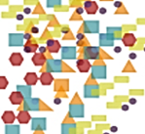
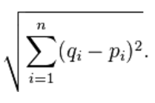

interactive Machine Learning Lifecycle
Case: data similarity:
Subset of Data
Sample
presented to User
User decides
Update data + learn Heuristics
Which two are more similar?

Slide 5

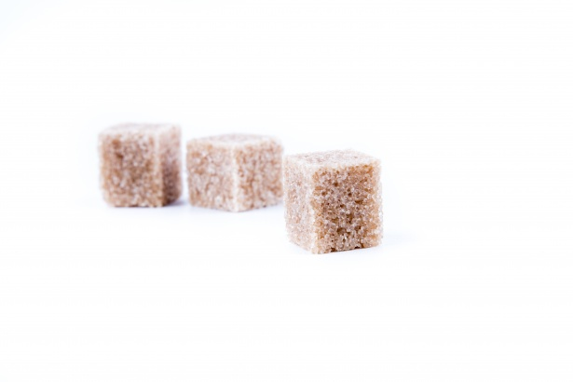

Privacy in the 21st century… ??
Privacy
Data protection laws
Technological progess

Slide 6
Properties & General Approach
Data properties => Reduce granularity
Identifiers := immediately reveal identity
name, email, phone nr., SSN
=> DELETE
Sensitive data
medical diagnosis, symptoms, drug intake, income
=> NECESSARY, KEEP
Quasi-Identifiers := used in combination to retrieve identity
Age, zip, gender, race, profession, education
=> MAYBE USEFUL
=> MANIPULATE / GENERALIZE
Name | Age | Zip | Gender | Disease
Alex | 25 | 41076 | Male | Allergies
… | … | … | … | …

Slide 7
K Anonymization criterion
k-anonymity: for every entry in the DS, there must be at least k-1 identical entries (w.r.t. QI's) => this is 3-anon:
Node | Name | Age | Zip | Gender | Disease
X1 | Alex | 25 | 41076 | Male | Allergies
X2 | Bob | 25 | 41075 | Male | Allergies
X3 | Charlie | 27 | 41076 | Male | Allergies
X4 | Dave | 32 | 41099 | Male | Diabetes
X5 | Eva | 27 | 41074 | Female | Flu
X6 | Dana | 36 | 41099 | Female | Gastritis
X7 | George | 30 | 41099 | Male | Brain Tumor
X8 | Lucas | 28 | 41099 | Male | Lung Cancer
X9 | Laura | 33 | 41075 | Female | Alzheimer
Node | Age | Zip | Gender | Disease
X1 | 25-27 | 4107* | Male | Allergies
X2 | 25-27 | 4107* | Male | Allergies
X3 | 25-27 | 4107* | Male | Allergies
X4 | 30-36 | 41099 | * | Diabetes
X5 | 27-33 | 410** | * | Flu
X6 | 30-36 | 41099 | * | Gastritis
X7 | 30-36 | 41099 | * | Brain Tumor
X8 | 27-33 | 410** | * | Lung Cancer
X9 | 27-33 | 410** | * | Alzheimer

Slide 8
Limits of anonymization
Trade-off between:
Data utility => min. information loss
Privacy => max. information loss
Both can be easily achieved (but not together ☺)
Node | Name | Age | Zip | Gender | Disease
X1 | Alex | 25 | 41076 | Male | Allergies
X2 | Bob | 25 | 41075 | Male | Allergies
X3 | Charlie | 27 | 41076 | Male | Allergies
X4 | Dave | 32 | 41099 | Male | Diabetes
X5 | Eva | 27 | 41074 | Female | Flu
X6 | Dana | 36 | 41099 | Female | Gastritis
X7 | George | 30 | 41099 | Male | Brain Tumor
X8 | Lucas | 28 | 41099 | Male | Lung Cancer
X9 | Laura | 33 | 41075 | Female | Alzheimer
Node | Age | Zip | Gender | Disease
X1 | * | * | * | Allergies
X2 | * | * | * | Allergies
X3 | * | * | * | Allergies
X4 | * | * | * | Diabetes
X5 | * | * | * | Flu
X6 | * | * | * | Gastritis
X7 | * | * | * | Brain Tumor
X8 | * | * | * | Lung Cancer
X9 | * | * | * | Alzheimer

Slide 9
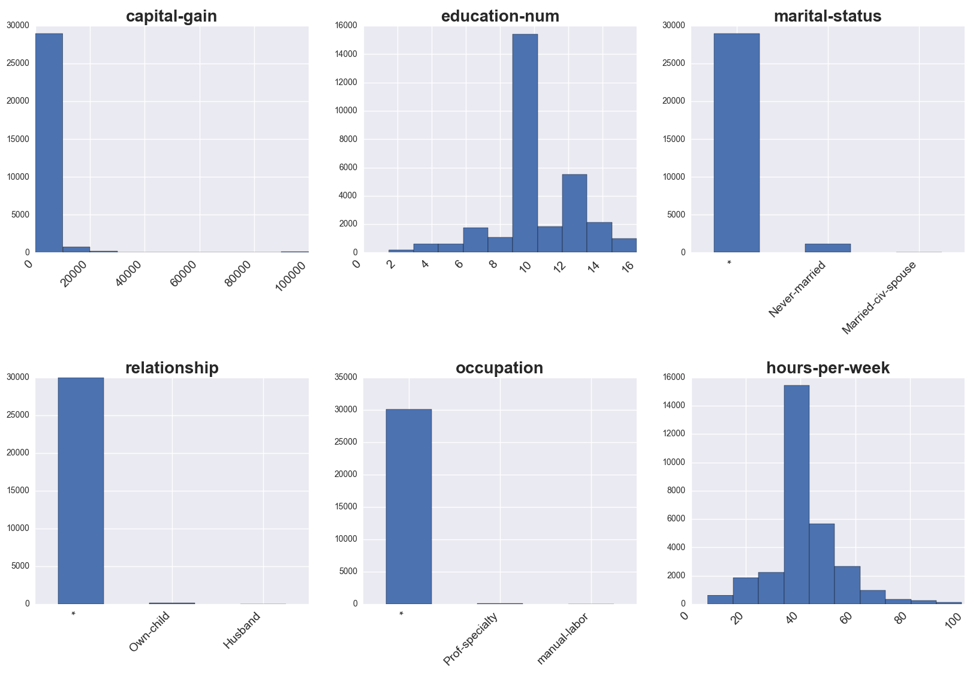
Anonymization - datasets
Notes:
Non-obvious for the numerical columns
Ranges => Averages of ranges…
Of course you get one of those for each combination of k-factor / weight vector applied…

Slide 10
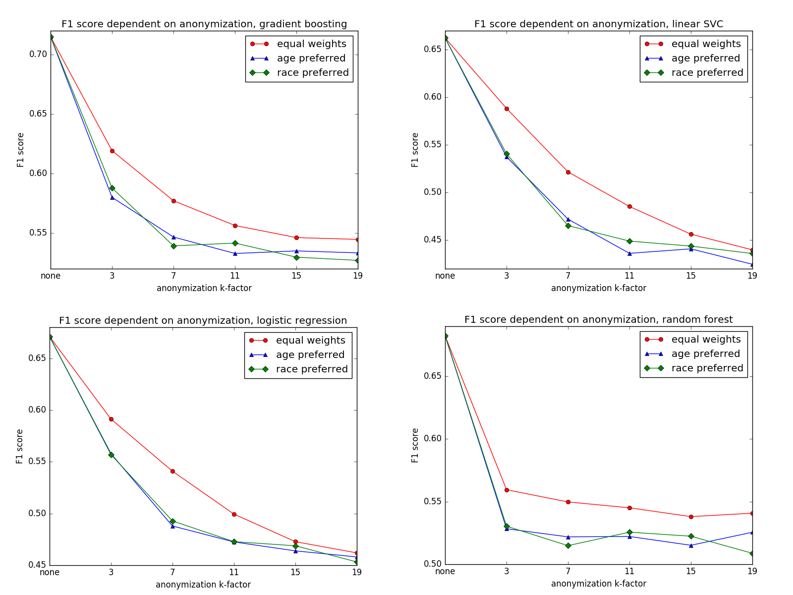
ML on Anonymization - Results
Notes:
There’s much more loss incurred directly at the “beginning”

Slide 11
Adapting Weight Vectors 1/2
[51 - 76] | * | North_America | Male | * | Married-civ-spouse
[51 - 76] | * | North_America | Male | * | Married-civ-spouse
[51 - 76] | * | North_America | Male | * | Married-civ-spouse
57 | Private | United-States | Male | White | Married-civ-spouse
[48 - 70] | Private | America | Male | White | *
[48 - 70] | Private | America | Male | White | *
[48 - 70] | Private | America | Male | White | *
Notes:
Question of weight vectors:
REVERSE MENTAL MODEL
Age => Probably interesting for many application areas
Race => Maybe interesting for certain kinds of diseases
Marital status => e.g. insurance companies want to conduct risk assessment for household policy

Slide 12
Adapting Weight Vectors 2/2
Applying a weight vector to our desired columns will change our cost function and thereby produce different anonymization results:
age | workclass | native-country | sex | race | marital-status
0.1667 | 0.1667 | 0.1667 | 0.1667 | 0.1667 | 0.1667
age | workclass | native-country | sex | race | marital-status
0.95 | 0.01 | 0.01 | 0.01 | 0.01 | 0.01

Slide 13
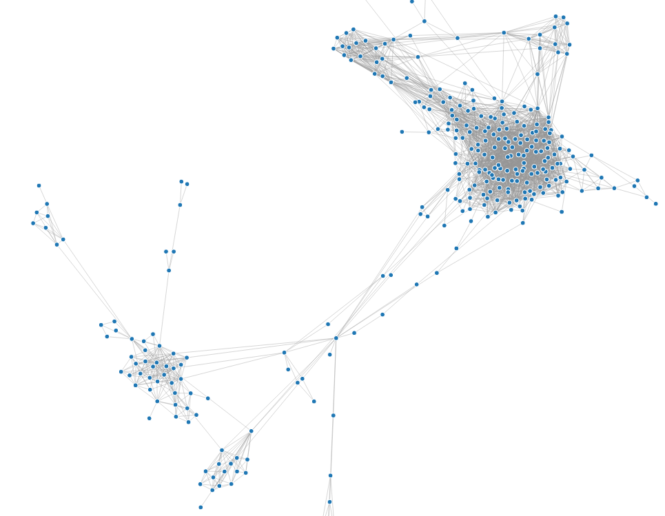

Graph based data sets
Graph data / social network data, in which
nodes represent microdata
edges represent their structural context
graph data are harder to anonymize
It's harder to model the background knowledge of an attacker.
It is harder to quantify the information loss of modifications.
?

Slide 14

Thank you!
Notes:
My DEDICATION is to make data valuable … Thank you!

