Slide 1


CD-MAKE 2017
The more the merrier -
Federated learning from local sphere recommendations
Bernd Malle, Nicola Giuliani, Peter Kieseberg and Andreas Holzinger
b.malle@hci-kdd.org

Slide 2
Introduction and Motivation
Thinking about Machine learning from a *European* startup perspective
Which brings a few particular challenges with it:
Usually less startup capital than U.S. competitors
=> therefore less money for computing power
much fewer possible customers (initially) than Asian competitors
=> less initial data
GDPR is a major impediment
=> expressely prohibits use of personal data...
Maybe we can circumnavigate all those hurdles via
Client-side Machine Learning
Notes:
Prepared for having this law now only applied to front-end databases but also to statistical of ML knowledge bases…

Slide 3
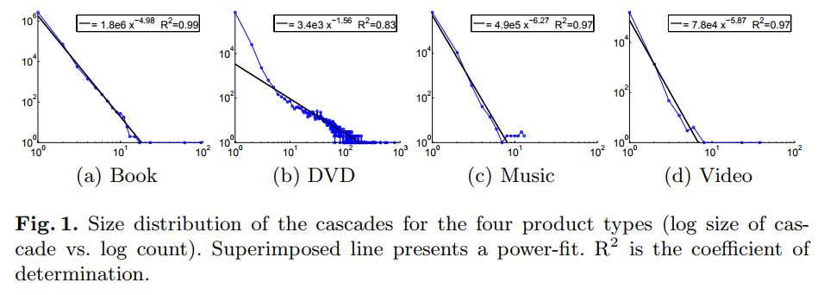
Introduction and Motivation
How far away are relevant decision points within a social networks usually?
Leskovec, even back in 2006 observed recommender cascades within an online shopping system
for 3 out of 4 products: maximum size of cascade was < 10
Leskovec, Jure, Ajit Singh, and Jon Kleinberg. "Patterns of influence in a recommendation network." Pacific-Asia Conference on Knowledge Discovery and Data Mining. Springer, Berlin, Heidelberg, 2006.
Notes:
Prepared for having this law now only applied to front-end databases but also to statistical of ML knowledge bases…

Slide 4
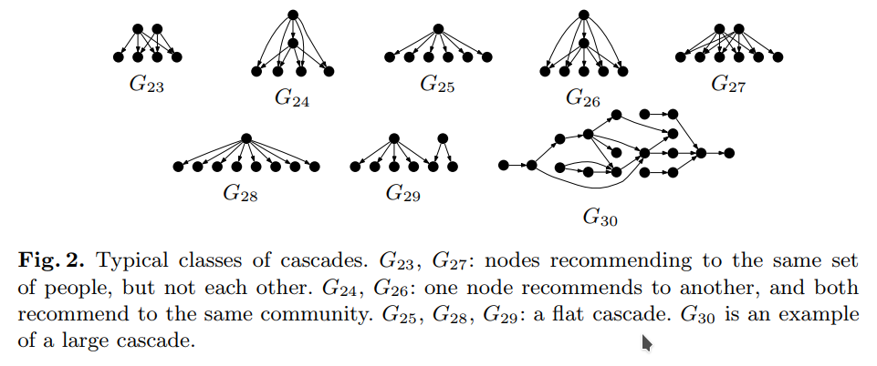
Recommendation Cascades
most were not chains, but one node influencing many others (splits) or several recommendations directed at one node (merges)
single recommendations made up the majority of 'cascades'
overall, the average ego network from which relevant recommendations originated was little more than 1(!)
Leskovec, Jure, Ajit Singh, and Jon Kleinberg. "Patterns of influence in a recommendation network." Pacific-Asia Conference on Knowledge Discovery and Data Mining. Springer, Berlin, Heidelberg, 2006.

Slide 5
Introduction and Motivation
the FB graph has been estimated to have a diameter of as low as 4
the diameter is shrinking with new connections (despite new users)
although the graph is globally very sparse, individual node neighborhoods contain surprisingly dense structure
Conclusion: We dont need the whole graph to calculate good recommendations – in most cases we only need to take a node's immediate vicinity into account!
Notes:
Prepared for having this law now only applied to front-end databases but also to statistical of ML knowledge bases…

Slide 6
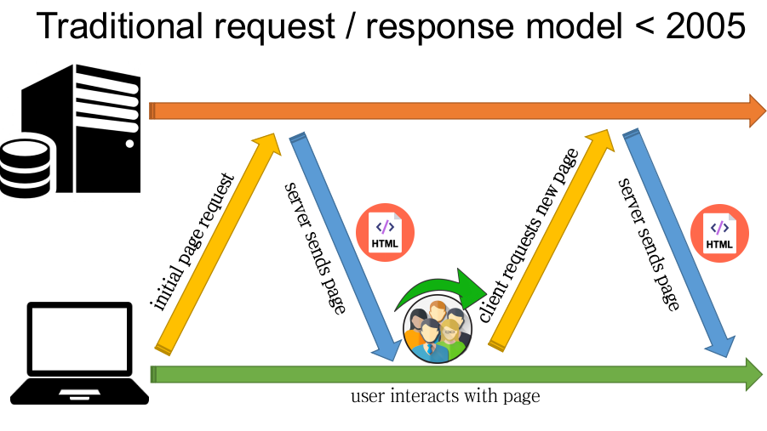
Traditional request / response cycle

Slide 7
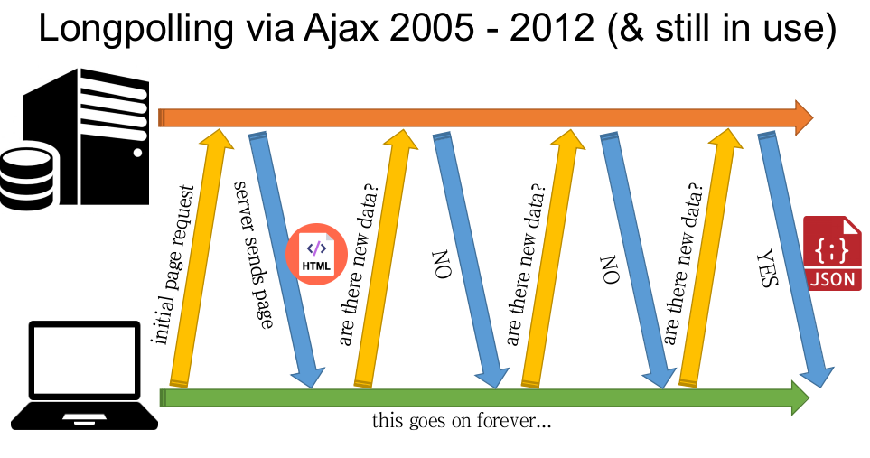
Longpolling / Ajax

Slide 8
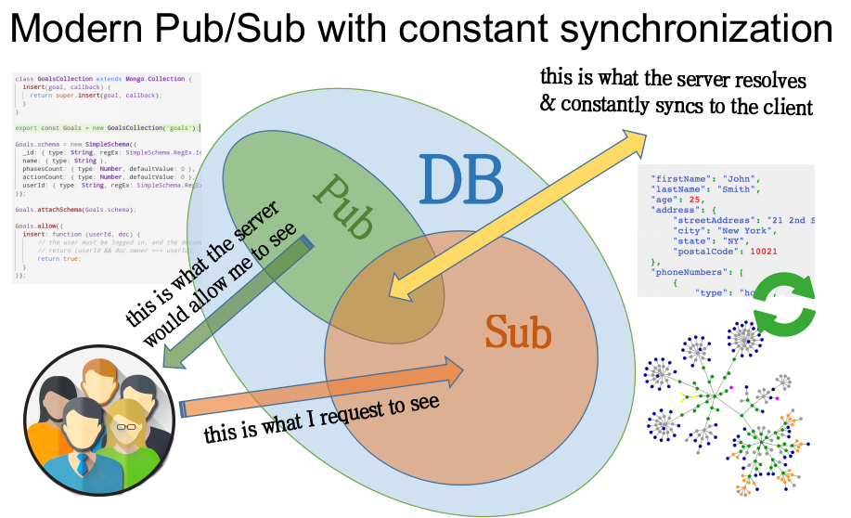
Publish / Subscribe with automatic updates

Slide 9
Consequences of Pub/Sub
This means in effect, that all information within the neighborhood of a node (if you see it from a network perspective) is constantly available within the browser / mobile device
my direct friends on a social network
the information / resources within my project group
Combining the two principles of Pub/Sub and recommender cascades, we see that a majority of relevant recommend-dations could be computed directly on the client
Notes:
Prepared for having this law now only applied to front-end databases but also to statistical of ML knowledge bases…

Slide 10
Global sphere / Local sphere
Many globally distributed databases dont have to / cannot be implemented as a graph (facebook also does not store one central graph, but rather superimposes relational DBs with a logical graph layer - GraphQL)
would need too many globally propagating updates –
"the consequences of a tiny node update could affect the farthest reaches of the global graph"
The local sphere can get it's information from many pub/sub mechanism targeting different endpoints in the global sphere
The local sphere is a superset of the actual user's data enriched with data from it's relevant vicinity, plus possibly sensitive information only available on the client itself.
Notes:
Prepared for having this law now only applied to front-end databases but also to statistical of ML knowledge bases…

Slide 11
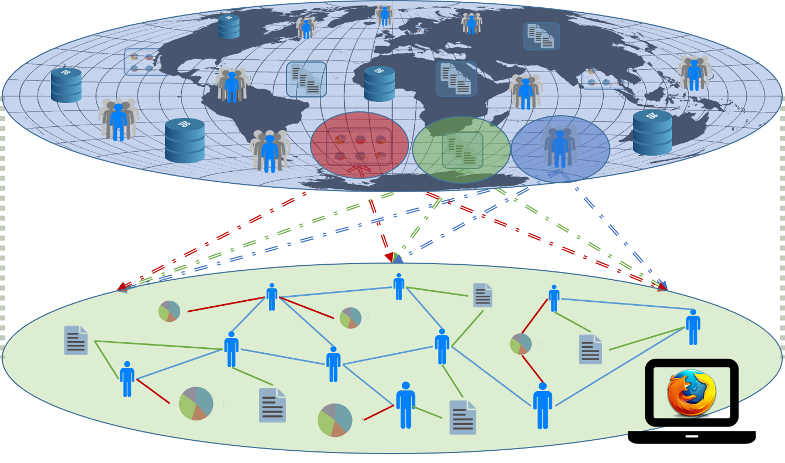
Global Sphere / Local Sphere / User data
GraphQL / Websockets / etc.

Slide 12
Advantages
GDPR says processing of personal data is expressely prohibited
but they are talking about data you collected
what if you haven't collected it because it never left the users' device?
You can potentially use a wealth of information available on the client device you could never access server-side
- address book
- calendar
- GPS
- emails
- messaging services
- …..
Notes:
Prepared for having this law now only applied to front-end databases but also to statistical of ML knowledge bases…

Slide 13
Advantages (coming back to the startup idea)
BYOPP - "Bring your own processing power"
- World's fastest supercomputer can do 93 Petaflops
- A Geforce 1080 runs at about 12 Teraflops (single prec.)
- You need ~7,750 customers with such cards to reach the TaihuLight
- iPhone 7: GPU operates at 729.6 GFLOPS
- ~130k iphones stack up to the TaihuLight
of course apps can never access the full potential of a client device (think of battery alone…), but those numbers give a good feeling about the magnitude we're talking about
a few hundred thousand users is not much for a successful startup today => SCALABILITY !!!
Notes:
Prepared for having this law now only applied to front-end databases but also to statistical of ML knowledge bases…

Slide 14
Proposed mechanism
Pub/Sub keeps the local sphere in sync with global data
Local algorithms compute recommendations
these can also come from a client-side crawler (like the FB crawler which scans URLs you paste into a comment field and extracts images from a website)
Upon user acceptance, a new node is introduced into the local sphere + updated to the global sphere
Client devices with overlapping local spheres now receive that node in the background
Their recommenders respond… => 1…
Notes:
Prepared for having this law now only applied to front-end databases but also to statistical of ML knowledge bases…

Slide 15
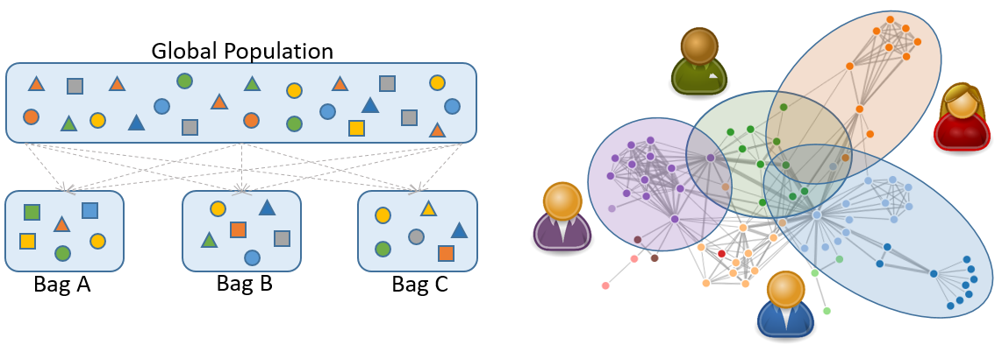
Machine Learning / Conclusion
Maybe it's even possible to implement Machine Learning paradigms on such a distributed platform (see bagging below)
Eventually, we might not even have to curate a global graph anymore - it could be a virtual, implicit, query-able instantiation of the sum of all local spheres at any given point in time!

Slide 16

Thank you!
Notes:
My DEDICATION is to make data valuable … Thank you!

