Slide 1
WP4 ‒ Supervised Federated ML
FeatureCloud: Providing the worldwide first technological solution to ensure full patient data control
Bernd Malle Medical University Graz
4th FC Consortium meeting 09/01/2020

Slide 2



WP4 – Status: Progress to date
Please list your progress on milestones and deliverables of your WP here in this overview table:
No. | Title | Month | Date | Status
D 4.1 | “Survey on graph parallelism” | 6 | 12/31/2019
D 4.2 | “Survey on graph types” | 6 | 12/31/2019
D 4.4 | “Experimental results for shape and composition of connection surfaces” | 18 | 12/31/2020
MS 25 | “Insight into graph partitions” | 18 | 12/31/2020

Slide 3
WP4 – Status: Progress to date
Please briefly describe your progress on milestones and deliverables of your WP here:
First item
Second item
Third item
First sub item
Second sub item

Slide 4
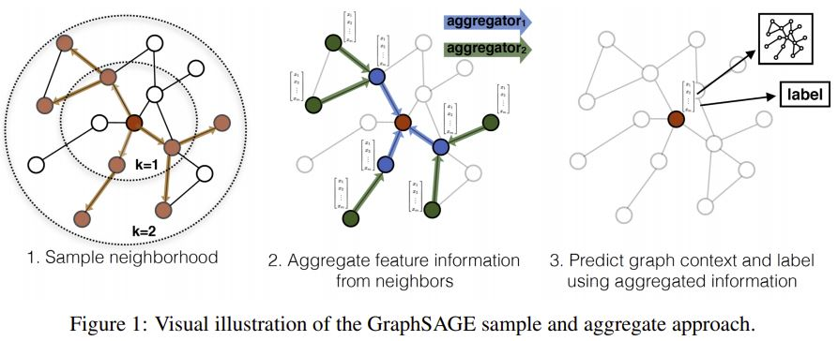

Slide 5
WP4 – What have we learned?
Please list and explain your findings (and add examples) within the last month.
First item
Second item
Third item
First sub item
Second sub item

Slide 6
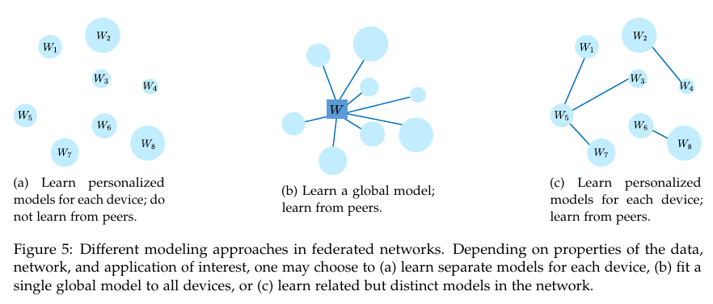

Slide 7
WP4 – Next important steps
Please briefly provide an outlook of the important steps for the next 6 months.
First item
Second item
Third item
First sub item
Second sub item

Slide 8
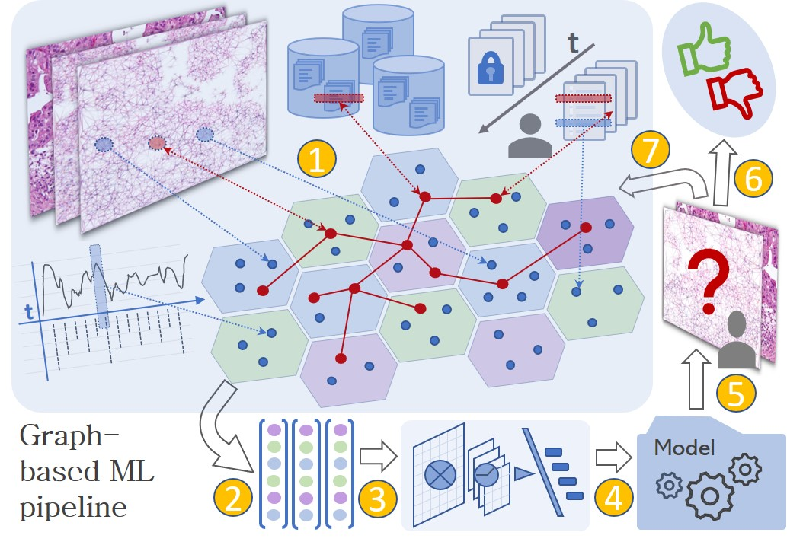
WP4 – Grand vision

Slide 9
WPX – Critical issues & items for discussion
Please list here critical issues (problems, open questions, etc.) for your WP:
First item
Second item
Third item
First sub item
Second sub item

Slide 10
Please mind the time for your presentation - see agenda.
Thank you.

Slide 11
Power Point Presentation
Design and sample slides

Slide 12
Placeholder for a headline
Type your copy text here …
Bullet list:
First item
Second item
Third item
First sub item
Second sub item

Slide 13
FeatureCloud colour palette
Data blue 0 R 70 G 150 B
Cloud blue
30 R 190 G 230 B
Safety green
200 R 210 G 0B

Slide 14
FeatureCloud table design
Table Header
Body content

