Slide 1


Data Engineering use case

Slide 2
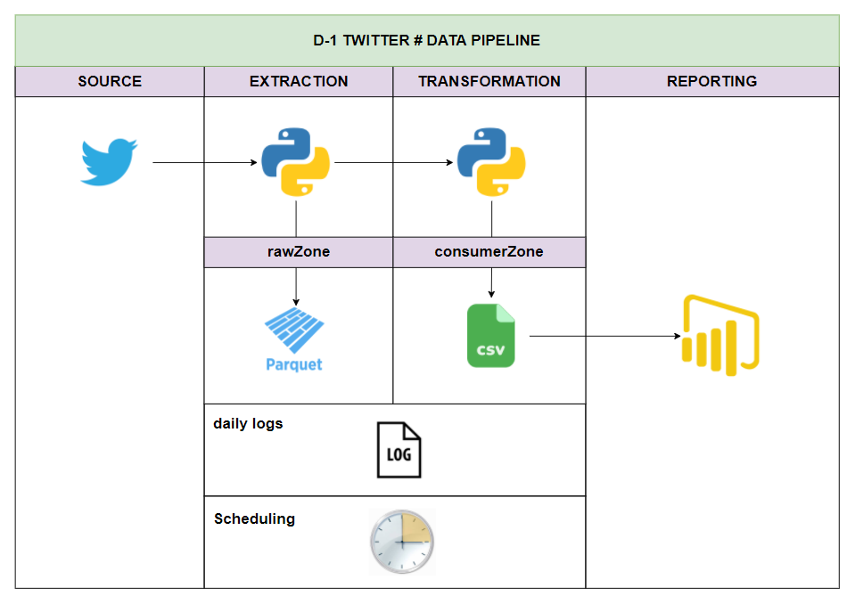
ETL Architecture

Slide 3
ETL Architecture

Slide 4
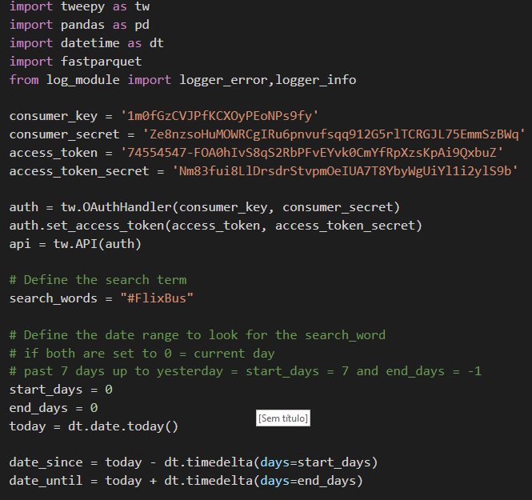
ETL Architecture – Extraction Script

Slide 5
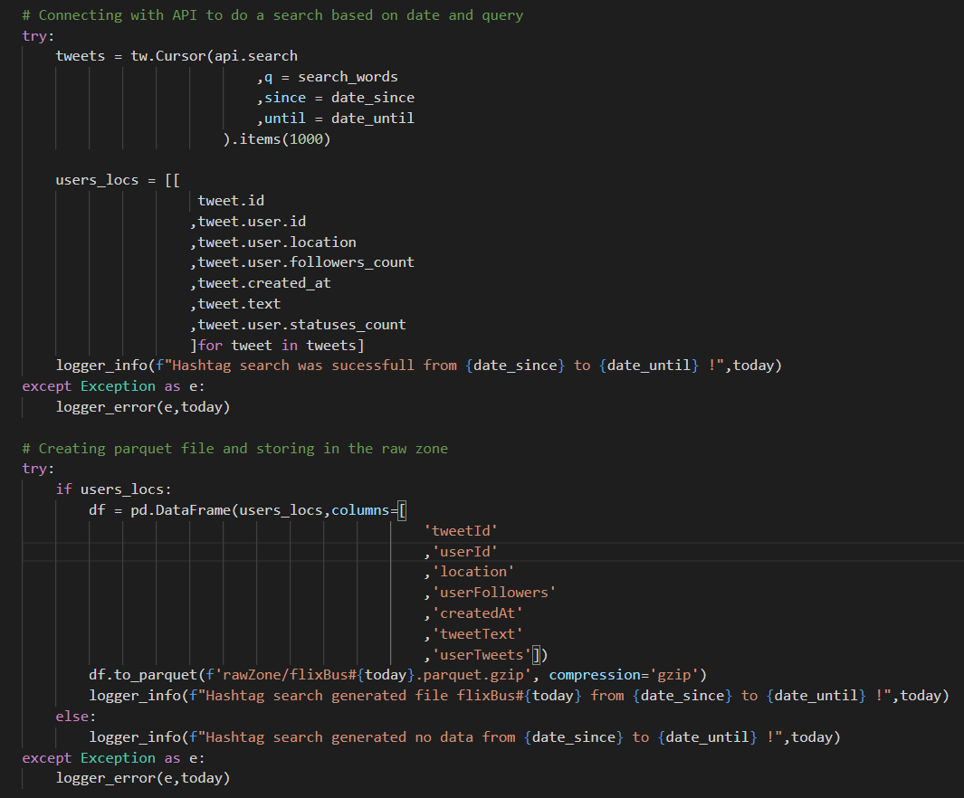
ETL Architecture – Extraction Script

Slide 6
ETL Architecture

Slide 7
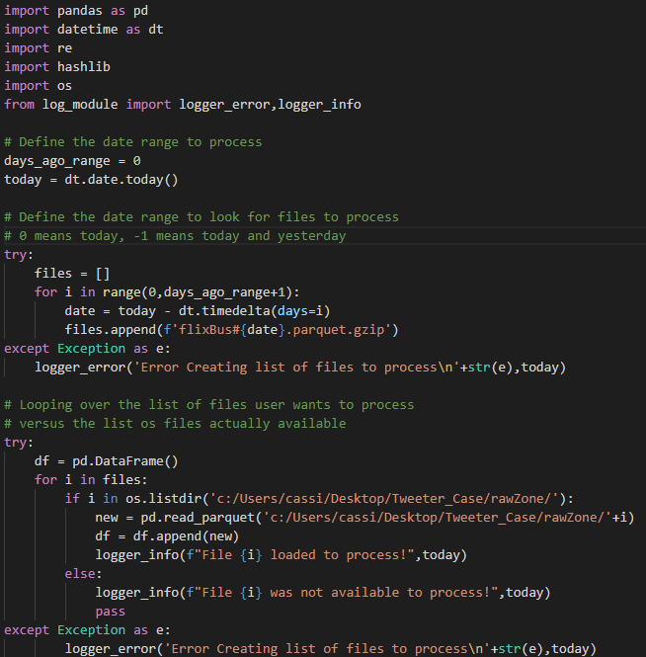
ETL Architecture – Transform Script

Slide 8
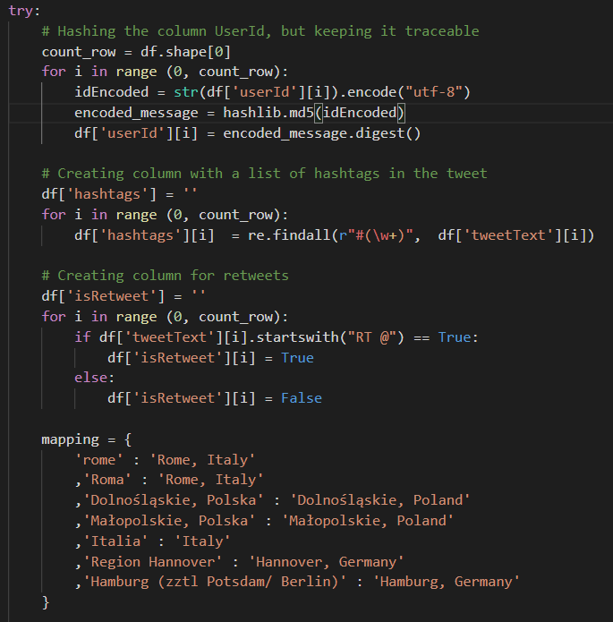
ETL Architecture – Transform Script

Slide 9
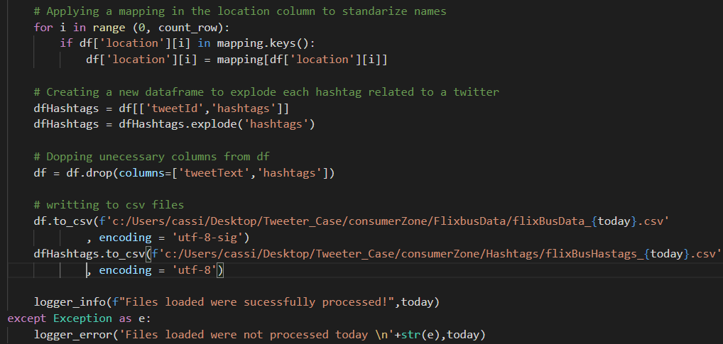
ETL Architecture – Transform Script

Slide 10
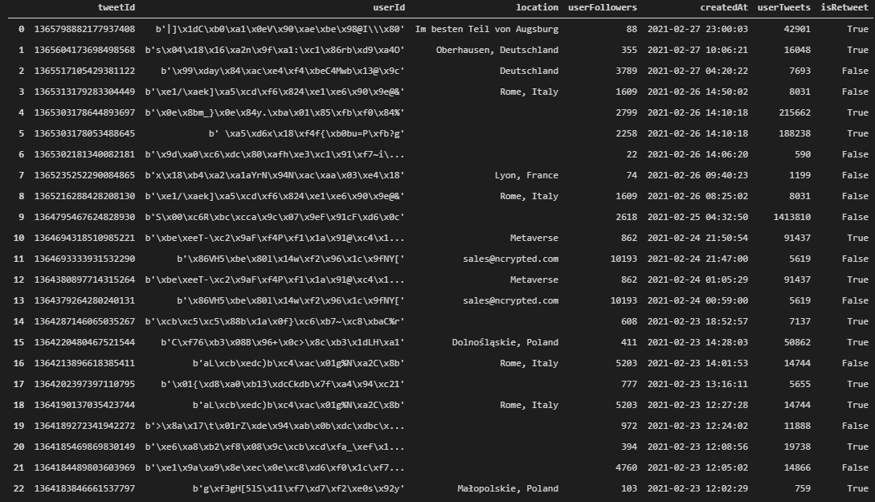
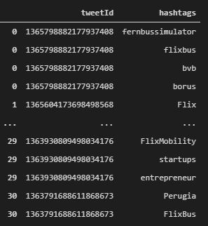
ETL Architecture – Table Results

Slide 11
ETL Architecture

Slide 12
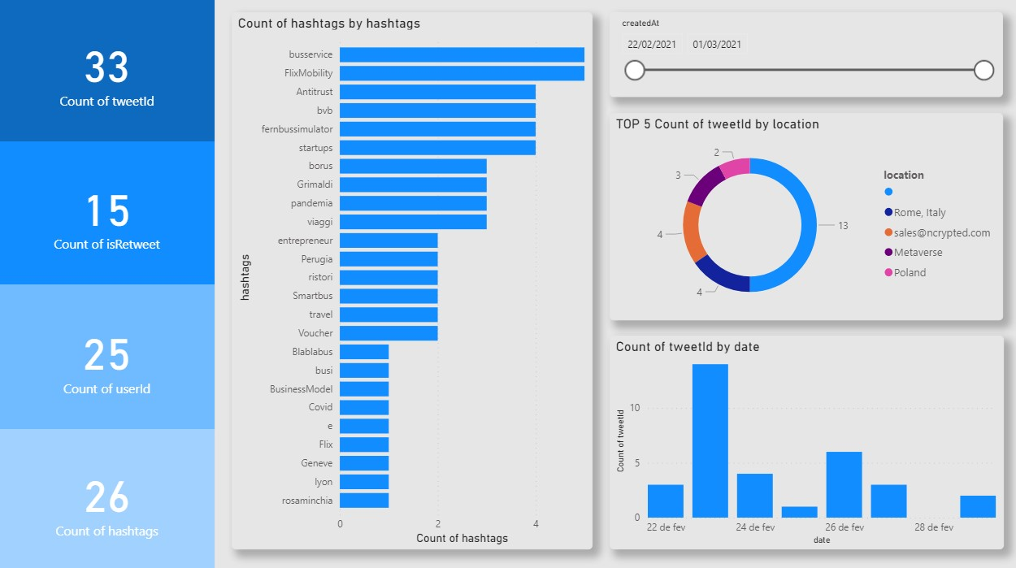
ETL Architecture – Reporting

Slide 13
ETL Architecture - Logging

Slide 14
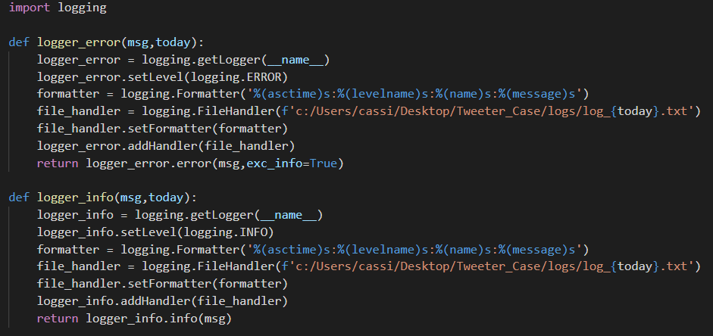
ETL Architecture – Logging – log_module

Slide 15

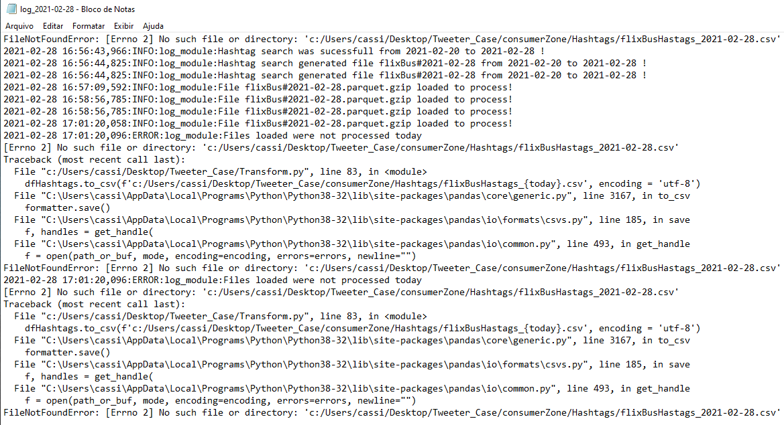
ETL Architecture – Logging – log_module

Slide 16
ETL Architecture - Scheduling

Slide 17
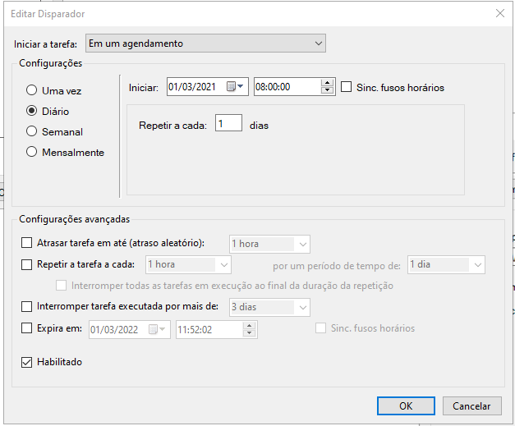
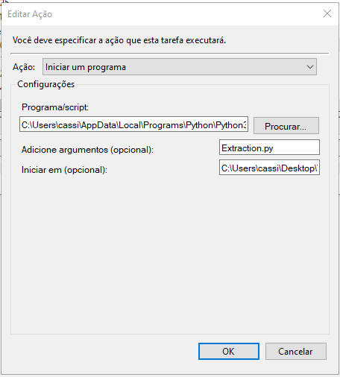
ETL Architecture - Scheduling

Slide 18
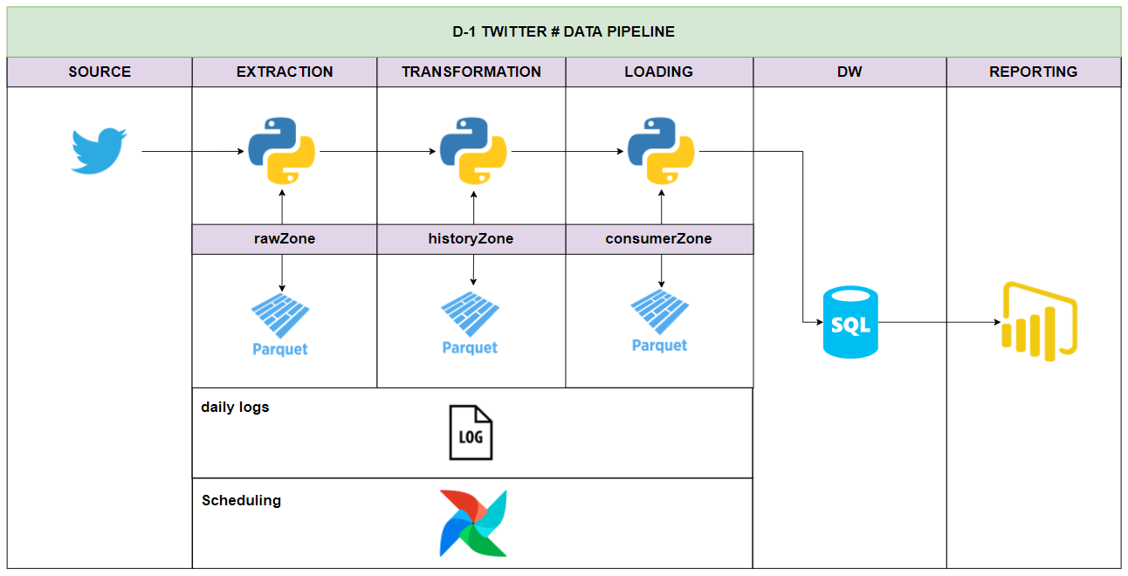
ETL Architecture - Improvements

Slide 19
ETL Architecture - Improvements
Implement cursor pagination in extraction, to handle bigger volumes of data
HistoryZone
All files zones in parquet
DW for data distribution
Location Mapping in na external file
Normalize data in DW and enhance with external sources
Schedule with Airflow for better chainning and monitoring
Reduce some loops
Define functions

Slide 20
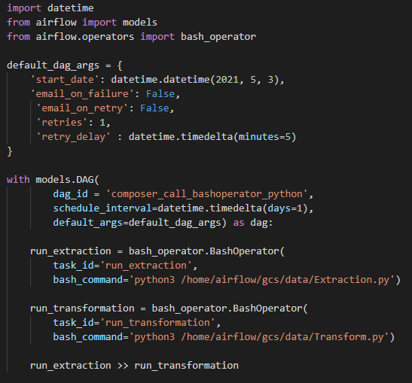
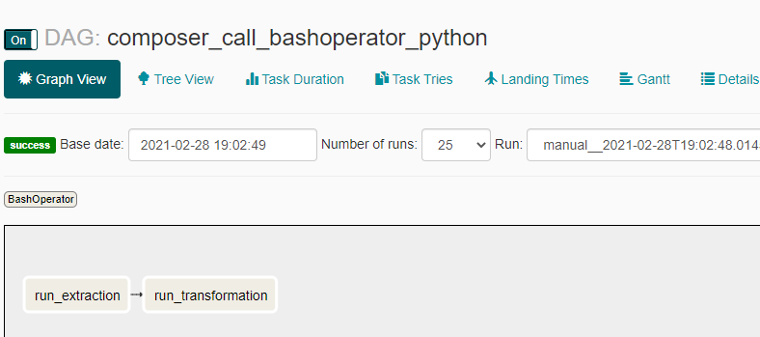
ETL Architecture - Improvements

Slide 21
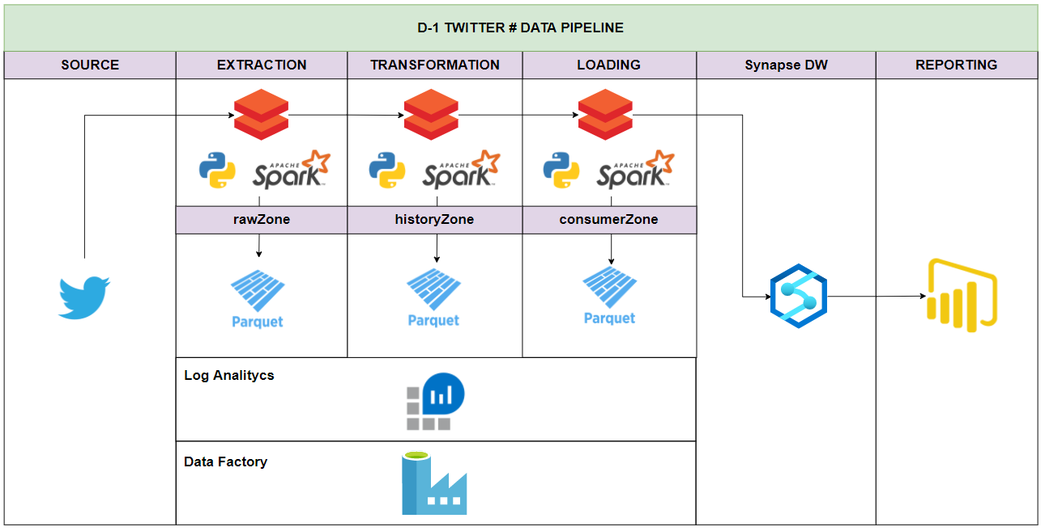
ETL Architecture - Proposal

Slide 22
ETL Architecture - Proposal
- Azure Blob storage Gen 2 as datalake
Databricks notebooks running spark/pyspark/pysql/sql
Parquet in all storage layers
Orchestration via Azure Datafactory
Azure Synapse Analytics as DW
Power Bi in Reporting Layer
Log Analytics as logging service
Azure DevOps as Versioning and CI/CD

