Slide 1
FlashFill++:
Scaling Programming by Example
by Cutting to the Chase
1600 x 800
1600 x 800
1600 x 800
JOSÉ CAMBRONERO - SUMIT GULWANI - VU LE - DANIEL PERELMAN ARJUN RADHAKRISHNA - CLINT SIMON - ASHISH TIWARI
Microsoft, USA
Cassio Luis Zamignan Forte Felippe cassioluis12@gmail.com

Slide 2
1600 x 800
1600 x 800
1600 x 800
Principles of Programming Languages
January 2023
Published by ACM | Organized by ACM SIGPLAN

Slide 3
1600 x 800
1600 x 800
1600 x 800
Programming-By-Examples (PBE)

Slide 4
Programming-By-Examples (PBE)
1600 x 800
1600 x 800
1600 x 800
PBE is a technique for teaching a computer new behavior by demonstrating actions on concrete examples.
PBE applications range from:
enabling non-experts to author programs for spreadsheet data manipulation
application creation in a low-code/no-code setting
automating professional developers’ repeated edits

Slide 5
1600 x 800
1600 x 800
1600 x 800
Domain-Specific Language (DSL)

Slide 6
Domain-Specific Language (DSL)
1600 x 800
1600 x 800
1600 x 800
DSL is a computer language specialized to a particular application domain.
An example of it is the HTML.
A domain-specific language is created specifically to solve problems in a particular domain and is not intended to be able to solve problems outside of it.

Slide 7
1600 x 800
1600 x 800
1600 x 800
FlashFill++

Slide 8
FlashFill++
1600 x 800
1600 x 800
1600 x 800
FlashFill++ is a PBE engine for performing rich string transformations, including datetime and number manipulations.
It’s designed to generate readable code in different target languages, including Excel’s formula language, PowerFx, and Python.
These challenges had the collaboration of the Microsoft Excel and PowerBI teams.

Slide 9
FlashFill++
1600 x 800
1600 x 800
1600 x 800
It focuses on string transformations, such as converting ‘Alan Turing’ to ‘turing, alan’.
But the technical contributions are more generally applicable to any grammar-based synthesis setting.

Slide 10
FlashFill++
1600 x 800
1600 x 800
1600 x 800
The main strength of FlashFill++ is its expanded DSL containing over 40 operators, including 25 for just strings and the rest for datetime and numbers, such as for rounding and bucketing*.
* transformation of numeric features into categorical features

Slide 11
FlashFill++
1600 x 800
1600 x 800
1600 x 800
In general, we get a novel search strategy, middle-out synthesis using cuts to reduce the original PBE problem over a large DSL into simpler PBE problems over sub-DSLs.

Slide 12
1600 x 800
1600 x 800
1600 x 800
Examples of generated codes

Slide 13
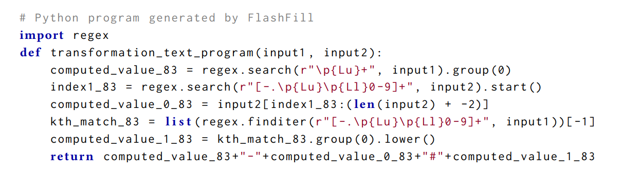
1600 x 800
1600 x 800
1600 x 800

Slide 14
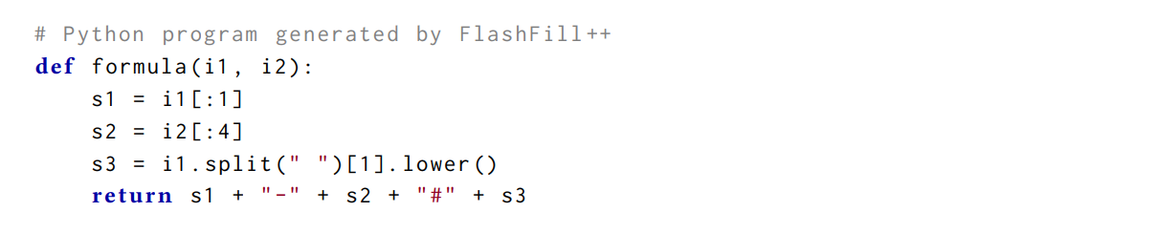
1600 x 800
1600 x 800
1600 x 800

Slide 15
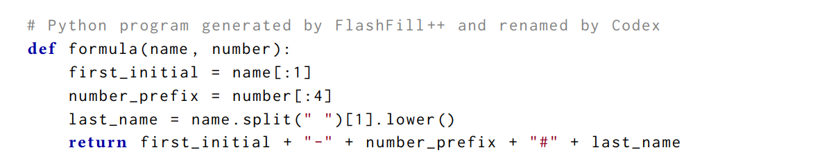
1600 x 800
1600 x 800
1600 x 800

Slide 16
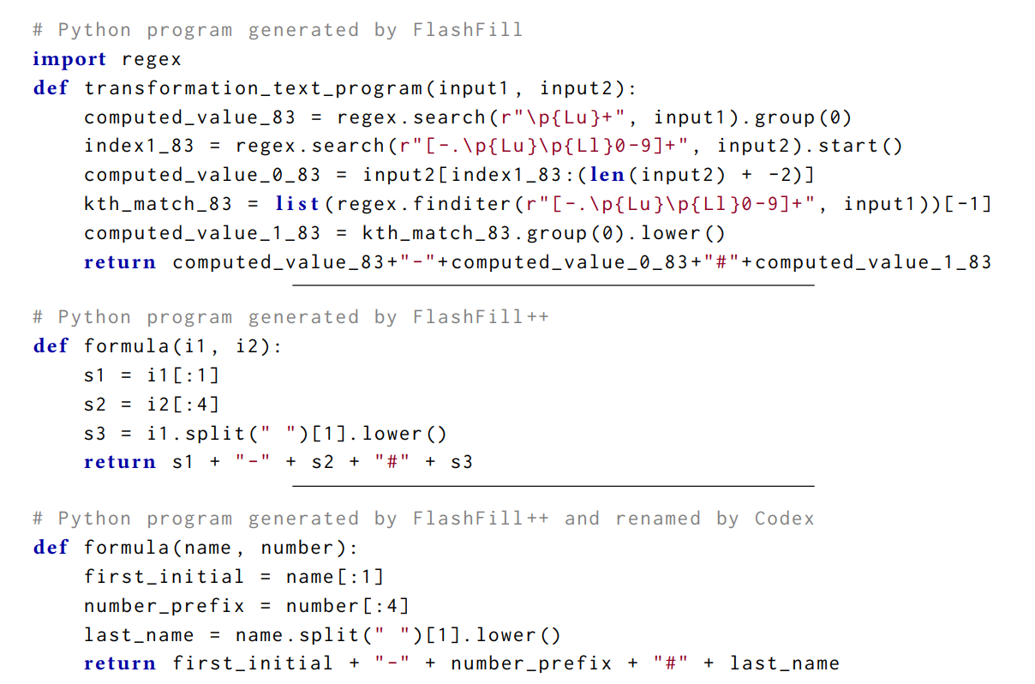
1600 x 800
1600 x 800
1600 x 800

Slide 17
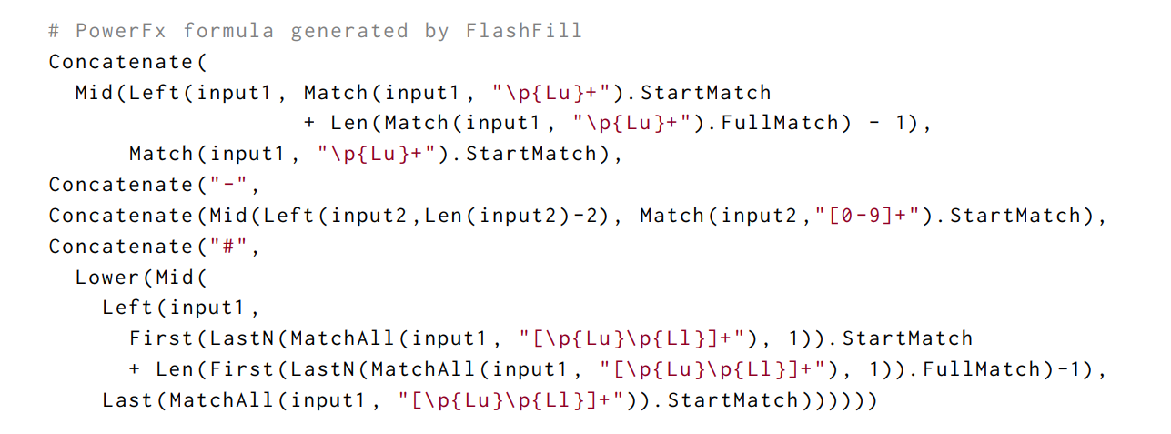
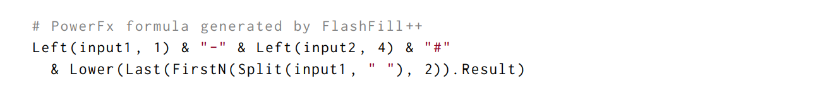
1600 x 800
1600 x 800
1600 x 800

Slide 18
1600 x 800
1600 x 800
1600 x 800
Expressiveness and Performance

Slide 19
Expressiveness and Performance
1600 x 800
1600 x 800
1600 x 800
FlashFill++ is expressive, covering a large class of string, datetime and number transformations, showing the added value from using cuts and guarded rules*.
* strategies adopted by the tool

Slide 20
Expressiveness and Performance
1600 x 800
1600 x 800
1600 x 800
It’s faster on average despite solving more (presumably harder) benchmarks and better than the best of the baselines on most hard instances.
Precedences in gDSLs consistently help FlashFill++ in improving both search (synthesis time) and ranking (minimum number of examples).

Slide 21
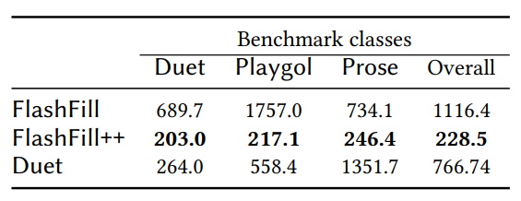
Expressiveness and Performance
1600 x 800
1600 x 800
1600 x 800
Average time (in ms) taken by the tools (rows) over successful benchmarks from the three sources (columns), and the average for each tool over the entire suite (last column).

Slide 22
1600 x 800
1600 x 800
1600 x 800
Limitations

Slide 23
Limitations
1600 x 800
1600 x 800
1600 x 800
The concepts of cuts and precedence have been developed exclusively for synthesis approaches based on concrete values, so-called version space algebra (VSA) based methods.
Designing a guarded DSL requires the DSL designer to have clear preference for certain operators over other alternatives.

Slide 24
1600 x 800
1600 x 800
1600 x 800
Conclusion

Slide 25
Conclusion
1600 x 800
1600 x 800
1600 x 800
Two techniques were introduced: cuts and precedence through guarded DSLs, that DSL designers can use to prune (trim) search in PBE.
Cuts enable a novel synthesis strategy.
The use of precedence through gDSLs allows to increase the size of the DSL.

Slide 26
Conclusion
1600 x 800
1600 x 800
1600 x 800
It was also performed a survey-based study on code readability, confirming that the programs synthesized by FlashFill++ are more readable than those generated by FlashFill.

Slide 27

1600 x 800
1600 x 800
1600 x 800
1621101010 - Cassio Luis Zamignan Forte Felippe
cassioluis12@gmail.com

