Slide 1

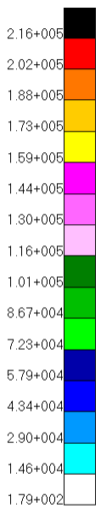
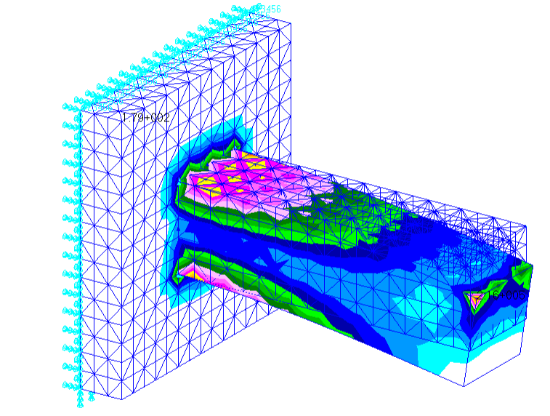
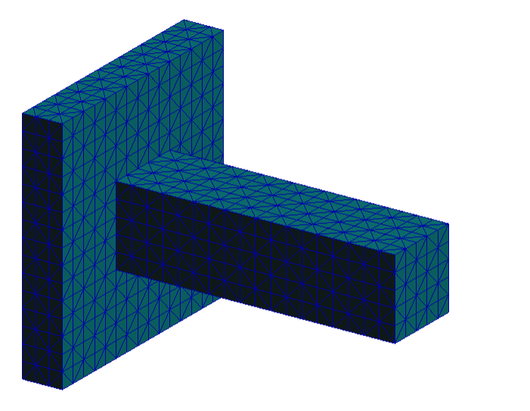



















$$3 m$$
$$F_{total}=10000 N$$
Isotropic linear tetrahedral elements
$$3.5 m$$
Global Edge Length $=0.2 m$
$E=210 GPa$
$ν=0.3$
$$1 m$$
$$1 m$$
$$(x_{4},y_{4},z_{4})$$
$$3 m$$
$$1 m$$
$$y$$
$$(x_{1},y_{1},z_{1})$$
$$x$$
$$1 m$$
$$(x_{3},y_{3},z_{3})$$
$$z$$
$$(x_{2},y_{2},z_{2})$$
$$0.5 m$$
Mesh
Von Mises Stress Result
Mesh

