Slide 1

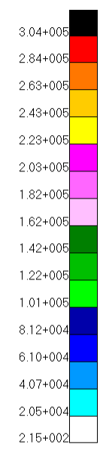
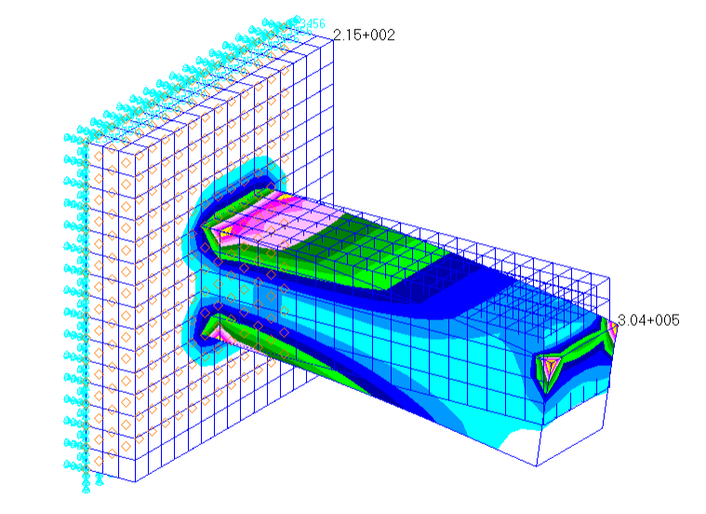
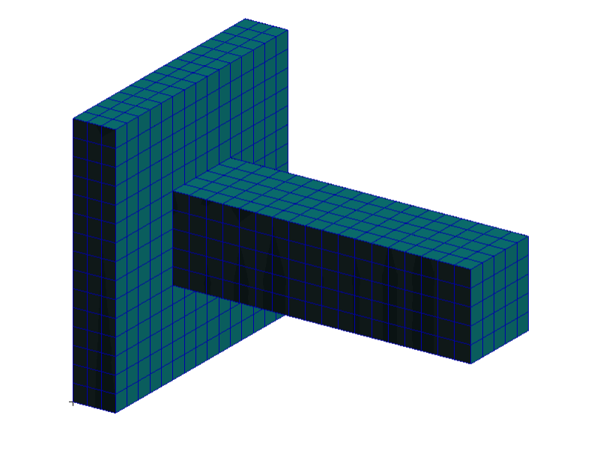















$$3 m$$
$$F_{total}=10000 N$$
Isotropic linear hexahedral elements
$$3.5 m$$
Global Edge Length $=0.2 m$
$E=210 GPa$
$ν=0.3$
$$1 m$$
$$1 m$$
$$(x_{3},y_{3},z_{3})$$
$$(x_{4},y_{4},z_{4})$$
$$3 m$$
$$(x_{7},y_{7},z_{7})$$
$$(x_{8},y_{8},z_{8})$$
$$1 m$$
$$y$$
$$x$$
$$1 m$$
$$(x_{1},y_{1},z_{1})$$
$$(x_{2},y_{2},z_{2})$$
$$z$$
$$(x_{6},y_{6},z_{6})$$
$$0.5 m$$
$$(x_{5},y_{5},z_{5})$$
Mesh
Von Mises Stress Result

