Slide 1
Requirements & Architecture
Team 2
Presenter: Chen Zeng
28/06/2017

Slide 2
Overview
What is the Requirements for Dublinbus Application?
What is the Software Architecture for this Project?
work sample
The Conclusion
References

Slide 3
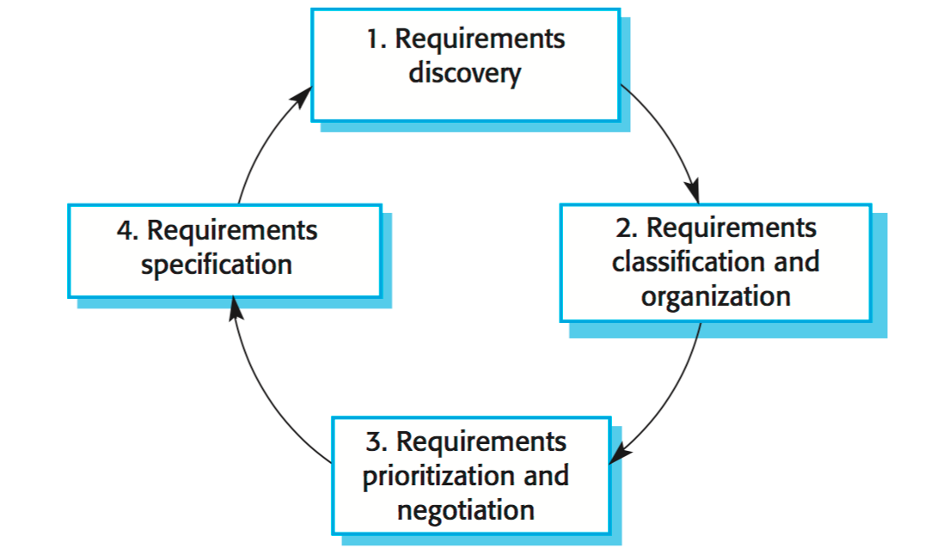
Requirement Process

Slide 4
Software Requirements
Introduction
Goals and Objectives : prepare user’s journey
Product Scope: input, output, data processing(text, send and receive)
Overall Description
Product Perspective: follow-0n member of dublinbus website
Product Functions: the system must do something
data flow diagram (DFD next slide)
User classes and Characteristics: users who need to take a bus
Non-Functional Requirements(quality requirements)
Software Quality Attributes: maintainability, testability
ease of use

Slide 5
Software Requirements DFD
user
input
Historical information
Process requires
database
output
check
Store & reuse
Verify the input data
Estimate travel time
Select the related data
prediction

Slide 6
Software requirements user case
View a Google map with markers
Type the date
Type the origin and destination
User
Choose the timestamp
Show the travel time
Google chart

Slide 7
Software Architecture
Definition
“The software architecture of a system is the set of structures needed to reason about the system, which comprise software elements, relations among them and properties of both.”
(Bass, Clements, Kazman 2013)

Slide 8
Software Architecture
The types of software architecture
Data centered architecture
Data flow architecture
Layered architecture
Client/Server architecture
Web server architecture
Web App architecture
….....

Slide 9
Software Architecture
Prediction model(clean GPS data)
Database: Workbench
ORM: SQLAlchemy
Server side
Framework: Flask
Template engine: Jinja 2
Browser: Chrome
Client side
CSS
HTML
JavaScript
JSON

Slide 10
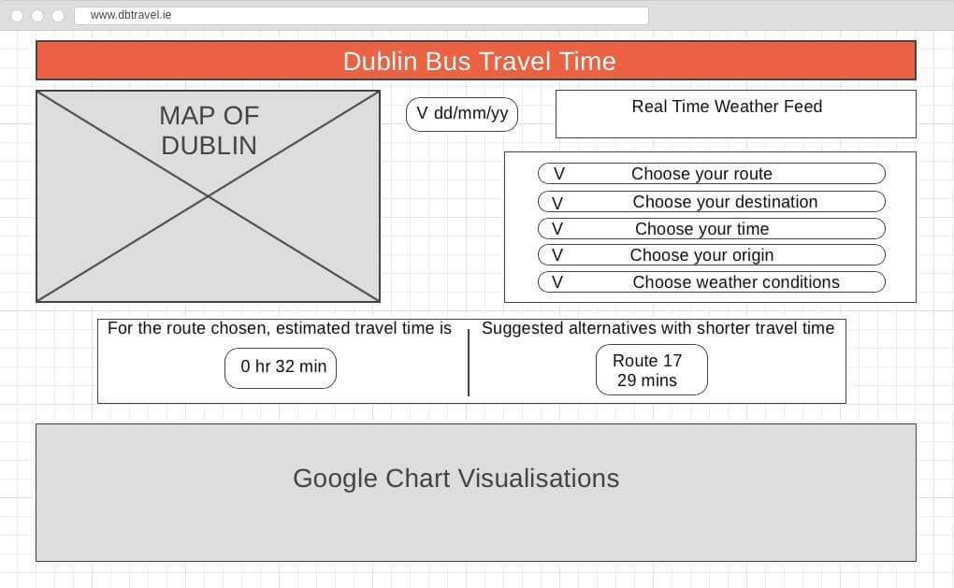
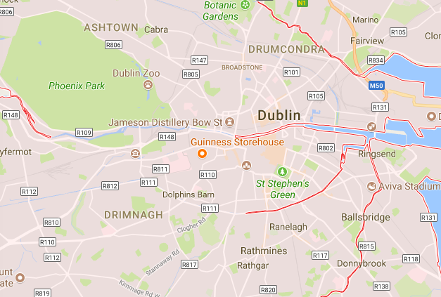
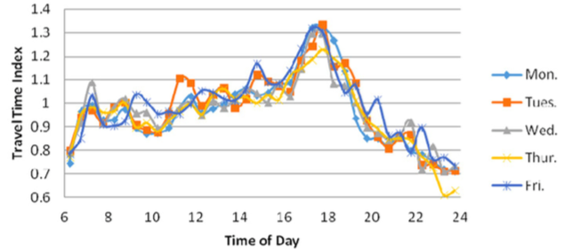
Web page sample

Slide 11
Conclusion
Priority requirements must be accomplished.
During the development, some requirements may be added or some be deleted.
Software Architecture is fixed, after discussing.
Further action: using the GPS historical data to create a website to estimate travel time.

Slide 12
Reference lists
Bass, Clements, Kazman 2013 Software Architecture in Practice, Third Edition.
Dr. Aonghus Lawlor 2017 COMP30670 Lecture17 Software Architecture.

Slide 13
Thank you for your time
Any Questions?

Slide 14
Model Results
Model | RMSE | MSE | MAE | Accuracy
Linear Regression | 185.42 | 34380.27 | 119.08 | 0.6216
Random Forest | 182.885 | 33447.088 | 113.5378 | 0.8103

