Slide 1

Sustainable Digital Education Technologies in Universities
A Multi-Dimensional Framework
Supervisor
Dr Lorenzo Angeli
Student
Sebastiano Cassol
March 20th, 2025 - University of Trento

Slide 2

DETs & Digitalization of Higher Education
Digital Education Technologies (DETs) encompass hardware and software resources that produce, share, and store information electronically to support and enhance learning efficiency, academic productivity, outcomes, and accessibility.
In the context of higher education institutions, Digitalization refers to the increasing adoption and integration of digital and computer-based technologies into university operations, teaching, learning, research, and administration.
March 20th, 2025 - University of Trento

Slide 3
The impact of Digitalization
Advantages
Accessibility and Inclusion
Academic productivity
Cost efficiency
Innovative teaching methods
Disadvantages
Institutional autonomy
Data governance
Lock-in and contractual constraints
Environmental impact
→ The problem of DETs selection
March 20th, 2025 - University of Trento

Slide 4
Research question
“How can higher education institutions evaluate the sustainability of digital education technologies?”
Main goal
Devise a framework that assists decision makers in the selection of sustainable digital education technologies
March 20th, 2025 - University of Trento

Slide 5
Sustainability
Brundtland report
“meeting the needs of the present without compromising the ability of future generations to meet their own needs”
Sustainable Development Goals: Target 4
“ensure inclusive and equitable quality education and promote lifelong learning opportunities for all”
Sustainability is the ability to be maintained or improved over the time
March 20th, 2025 - University of Trento

Slide 6
Three Pillars of Sustainability
Purvis et al.
Sustainability
Social
Economic
Environmental
March 20th, 2025 - University of Trento
Notes:
Social dimension: Focuses on human well-being, equity, and social justice.
Economic dimension: Concerns the sustainable management of resources and economic growth.
Environmental dimension: Aims to protect and preserve ecosystems and biodiversity.
—--------------
Social Dimension: This aspect of sustainability emphasizes human well-being, social justice, and equity. It includes considerations such as access to basic needs (healthcare, education, clean water), fair labor practices, human rights, and cultural preservation. A sustainable society ensures inclusivity, reduces poverty and inequality, and fosters strong social institutions that support long-term development.
Economic Dimension: The economic pillar focuses on creating a system that supports long-term economic growth without negatively impacting social and environmental aspects. It includes responsible resource management, fair trade, job creation, and economic stability. Sustainable economic development prioritizes efficiency, innovation, and investments that do not compromise future generations' ability to meet their needs.
Environmental Dimension: This pillar aims to maintain ecological integrity by protecting natural resources, reducing pollution, and preserving biodiversity. It promotes sustainable practices such as renewable energy use, conservation efforts, waste reduction, and climate change mitigation. A balance between development and environmental protection ensures that ecosystems remain viable for future generations.

Slide 7
Sustainability dimensions for DETs
Sustainability
Social
Economic
Environmental
Technical
Pedagogical
March 20th, 2025 - University of Trento

Slide 8
Sustainability dimensions for DETs
A DET should remain operational, efficient and adaptable over the time
A DET should grant the Quality of Service in depth of time
Andrikopoulos et al. - Software Sustainability in the Age of Everything as a Service
Lago et al. - Framing sustainability as a property of software quality
Technical
March 20th, 2025 - University of Trento

Slide 9
Sustainability dimensions for DETs
The ability of DETs to effectively support and enhance teaching and learning practices in a long-term, meaningful, and inclusive manner
Schuetze et al. - Digitalization of Higher Education: an Introduction
Lacka & Wong - Examining the Impact of Digital Technologies on Students’ Higher Education Outcomes
And many others!
Pedagogical
March 20th, 2025 - University of Trento

Slide 10
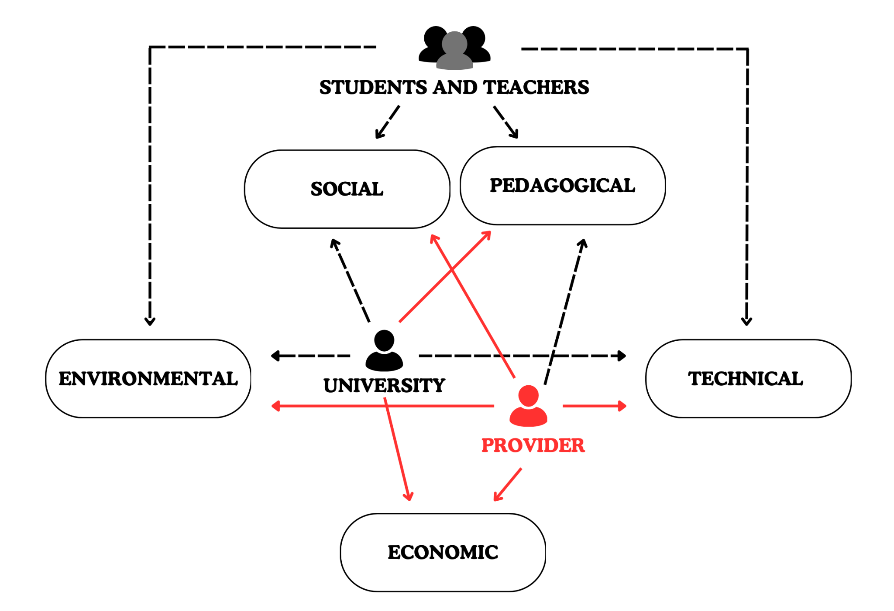
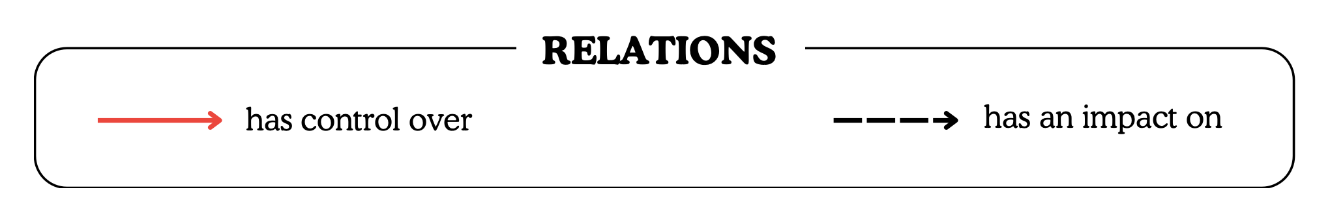
Impact of outsourcing
March 20th, 2025 - University of Trento

Slide 11
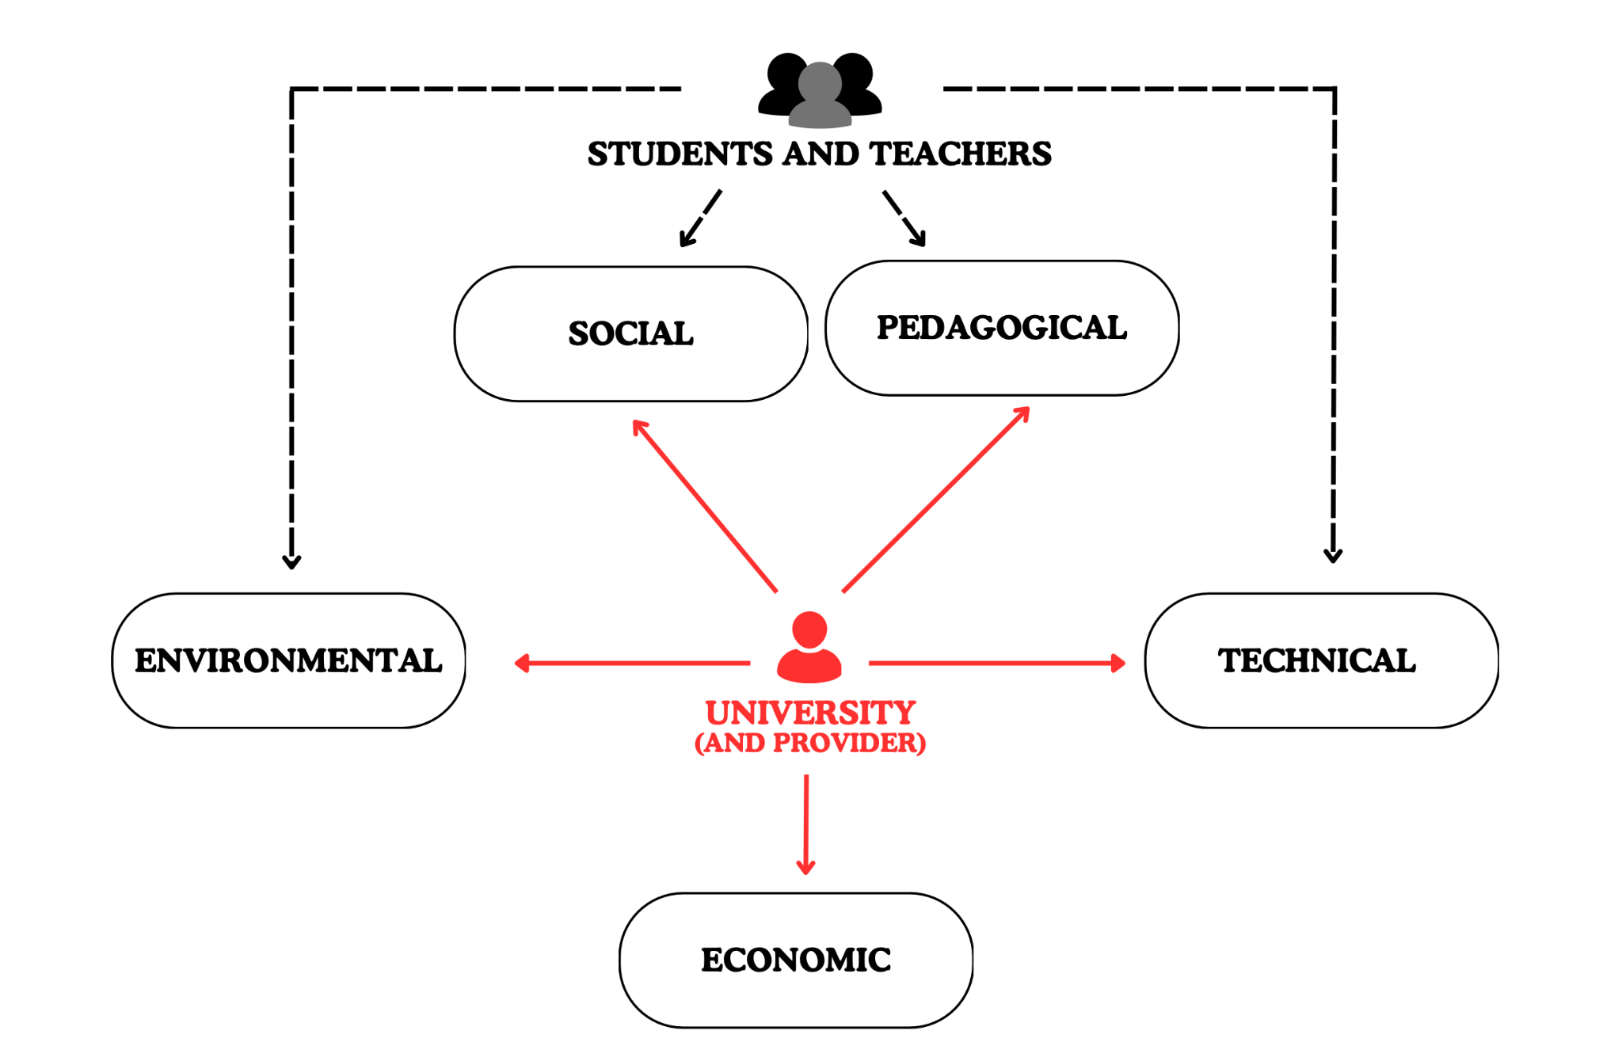
Impact of outsourcing
March 20th, 2025 - University of Trento

Slide 12
Sustainability dimensions for DETs
Sustainability
Social
Economic
Environmental
Technical
Pedagogical
March 20th, 2025 - University of Trento

Slide 13
Assessment methodology
Traffic-light model
Scoring system
Good
Acceptable
Bad
Not applicable
+1 point
0 point
-1 point
Not considered
March 20th, 2025 - University of Trento

Slide 14
Economic dimension
Indicator | Metric
Return of Expenses | Generated value relative to expenses
Provisioning | Quality of provisioning
Scaling policies | Waste of resources
Vendor Synergies | Use of lock-in practices
Exit costs | Expanses of cost/migration
Provisioning indicator
The provisioning indicator is the relation between:
cloud-based or local resources allocated
resources required to ensure the efficient operation
Considering the expected users, the result is the cost per user
March 20th, 2025 - University of Trento

Slide 15
Technical dimension
Indicator | Metric
Availability | Uptime (%)
Reliability | Error rate (%)
Scalability | Support of scalability techniques
Adaptability | Degree of integration (e.g., SSO, 3rd party services)
Maintainability | Ease of configuration, updates, and upgrades
Repairability | Interventions allowed
Maintainability indicator
The maintainability indicator assess whether the DET is:
easy to be configured
easy to be updated and upgraded
supported by documentation
supported by community, developers or the company
March 20th, 2025 - University of Trento

Slide 16
Social dimension
Indicator | Metric
Community awareness | Awareness about the DET
Involvement in sustainability | Distance to sustainability claim
Inclusion | Compliance with accessibility guidelines
Privacy policy | Protection and ethical use of user data, transparency on data collection
Capability | Required internal capacity and knowledge
Privacy policy indicator
The privacy policy indicator ensures proper collection and use of users’ data, examining:
content of the policy
readability of the policy
sub-processors involved
security measures to ensure data protection
March 20th, 2025 - University of Trento

Slide 17
Pedagogical dimension
Indicator | Metric
Engaged with instructional practices | Engagement in pedagogical research and educational context
Usability | Usability framework
Impact on education | Learning curve, workflow integration, output quality, and adaptability to the academic context
Purpose | Potential to solve the problem
Usability indicator
The privacy policy indicator determines whether the DET is accessible, efficient and user-friendly
Evaluation can be done with:
usability heuristics
usability tests
surveys
automated tools
March 20th, 2025 - University of Trento

Slide 18
Environmental dimension
Indicator | Metric
Energy consumption | kilowatt-hours (kWh)
Carbon emissions | Material footprint (kg - tons per unit)
Raw material consumption | Carbon footprint (kg CO₂-eq)
Sustainability in design | Consideration of sustainability principles in design and development
Sustainability through design | Promotion of sustainability practices
Sustainability in design indicator
The sustainability in design indicator evaluates how sustainability is taken into account from the early design phases of the DET
Can be inferred from:
design goals in documentation and reports
DET characteristics
March 20th, 2025 - University of Trento

Slide 19
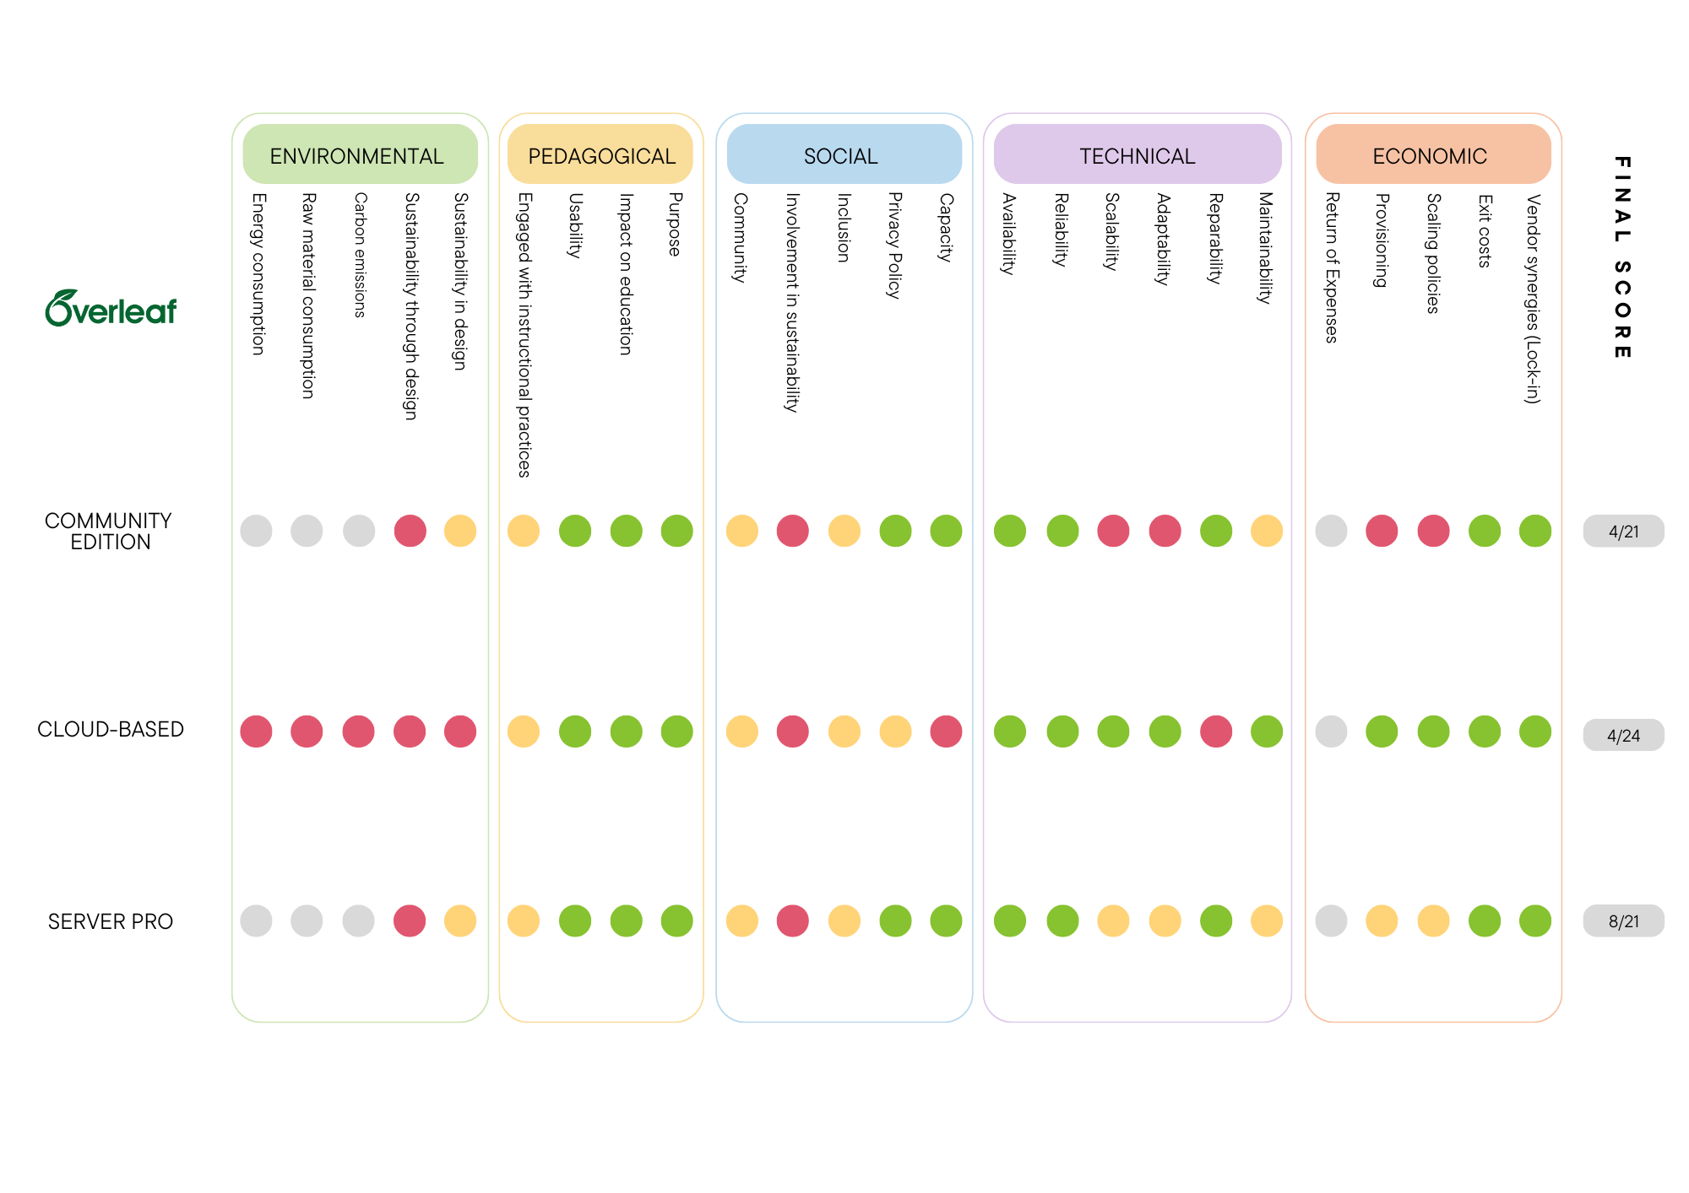
March 20th, 2025 - University of Trento

Slide 20
March 20th, 2025 - University of Trento

Slide 21
March 20th, 2025 - University of Trento

Slide 22
March 20th, 2025 - University of Trento

Slide 23
March 20th, 2025 - University of Trento

Slide 24
March 20th, 2025 - University of Trento

Slide 25
March 20th, 2025 - University of Trento

Slide 26
Key insights
Cloud-based performed best in the economic and technical dimensions, reflecting the motivations that lead universities to rely on external providers
Cloud-based performed worst in the environmental dimension
Community edition suffers technical limitations
Pedagogical is the same for every version, that share the same core functionalities
Self-hosted versions can mitigate some critical issues of the cloud-based version
(this slide was not included in the original presentation, the content was said by the student while showing the result)
March 20th, 2025 - University of Trento

Slide 27
Limitations
Scoring system and indicator weighting issues
equal indicator weighting creates imbalances across sustainability dimensions
the scoring system may be too strict, lowering final scores
Addressing “red zones”
is this enough to exclude the DET from the selection?
Challenges of multi-dimensionality
requires broad working group
requires expertise among multiple disciplines
March 20th, 2025 - University of Trento

Slide 28
Conclusions and Future work
Expanding case studies
Refining indicators
Improving environmental metrics
Optimizing scoring and weighting
Validation and practical application
March 20th, 2025 - University of Trento

