Slide 1
Preparations
Experience Poll via Whova
Familiarity with Excel
Familiarity with R
Familiarity with Language Modeling
Set up collaborative environment
Access to QR Code and Jamboards
Set out sticky notes and permanent markers on tables

Slide 2
Accessibility
We are committed to providing a session that is accessible to the widest possible audience, regardless of technology or ability.
We are actively working to increase the accessibility and usability of our work and in doing so adhere to many of the available standards and guidelines.
Please do not hesitate to let one of our presenters know if you are in need of accommodations to view and engage with the content.

Slide 3
Natural Language Processing (NLP) Data Techniques with Symbolic & Nonsymbolic Mathematical Language
Discovery Research PreK-12 PI Meeting in Arlington, VA
Workshop facilitation by Cassondra Griger, M.S.Ed.
Supported by DRL-1813760 (PI: Yasemin Copur-Gencturk, Ph.D.)
June 29, 2023
Notes:
Data preprocessing for modeling techniques of natural language processing (NLP) is particularly important in the context of mathematics due to symbolic and nonsymbolic representations. Preprocessing for NLP is a crucial step to ensuring text is accurately capturing the participant’s observed response to stimuli with context and meaning in mind. However, integrity of the data can be easily undermined through intensive data manipulation to “make meaning” and establish the context of language. In mathematics, language also encompasses symbolic communication, which complicates encoding and preprocessing the data. Topic modeling, an NLP method, is a practical tool for measuring content and pedagogical knowledge via language-based constructed response data that requires critical decision-making in the preprocessing stage. This session will present issues and solutions to manage the integration of symbolic and nonsymbolic language through a proposed framework of NLP-focused data preprocessing. Consequently, it will curate an innovative intersection of preK-12 mathematics content and data literacy for STEM teachers and researchers to encourage efficient and accurate interdisciplinary standards and practices.
The collection of responses with an online survey platform is commonplace but can lend to text discrepancies during data encoding and formatting. The most considerable character encoding issues during the conversion include the loss of mathematically relevant symbols (e.g., +, -, *). These symbols play a role in the assessment of an individual’s expression of mathematical knowledge. To ensure representation and accuracy in model inference, a demonstration will show how to correctly migrate data in such a way that will retain all values and formatting.
To model topic inference, the response data must first be tokenized. Tokenization is an extraction technique used to separate words into n-grams from a feedback response string to form individual data points. Typically, punctuation and symbols are removed at this stage. To address this issue, symbolic characters must undergo translation to nonsymbolic terms (e.g., convert * to “multiply”) prior to tokenization. However, symbols that are multifunctional in nature (e.g., hyphen, em/en dash, forward slash) or variables prove to be complex to conceptually cover all possible, conditional variations and subsequently hard code. Here, we must conditionally define that two numbers surround the space prior to and following the symbol. However, even with these measures in place, manual checking is required and limitations still exist for operational, numerical, and variable representation. Methods for efficient manual checking and conditional limitations will be walked through.
Following tokenization, the n-grams are lemmatized. Lemmatization is the process of applying an algorithm that uses an embedded dictionary to find the present tense stem (otherwise known as root) word given the n-gram token. This step establishes the n-grams that will undergo probabilistic determination in the mixture model. The caveat to mixture modeling is that the n-gram may show in more than one topic and the care spent on the n-grams has implications for making meaning of the topics’ probability distributions. For example, instead of having a term for “multiply” and a term for “multiplication,” “multiplication” can be hard coded to return “multiply” in this preprocessing step to alleviate unnecessary overlap in n-grams’ context and meaning. This saves considerable time in the manual review, even though it requires considerable foresight. The presenters will highlight several case examples to consider when hard coding.
Lastly, stop words are a sensitive discussion with many varying opinions on what is a stop word and if removing low frequency stems (i.e., five or fewer observations given the data example) significantly affects the topic model. Schofield, Magnusson, and Mimno (2017) reported that the creation of a stop word list is inefficient via model comparison and the subjectivity of stop word selection hinders replicability. Most commonly, researchers will typically remove the following associations, but not limited to: high frequency words (e.g., the, is, I), conjunctions, and prepositions. Again, there are issues with removing some stop words, such as “a,” as this letter is notably used in mathematic contexts as a variable. To distinguish these contexts, manual review is required to comb through hundreds of feedback responses to make the distinction between articles and variables. The presenters invite the audience to collaborate on efficiency solutions for cases such as this.
The following bullet points outline the proposed session’s structure and format.
Issues and Solutions in Preprocessing Data for Topic Modeling (50 minutes)
1) data encoding and formatting
2) tokenization
3) lemmatization
4) stop word selection
Mathematical Semantics: Symbolic vs Nonsymbolic Representation of Language (25 minutes)
1) Issues in stimuli and preprocessing: How can preprocessing be made more efficient and accurate in ensuring the data’s integrity maintains or improves from collection to analysis? test design: How can a measure’s development be improved with the consideration of the semantics?
2) Issues in
Presenters will share a step-by-step document prior to the session so that participants may follow along through the methodology. It includes a proposed framework for preprocessing symbolic and nonsymbolic language in the context of mathematics, specifically for proportional reasoning content and generalizable to other mathematical targets. The floor will remain open to questions and discussion as the walkthrough proceeds. The presenters encourage participants to make suggestions and express concerns via their scope of expertise, network, and/or experience. It is expected the participants will deepen their data literacy knowledge base and be able to generalize these techniques and discussions with their own research content and practices.
How the session will address the focal area and the session objectives.
Structure/format
plan for interaction with the participants, and expected outcomes.

Slide 4








Yasemin Copur-Gencturk, Ph.D.
opurgen@usc.edu
Allan S. Cohen, Ph.D.
acohen@uga.edu
Chandra Orrill, Ph.D.
chandra.orrill@rethinklearning.com
Jonathan Templin, Ph.D.
jonathan-templin@uiowa.edu

Slide 5


teachers’ acquisition of knowledge and pedagogical skills
transfer of these skills into their practice, with special attention to issues of equity
@scienceofteach

Slide 6





Cassondra Griger, M.S.Ed.
Ph.D. Student
cgriger@uiowa.edu
John Ezaki
Ph.D. Candidate
jezaki@usc.edu
Cigdem Toptas, Ph.D.
Successful Defense
c.toptas@uga.edu
Sebnem Atabas, Ph.D.
Assistant Professor
sebnem.atabas@gmail.com

Slide 7

INFORMATION LIMITATION
MIXED METHODS
Selected responses afford a limited observation of valuable, contextual information
Constructed responses allow us to capture greater detail
NLP can qualitatively and quantitatively capture patterns of knowledge
Notes:
Motivation for the methods.

Slide 8
Objectives
… to equip participants with data preprocessing techniques specifically tailored to handle both symbolic and nonsymbolic mathematical language, from constructed response data.
… to gain knowledge and skills necessary to effectively process and analyze mathematical text data, leveraging NLP methods to uncover insights and extract meaningful information from these specialized domains.
… to explore practical applications of NLP in educational settings, enabling them to make informed decisions and derive valuable insights from mathematical content.
Notes:
Floor will remain open to questions and discussion as the session proceeds. The presenters encourage participants to make suggestions and express concerns via their scope of expertise, network, and/or experience.

Slide 9


Agenda
Experience Poll
Describing PCK Construct the Data
Experiential Processing Exercise
Preprocessing Data Techniques for Topic Modeling
Math Vocabulary Brainstorm Exercise
Mathematical Semantics: Symbolic vs Nonsymbolic Language
Questions & Discussion
Notes:
Yellow symbolizes audience engagement and red symbolizes content dissemination.
Step-by-step document to follow along through the methodology.
Includes a proposed framework for preprocessing symbolic and nonsymbolic language in the context of mathematics, specifically for proportional reasoning content and generalizable to other mathematical targets.

Slide 10
middle school in-service teachers
feedback to student written responses
pedagogical content knowledge (PCK) schemas
mathematical contexts of proportional reasoning
Notes:
Collection of teacher’s feedback to student written responses to understand pedagogical content knowledge (PCK) schemas of middle school in-service teachers using mathematical contexts of proportional reasoning
To gather data from the sample, 49,638 publicly available teachers’ emails were purchased from an educational database company (K12-data). Each email was sent an invitation to complete an online survey for a larger National Science Foundation (NSF) project investigating teachers’ knowledge of ratios and proportional reasoning (Grant Number 1813760). Of the emails acquired, 49,191 were unique individual teachers and our initial recruitment email had a bounce back or block rate of ~11% (5,546 emails were bounced or blocked). Approximately 16% of teachers opened the email they were sent and of those that opened the email, there was a 17% completion rate.

Slide 12

Pedagogical Content Knowledge (PCK)
PCK is an external and internal construct, as it is constituted by:
what a teacher knows
what a teacher does
the reasons for the teacher’s actions
Baxer ve Lederman (1999, p. 158) Gess-Newsome (1999)
Magnusson, Krajacik, & Borko (1999)
Van Driel, Bijaard & Verloop (2001)
Notes:
[WILL HAVE STICKY NOTES AND PERMANENT MARKERS ON TABLES]

Slide 13



Stages of Processing Response Data
Data Encoding & Formatting
Tokenization
Lemmatization
Stop Word Selection
Data Collection
Manual Check
Notes:
Using RStudio and Excel, the session will review fundamental processing techniques for language-based, constructed responses and speak further on the complexities symbolic characters afford The four critical stages of processing data for topic modeling methods will concern data encoding and formatting, tokenization, lemmatization, and stop word selection.

Slide 14
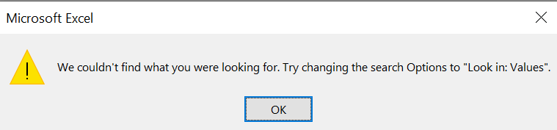
Data Encoding & Formatting
Exportation of raw data sometimes results in funky characters since Qualtrics can only export in CSV with UTF-8 encoding and TSV.
Without reformatting, special characters like 是 or ñ may not show correctly upon import. Or conversely, symbols are encoded as 是
Import using Unicode Text (*.txt) if you are using Excel on Windows or CSV UTF-8 (Comma delimited) (.csv) if you are using Excel on Mac.
Excel doesn’t allow certain characters to be searched, so you must preface with ~
*
’
?
%

Slide 15
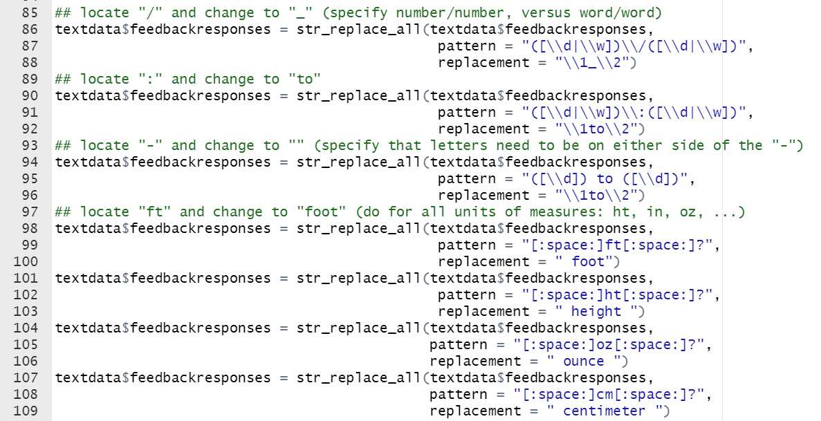
Notes:
Speak to the limitations, where there are misspellings, lack of spaces, “expanded” equations (this divided by that which is equal to)

Slide 16
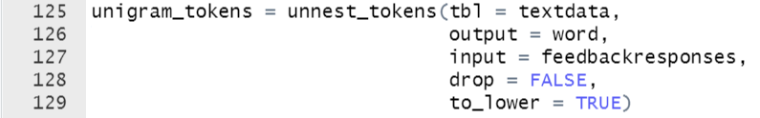
Tokenization
Notes:
Tokenization is the process of breaking down a text into individual tokens, which are typically words or subwords. The input text is divided into meaningful units, such as words or punctuation marks, by splitting it based on specific rules or patterns.

Slide 17
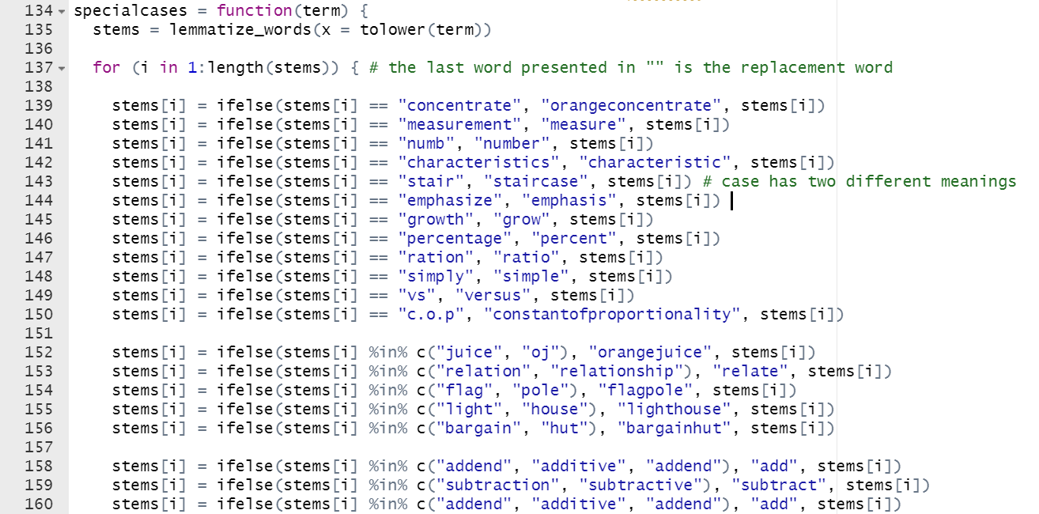
Lemmatization
Notes:
Lemmatization is the process of reducing words to their base or canonical form, known as the lemma. The lemma represents the dictionary form or the root of a word. Lemmatization takes into account the morphological analysis of words and applies linguistic rules to transform them to their base form. This helps to unify different inflected forms of a word, such as plurals or verb conjugations, into a single representation.

Slide 18
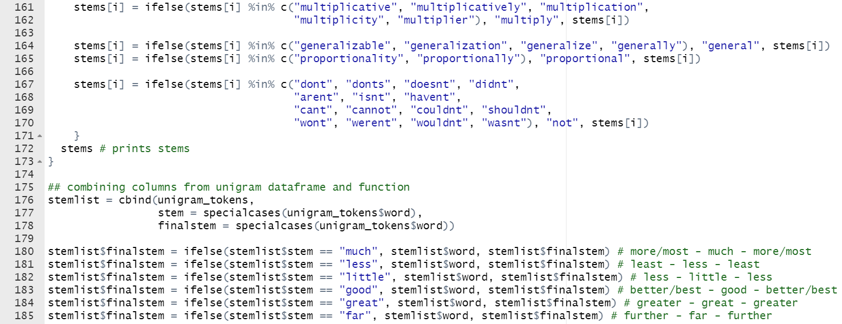
Lemmatization
Notes:
Lemmatization is the process of reducing words to their base or canonical form, known as the lemma. The lemma represents the dictionary form or the root of a word. Lemmatization takes into account the morphological analysis of words and applies linguistic rules to transform them to their base form. This helps to unify different inflected forms of a word, such as plurals or verb conjugations, into a single representation.

Slide 19
Stop Words
Type | Examples / Notes
generally high frequency words | i, we, he, she, they, you, your
articles, prepositions, conjunctions | the, a, and, but, or, so, however, since, because, any (-times, -thing, -one, -way), some (-times, -thing, -one), other, therefore, thus, back, up, through, upon, whether, yet
question starters | who, what, where, when, why, how, if, which
past and future verb tenses | should, could, would
extremely low frequency words (frequency <= 5) | made little difference in model fit (cite)
Notes:
PROS 1. Stop words are often removed from the text before training deep learning and machine learning models since stop words occur in abundance, hence providing little to no unique information that can be used for classification or clustering. 2. With removing stopwords, dataset size decreases, and the time to train the model also decreases without a huge impact on the accuracy of the model. 3. Stopword removal can potentially help in improving performance, as there are fewer and only significant tokens left. Thus, the classification accuracy could be improved
CONS 1. Improper selection and removal of stop words can change the meaning of our text. So we have to be careful in choosing our stop words.
cite: https://medium.com/@saitejaponugoti/stop-words-in-nlp-5b248dadad47

Slide 20
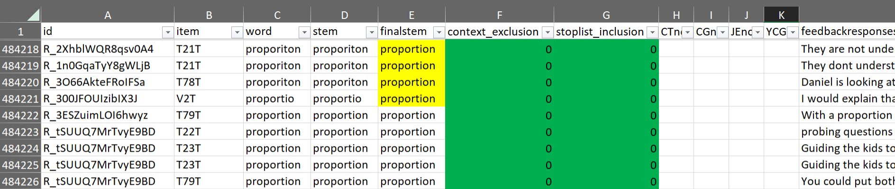
Data Structure

Slide 21

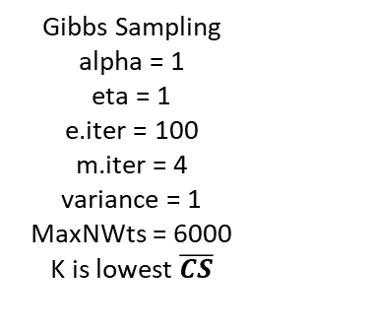
Model Fitting
Output
Visualizations
LDA
Top 30 Words
Model Equation
Top 10 Proportions by Topic and Responses
Topic Proportion Means
no
Model Selection Indices
Cosine Similarity Average ($\overline{CS}$)
Cosine Similarity Average ((𝑪𝑺) ̅)
sLDA
yes
yes
yes, with score
uLDA
yes, by score
yes
yes, with no score
yes, all together
Gibbs Sampling
alpha = 1
eta = 1
e.iter = 100
m.iter = 4
variance = 1 MaxNWts = 6000
K is lowest $\overline{CS}$
Gibbs Sampling
alpha = 1
delta = 1
burnin= 10000, iter= 15000
$y={β_{1}t}_{1}+{β_{2}t}_{2}+{β_{3}t}_{3}$+ …
Table
Table
Box & Whisker
100% Stacked Bar
Notes:
Document term matrix is needed for model fitting – it provides a matrix of the frequency for each unique word in each constructed response. We run this procedure for every item.

Slide 22
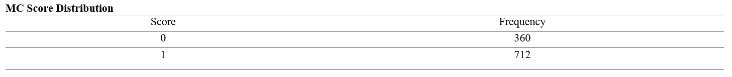
Descriptives

Slide 23
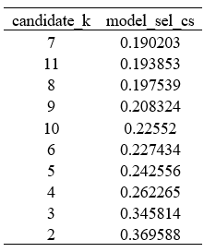
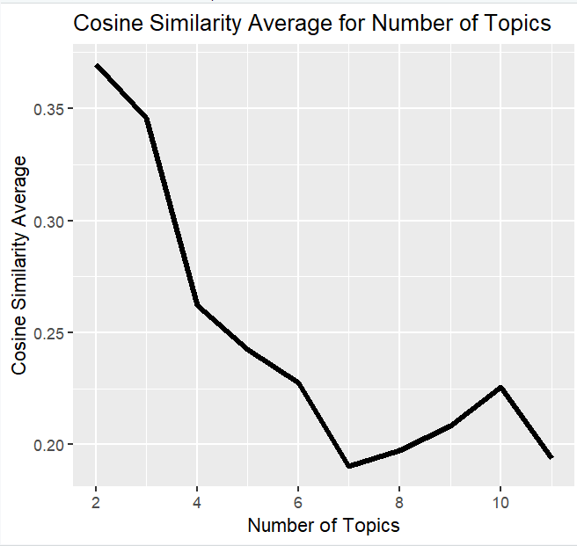
Model Selection Indices

Slide 24
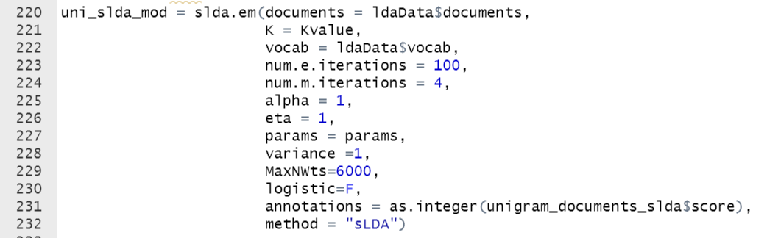
Latent Dirichlet Allocation (LDA)

Slide 25
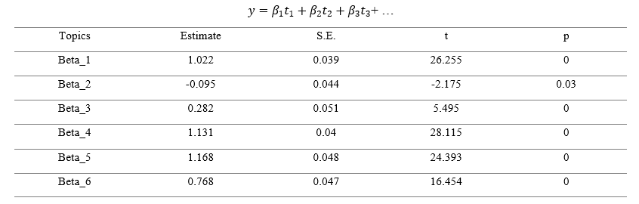
Model Equation
Notes:
The slda.em function creates derived variables based on the presence of the topics in each document (in our case, each response) and then feeds those derived variables into a linear regression model where the MC dichotomous score (or sometimes a categorical) is the response variable and the only explanatory variables are those derived variables.

Slide 26
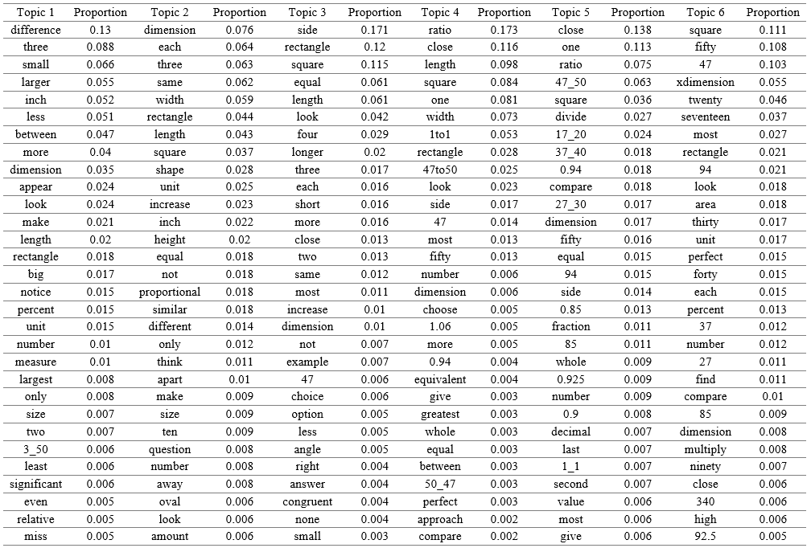

Slide 27
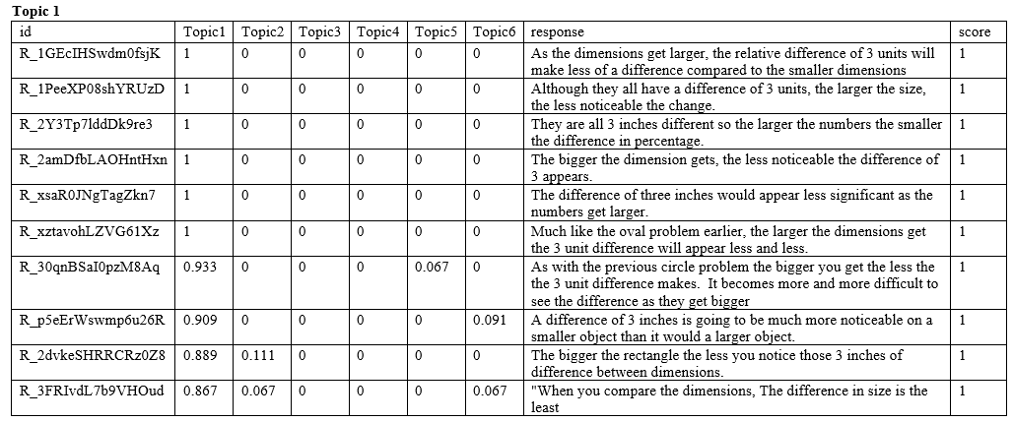
Top Proportions by Topic and Responses

Slide 28
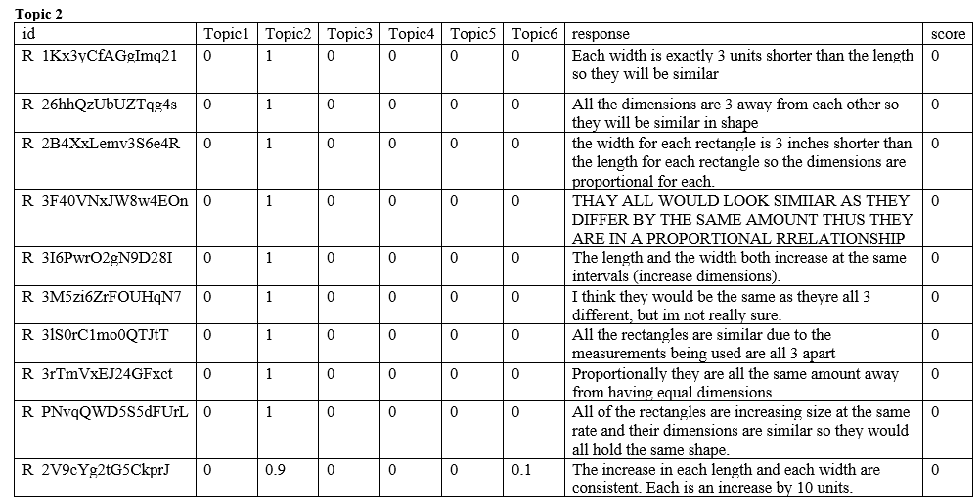
Top Proportions by Topic and Responses

Slide 29
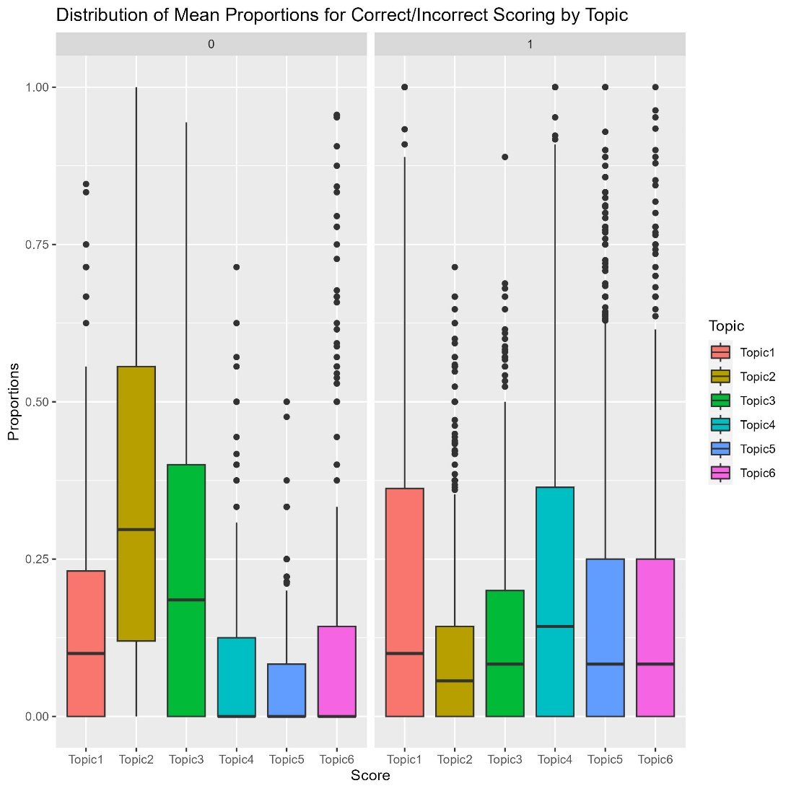
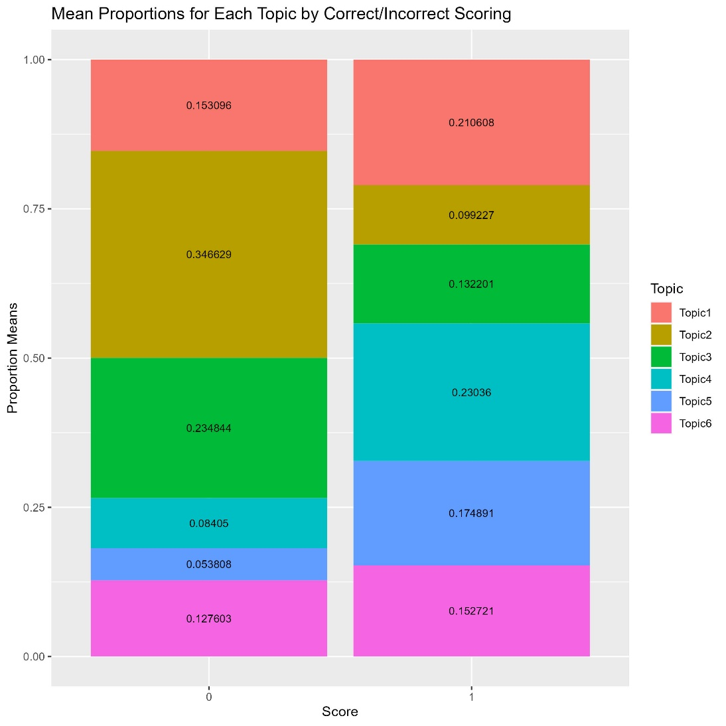

Slide 30

Math Vocabulary Brainstorm Exercise
Notes:
[WILL HAVE STICKY NOTES AND PERMANENT MARKERS ON TABLES]
Issues in stimuli and test design: How can a measure’s development be improved with the consideration of the semantics?
Issues in preprocessing: How can preprocessing be made more efficient and accurate in ensuring the data’s integrity maintains or improves from collection to analysis?

Slide 31
Math Vocabulary
 | Symbolic | Nonsymbolic
Addition | + | and, add x and y, by
Subtraction | - | from, subtract x by y, take away
Multiplication | * x | of, by
Division | / | by, over
Order / Sequence | 1st 2nd 3rd | first, second, third
Parentheses / Coordinates | () [] {}
Exponents | ^0 ^{n} | raised to the power, squared, n-th
Fraction | / | of, over, n-th
Decimal | . , | tens, ones, hundredths, thousandths
Percent | % 0.00 - 000.00 | percent, out of 100
Ratio | : / | to, the ratio of x to y
Proportion | x/y = z/a | x over y is to z over a
Equation | = | equals, is
Variables | a, b, c, x, y, z | variable a
Notes:
Not an exhaustive listing.

Slide 32
Many concepts can be understood with unigrams, such as ratio, fraction, proportion, etc. However, sometimes multigrams are required. That is, more than 1 word is needed to understand the context.
constructed response
stem word
constant
of
constantofproportionality
proportionality
Notes:
Mathematical N-Grams
N-grams indicate a sequence of n words (uni = 1, multi = more than 1).
We can use n-grams in cleaning to help maintain context.
Challenges: What if the subject is talking about a different “constant”? …a different “proportionality”?
Another example, “scale” and “factor” combined to “scalefactor”

Slide 33
Nonsymbolic Context
relationship
relate
relation
proportionally
proportional
proportionality

Slide 34
ofprep
of
offraction
ofmultiply
byprep
byfraction
by
bymultiply
bydimension
bydivisor
Notes:
Prepositions that have mathematical meaning

Slide 35
multiplicatively
multiplicative
multiplication
multiply
multiplicity
multiplier
Notes:
Potentially forgiving too much information

Slide 36
Symbolic Context
slashor
/
slashfraction
colonratio
:
colon

Slide 37
asteriskmultiply
*
asterisk
xdimension
x
xmultiply
xvariable

Slide 38
Research Considerations
Design of Experiment
Response Length
Preprocessing Context
Content Area
Model
Mixed Membership
Visualizations
Translational Science
Guide Formats
Proofreader Plugin
Stop Words
Making Meaning
Model Fit
How can these approaches be applied in the educational setting?
Notes:
Explore machine learning techniques to improve efficiency in data processing and analysis
More advanced text mining packages in R or Python may offer additional flexibility in modeling complex relationships between topics, response variables, and covariates
Effects of symbolic and nonsymbolic language on topic probability and proficiency

Slide 39
Classroom Considerations
Gouet, Carvajal, Halberda, & Peña (2020)
Newcombe, Levine, & Mix, (2015)
Price & Fuchs (2016)
Price & Wilkey (2017)
Schneider, Beeres, Coban, Merz, Schmidt, Stricker, & De Smedt (2016)
Tikhomirova, Kuzmina, Lysenkova, & Malykh (2019)
Patterns of content and how teachers migrate from on topic to another
i.e., professional development through nuances in understanding and teaching
Clarity in task instructions: procedural, conceptual, or both
Curriculum-based problem distributions
Relation between symbolic and nonsymbolic foundations of math performance and competence
Notes:
This approach (NLP) goes beyond mathematical language…
Gouet, Carvajal, Halberda, & Peña , 2020; Newcombe, Levine, & Mix, 2015; Price & Fuchs, 2016; Price & Wilkey, 2017; Schneider, Beeres, Coban, Merz, Schmidt, Stricker, & De Smedt, 2016; Tikhomirova, Kuzmina, Lysenkova, & Malykh, 2019
Patterns of content and how teachers migrate from on topic to another
Professional development through nuances in understanding and teaching
Curriculum-based problem distributions
Emphasis on representational equity of problem types and language
Mediating relation between symbolic and nonsymbolic foundations of math competence
Clarity in task instructions: procedural, conceptual, or both
Dialing in misconceptions
Identifying preferences in detail (e.g., income +$00,000, organic chemistry)
Student modeling preferences and pedagogical style of teacher
Price & Wilkey (2017). Cognitive mechanisms underlying the relation between nonsymbolic and symbolic magnitude processing and their relation to math.
Tikhomirova, Kuzmina, Lysenkova, & Malykh (2019). The Relationship Between Non-symbolic and Symbolic Numerosity Representations in Elementary School: The Role of Intelligence.
Newcombe, Levine, & Mix (2015). Thinking about quantity: the intertwined development of spatial and numerical cognition.
Gouet, Carvajal, Halberda, & Peña (2020). Training nonsymbolic proportional reasoning in children and its effects on their symbolic math abilities.
Price & Fuchs (2016). The Mediating Relation between Symbolic and Nonsymbolic Foundations of Math Competence.
Schneider, Beeres, Coban, Merz, Schmidt, Stricker, & De Smedt (2016). Associations of non-symbolic and symbolic numerical magnitude processing with mathematical competence: a meta-analysis.

Slide 40
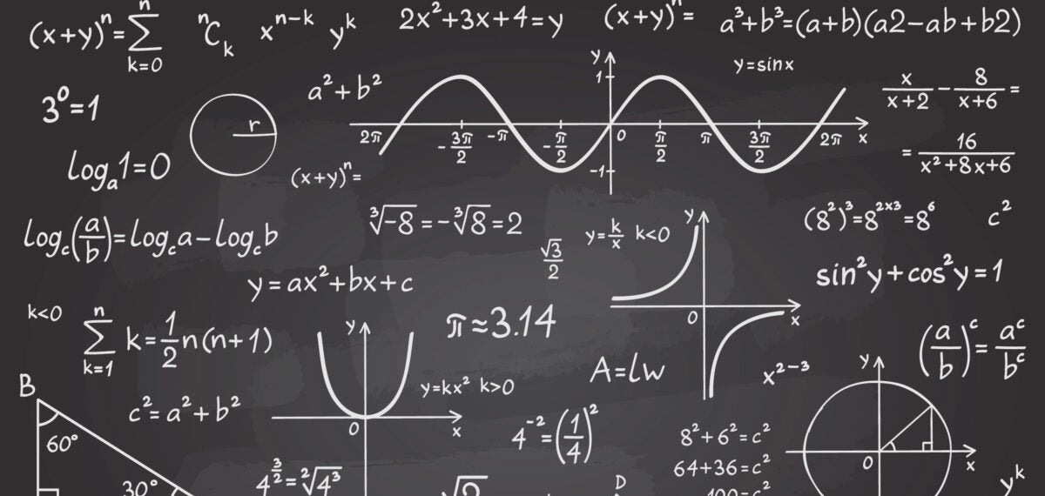
“All models are wrong,
but some are useful”
Box and Draper, 2007, p. 414
Notes:
Limitations to computer heuristics, especially with a variety of sampling methods and hyperparameters
Heuristics are mental shortcuts that can facilitate problem-solving and probability judgments. These strategies are generalizations, or rules-of-thumb, reduce cognitive load, and can be effective for making immediate judgments, however, they often result in irrational or inaccurate conclusions.
ML & DL will ease the cognitive burden, but not completely eradicate

Slide 41
Thank-you

Slide 42
Machine Learning (ML) & Deep Learning (DL)
Artificial Intelligence (AI)
Machine Learning (ML)
Deep Learning (DL)
AI is the concept of mimicking the performance of human intelligence.
ML gives machines the ability to learn from and make decisions or predictions to identify patterns and make decisions based on large data.
DL relies on neural networks with many layers.
Notes:
Artificial Intelligence (AI): This is the broadest concept, encompassing any system that can perform tasks that would typically require human intelligence, such as understanding natural language, recognizing patterns, solving problems, and making decisions.
Machine Learning (ML): This is a subset of AI that focuses on giving machines the ability to learn and improve from experience. ML algorithms use a set of training data to enable machines to make predictions or decisions without being specifically programmed to do so.
Deep Learning: This is a subset of machine learning that uses neural networks with many layers (hence 'deep') to analyze various factors with a structure similar to the human brain. It can learn to recognize patterns in data and is a key technology behind driverless cars, enabling them to recognize a stop sign and distinguish a pedestrian from a lamppost.

