Slide 1
The SPY Breakeven Volatility Surface
From a Single Delta-Hedged Path to a Market-Comparable Vol Surface
Block-Bootstrap Breakeven Volatility Modeling
Underlying: SPY | Methodology: Block-Bootstrap Delta-Hedge Simulation
1 / 32

Slide 2
Agenda
1. Single-Path Breakeven Volatility
2. Block Bootstrap: From One Path to a Distribution
3. The Breakeven Volatility Smile
4. Expanding to a Full Volatility Surface
5. Market Implied Vols & the Variance Risk Premium
2 / 32

Slide 3
1 · SINGLE-PATH BREAKEVEN VOLATILITY
The Core Idea
• Delta-hedge a long option daily using Black-Scholes greeks computed at a chosen hedging volatility σ
• Walk the option forward along one realized price path, rebalancing the hedge every day
• Sum the day-by-day hedge P&L over the option's life
• Breakeven volatility σᵇᴱ is the σ that makes that total P&L exactly zero
Black-Scholes Greeks (used to price & hedge each day)
d₁ = [ln(S/K) + (r + σ²/2)T] / (σ√T) d₂ = d₁ − σ√T
Call price: C = S·N(d₁) − K·e⁻ʳᵀ·N(d₂) Delta: Δ = N(d₁) Gamma: Γ = φ(d₁) / (Sσ√T)
Breakeven Condition
Total P&L(σ) = Σₜ [ C(Sₜ₊₁) − C(Sₜ) − Δₜ·(Sₜ₊₁ − Sₜ) ] → solve Total P&L(σᵇᴱ) = 0
3 / 32

Slide 4
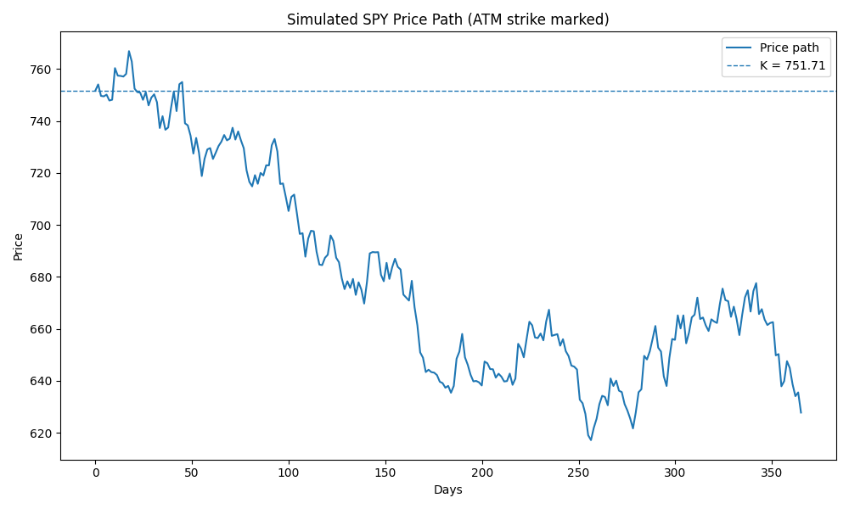
One Simulated Price Path
• A single 1-year GBM path for a 100% moneyness (ATM) SPY call, strike marked
• This is the “realized path” we will delta-hedge against
4 / 32

Slide 5
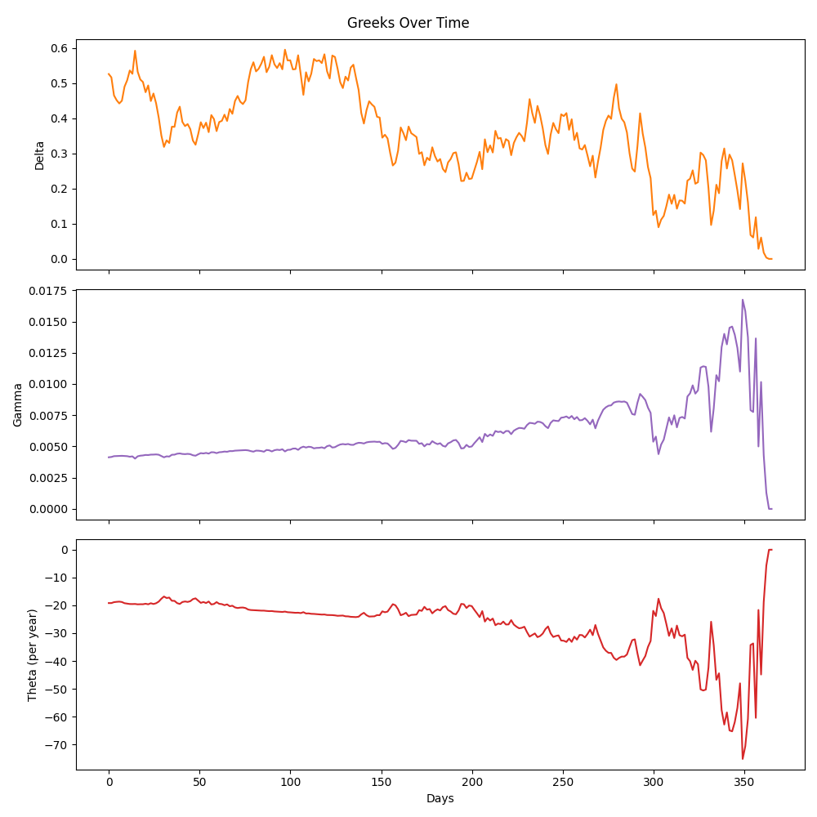
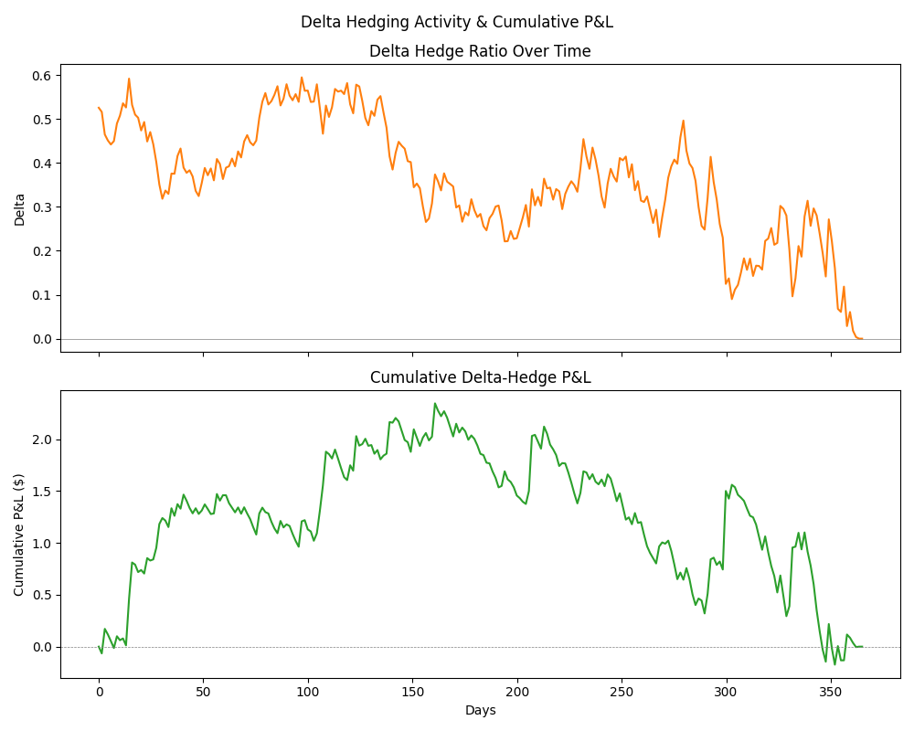
Delta Hedging the Path
• Every day: recompute delta/gamma/theta at that day's spot & remaining time, rebalance the hedge
5 / 32
Greeks over time
Delta position & cumulative hedge P&L

Slide 6
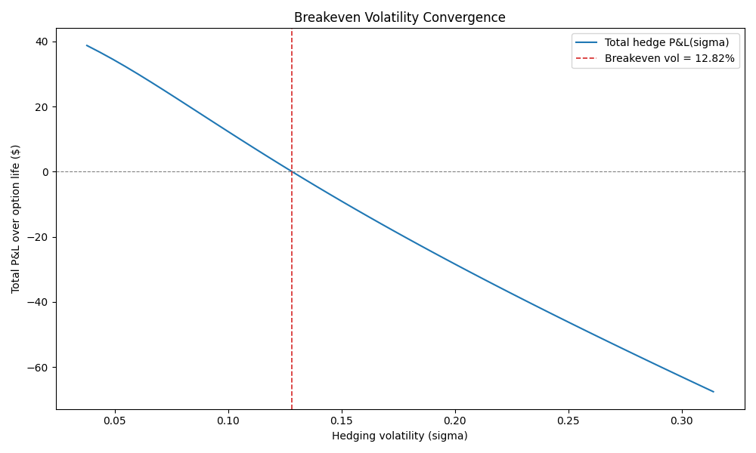
Solving for the Breakeven Vol
• Root-find σ so that total hedge P&L over this path is zero, via Brent's method
Alertblock
One path is one draw from a random process — its breakeven vol is a single noisy estimate. We need many paths to get a stable answer.
6 / 32

Slide 7
2 · BLOCK BOOTSTRAP
Why One Path Isn't Enough
• A single simulated path is one random draw — its breakeven vol carries sampling noise
• We want the estimate to reflect real SPY return dynamics: fat tails, volatility clustering, the leverage effect
• Two options: Monte Carlo many GBM paths, or resample real historical returns
• We chose block bootstrap of real SPY history — it preserves the actual texture of the market rather than an idealized lognormal assumption
Examples
Plain (IID) resampling of individual days would destroy that texture — day-to-day autocorrelation and volatility clustering are exactly the signal we want to keep.
7 / 32

Slide 8
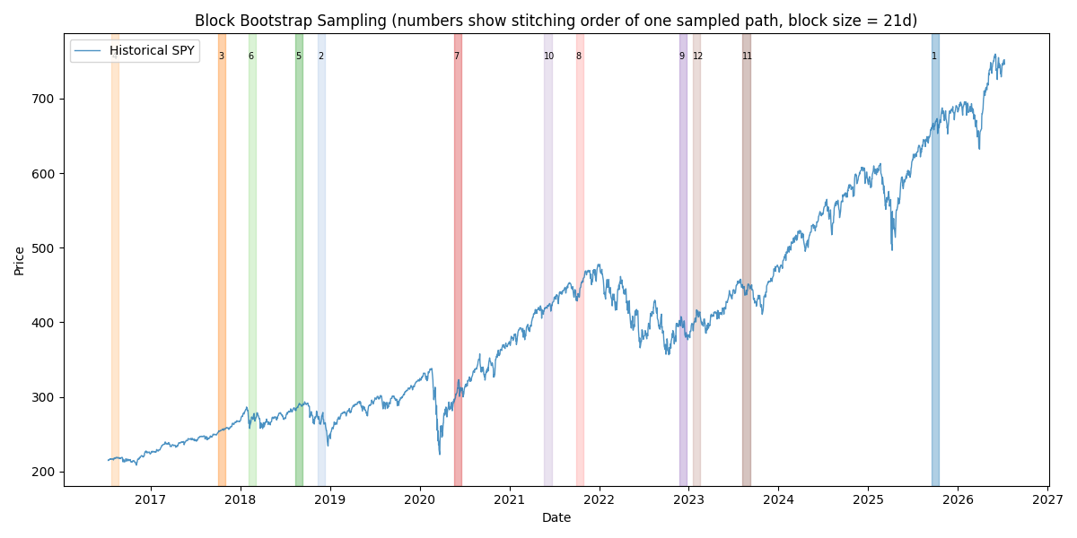
Block Bootstrap Methodology
• Stitch together randomly drawn, contiguous 21-trading-day blocks (≈ 1 month) of real historical SPY log returns
• Blocks are drawn from ≈ 10 years of daily SPY price history
• Preserves each block's internal autocorrelation & vol clustering, while mixing different historical regimes across blocks
Shaded, numbered windows = the blocks stitched into one sampled path
8 / 32

Slide 9
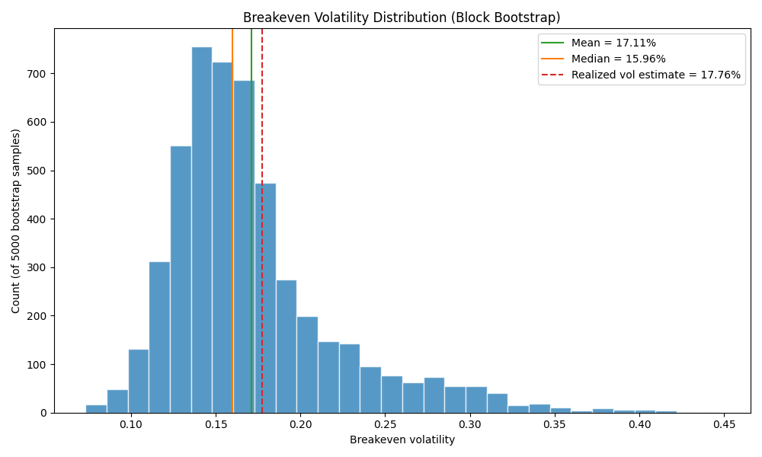
Distribution of Breakeven Vols
• Repeat the single-path procedure across thousands of bootstrapped paths for the same option
• Each path gives its own breakeven vol → a full distribution, not a single number
Block
The mean of this distribution is what we report as “the” breakeven volatility for the option.
9 / 32

Slide 10
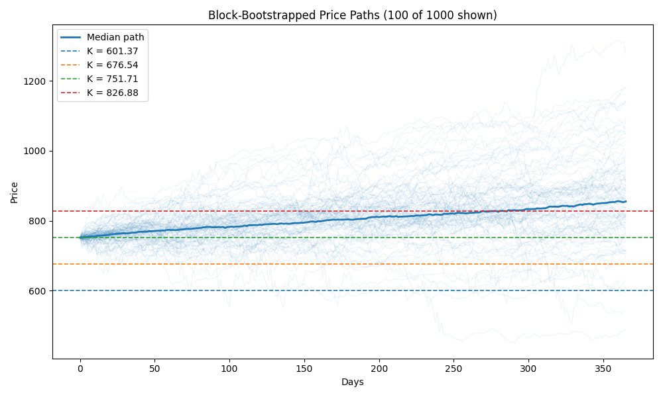
3 · THE BREAKEVEN VOLATILITY SMILE
From One Option to Four
• Expand from the single ATM call to four options: 80% put, 90% put, 100% call, 110% call
• All four are evaluated against the exact same bootstrapped path ensemble — apples-to-apples
All bootstrapped paths for the 1-year option, with the 4 strikes marked
10 / 32

Slide 11
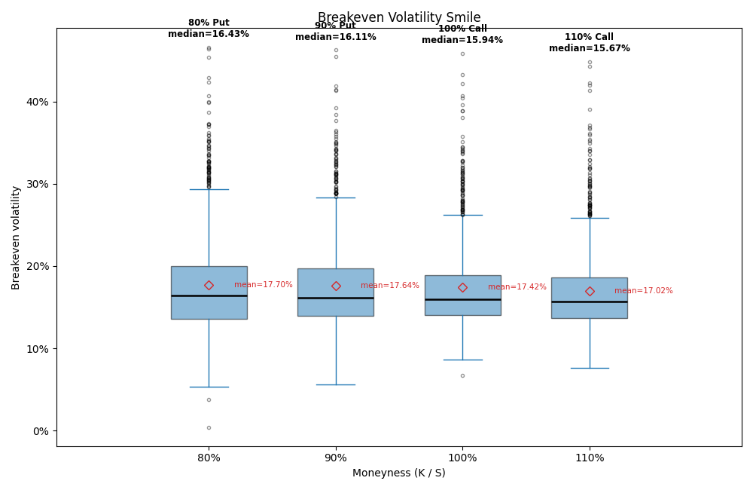
The Breakeven Volatility Smile
• For each option, root-find breakeven vol on every bootstrapped path — box = full distribution, black line = median, red diamond = mean
Examples
Slight downward skew, highest at the 80% put (median 16.4%) to lowest at the 110% call (median 15.7%) -- the leverage effect: equity selloffs historically coincide with higher realized vol, so paths drifting toward the 80% strike are more likely to reflect a higher-vol historical regime than ones drifting toward 110%.
11 / 32

Slide 12
Interpreting the Smile
• Breakeven vol is highest for the 80% put (median 16.4%) and declines steadily to the 110% call (median 15.7%)
• This is the leverage effect: equity selloffs coincide with higher realized volatility (vol clustering, fat left tail)
• A path that drifts down toward the 80% strike is more likely to have passed through a higher-vol historical regime than one drifting up toward 110%
• So the 80% put's gamma exposure ends up realized-vol-weighted higher than the 110% call's
Examples
80% Put: 16.43% 90% Put: 16.11% 100% Call: 15.94% 110% Call: 15.67% (all medians)
12 / 32

Slide 13
4 · EXPANDING TO A FULL SURFACE
Scaling Up the Grid
• Moneyness: 80% to 115% in 5% steps — puts below 100%, calls at/above (8 levels)
• Expiries: 1M, 2M, 3M, 6M, 1Y, 2Y, 3Y (7 tenors)
• 8 × 7 = 56 (expiry, moneyness) cells, each solved the same way: its own bootstrapped path ensemble, its own breakeven-vol distribution
Block
Same methodology throughout — only the grid got bigger, not the underlying logic.
13 / 32

Slide 14
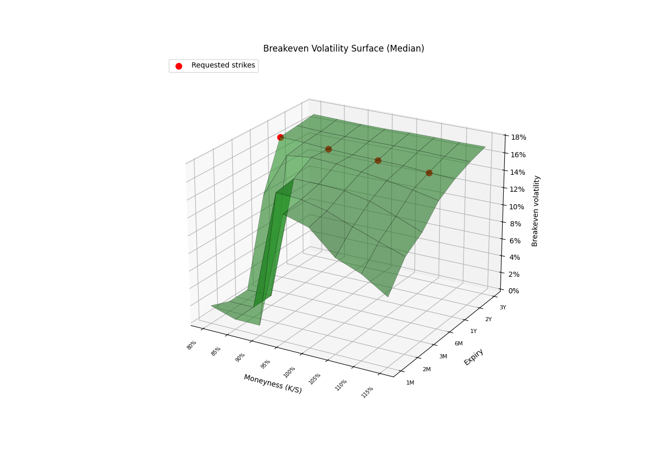
The Breakeven Volatility Surface
• Red markers = the four original moneyness levels your manager asked for, at the 1Y expiry
14 / 32

Slide 15
Noise at the Short-Dated Wing
• Look closely at the surface near 80-85% moneyness at 1M-2M — it collapses sharply
• A 20% drop in a month is astronomically unlikely at any realistic volatility, so the option is worth ~0 for every σ we test
Total P&L(σ) ≈ 0 across the entire bracket
σ = lo
σ = hi
Alertblock
Any “root” found there is floating-point noise, not signal. Our pipeline detects this (|P&L| below tolerance at both ends) and reports NaN instead of a fabricated number.
15 / 32

Slide 16
5 · MARKET IMPLIED VOLS & THE VRP
Pulling the Market Surface
• Pull SPY's live listed option chain (Alpaca) onto the exact same (expiry, moneyness) grid
• Real listed expirations are fixed calendar dates — search a window around each target date and take whichever listed expiry is actually closest
• That window widens for longer-dated targets, since LEAPS are listed far more sparsely than near-term monthlies
• For each moneyness level, take the listed strike closest to S × moneyness
Examples
Target: 1Y out → matched to actual listed expiry 2027-06-30 (nearest available)
16 / 32

Slide 17
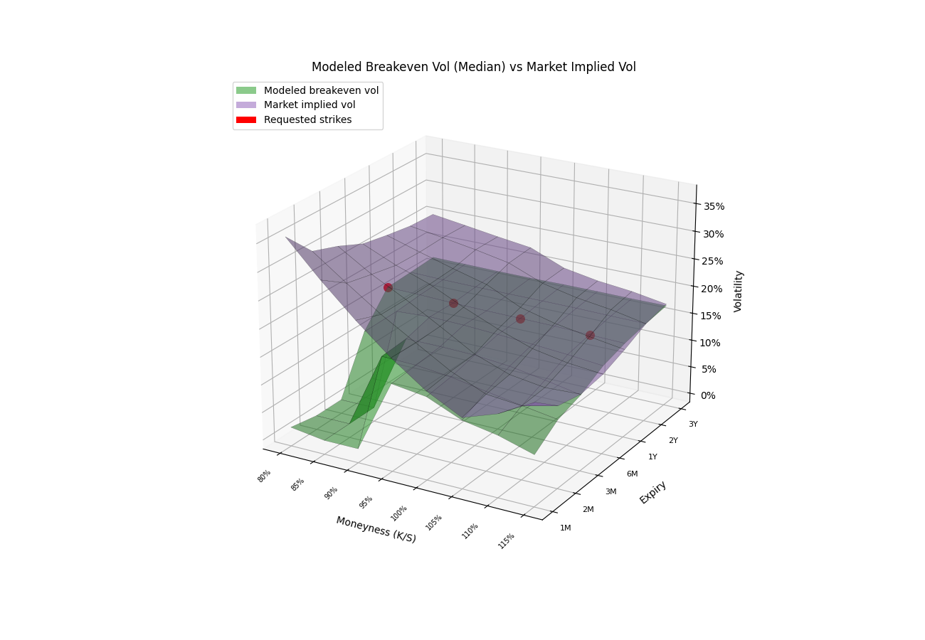
Modeled vs Market: The Dual Surface
• Green = our modeled breakeven vol surface Purple = live market implied vol surface
17 / 32

Slide 18
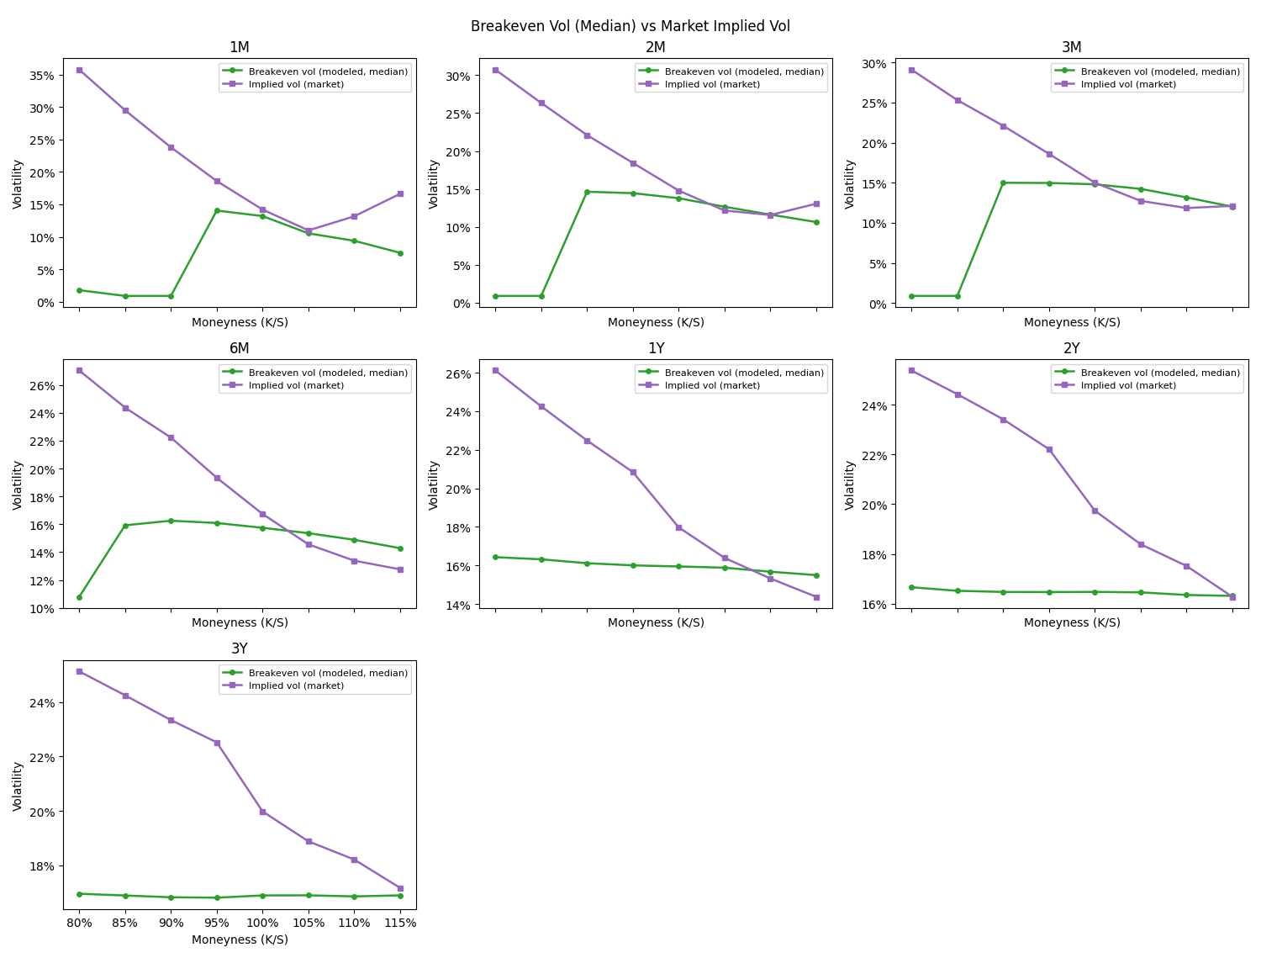
Modeled vs Market by Expiry
• Same comparison, flattened to plain lines per expiry — easier to read exact levels than the 3D surface
18 / 32

Slide 19
The Variance Risk Premium
• The gap between what the market actually charges for an option (implied vol) and what historical hedging outcomes say it should have cost (breakeven vol)
Block
Vol-point terms: VRP = σ_IV − σ_BE
Block
Variance terms (textbook definition): VRP = σ_IV² − σ_BE²
Examples
Positive VRP = the market is charging more than history says was needed — compensation for bearing tail/crash risk that realized hedging outcomes don't fully justify.
19 / 32

Slide 20
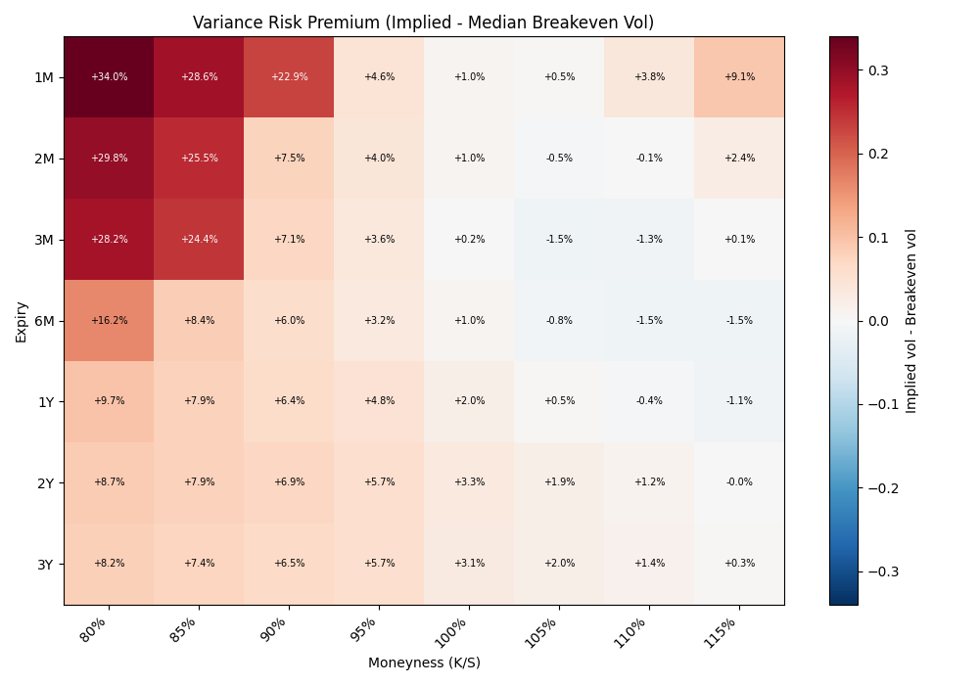
VRP Across the Surface (Normal Sampling)
• Largest at short-dated, deep OTM puts — smallest (near zero) further out and higher in moneyness
20 / 32

Slide 21
Why Are Downside Puts So Rich?
• 80% put, 1-month: implied vol trades +32.8 vol points over modeled breakeven vol
1
2
3
Crash / Tail-Risk Premium
Portfolio Insurance Demand
Supply-Demand Imbalance
Market makers charge for jump and crash risk that a 10-year bootstrap sample under-represents.
Institutions are structural buyers of downside protection — persistent demand inflates OTM put prices.
Few natural sellers of crash insurance; those who do demand a premium for the risk they're absorbing.
21 / 32

Slide 22
6 · STRESS-PERIOD SENSITIVITY
Sensitivity Check: Sampling Only From Stress Periods
• So far, blocks are drawn uniformly across ~10 years of history -- most of that history is calm, ordinary markets
• What if we restrict sampling to only historically stressed periods -- does the picture change?
• "Stress" = trailing 21-day realized vol in the top quartile of its own history, AND a negative trailing 21-day return -- this excludes violent relief rallies (high-vol, but not selloffs)
Examples
Down-stress pool: 368 eligible 21-day windows out of 2,483 (14.8% of history) -- includes Feb 2018 “Volmageddon,” Q4 2018, the 2020 COVID crash, and the 2022 bear market.
22 / 32

Slide 23
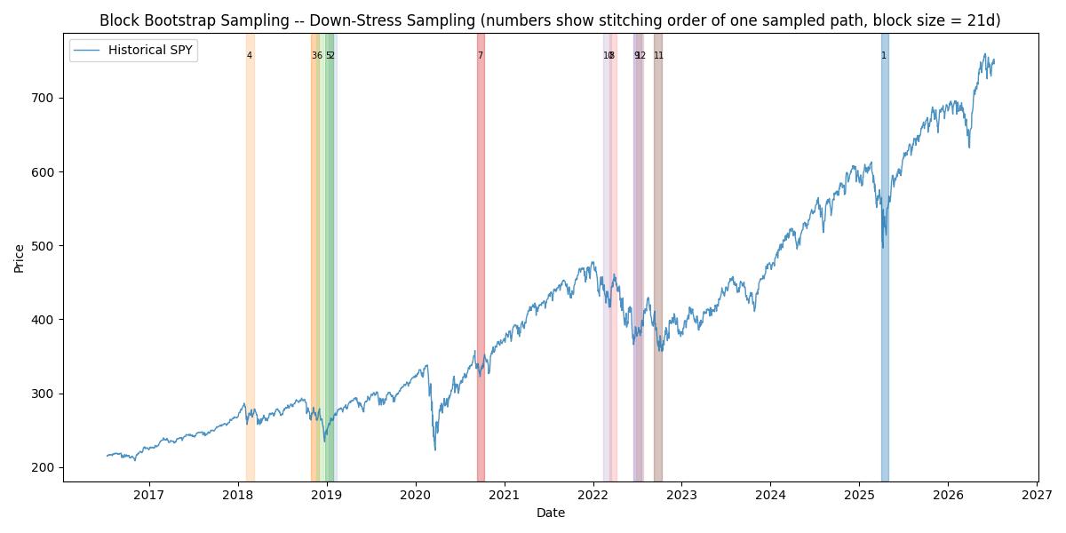
Where We're Actually Sampling From
• Same block-bootstrap mechanism as before -- just restricted to the shaded stress windows below
Down-stress-only sampling: every shaded block sits inside a real historical selloff
23 / 32

Slide 24
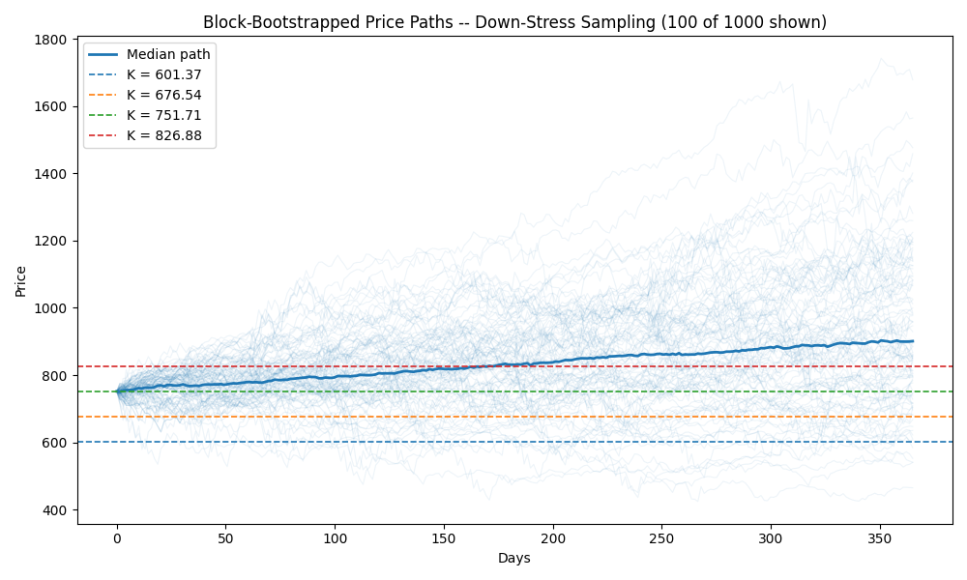
The Resulting Paths: Normal vs Down-Stress
• Same block-bootstrap mechanism, same number of paths -- only the historical pool differs
Normal Sampling
Down-Stress Sampling
24 / 32

Slide 25
Breakeven Vol Jumps Under Stress-Only Sampling
• Same four options, same 1-year expiry -- only the sampling pool changes
Moneyness | 80% Put | 90% Put | 100% Call | 110% Call
Normal (median) | 16.4% | 16.1% | 15.9% | 15.7%
Down-Stress (median) | 29.6% | 29.0% | 28.8% | 28.0%
Block
Roughly +12-14 vol points higher across every strike once we condition on genuine historical selloffs instead of the full, mostly-calm 10-year history.
25 / 32

Slide 26
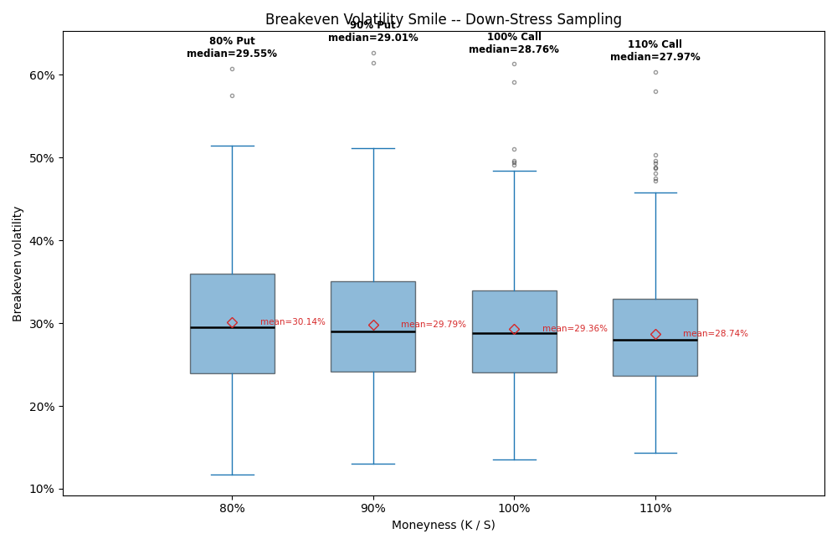
The Smile Itself: Normal vs Down-Stress
• The whole distribution shifts up and widens under stress-only sampling -- not just the mean/median
Normal Sampling
Down-Stress Sampling
26 / 32

Slide 27
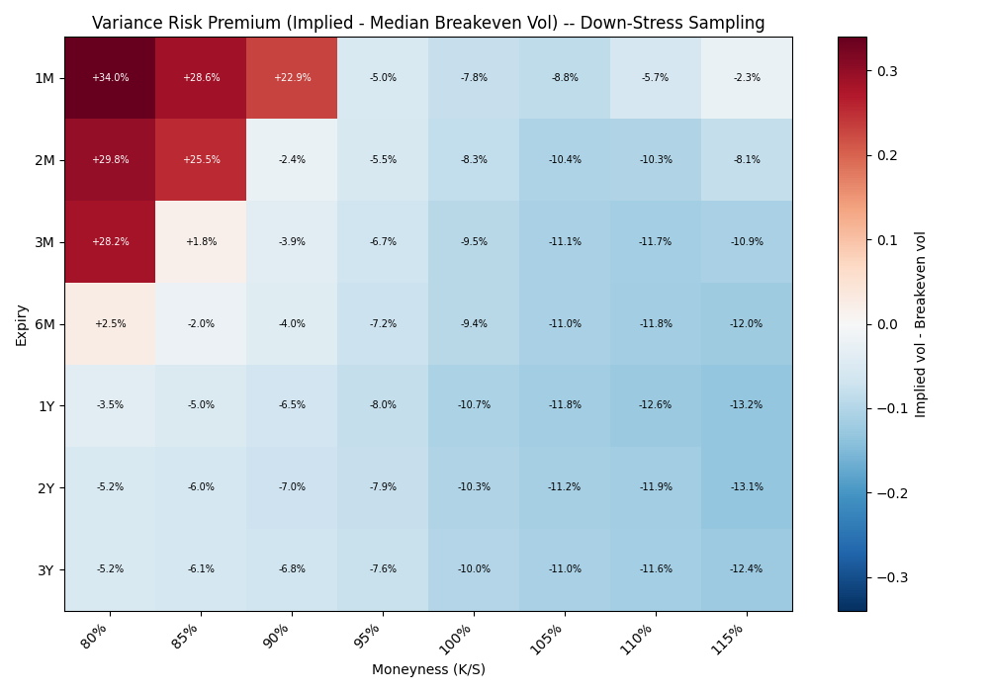
VRP Reassessed Under a Stress-Conditioned Benchmark
• Same market implied vols -- only the breakeven-vol benchmark now reflects selloff-only history
27 / 32

Slide 28
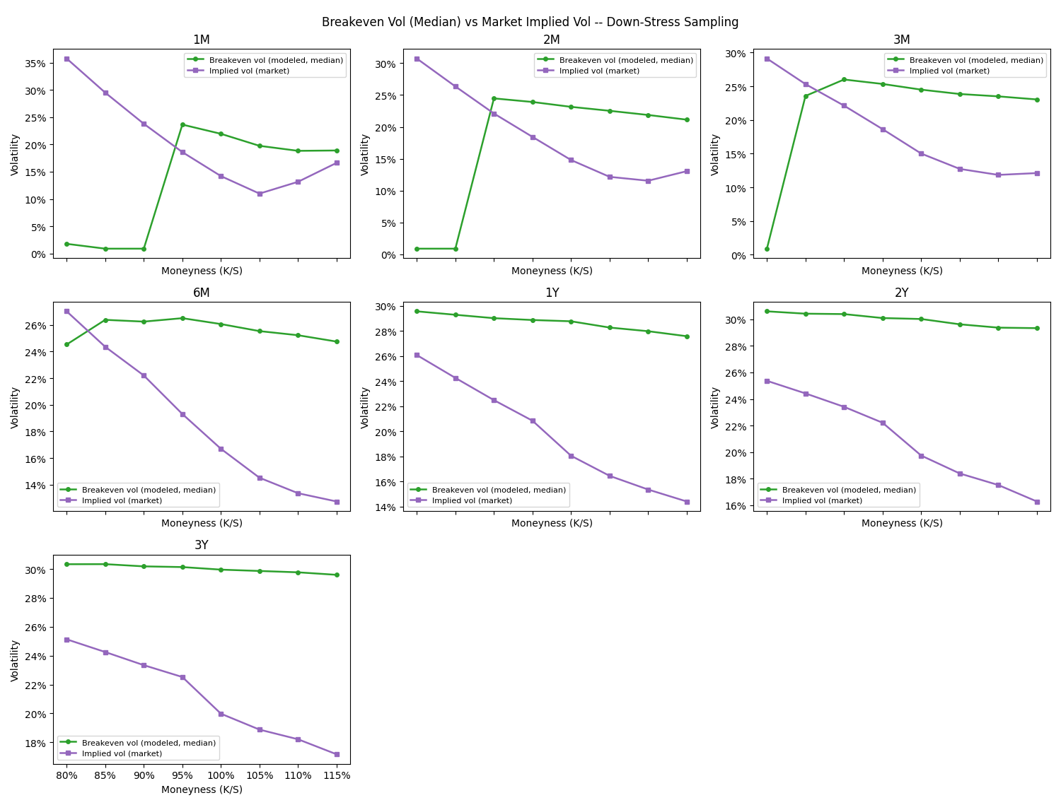
Modeled vs Market: Normal vs Down-Stress
• Under stress-only sampling, the green (modeled) line moves up to meet -- or exceed -- the purple (market) line across most tenors
Normal Sampling
Down-Stress Sampling
28 / 32

Slide 29
What This Tells Us
• Almost everywhere, VRP flips negative under stress-only conditioning: most of the market's apparent “richness” vs. normal-history breakeven vol is explained once the benchmark itself assumes a selloff
• Exception -- 1-month, 80-90% moneyness: VRP is identical under both sampling regimes (+34.0%, +28.6%, +22.9%)
• That's mechanical, not a coincidence: a 1-month option is built from a single 21-day block, so reaching 80-90% moneyness needs one of the same rare extreme historical blocks regardless of which pool it's drawn from
Alertblock
The one place the market still looks rich even against a pure crash benchmark: the shortest-dated, deepest-left-tail corner. That residual likely reflects risks even a real selloff sample doesn't fully capture -- sharper single-month drops, overnight gaps, or a structural liquidity/insurance premium.
29 / 32

Slide 30
Limitations & Next Steps
• Breakeven-vol distributions are right-skewed (mean > median) — we report the median as primary for this reason
• Block bootstrap only resamples the observed ~10-year history — even stress-only sampling can't produce a crash unlike anything already in the sample
• Market matching snaps to the nearest listed strike/expiry, which adds a small amount of basis noise to the comparison
• Next: extend history further back, add a sequential/uniqueness-weighted bootstrap variant, track VRP over time
30 / 32

Slide 31
Summary
• Single path → delta-hedge it → root-find the vol that breaks even
• Block bootstrap thousands of realistic paths → a distribution, not one noisy number
• Four options, one shared path ensemble → a breakeven volatility smile
• More strikes, more expiries → a full breakeven volatility surface
• Compared to the market: options price in a real, measurable variance risk premium — largest for short-dated, deep OTM puts
• Conditioning the sample on real historical selloffs closes most of that gap -- except at the shortest-dated, deepest-OTM corner, which stays rich even then
31 / 32

Slide 32
Thank You
Questions?
32 / 32

