Slide 1
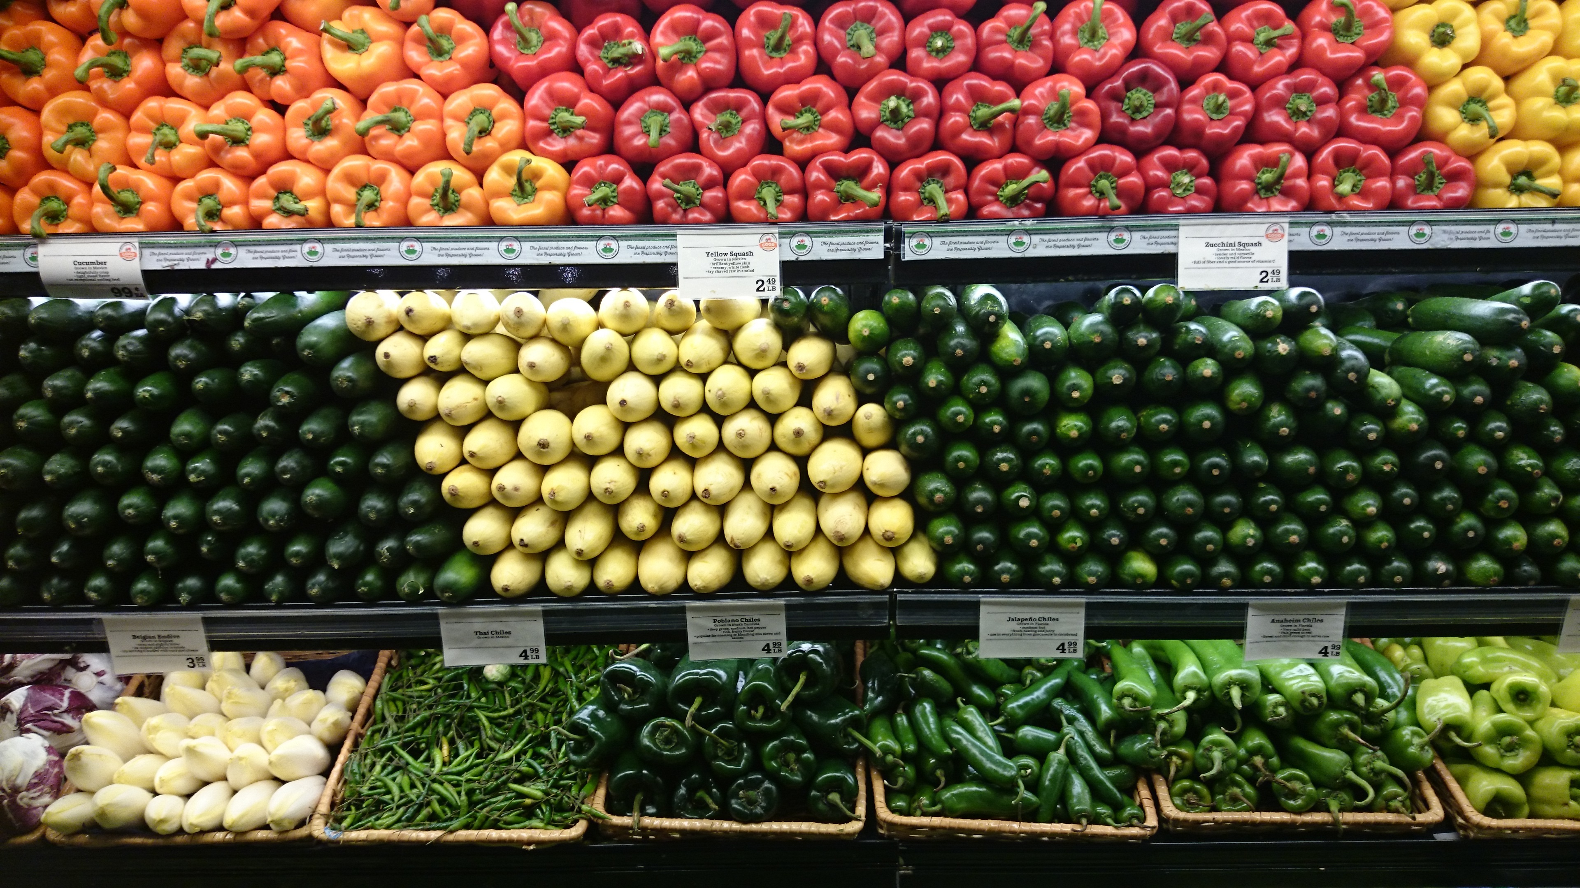
Predicting Food Insecurity with Machine Learning
By: Cassy Clark
Notes:
Good afternoon! I’m excited to share with you all my project I’ve been working on to predict food insecurity in hopes that local and federal government officials and policy makers can be proactive in the fight to end the meal gap and offer affordable and accessible food for all.

Slide 2
Introduction
Inspiration for project:
The Bok Choy local project
13.7 million households experienced food insecurity in 2019
$161 billion worth of food thrown out each year
Data:
CPS Food Insecurity 2019 Data
Question to answer:
Can we predict whether someone will experience food insecurity or not.
Notes:
I’d like to start with an introduction about how and why I chose this subject as well as a brief overview of what I will be discussing with you all. To start, I had an idea where I wanted to create a web-app for folk to use where they could see what produce was in season as well as easy, affordable plant-based recipes to try out. Since this didn’t answer a data science question, I began to dig deeper into what this idea means to me. In doing so, I remembered this local project known as the Bok Choy Project started by Shauntrice Rice, Root Cause Research Center, and Nichole Funk here in Louisville, KY. Their project visually shows the difference in food selection at Kroger’s all across town and highlight’s how the Kroger in the West End, and area of Louisville that has a higher BIPOC population as well as lower income households, had a smaller produce section, less organic options, and no Bok Choy to show how food insecurity and food apartheids happen here in Louisville. In addition to that, it was reported in 2019 that 13.7 million households in America experienced food insecurity while there is over $161 billion worth of food thrown out each year. This is a problem I have felt compelled to advocate for for years now and wanted to try and do so with machine learning.
The data used for my project came from the Census Current Population Survey on Food Insecurity from 2019 and the question that I want to answer is can we predict whether or not someone will experience food insecurity so that we can bridge the meal gap and help our fellow comrades get the healthy and affordable food they need as well as deserve.

Slide 3
Diving Deeper into the Data
Data and data dictionary gathered from Census.gov under their food security data sets page
Original data set contained over 500 columns of various questions, many of which were dropped due to the replicative nature of the question
Original data set had over 138,000 rows of which individuals from households with more than 1 person were dropped, mostly based on age
Changed numerical values back to actual categorical values
Notes:
So now to begin with diving deeper into the data. I gathered this data from Census.gov under their food security data sets page. My hope was originally to gather the data sets from 2019-2016 but there were formatting challenges that occurred when trying to access the data from 2016-2018 where all the columns merged as 1 with none of the same column labels as in the 2019 data sets. The census provides a data dictionary with each set and the one for 2019 was over 200 pages detailed what each column label meant as well as what each value label meant.
Before cleaning, the data set had over 500 columns, which after reading the data dictionary I discovered that a majority of columns were essentially the same question asked in multiple different ways. These repeat question columns were dropped, and a lot of the columns were renamed to provide an easier understanding of what I was looking at.
There were over 138,000 rows within the original data set too which I discovered was because each person from each household was questioned. I decided to drop anyone under the age of 16, I chose 16 because I had found that most 16-year old’s held jobs and I wanted to keep the main person questioned from each household in the data set. Because if they had answered yes to being food insecure, this meant the whole household was food-insecure.
After going through the data set and data dictionary, I noticed that all the categorical variables were already converted to different types of numerical values. Again, for easier understanding of my data set, I decided to change all these values back to their original values until modeling.
Lastly, a master column that would indicate food secure (0) and food insecure (1) was created based on responses to the various questions asked about feeling as though they had enough to feed their families, never had to worry about where food came from, received any assistance at any point in the year or not, and so on. After creating this, any questions used to calculate the master column were then dropped.

Slide 4
Variable Changes
Created age groups
Modified number of persons in a household
Reverted income back to dollar amounts
Notes:
While conducting my EDA, I decided to switch up some variables for easier readability. For age, since it ranged from 16-85, I decided to create age groups for a friendly graph.
Number of individuals in a household ranged from 1-14 and this was changed to 1-6 with anyone who had 6 or more being grouped under 6
Income was on a scale from1-16, so these values were changed back to their original which then ranged from $5,000-$150,000

Slide 5
Exploratory Data Analysis
After finishing the data cleaning process, I wanted to look for any trends or highly correlated factors that would result in an individual experiencing food insecurity
Key explorations were hours worked in a week, difference location had on food insecurity, age analysis, number of individuals in a household as well as family income, race and ethnicity, gender, and marital status
Turned out to be not a diverse data set
Notes:
Once I finally completed the data cleaning, I wanted to look for any specific trends and correlations within the data set that way I could really get to know this data set. Exploring the data helped me figure out how I wanted to deal with null values and the values from the data dictionary that corresponded with -1 which meant not in universe/not-applicable, -2 which meant don’t know, and -9 which meant no response. The key explorations that drove this were hours worked in a week, location-based food security, age analysis, number of individuals in a household, family income, race and ethnicity, gender, and marital status.
For hours worked, there was a value of -4 which translated to the person’s hours varied each week. These values were changed to 40 since 40 was the mode and all the individuals held jobs. There were almost 20,000 rows of individuals who had values of -1 for this question and when I looked at these rows, they did not share how many jobs they had or what type of job they had so I changed these values to 0. Almost all values that were -1 were changed to 0 during cleaning and analysis because I did not want to be working with any negative numbers when modeling. I felt this was the right choice since almost all questions that were asked did not contain any variable of 0.When I did location-based analysis, I found that there was an even distribution among those who were food secure and food insecure across the states even though the amount of people questioned from each state ranged greatly.
Another thing I found from this data set is that it is not a diverse data set. 82% of individuals were white, over 50% of households had 1 or 2 people, and the average household income was $150,000. This will be addressed later in the presentation as well.

Slide 6
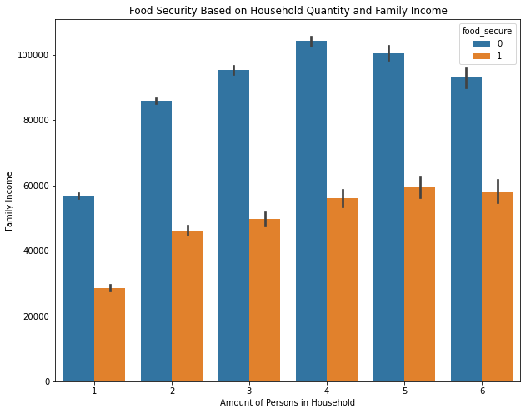
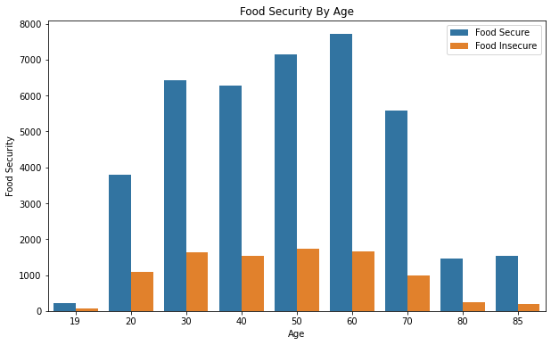
Notes:
Here I just wanted to show the graphs for food security based on number of people in a household and food security based on age. The blue bars represent food security, and the orange bars represent food insecurity. We can see here that with larger families, food insecurity occurs more frequently even as income increases.

Slide 7
Other Areas Explored
Number of jobs and Food security
Gender and Income based food security
Outliers found here
Food pantry location unknown
Family size and marital status in relation to food security
Job type and food security levels
Notes:
Some outliers were discovered when I explored gender analysis as well as food recipient analysis. For gender, the outliers, though very few, were women who had a family income of $150,000 and said they were food insecure. When looking at these rows, these individuals had jobs, small households, no disability, nothing that stood out to indicate what might be the cause of these outliers. I decided to drop them since I couldn’t find any indication of food insecurity and figured that they may have just either answered some questions wrong or their responses were recorded incorrectly.
Everyone in the questionnaire was asked if they knew or had a food pantry or something similar near by. Of those who were food insecure, about half of them either had no idea where one was or said there was not one close to them.
I also explored relationships between family size and marital status regarding food security and job type as well. Nothing too special came from these as most people were still married and most people either worked at a for profit job or did not indicate the type of job they had.

Slide 8
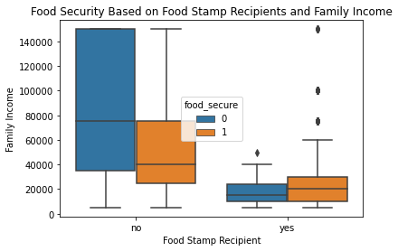
Food Recipient Analysis
Notes:
Of the roughly 50,000 rows left after dropping all but one person from each household, I discovered that about 47,000 said they have never or do not receive food stamps and/or assistance and only about 3,000 do. I did a quick plot of these answers and household income to see if all who were food insecure were receiving adequate assistance. Long story short, they were not. Many folks who were food insecure had answered no to receiving assistance and a few who were food secure did receive assistance.
Whenever I took a deeper look into the outliers of those who said they were food insecure and the household income was over $75,000, I found that most these folks had 6+ persons households. To put this in perspective, say we have a household with 6 people and the income is $150,000. Assuming it is a two-parent household with 4 kids with both parents working, this would mean that each parent makes about $75,000 a year. Now let’s say this family lives in California. According to livingwage.mit.edu, the required family income for a 2-parent household with 3 kids is about $104,251 to make ends meet. This scenario explains the outliers well in my opinion given the fact that many individuals experiencing food insecure do not just have children living with them but also their parents and are not a two-parent household.

Slide 9
Modeling Process
Question being asked → Classification modeling to answer
Final data cleaning steps
Pre-processing steps
Baseline score found
Wanted to minimize as many false negatives as I could
Notes:
The question that I was asking was if I could build a model to use to predict food insecurity so that local and federal government officials and policy makers as well as community members could be proactive in the fight to bridge the meal gap. To answer this, classification models would need to be used to classify individuals as being food secure or insecure. Before I could officially begin modeling, I needed to convert some of my categorical values back to numerical values. Any place where someone had answered yes was changed to a value of 1 and no was changed to a value of 0.
For the columns like State and Region that didn’t have simple yes or no responses, I did a pre-processing step of target encoding which replaces each value in the column with the mean target value of the category. A baseline score of 82% classified as foods secure and 18% classified as food insecure was calculated followed by setting up the X and y variables which were then scaled for the models that required using scaled data, or in other words, the models that would need the values of income and number of people in a household to be scaled to more relatable values.
For this question, I wanted to find the model that not only scored the best but also minimized false negatives the most. I wanted to eliminate the amount of individuals being misclassified as food secure but actually are food insecure.

Slide 10
Modeling Process Cont.
Ran several different models
Random Forest
Random Forest
Difference of 14 misclassified food secure
Metrics checked for each model
Misclassified percentage for positive and negative classes
Accuracy
f1-score
Histogram Gradient Boosting Classifier
Notes:
Overall I ended up running 9 different models including some experimental models and found that my best ones were the Random Forest and the Histogram Gradient Boosting Classifier. In the end I ended up choosing the random forest as the best model to answer this question. The scores for the two were almost identical but the random forest model had performed better with minimizing false negatives. The metrics checked for the models included the misclassified percentages of the positive class (food insecurity) and negative class (food security), accuracy, f1-scores, and the ROC-AUC score which I will touch on all of these a bit more in just a second.

Slide 11
Random Forest Model
Well fit model
Least amount of folks being misclassified as food secure when they are food insecure
Highest f1 score for class 0 and class 1
ROC-AUC score of 0.96
Notes:
Now to talk about the random forest model and why I chose it as the best model. The score for the training set was roughly 0.96 and for the testing set was roughly 0.95 which indicated that this model does well with new data being introduced in order to classify which category the new data will fall under. After this, I looked at the misclassification of food secure and food insecure rates to determine the best model.
Random forest performed the best in this area with 613 misclassified as being food secure but were food insecure and 155 misclassified as being food insecure but were food secure. All the other models had a higher rate of misclassifying more as food secure but were food insecure. Since I was dealing with heavily imbalanced classes, I also wanted to look at the f1-score and ROC-AUC score. The f1-score looks at both the misclassified food secure and misclassified food insecure and produce a weighted average for each. The closer to 1 the score is, the better. For food secure, the f1 score was 0.97 and for food insecure, the score was 0.86.
The ROC-AUC is used to visualize the capability of the model to distinguish between the different classes, or in this case to distinguish between food secure and food insecure. Like the f1-score, we want the ROC score to be as close to 1 as possible. For this model, the score was 0.96 which means that the model has a 96% chance of being able to distinguish between the food secure and food insecure classes.

Slide 12
Next Steps
2020 CPS Food Security data
1
Gather non-census data for more diverse data
2
Ready new data and model for deployment
3
Send out alternative questionnaire
4
Notes:
The next steps I have for continuing this project includes gathering the 2020 food security data when the census.gov makes it available in December. I also plan to gather data outside of the census that way I can create a master data set that is more diverse and representative of the actual population. I would then want to tune the new data set to place into my model so that I can have variables that play nice with deployment and streamlit. Once deployed I would love to send the model out in place of the census since there are a lot of people who do not want to answer or feel comfortable answering census surveys. By doing this, we could get a more accurate representation of food insecurity for future years so that actions can be taken now so that every person has accessible and affordable healthy food options.

Slide 13
Any Questions? ☺
Notes:
Thank you all so much for your time and I am open for questions now. Thank you!

