Slide 1
Embedded Software Essentials
Compiling and Invoking GCC
C1 M2 V2

Slide 2
Copyright
Copyright (C) 2017 by Alex Fosdick. Redistribution, modification or use of this presentation is permitted as long as the files maintain this copyright. Users are permitted to modify this and use it to learn about the field of embedded software. Alex Fosdick and the University of Colorado are not liable for any misuse of this material.

Slide 3
Build Process (linear)
*.c
*.c
*.c
*.c
*.c
*.c
*.c/*.h
Preprocessor
*.i
Compiler
Proper
*.s
Source Files
Preprocessed Files
Assembly Files
*.c
*.c
Assembler
*.o
Linker
Relocatable File
Locator
Executable
Object Files

Slide 4
Build Process (linear)
Building
Compiling
*.c
*.c
*.c
*.c
*.c
*.c
*.c/*.h
Preprocessor
*.i
Compiler
Proper
*.s
Source Files
Preprocessed Files
Assembly Files
*.c
*.c
Executable
Assembler
*.o
Linker
Relocatable File
Locator
Object Files
Notes:
Circle the entire process and write build or compile

Slide 5
Build Process (linear)
GNU’s Compiler Collection (GCC)
Toolchain
Building
Compiling
Preprocessor
*.c
*.c
*.c
*.c
*.c
*.c
*.c/*.h
Preprocessor
*.i
Compiler
Proper
*.s
Compiler
Source Files
Preprocessed Files
Assembly Files
Assembler
*.c
Linker
*.c
Executable
Assembler
*.o
Linker
Relocatable File
Locator
Object Files
Locator
Notes:
Circle the entire process and write build or compile
Single pathway

Slide 6
Build Process (linear)
GNU’s Compiler Collection (GCC)
Toolchain
Building
Compiling
Preprocessor
*.c
*.c
*.c
gcc
*.c
*.c
*.c
*.c/*.h
Preprocessor
*.i
Compiler
Proper
*.s
Compiler
Source Files
Preprocessed Files
Assembly Files
as
Assembler
*.c
Linker
*.c
Executable
Assembler
*.o
Linker
Relocatable File
Locator
ld
Object Files
Locator
Notes:
Circle the entire process and write build or compile

Slide 7
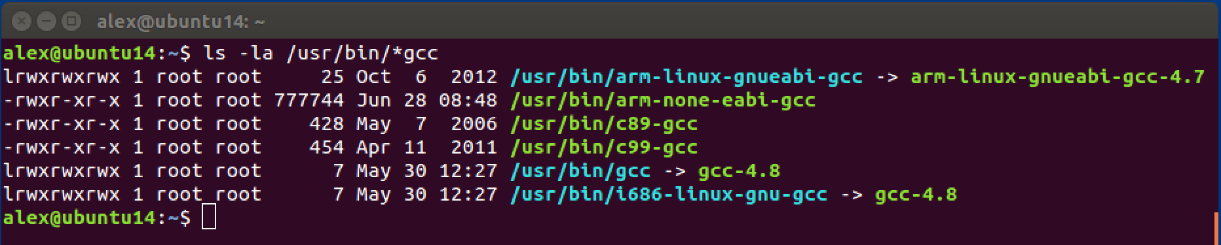
GCC Tool Check
Many compilers toolchains can be installed
$ ls –la /usr/bin/*gcc
arm-none-eabi-gcc
-Arch = ARM
-Vendor = N/A
-OS = None (Bare-Metal)
-ABI = EABI
arm-linux-gnueabi-gcc
-Arch = ARM
-Vendor = N/A
-OS = Linux OS
-ABI = GNUEABI
<ARCH>-<VENDOR>-<OS>-<ABI>
Notes:
Circle the entire process and write build or compile
arch[-vendor][-os]-abi
arch = architecture: arm, mips, x86, i686...
vendor = tool chain supplier: Apple
os is for operating system: linux, none (bare metal)
abi is for application binary interface convention: eabi, gnueabi, gnueabihf

Slide 8
Compilers
Native Compiler:
gcc -> gcc-4.8
Cross Compiler:
arm-none-eabi-gcc
For code run on the host machine
For code run on the target processor
Notes:
Circle the entire process and write build or compile
arch[-vendor][-os]-abi
arch = architecture: arm, mips, x86, i686...
vendor = tool chain supplier: Apple
os is for operating system: linux, none (bare metal)
abi is for application binary interface convention: eabi, gnueabi, gnueabihf

Slide 9
Compilers
Cross Compiler:
arm-none-eabi-gcc
Showd all tools in the Cross-Compiler Toolchain
For code run on the target processor
$ ls –la /usr/bin/arm-none-eabi*
Notes:
Circle the entire process and write build or compile
arch[-vendor][-os]-abi
arch = architecture: arm, mips, x86, i686...
vendor = tool chain supplier: Apple
os is for operating system: linux, none (bare metal)
abi is for application binary interface convention: eabi, gnueabi, gnueabihf

Slide 10
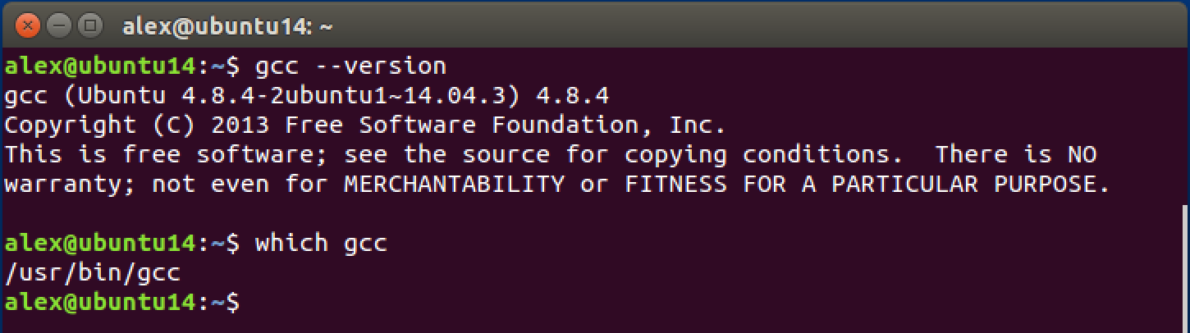
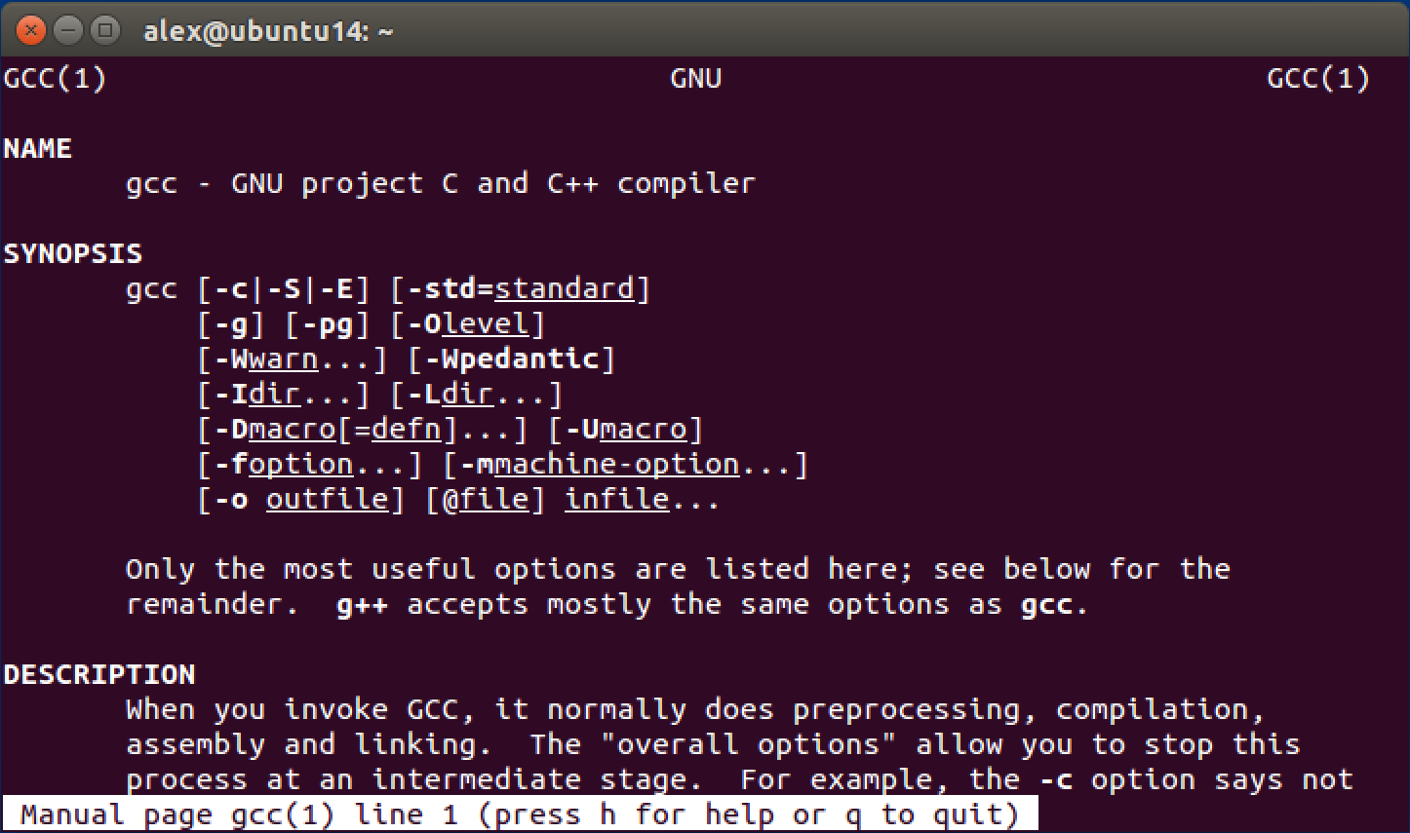

GCC Tool Check
$ gcc --version
$ which gcc
$ man gcc
10
Notes:
Circle the entire process and write build or compile

Slide 11
Typical Build Process
Assembly Files → Object Files → Library Files → Executable File → | .s Extension .o Extension .a Extension (with .h) Extension Varies
*.c
*.c
*.c
*.c
*.s
*.o
Linker File
Assembler
Source Files
*.c
*.c
Library
Files
*.a
Executable
Linker
Relocatable File
Locator
*.c
*.c
*.c
*.c
*.c
*.h
*.o
Compiler
Source Files
Object Files

Slide 12
Typical Build Process
Assembly Files → Object Files → Library Files → Executable File → | .s Extension .o Extension .a Extension (with .h) Extension Varies
Assembler (as)
*.c
*.c
*.c
*.c
*.o
*.s
Linker File
Assembler
Source Files
*.c
Linker (ld)
*.c
Library
Files
*.a
Executable
Linker
Relocatable File
Locator
Compiler (gcc)
*.c
*.c
*.c
*.c
*.c
*.h
*.o
Compiler
Source Files
Object Files

Slide 13
Typical Build Process
Assembly Files → Object Files → Library Files → Executable File → | .s Extension .o Extension .a Extension (with .h) Extension Varies
Compiler (gcc)
Assembler (as)
*.c
*.c
*.c
*.c
*.o
*.s
Linker File
Assembler
Linker File
Source Files
*.c
Linker (ld)
*.c
Library
Files
*.a
Executable
Linker
Relocatable File
Locator
Compiler (gcc)
*.c
*.c
*.c
*.c
*.c
*.h
*.o
Compiler
Compiler
Source Files
Object Files

Slide 14
Typical Build Process
Assembly Files → Object Files → Library Files → Executable File → | .s Extension .o Extension .a Extension (with .h) Extension Varies
Compiler (gcc)
Assembler (as)
*.c
*.c
*.c
*.c
*.o
*.s
Linker File
Assembler
Linker File
Source Files
*.c
Linker (ld)
*.c
Library
Files
*.a
Executable
Linker
Relocatable File
Locator
Compiler (gcc)
*.c
*.c
*.c
*.c
*.c
*.h
*.o
Compiler
Compiler
Source Files

Slide 15
Compilation Proper
*.c
*.c
*.c
*.c
*.c
*.h
Compilation
Proper
*.s
C-Programming
(High Level Language)
Source Files
Assembly Files
int x = 0;
int y = 20;
int z = 5;
…
while (y >= z) {
y = y – z;
x++;
}

Slide 16
Compilation Proper
*.c
*.c
ARM Assembly Language
*.c
*.c
*.c
*.h
Compilation
Proper
*.s
C-Programming
(High Level Language)
ldr r2, y
ldr r3, z
ldr r4, x
LOOP:
sub r2, r3
inc r4
cmp r2, r3
bgt LOOP
str r2, y
str r4, x
Source Files
Assembly Files
int x = 0;
int y = 20;
int z = 5;
…
while (y >= z) {
y = y – z;
x++;
}
High level language translated to low level language via compiler

Slide 17
Assembly to Machine Code
*.c
*.c
Assembly Language | Machine Code
movs r3, #0 | 0x2300
strb r3, [r7, #7] | 0x71fb
adds r3, r7, #7 | 0x1dfb
str r3, [r7, #8] | 0x60bb
adds r1, r7, #7 | 0x1df9
adds r3, r7, #6 | 0x1dbb
*.c
*.c
*.s
Assembler
*.o
Assembly Files
Object Files
movs r3, #0
Operation
Operand
17

Slide 18
General Compiler Flags
Option & Format | Purpose
-c | Compile and Assemble File, Do Not Link
-o <FILE> | Compile, Assemble, and Link to OUTPUT_FILE
-g | Generate Debugging Information in Executable
-Wall | Enable All Warning Messages
-Werror | Treat All Warnings as Errors
-I<DIR> | Include this <DIR> to Look for Header Files
-ansi -std=STANDARD | Specify Which Standard Version to Use (ex: c89,c99)
-v | Verbose Output from GCC

Slide 19
Architecture Specific Compiler Flags
Option & Format | Purpose
-mcpu=[NAME] | Specifies Target ARM Processor and Architecture (ex: cortex-m0plus)
-march=[NAME] | Target ARM Architecture (ex: armv7-m, thumb)
-mtune=[NAME] | Target ARM Processor (ex: cortex-m0plus)
-mthumb | Generate code in Thumb States (ISA)
-marm | Generate code in ARM State (ISA)
-mthumb-interwork | Generate code that supports calling between ARM and Thumb (ISA)
-mlittle-endian | Generate code for Little Endian Mode
-mbig-endian | Generate code for Big Endian Mode
Notes:
../configure --target=arm-axon-eabi --prefix=toolchain \ --with-cpu=cortex-m0 --with-mode=thumb \ --enable-interwork --disable-multilib \ --enable-languages="c" --with-newlib --without-headers \ --disable-shared --with-gnu-as --with-gnu-ld \ 2>&1 | tee configure.log

