Slide 1

Embedded Software Essentials
The Preprocessor
C1 M2 V3

Slide 2
Copyright
Copyright (C) 2017 by Alex Fosdick. Redistribution, modification or use of this presentation is permitted as long as the files maintain this copyright. Users are permitted to modify this and use it to learn about the field of embedded software. Alex Fosdick and the University of Colorado are not liable for any misuse of this material.

Slide 3
The Preprocess [S1.2.3.1]
First Step In Build Process
*.c
*.c
*.c
*.c
*.c
*.c
*.c/*.h
Preprocessor
*.i
Compiler
Proper
*.s
Source Files
Preprocessed
Files
Assembly Files
*.c
*.c
Assembler
*.o
Linker
Relocatable File
Locator
Executable
Object Files

Slide 4
Preprocessor Directives [S1.2.3.2]
Special keywords used by the preprocessor before compilation
→ Compile Time switches
Directives start with ‘#’ sign
Important Directives
#define, #undef
#ifndef, #ifdef, #endif
#include
#warning, #error
#pragma

Slide 5
Preprocessor’s Role [S1.2.3.3.a]
Compiler (gcc)†
*.c
*.c
*.c
*.c
*.c
*.c
To Linker
*.c/*.h
Preprocessor
*.i
Compiler
Proper
*.o
Source Files
Object Files
Output with –E option
*.c
*.c
*.i
† = The preprocessor is bundled with the compiler
Preprocessed Files

Slide 6
Preprocessed Output [S1.2.3.3.b]
Stop after preprocessing
Output the preprocessed file to a *.i extension
$ gcc -E -o main.i main.c

Slide 7
#define as a Constant [S1.2.3.4]
Used for defining constants, features or macro functions
Constant Examples:
#define <MACRO-NAME> <MACRO-VALUE>
#define LENGTH (10)
#define NO_ERROR (0)
#define ERROR (1)
/* Macro defined as another macro */
#define UART_ERROR ERROR

Slide 8
Macro Substitution [S1.2.3.5a]
Original File
#define ZERO (0)
#define LENGTH (10)
int main(){
char arr[LENGTH];
memset(arr, ZERO, LENGTH);
…
return 0;
}
After Preprocessing
int main(){
char arr[10];
memset(arr, 0, 10);
…
return 0;
}
Preprocessor

Slide 9
Macro Substitution [S1.2.3.5b]
Original File
#define ZERO (0)
#define LENGTH (10)
int main(){
char arr[LENGTH];
memset(arr, ZERO, LENGTH);
…
return 0;
}
After Preprocessing
int main(){
char arr[10];
memset(arr, 0, 10);
…
return 0;
}
Preprocessor

Slide 10
#define as a Macro Function [S1.2.3.6]
Provide Macro Function name, parameters, and operation
Constant Examples:
#define <MACRO-FUNCTION>(<PARAMS>) (<OPERATION>)
#define SQUARE(x) (x*x)
…
int y_sqrd;
int y = 2;
y_square = SQUARE(y);
→ y_square will equal 4

Slide 11
Macro Function Substitution [S1.2.3.7a]
Original File
After Preprocessing
#define SQUARE(x) (x*x)
int main(){
int y_sqrd;
int y = 2;
y_square = SQUARE(y);
return 0;
}
int main(){
int y_sqrd;
int y = 2;
y_square = (y*y);
…
return 0;
}
Preprocessor

Slide 12
Macro Function Substitution [S1.2.3.7b]
Original File
After Preprocessing
#define SQUARE(x) (x*x)
int main(){
int y_sqrd;
int y = 2;
y_square = SQUARE(y);
return 0;
}
int main(){
int y_sqrd;
int y = 2;
y_square = (y*y);
…
return 0;
}
Preprocessor

Slide 13
Macro Function Issues [S1.2.3.8a]
Original File
After Preprocessing
#define SQUARE(x) (x*x)
int main(){
int y_sqrd;
int y = 2;
y_square = SQUARE(y++);
return 0;
}
int main(){
int y_sqrd;
int y = 2;
y_square = (y++*y++);
…
return 0;
}
Preprocessor

Slide 14
Macro Function Issues [S1.2.3.8b]
After the line y_square executes:
y = 4
y_square = 6
Original File
After Preprocessing
#define SQUARE(x) (x*x)
int main(){
int y_sqrd;
int y = 2;
y_square = SQUARE(y++);
return 0;
}
int main(){
int y_sqrd;
int y = 2;
y_square = (y++*y++);
…
return 0;
}
Preprocessor
Undefined Behavior!!!
Notes:
If num = 2, after num = 4, y = 6

Slide 15
#define/#undef as a Feature [S1.2.3.9]
Directive used for Boolean Compilation Conditions
Constant Examples:
#define <FEATURE-NAME>
/* Define feature for the MSP */
#define MSP_PLATFORM
#define TEN (10)
/* Undefine the Constant TEN */
#undef TEN
#define KL25_PLATFORM
/* Undefine the Feature */
#undef KL25_PLATFORM

Slide 16
#if-else Directives [S1.2.3.10]
Conditionally compile blocks of code
#ifdef
#ifndef
#elif
#else
#endif – End of block (required)
Useful for debugging
“Turn Off” Large amounts of code
#define COMPILE_CODE
…
#ifdef COMPILE_CODE
// Code will be compiled
#endif
#define DO_NOT_COMPILE_CODE
…
#undef DO_NOT_COMPILE_CODE
#ifdef DO_NOT_COMPILE_CODE
// Code will be NOT be compiled
#endif

Slide 17
#if-else & #define Directives [S1.2.3.11]
int main(void){
#ifdef ( KL25_PLATFORM ) && ( ! MSP_PlATFROM )
kl25_initialize();
#elif ( MSP_PlATFROM ) && ( ! KL25_PLATFORM )
msp_initialize();
#else
#error “Please specify one platform target”
#endif
/* More code here */
return 0;
}

Slide 18
#include Directive [S1.2.3.12]
Includes software defined in other files
Declarations get copied into file
Include file from local directory
#include “uart.h”
Include file from a library path or include path:
#include <stdio.h>

Slide 19
#include Directive [S.1.2.3.13a]
my_file.c
#include “my_file.h”
char arr[LENGTH];
void clear(char * ptr, int size){
int i;
for(i = 0, i < size, i++){
ptr[i] = 0;
}
}
my_file.i
void clear(char * ptr, int size);
char arr[10];
void clear(char * ptr, int size){
int i;
for(i = 0, i < size, i++){
ptr[i] = 0;
}
}
Preprocessed
my_file.h
#define LENGTH (10)
void clear(char * ptr, int size);

Slide 20
#include Directive [S.1.2.3.13b]
my_file.c
#include “my_file.h”
char arr[LENGTH];
void clear(char * ptr, int size){
int i;
for(i = 0, i < size, i++){
ptr[i] = 0;
}
}
my_file.i
void clear(char * ptr, int size);
char arr[10];
void clear(char * ptr, int size){
int i;
for(i = 0, i < size, i++){
ptr[i] = 0;
}
}
Preprocessed
my_file.h
#define LENGTH (10)
void clear(char * ptr, int size);

Slide 21
#pragma [S1.2.3.14]
Gives a specific instruction to the compiler
Controls compilation from software instead of command line
Implementation/Compiler specific → Unrecognized pragmas will be ignored
Adds options to compiler for specific function
#pragma GCC push_options
Causes an error during compilation if code uses these functions
#pragma GCC poison printf sprint fprintf
Compile a function with a specific architecture
#pragma GCC target (“arch=armv6”) -or-
(“cpu=cortex-m0plus”)

Slide 22
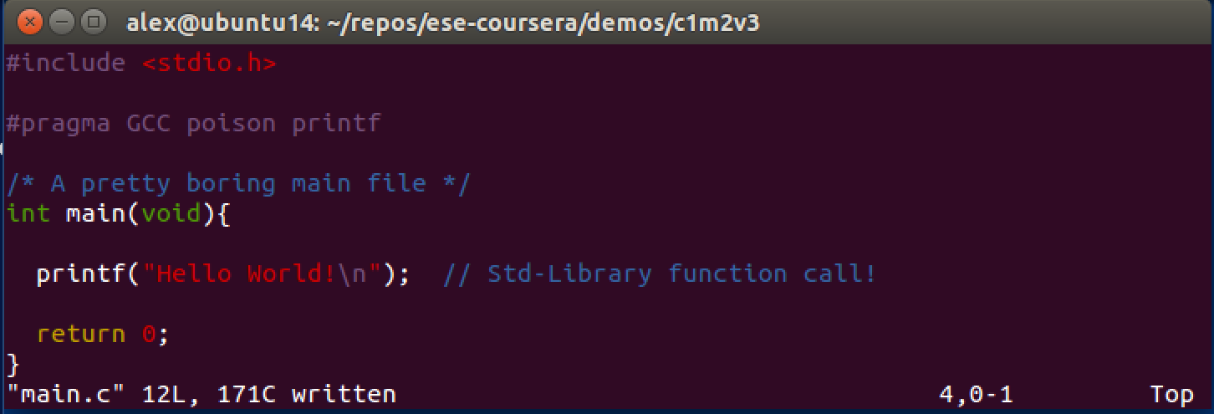
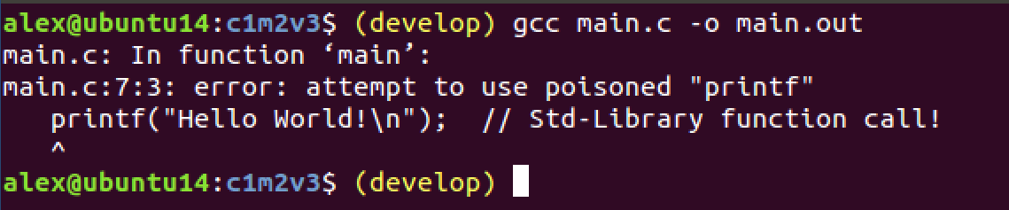
Pragma Compile Failure [S1.2.3.15]

Slide 23
Compile Time Switch [S1.2.3.16]
Condition provided at Compile time to dictate WHAT should be compiled
Uses combination of #if-else and #define directives
#if defined ( KL25Z_PLATFORM ) && ! defined ( MSP_PLATFROM )
kl25_initialize();
#elif ( MSP_PLATFROM ) && ( ! KL25Z_PLATFORM )
msp_initialize();
#else
#error “Please specify one platform target”
#endif

Slide 24
Compile Time Switch [S1.2.3.17]
Condition provided at Compile time to dictate WHAT should be compiled
Uses combination of #if-else and #define directives
Add extra option to gcc command to define Macro
Compiler (gcc)
*.c
*.c
To Compiler Proper
*.c
*.c
*.c/*.h
Preprocessor
*.i
–D<MACRO-NAME>
Source Files
$ gcc –DMSP_PLATFORM –o main.out main.c

Slide 25
Compile Time Switch [S1.2.3.18a]
KL25z
MSP432
Application
Application
Device_Lib
Device_Lib
UART_Lib (KL25z)
Each has unique Hardware and Firmware configuration
UART_Lib (MSP432)
UART Peripheral Module
UART Peripheral Module
GPIO HW
GPIO HW
UART Connected Device
UART Connected Device

Slide 26
Compile-Time Switch [S1.2.3.18b]
KL25z
KL25z Executable Program
UART Peripheral Module
Software Repository
GPIO HW
Application.c/.h
#ifdef KL25Z_PLATFORM && ...
#include “kl25_uart.h”
#elif MSP_PLATFORM && ...
#include “msp_uart.h”
#else
…
#endif
UART Connected Device
Device_Lib.c/.h
MSP432
UART_Lib (KL25z)
MSP432 Executable Program
UART_Lib (MSP432)
UART Peripheral Module
*.c
*.c
GPIO HW
*.c
*.h
Compiler & Linker
Executable
UART Connected Device

Slide 27
Compile-Time Switch [Fig 1.2.3.18c]
KL25z
KL25z Executable Program
UART Peripheral Module
Software Repository
GPIO HW
Application.c/.h
#ifdef KL25Z_PLATFORM && ...
#include “kl25_uart.h”
#elif MSP_PLATFORM && ...
#include “msp_uart.h”
#else
…
#endif
UART Connected Device
Device_Lib.c/.h
Compiler & Linker
MSP432
UART_Lib (KL25z)
MSP432 Executable Program
UART_Lib (MSP432)
UART Peripheral Module
GPIO HW
$ gcc -DKL25Z_PLATFORM –c Device_lib.c …
UART Connected Device

Slide 28
Compile-Time Switch [Fig 1.2.3.18d]
KL25z
KL25z Executable Program
UART Peripheral Module
Software Repository
GPIO HW
Application.c/.h
#ifdef KL25Z_PLATFORM && ...
#include “kl25_uart.h”
#elif MSP_PLATFORM && ...
#include “msp_uart.h”
#else
…
#endif
UART Connected Device
Device_Lib.c/.h
Compiler & Linker
MSP432
UART_Lib (KL25z)
MSP432 Executable Program
UART_Lib (MSP432)
UART Peripheral Module
GPIO HW
$ gcc -DMSP_PLATFORM –c Device_lib.c …
UART Connected Device

Slide 29
Preprocessor Command Line Define [Unused]
Compiler (gcc)
*.c
*.c
To Compiler Proper
*.c
*.c
*.c/*.h
Preprocessor
*.i
Source Files
Add extra option to gcc command line to define Macro
–D<MACRO-NAME>
$ gcc –DMSP_PLATFORM –o main.out main.c

