Slide 1
Embedded Software Essentials
Make
C1 M2 V6

Slide 2
Copyright
Copyright (C) 2017 by Alex Fosdick. Redistribution, modification or use of this presentation is permitted as long as the files maintain this copyright. Users are permitted to modify this and use it to learn about the field of embedded software. Alex Fosdick and the University of Colorado are not liable for any misuse of this material.

Slide 3
Building Manually [S1a]
Building can be tedious
Many GCC flags
Many independent commands
Many build targets
Many supported architectures
Many source files
Building manually can
Cause Consistency issues
Waste development time
Linux Kernel Example
*.c Files: 23,000+
*.h Files: 18,000+
*.S Files: 1,400+

Slide 4
Building Manually [S1b]
Building can be tedious
Many GCC flags
Many independent commands
Many build targets
Many supported architectures
Many source files
Building manually can
Cause Consistency issues
Waste development time
Manually compiling each file and linking is NOT scalable for large software projects or large teams
Large chance for human error

Slide 5
Example Compile in KDS [S2a]
Project for a KL25z Platform with a Cortex-M0+with containing 2 Source files and some startup Files
12:27:47 **** Build of configuration Debug for project project2 ****
make all
Building file: ../Sources/main.c
Invoking: Cross ARM C Compiler
arm-none-eabi-gcc -mcpu=cortex-m0plus -mthumb -O0 -fmessage-length=0 -fsigned-char -ffunction-sections -fdata-sections -g3 -DTIMER_INTERRUPT=0 -I"../Sources" -I"../Includes" -std=c99 -MMD -MP -MF"Sources/main.d" -MT"Sources/main.o" -c -o "Sources/main.o" "../Sources/main.c"
Finished building: ../Sources/main.c
Building file: ../Sources/memory.c
Invoking: Cross ARM C Compiler
arm-none-eabi-gcc -mcpu=cortex-m0plus -mthumb -O0 -fmessage-length=0 -fsigned-char -ffunction-sections -fdata-sections -g3 -DTIMER_INTERRUPT=0 -I"../Sources" -I"../Includes" -std=c99 -MMD -MP -MF"Sources/memory.d" -MT"Sources/memory.o" -c -o "Sources/memory.o" "../Sources/memory.c"
Finished building: ../Sources/memory.c
Building file: ../Project_Settings/Startup_Code/startup_MKL25Z4.S
Invoking: Cross ARM GNU Assembler
arm-none-eabi-gcc -mcpu=cortex-m0plus -mthumb -O0 -fmessage-length=0 -fsigned-char -ffunction-sections -fdata-sections -g3 -x assembler-with-cpp -MMD -MP -MF"Project_Settings/Startup_Code/startup_MKL25Z4.d" -MT"Project_Settings/Startup_Code/startup_MKL25Z4.o" -c -o "Project_Settings/Startup_Code/startup_MKL25Z4.o" "../Project_Settings/Startup_Code/startup_MKL25Z4.S"
Finished building: ../Project_Settings/Startup_Code/startup_MKL25Z4.S
Building file: ../Project_Settings/Startup_Code/system_MKL25Z4.c
Invoking: Cross ARM C Compiler
arm-none-eabi-gcc -mcpu=cortex-m0plus -mthumb -O0 -fmessage-length=0 -fsigned-char -ffunction-sections -fdata-sections -g3 -DTIMER_INTERRUPT=0 -I"../Sources" -I"../Includes" -std=c99 -MMD -MP -MF"Project_Settings/Startup_Code/system_MKL25Z4.d" -MT"Project_Settings/Startup_Code/system_MKL25Z4.o" -c -o "Project_Settings/Startup_Code/system_MKL25Z4.o" "../Project_Settings/Startup_Code/system_MKL25Z4.c"
Finished building: ../Project_Settings/Startup_Code/system_MKL25Z4.c
Building target: project2.elf
Invoking: Cross ARM C++ Linker
arm-none-eabi-g++ -mcpu=cortex-m0plus -mthumb -O0 -fmessage-length=0 -fsigned-char -ffunction-sections -fdata-sections -g3 -T "MKL25Z128xxx4_flash.ld" -Xlinker --gc-sections -L"C:/classes/boulder/ECEN5013/Spring2016/kds_wksp/project2/Project_Settings/Linker_Files" -Wl,-Map,"project2.map" -specs=nano.specs -specs=nosys.specs -o "project2.elf" ./Sources/main.o ./Sources/memory.o ./Project_Settings/Startup_Code/startup_MKL25Z4.o ./Project_Settings/Startup_Code/system_MKL25Z4.o
Finished building target: project2.elf
12:27:49 Build Finished (took 1s.659ms)

Slide 6
Example Compile in KDS [S2b]
Project for a KL25z Platform with a Cortex-M0+with containing 2 Source files and some startup Files
12:27:47 **** Build of configuration Debug for project project2 ****
make all
Building file: ../Sources/main.c
Invoking: Cross ARM C Compiler
arm-none-eabi-gcc -mcpu=cortex-m0plus -mthumb -O0 -fmessage-length=0 -fsigned-char -ffunction-sections -fdata-sections -g3 -DTIMER_INTERRUPT=0 -I"../Sources" -I"../Includes" -std=c99 -MMD -MP -MF"Sources/main.d" -MT"Sources/main.o" -c -o "Sources/main.o" "../Sources/main.c"
Finished building: ../Sources/main.c
Building file: ../Sources/memory.c
Invoking: Cross ARM C Compiler
arm-none-eabi-gcc -mcpu=cortex-m0plus -mthumb -O0 -fmessage-length=0 -fsigned-char -ffunction-sections -fdata-sections -g3 -DTIMER_INTERRUPT=0 -I"../Sources" -I"../Includes" -std=c99 -MMD -MP -MF"Sources/memory.d" -MT"Sources/memory.o" -c -o "Sources/memory.o" "../Sources/memory.c"
Finished building: ../Sources/memory.c
Building file: ../Project_Settings/Startup_Code/startup_MKL25Z4.S
Invoking: Cross ARM GNU Assembler
arm-none-eabi-gcc -mcpu=cortex-m0plus -mthumb -O0 -fmessage-length=0 -fsigned-char -ffunction-sections -fdata-sections -g3 -x assembler-with-cpp -MMD -MP -MF"Project_Settings/Startup_Code/startup_MKL25Z4.d" -MT"Project_Settings/Startup_Code/startup_MKL25Z4.o" -c -o "Project_Settings/Startup_Code/startup_MKL25Z4.o" "../Project_Settings/Startup_Code/startup_MKL25Z4.S"
Finished building: ../Project_Settings/Startup_Code/startup_MKL25Z4.S
Building file: ../Project_Settings/Startup_Code/system_MKL25Z4.c
Invoking: Cross ARM C Compiler
arm-none-eabi-gcc -mcpu=cortex-m0plus -mthumb -O0 -fmessage-length=0 -fsigned-char -ffunction-sections -fdata-sections -g3 -DTIMER_INTERRUPT=0 -I"../Sources" -I"../Includes" -std=c99 -MMD -MP -MF"Project_Settings/Startup_Code/system_MKL25Z4.d" -MT"Project_Settings/Startup_Code/system_MKL25Z4.o" -c -o "Project_Settings/Startup_Code/system_MKL25Z4.o" "../Project_Settings/Startup_Code/system_MKL25Z4.c"
Finished building: ../Project_Settings/Startup_Code/system_MKL25Z4.c
Building target: project2.elf
Invoking: Cross ARM C++ Linker
arm-none-eabi-g++ -mcpu=cortex-m0plus -mthumb -O0 -fmessage-length=0 -fsigned-char -ffunction-sections -fdata-sections -g3 -T "MKL25Z128xxx4_flash.ld" -Xlinker --gc-sections -L"C:/classes/boulder/ECEN5013/Spring2016/kds_wksp/project2/Project_Settings/Linker_Files" -Wl,-Map,"project2.map" -specs=nano.specs -specs=nosys.specs -o "project2.elf" ./Sources/main.o ./Sources/memory.o ./Project_Settings/Startup_Code/startup_MKL25Z4.o ./Project_Settings/Startup_Code/system_MKL25Z4.o
Finished building target: project2.elf
12:27:49 Build Finished (took 1s.659ms)

Slide 7
Example Compile in KDS [S3]
Each compile, assemble and link command are
More then 100 Characters
More then 10 Flags
Need something to simplify this!
Building file: ../Sources/main.c
Invoking: Cross ARM C Compiler
arm-none-eabi-gcc -mcpu=cortex-m0plus -mthumb -O0 -fmessage-length=0 -fsigned-char -ffunction-sections -fdata-sections -g3 -I"../Sources" -I"../Includes" -std=c99 -MMD -MP -MF"Sources/main.d" -MT"Sources/main.o" -c -o "Sources/main.o" "../Sources/main.c"
Building file: ../Project_Settings/Startup_Code/startup_MKL25Z4.S
Invoking: Cross ARM GNU Assembler
arm-none-eabi-gcc -mcpu=cortex-m0plus -mthumb -O0 -fmessage-length=0 -fsigned-char -ffunction-sections -fdata-sections -g3 -x assembler-with-cpp -MMD -MP -MF"Project_Settings/Startup_Code/startup_MKL25Z4.d" -MT"Project_Settings/Startup_Code/startup_MKL25Z4.o" -c -o "Project_Settings/Startup_Code/startup_MKL25Z4.o" "../Project_Settings/Startup_Code/startup_MKL25Z4.S"
Building target: project.elf
Invoking: Cross ARM C++ Linker
arm-none-eabi-g++ -mcpu=cortex-m0plus -mthumb -O0 -fmessage-length=0 -fsigned-char -ffunction-sections -fdata-sections -g3 -T "MKL25Z128xxx4_flash.ld" -Xlinker --gc-sections -L"C:/coursera/kds_wksp/project2/Project_Settings/Linker_Files" -Wl,-Map,"project.map" -specs=nano.specs -specs=nosys.specs -o “project.elf" ./Sources/main.o ./Sources/memory.o ./Sources/ports.o ./Sources/timer.o ./Project_Settings/Startup_Code/startup_MKL25Z4.o ./Project_Settings/Startup_Code/system_MKL25Z4.o

Slide 8
Build Management Software [S4]
Build Management Software (or Build Automation) provides a simple and consistent method for producing a target executable
Automated the process of
Preprocessing
Assembling
Compiling
Linking
Relocating
Build System
*.c
*.c
*.c
*.c
*.s
Assembler
*.o
Linker File
*.c
*.c
Library
Files
*.a
Linker
Relocatable File
Locator
Executable
*.c
*.c
*.c
*.c
*.c
*.h
Compiler
*.o
Object Files
Notes:
https://www.gnu.org/graphics/agnuhead.html

Slide 9
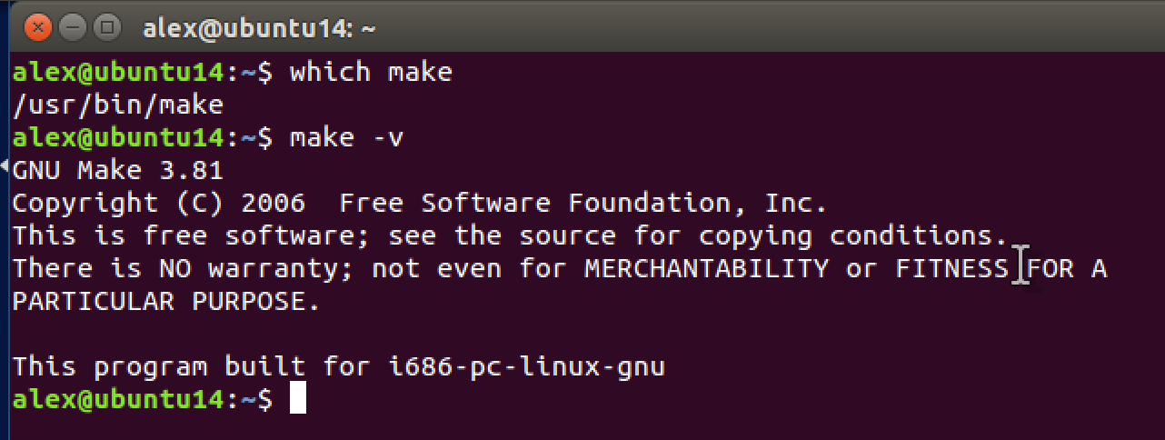
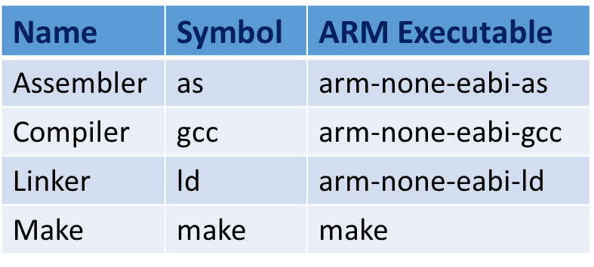
GNU Compiler Collection [S5]
GNU Toolset performs all operations using make
Preprocessing
Assembling
Compiling
Linking
Relocating
Build System
*.c
*.c
*.c
*.c
*.s
Assembler
*.o
Linker File
*.c
*.c
Library
Files
*.a
Linker
Relocatable File
Locator
Executable
*.c
*.c
*.c
*.c
*.c
*.h
Compiler
*.o
Object Files
Notes:
Emphasize differences between an MCU and a Embedded OS

Slide 10

GNU Make [S6]
GNU Make
“Tool that controls the generation of executables and other non-source files of a program from the program’s source files.”²
GNU = GNU’s Not Unix
A collection of software, a Toolset
Contains GCC = GNUs Compiler Collection
Make is our Build Management Software
Determines what files need to be compiled/recompiled in a project given a makefile
Helps generate build dependencies and other files
Widely used and free
Notes:
[picture] https://www.gnu.org/graphics/agnuhead.html
[2] GNU Make. Website. https://www.gnu.org/software/make/. 27 January 2016.

Slide 11
GNU Toolchain [S7a]
Makefile
Linker File
GNU Make
*.c
*.c
*.c
*.c
*.s
*.o
Assembler
*.c
*.c
*.a
Relocatable File
Executable
Linker
Locator
*.c
*.c
*.c
*.c
*.c
*.h
*.o
Compiler
Source Files
Notes:
Emphasize differences between an MCU and a Embedded OS

Slide 12

Makefiles [S8]
One or more files used to tell make how to build a particular project
Invoked from the command line
Makefiles have build targets or build rules
These are recipes for how to build a particular executable or non-source file
Executables can have dependencies
Requirements needed for a particular recipe
These can be auto-generated from make
Can define variables/constants to use during compilation
Compiler Instance
Compiler/Linker Options
Architecture to build for
Compile Time Switch
12
Notes:
ARM = Acorn RISC Machine – All risc processors
Risc examples: ARM, MIPS, SPARC, IBM Power PC, AtmelAVR
Cisc Examples: x86, AMD, Motorolla 68k, PDP
Give an example of reasons to have the two different:
-Lots of specialized instructions which give some type of speed or efficiency boost, incorporate many operations with lds/strs
-a reduced Common set of instructions (frequently used)
One instruction set computer, minimal instruction set computer, very long instruction word (VLIW)

Slide 13
Makefile Rules/Targets [S9]
Many multiple rules can be executed for any given instance of make that is run
Specify target you wish to execute when invoking make
$ make main.o
$ make all
$ make clean
If no target is specified, defaults to first defined target in the makefile
$ make
Example Makefile Targets
13
Notes:
ARM = Acorn RISC Machine – All risc processors
Risc examples: ARM, MIPS, SPARC, IBM Power PC, AtmelAVR
Cisc Examples: x86, AMD, Motorolla 68k, PDP
Give an example of reasons to have the two different:
-Lots of specialized instructions which give some type of speed or efficiency boost, incorporate many operations with lds/strs
-a reduced Common set of instructions (frequently used)
One instruction set computer, minimal instruction set computer, very long instruction word (VLIW)

Slide 14
GNU Compiler Collection [S10]
Makefile
Linker File
GNU Make
*.c
*.c
*.c
*.c
*.s
*.o
Assembler
*.c
*.c
*.a
Relocatable File
Executable
Linker
Locator
*.c
*.c
*.c
*.c
*.c
*.h
*.o
Compiler
Source Files
Object Files
Notes:
Emphasize differences between an MCU and a Embedded OS

Slide 15
Build System [S11]
Makefile(s)
Linker File
*.c
GNU Make
*.c
*.s
*.c
Executable
*.c
*.a
*.c
*.c
*.c/*.h
Source Files
*.o
*.o
*.o
Dependency Files
Map Files
$ make all
Object Files
Generated Files
Notes:
Many of these steps are combined in one operation

Slide 16
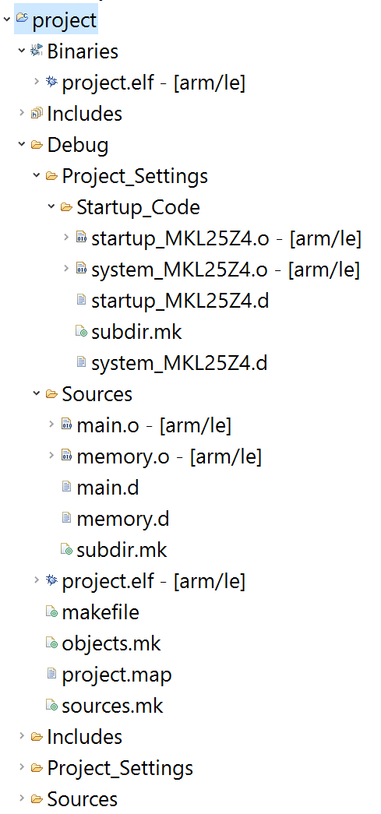
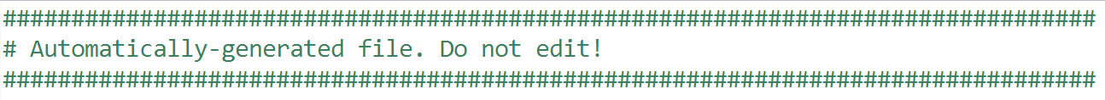
IDE and Make Autogeneration
Kinetis Design Studio Make Build System
Your IDE typically will list Makefiles, output files, and executables in the project explorer
IDE will dynamically create Makefiles through the use of file auto-generation
Software teams DO NOT use IDE autogenerated build systems, they create their own
Banner that gets inserted at the top of all of your auto-generated files

Slide 17
IDE and Make Autogeneration
Kinetis Design Studio Make Build System
Your IDE typically will list Makefiles, output files, and executables in the project explorer
IDE will dynamically create Makefiles through the use of file auto-generation
Software teams DO NOT use IDE autogenerated build systems, they create their own
Banner that gets inserted at the top of all of your auto-generated files

