Slide 1

A not so depth overview
Docker

Slide 2

What is Docker ?
Docker is a tool that allows developers, sys-admins etc. to easily deploy their applications in a sandbox (called containers) to run on the host operating system i.e. Linux. The key benefit of Docker is that it allows users to package an application with all of its dependencies into a standardized unit for software development. Unlike virtual machines, containers do not have high overhead and hence enable more efficient usage of the underlying system and resources.
- Docker website
Containers
Offer a logical packaging mechanism in which applications can be abstracted from the environment in which they actually run. This decoupling allows container-based applications to be deployed easily and consistently, regardless of whether the target environment is a private data center, the public cloud, or even a developer’s personal laptop. This gives developers the ability to create predictable environments that are isolated from the rest of the applications and can be run anywhere.

Slide 3
Why so Popular ?
Fixed “works on my machine” problem
Simplicity: Easy to use and learn, reducing development time
Flexibility: Supports a wide range of programming languages and frameworks
Scalability: Scales effortlessly from development to production environments
Community Support: Large and active community contributing to its ecosystem

Slide 4
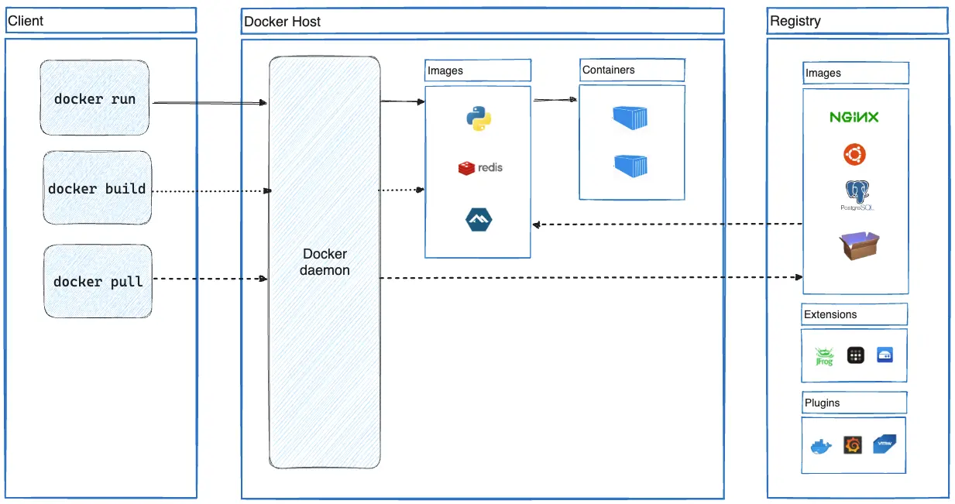
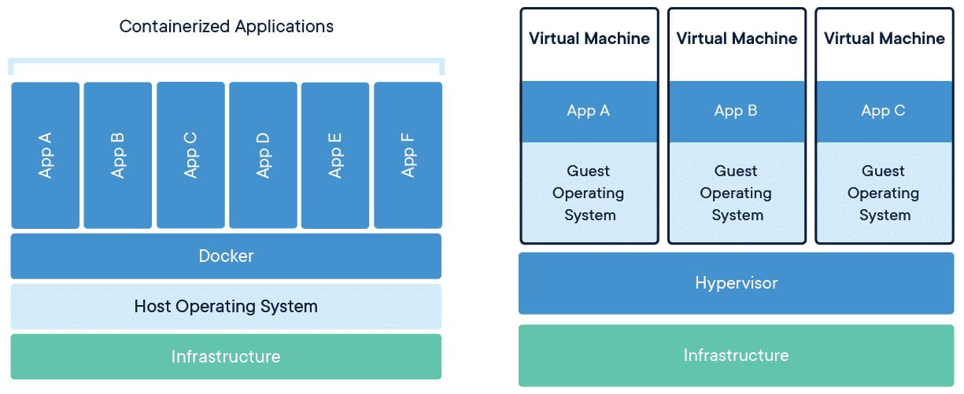
Architecture

Slide 5
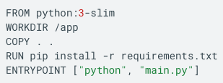
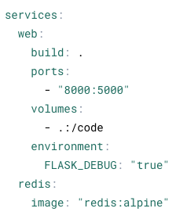
Dockerfile & docker-compose
Dockerfile
docker-compose.yaml

Slide 6
Challenge Time!
Requirements:
Git
Docker
Clone Repository:
git clone https://github.com/casta-114/il-docker-workshop.git

Slide 7
Resources
Docker for beginners: https://docker-curriculum.com/#what-is-docker-
Docker CLI Cheat Sheet: https://docs.docker.com/get-started/docker_cheatsheet.pdf
Docker Hub: https://hub.docker.com
Docker Desktop: https://www.docker.com/products/docker-desktop/
GitHub: https://github.com
Github Desktop: https://desktop.github.com
Git Cheat Sheet: https://education.github.com/git-cheat-sheet-education.pdf

