Slide 1
K-means
Parallel Computing Course
Antonio Castellucci
Michela Crulli

Slide 2
Overview
Introduction
What is K-means
What we have done
Implementation
ImagesHandler
C++ implementation
OpenMP implementation
CUDA implementations
Dataset
Results
Test platform
Tests
Conclusions

Slide 3
Introduction
In this project, we realize a program which do k-means clustering with three different approaches:
a sequential implementation
C++
three parallel implementation
OpenMP
CUDA naive
CUDA with reduction

Slide 4
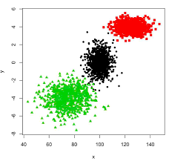
Introduction
What is K-means?
K-means clustering aims to partition input data into k cluster in which each data belongs to the cluster with the nearest mean.

Slide 5
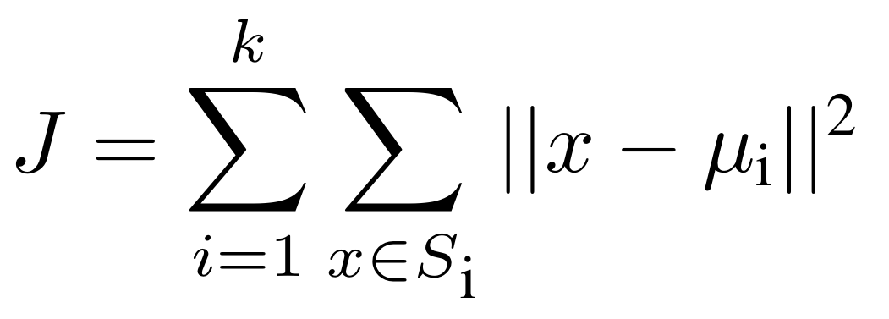
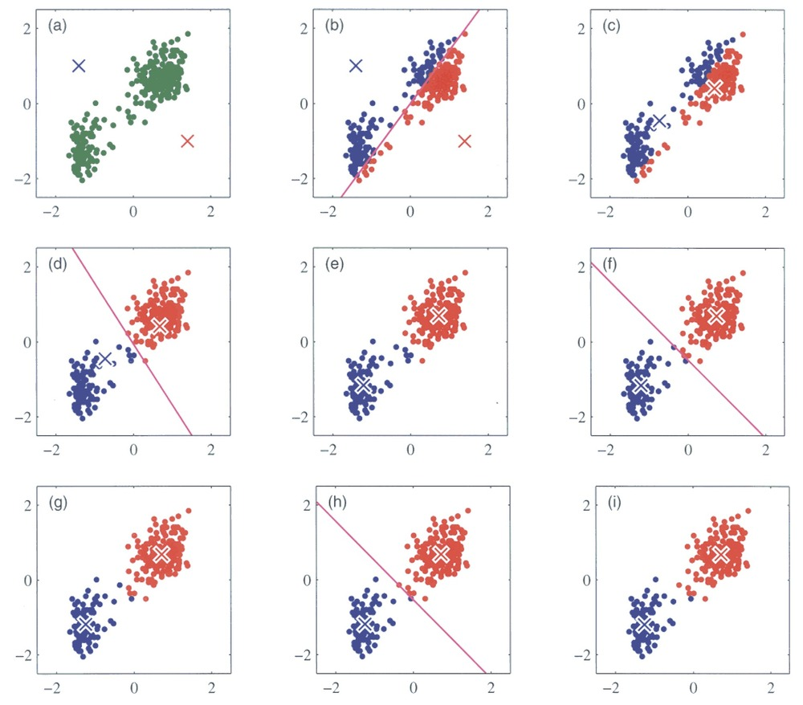
Introduction
Steps:
Decide number of clusters
Distance from each point to each centroids
Re-calculate of each centroid with the minimization of:
Iterate from step two until in two
iteration clusters don’t change

Slide 6
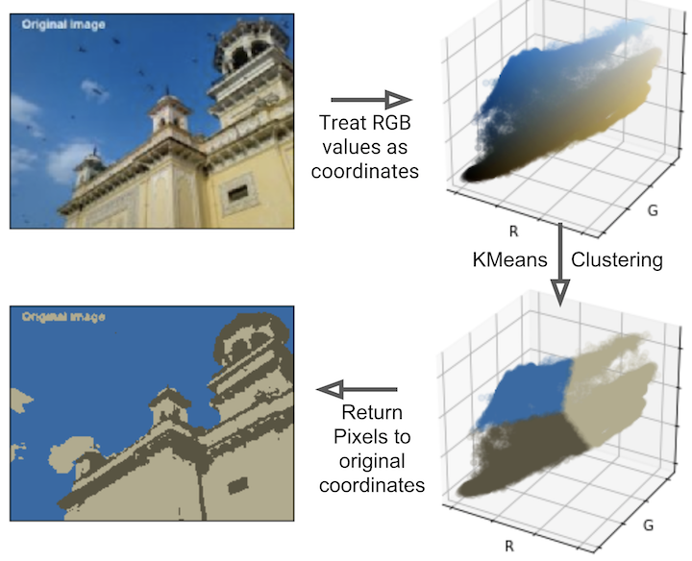
Introduction
What we have done
K-means applied to images to have a better and immediate view

Slide 7
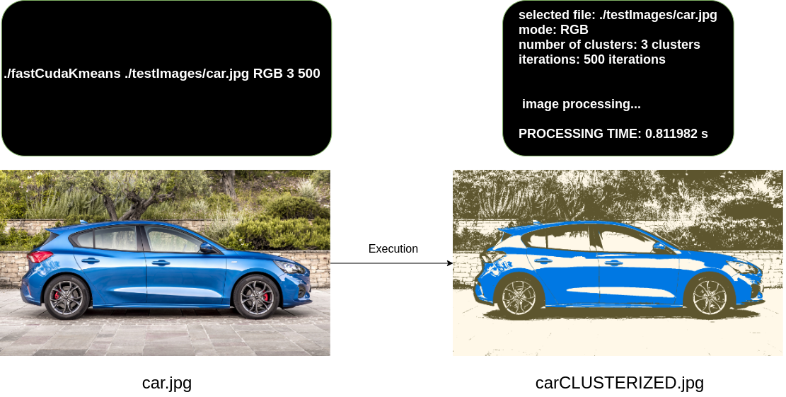
Introduction
Input output structure
scriptable programs with unique interface between three versions

Slide 8
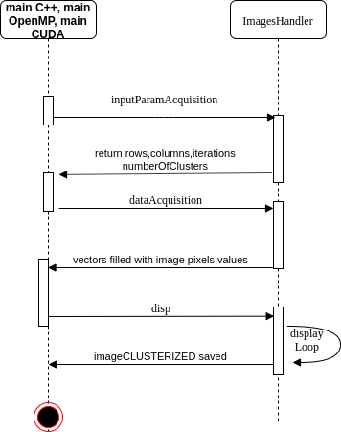
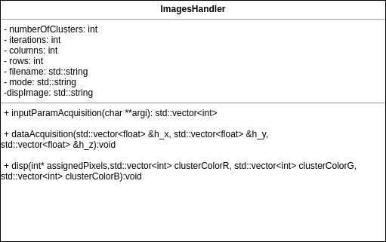
Implementation
ImagesHandler
What is? It’s a common class that define interfaces for pixels values acquisition and processed data handling
Why? For the separation of
concerns and code reusability

Slide 9
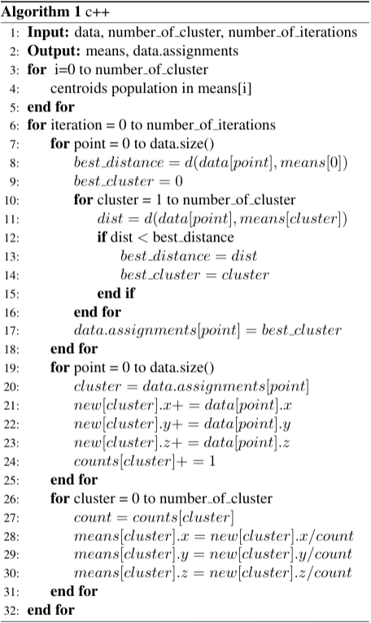
Implementation
C++ implementation

Slide 10
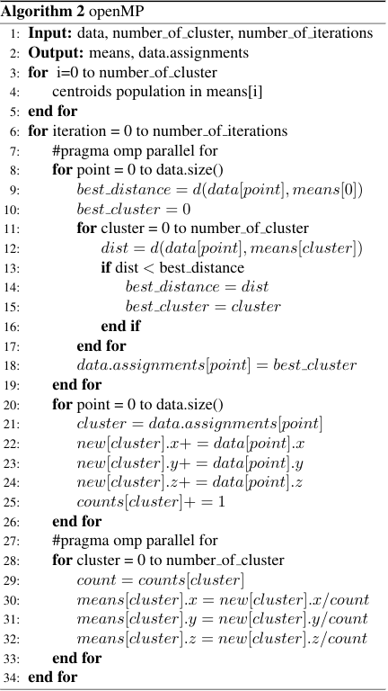
Implementation
OpenMP implementation

Slide 11
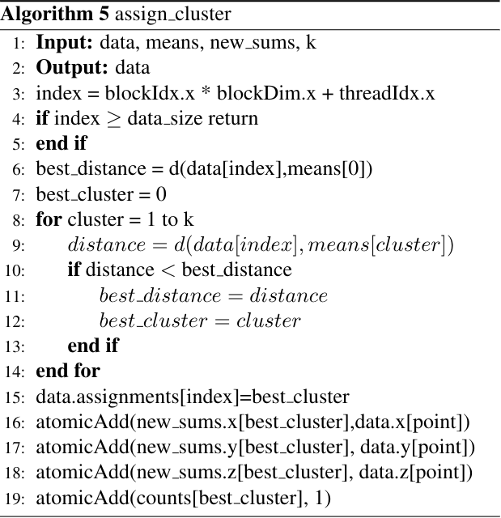
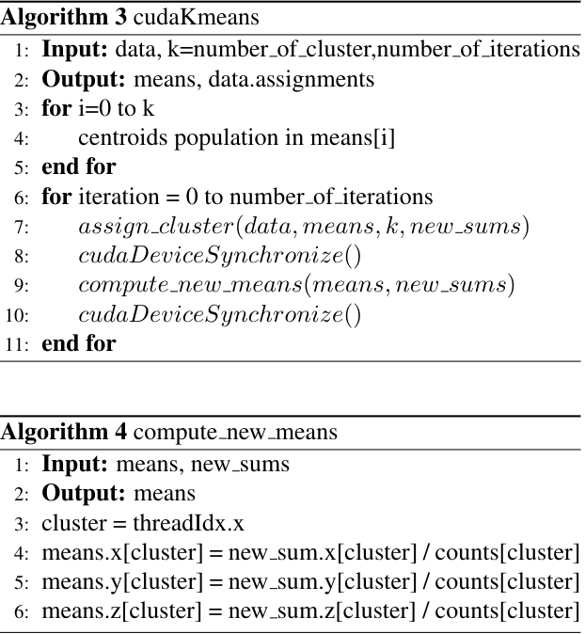
Implementation
CUDA Naive
implementation

Slide 12
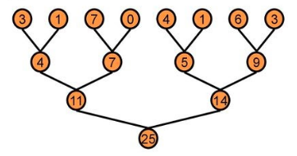
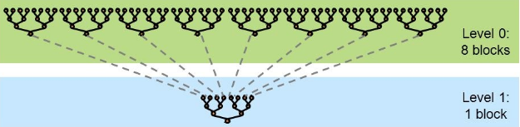
Implementation
Reduction
Mark Harris tricks:
Unrolling loops
Multiple adds/threads

Slide 13
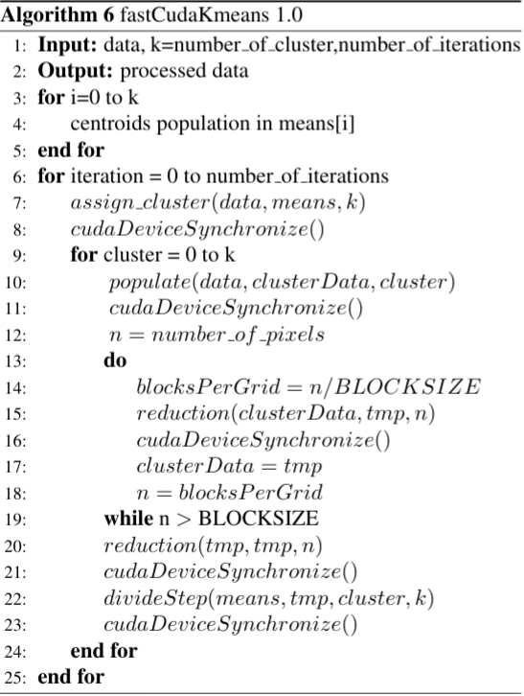
Implementation
fastCuda 1.0
means: #Cluster (k)
x
250 | 100
250 | 100
250 | 100
0 | 0
y
z
ass
ID
Cluster 0
ID
Cluster 1
data: #Pixels
x
255 | 255 | 200 | 200
255 | 255 | 200 | 200
255 | 255 | 200 | 200
0 | 0 | 0 | 0
y
z

Slide 14
Implementation
assign_cluster(data, means, k)
Data: #Pixels
Data: #Pixels
x
255 | 255 | 200 | 200
255 | 255 | 200 | 200
255 | 255 | 200 | 200
0 | 0 | 0 | 0
assign_cluster
255 | 255 | 200 | 200
255 | 255 | 200 | 200
255 | 255 | 200 | 200
0 | 0 | 1 | 1
y
z
ID
Cluster 0
ID
Cluster 1

Slide 15
Implementation
fastCuda 1.0
data: #Pixels
clusterData: #Pixels
255 | 255 | 200 | 200
255 | 255 | 200 | 200
255 | 255 | 200 | 200
0 | 0 | 1 | 1
populate
255 | 255 | 0 | 0
255 | 255 | 0 | 0
255 | 255 | 0 | 0
1 | 1 | 0 | 0
Cluster 0
Population step
ID
Cluster 0

Slide 16
Implementation
fastCuda 1.0

Slide 17
Implementation
fastCuda 1.0

Slide 18
Implementation
divideStep(means,tmp,cluster,k)
clusterData: #Pixels
means: #clusters
X*
Y*
Z*
NoE
X*/NoE
Y*/NoE
Z*/NoE
reduction
divideStep
Cluster 0
updated

Slide 19
Implementation
populate 2.0 (data, clusterData, cluster)
data: #Pixels
clusterData: #Pixels * #Clusters
255 | 255 | 200 | 200
255 | 255 | 200 | 200
255 | 255 | 200 | 200
0 | 0 | 1 | 1
255 | 255 | 0 | 0
255 | 255 | 0 | 0
255 | 255 | 0 | 0
1 | 1 | 0 | 0
0 | 0 | 200 | 200
0 | 0 | 200 | 200
0 | 0 | 200 | 200
0 | 0 | 1 | 1
Populate 2.0
ID
Cluster 0
ID
Cluster 1
#Pixels

Slide 20
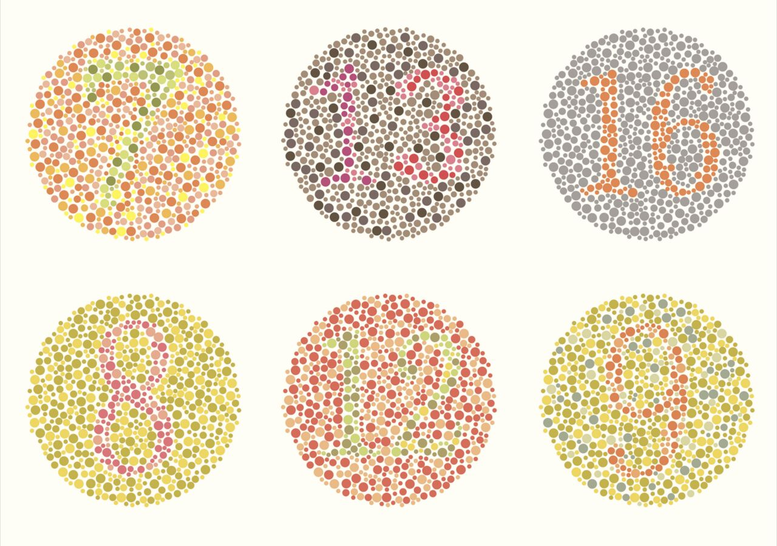
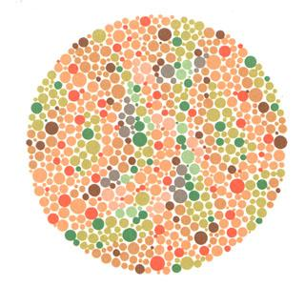
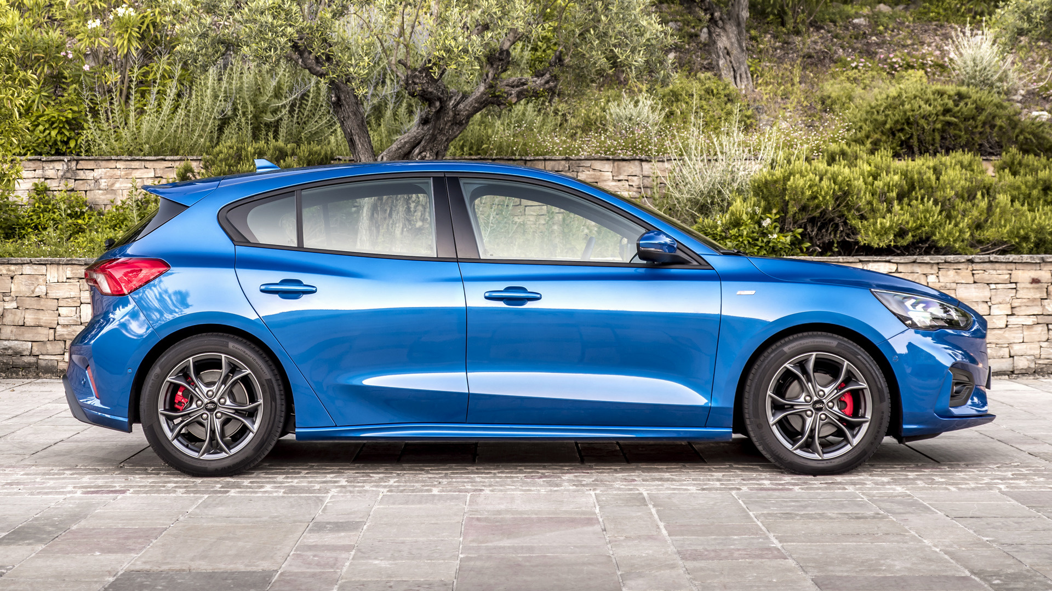

Dataset
We use images of different sizes :
100000 pixels 1 millions pixels
2 millions pixels 10 millions pixels

Slide 21
Results
Test Platform
MSI GS65 with:
i7-8750H 6 CORES 12 THREAD
16 GB 2400 MHz DDR4 RAM
RTX 2060 6GB GDDR6

Slide 22
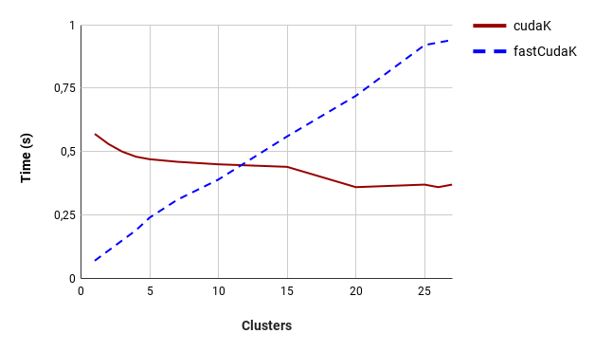
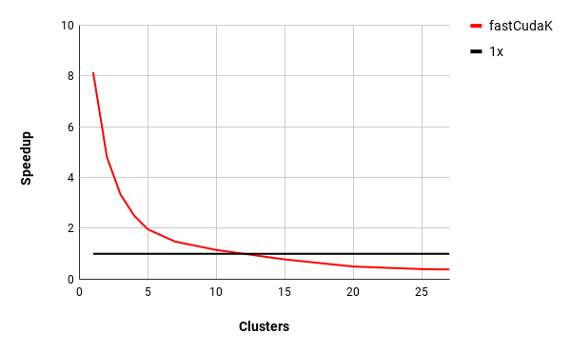
Results
cudaKmeans Vs fastCudaKmeans 2.0 with 2 millions pixels, 100 iterations as the number of clusters changes

Slide 23
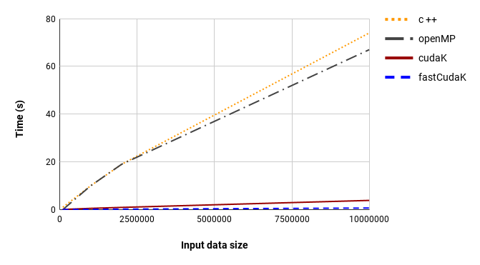
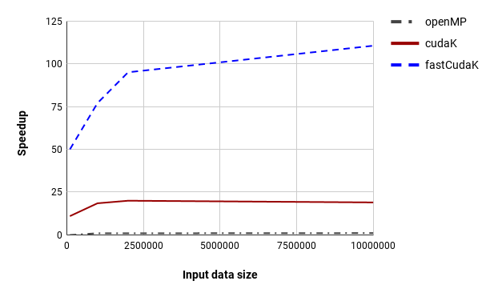
Results
All versions compared respect to input data size with 2 clusters and 200 iterations

Slide 24
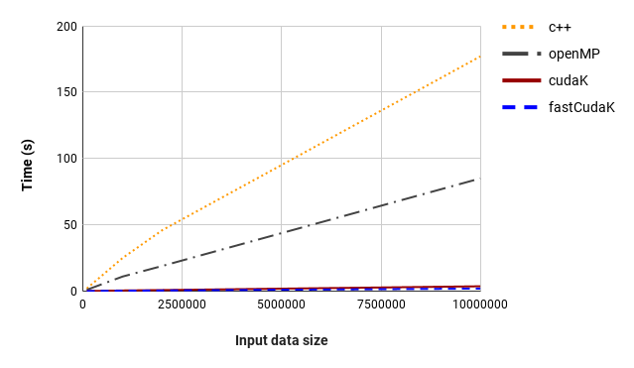
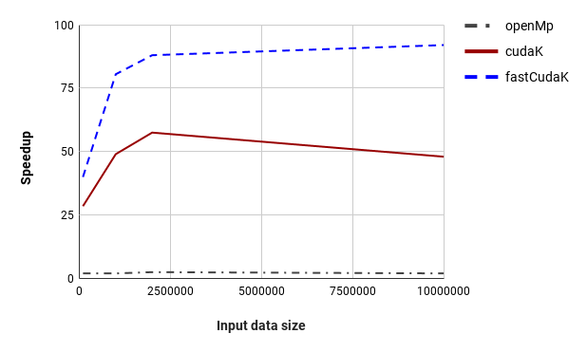
Results
All versions compared respect to input data size with 7 clusters and 200 iterations

Slide 25
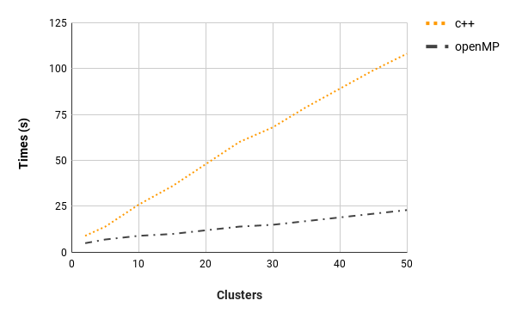
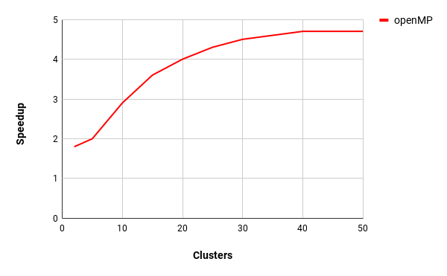
Results
C++ Vs OpenMP with 10 millions pixels compared respect to the number of clusters changes

Slide 26
Conclusions
Understand CUDA performance characteristics
Use peak performance metrics to guide optimization
Understand parallel algorithm complexity theory, identify type of bottleneck e.g. memory, core computation, or instruction overhead
Optimize the algorithm, then unroll loops
Use template parameters to generate optimal code

Slide 27
Conclusions
Thanks for the attention!

