Slide 1
Bigram/Trigram
Generation
Parallel Computing Course
Antonio Castellucci
Michela Crulli

Slide 2
Overview
Introduction
What are n-grams
What we have done
Hadoop & Amazon Web Service (AWS)
Dataset
Implementation
Sequential implementation
Parallel implementation
Distributed implementation
Results
Test platform
Parallel implementation setup
AWS
Tests
Conclusions

Slide 3
Introduction
In this project, we realize a program which generates bigrams and trigrams with three different approaches:
a sequential implementation (Java)
a parallel implementation (Java threads)
a distributed implementation (Hadoop)

Slide 4
Introduction
What are n-grams?
An n-gram is a contiguos sequence of n items (letters, words, syllables or phonemes) from a given text or speech
Why?
make new word predictions
make spelling error corrections

Slide 5
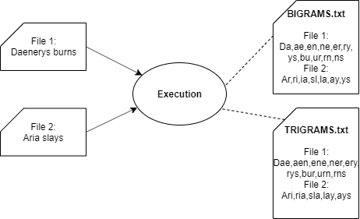
Introduction
Input output structure

Slide 6
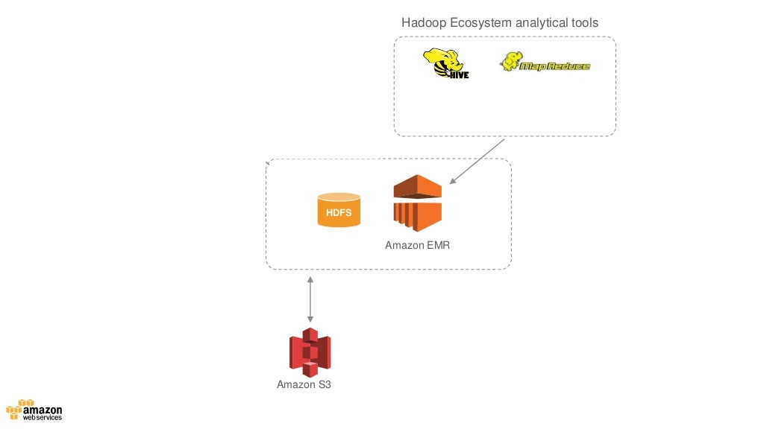
Introduction
Hadoop & Amazon Web Service (AWS)

Slide 7
Dataset
We use:
a collection of 3000 books (1.1 GB,from Gutemberg’s Project) and on the collection’s subsets:
2000 (abt 800 megabyte)
1000 (abt 400 megabyte)
500 (abt 80 megabyte)
150 (abt 50 megabyte)
100 (abt 40 megabyte)
50 (abt 20 megabyte)
The size of each book is about 360 KB

Slide 8
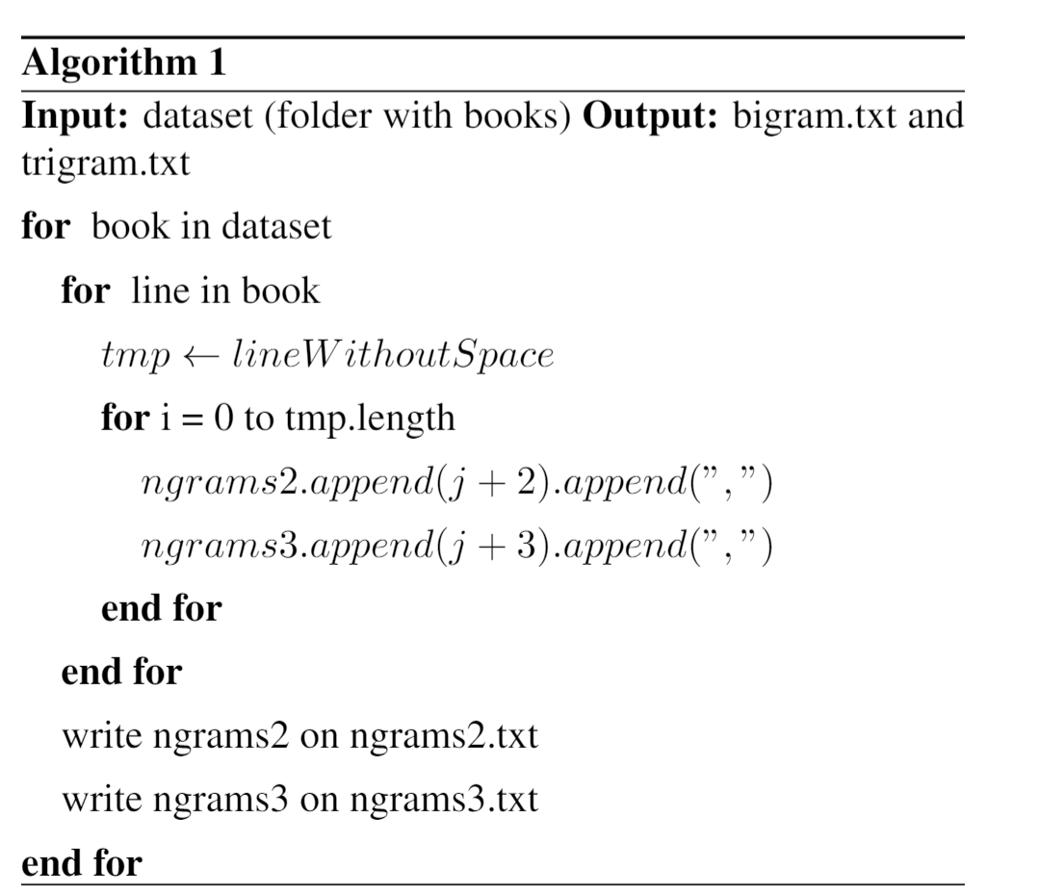
Implementation
Sequential implementation

Slide 9
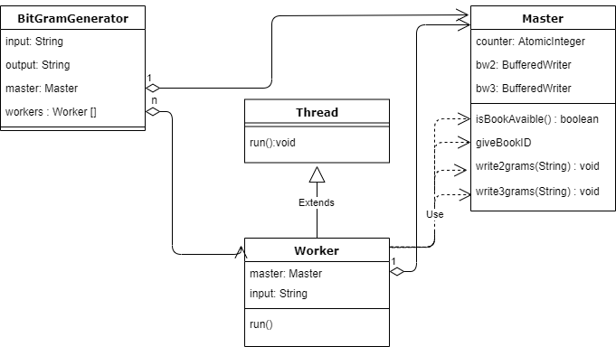
Implementation
Parallel implementation

Slide 10
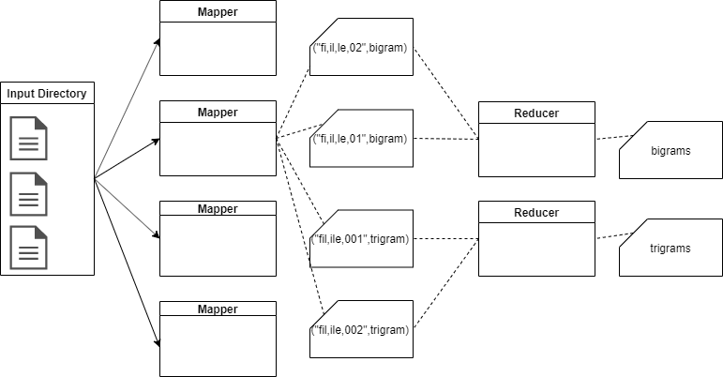
Implementation
Hadoop implementation

Slide 11
Results
Test platform
MSI GS65 with:
i7-8750H 6 CORES 12 THREAD
16 GB 2400 MHz DDR4 RAM
M2 SSD SAMSUNG MZVLW256HEHP

Slide 12
Results
Parellel implementation setup
12 threads and 1 book to process each time
AWS
Emr cluster:
m4.xlarge 1 master 4 slaves, Amazon Hadoop version 2.8.5
Storage:
S3 bucket

Slide 13
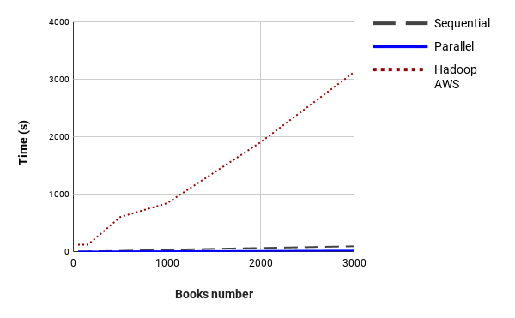
Results
All versions compared respect to the number of books

Slide 14
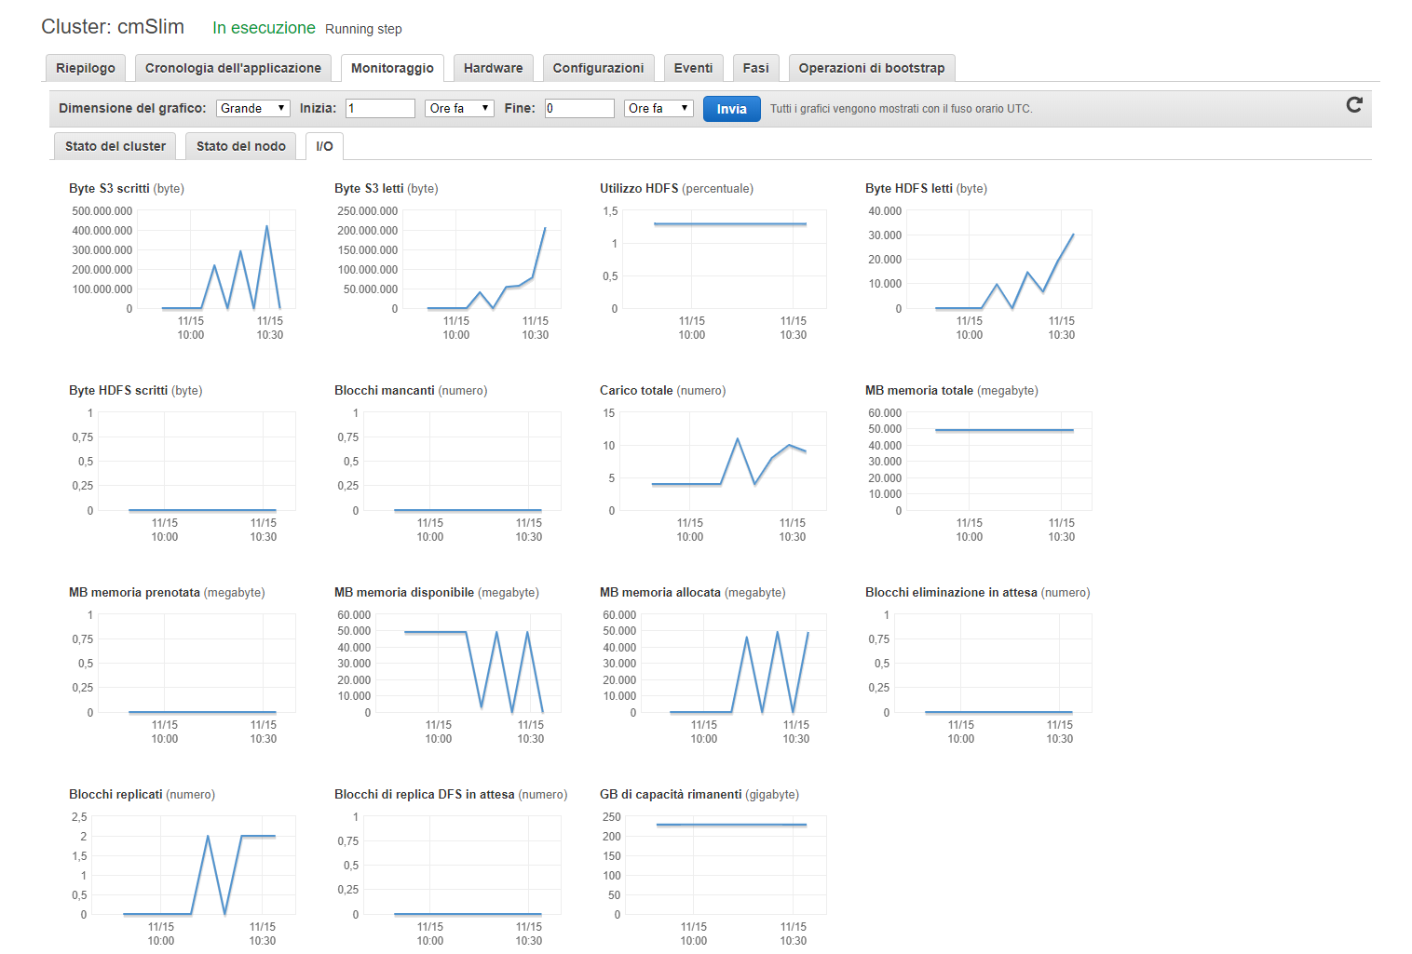
Results
AWS

Slide 15
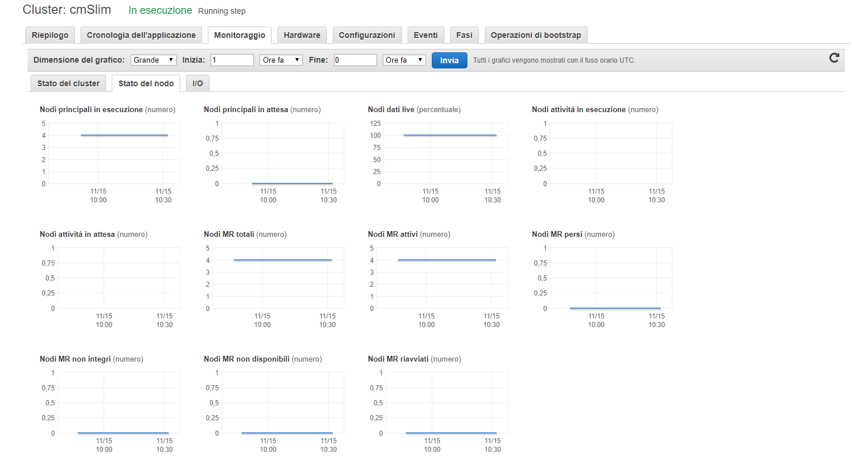
Results
AWS

Slide 16
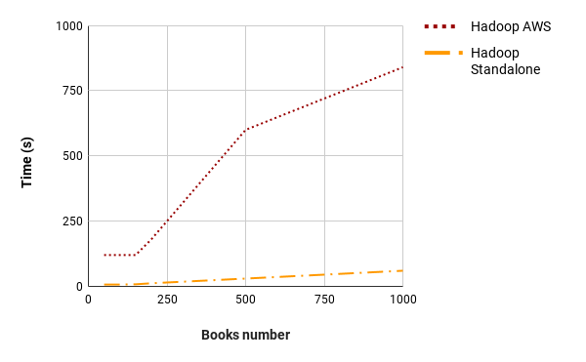
Results
AWS vs Standalone respect to the number of books

Slide 17
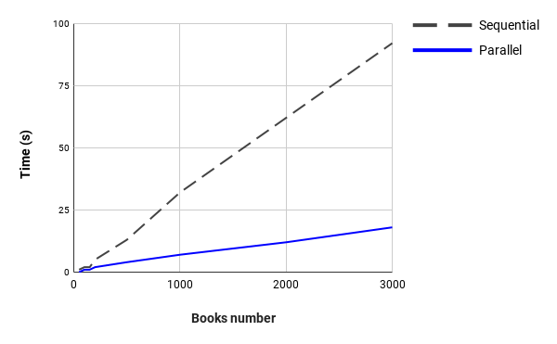
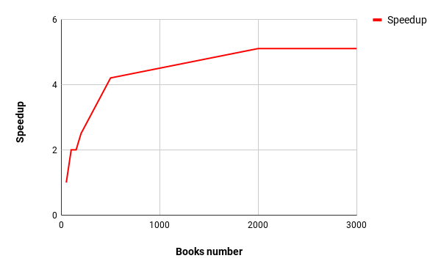
Results
Parallel vs sequential respect to number of books

Slide 18
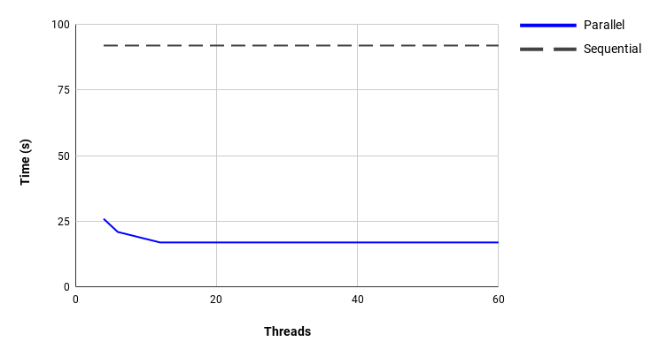
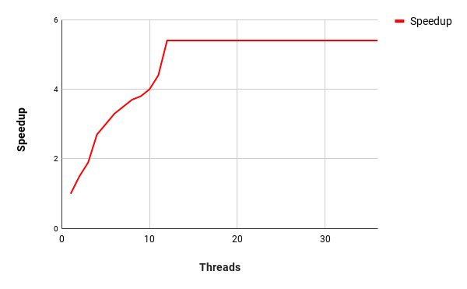
Results
Parallel vs sequential respect to number of threads

Slide 19
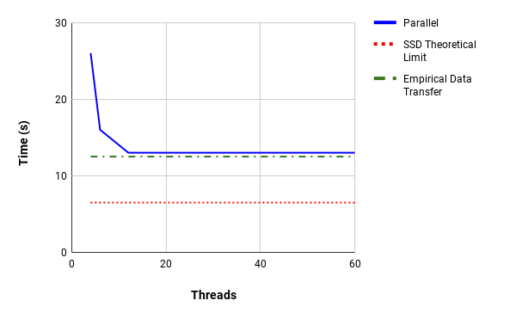
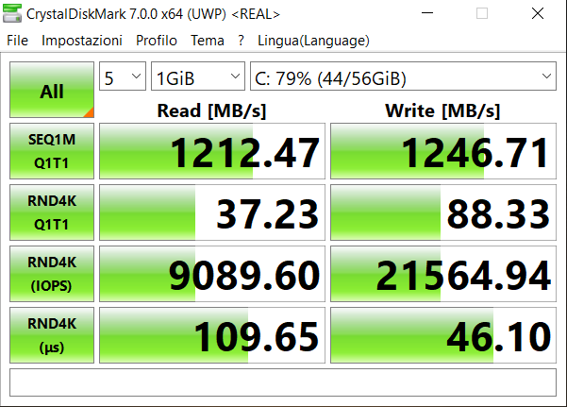
Results
A deeper analysis

Slide 20
Conclusions
Classic case of Hadoop usage:
perform local computations over huge amounts of input data while returning relatively small result set, which makes our case not suitable to be implemented with Hadoop
A program for n-grams counting rather than writing them only, probably we would have been able to see the potential of this distributed technology

Slide 21
Conclusions
Thanks for the attention!

