Slide 1



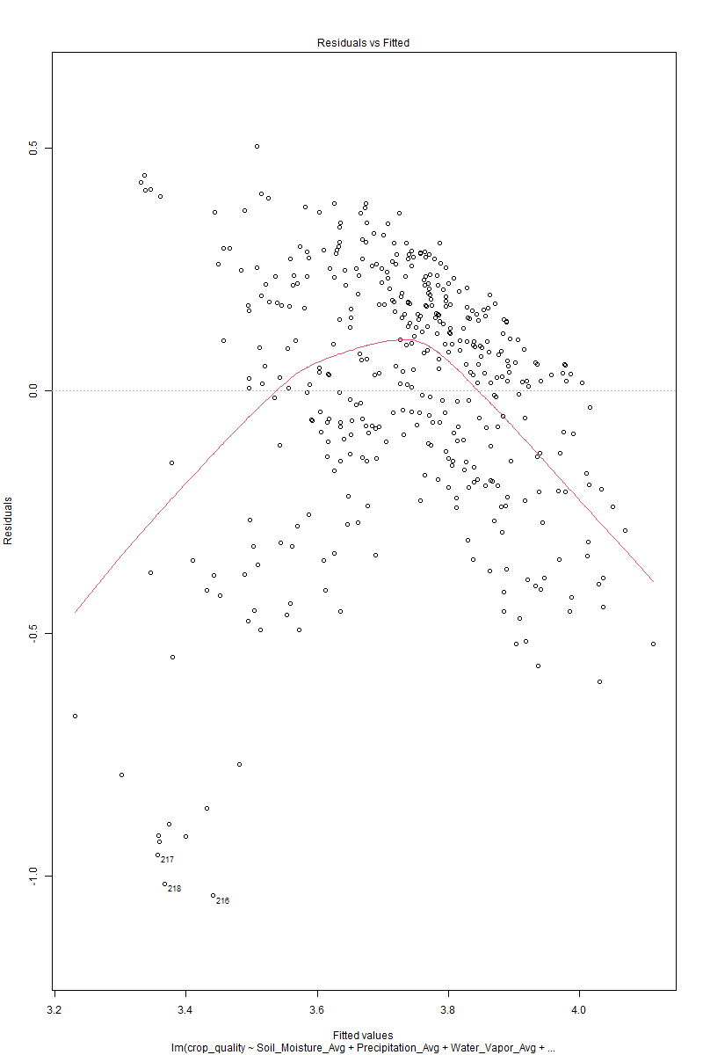
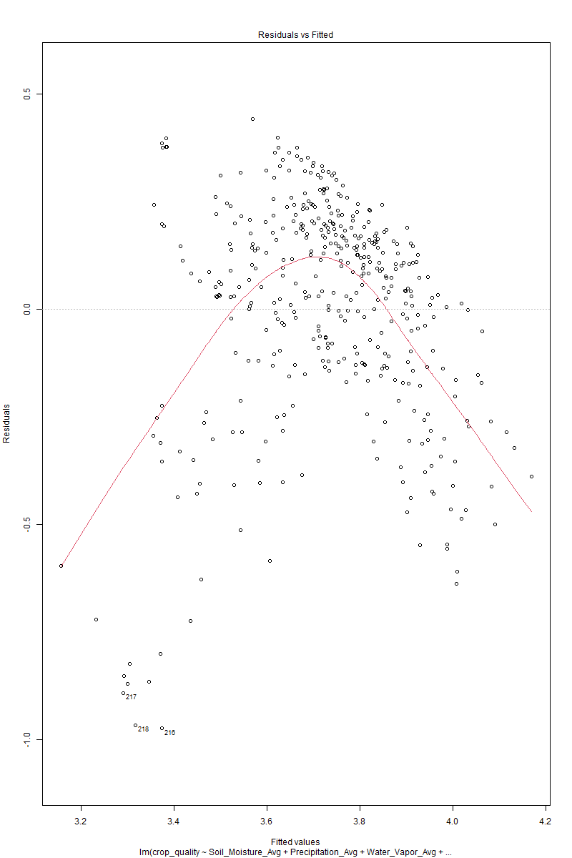
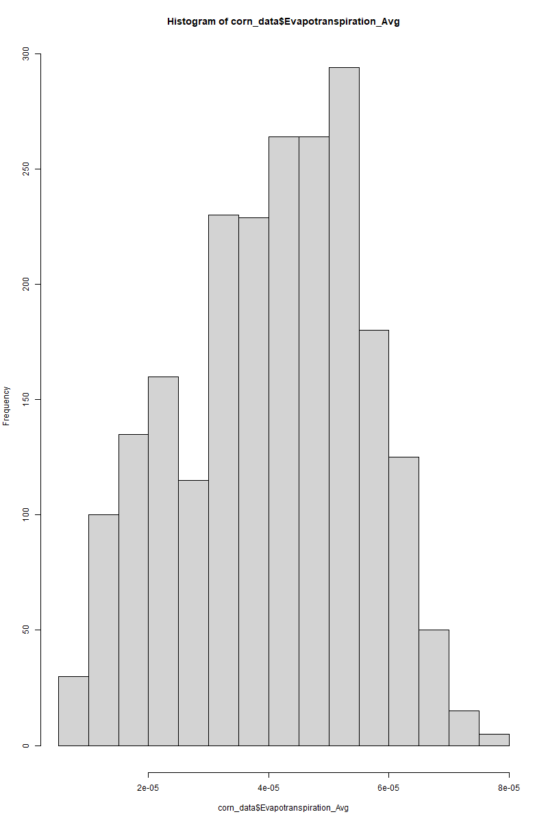
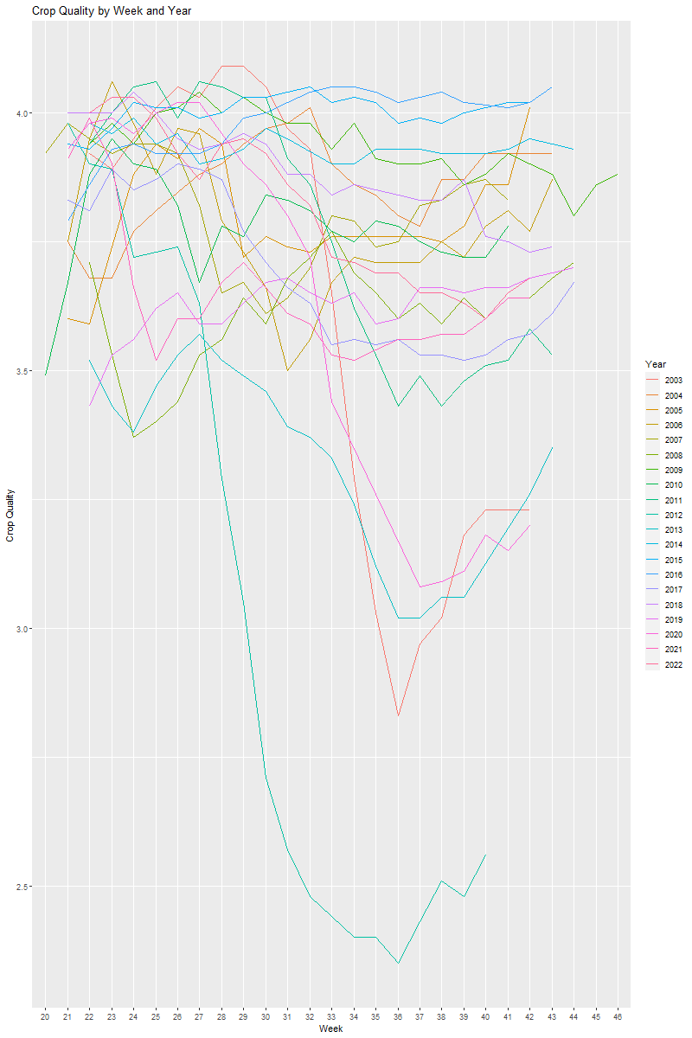
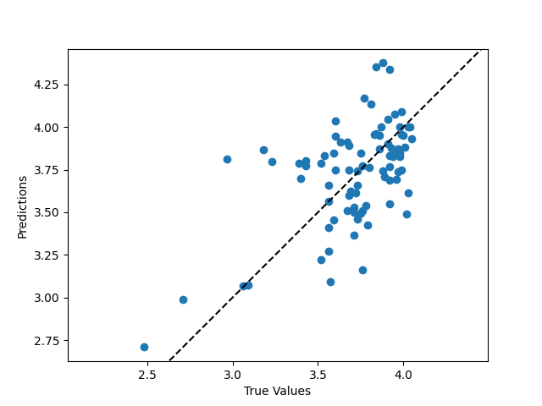
Assessing the Impact of Climate Change on Corn Quality in Iowa: A Comprehensive Data Analysis of Environmental Variables
Joseph Xiao^{(xiaoj6@rpi.edu)}
Abstract
Linear Regression Model
EDA and Data Cleaning
This project aims to explore the impact of weather data on the quality of corn produced in the US, specifically in Iowa. In recent years, climate change has accelerated and the environment has been constantly changing. Global temperatures have risen 1.98℉ from 1901 to 2020, but climate change is more than just temperature. Weather patterns that are vital to agriculture production have been changing, such as wind and precipitation.
Based on the mostly normal distribution of the environmental variables and the values calculated from the chi-squared test I decided to conduct a linear regression analysis to determine the effect of environmental variables on corn quality. The first linear regression model I ran had crop quality as the response variable and the six environmental columns as predictor variables. The regression results showed that soil moisture, water vapor, surface air temperature, and evapotranspiration were significant predictors of corn quality with all their p-values less than 0.05. These four results made a lot of sense as each of these factors affects some important growth factors for plants. The surprising result was seeing that the precipitation average and surface water were not significant(p>0.05). When discussing environmental factors in my introduction I was sure one of the main factors was rainfall. A possible explanation for this is the skewdness of the rain data - a majority of days it does not rain so when it does the data is skewed heavily to the right. In the future, I would try to find another rainfall variable, not just one that measures daily average precipitation. The adjusted R squared value for the first model was 0.251, indicating that around 25% of the variation in corn quality could be explained by the six environmental variables. While not very high, this r-squared value was still significant and supported the analysis and the original hypothesis. The second linear regression model I ran had all the predictor variables just with year and the week number added. This model was very similar to the first one and it seems that adding the year and week did not have as significant of a change as I would have wanted. However, the R-squared value did go up to .2985 which shows a slight improvement in the accuracy of the model.
The analysis started with cleaning and reformatting of the corn data and six environmental datasets. Summary statistics were conducted on all datasets to examine variable types and distributions. The corn quality data had a “Week Ending” variable that was in characters so it had to be converted to date format in order to analyze it. A function was created to aggregate daily environmental data on a weekly basis. Histograms were created for each of the six environmental variables. Surface air temperature was observed to be normally distributed, but canopy surface water was heavily skewed to the right. Evapotranspiration, soil moisture, and water vapor were all mostly normally distributed, while average precipitation was heavily skewed to the right. The analysis continued with plotting each variable in relation to the week-ending date. The x-axis was changed to the different months of the year, where each year is graphed as a different colored line. The analysis showed a problem in the data due to the corn quality dataset having five entries for each date value. These columns were combined into one clear “quality_score” and assigned numerical values
Problem Area
I wanted to examine the effect of some of these shifting weather factors on agriculture in the US. Corn is the most widely produced crop in the US and Iowa is the country’s largest producer. The hypothesis of this study is that changes in weather data, including evapotranspiration, air temperature, and precipitation, have a significant negative effect on the quality of corn produced in Iowa. This project aims to improve our understanding of the relationship between weather data and corn quality and also to provide info that can potentially be used to mitigate these effects. Prior research has explored the relationship between the warming climate and corn production, with studies showing that the warming climate can significantly decrease corn yields. However, these studies have focused on the relationship between weather and yields rather than quality. By examining the effect of weather data on corn quality, I hope to contribute to existing research and provide a more complete understanding of the environmental factors that impact corn production.
The Data
Neural Network
I went to the National Agriculture Statistics Service website to use their tool called Quick Stats. I used this tool to get weekly data on the quality of crops in Iowa from 2002 to 2022, specifically for corn. After obtaining the corn quality data, I needed weather data to see how they were correlated. I used the NASA Giovanni tool to access data from models such as NLDAS, parse, and return relevant info. I chose 6 different environmental factors that affect crop growth: daily accumulated precipitation, air temperature, perceptible water vapor, evapotranspiration, plant canopy surface water, and root zone soil moisture. These factors tend to cycle by year, but there is a lot of variance within each year. The time series graphs generated by Giovanni gave me a pretty good idea of the different ranges and variances within the data even before analysis
I ran a second model using a simple neural network, which is very popular in the field of machine learning because it excels at fitting data, including identifying and modeling nonlinear relationships. By examining multiple environmental factors and their complex interactions with corn quality, a neural network takes into account the different relationships they have and can identify which relationships are important even when not specified by the user. To create this neural network, I first cleared the data by dropping categorical data such as week ending and state. I then split the data into training and testing sets, with 80% of the data used for training and 20% for testing. Due to the variance in variable values, I standardized my input values using the standard scaler from sci kits. I built the actual neural network model using Keras with three layers: the input layer with 64 neurons and ReLU, a hidden layer with 64 neurons and ReLU, and an output layer with one neuron and a linear activation function. I compiled the model with the Adam optimizer and mean squared loss error function, and trained it for 100 epochs initially. The performance of the model was calculated by computing the mean squared error loss. The test loss was 0.0927, and the training loss was 0.0348. Next, I increased the epochs to 1000 and the test loss decreased to 0.0879, while the training loss decreased to 0.0151. Finally, for 10000 epochs, the test loss was 0.0761 and the training loss was 0.0150.
Conclusion
The goal of this project was to create models that predicted the quality score of corn based on six environmental factors: surface air temperature, canopy surface water, evapotranspiration, soil moisture, water vapor, and average precipitation. From the models used I concluded that environmental variables such as soil moisture, water vapor, surface air temperature, and evapotranspiration have a significant effect on corn quality. While both the linear regression model and the neural network demonstrated this, the neural network was more convincing with a significantly lower loss. Overall, the analysis supports the hypothesis that changes in weather data, including evapotranspiration, air temperature, and precipitation, have a significant negative effect on the quality of corn produced in Iowa. For subsequent explorations I would stick to the neural network and explore a larger variety of environmental factors and expand the scope of crops I am looking at.
Poster: MT15A-08
Glossary:
RPI – Rensselaer Polytechnic Institute

