Slide 1
FINAL-YEAR PROJECT • VISUAL ANALYTICS
Cloud-Native Construction Project
Intelligence Platform
Predictive Delay-Risk Scoring & Real-Time Performance Analytics
TEAM
Hasnain Makada
Sahil Mall
Aryan Kishor Sao
26MML0031
26MML0049
26MML0046
Dept. of Computer Science & Engineering · Vellore Institute of Technology, Vellore
FastAPI
PostgreSQL
scikit-learn
Power BI
Docker
Kubernetes

Slide 2
TEAM
Project Team
HM
SM
AK
Hasnain Makada
Sahil Mall
Aryan Kishor Sao
26MML0031
26MML0049
26MML0046
The project spans data engineering, analytics, machine learning, visualization, and cloud-native deployment — delivered as one integrated system.
CCPIP — Final-Year Project
02

Slide 3
OVERVIEW
Agenda
01
Introduction & Motivation
06
Data Model & Implementation
Why construction control needs a deployable platform
Schema, EVM, ML risk, web UI, Power BI
02
Problem Definition
07
Live Platform Walkthrough
Fragmentation, retrospection, and the analytics–deployment gap
Screenshots of the working dashboard
03
Literature Review
08
Deployment & Results
What prior work covers — and leaves open
Kubernetes, benchmarks, validation
04
Research Gap & Objectives
09
Conclusion & Future Work
The missing link and the seven objectives
Contributions and next steps
05
System Architecture
Ingestion → storage → analytics → visualization
CCPIP — Final-Year Project
03

Slide 4
01 — INTRODUCTION
Motivation
• Construction project control depends on the triple constraint: schedule, cost, and scope.
• Despite tools like Primavera P6 and MS Project, cost overruns and schedule slippage remain endemic.
• A root cause is delayed visibility: progress and cost data are collected through manual site logs, spreadsheets, and disconnected subcontractor reports.
  – Variances are identified only at periodic commercial meetings — long after corrective action could help.
• Industry 4.0 (BIM, IoT, QR capture) and BI dashboards (Power BI) show value individually, but remain siloed.
  – The need: continuous, evidence-based monitoring — not retrospective reporting.
Triple Constraint
Delayed Visibility
Our Aim
Schedule · Cost · Scope tracked together
Data fragmented and reported late
Continuous, predictive project control
CCPIP — Final-Year Project
04

Slide 5
01 — PROBLEM
Three Systemic Deficiencies
1. Data Fragmentation & Latency
2. Retrospective, Not Predictive
3. Analytics Disconnected from Deployment
Site records, cost sheets, and baselines live in siloed applications with no unified schema. Teams manually rebuild reporting models every cycle.
CPI and SPI describe historical performance. They offer no probabilistic forecast to warn of activity-level delay before the critical path slips.
Advanced predictive models exist as isolated research scripts — not reproducible, containerized, auto-scaling systems.
Consequence: schedule and cost variances are discovered too late for preventive intervention — and there is no single reproducible system to fix it.
CCPIP — Final-Year Project
05

Slide 6
03 — LITERATURE REVIEW
Related Work — Part I
Study | Purpose | Key Observation | Limitation
Chiu & Russell (2011) | Construction data visualization environment | Visual frameworks improve schedule comprehension vs. Gantt charts | Schedule-only; no cost, resources, or prediction
Al-Sulaiti et al. (2021) | Power BI dashboards for EPC KPIs | Dynamic reporting elevates management visibility | Descriptive assessment; not predictive or cloud-native
Radman et al. (2022) | Digital delay-management lifecycle (DC → DA → DP) | Integrated data lifecycle is essential to cut latency | Conceptual architecture; no ML or containerization
Visualization and data-lifecycle work is mature — but stays descriptive and schedule-centric.
CCPIP — Final-Year Project
06

Slide 7
03 — LITERATURE REVIEW
Related Work — Part II
Study | Purpose | Key Observation | Limitation
Gajera (2023) | Power BI integrated with project controls | Dynamic cost tracking; ~25% lower reporting latency | Descriptive visualization; no predictive model
Zhang & Wang (2023) | Probabilistic schedule risk (SORM + softmax CPM) | Differentiable reliability finds most-probable failure point | Isolated numerical model; no ingestion or UI
Radman et al. / RealCONs (2026) | QR + BIM + SQL + Power BI field monitoring | Strong data continuity (SPI 1.01 vs 0.89) | Deterministic EV; no predictive ML or containers
Predictive and deployment techniques exist in isolation — never combined into one platform.
CCPIP — Final-Year Project
07

Slide 8
04 — RESEARCH GAP
The Missing Link
No study presents a single, reproducible architecture that ingests heterogeneous project data, computes EVM, predicts delay risk with machine learning, visualizes results, and deploys reproducibly — all in one system.
Separation
Fragile Pipelines
No Reproducibility
Predictive algorithms live apart from visual business intelligence.
Manual, spreadsheet-bound data preparation.
No containerized, auto-scaling deployment architecture.
→ The platform we build closes all three gaps in one deployable system.
CCPIP — Final-Year Project
08

Slide 9
04 — OBJECTIVES
Seven Objectives
1
Unified Data Model
2
Validated Ingestion
Project, activity, progress, cost, resource, KPI, risk entities
FastAPI microservice rejecting malformed data (HTTP 422)
3
Automated EVM
4
Delay-Risk Engine
CV, SV, CPI, SPI, EAC, TEAC computed in the pipeline
ML classifiers + probabilistic reliability formulation
5
Multi-tier Dashboard
6
Cloud-Native Deploy
Executive, cost, schedule, and risk views
Docker + Kubernetes with probes, HPA, persistence
7
Evaluation Method
Analytical correctness, prediction quality, deployment repeatability
CCPIP — Final-Year Project
09

Slide 10
05 — STACK
Technology Stack
INGESTION & COMPUTE
STORAGE & ANALYTICS
PRESENTATION & DEPLOY
Python
PostgreSQL
Web UI (Jinja2 + Chart.js)
Core language for all services
3-tier relational store
Interactive dashboard
FastAPI
SQLAlchemy + Alembic
Microsoft Power BI
Async REST layer + validation
ORM + migrations
DAX decision layer
Pydantic
Pandas / NumPy
Docker
Strict schema validation (422)
EVM computation
Reproducible images
scikit-learn
Kubernetes
Delay-risk classifiers
Orchestration, HPA, probes
CCPIP — Final-Year Project
10

Slide 11
05 — ARCHITECTURE
End-to-End Data Flow
Data Sources
Ingestion API
PostgreSQL
Analytics + ML
Curated Views
Web UI / Power BI
CSV / REST / site updates
FastAPI + Pydantic validation
3-tier schema + views
EVM + delay-risk scoring
Reporting-ready data
Dashboards & alerts
Kubernetes orchestrates every backend service — health probes, autoscaling, persistent storage.
• Separation of concerns: ingestion, storage, analytics, and presentation are independent.
  – A dashboard outage never compromises data capture; analytics scales without redesign.
• Power BI consumes curated views (not the live OLTP tables), keeping the BI model simple.
CCPIP — Final-Year Project
11

Slide 12
06 — DATA MODEL
A Three-Tier Relational Schema
MASTER ENTITIES
TIME-SERIES (append-only)
COMPUTED OUTPUTS
Project
ProgressUpdate
KPIResult
id · name · contractor · BAC · baseline dates
activity · timestamp · % complete · PV · EV
PV · EV · AC · CV · SV · CPI · SPI · EAC · TEAC
Activity
CostRecord
RiskResult
id · WBS · trade · planned dates · budget · float · criticality
activity · timestamp · actual cost
delay probability · category · model version · top features
ResourceRecord
workers · equipment · material
Curated SQL views (v_activity_current, v_project_summary, v_progress_trend, v_cost_trend) expose reporting-ready fields to the UI and Power BI.
CCPIP — Final-Year Project
12

Slide 13
06 — IMPLEMENTATION
Validated Ingestion Pipeline
• FastAPI exposes async REST endpoints for projects, activities, progress, costs, and resources.
• Every payload is validated against strict Pydantic schemas before touching the database.
  – Malformed data is rejected with HTTP 422 — bad records never reach storage.
  – Negative budgets, finish-before-start dates, naive timestamps, and out-of-range values are all caught.
• Records are upserted idempotently (PostgreSQL ON CONFLICT), so re-running is safe.
• Alembic migrations build the schema; curated views are re-applied idempotently.
REJECTED (HTTP 422)
ACCEPTED & STORED
percent_complete = 150 · naive timestamp · budget = -5
19,317 records ingested — 0 rejected in the verified run
CCPIP — Final-Year Project
13

Slide 14
06 — IMPLEMENTATION
Earned Value Management
• The analytics worker computes EVM as of a per-project status date (midpoint of each project's reporting window).
• PV/EV come from the latest progress snapshot at or before the status date; AC is cumulative cost to that date.
• Indicators are persisted to KPIResult for downstream UI and Power BI consumption.
CV
SV
CPI
EV − AC
EV − PV
EV / AC
Cost Variance
Schedule Variance
Cost Performance Index
SPI
EAC
TEAC
EV / PV
BAC / CPI
Duration / SPI
Schedule Performance Index
Estimate At Completion
Time Estimate At Completion
Every KPI row is verified: CV = EV − AC, SV = EV − PV, CPI = EV / AC, SPI = EV / PV.
CCPIP — Final-Year Project
14

Slide 15
06 — IMPLEMENTATION
Predictive Delay-Risk Modeling
SUPERVISED BINARY CLASSIFICATION
PROBABILISTIC RELIABILITY
yᵢ = 1 if (ActualFinishᵢ − PlannedFinishᵢ) > τ
Sᵢ = Softmax(Eⱼ)
τ = acceptable schedule buffer. Features: planned duration, total float, predecessor count, subcontractor delay rate, criticality, SPI trend.
A temperature-scaled softmax surrogate of the CPM max operator locates the most-probable failure point across the activity network.
MODEL SELECTION
Model | Acc. | Prec. | Rec. | F1 | ROC-AUC
Random Forest | 0.880 | 0.704 | 0.805 | 0.746 | 0.955
Gradient Boosting | 0.903 | 0.820 | 0.713 | 0.762 | 0.943
SVM (selected) | 0.920 | 0.849 | 0.791 | 0.811 | 0.969
Each activity gets a delay probability → Low / Medium / High category, surfaced as early-warning alerts.
CCPIP — Final-Year Project
15

Slide 16
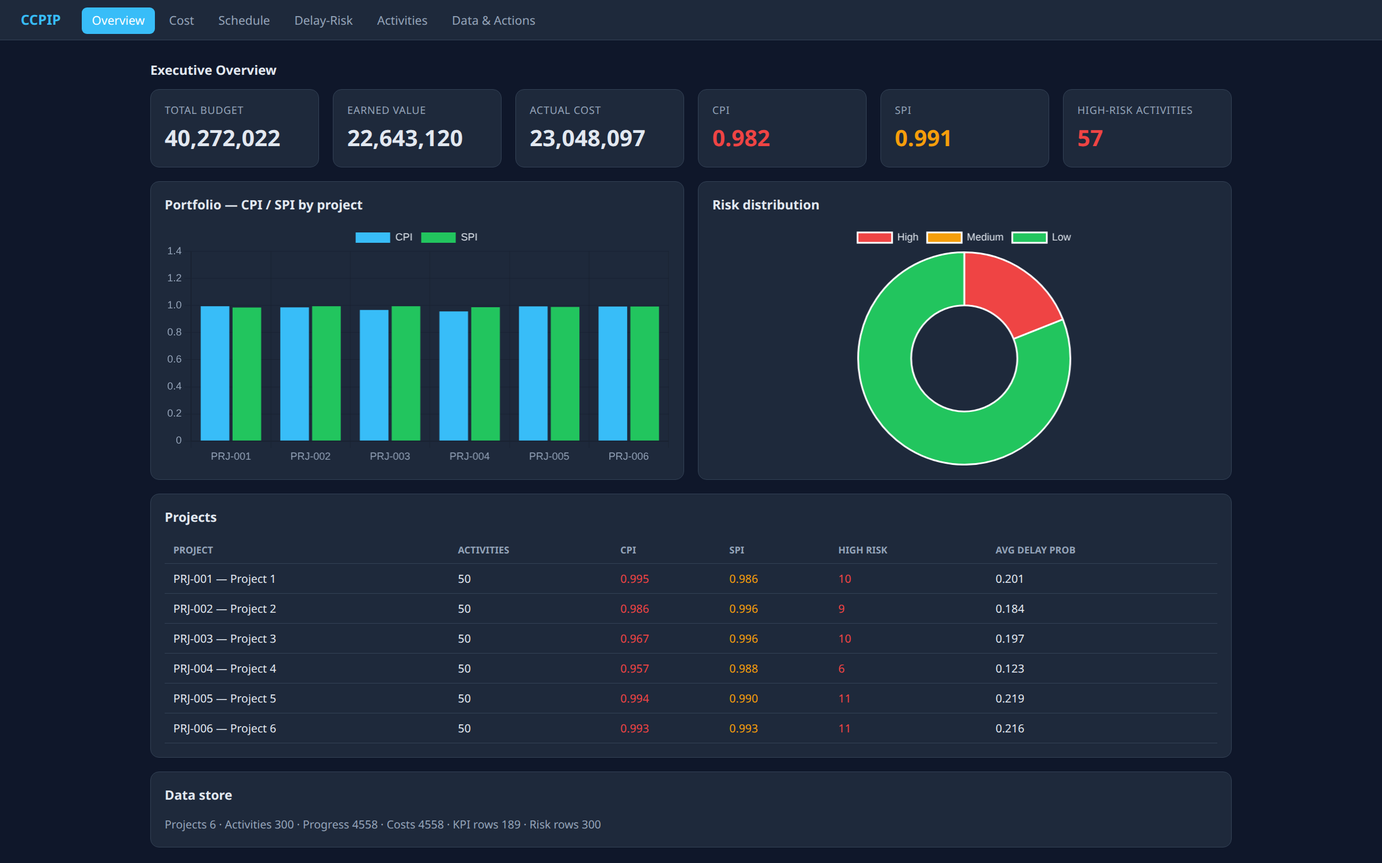
07 — LIVE PLATFORM
Interactive Web Dashboard — Overview
WHAT IT SHOWS
▸
Portfolio KPIs: budget, EV, AC
▸
CPI and SPI with colour status
▸
High-risk activity count
▸
Per-project CPI / SPI chart
▸
Risk distribution doughnut
CCPIP — Final-Year Project
16
Live dashboard — Executive Overview

Slide 17
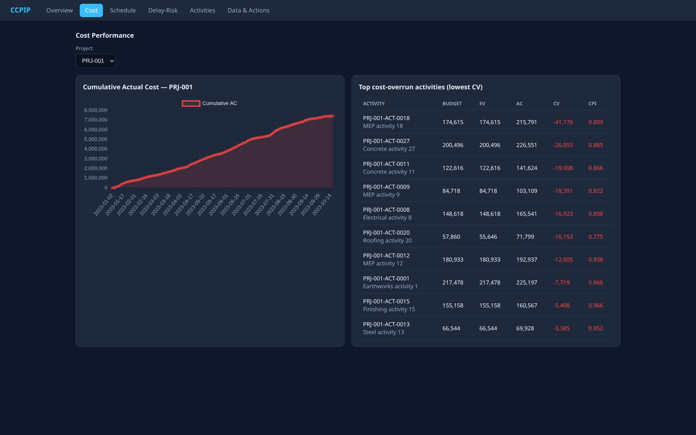
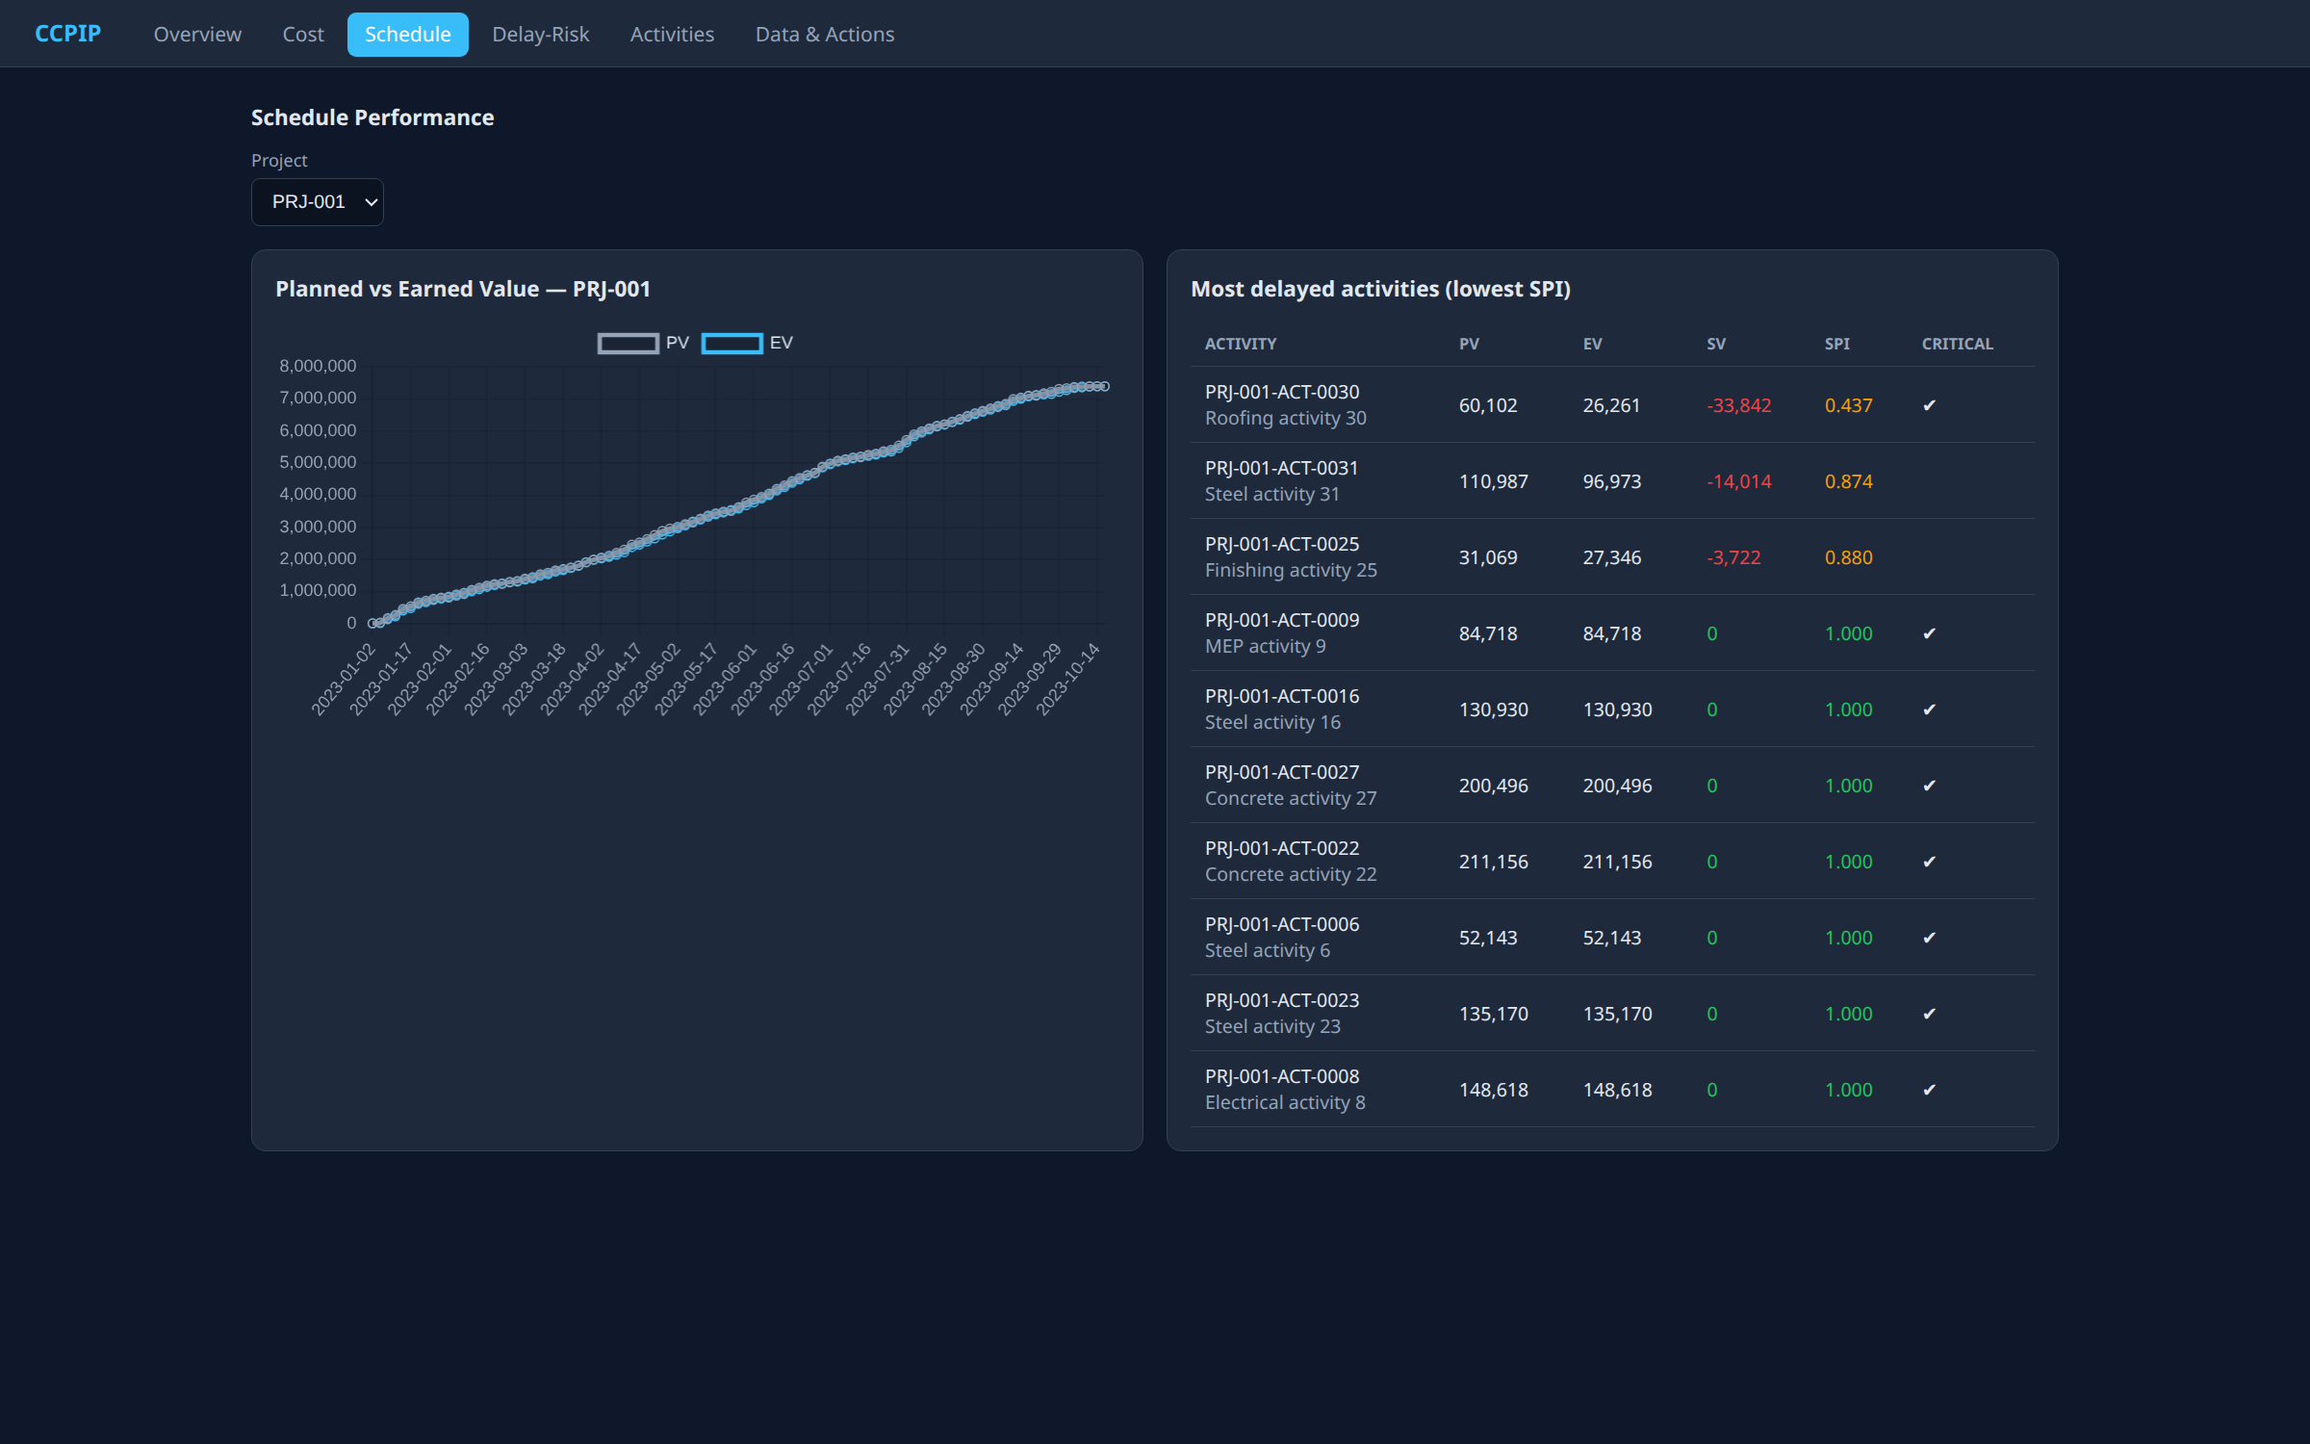
07 — LIVE PLATFORM
Cost & Schedule Performance
Cost — cumulative actual-cost curve + overruns
Schedule — planned vs earned value S-curve
Both views recompute live from PostgreSQL — no manual refresh, no spreadsheet.
CCPIP — Final-Year Project
17

Slide 18
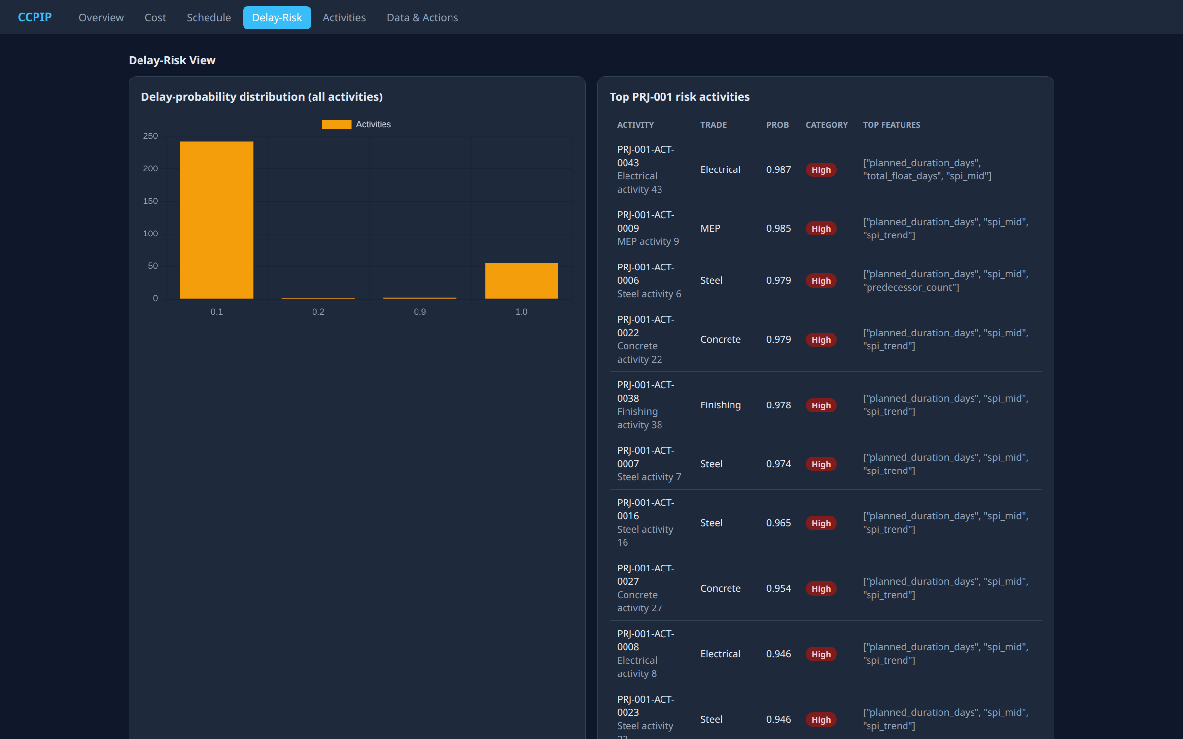
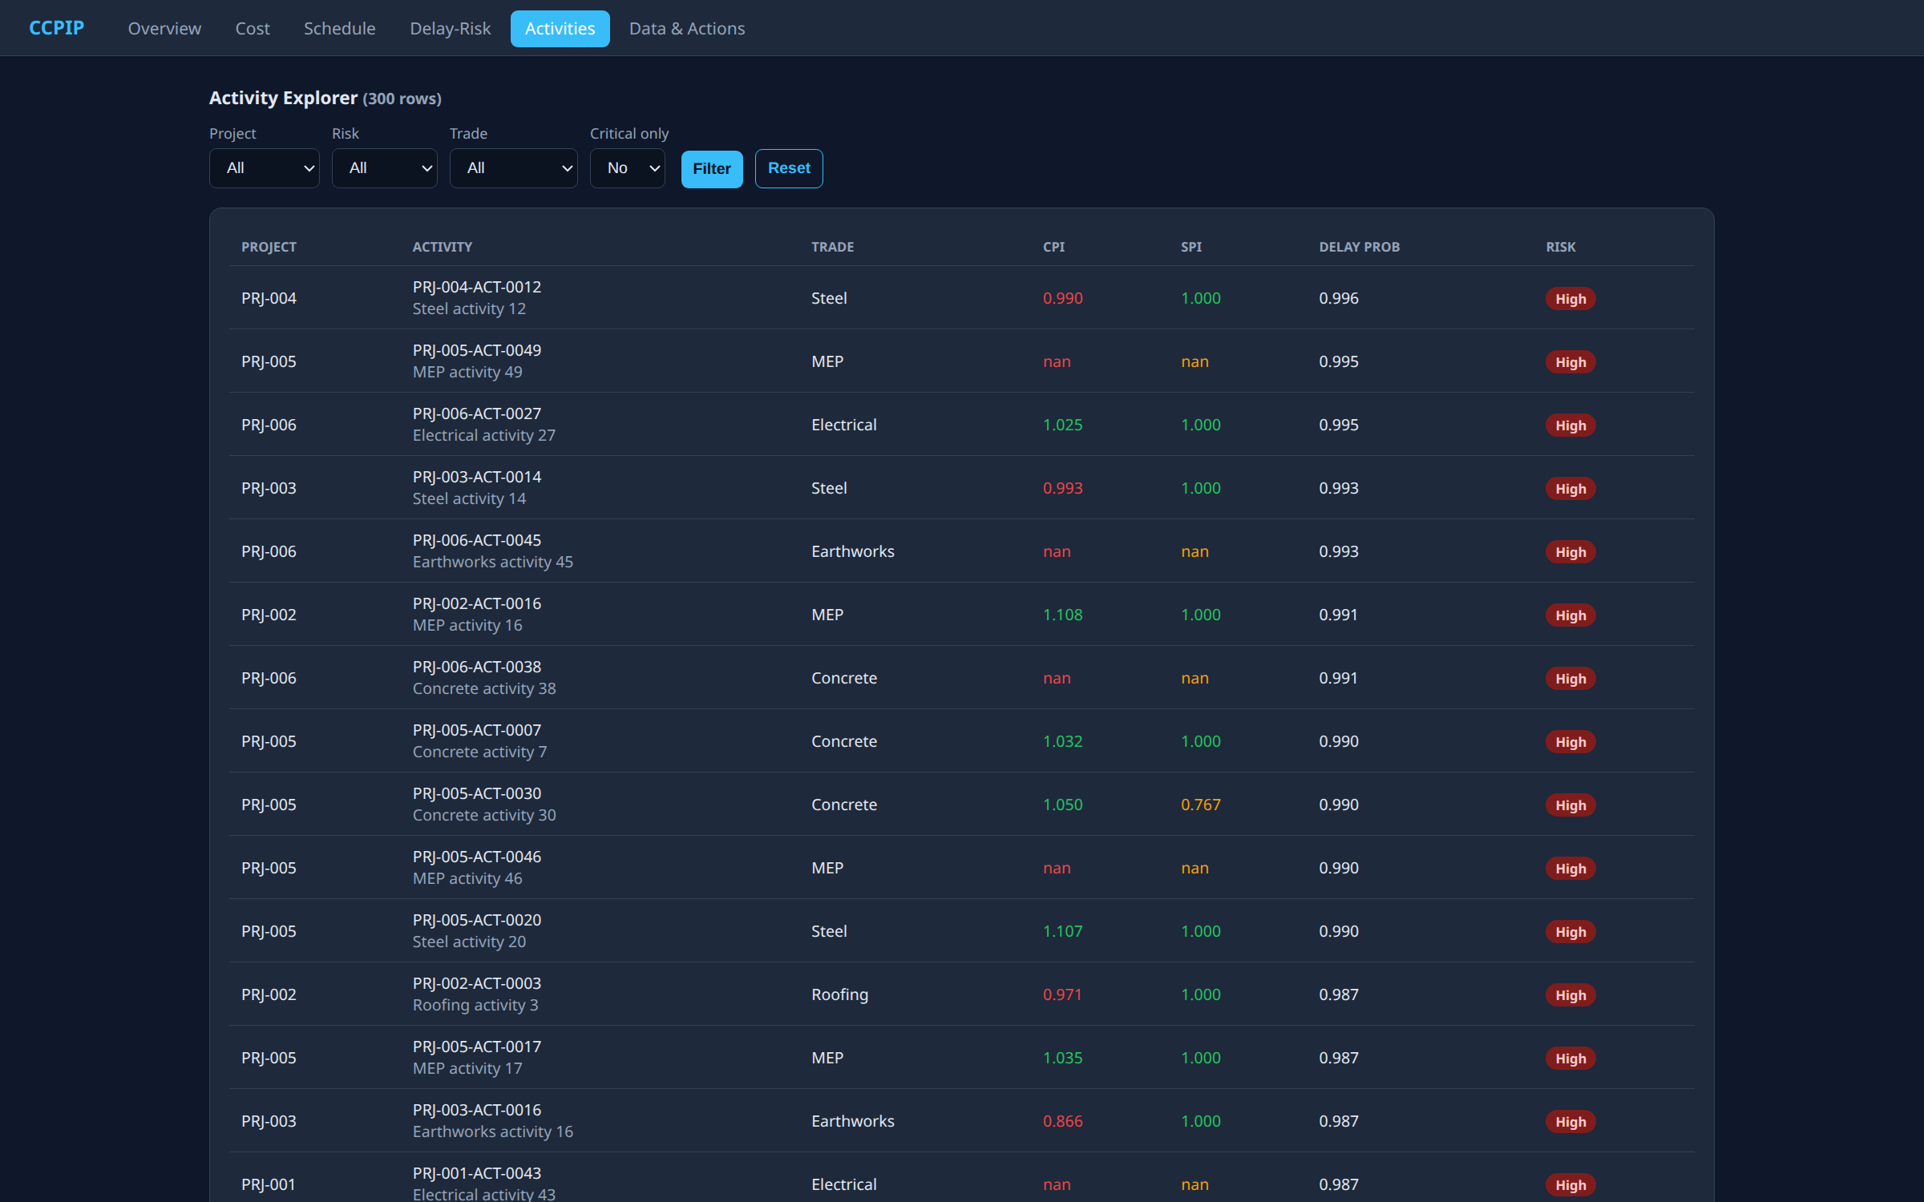
07 — LIVE PLATFORM
Delay-Risk & Activity Explorer
Delay-Risk — probability histogram + top-risk list
Activities — filterable explorer
Every activity carries a delay probability and a Low / Medium / High risk badge.
CCPIP — Final-Year Project
18

Slide 19
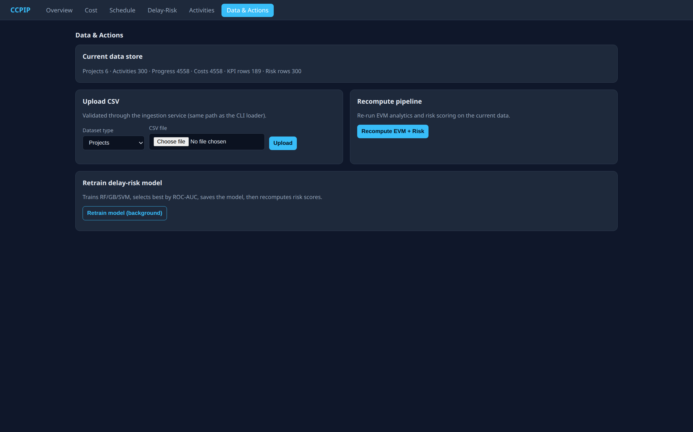
07 — LIVE PLATFORM
Data & Actions — Full Control from the UI
ACTIONS
▸
Upload CSV (validated via API)
▸
Recompute EVM + Risk
▸
Retrain the ML model
▸
See live row counts
▸
No CLI required
CCPIP — Final-Year Project
19
Data & Actions — upload, recompute, retrain

Slide 20
07 — POWER BI
Decision Layer
• Power BI connects to curated PostgreSQL views (import or DirectQuery) — not the raw OLTP tables.
• DAX measures compute cumulative PV/EV/AC curves and portfolio-level CPI/SPI.
• Four report pages mirror the platform's decision tiers.
Executive Overview
Cost Performance
Budget vs. EV vs. AC · CPI · SPI · high-risk count
Budget/actual/earned curves · cost-variance trend
Schedule Performance
Delay-Risk View
Planned vs. actual · SV · SPI trend · delayed list
Risk probability · category · contributing features
Reproducible even offline: curated views export to CSV for template import.
CCPIP — Final-Year Project
20

Slide 21
08 — DEPLOYMENT
Cloud-Native on Kubernetes
KUBERNETES CLUSTER
StatefulSet: db
Deployment: ingestion
Deployment: web
Job: pipeline
PostgreSQL + PVC
2 replicas · HPA 2–6
1 replica · health probes
migrate → ingest → train → verify
Liveness / readiness probes
Horizontal Pod Autoscaling
Persistent Volume Claims
Secrets isolation
Declarative manifests (kustomize)
• Docker packages a single shared image; Kubernetes provides reproducible orchestration.
• Self-healing verified: a deleted ingestion pod is rescheduled in ~1 second.
CCPIP — Final-Year Project
21

Slide 22
08 — RESULTS
Model Benchmark
TABLE II — DELAY-RISK CLASSIFIERS (5-FOLD CV)
WHY IT MATTERS
Model | Acc. | Prec. | Rec. | F1 | ROC-AUC
Random Forest | 0.880 | 0.704 | 0.805 | 0.746 | 0.955
Gradient Boosting | 0.903 | 0.820 | 0.713 | 0.762 | 0.943
SVM (selected) | 0.920 | 0.849 | 0.791 | 0.811 | 0.969
• Accuracy alone is misleading on imbalanced delay data.
• ROC-AUC 0.969 means strong separation of delayed vs. on-time activities.
• F1 0.811 balances precision and recall for actionable alerts.
• Calibrated SVM probabilities feed the risk categories directly.
SVM selected by highest ROC-AUC (0.969).
CCPIP — Final-Year Project
22

Slide 23
08 — VALIDATION
Correctness, Reliability & Reproducibility
✓
EVM correctness
✓
End-to-end verification
All KPI rows satisfy CV = EV − AC, SV = EV − PV, CPI = EV / AC, SPI = EV / PV
Automated E2E check passes: row counts, identities, risk bounds, non-empty views
✓
Self-healing
✓
Autoscaling
A deleted ingestion pod is rescheduled by Kubernetes in ~1 second
HPA scales the ingestion tier between 2 and 6 replicas on CPU
✓
Ingestion integrity
✓
Reproducibility
19,317 records ingested, 0 rejected; malformed payloads return HTTP 422
One-command launch; seeded synthetic dataset; identical results every run
CCPIP — Final-Year Project
23

Slide 24
08 — REPRODUCIBILITY
One Command to Run Everything
LINUX / macOS
WINDOWS (POWERSHELL)
./run.sh
.\run.ps1
→ builds image · starts DB + API + UI · runs pipeline · prints http://localhost:8080
Generate
Ingest
Store
Analyse
Predict
Verify
seeded synthetic data
validated via API
PostgreSQL
EVM metrics
train + score risk
E2E checks
Deliverables: source code, Docker + Kubernetes manifests, web UI, Power BI layer, tests, and full documentation — all open and reproducible.
CCPIP — Final-Year Project
24

Slide 25
09 — CONCLUSION
Contributions
• One reproducible, cloud-native platform unifying ingestion, storage, EVM analytics, ML risk, and visualization.
• Genuine EVM and a valid delay-risk classifier — enabled by an activity-level dataset with real baselines.
• Calibrated SVM achieving 0.969 ROC-AUC on delay prediction.
• Self-healing Kubernetes deployment with autoscaling and validated failover.
• An interactive web UI plus a Power BI decision layer over curated views.
• Open, one-command launch across Linux, macOS, and Windows.
From retrospective reporting → continuous, evidence-based project control.
CCPIP — Final-Year Project
25

Slide 26
09 — FUTURE WORK
Next Steps
Live Vision Feeds
4D BIM Integration
Computer-vision progress capture from on-site cameras.
Embed 4D BIM models directly within the dashboard canvas.
Real-World Validation
Graph Risk Features
Validate on real historical project portfolios.
Extend the risk model with schedule-network graph features.
Access Control
Cost Forecasting
Role-based access control and multi-tenant support.
Probabilistic cost-overrun forecasting alongside delay risk.
CCPIP — Final-Year Project
26

Slide 27
REFERENCES
Selected Sources
[1] Chiu & Russell (2011). Design of a construction management data visualization environment. Automation in Construction, 20(4), 399–417.
[2] Al-Sulaiti et al. (2021). Using data analytics and visualization dashboards for EPC performance assessment. IEEE ICIEA, 207–211.
[3] Radman et al. (2022). Digital technologies and data-driven delay management. Frontiers in Built Environment, 8, 1029586.
[4] Gajera (2023). Integrating Power BI with project control systems. IJSRCE, 7(5), 154–160.
[5] Zhang & Wang (2023). Quantifying schedule delay risk with BIM and probabilistic reliability. Advances in Civil Engineering, 5525655.
[6] Radman et al. (2026). RealCONs: digital monitoring, delay detection and visualization framework. Automation in Construction, 183, 106781.
[7] Ghosh et al. (2024). Use of visual dashboards in construction projects. ASC Intl. Conference, EPIC Series, 5, 486–494.
CCPIP — Final-Year Project
27

