Slide 1
Robust Distributed Symmetric-key Encryption
Alex Castro, Steve Chang,
Garrett Christian, and Rachel Litscher
Notes:
What are the names of the students on the project?

Slide 2
What Our Group Worked on
Based on Professor Wang’s paper: “Robust distributed symmetric-key encryption”
Implemented the scheme in C++
Found parallel improvements using OpenMP and C++ threads
Dockerized the application, ran on different environments, and on Google Cloud
Notes:
What work did you do

Slide 3
What is Distributed Symmetric-key Encryption
A full set of keys are split between N servers
Each machine holds a partial key set
A secret is generated using the full key set
Machines work together using their partial key sets to encrypt and decrypt messages
No set of machines less than the T threshold can reconstruct the secret alone
Notes:
Add image similar to prof wang’s slide show with servers and diff colored keys to illustrate the partial key sets

Slide 4
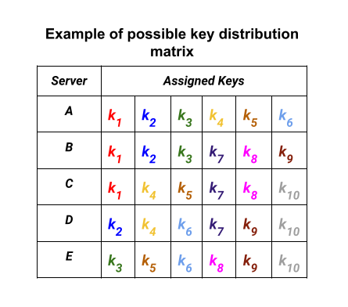
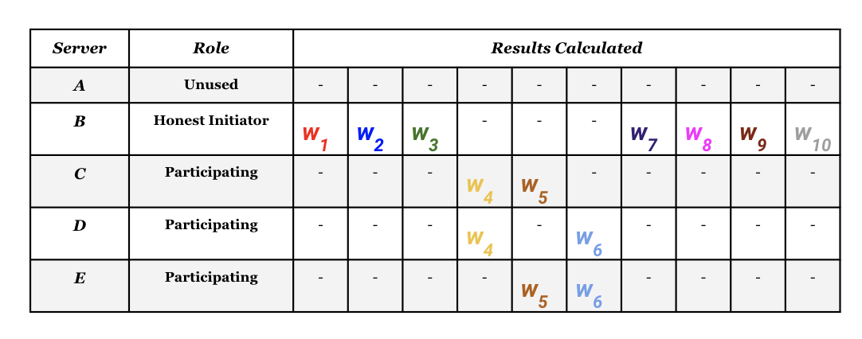
What Makes Professor Wang’s Robust
Notes:
Add image of omega table and image of N 5 T 3 partial w results table to illustrate redundancy

Slide 5
Different Roles in the Scheme
Dealer: supplies the omega table and partial keys to the DiSE Servers
Client: begins either a encryption or decryption transaction
DiSE Server: waits to be contacted by one of the other roles
Honest Initiator: random DiSE Server chosen by the client who manages the transaction
Participant: contacted by the Honest Initiator to create the partial w’s for either encryption or decryption

Slide 6
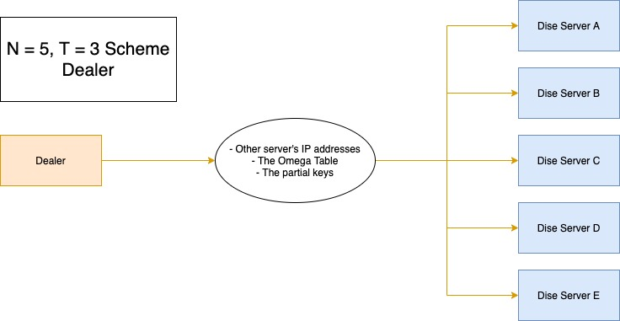
Dealer Flow
Generate key list and populates the omega matrix
Send data assigned to each server to the corresponding server in parallel
Notes:
Insert dealer flow diagram of N 5 T 3 case

Slide 7
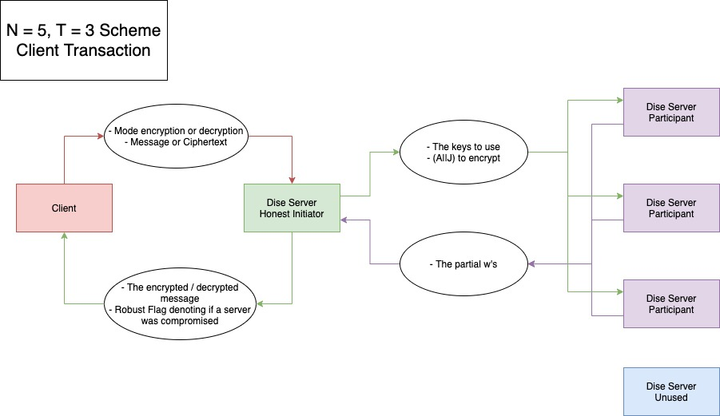
Transaction Communication Overview
Notes:
Insert transaction flow diagram maybe don’t go too deep here since we’re about to break it down in depth

Slide 8
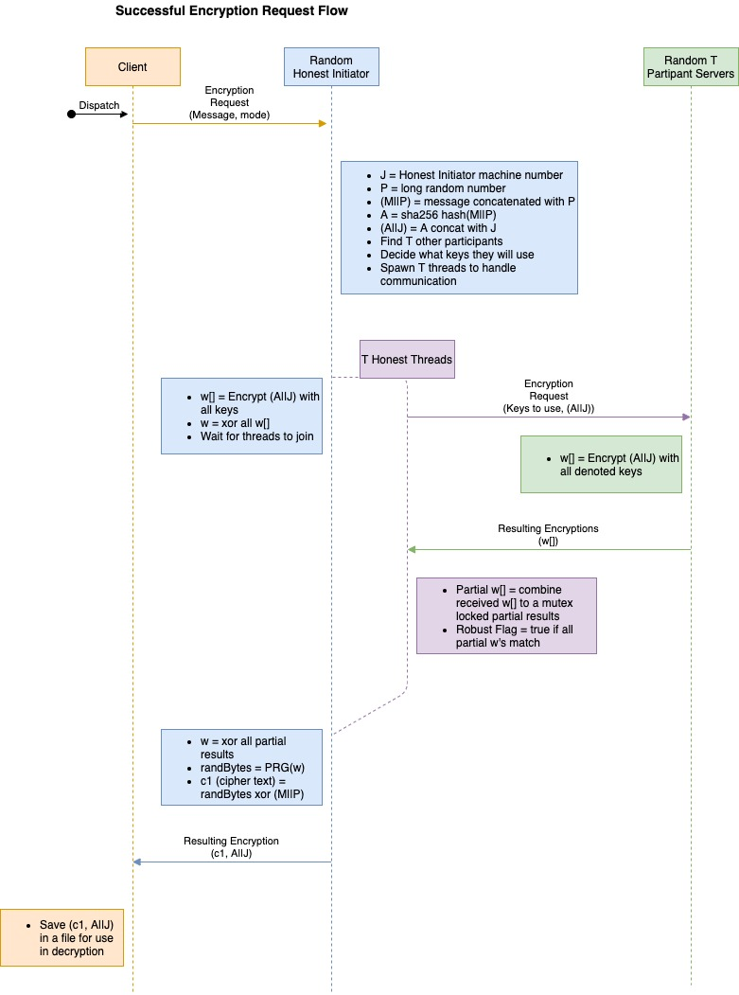
Encryption Flow
Client Hits a random Server to be Honest Initiator
Honest Init creates M||P and A||J
Asks random T to create partial W’s
Notes:
Insert detailed encryption Flow diagram or split into multiple slides with different sections of the diagram to step through the flow

Slide 9
Encryption Flow
Honest Initiator checks robustness
Uses a pseudo-random number generator with the final W as seed
xors final w with the message
Client saves (C1, A||J)
Notes:
Insert detailed encryption Flow diagram or split into multiple slides with different sections of the diagram to step through the flow

Slide 10
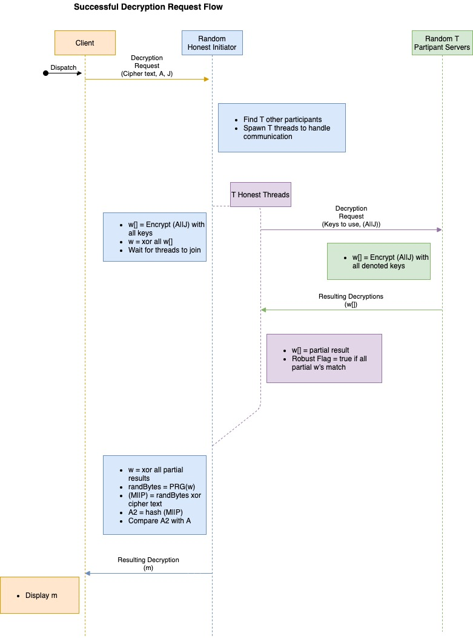
Decryption Flow
Client sends (C1, A||J) to random Honest Initiator
Performs encryption steps in reverse
Key difference is that it checks the hash of M||P with the provided A
Notes:
Insert Decryption Flow Diagram same deal as enc

Slide 11
Roadblocks
We were building the application from the ground up
Had difficulty running the larger case
Due to version issues, we could not use OpenSSL and Crypto++ for the pseudo-random number generator
Notes:
what roadblocks did you run into?

Slide 12





DOCKER Running on Different Virtual Machines
To demonstrate the portability of our application we ran it on multiple types of virtual machines
Virtual Machines Used:
Ubuntu
Debian
Kali
Notes:
Add image still to do

Slide 13
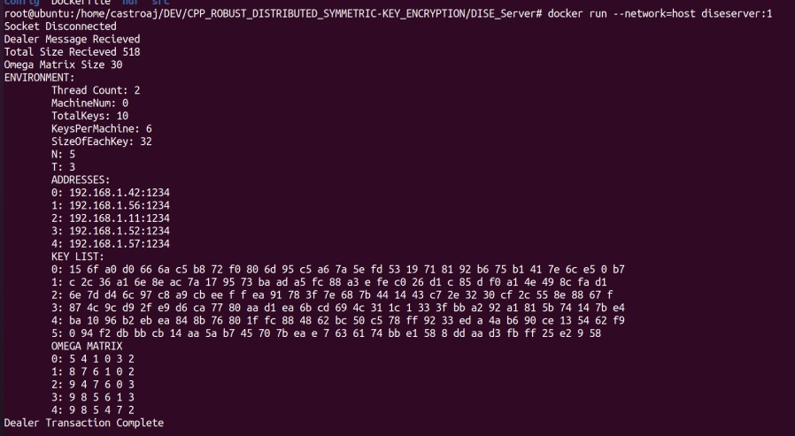
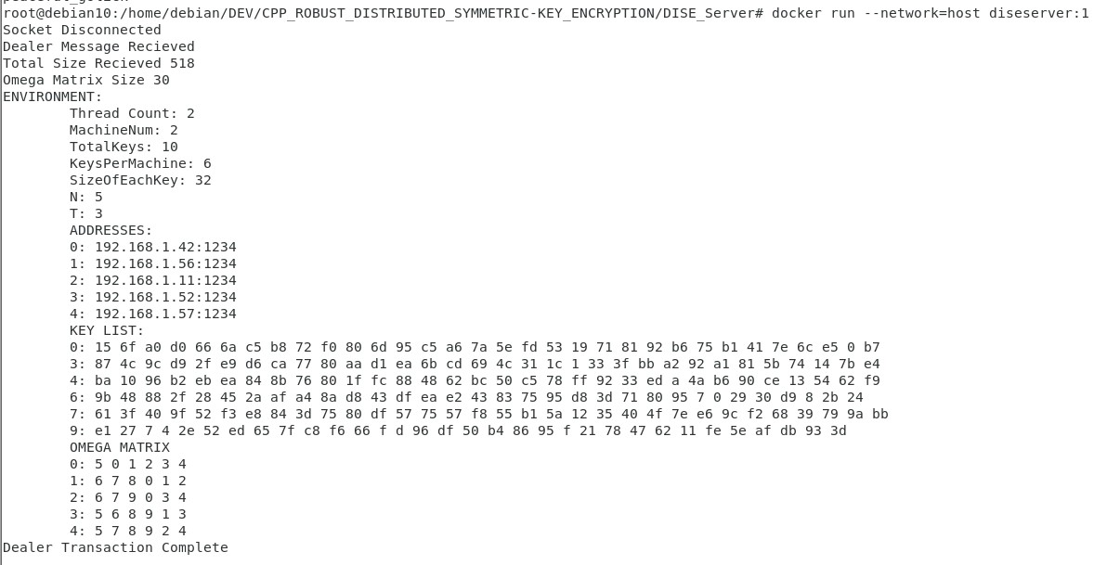
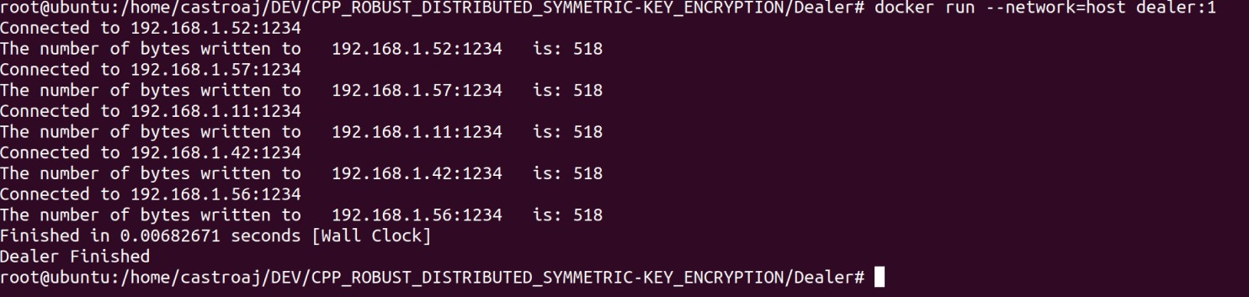
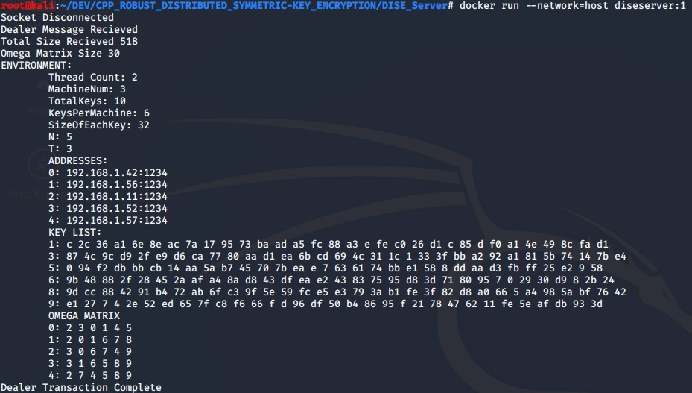
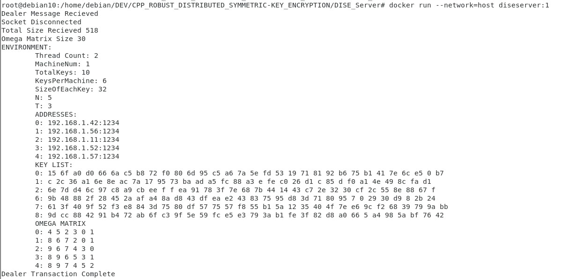
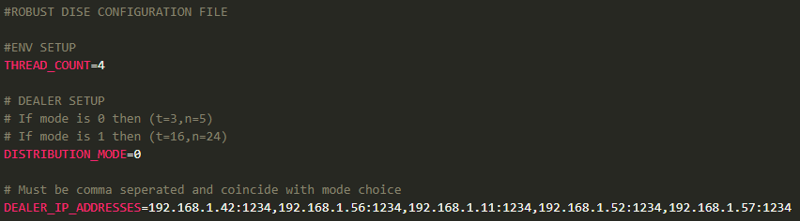
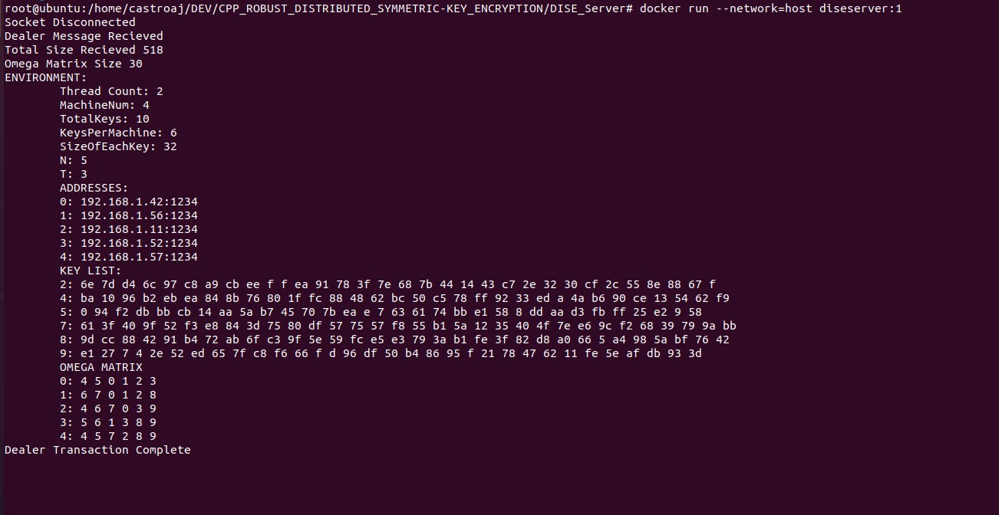
DOCKER Demo of N 5 T 3 - DEAL
Dealer
MACHINE 2- Debian // IP:192.168.1.11:1234
MACHINE 0 - Ubuntu // IP: 192.168.1.42:1234
Dealer Configuration File
MACHINE 3 - Kali // IP: 192.168.1.52:1234
MACHINE 1- Debian // IP: 192.168.1.56:1234
MACHINE 4 - Ubuntu // IP: 192.168.1.57:1234
Notes:
Run once with all honest
then once with a compromised server

Slide 14
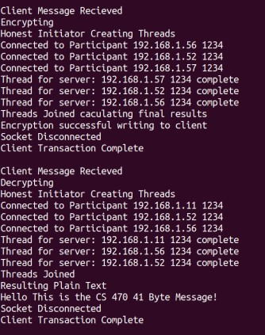
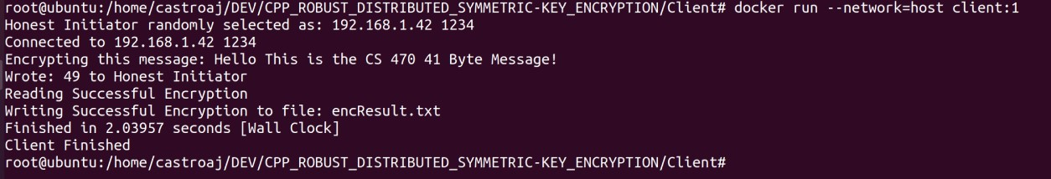
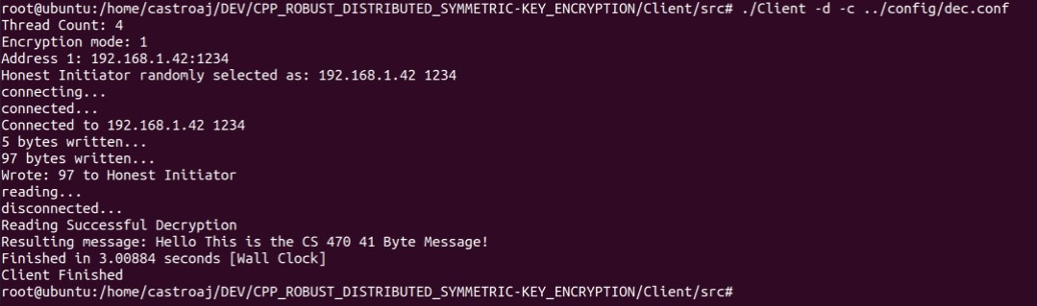
DOCKER Demo of N 5 T 3 - ENC / DEC
Client - Encryption Request
Client - Decryption Request
Honest Initiator
Contacts: 192.168.1.11
192.168.1.52
192.168.1.56

Slide 15
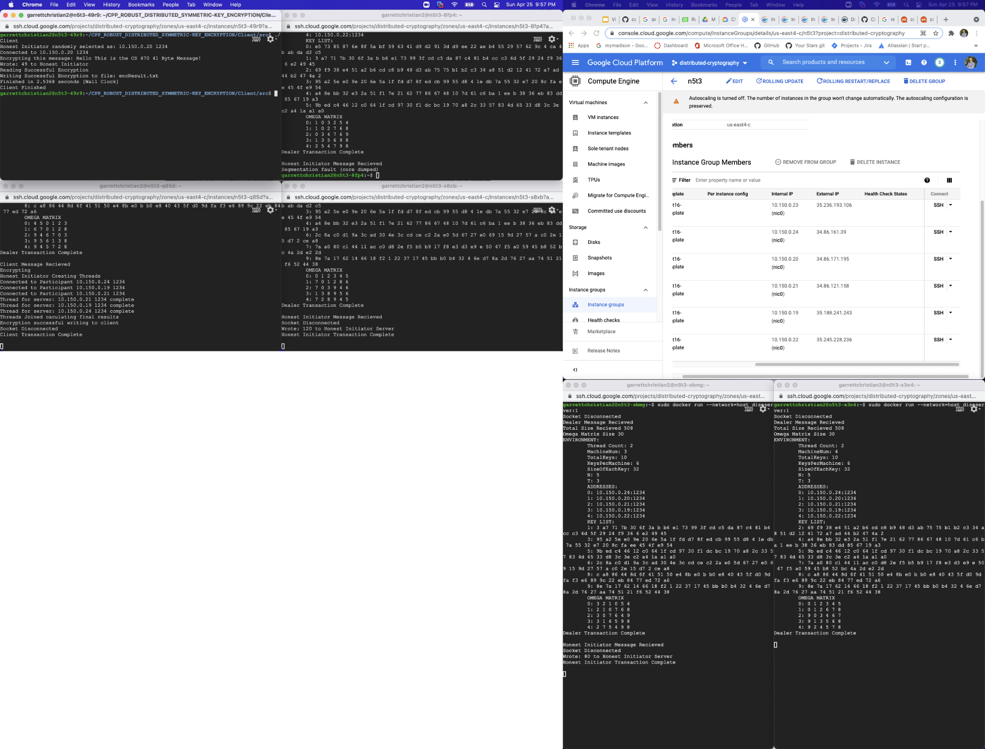
DOCKER Running on Google Cloud

Slide 16
Live Local Host Demo (N=5, T= 3)

Slide 17
Thank You!

