Slide 1
Space Invaders

Slide 2
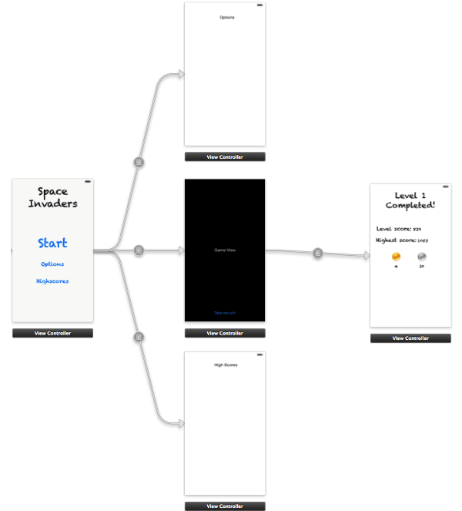
Our Story Board

Slide 3
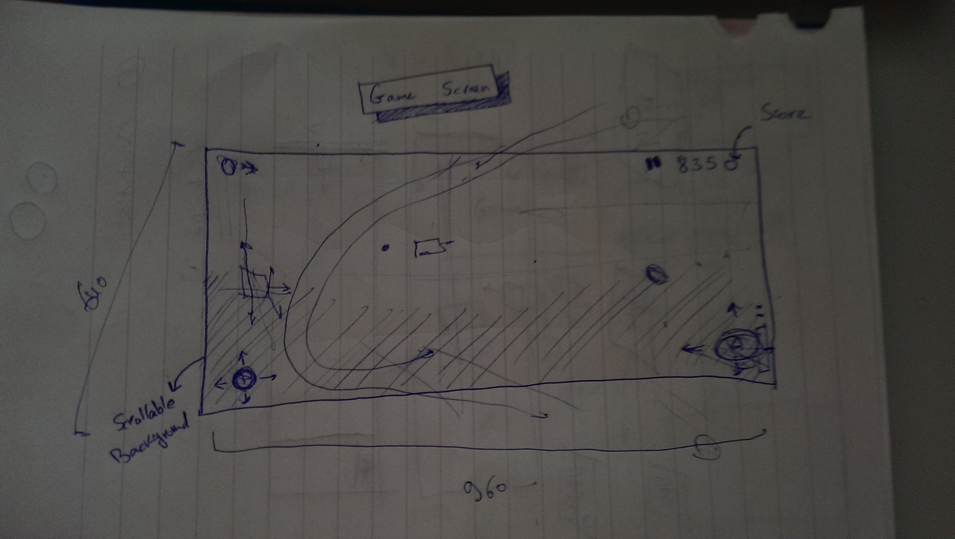
Game View Sketch

Slide 4
Upgrade Ideas
All Upgrades are active for a few amount of seconds after they’ve been activated.
Slow Motion for Every Enemy and (maybe)their bullets
Faster Shooting Mode
All enemies die in one instant
An upgrade to be able to keep shooting non stop.(and hence only move the cannon)

Slide 5
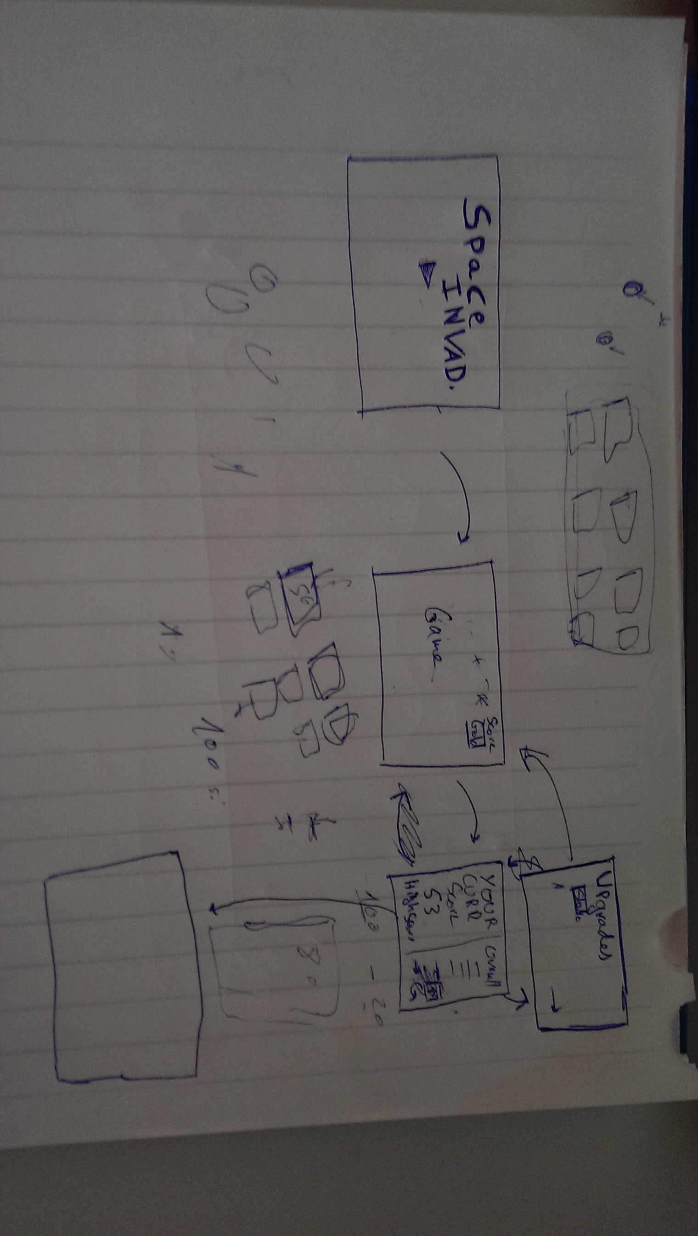
Upgrade View Sketch

