Slide 1

Space Invaders IOS :)
(Yes: The first thing that may change is the name)
Mohamed Emad
Mohamed Edal
Ravi Kanth Kosuru

Slide 2
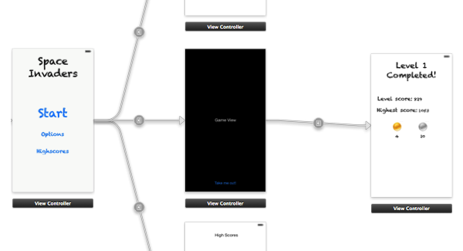
Our Story Board

Slide 3
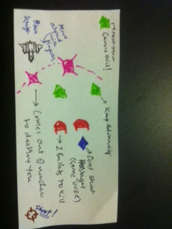
Game View Sketch

Slide 4
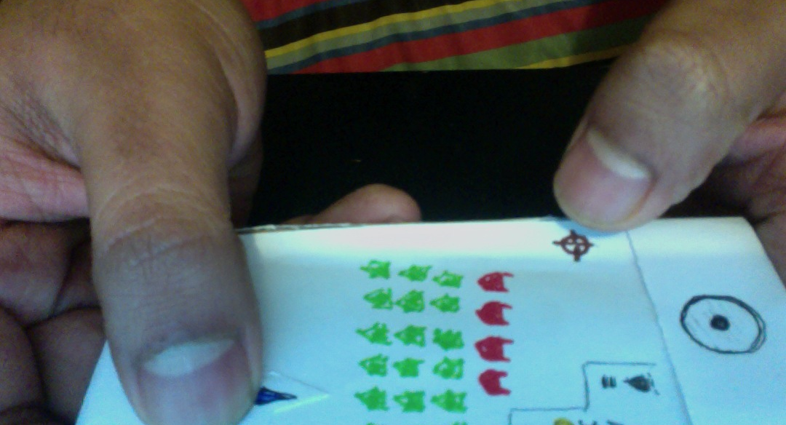
Game Play

Slide 5
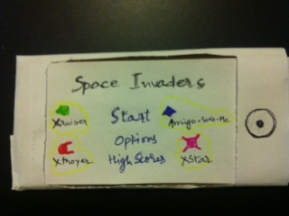
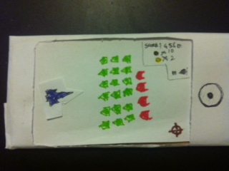
Prototype

Slide 6
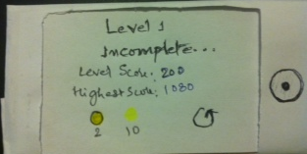
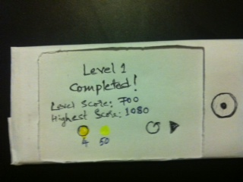

Slide 7
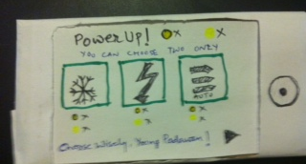
Power UP!

Slide 8
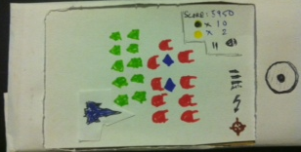
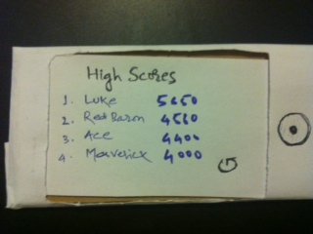

Slide 9
Upgrade Ideas & Upgrade View Sketch
All Upgrades are active for a few amount of seconds after they’ve been activated.
Slow Motion for Every Enemy and (maybe)their bullets
Faster Shooting Mode
All enemies on screen destroyed in an instant
An upgrade to be able to keep shooting non stop.(and hence only move the cannon)

