Slide 1

14/09/2020 Milan
Filippo Maria Casula
Giulia Mura
Enrico Ragusa
Kevin Tranchina
DataScience Lab

Slide 2
Data Description
Pre-processing
Model
Test Prediction
Dataset - structure
TS
VAR_CLASS
USAGE
KIT_ID
AVG_SPEED_DW
NUM_CLI
Time of monitoring Usage
Total traffic KIT in Bit/s, granularity 5 minutes, Downstream.
Kits’ Identification
Average downstream speed of customer attestation to kit
% filling customers kit (compared to total)
VAL = 0 → No disservice
VAL = 1 → Disservice potentially perceived by the customer
VAL = 2 → Disservice

Slide 3
Data Description
Pre-processing
Model
Test Prediction
About training.csv
Sampling period: 01/11/2018 – 30/11/2018
N°of observation: 16 522 034
N°of observation NaN: 0
Total number of Kit_ID : 1977
Number of Kits with disservice : 3
Number of records with var_class= 0 : 16 521 526
Number of records with var_class= 1: 36
Number of records with var_class= 2: 472
AVG_SPEED_DW: constant for a KIT_ID as time changes.

Slide 4
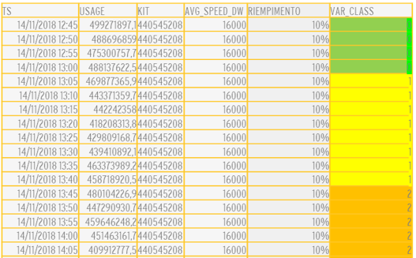
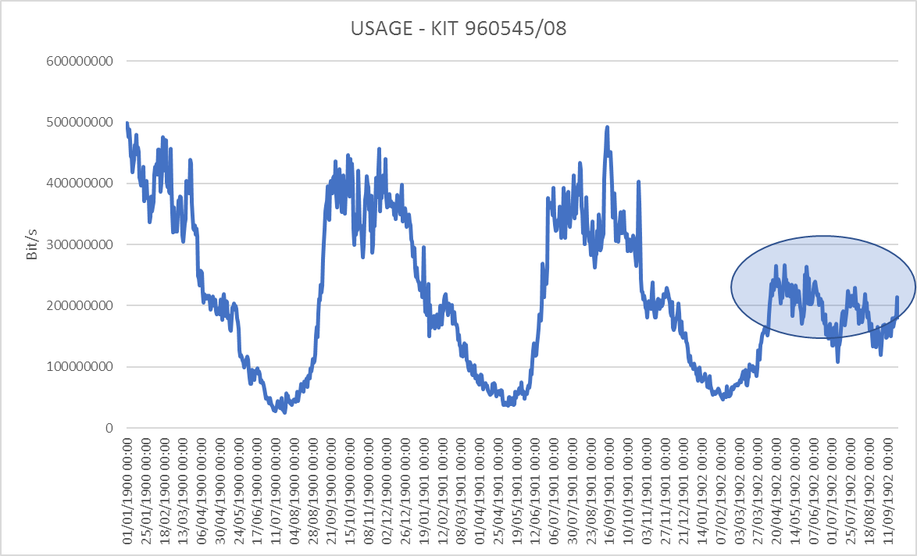
Descrizione Dati
Data Description
Pre-processamento
Pre-processing
Modelli
Model
Predizione Test
Test Prediction
Dataset - Disservice
Disservizio

Slide 5
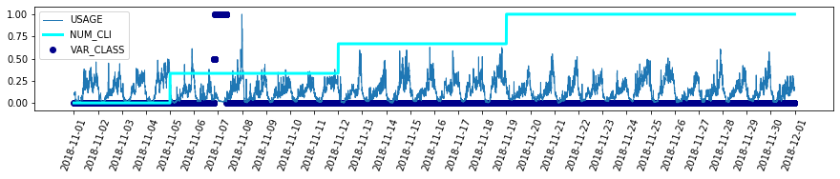
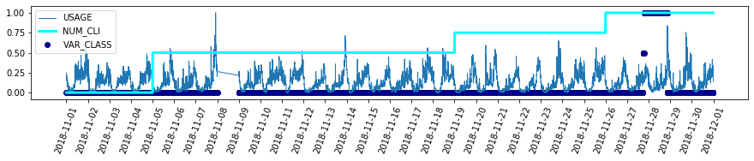
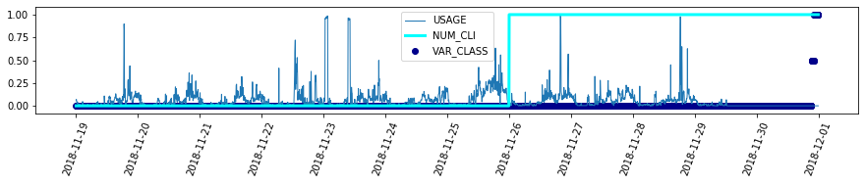
Descrizione Dati
Data Description
Pre-processamento
Pre-processing
Model
Modelli
Test Prediction
Predizione Test
KIT_ID = 3409364152
AVG_SPEED_DW= 85320
KIT_ID = 1629361016
AVG_SPEED_DW= 81270
KIT_ID = 2487219358
AVG_SPEED_DW= 75411

Slide 6

QUESTION
Data Description
Pre-processing
Model
Test Prediction
Are you able to establish an algorithm that intercepts possible problems related to the presence of a fault based on traffic variation, before the reports of customers arrive? The quality of the fault status recognition mechanism shall be assessed and measured against: - the delay in recognising the situation - the probability that the recognised situation is indeed a real problem (minimising false positives) - the percentage of actual recognised failure situations

Slide 7
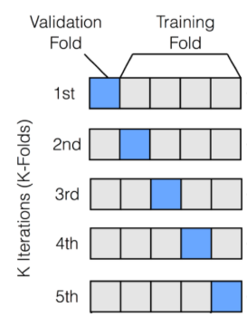
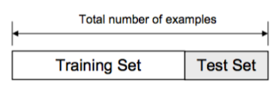
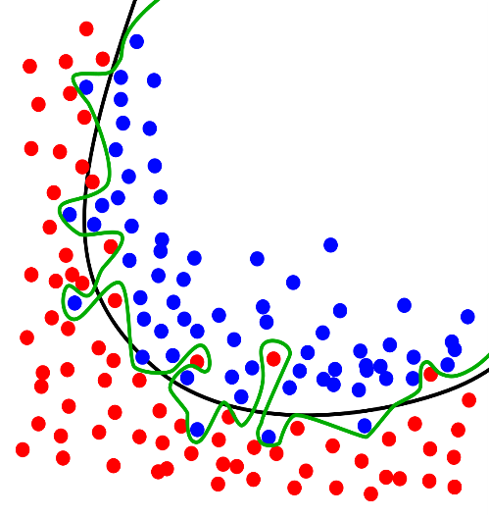


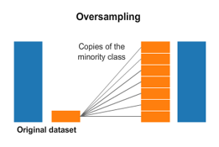
Data flow
Data Description
Pre-processing
Model
Test Prediction
Overfitting
Check
on time interval
Selection and definition Features
Split train/test
Removing outliers
SMOTE
Standardization
Sampling
Notes:
© Copyright PresentationGo.com – The free PowerPoint template library

Slide 8
Data Description
Pre-processing
Model
Test Prediction
Algorithms
Multiclass
Random Forest
Logistic Regression
Binary
Random Forest
ADA Boost

Slide 9
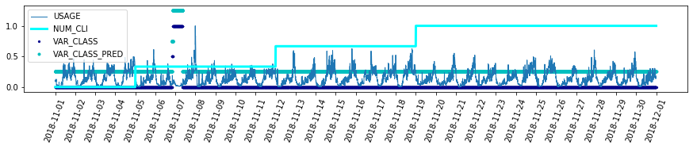
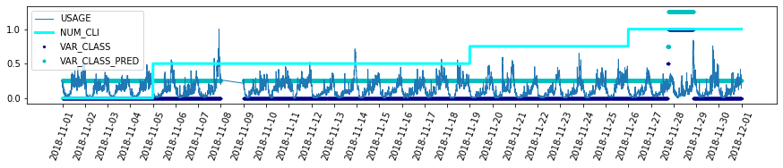
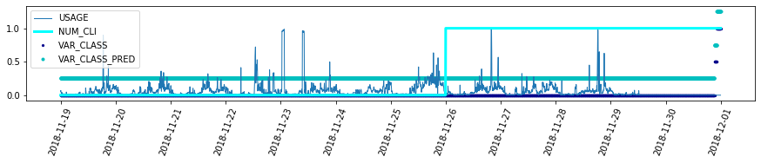
Descrizione ati
Pre-processment
Model
Data Description
Pre-processing
Test Prediction
MUlticlass and binary random forest forecasting
KIT_ID = 3409364152
AVG_SPEED_DW= 85320
KIT_ID = 1629361016
AVG_SPEED_DW= 81270
KIT_ID = 2487219358
AVG_SPEED_DW= 75411
Random Forest_Hold Out

Slide 10


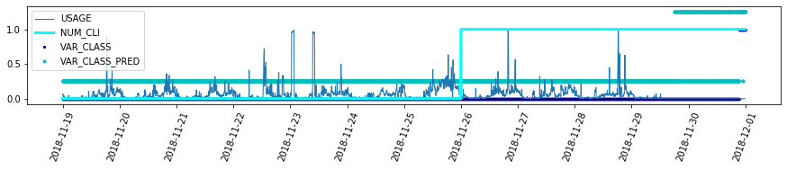
Descrizione ati
Pre-processment
Model
Data Description
Pre-processing
Test Prediction
Binary ada-boost forecasting
KIT_ID = 3409364152
AVG_SPEED_DW= 85320
KIT_ID = 1629361016
AVG_SPEED_DW= 81270
KIT_ID = 2487219358
AVG_SPEED_DW= 75411
Ada-boost Hold-Out

Slide 11
Data Description
Pre-processing
Model
Test Prediction
About Test.csv
Sampling period: 01/02/2019 – 28/02/2019
N° observation: 16 926 846
N° observation NaN: 0
Total number Kit_ID : 2121

Slide 12

Data Description
Pre-processing
Model
Test Prediction
Multiclass Algorithm
Binary Algorithm
Random
Forest
N° Kit_Id predicted with disservice: 2
ADA-Boost
N° Kit_Id predicted with disservice: 5
Random
Forest
N° Kit_Id preditcted with disservice: 2
KIT_ID: 1970831019 - 1824349749
Usage at the moment of prediction:
0 bit/s
KIT_ID: 1970831019, 1824349749 2709380104, 2130171679, 1629361016
Usage at the moment of prediction:
2x10^8 - 0 bit/s

Slide 13


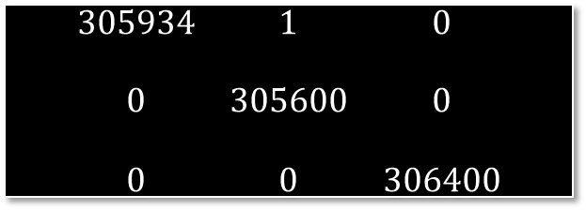
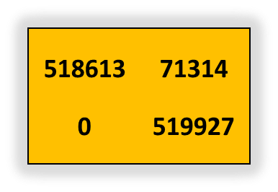
Data Description
Pre-processing
Model
Test Prediction
Summarizing…
Cross Validation
Late on Training
0 Random Forest
Earlier ADA-BOOST
$$\begin{matrix}\begin{aligned}\text{518613} \\ \end{aligned} & \begin{aligned}\text{71}\text{314} \\ \end{aligned} \\ \text{0} & \text{519927}\end{matrix}$$
Multiclass
Confusion Matrix
Binary FP = 1314
Multiclass FP= 1
$$\begin{matrix}\begin{aligned}305934 \\ \end{aligned} & \begin{aligned}1 \\ \end{aligned} & \begin{aligned}0 \\ \end{aligned} \\ 0 & 305600 & 0 \\ \begin{aligned} \\ 0\end{aligned} & \begin{aligned} \\ 0\end{aligned} & \begin{aligned} \\ 306400\end{aligned}\end{matrix}$$

Slide 14
Test Prediction
Descrizione Dati
Pre-processamento
Predizione
Risultati
Data Description
Pre-processing
Model
A proposal for changes
Monitoring of certain kits
Extension of the sampling interval
Cost-Sensitive

Slide 15
THANKS
FOR ATTENTION

