Slide 1
Network programming with Netty

Slide 2

Netty
High performant event-driven framework
TCP, UDP HTTP 1.1, HTTP 2, WebSockets

Slide 3

Faster is better

Slide 4
Disclaimer
Netty is not user-friendly
Writing Java/Scala/Kotlin code as it is in C
Scheduling and executing blocking calls via ExecutorService
Reusing sharable objects

Slide 5
Netty IO tools
Netty uses a single-threaded concurrency model
Non-blocking IO
OS specific transports (EPOLL on Linux x86-64; KQueue on FreeBSD/MacOS x86-64)
Off-heap allocators (pooled/unpooled)

Slide 6
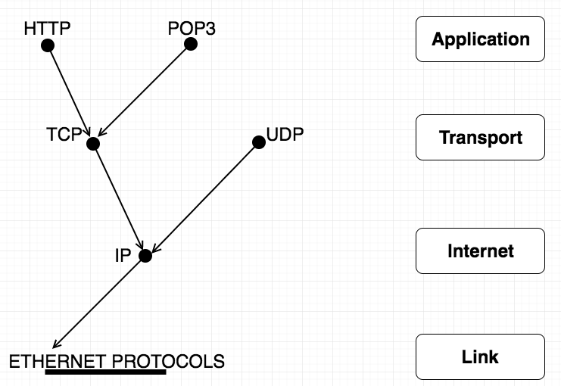
Network

Slide 7
Network: TCP/IP
Structure of a TCP/IP connection and relationships among the protocols, applications, and the sockets API in the hosts and routers, as well as the flow of data from one application to another. The socket is the entity that is placed between the transport layer and the application layer

Slide 8
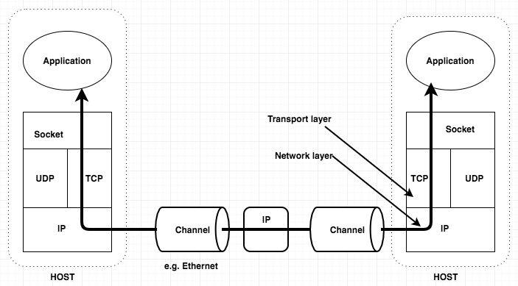
Network

Slide 9
Network socket
A socket is a software object that acts as an end point establishing a bidirectional network communication link between a server-side and a client-side program
In Java, socket classes represent the communication between client and server programs. Socket classes handle client-side communication, and server socket classes handle server-side communication.

Slide 10


Network socket
The client knows the hostname of the machine on which the server is running and the port number on which the server is listening
Server accepts the connection. Upon acceptance, the server gets a new socket bound to the same local port and also has its remote endpoint set to the address and port of the client
On the client side, if the connection is accepted, a socket is successfully created and the client can use the socket to communicate with the server.
A socket is bound to a port number so that the TCP layer can identify the application that data is destined to be sent to

Slide 11
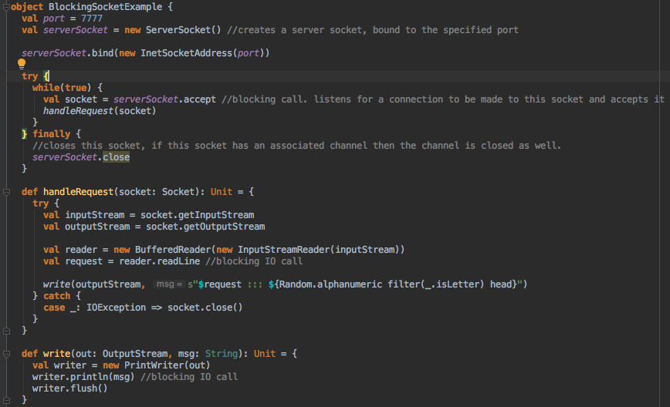

Slide 12
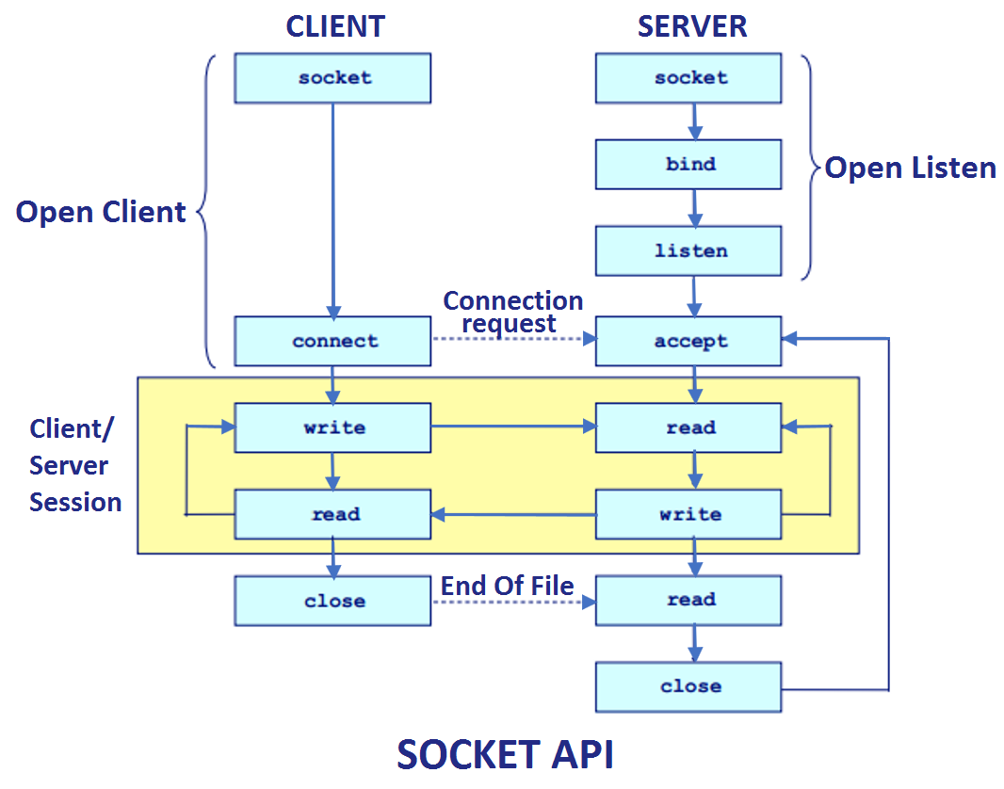
So, what happened?

Slide 13
Sockets: deeper understanding
The steps involved in establishing a socket on the server side: - create a socket with the socket() system call - bind the socket to an address using the bind() system call. For a server socket on the Internet, an address consists of a port number on the host machine. - listen for connections with the listen() system call - accept a connection with the accept() system call. This call typically blocks until a client connects with the server.

Slide 14
Sockets: deeper understanding
Socket types
There are two widely used socket types, stream sockets, and datagram sockets. Stream sockets treat communications as a continuous stream of characters, while datagram sockets have to read entire messages at once. Each uses its own communications protocol. Stream sockets use TCP (Transmission Control Protocol), which is a reliable, stream oriented protocol, and datagram sockets use UDP (Unix Datagram Protocol), which is unreliable and message oriented.

Slide 15
Sockets: deeper understanding
File descriptors
When created new stream IO, Kernel returns to process that created IO stream his file descriptor. A file descriptor is a position in an array of pointers (fd table) and these pointers point to a “file” in memory. The file descriptor (as returned by open() or socket() ) is an index into this table or pointer, these pointer can then point to different structures depending on if it's a file or a socket. Each process has its own fd table. Whenever we create a socket an entry is made in the file descriptor table which contains standard IO and standard errors and other details. The file descriptor acts as a pointer to the File Table which contains information about what action is to be taken i.e read, write, etc

Slide 16
Sockets: deeper understanding
The Kernel have a global data structure, called file table, to store information of file access.
Entry in file table contains: 1) a pointer to in-core inode table 2) the offset of next read/write in the “file” 3) access rights (read/write) allowed to opening process 4) reference count

Slide 17
Sockets: deeper understanding
Сreates an inode for sockets however data is in sockfs filesystem which is a virtual filesystem within Kernel itself, and space is allocated via kmalloc type of function. Thus sockets have inode to have file-like access, but not present on physical filesystem.
Sockets are anonymous files residing in memory

Slide 18
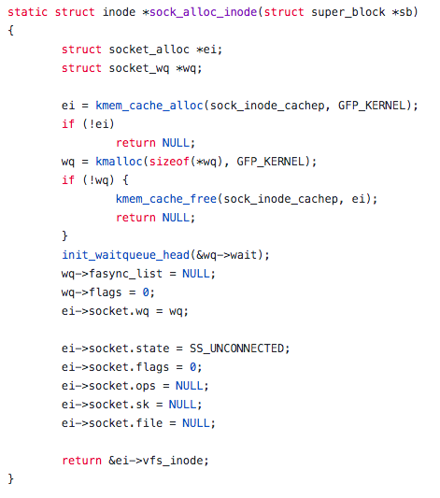

Slide 19
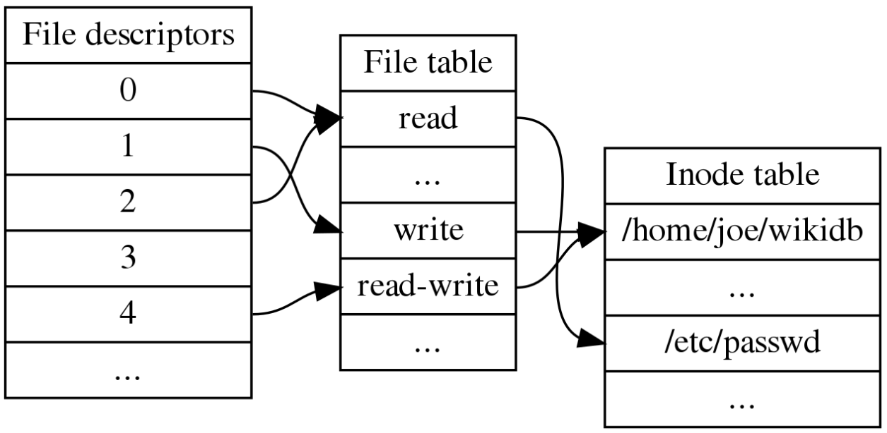
Sockets: deeper understanding

Slide 20
Non-blocking IO
With non-blocking I/O, used a single thread to handle multiple concurrent connections - In NIO based systems, instead of writing data onto output streams and reading data from input streams, we read and write data from buffers. You can think of the buffer as a temporary storage place and there are different types of Java NIO buffer classes (eg: ByteBuffer, CharBuffer , ShortBuffer etc..) available for us to use, even though most network programs use ByteBuffer exclusively. - Channel is the medium that transports bulk of data into and out of buffers and it can be viewed as an endpoint for communication. (for example if we take SocketChannel class, it reads from and writes to TCP sockets. But the data must be encoded in ByteBuffer objects for reading and writing.) - сoncept called Readiness Selection which basically means “the ability to choose a socket that will not block when data is read or written”

Slide 21
Non-blocking IO
Selector Java NIO has a class called Selector that allows a single thread to examine I/O events on multiple channels. That is, this selector can check the readiness of a Channel for operations, such as reading/writing. Different channels can be registered with a Selector object and you can specify which operations you are interested in observing and each of these channels are assigned a separate SelectionKey which serve as a pointer to a Channel.

Slide 22
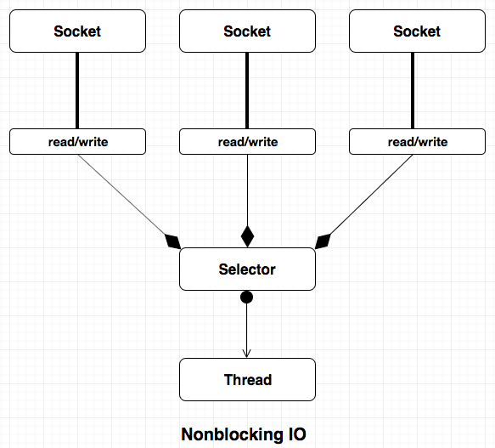

Slide 23
NIO TCP server
- create a Selector to handle multiple Channels and more importantly they allow the server to find all the connections that are ready to receive output or send input. - ServerSocketChannel class is wholly responsible for accepting new incoming connections - then bind the server socket channel to a particular host and a port - register this server socket channel with the selector and the SelectionKey.OP_ACCEPT parameter tells the Selector to listen to only incoming connections. Basically the second parameter tells what events we are interested in listening for in the monitored channel. OP_ACCEPT tells that the server socket channel is ready to accept a new connection from a client - Selector’s select() method checks whether there’s anything ready to be acted on. Calling this inside an infinite loop to wait infinitely for new activity. - once the Selector finds a ready channel, selectedKeys() method returns a Set<SelectedKeys>: each representing a ready Channel and we can loop through each Channel and perform the necessary operations

Slide 24
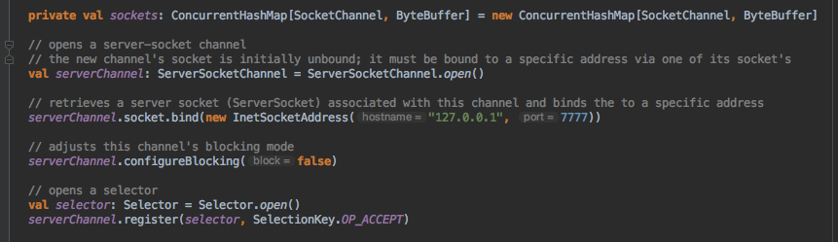
NIO TCP server

Slide 25
NIO TCP server
- only one thread, the main thread, processes multiple simultaneous connections. - when we get a channel, we can handle the operational logic. The Channel represented by SelectionKey can either be server socket informing that a new connection has been made or a client socket that is ready to read or write data onto the Channel - if key is acceptable that means client requires a connection - if key is readable that means server is ready to read data from client - if key is writable that means server is ready to write data to client

Slide 26
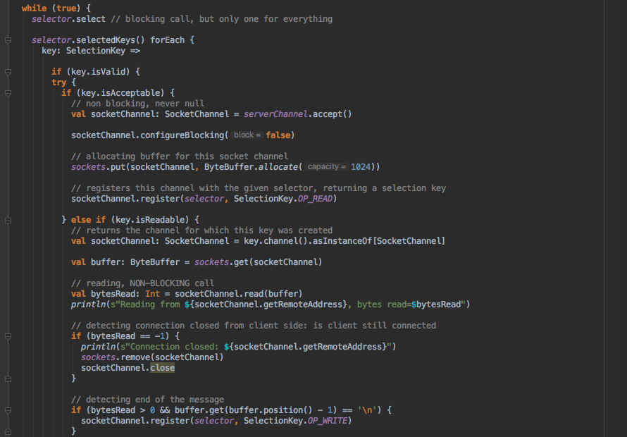

Slide 27
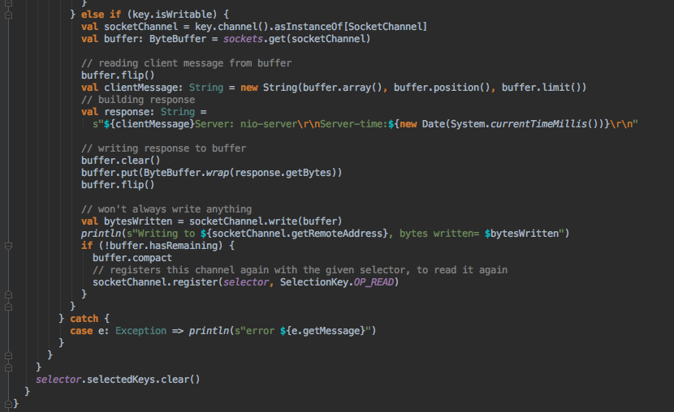

Slide 28
Netty
Netty is a non-blocking I/O client-server framework for the development of Java network applications such as protocol servers and clients. The asynchronous event-driven network application framework and tools are used to simplify network programming such as TCP and UDP socket servers. Netty includes an implementation of the reactor pattern of programming

Slide 29
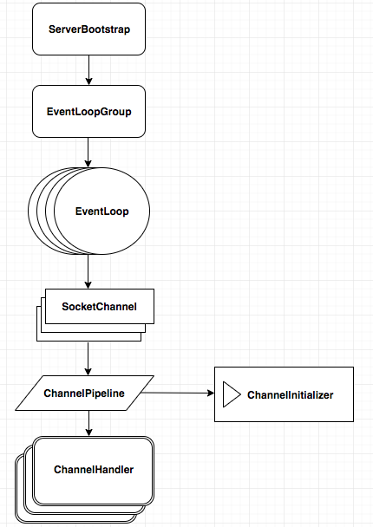

Slide 30
Netty: overview
ServerBootsrap - bootstraps a server: starting threads, opening sockets
EventLoopGroup - group of EventLoop's. Multiple EventLoop's can be grouped together. EventLoop shares some resources like threads. Allows registering Channels that get processed for later selection during the event loop
EventLoop - is a loop that keeps looking for new events, e.g. incoming data from network sockets (from SocketChannel). When an event occurs, the event is passed on to the appropriate event handler, for instance a ChannelHandler. EventLoop is always executed by the same thread
SocketChannel - represents a TCP connection to another computer over a network. Managed by an EventLoop, and always only by that same EventLoop, a SocketChannel instance is also only accessed by the same thread

Slide 31
Netty: overview
ChannelInitializer - is a special ChannelHandler which is attached to the ChannelPipeline of a SocketChannel when the SocketChannel is created. Easy way to initialize a Channel once it was registered to its EventLoop. The ChannelInitializer is then called so it can initialize the SocketChannel. After initializing the SocketChannel the ChannelInitializer removes itself from the ChannelPipeline.
ChannelPipeline - each SocketChannel has a ChannelPipeline. The ChannelPipeline contains a list of ChannelHandler instances. When the EventLoop reads data from a SocketChannel the data is passed to the first ChannelHandler in the ChannelPipeline. The first ChannelHandler processes the data and can choose to forward it to the next ChannelHandler in the ChannelPipeline, which then also processes the data and can choose to forward it to the next ChannelHandler in the ChannelPipeline etc.
ChannelHandler - handles the data that is received from a SocketChannel. A ChannelHandler can also handle data that is being written out to a SocketChannel; handles an I/O event or intercepts an I/O operation, and forwards it to its next handler in its ChannelPipeline.

Slide 32
Netty: memory management
Netty uses the idea of ​​jemalloc, which is a concurrent malloc algorithm implemented by FreeBSD. Jemalloc relies on multiple Arenas to allocate memory. There are a fixed number of multiple instances in the running application. The default number is related to the number of processors. The reason for having multiple Arenas in the system is that competition is inevitable due to memory allocation by each thread, which may greatly affect the efficiency of memory allocation. To alleviate thread competition during high concurrency, Netty allows users to create multiple allocators. (Arena) to separate locks and improve memory allocation efficiency. Each thread saves Arena and cache pool information, which reduces competition and improves access efficiency. Arena divides memory into a number of Chunks for management Pool Area of Netty Memory Pool Keywords: Programming less Netty Attribute REST Pool Area is a core container in Netty memory pool. Its main function is to manage a series of Pool Chunks and Pool Subpages created DirectArena and HeapArena are two specific implementations of PoolArena to manage different types of memory applications and releases, and the main memory processing work is in PoolArena

Slide 33
Netty IO EventLoop
Netty's IO thread (EventLoop) can handle thousand of client connections concurrently due to the aggregation of the selector. When a thread reads and writes data from a client socket channel, the thread can perform other tasks if no data is available. Threads typically use non-blocking IO idle time to perform IO operations on other channels, so a single thread can manage multiple input and output channels.
An I/O thread can concurrently process N client connections and read/write operations

Slide 34
Netty: Inbound/Outbound handlers
As we work with the network protocol, we need to perform data serialization and deserialization. For this purpose, Netty introduces special extensions of the ChannelInboundHandler for decoders which are capable of decoding incoming data. The base class of most decoders is ByteToMessageDecoder. For encoding outgoing data, Netty has extensions of the ChannelOutboundHandler called encoders. MessageToByteEncoder is the base for most encoder implementations. We can convert the message from byte sequence to Java object and vice versa with encoders and decoders.

Slide 35
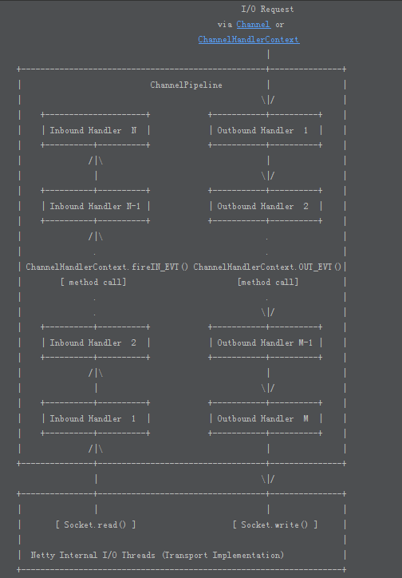
Netty: Inbound/Outbound handlers

Slide 36
Netty HTTP server
Let’s write Netty HTTP server

Slide 37
Netty HTTP server
The basic process is as follows: - create two EventLoopGroups, where bossGroup is used for accept connection establishment events and distribution requests, workerGroup is used to handle I/O read and write events and business logic - based on ServerBootstrap, configure EventLoopGroup, Channel type, connection parameters, configure inbound/outbound event handler - bind the port and start working

Slide 38
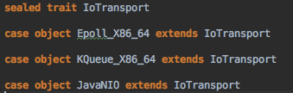
Netty: show me the code
So, lets write some code Here is algebra for IO transport

Slide 39
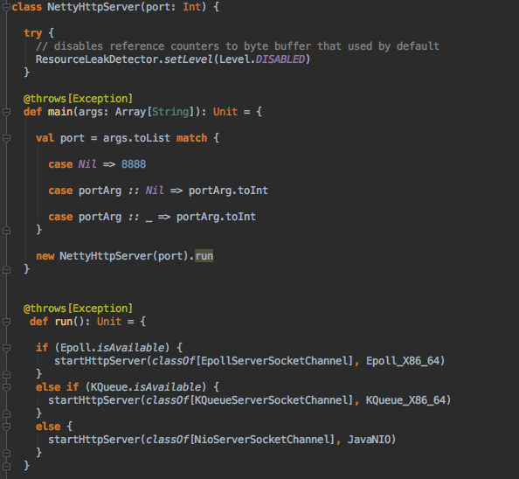
Netty: show me the code

Slide 40
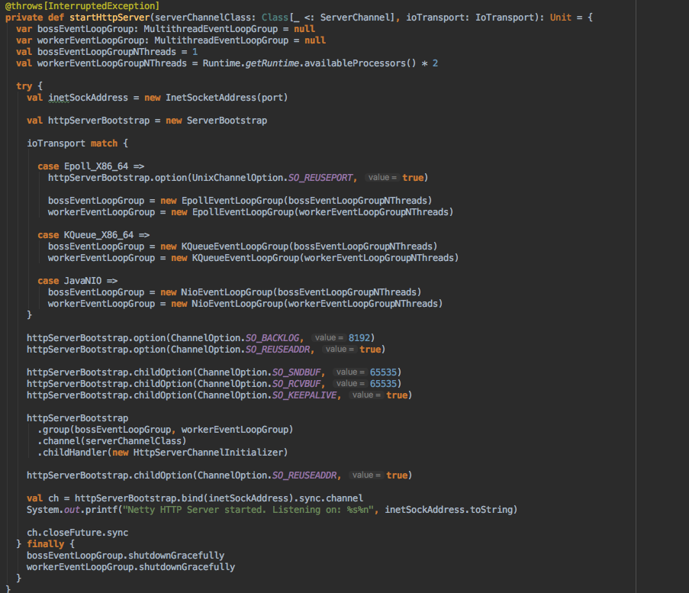
Netty: show me the code

Slide 41
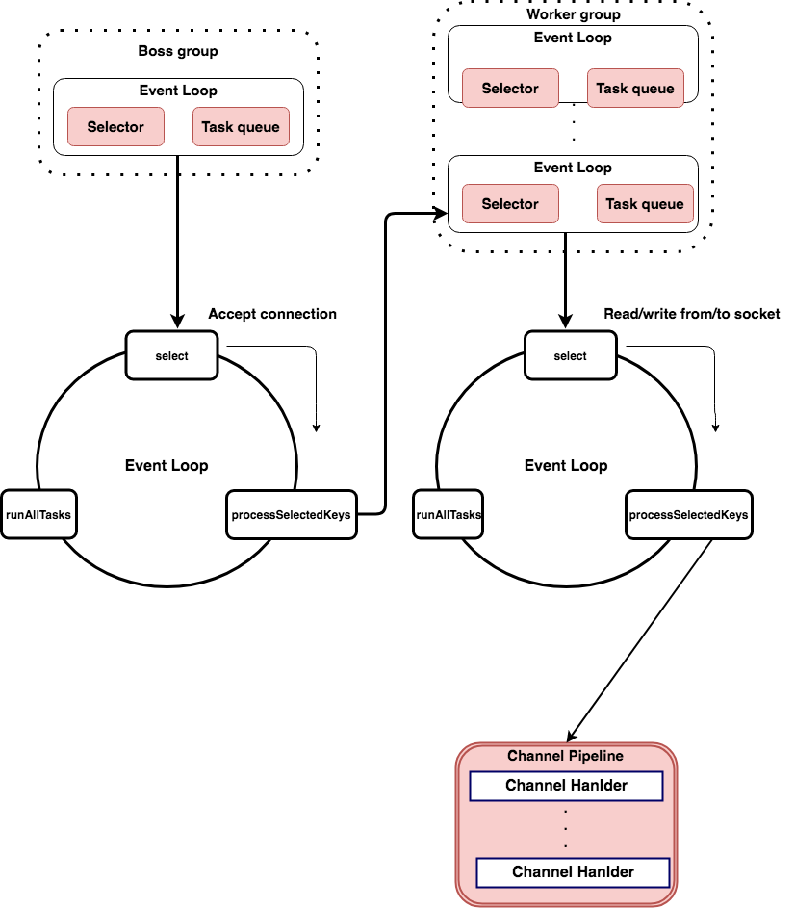

Slide 42
Server contains 1 boss EventLoopGroup and n core * 2 worker EventLoopGroup. This group contains multiple EventLoop. Each EventLoop contains 1 selector and 1 event loop thread Boss EventLoop loop performs three steps: - polling accept event - handle the accept I/O event, establish a connection with the client, generate a SocketChannel, and register the SocketChannel to the Selector of a worker EventLoop. - process the task in the task queue, runAllTasks. Tasks in the task queue include tasks that the user invokes EventLoop execute or schedule, or tasks that other threads submit to the event loop.

Slide 43
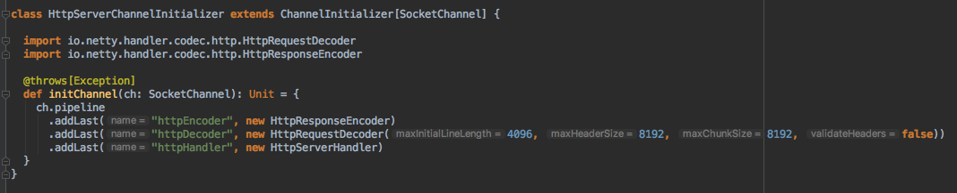
Netty: show me the code
The handler specified here will always be evaluated by a newly accepted Channel. The ChannelInitializer is a special handler that is purposed to help a user configure a new Channel

Slide 44
Worker Group actions: The task performed by each worker EventLoop loop consists of 3 steps: - polling read/write events - I/O events, i.e. read/write events, processed when SocketChannel is readable and writable events occur - process the tasks in the task queue, runAllTasks.

Slide 45
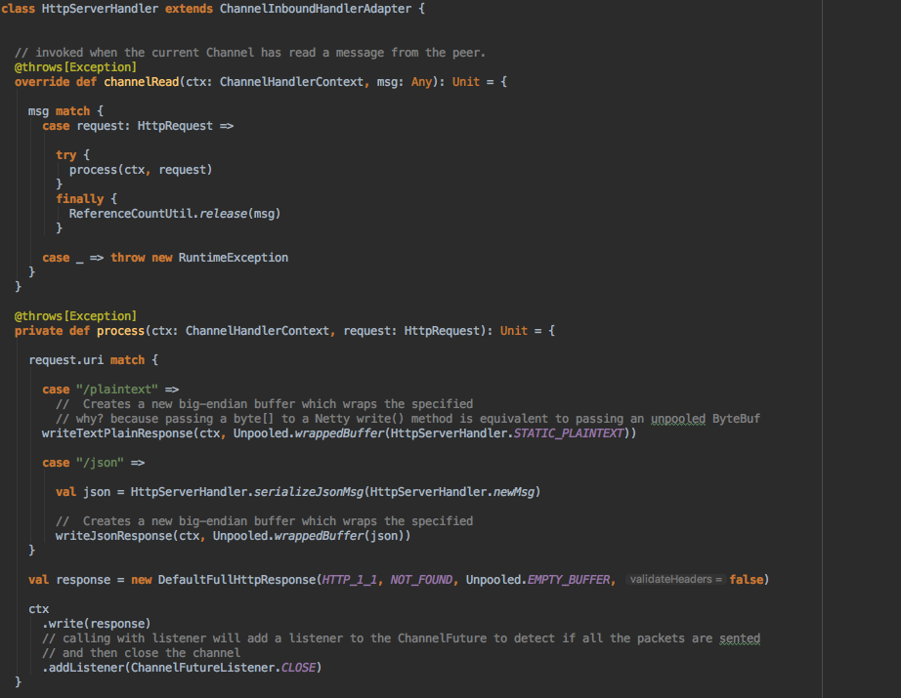

Slide 46
Netty: ChannelHandlerContext
All context information related to the Channel, and associate a ChannelHandler object Each channel in Netty has one and only one ChannelPipeline corresponding to it A Channel contains a ChannelPipeline, and ChannelPipeline maintains a doubly linked list of ChannelHandlerContext, and each ChannelHandlerContext is associated with a ChannelHandler. Inbound and outbound events are in a doubly linked list. Inbound events are passed from the linked list head to the last inbound handler. The outbound event is passed from the linked list tail to the first outbound handler. Kinds of handlers do not interfere with each other

Slide 47
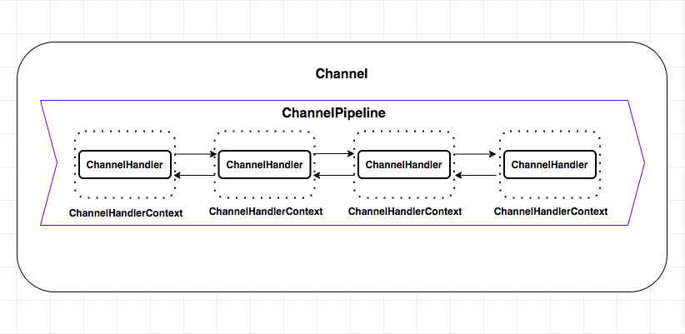
Netty: ChannelHandlerContext

Slide 48
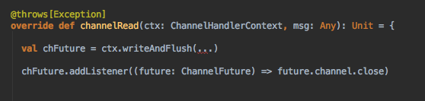
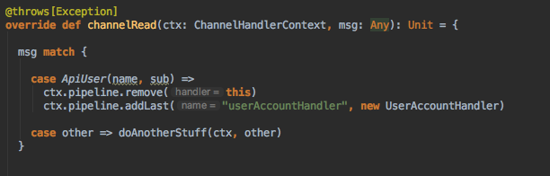
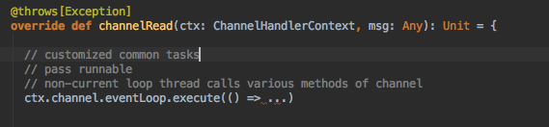
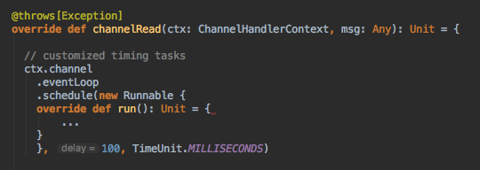
Netty: ChannelHandlerContext

Slide 49
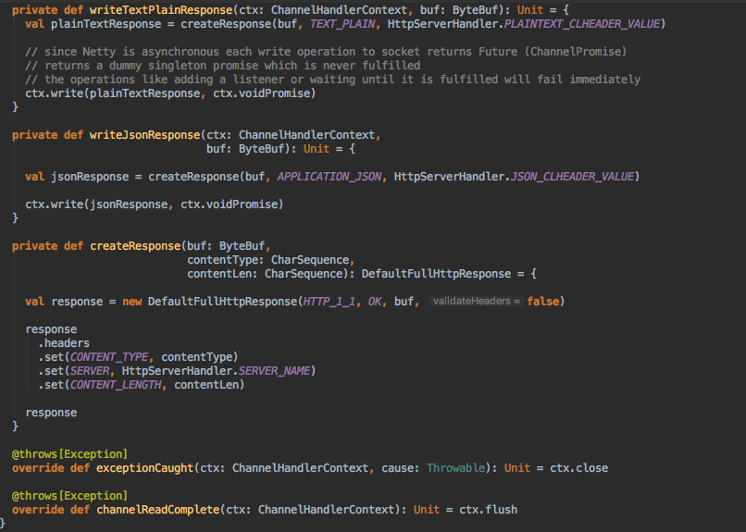

Slide 50
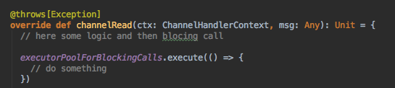
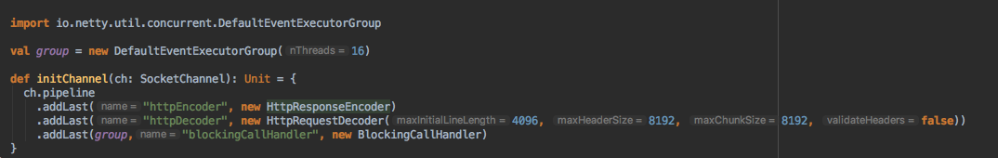
Netty: blocking calls
Golden rule: don’t block EventLoop

Slide 51
Netty: OS specific transport
Netty provides the following platform specific JNI transports: - Linux - MacOS/BSD These JNI transports add features specific to a particular platform, generate less garbage, and generally improve performance when compared to the NIO based transport

Slide 52
Netty: OS specific transport (Linux)
epoll is a Linux kernel system call for a scalable I/O event notification mechanism epoll can process big count of simultaneously opened connections with complexity O(1), because epoll returns that file descriptors, that need an attention (READ/WRITE)
epoll API - epoll_create() — creates data structure(epoll instance). It’s a singleton for all file descriptors that listening. - epoll_ctl() — used for managing poll instance: EPOLL_CTL_ADD (add file descriptor to listening), EPOLL_CTL_MOD (modifying listening parameters) -epoll_wait() — returns count (one or more) file descriptors from listeners, that has changed: ready for I/O EPOLLINN - new data (for reading) in file descriptor EPOLLOUT - file descriptor is ready for receiving data (for writing) EPOLLHUP - closing file descriptor

Slide 53
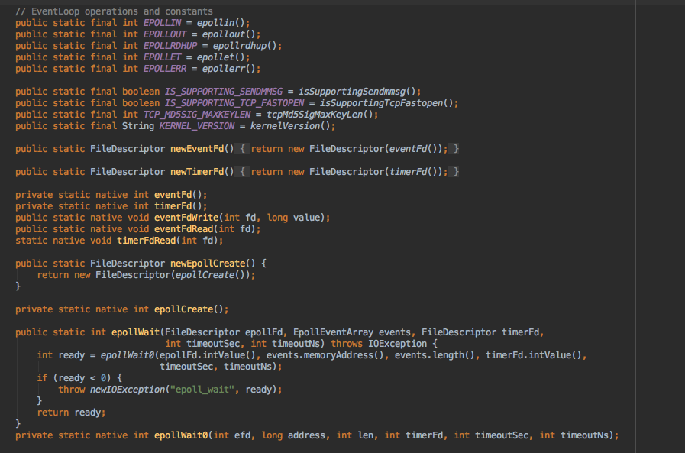
Netty EpollEventLoop

Slide 54
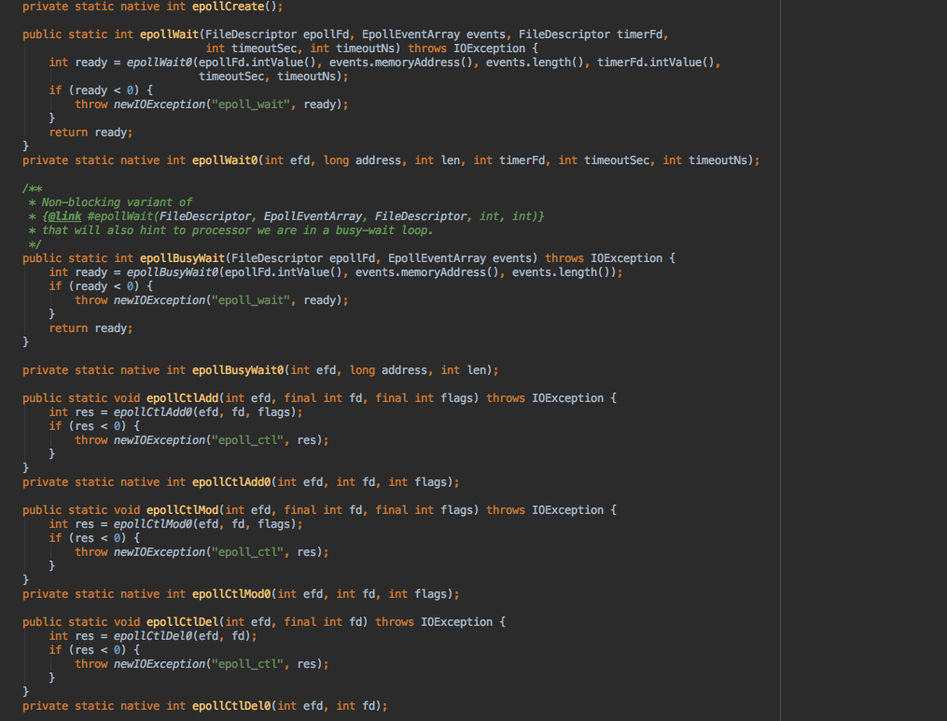
Netty EpollEventLoop

Slide 55
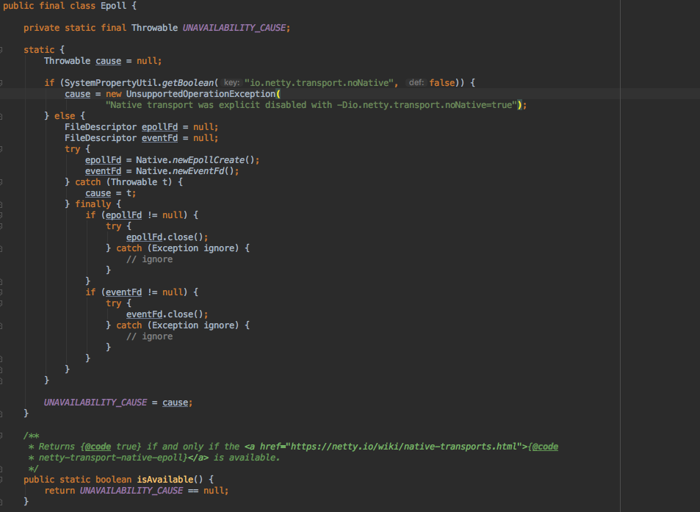
Netty Epoll

Slide 56
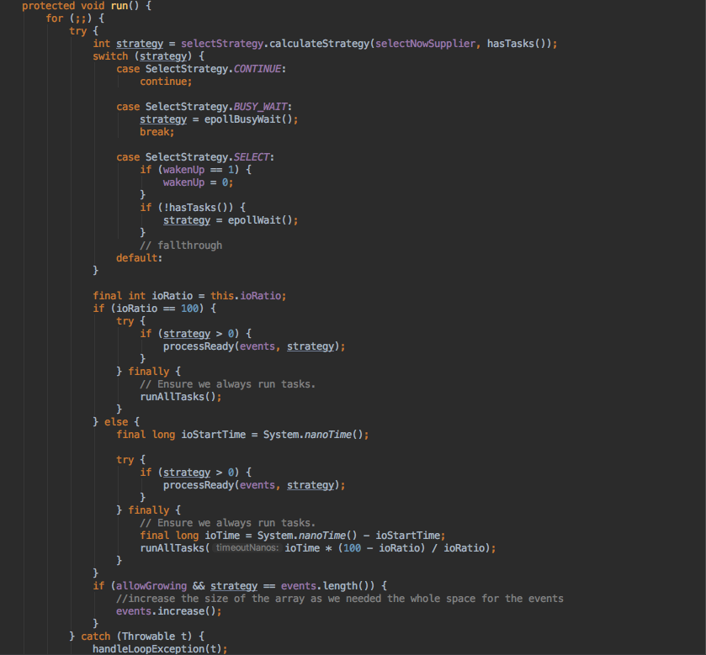
Netty EpollEventLoop run() method

Slide 57
Netty: OS specific transport (FreeBSD/MacOS)
KQueue also supports multiple contexts for each process. kqueue() performs the same thing as epoll_create(). However, the kevent() call integrates the role of epoll_ctl() (adjusting the interest set) and epoll_wait() (retrieving the events) with kevent() While the details of those fields are beyond the scope of this article, you may have noticed that there is no explicit file descriptor field. This is because KQueue is not designed as a mere replacement of select()/poll() for socket event multiplexing, but as a general mechanism for various types of operating system events. The filter field specifies the type of kernel event. If it is either EVFILT_READ or EVFILT_WRITE, kqueue works similar to epoll. In this case, the ident field represents a file descriptor. The ident field may represent other types of identifiers, such as process ID and signal number, depending on the filter type

Slide 58
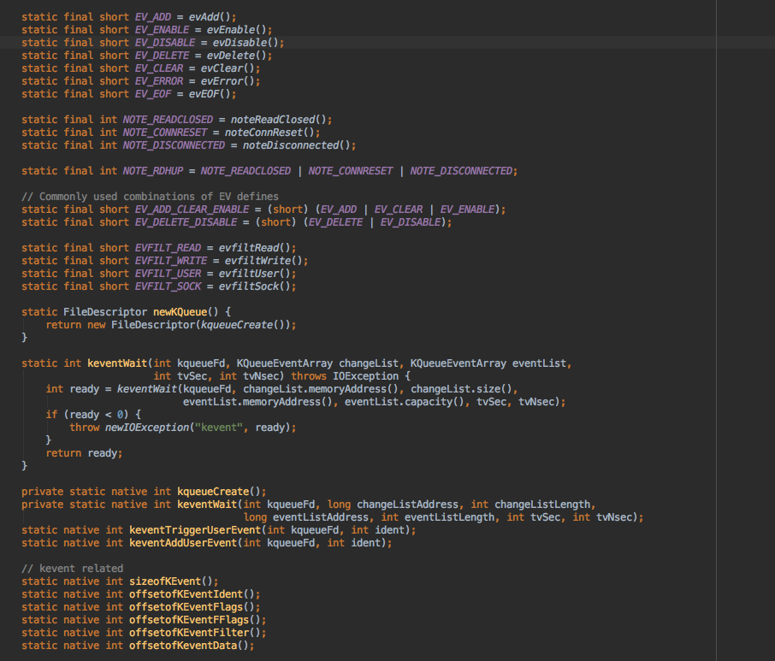
Netty KQueueEventLoop

Slide 59
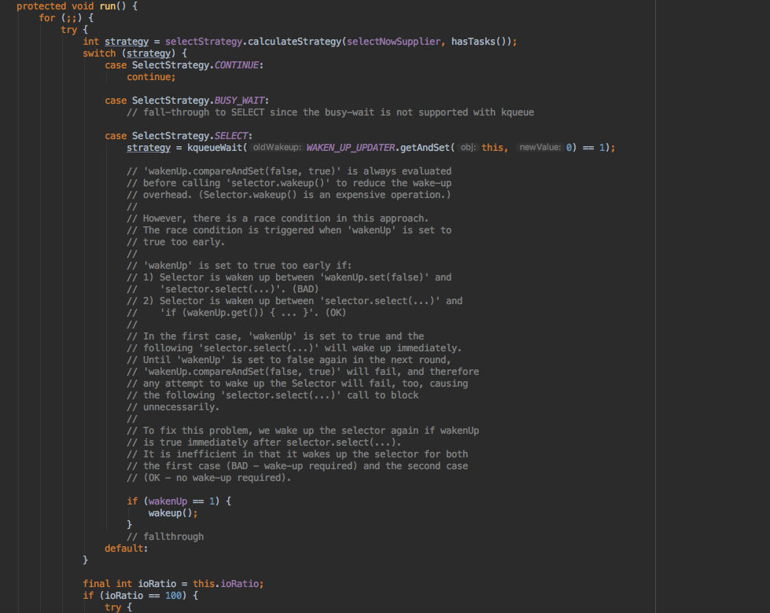
Netty KQueueEventLoop run() method

Slide 60
Netty: OS specific transport (FreeBSD/MacOS)
struct kevent { uintptr_t ident; /* identifier for this event */ int16_t filter; /* filter for event */ uint16_t flags; /* general flags */ uint32_t fflags; /* filter-specific flags */ intptr_t data; /* filter-specific data */ void *udata; /* opaque user data identifier */ }; int kqueue(void); int kevent(int kq, const struct kevent *changelist, int nchanges, struct kevent *eventlist, int nevents, const struct timespec *timeout); In kqueue, the versatile struct kevent structure supports various non-file events. For example, your application can get a notification when a child process exits (with filter = EVFILT_PROC, ident = pid, and fflags = NOTE_EXIT). Even if some resources or event types are not supported by the current kernel version, those are extended in a future kernel version, without any change in the API

Slide 61

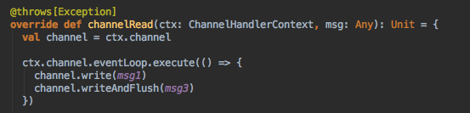
Netty: best practices
Fast search of pattern
Only use heap buffers if need to operate on byte[] in ChannelOutboundHandler
Always combine operations if possible when act on the Channel from outside the EventLoop to reduce overhead of wakeups and object creation!

Slide 62
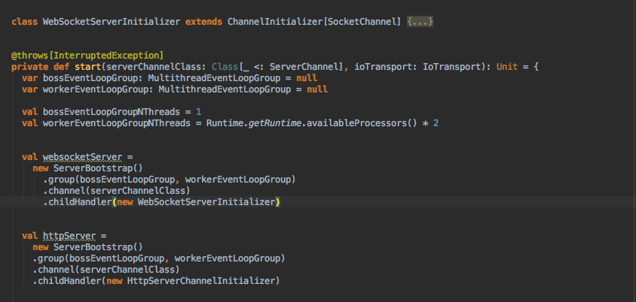
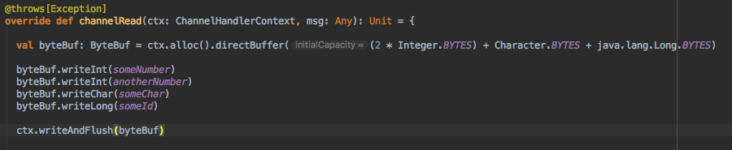
Netty: best practices
Reuse EventLoop
Off-heap messages

Slide 63

Based on Netty frameworks
You can use Vert.x with multiple languages including Java, JavaScript, Groovy, Ruby, Ceylon, Scala and Kotlin. Vert.x doesn't preach about what language is best — you choose the languages you want based on the task at hand and the skill-set of your team. We provide idiomatic APIs for every language that Vert.x supports.
Reactive web development with Vert.x-WEB, asynchronous DB client (MySQL, PostgreSQL), reactive Kafka client, asynchronous RabbitMQ (AMQP) client, Vert.x Reactive Streams

Slide 64
Thank you!

