Slide 1
Data Warehouse, Business Intelligence and Advanced Data Analytics of Reddit Sentiment and Securities Price Movement
Reddit community sentiment against hourly prices of 34 assets, from one warehouse to one dashboard.
Rithipong Leanghirunkun
Chulalongkorn University · MSc Information Technology in Business
Historical data, Oct 2024 to Aug 2026. Not real-time. Not investment advice.

Slide 2
AGENDA
Seven parts, one story.
1
The pain point
5
A user story
Why a single view is missing
One asset, BTC-USD, page by page
2
The users
6
Executive questions
Who uses it, and for what
Every question, answered, with its page
3
The architecture
7
QA
Data flow, tools and models
Tests, limits, questions
4
The six systems
What each one does, and the dashboards

Slide 3
1 PAIN POINT
Analysts have no single place to see Reddit sentiment next to prices.
No organised data
Limited analysis
Scattered data
No signal detection
Analysts follow Reddit by hand.
Data is scattered and not ready to use with prices.
Text is not turned into numbers.
No sentiment score, volume or positive and negative share.
Prices and sentiment sit apart.
No single source of truth, no single dashboard.
Nothing flags unusual volume.
Nothing flags a clear sentiment shift.

Slide 4
1 PAIN POINT
The project answers with six goals.
1
Collect and process Reddit data
Historical posts and comments from six communities, in one warehouse.
2
Score sentiment
VADER and FinBERT on every text, with a rule to settle conflicts.
3
One BI dashboard
Price, volume, Reddit volume and sentiment side by side.
4
Test the link to future returns
Correlation, historical win rate and logistic regression.
5
Detect signals
Flag unusual volume and clear sentiment in historical data.
6
Judge the evidence
Compare Reddit indicators against a random baseline.

Slide 5
2 USERS
The users: the investment analyst team of a FinTech trading platform.
Gauge attention
Follow prices
Investment
analyst team
Which assets are mentioned most, and when volume is unusually high.
Price, trading volume and future returns of each asset.
Check relationships
Find hours to review
Whether sentiment relates to future returns, as extra data for reading the market.
Signals at thresholds the analyst sets, as a start for deeper checks.

Slide 6
2 USERS
What the team gets out of it.
1
Saves time, reduces bias
Large, unstructured community text becomes numbers instead of being read by hand.
2
One source of truth
Prices, Reddit sentiment and statistics sit in one system.
3
Evidence from history
Relationships, direction accuracy and several data conditions are compared.
4
A start for deeper checks
Signals point to hours, assets or groups worth analysing next.
5
Room to grow
The design can extend to other sources, such as Twitter/X, or other assets.

Slide 7
3 ARCHITECTURE
Data flow: two sources, one SQLite database, one dashboard.
Academic Torrents
Import
SQLite
Processing
Dashboard
Historical Reddit
posts and comments
Monthly files,
6 communities
Single source of truth
Clean text
Transform
Align to the hour
Sentiment
Relationships
Signals
Streamlit
Home + 7 pages
All six systems read and write here, so no data is duplicated between them.
yfinance
Import
Hourly prices
34 assets
Price download
1 Reddit warehouse
2 Price warehouse
3 Sentiment analysis
4 Relationship analysis
5 Investment analysis
6 Signal detection
Every step is a Python script that can be re-run. The raw data is never edited.

Slide 8
3 ARCHITECTURE
Tools: Python end to end, on one Windows PC.
Job | Tools
Language and editor | Python 3.14, Visual Studio Code
Store | SQLite (one database file)
Import | zstandard (Reddit files), yfinance (prices)
Manage and compute data | pandas, NumPy
Sentiment | NLTK 3.10.3 (VADER), PyTorch 2.11.0 with CUDA 12.8, Transformers 5.19.0 (FinBERT)
Statistics and machine learning | SciPy 1.18.1, scikit-learn 1.9.1
Display | Streamlit 1.65.0, Matplotlib 3.11.2, Seaborn 0.13.2
Machine | Windows 11, NVIDIA RTX 5070 (12 GB), 32 GB RAM

Slide 9
3 ARCHITECTURE
Models: two for sentiment, one for relationships.
VADER
FinBERT
Logistic regression
Rule-based, built for social media.
Reads symbols such as $, % and !.
Score from −1 to +1.
Language model trained on financial text (ProsusAI/finbert).
Score = P(positive) − P(negative), from −1 to +1.
scikit-learn.
Predicts up or down of the future return.
Judged by AUC-ROC, 5 time-ordered folds.
How the two sentiment models are joined
A neutral band of ±0.05 turns scores into positive, neutral or negative. A merge rule settles conflicts and records which rule decided.

Slide 10
3 ARCHITECTURE
Star schema with 3 fact tables and 6 dimensions.
Reddit volume and ticker mention counts.
DimTime, DimTicker, DimSource.
FactRedditVolume
Dimensions
618,518 rows
DimTime. 17,544 hours.
DimTicker. 34 assets, by asset group.
DimSource. 12 sources: 6 communities by post or comment.
DimSentimentSource. 7 sources: 6 communities plus all combined.
DimMajoritySentiment. 3 classes: positive, negative, neutral.
DimDetectionConfig. 30 signal settings.
Close, volume, future returns 1 to 12 hours, RSI, ATR.
DimTime, DimTicker.
FactMarketPrice
250,253 rows
Sentiment, class shares, win rate, p-values.
DimTime, DimTicker, DimSentimentSource, DimDetectionConfig, DimMajoritySentiment.
FactMarketSentiment
250,253 rows

Slide 11
3 ARCHITECTURE
Built in seven steps, each one a numbered Python script.
1
Install the software
Python, libraries, GPU for FinBERT.
2
Import the data
Monthly Reddit files for 6 communities; hourly prices for 34 assets.
3
Build the warehouse
Fact and dimension tables, with the 34 assets loaded.
4
Clean text, extract tickers
Cleaned text, quality filter, ticker mentions.
5
Score sentiment
VADER and FinBERT, merge rule, hand-labelled check.
6
Analyse and detect
Hourly dataset, 9 panels, statistics, signals.
7
Dashboard and tests
Streamlit dashboard, then three groups of tests.

Slide 12
4 SIX SYSTEMS
Six systems, from raw data to signals.
System | Takes in | Produces | Shown on
1 Reddit warehouse | Academic Torrents monthly files | Hourly volume and mentions per asset and community | Reddit Volume, Ticker Mentions
2 Price warehouse | yfinance hourly bars | Close, volume, future returns, RSI, ATR | Price and Return
3 Sentiment analysis | Cleaned texts | Final sentiment of every text, with its rule | Market and Sentiment
4 Relationship analysis | Sentiment and returns | Correlation, win rate, logistic regression in 9 panels | Statistical Analysis
5 Investment analysis | Results of systems 1 to 4 | Overview, ranking and threshold settings | Market and Sentiment, Statistical Analysis, Lead and Lag
6 Signal detection | Thresholds the user sets | List of signals with past statistics | Hot Events

Slide 13
4 SIX SYSTEMS · SYSTEM 1
System 1, Reddit warehouse: 22 million texts from six communities.
Texts per community (cleaned, scored)
22,029,119
73.2%
r/wallstreetbets
16,130,876
texts in total
from wallstreetbets
r/stocks
1,909,932
r/CryptoCurrency
1,536,115
Source and dashboards
r/StockMarket
1,063,472
Academic Torrents monthly files, six communities, English only.
275,242 posts and 21,753,877 comments.
Dashboards: Reddit Volume and Ticker Mentions.
r/investing
1,013,010
r/options
375,714

Slide 14
4 SIX SYSTEMS · SYSTEM 2
System 2, price warehouse: hourly prices of 34 assets from yfinance.
22 stocks and ETFs
6 crypto
6 futures
AAPL, AMC, AMD, BITO, BRK-B, COIN, GME, HOOD, IBIT, IWM, JNJ, JPM, KO, MARA, MSFT, MSTR, NVDA, PLTR, QQQ, SPY, TSLA, XOM
BTC-USD, DOGE-USD, ETH-USD, SHIB-USD, SOL-USD, XRP-USD
CL=F, ES=F, GC=F, NG=F, NQ=F, RTY=F
What is stored per hour
Limits and dashboard
Close and trading volume.
Future returns after 1, 2, 3, 6 and 12 hours.
RSI and ATR.
250,253 hourly rows. Stocks and ETFs have about 7 bars a day.
Dashboard: Price and Return.

Slide 15
4 SIX SYSTEMS · SYSTEM 3
System 3, sentiment: two models, nine merge rules in three cases.
Same class
50.15%
One neutral
37.59%
Opposite
12.26%
VADER and FinBERT give the same class
One model neutral, the other positive or negative
One model positive, the other negative
21.76%
Both positive or both negative, scores within 0.50: average them.
37.12%
No finance keyword: use the directional score.
0.16%
Keyword positive or negative: use the model that agrees.
7.85%
Same direction but over 0.50 apart: take the score closer to 0.
0.24%
Keyword agrees with it: use the directional score.
12.08%
No keyword: score 0, undecided.
20.54%
Both neutral: average them. (extension)
0.23%
Keyword disagrees or is mixed: score 0, undecided.
0.01%
Keyword mixed: score 0, undecided. (extension)
Finance keywords: word lists for positive and negative, searched only in what the commenter wrote. A negator two words before ('not bullish') cancels the word. Neutral band ±0.05. 2,714,134 texts (12.3%) stay undecided: score 0, flagged. A tenth rule (only one model scored) is not used by any text.

Slide 16
4 SIX SYSTEMS · SYSTEM 3
System 3 result: overall sentiment is balanced, leaning slightly negative.
Share of texts by class (%), neutral band ±0.05
Reading it
48.4
VADER leans positive, FinBERT leans neutral.
The merged result is close to a third each.
38.8
32.4
32.9
34.4
34.7
30.3
30.9
17.3
Careful
The final neutral share includes the 12.32% undecided texts.
Truly neutral texts are about 20.5%.
Positive
Neutral
Negative
VADER
FinBERT
Final sentiment

Slide 17
4 SIX SYSTEMS · SYSTEM 3
System 3 test: against 400 hand labels the merge matches FinBERT.
Accuracy against hand labels (%)
Method
400 new comments from 7 rule groups, 50 each (100 for the largest).
Split into a tune set and a test set of 200.
Labelled by hand: 104 positive, 133 negative, 163 neutral.
47.4
49.7
48.4
47.9
47.1
44.2
42.4
44.4
43.3
Result
Tune set (200)
Test set (200)
All 400
Merge 47.1%, FinBERT 47.9%: a tie. VADER 43.3%.
About 47% is not high. The rules stay as in the proposal.
VADER alone
FinBERT alone
Merge rules
One labeller. Accuracy is weighted by how large each rule group is in the warehouse.

Slide 18
4 SIX SYSTEMS · SYSTEM 3
System 3 test: the merge wins where the models clash and a keyword helps.
Rule group | Texts | VADER | FinBERT | Merge | All neutral
Same class | 50 | 48% | 48% | 48% | 38%
Same class, far apart | 50 | 36% | 36% | 36% | 52%
Both neutral | 50 | 66% | 66% | 66% | 66%
One neutral, keyword | 50 | 22% | 28% | 38% | 20%
One neutral, no keyword | 100 | 38% | 45% | 38% | 45%
Opposite, keyword | 50 | 46% | 42% | 68% | 12%
Opposite, no keyword | 50 | 18% | 34% | 48% | 48%
Reading it
Opposite models with a keyword: merge right on 68%, VADER 46%, FinBERT 42%.
Largest group, one neutral and no keyword: merge 38% against FinBERT 45%. Too few texts to change the rule.
Text sent to the models
Post title + comment (used): 47.1%.
Comment only: 45.4%.
Title + post body + comment: 35.9%, clearly worse.
All neutral = answer neutral for every text, the baseline the supervisor asked about. Accuracy is the share matching the hand label.

Slide 19
4 SIX SYSTEMS · SYSTEM 3
System 3 test: a wider neutral band of ±0.10 does not help, so ±0.05 stays.
48.41% → 63.09%
47.1% → 45.2%
8.69%
FinBERT texts called neutral, band ±0.05 against ±0.10.
Merge-rule accuracy on all 400 labels.
of texts (1,914,518) change final class between the two bands.
What changes
Decision
FinBERT puts far more texts in neutral at ±0.10.
The final class shares move only a little.
Undecided texts fall from 12.32% to 8.49%.
The merge loses 1.9 points at ±0.10; FinBERT alone gains 2.4.
Keep ±0.05, the band the VADER authors recommend.
The band is a parameter, so it can be changed later.

Slide 20
4 SIX SYSTEMS · SYSTEM 4
System 4, relationships: nine data panels, three methods.
Baseline
Global (all assets pooled)
Ticker (per asset)
Three methods
Random direction, no Reddit data
all texts
strong, |score| ≥ 0.05
quality, |score| ≥ 0.30
volume spike, Z > 1.5
all texts
strong, |score| ≥ 0.05
quality, |score| ≥ 0.30
volume spike, Z > 1.5
Pearson and Spearman correlation.
Historical win rate against a 50% baseline.
Logistic regression, AUC-ROC.
What it found
No ability to predict price direction. Direction accuracy is about 50%, AUC about 0.50 and correlation near zero, like the random panel. Stricter filters did not help.

Slide 21
4 SIX SYSTEMS · SYSTEM 5
System 5, investment analysis: the analyst's view of the results.
Dashboard 1: overview
Dashboard 2: ranking
Extension: Lead and Lag
Close against average sentiment.
Volume Z-score against sentiment.
Positive, negative and neutral shares.
Most positive and negative assets.
Historical win rate and p-values by asset and horizon.
Thresholds the user sets: Z-score, sentiment, horizon.
Feeds system 6.
Does sentiment relate to returns before or after an hour?
Average sentiment after price rises or falls.

Slide 22
4 SIX SYSTEMS · SYSTEM 6
System 6, signal detection: from thresholds the user sets to a signal list.
Volume Spike
Positive Sentiment Spike
Negative Sentiment Spike
Combined Signal
Setting | Choices | Default
Reddit Volume Z-score | 1.5, 2.0, 2.5 | 1.5
Sentiment threshold (absolute) | 0.05, 0.30 | 0.30
Horizon | 1h, 2h, 3h, 6h, 12h | 1h
What it gives
3 × 2 × 5 = 30 settings.
Six threshold sets found 312,115 signals.
Each signal has a level: low, medium or high.
Shown on Hot Events. No outside alerts.
A signal is a place to look, not an order to trade.

Slide 23
4 SIX SYSTEMS · DASHBOARDS
The dashboard: Home plus seven pages, one question per page.
Page | What the analyst does with it
1 Reddit Volume | See hourly post and comment volume and unusually high hours.
2 Ticker Mentions | See which assets are mentioned most, the trend, and in which community.
3 Price and Return | See price, trading volume, future returns 1 to 12 hours, the most volatile group.
4 Market and Sentiment | Compare price with sentiment, see class shares and the standout assets.
5 Statistical Analysis | Check whether sentiment relates to returns: correlation, win rate, logistic regression.
6 Lead and Lag (extension) | See whether sentiment or price changes first.
7 Hot Events (extension) | See the signals at thresholds you set, with returns after each signal.

Slide 24
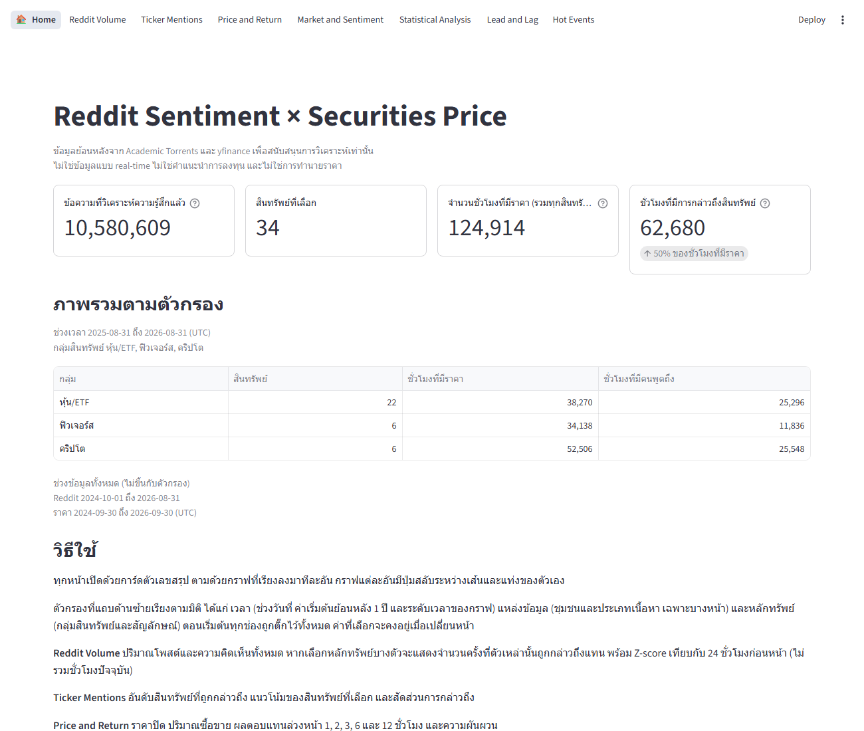
4 SIX SYSTEMS · DASHBOARDS
Every page has the same layout and the same filters.
1 Navigation bar
On top: Home plus the seven pages.
2 Filters (left)
Time: date range and chart level. Source: community, post or comment. Asset: group and symbol. Some pages: majority sentiment, signal thresholds.
3 Summary cards
Key numbers of the page for the chosen filters.
4 View options
Above each chart: return horizon, how shares are counted, data panel.
The dashboard itself is in Thai.

Slide 25
5 USER STORY
User story: is Reddit chatter about BTC-USD telling me anything about its price?
An investment analyst opens the dashboard with one question and walks through the pages in order. All numbers are what the pages show for the full range, all communities.
1
2
3
4
5
6
7
How busy is Reddit?
Is BTC-USD talked about?
What did price do?
What is the mood?
Who moves first?
Is it reliable?
What to watch?
Reddit Volume
Ticker Mentions
Price and Return
Market and Sentiment
Lead and Lag
Statistical Analysis
Hot Events
Why BTC-USD: it is the most-mentioned asset and trades around the clock, so it has the most hours to test.

Slide 26
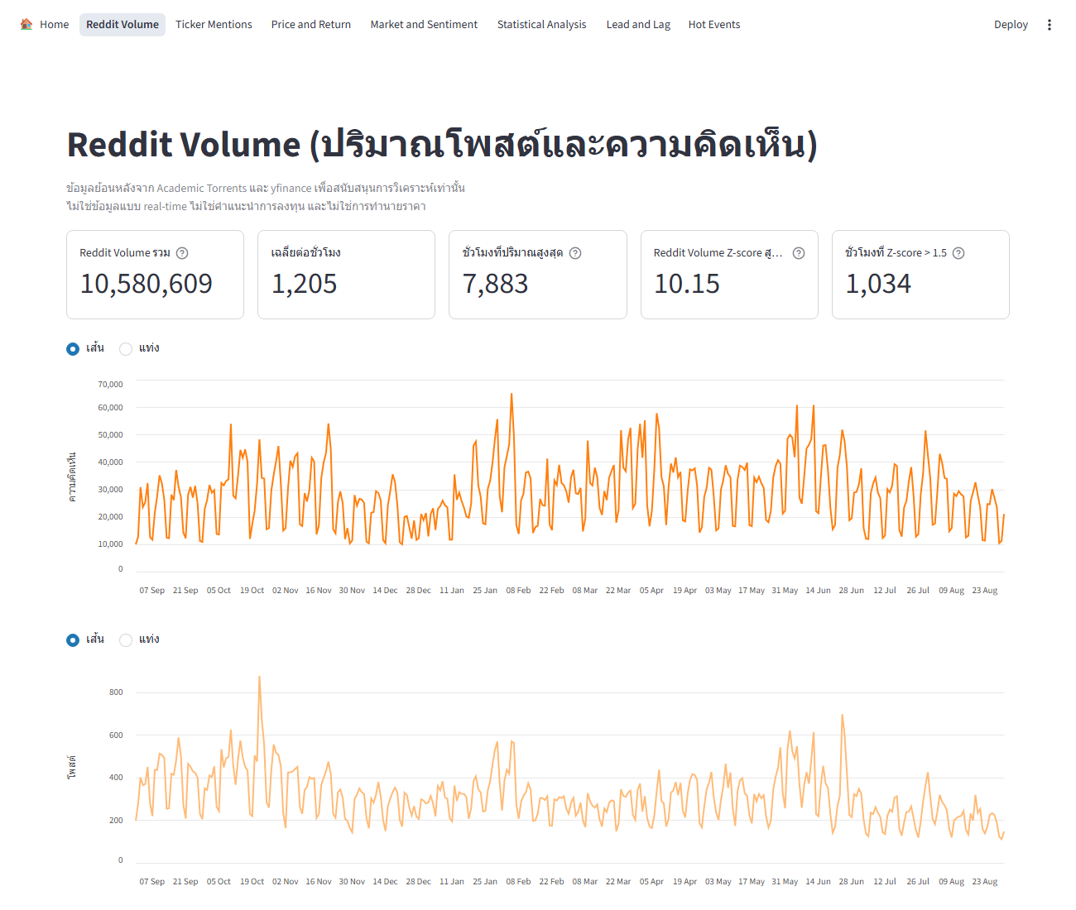
5 USER STORY · STEP 1 · REDDIT VOLUME
First, how busy is Reddit overall?
What the analyst does
Pick the full range and all communities.
Find the highest hour and the Z-score line.
17,362
1,311
texts in the peak hour, 9 Apr 2025, 17:00 UTC
texts in an average hour. 1,968 hours had Z-score above 1.5
Big spikes are rare. Note the date and look at prices in that hour.
Default filters. Choose BTC-USD in the sidebar to follow along. The dashboard is in Thai.

Slide 27
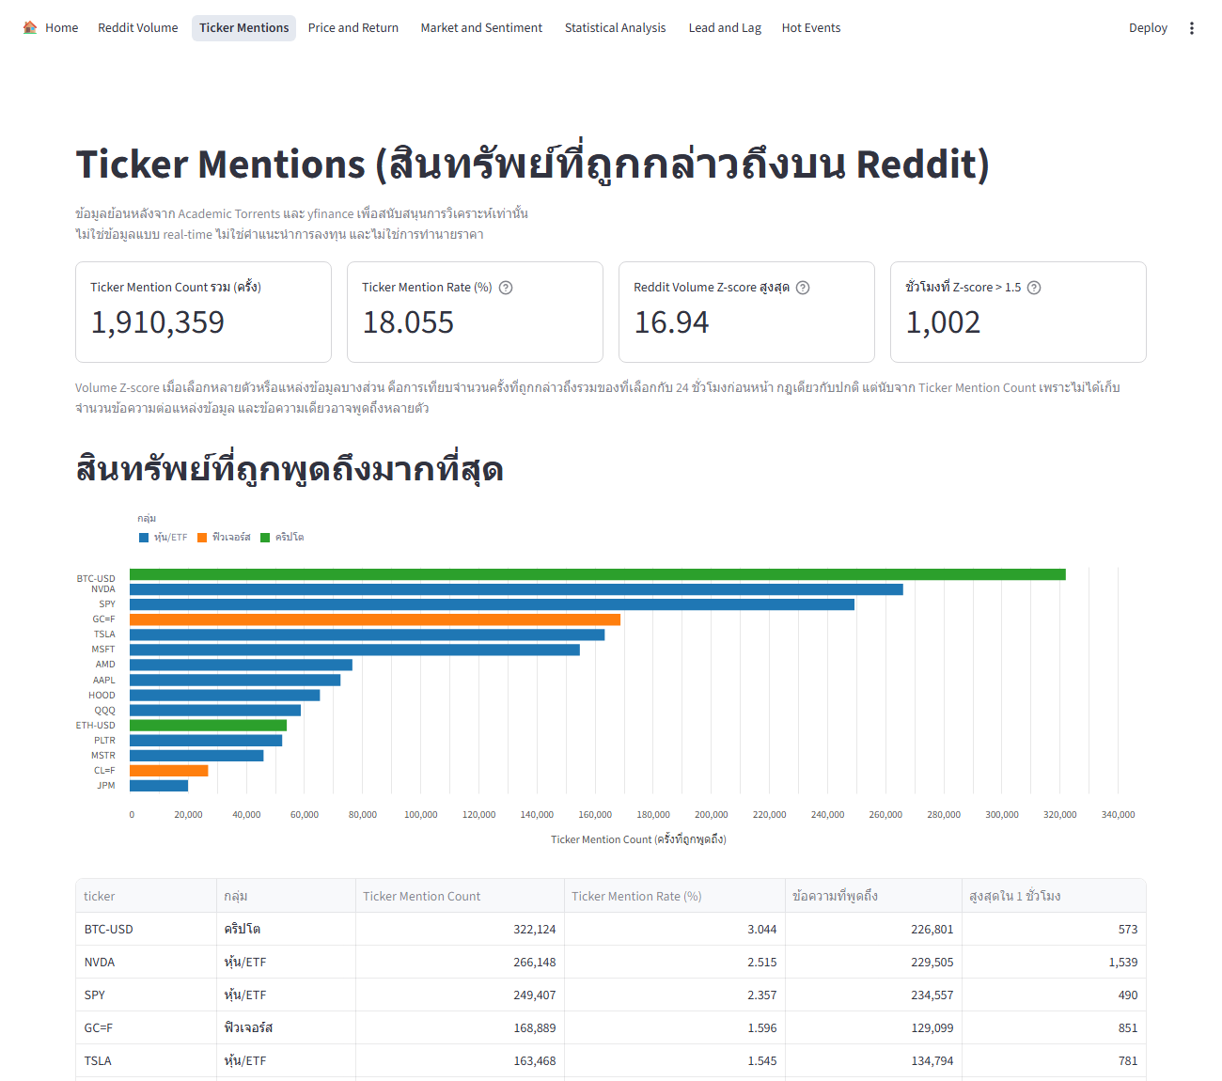
5 USER STORY · STEP 2 · TICKER MENTIONS
Is BTC-USD talked about enough to judge?
What the analyst does
Read the ranking of most-mentioned assets.
Open the BTC-USD trend.
#1 of 34
900,891
BTC-USD is the most-mentioned asset. Next is TSLA (759,742)
mentions, 4.09% of all texts
Plenty of text, so BTC-USD is a fair asset to test.
Default filters. Choose BTC-USD in the sidebar to follow along. The dashboard is in Thai.

Slide 28
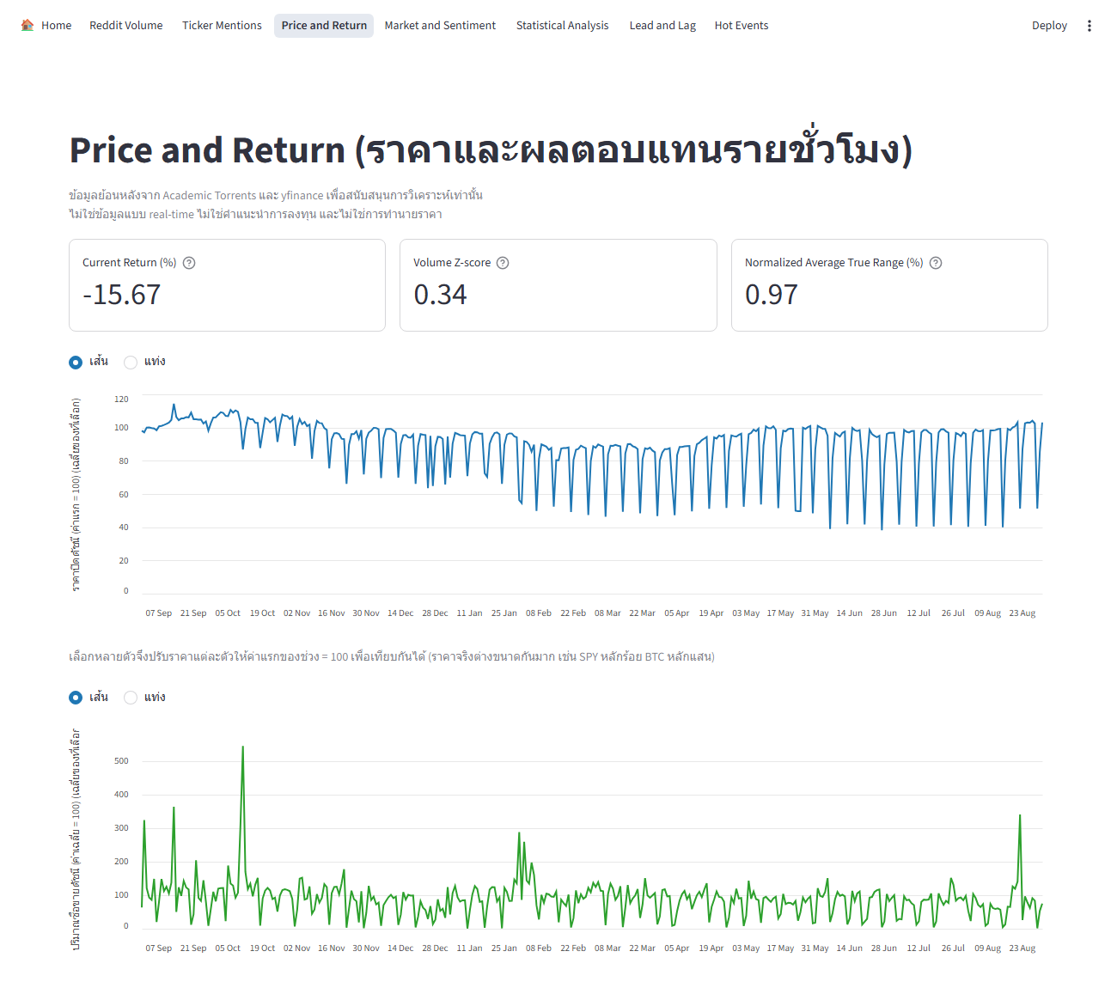
5 USER STORY · STEP 3 · PRICE AND RETURN
What did BTC-USD's price do?
What the analyst does
Look at price, RSI and volatility.
Check future returns by asset group.
+23.7%
50.4%
close from 63,491 to 78,563
of crypto hours were up after 1 hour. Average return 0.00231%
A strong rise overall, but any single hour is close to a coin flip.
Default filters. Choose BTC-USD in the sidebar to follow along. The dashboard is in Thai.

Slide 29
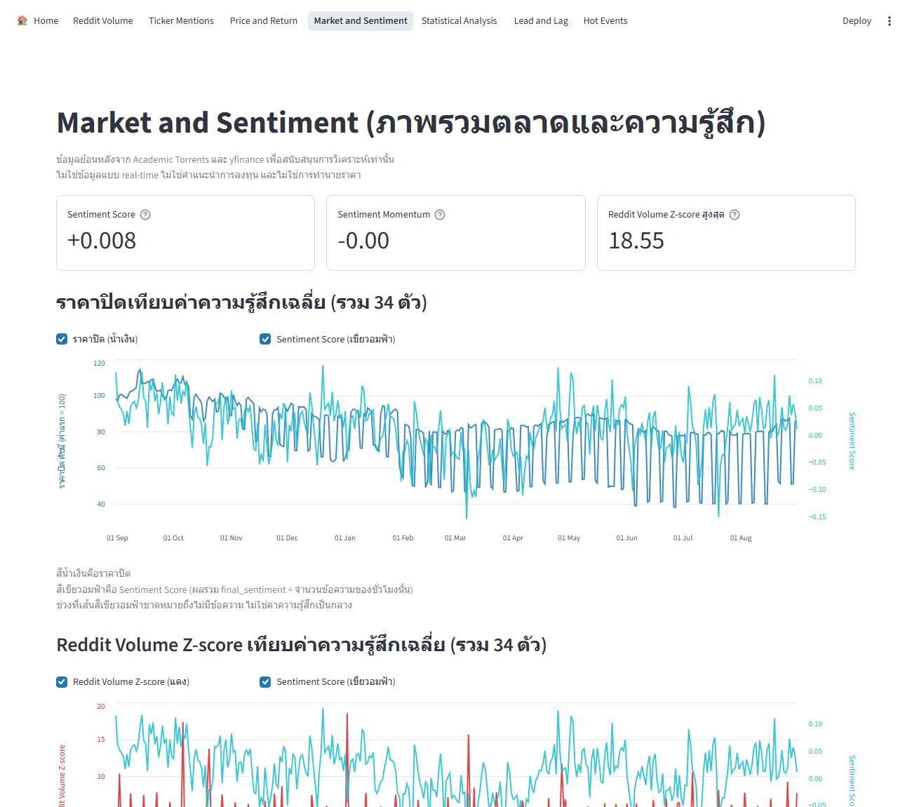
5 USER STORY · STEP 4 · MARKET AND SENTIMENT
What is the mood on BTC-USD?
What the analyst does
Put price next to average sentiment.
Read the positive and negative shares and the ranking.
+0.026
41.0% / 33.8%
Sentiment Score from 607,251 texts
positive / negative texts. Rank 20 of 33
Mildly positive, close to neutral. BTC-USD is not an outlier.
Default filters. Choose BTC-USD in the sidebar to follow along. The dashboard is in Thai.

Slide 30
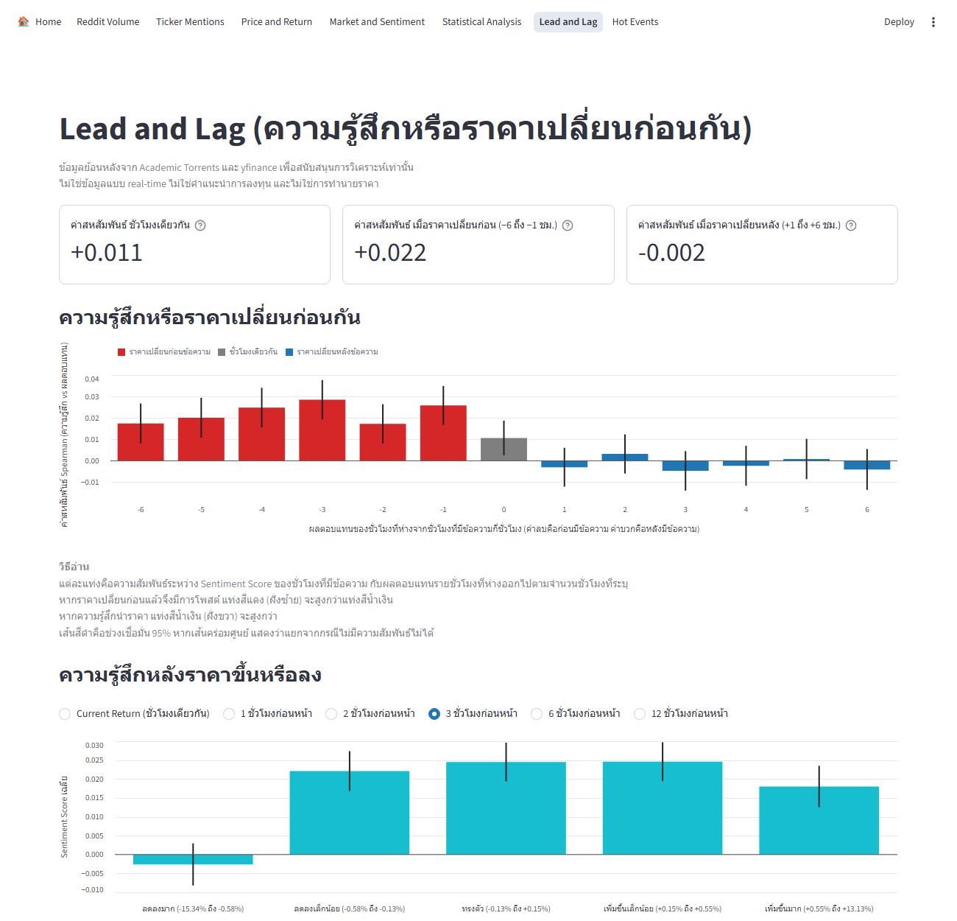
5 USER STORY · STEP 5 · LEAD AND LAG
Does sentiment move before price, or after?
What the analyst does
Read the lag chart, from 6 hours before to 6 hours after.
Compare the bars on each side of zero.
+0.026
-0.003
average correlation with returns in the 6 hours BEFORE the text
average correlation with returns in the 6 hours AFTER the text
Price moves first, then people talk. Sentiment does not lead price.
Default filters. Choose BTC-USD in the sidebar to follow along. The dashboard is in Thai.

Slide 31
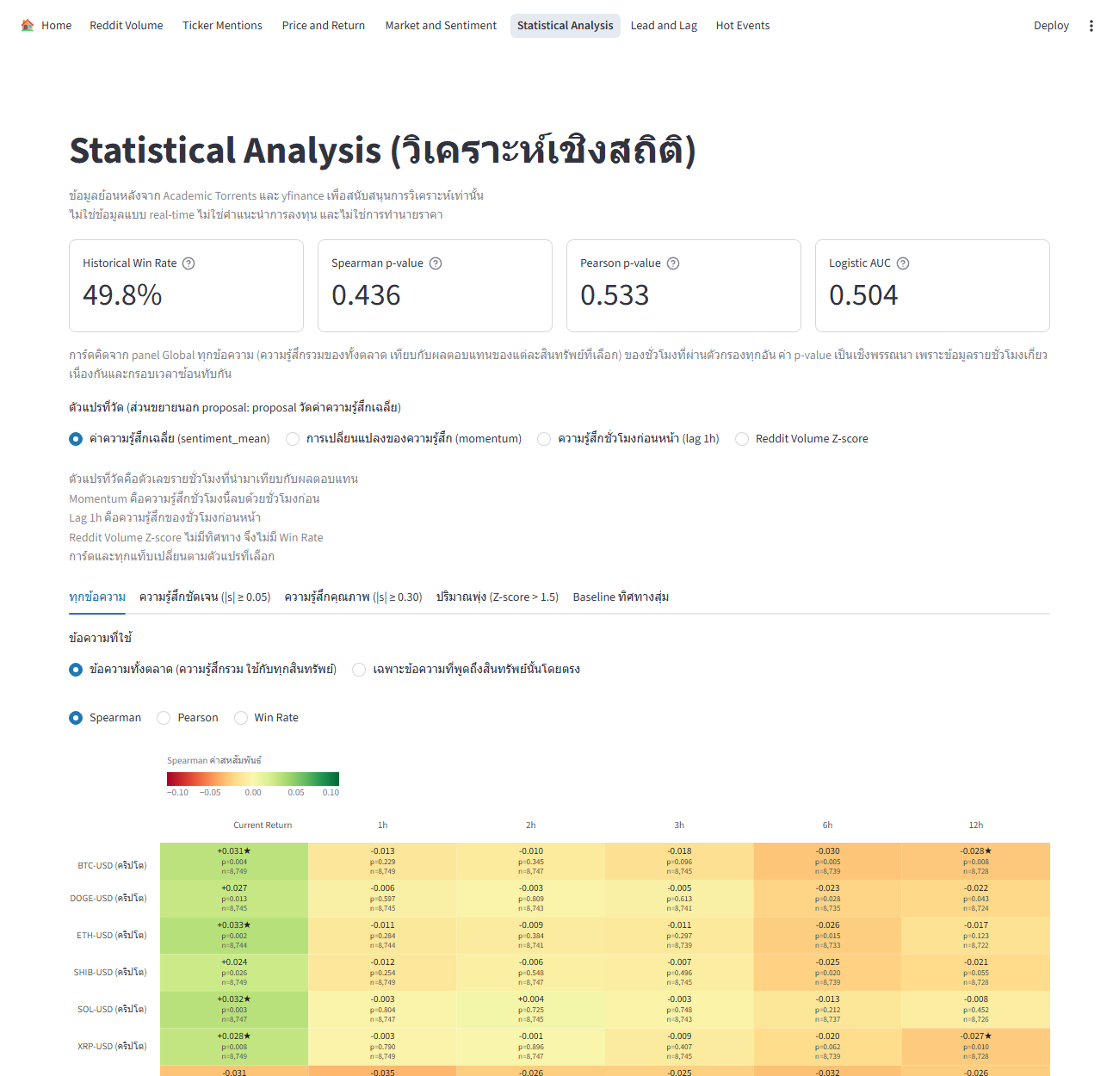
5 USER STORY · STEP 6 · STATISTICAL ANALYSIS
How far can the analyst trust a link?
What the analyst does
Open the BTC-USD row for each return horizon.
Read the correlation, its adjusted p-value and the win rate.
-0.013 to -0.003
49.3% to 50.1%
correlation with returns 1 to 12 hours ahead. Adjusted p-values 0.49 to 0.92
win rate, against a 50% baseline
No reliable link to future price. Only the same hour's return shows a small one.
Default filters. Choose BTC-USD in the sidebar to follow along. The dashboard is in Thai.

Slide 32
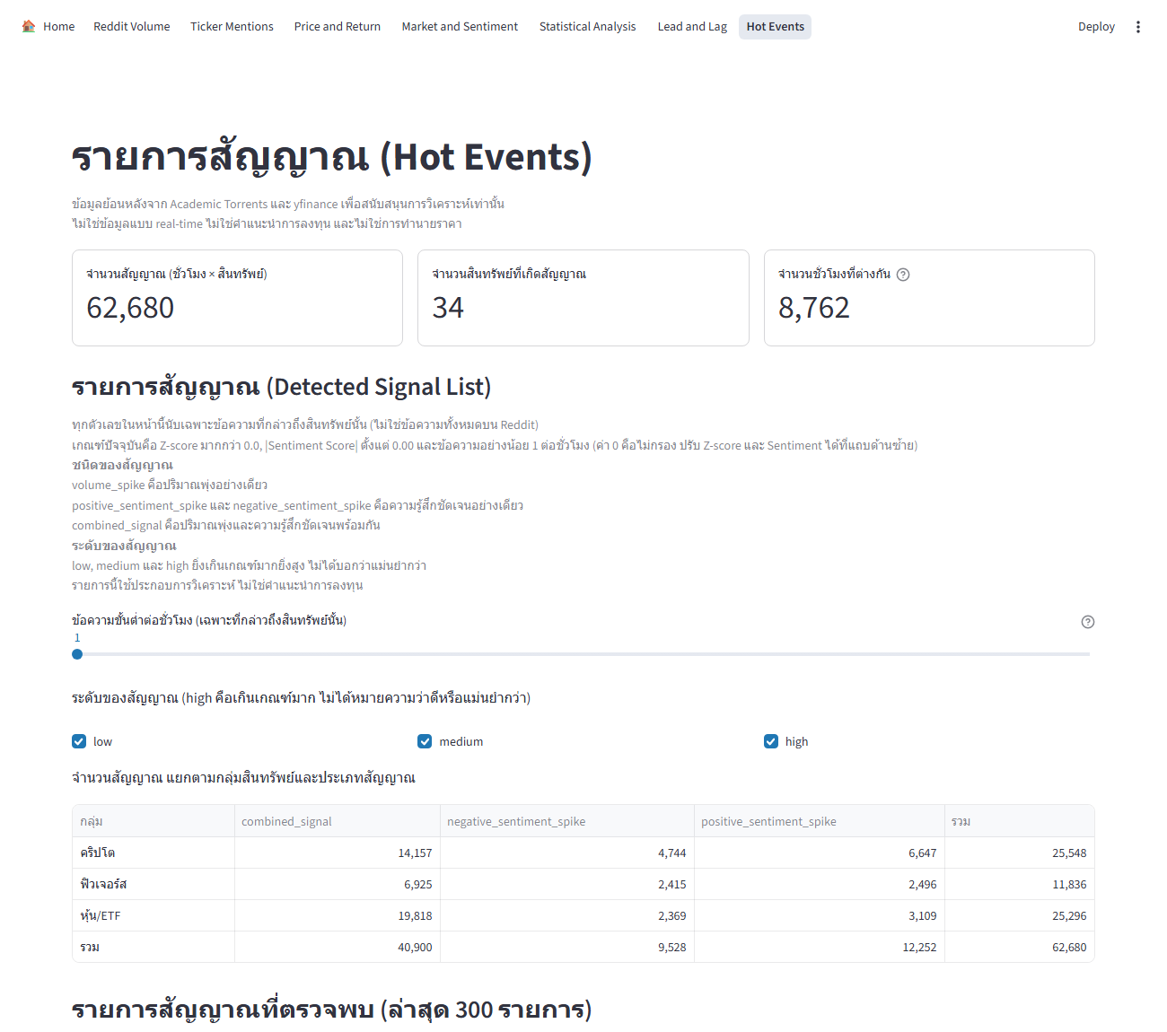
5 USER STORY · STEP 7 · HOT EVENTS
So what should the analyst watch?
What the analyst does
Set Z-score 1.5 and sentiment 0.05.
Read the signal list and what price did after each.
12,259
50.9%
BTC-USD signals: 6,515 positive, 3,868 negative, 1,286 combined, 590 volume
of signal hours: price moved the way sentiment pointed (1 hour)
About a coin flip. Use signals to pick hours to study, not to trade.
Default filters. Choose BTC-USD in the sidebar to follow along. The dashboard is in Thai.

Slide 33
5 USER STORY
The analyst's conclusion on BTC-USD.
What was found
What to do with it
Why it still helps
BTC-USD is the most-talked-about asset.
Its mood is mildly positive.
Sentiment follows price, not the other way round.
No reliable link to future returns.
Watch Reddit as a mood and attention gauge.
Use signals to choose hours to examine.
Do not trade on Reddit sentiment alone.
One place to see it all.
A verified "no signal" stops the team chasing patterns that are not there.
Historical data. Not investment advice.

Slide 34
6 EXECUTIVE QUESTIONS · SYSTEMS 1 AND 2
Systems 1 and 2: volume and prices.
Question | Answer | Page
Which asset is mentioned most? | BTC-USD, 900,891 mentions (4.09% of texts). Then TSLA, NVDA and SPY. | Ticker Mentions
Is hourly volume rising or falling? | No clear trend (ρ −0.060, p 0.111). Average 1,311 texts an hour, peak 17,362 on 9 Apr 2025. | Reddit Volume
What are the price and volume of each asset? | Chosen per asset. BTC-USD went from 63,491 to 78,563, up 23.7%. | Price and Return
How do future returns differ by group? | Averages near 0. Price rose in about 50 to 52% of hours. Stocks and ETFs have few samples at 6 hours and none at 12. | Price and Return
Which group is the most volatile? | Stocks and ETFs (Normalized ATR 1.17%), then crypto 0.88%, then futures 0.53%. | Price and Return

Slide 35
6 EXECUTIVE QUESTIONS · SYSTEM 3
System 3: sentiment.
Question | Answer | Page
Is overall sentiment positive or negative? | Balanced, leaning slightly negative: 32.4% positive, 32.9% neutral, 34.7% negative. | Market and Sentiment
Which assets are most positive or negative? | Most positive: NG=F +0.121, SHIB-USD +0.121, KO +0.114. Most negative: CL=F −0.217, ES=F −0.116, NQ=F −0.090. | Market and Sentiment
How well do VADER and FinBERT agree? | Same class 50.15%, one neutral 37.59%, opposite 12.26%. The merge rule settles conflicts. 12.3% stay undecided and are flagged. | Market and Sentiment
What are the hourly positive, negative and neutral shares? | A share chart over time, switchable from hourly to yearly. | Market and Sentiment

Slide 36
6 EXECUTIVE QUESTIONS · SYSTEM 4
System 4: relationships.
Question | Answer | Page
How does sentiment relate to future price direction? | No ability to predict was found: win rate about 50%, AUC about 0.50, correlation near zero. BTC-USD: ρ −0.013 to −0.003. | Statistical Analysis
Does the pattern differ by asset group? | Across the nine panels the result stays near 50%. Stricter filters (clear-direction texts, volume spikes) did not help. | Statistical Analysis
Is earlier sentiment better than current? | No. For BTC-USD price moves first: average ρ +0.026 for the 6 hours before a text, −0.003 for the 6 hours after. | Lead and Lag
Which factor deserves the most weight? | Logistic regression compares six variable groups: level, direction, vote, volume, lag, momentum. With AUC near 0.50 it is not read as a signal. | Statistical Analysis

Slide 37
6 EXECUTIVE QUESTIONS · SYSTEM 5
System 5: investment analysis.
Question | Answer | Page
Which assets have unusually high sentiment or volume Z-score? | Ranking by sentiment (top: NG=F, SHIB-USD, KO) and by Z-score for the chosen period. Market-wide, 1,968 hours have Z above 1.5. | Market and Sentiment
Which assets show an interesting win rate, by horizon? | Win rates sit near 50% in every horizon. BTC-USD: 49.3% to 50.1%. | Statistical Analysis
How do thresholds change the number of conditions found? | Stricter means fewer. BTC-USD at sentiment 0.05: 12,259 signals at Z 1.5, 11,912 at Z 2.5. At sentiment 0.30: 2,371 and 1,326. | Hot Events
Does majority sentiment agree with the future return direction? | No visible link. After BTC-USD signal hours, price moved the way sentiment pointed 50.9% of the time (1 hour). | Hot Events

Slide 38
6 EXECUTIVE QUESTIONS · SYSTEM 6
System 6: signal detection.
Question | Answer | Page
Which assets meet the signal conditions? | The signal list shows every asset that meets the thresholds in the period. BTC-USD alone has 12,259 at Z 1.5 and sentiment 0.05. | Hot Events
Which types of signal were found? | BTC-USD: 6,515 positive spikes, 3,868 negative spikes, 1,286 combined, 590 volume spikes. | Hot Events
What do past statistics say about flagged assets? | Historical win rate and correlation sit beside each signal: near 50% and near 0. Not a promise of return. | Hot Events
How do thresholds change the number and type of signals? | 30 settings (Z-score × sentiment × horizon). Six threshold sets found 312,115 signals in total. | Hot Events

Slide 39
6 EXECUTIVE QUESTIONS
Reddit sentiment describes the market, not where it goes next.
What the system gives
What the results show
How to use it
One place for sentiment and prices.
A tool to explore history and test hypotheses.
Signals as a start for deeper checks.
No ability to predict price direction in this data.
Direction accuracy about 50%, AUC about 0.50, correlation near zero.
Stricter filters did not help.
As supporting data for interpretation.
Not as a price signal on its own.
Not investment advice.
A clear "no signal" is still a result: it stops the team from chasing patterns that are not there.

Slide 40
7 QA
The system was tested in three parts.
32 / 32
371 / 371
checks passed on data logic and linking (25 Oct 2026).
dashboard numbers matched direct SQL (30 Oct 2026).
Data logic
Data linking
Display
Cleaned text is never empty.
Final sentiment stays within −1 and +1.
Future returns are right for each horizon.
Only the 34 assets are extracted.
Tables join correctly on timestamp and Ticker.
The merge rule was checked on a hand-labelled sample.
Charts, tables, filters and key numbers on Streamlit match the database.

Slide 41
7 QA
Five problems met along the way, and how each was handled.
Price data
Few hourly bars for stocks and ETFs; rows with no close price.
Returns only when a bar sits exactly n hours later; unavailable cases say insufficient data.
Sentiment
FinBERT 48.4% neutral against VADER 30.3%; slang; 12.3% undecidable; parent title shifts about 21.8%.
Keyword merge rule, an is_ambiguous flag, a hand-labelled check, and the post title is always included.
Statistics
Many tests raise the chance of lucky results; time series can leak the future.
Benjamini–Hochberg adjustment and time-ordered splits with a gap.
Size and tools
A 12.8 GB database; FinBERT on 22 million texts took hours.
GPU with fp16, resumable scripts, read-only database access.
Reddit access
Reddit changed its API access policy in March 2026.
Use historical monthly files; scope is historical, not real-time.

Slide 42
7 QA
Questions you may get.
If it cannot predict, what is it for?
Why adjust the p-values?
It is a tool to explore historical data and test hypotheses. Reddit sentiment should not be used alone as a price signal.
Tests run across assets, horizons and 9 data panels, so some look significant by chance. Benjamini–Hochberg controls the false discovery rate.
Is Reddit a proxy for the market?
Why historical data, not real-time?
Not fully. r/wallstreetbets is 73.2% of the texts, so pooled results mostly reflect that crowd.
Reddit tightened API access in March 2026, so the scope is historical data from Academic Torrents.

Slide 43
Q&A
Thank you. Happy to open any page.

