Slide 1


智能片上集成系统设计
Introduction of Intelligent Computing Chip and System
Lecture 5 : Digital Formats and Quantization
Instructor: Shiwei Liu, Assistant Professor

Slide 2
Overview of the Lecture
Objective: introduce the key concepts of Transformer models, and explore popular quantization techniques for efficient computation.
Topics:
Transformer & LLMs
Digital Formats: INT + FP
Hardware Implementation of INT MAC
Quantization Schemes

Slide 3
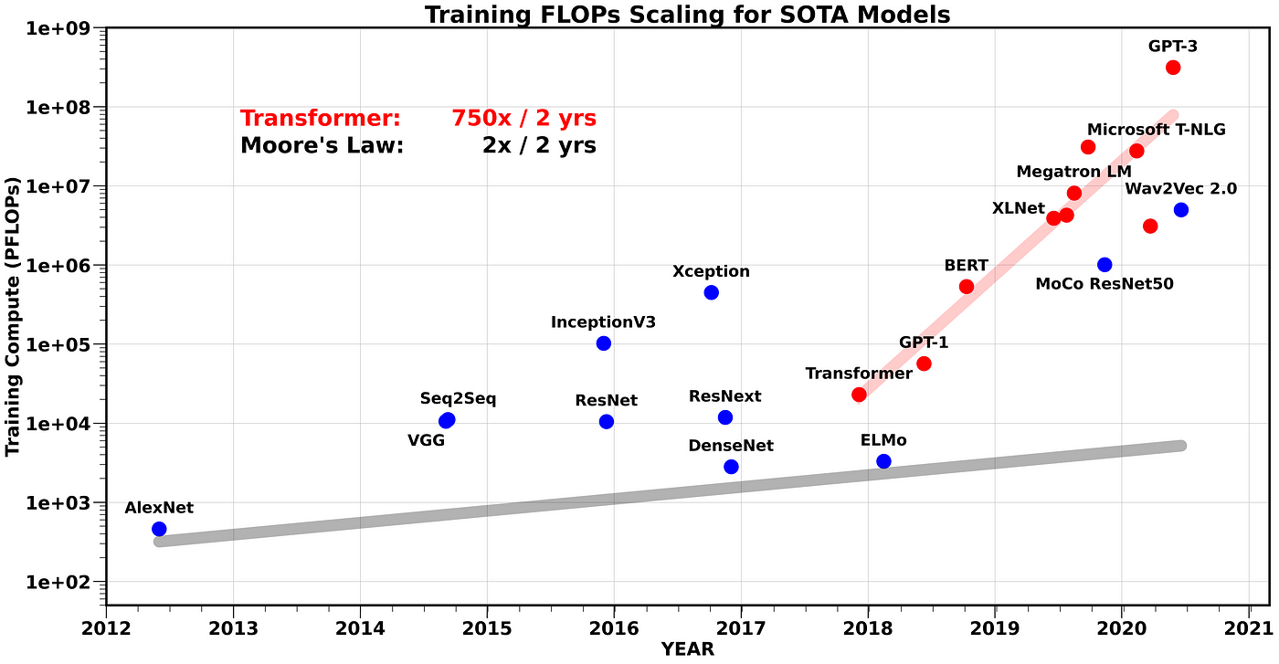
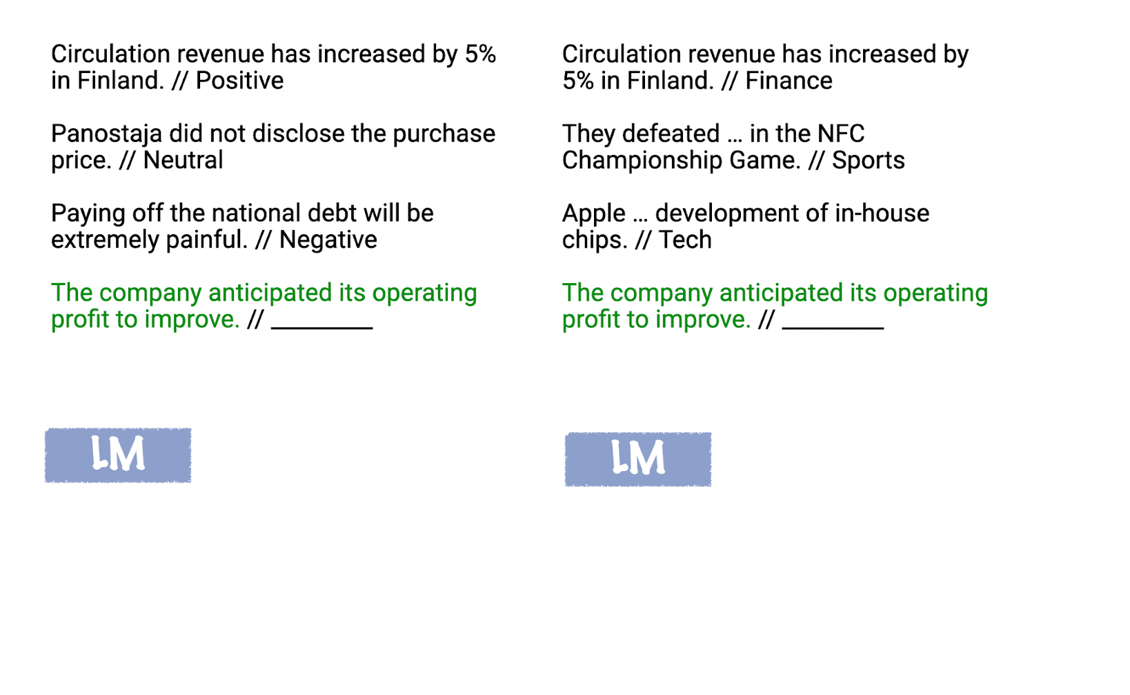
Large Language Models and Pre-Training
LLMs are large-scale models utilizing transformers for tasks like language understanding and generation
Pre-trained models, like GPT, can perform many tasks without explicit fine-tuning by leveraging their extensive pre-training, enabling in-context learning.

Slide 4

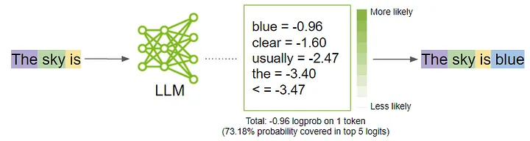

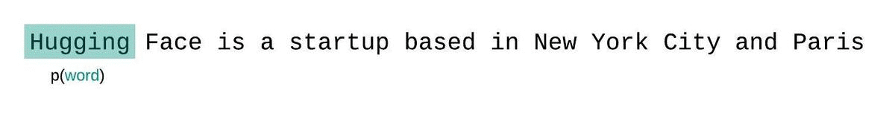
Self-supervised Learning and Perplexity
During LLM training, the model learns to predict the next/masked word (or token) in a sequence as the ground truth without data label, called self-supervise learning.
Perplexity measures how well a model predicts a sequence of words. Lower PPL means the predicted probabilities are closer to the true distribution of words, while higher PPL means the model is struggling to make accurate predictions (uncertain)
where q(w_{i}) is the predicted probability of the i-th word in the sequence. PPL is the exponential of the cross-entropy

Slide 5
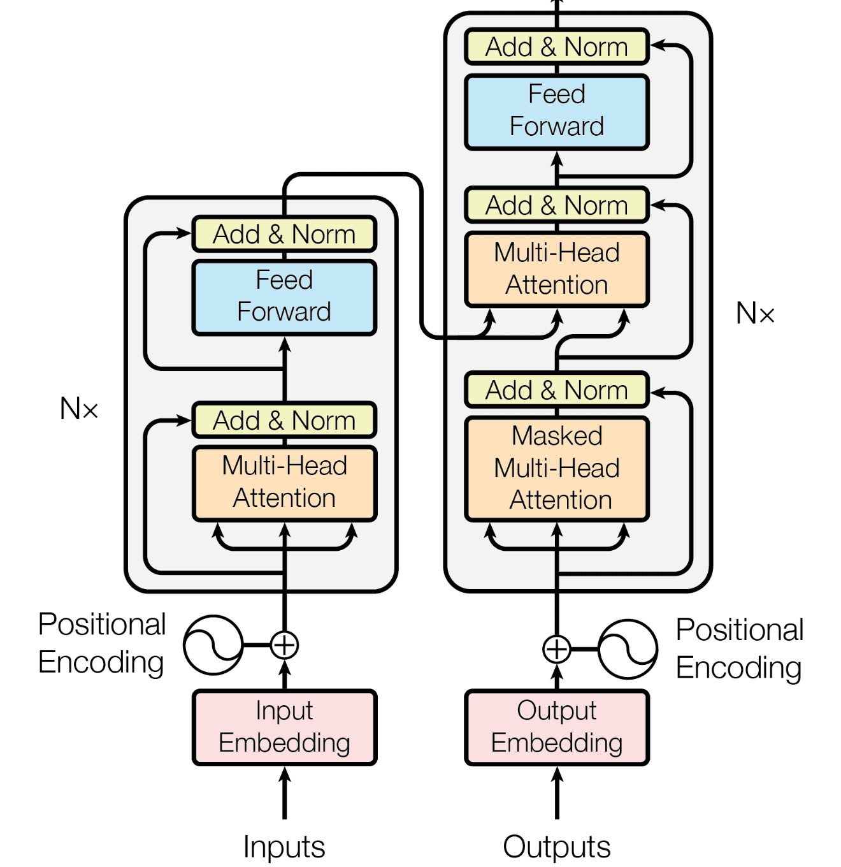
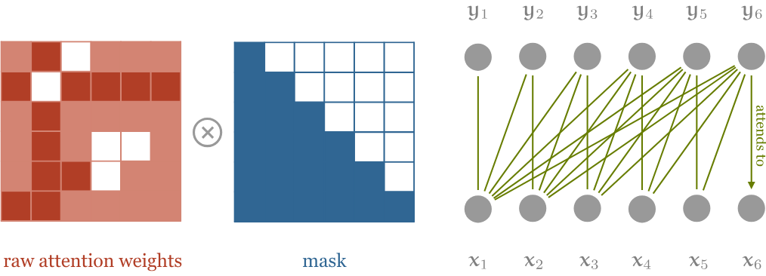
Masked Self-Attention
Encoder processes input sequences using bidirectional self-attention, where KQs of all other token’s are all computed.
In decoders, casual masking employs unidirectional self-attention, preventing attending to future tokens to maintain autoregressive generation.

Slide 6
Large Language Models and Pre-Training
LLMs are large-scale models utilizing transformers for tasks like language understanding and generation
Pre-trained models, like GPT, can perform many tasks without explicit fine-tuning by leveraging their extensive pre-training, enabling in-context learning.

Slide 7
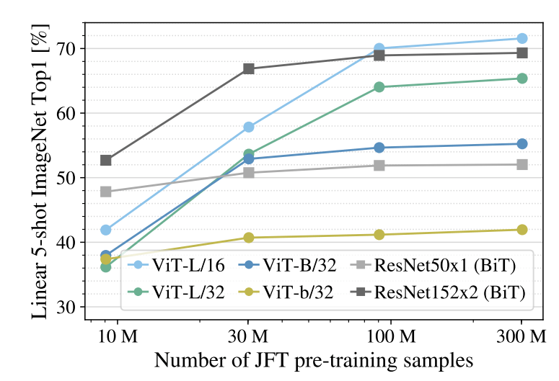
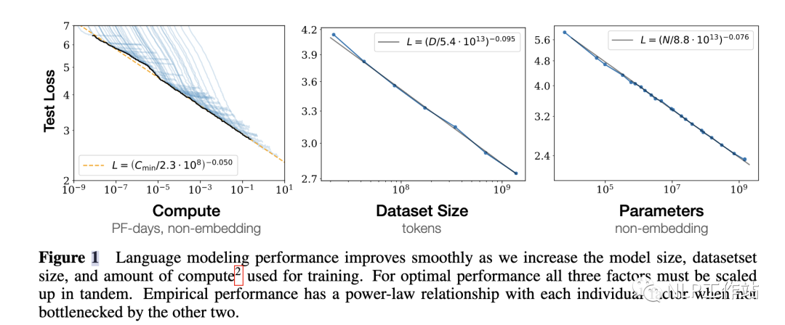
Scaling Law of LLMs
Transformers minimize structural assumptions, relying on self-attention to capture global dependencies dynamically, which reduces explicit inductive bias and keep increasing accuracy during model scaling.
LLMs’ performance scales predictably with three key factors: computational resources (compute), dataset size, and model parameters.

Slide 8
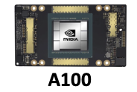
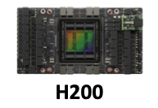
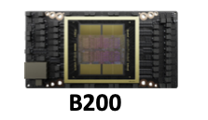
Hardware Metrics for AI Computing
There are three key elements directly affecting AI chips’ performance: computing, memory and interconnect bandwidth between them.
State-of-the-arts AI chips keep advancing the three specifications.
Technology | 7nm | 5nm | 4nm
Gate Count (B) | 54 (1x) | 80 (1.48x) | 104 (1.9x/die, 2 die)
BF16 TFLOPS | 624 (1x) | 1979 (3.2x) | 4500 (7.2x)
Memory Type | HBM2 x6 | HBM3e x6 | HBM3e x8
Memory Cap. | 80 GB (1x) | 141 GB (1.7x) | 192 GB (2.4x)
Memory Bandwidth | 1555 GBps (1x) | 4800 GBps (3.1x) | 8000 GBps (5.1x)

Slide 9
Bottleneck for LLM Deployment
GPU Compute performance are dominated by communication between processor and external DRAM in Large Language Model applications.
Deploying Llama-13B on GPU (batch=1) takes 99% of latency for data movement.
t_{comp}
 | Parameter | Value
Llama2- 13B Model | Weight | 12.9 GB
 | KV Cache | 2.7 GB
 | OPs | 159 G
RTX4090 GPU Spec. | INT8 TOPS | 1321TOPS
 | DRAM Cap. | 24GB
 | GDDR BW | 1008GBps
t_{mem}=15.4ms t_{comp}=0.12ms, if batch=1
Compute
t_{mem}
Memory
Access
Run time of Generative LLM
t_{token} = t_{mem} + t_{comp}
Weight + KV (GB)
Operation #
t_{mem} ≈
t_{comp} ≈
>>
Bandwidth (GBps)
GPU Perf.(TOPS)

Slide 10
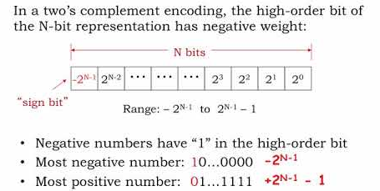
Number Representation Basics: Integer
Two’s complementary: the most common method for representing signed integers in binary, where negative numbers are represented by inverting all bits and adding 1.
Fixed-point representation allows numbers with a fixed number of fractional bits, where the digit point is pre-defined.
sign
mantissa(7-bits)
8-bit
Scale
Option 1
0
1
1
0
0
1
0
0
Integer
([7-f]-bits)
fractional
(f-bits)
12.75
s=0
m=102
f=13
sign
mantissa(7-bits)
8-bit
Scale
Option 2
0
1
1
0
0
1
0
0
fractional
(f-bits)
0.19921785
s=0
m=102
f=9

Slide 11
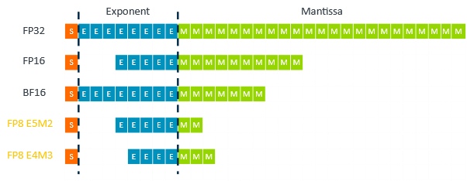
Number Representation Basics: Floating Points
In floating-point representation, a number is expressed with exponent scaling the number, and mantissa representing significant digits.
IEEE 754 Standards: Define formats like single/half-precision (FP32/16), while BF16 provides a wider exponent range with large dynamic ranges during training.
E8M23
E5M10
IEEE 754 Floating Point Standard
FP32: Value= (-1)^{S} x (1.M) x 2 ^{E-127(bias)}
00000…0 represents 0
Value = +(1+0.11₂) ◊2 ¹³⁰⁻¹²⁷ = 1.75◊8 = 14
E8M7

Slide 12
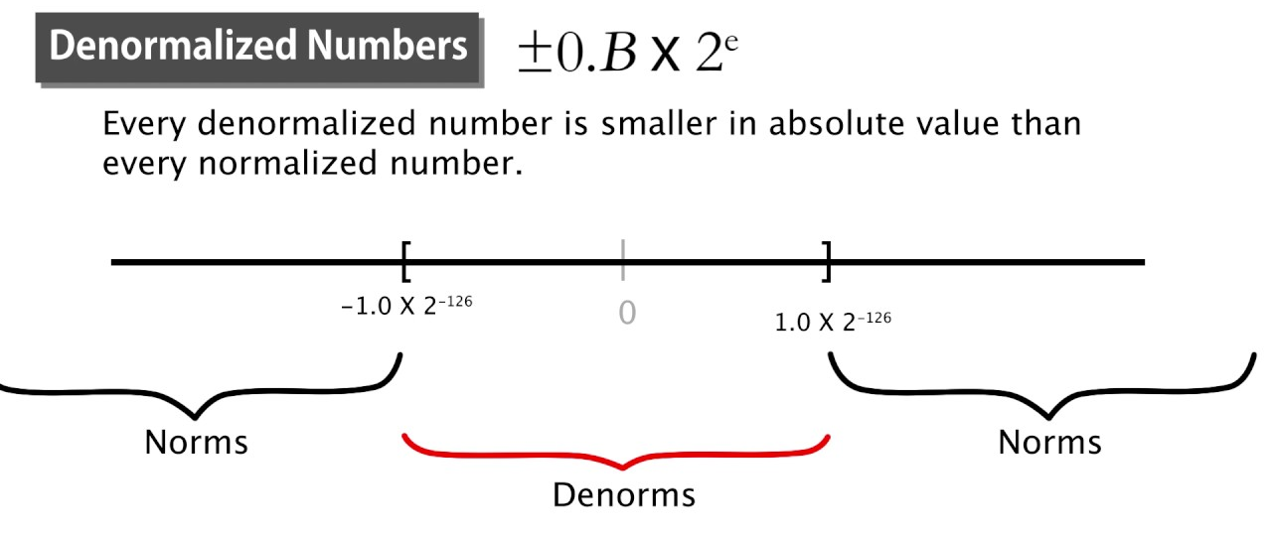
Subnormals and Special Values in IEEE754
Subnormal Numbers (Denormals): representation of values closer to zero than the smallest normalized numbers, filling the underflow gap of normalized FP.
Other special values representing overflow conditions (infinity) and undefined results, respectively, facilitating error handling in computations (div 0, or …)
Values | Exponent E | Mantissa M
0 | 0 | 0
Infinity | 255 | 0
Denormal numbers | 0 | Non Zero
NaN (Not a number) | 255 | Non Zero

Slide 13

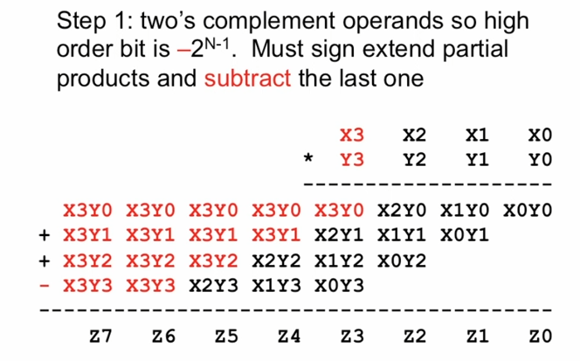
Signed (2’s Comp) Multiplier Implementation
Understanding Signed Fixed-Point Multiplier Design Through Two’s Complement Representation.
Binary Expansion of Y:
Partial Products (Lines 1–3): Sign-extended X
Partial Product (Line 4): Subtraction
→ Generates a Large Number of Partial Products

Slide 14
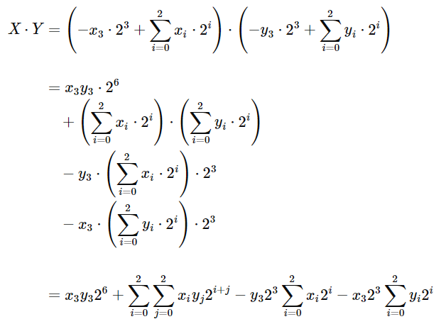
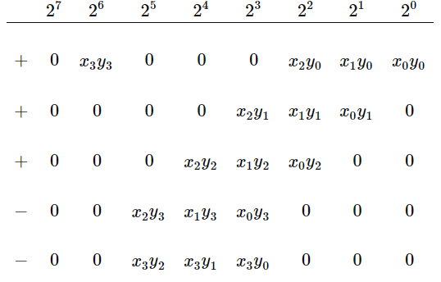
Signed (2’s Comp) Multiplier Implementation
Reduce the Number of Partial Products:
Step 1: Expand both X and Y in binary, handling the sign bits x3 and y3 separately.

Slide 15
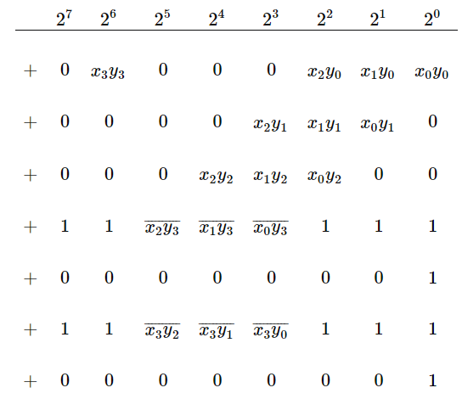
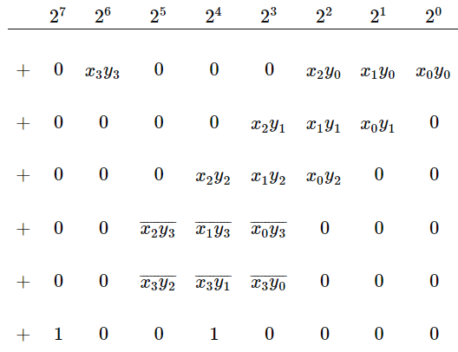
Signed (2’s Comp) Multiplier Implementation
Step 2: Eliminate Subtraction in Partial Products
Step 3: Accumulate Constant 0s/1s and Propagate Carries

Slide 16
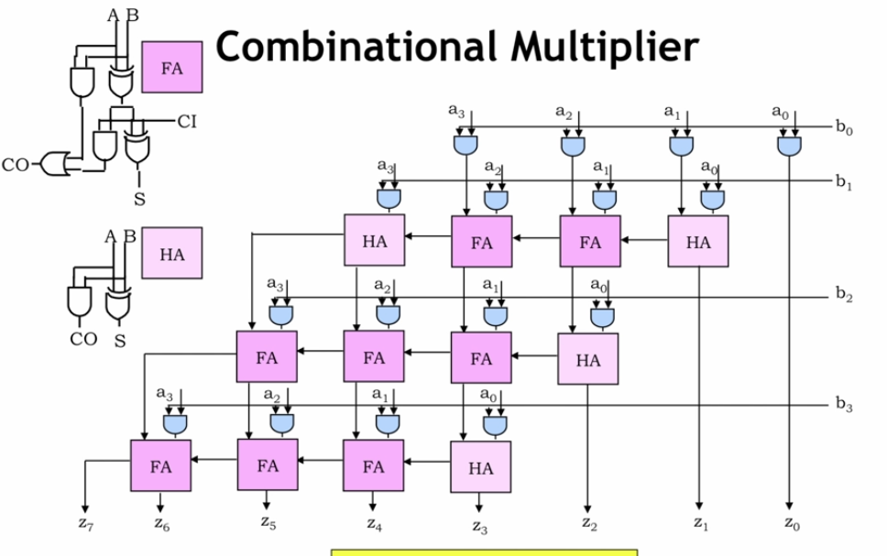

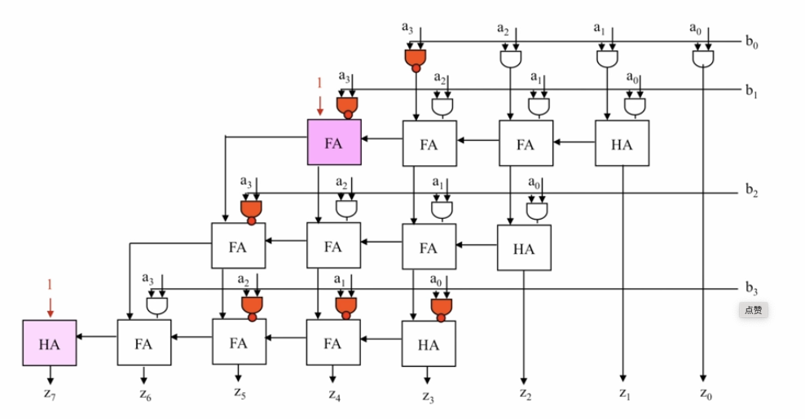
Signed (2’s Comp) Multiplier Implementation
By using the math conversion, the 2’s complement multiplier can perform signed operation with almost same latency/throughput and power consumption as the combinational unsinged multiplier.

Slide 17
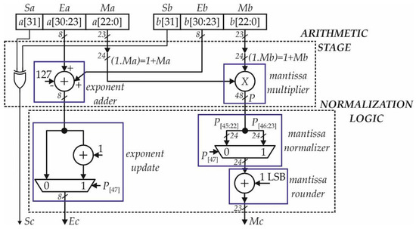
FP Multiplier Implementation
In Floating point multiplying, adjust the exponents of both operands so they are match, ensuring the binary points align for accurate multiplication.
Note that the final result
should be normalized so
that the leading bit of the
significand is non-zero.
For vector product, exponent
alignment among elements
is necessary.

Slide 18
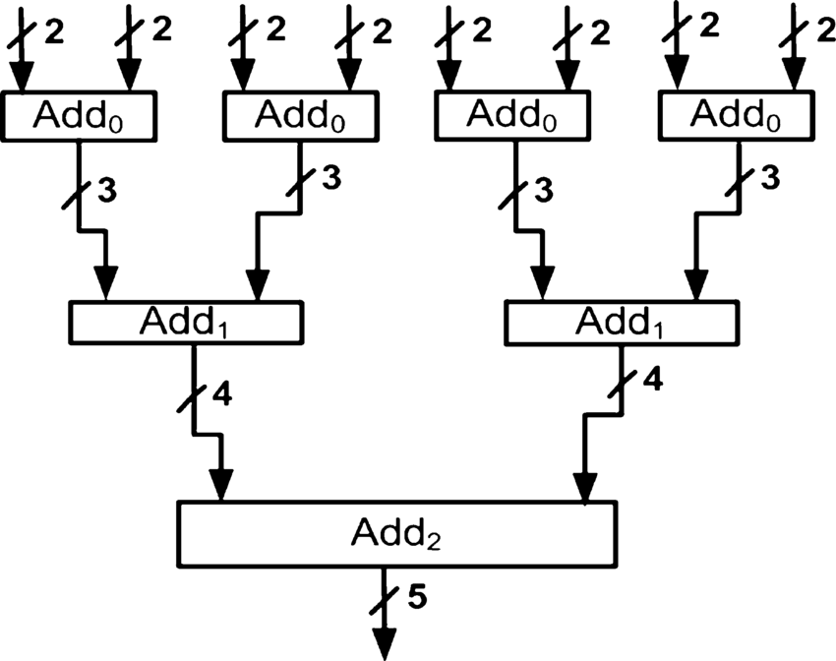
Accumulation Implementation
Serial accumulation, intermediate results are accumulated sequentially, one step at a time, which has lower throughput but consumes less hardware resources.
Parallel accumulation involves simultaneous accumulation of multiple partial sums, offering high throughput.
Question: Which stage has most FA?
For vector product, exponent
alignment among elements
is necessary.
Weight
(N-bits)
2N+M-bits
+
2N-bits
Accumulate
Quantize
To N-bits
Output
(N-bits)
X
Activation
(N-bits)
NxN
multiply
Sometimes
Partial Sum
Reg File

Slide 19
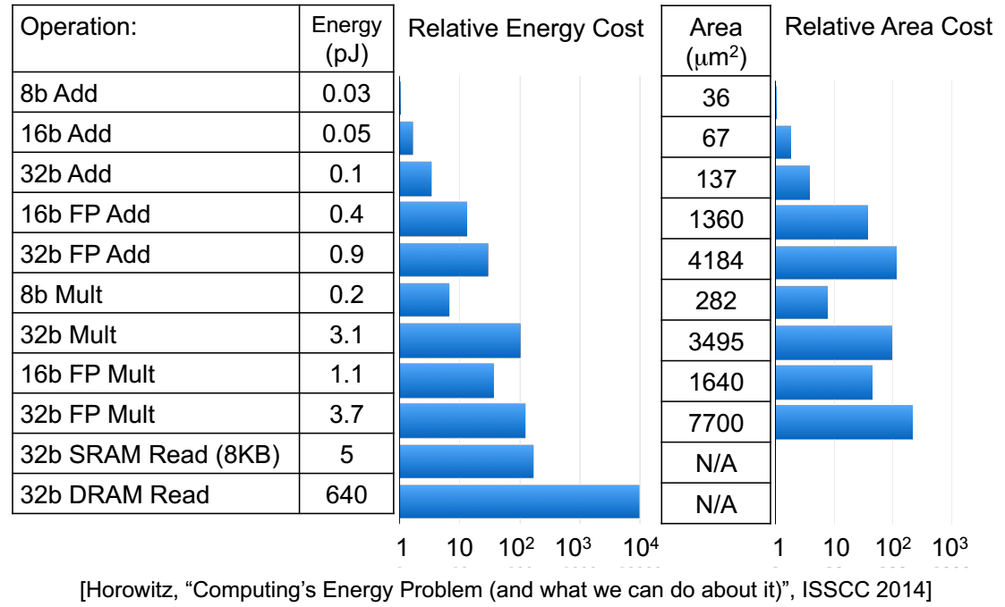
Quantization from Training to Inference
Low precision is always preferred:
  Reduce memory footprint & access
  Power and area efficient compute logic
The energy consumption of Mult is proportional to N², where N=bit width.

Slide 20
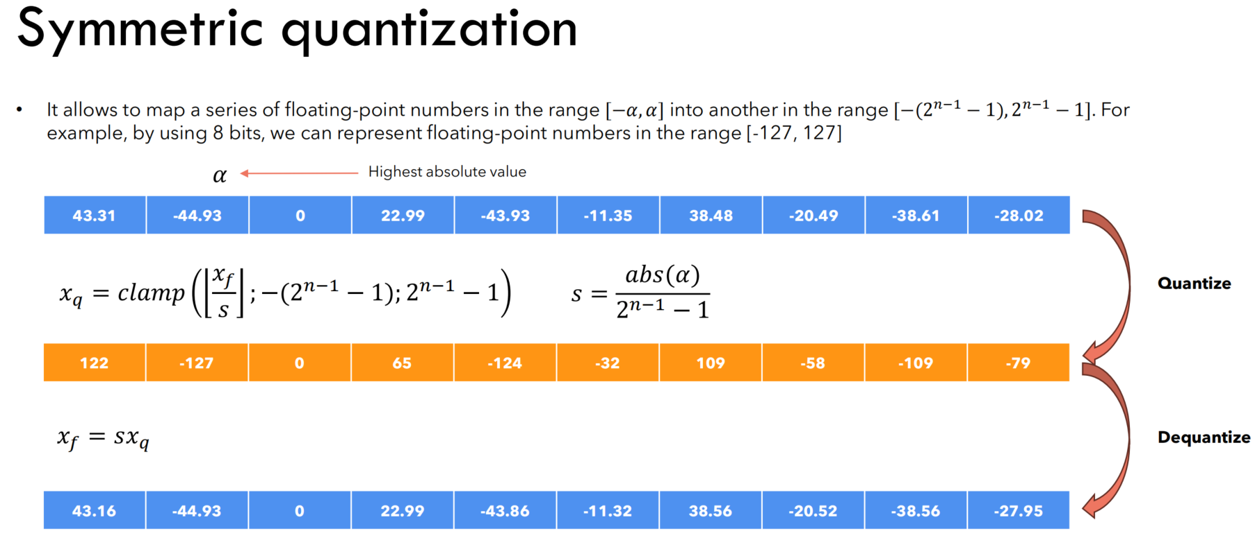

Symmetric Quantization
Symmetric Quantization: Map FP32 values to the symmetric N-bit integer with range [-(2^{n-1}-1), 2^{n-1}-1].
The quantized data preserves the original zero point.

Slide 21
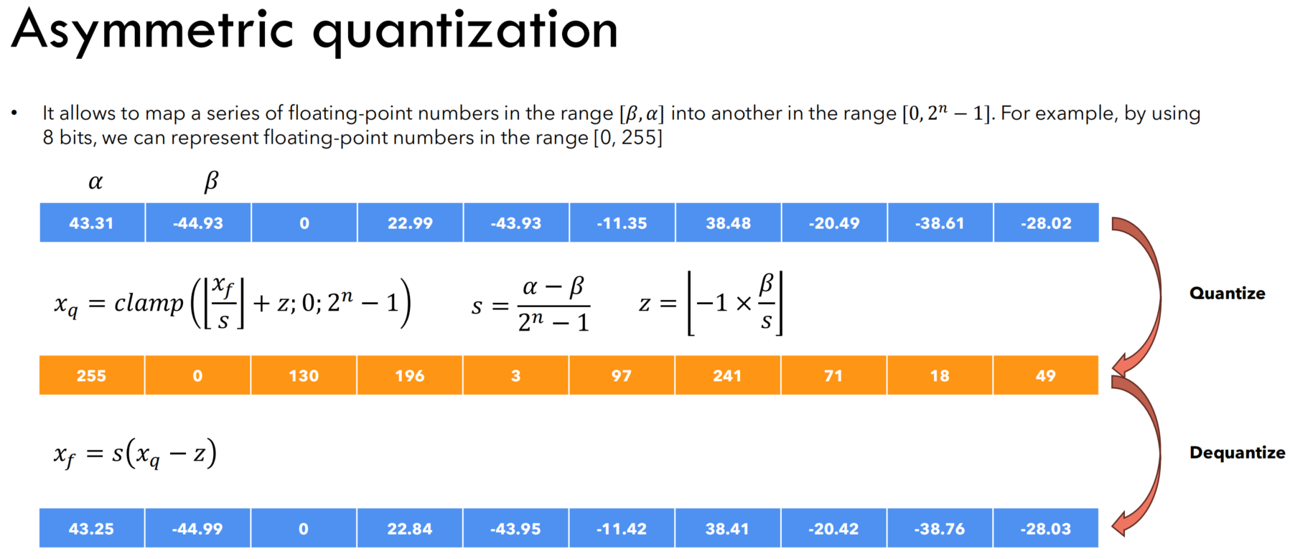
Asymmetric Quantization
Asymmetric Quantization: Map FP32 values to [0, 2^{n}-1], where the quantized zero point differs from the original zero point.

Slide 22
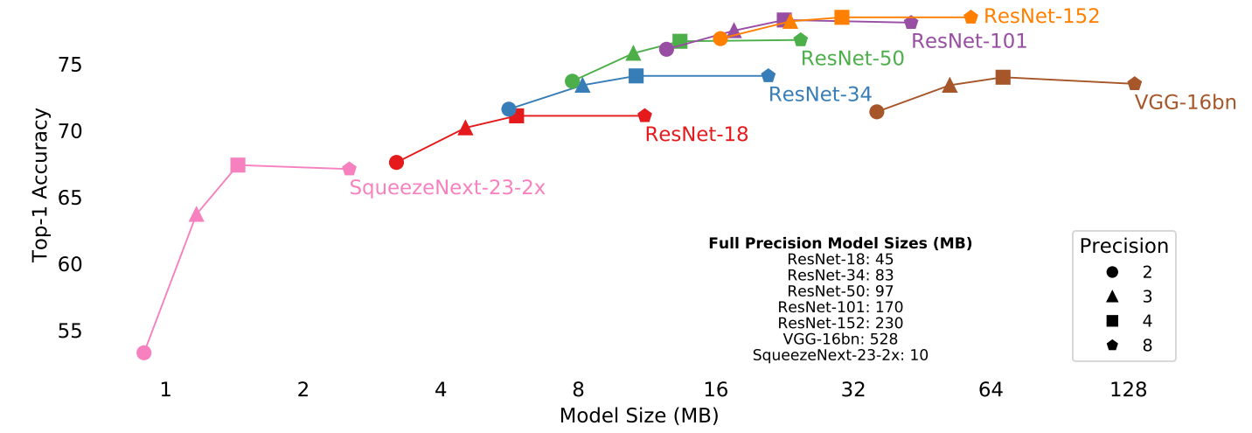
Low Bit-width Quantization
Performance-Accuracy Trade-off: LSQ methods reducing numerical precision through quantization decreases model size and enhances processing speed.
CNN tasks often utilize 4 to 8-bit quantization for matrix multiplication (others or not quantized), achieving efficient performance with minimal accuracy degradation
https://arxiv.org/abs/1902.08153

Slide 23
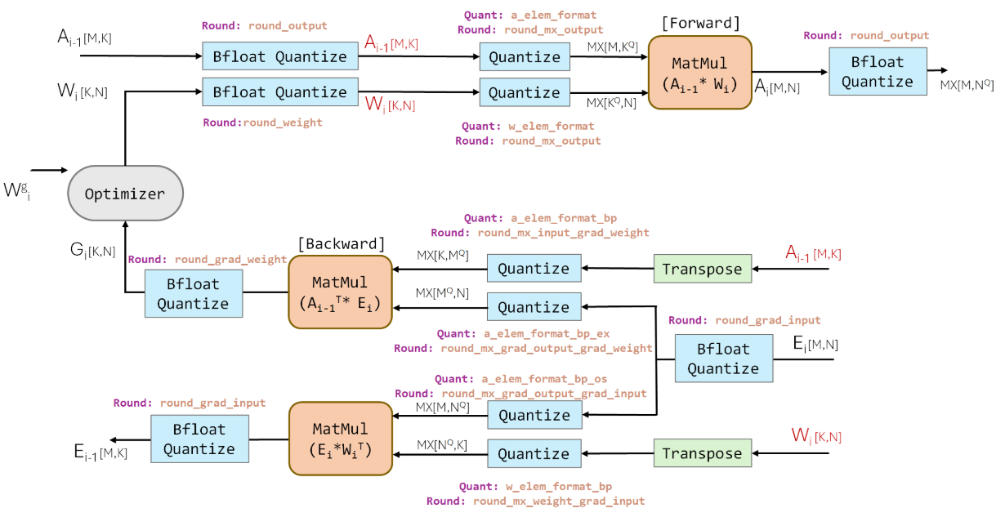
Quantization Aware Training
Quantization Aware Training (QAT) simulates the effects of quantization during training, allowing the model to adapt and minimize accuracy loss when deployed with lower precision.
Full precision training
as initial weights
Full dataset for QAT
Pros: high accuracy
Cons: increase
training complexity

Slide 24
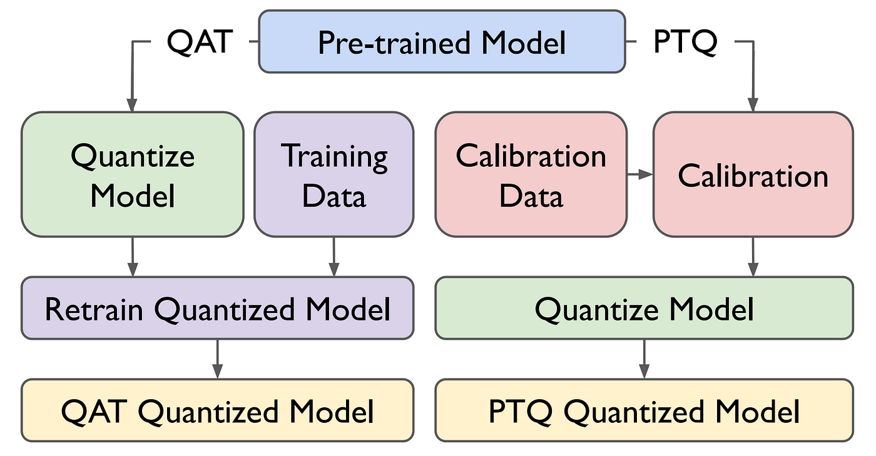
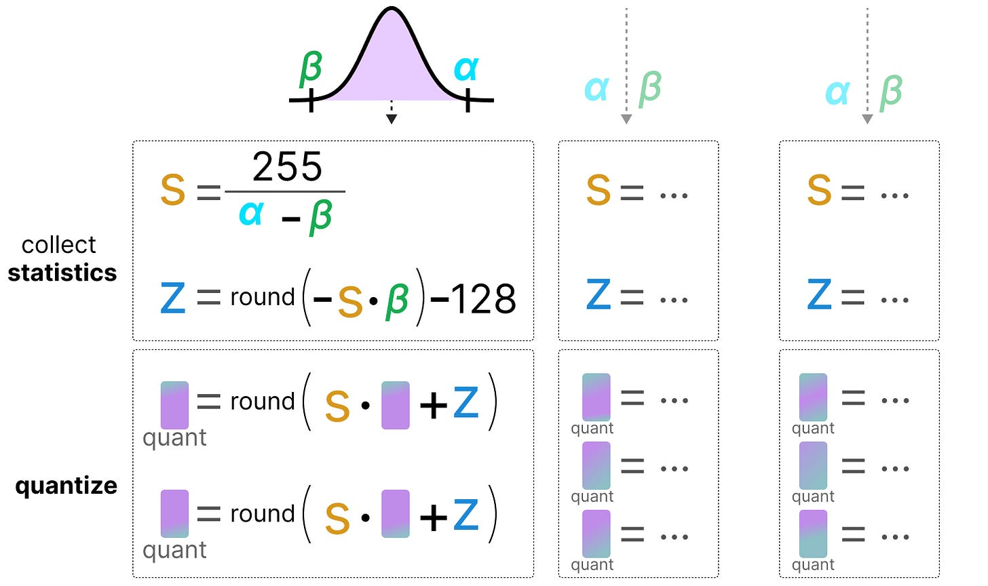
Post-Training Quantization
Post-training quantization (PTQ) converts pre-trained FP32 neural networks to lower precision without retraining, considering extreme cost for LLM re-train.
A small, representative dataset (e.g., 100–1,000 samples) is used to compute quantization parameters (scale/zero-point), called calibration data.

