Slide 1


智能片上集成系统设计
Introduction of Intelligent Computing Chip and System
Lecture 6 : Quantization and MAC Circuit
Instructor: Shiwei Liu, Assistant Professor

Slide 2
Overview of the Lecture
Objective: introduce the key methods of quantization, and explore low power and energy efficient MAC implementation.
Topics:
Quantization (cont’d)
Energy Efficient MAC Implementation

Slide 3
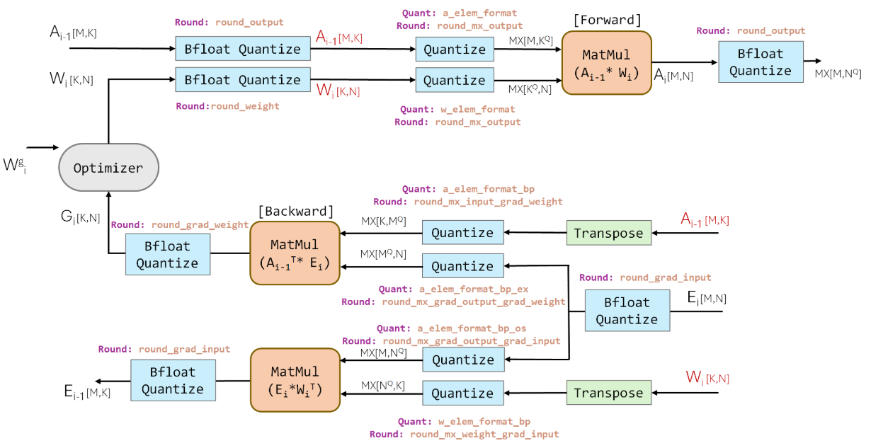
Quantization Aware Training
Quantization Aware Training (QAT) simulates the effects of quantization during training, allowing the model to adapt and minimize accuracy loss when deployed with lower precision.
Full precision training
as initial weights
Full dataset for QAT
Pros: high accuracy
Cons: increase
training complexity

Slide 4
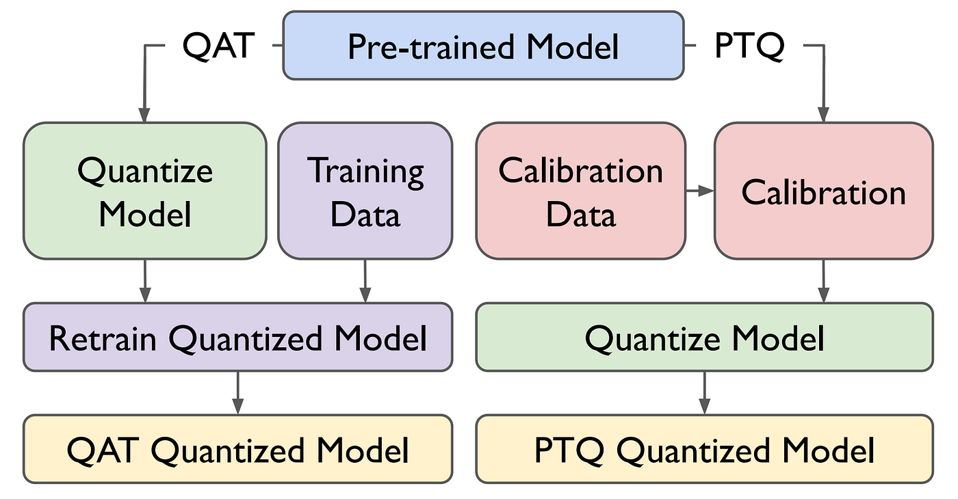
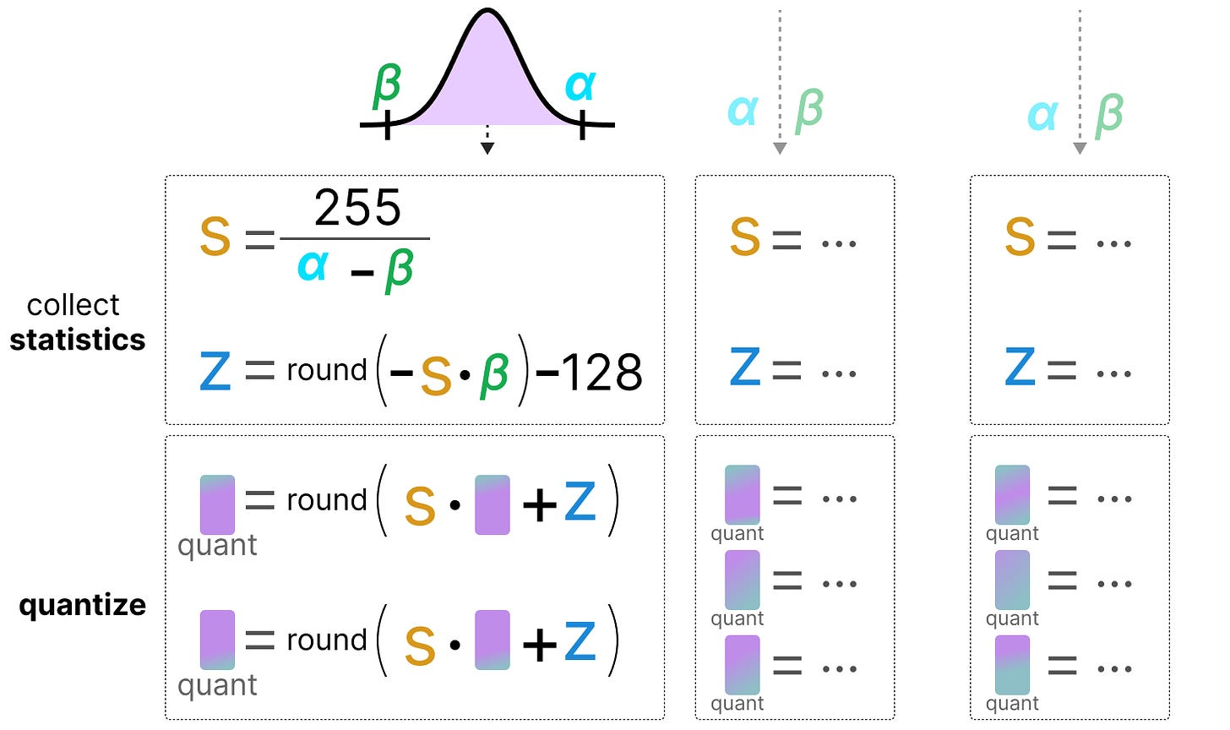
Post-Training Quantization
Post-training quantization (PTQ) converts pre-trained FP32 neural networks to lower precision without retraining, considering extreme cost for LLM re-train.
A small, representative dataset (e.g., 100–1,000 samples) is used to compute quantization parameters (scale/zero-point), called calibration data.

Slide 5
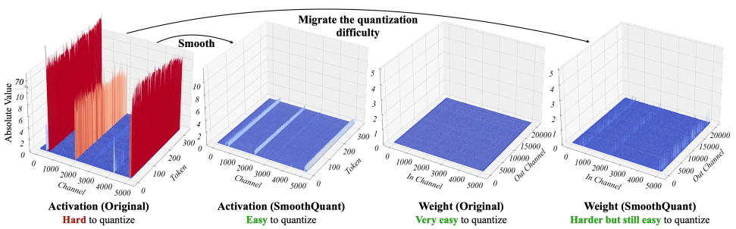
PTQ: SmoothQuant
SmoothQuant: https://github.com/mit-han-lab/smoothquant
Outliers in activations expand the data distribution, while weights typically have a smoother and narrower distribution.
SmoothQuant introduces a smoothing factor to mitigate activation outliers and mathematically shifts quantization difficulty from activations to weights through an equivalent transformation.

Slide 6
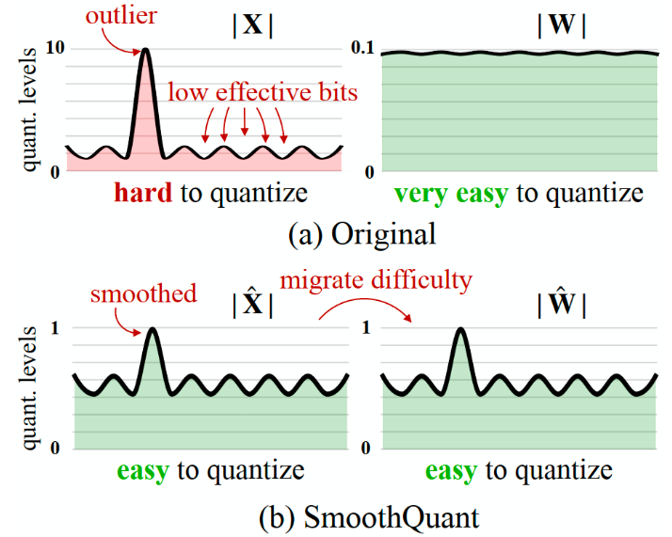




PTQ: SmoothQuant
Key Idea: Smooth the activations by dividing each channel by its smoothing factor, and multiply each weight element in the corresponding channel by the same factor.
This mathematically equivalent transformation preserves the output exactly, significantly reducing the activation range while slightly increasing the weight range.
Before SmoothQunat：
After SmoothQunat：

Slide 7
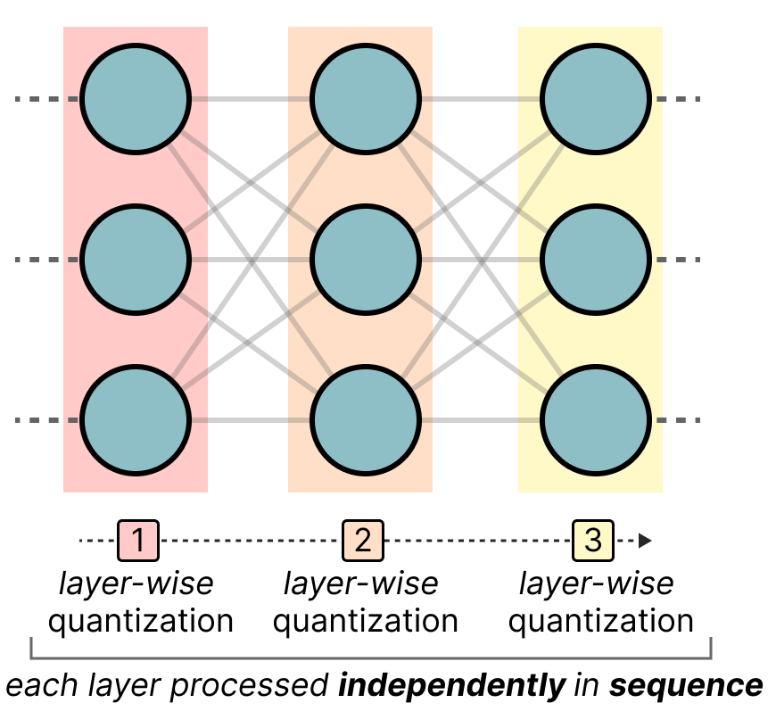



GPTQ：Generalized PTQ
GPTQ uses asymmetric layer-wise quantization. It first converts the layer’s weights into the inverse-Hessian, a second-order derivative of the model’s loss function, and quantize and then dequantize the weight of the first row in our weight matrix. This process allows us to update the quantization error according to the importance.
Goal:
Using the property of the Frobenius norm:
The second derivative of this quadratic loss:
Adjust the remaining weights:

Slide 8
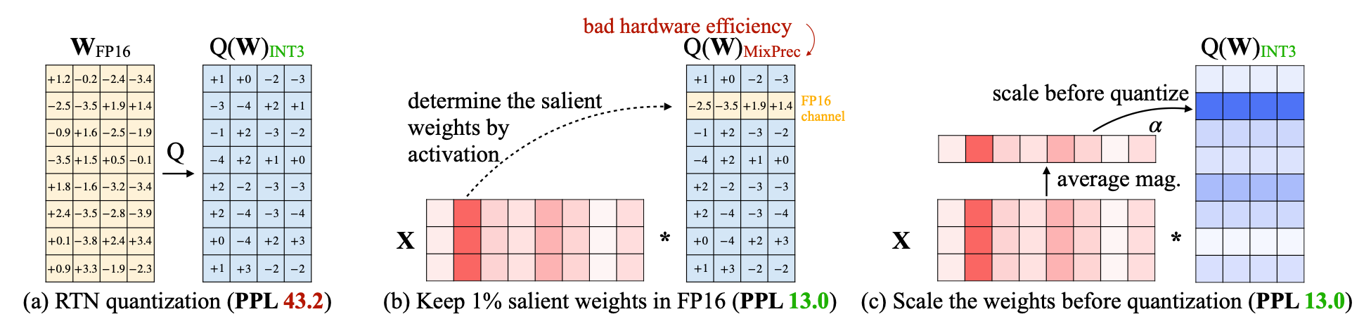
Mixed-Precision Quantization
It is found only 1% of salient weights channels in FP16 can greatly improve perplexity. But they are determined by the activation distribution, so Activation Aware Quantization (AWQ) is adopted
Outlier-Aware Quantization methods, allocating higher precision to outliers and lower precision to inliers, optimizing both performance and efficiency.

Slide 9
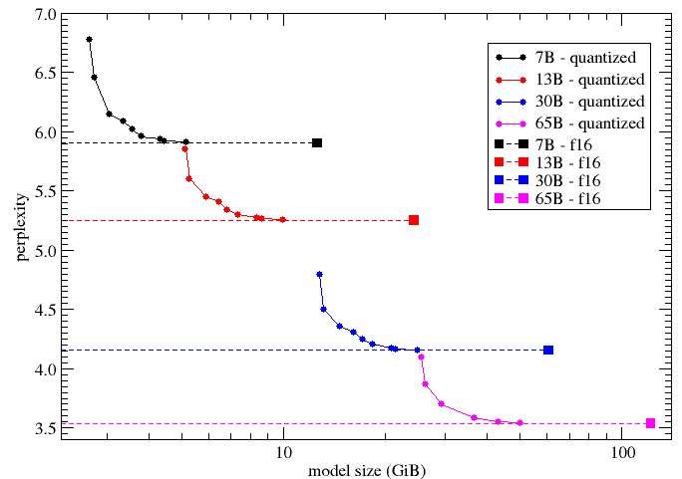
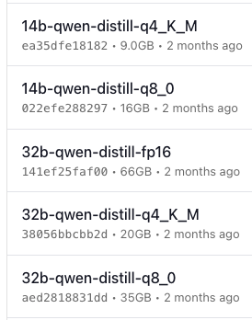
GPT-Generated Unified Format (GGUF)
K-Quants are advanced quantization techniques within the GGUF framework that allocate varying bit-widths to different model weights.
Type 0: w=d×q; Type M: half Q4, half Q6
Question: Larger Model vs Lower bit-width Quantization ?
 | Quantize Scheme | PPL | Size GB
7B | Q4_K_S | 6.0 | 3.56
 | Q6_K | 5.91 | 5.15
 | FP16 | 5.91 | 13
13B | Q2_K | 5.85 | 5.13
 | Q4_K_S | 5.34 | 6.80
 | Q6_S | 5.25 | 9.95
 | FP16 | 5.25 | 25
Notes:
Quantization Levels in K-Quants are denoted by labels like Q3_K_S or Q4_K_M, where the number indicates the bit-width, 'K' signifies the use of K-Quantization, and the suffix (e.g., '_S' or '_M') represents specific quantization configurations.

Slide 10
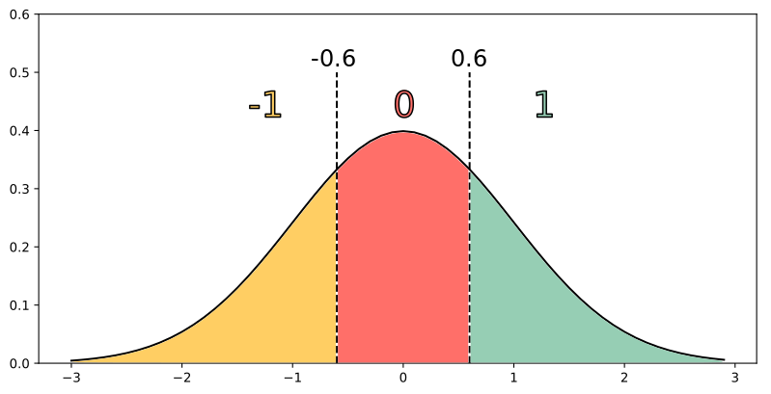
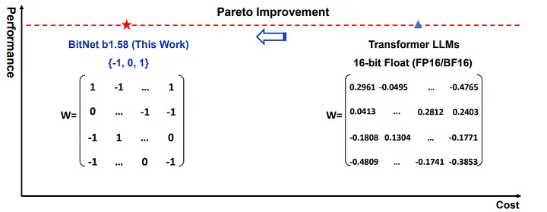
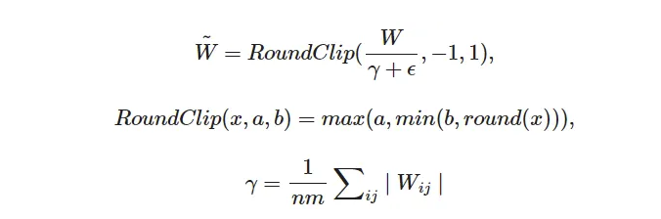
BitNet
BitNet Quantization uses ternary quantization (values of -1, 0, and 1) to reduce memory requirements and computational complexity with less accuracy loss.
Hardware implementation is simplified to addition and subtraction operations, significantly decreasing the energy overhead associated with multiplication.

Slide 11
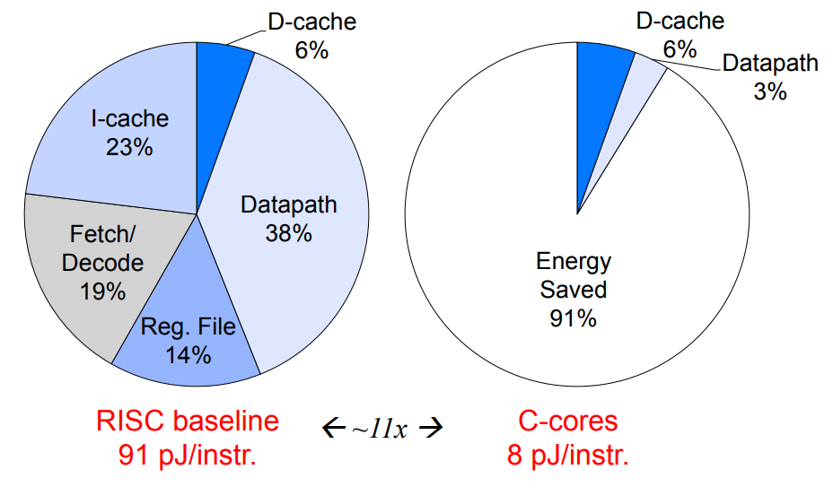
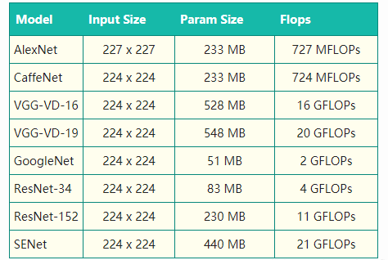

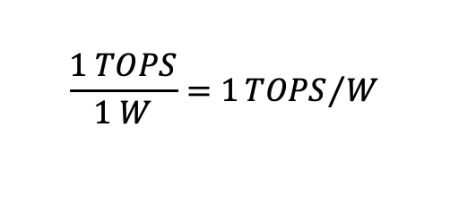
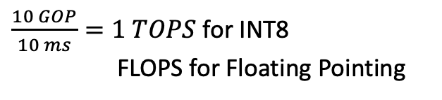
Metrics of Intelligent Compute Circuits
$Power=Rate×\frac{Energy}{Inference}=Rate×\frac{Operations}{Inference}$ $×\frac{Energy}{Operations}$
[Murmann, ESSCIRC
Workshop, 2020 ]
Throughput
Improve HW fabric,
Process technology
Ultimate
care-about
Effective Instruction Rate
$\frac{10 GOP}{10 ms}=1 TOPS$ for INT8
FLOPS for Floating Pointing
Operation Number.
Energy-Efficiency
$$\frac{1 TOPS}{1 W}=1{TOPS}/W$$
Question: Why RISC-based CPU is not efficient for AI Compute?

Slide 12
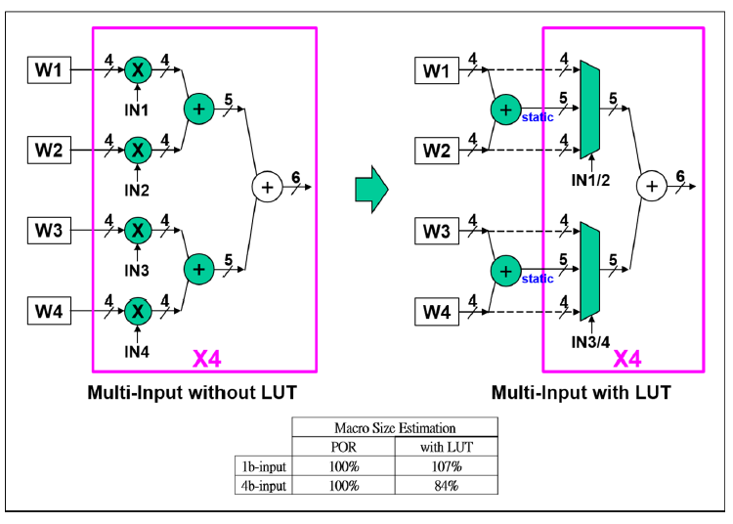
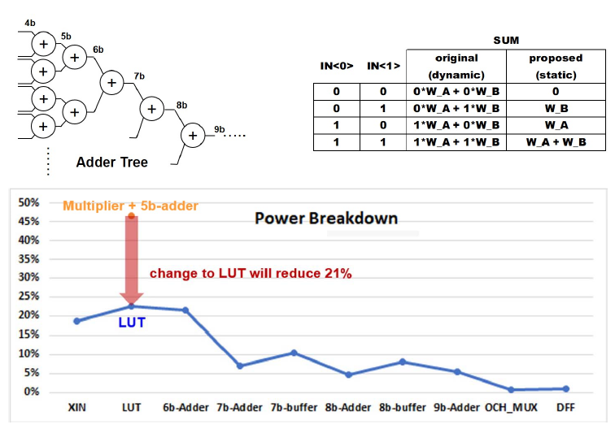
Efficient MAC Circuits: LUT
Look-up-table (LUT) based Multiplier and Accumulation circuits utilizes pre-computed sums as inputs. Part of the accumulation power can be shared for multiple inputs.

Slide 13
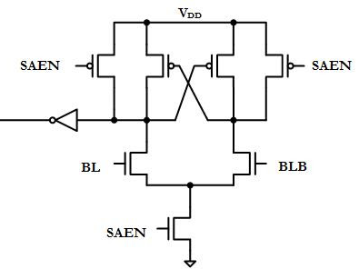
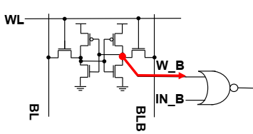
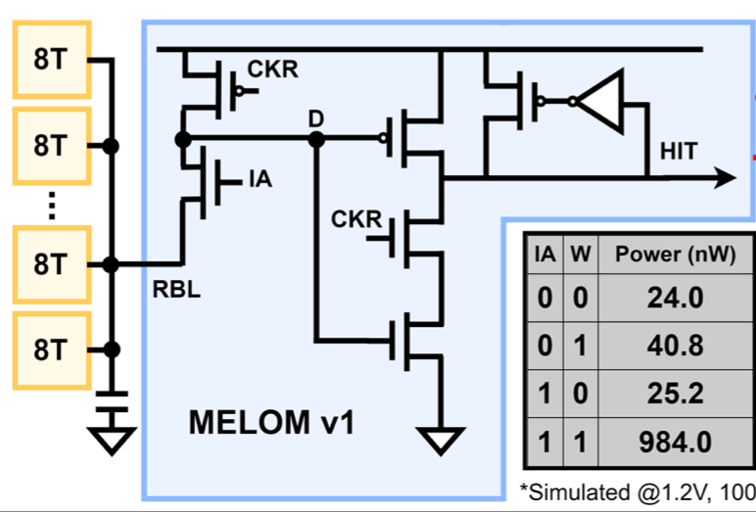
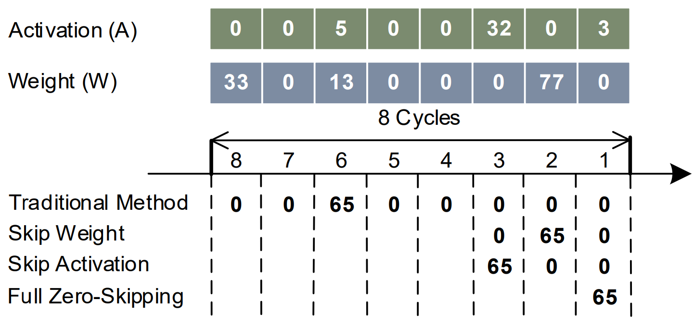
Efficient MAC Circuits: Logic Fusing
Customized CIM circuits that fuses bit-wise multiplier (AND), readout latch circuit (SA) and zero-detection based power saving technology into one gate.
Fudan Univ., ISSCC 2022
When A=W=BIT-1,then precharge.
W=0
IA=0
Bitwise Multiplication
Sense
Amplifier
Zero
Data
Gating

Slide 14
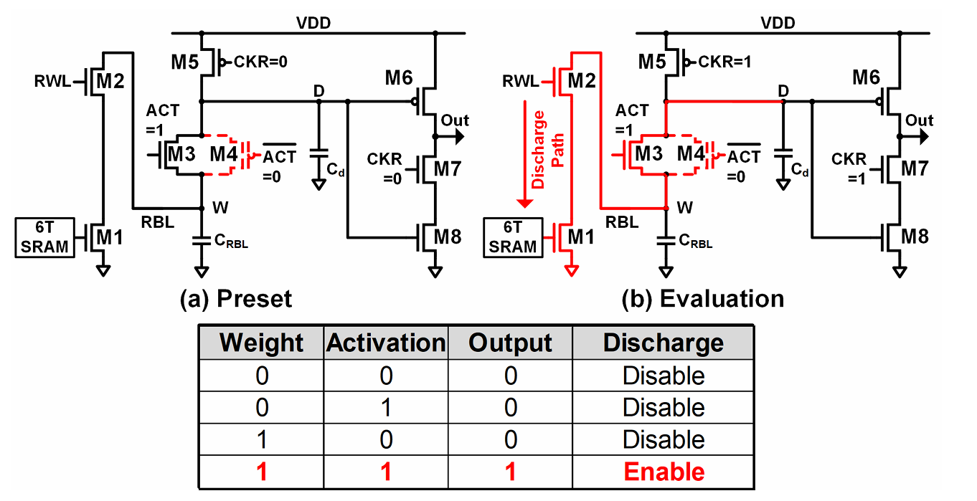
Efficient MAC Circuits: Logic Fusing
Customized CIM circuits that fuses bit-wise multiplier (AND), readout latch circuit (SA) and zero-detection based power saving technology into one gate.
Fudan Univ., ISSCC 2022

Slide 15
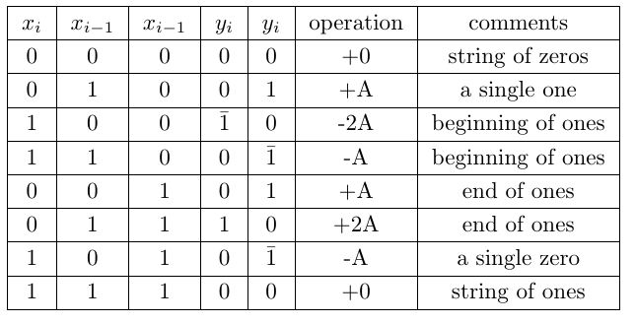
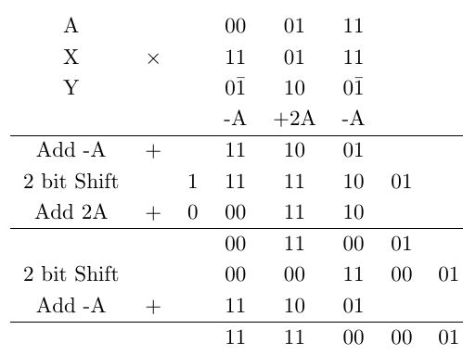
Efficient MAC Circuits: Booth Multiplier
Booth’s algorithm reduces the number of partial products in multiplication, allowing for fewer additions and subtractions. By encoding both positive and negative numbers in a binary form, Booth's multiplier efficiently handles signed numbers, reducing the complexity of multiplication
2

Slide 16
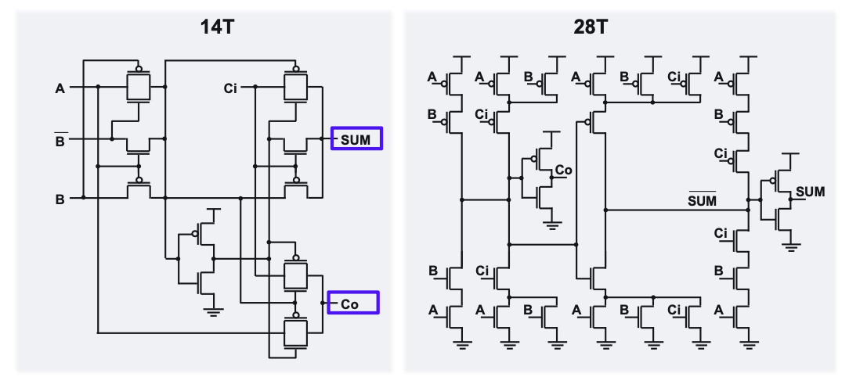
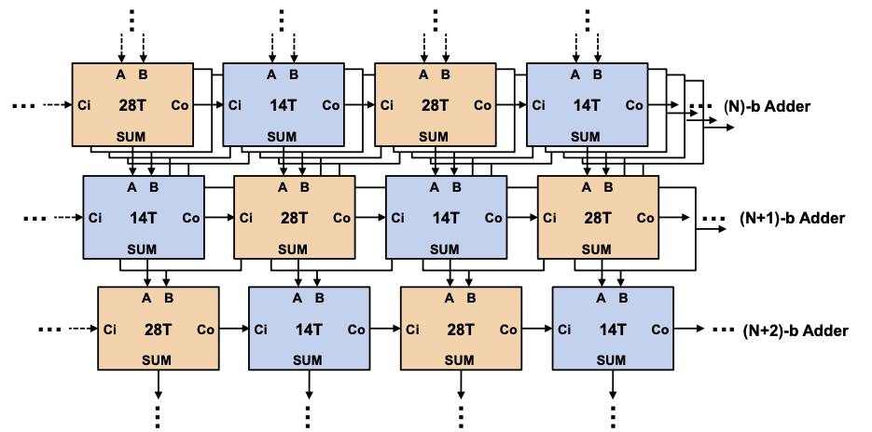
Efficient MAC Circuits: Full Adder
Different implementation of full adder in digital logic (14T vs. 28T) have different feature: low power/low driving strength …
Interleaving 28T and 14T full adders in the adder tree, the energy efficiency can be increased by 30%.

Slide 17
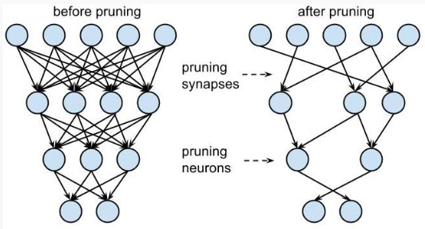
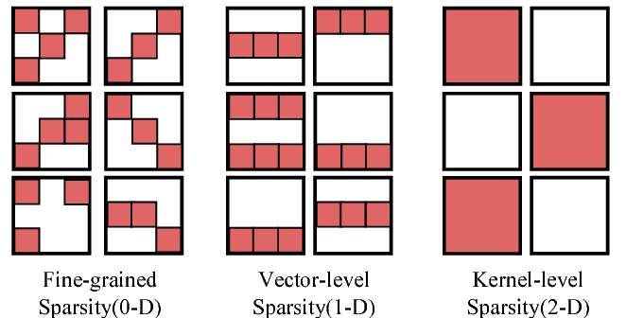
Sparse Computing & Pruning
Exploits inherent zeros in neural activations/weights (40-90% sparsity) to reduce memory transactions by 2-5×.
Structured Pruning: Removes entire neuron groups (vs. unstructured pruning) to maintain hardware-friendly data patterns, but cause accuracy loss.

Slide 18
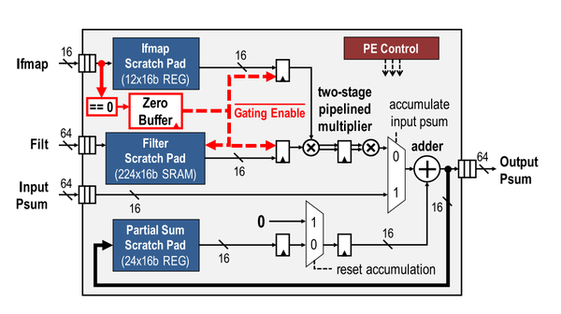
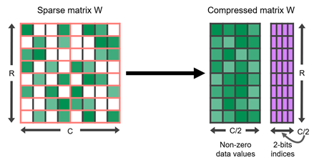
Sparse Computing
Modern GPUs use 2:4 bank balance sparse patterns (since NVIDIA Ampere) to achieve 2× throughput gains while maintaining 95% model accuracy
Zero-Skipping/Data Gating Multipliers: Specialized arithmetic units bypass zero-operand multiplications (30-70% of MAC operations).

Slide 19

Gather/Scatter Networks for Sparse Computing
For bank balance of large span, gather and scatter network (Buttferfly, Benes, etc) are used to extract feature elements corresponding to non-zero weight.
A transmission-gate based in-memory butterfly network is designed for 32:8 spasity
Fudan Univ., ISSCC 2023

Slide 20
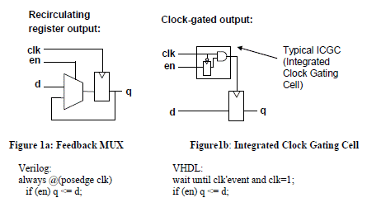
Clock Gating Circuits
Clock gating selectively disables the clock signal to inactive circuits, preventing unnecessary toggling. This reduces dynamic power consumption.
Latch-based clock gating helps prevent glitches on the clock output signal, assuming appropriate timing constraints are applied during design implementation. It also facilitate the enable signal can be synchronized with the clock.

Slide 21
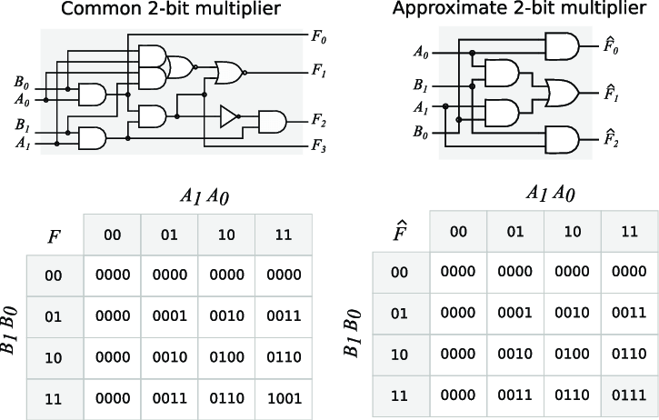
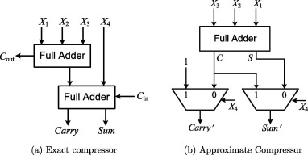
Approximate Computing
Approximate computing reduces precision in calculations to save energy. By eliminating carries in multiplier/adders, the circuit delay can decrease by 50%
Question: What is the truth table of the Approximate compressor ?

