Slide 1


智能片上集成系统设计
Introduction of Intelligent Computing Chip and System
Lecture 7 : Build a Simple RISC ISA
Instructor: Shiwei Liu, Assistant Professor

Slide 2
Overview of the Lecture
Objective: introduce the intelligent computing architecture from the view of ISA, and implement an very simple example.
Topics:
Review on Instruction Set Architecture
Build a very simple ISA with Verilog

Slide 3
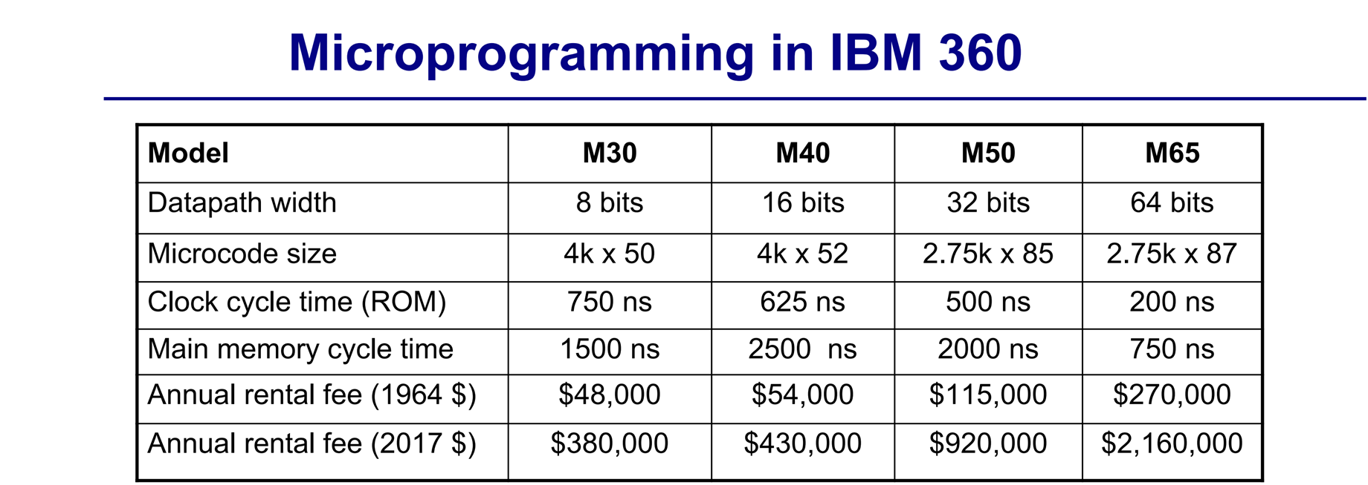
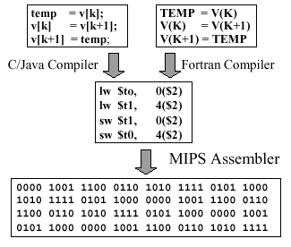
Instruction Set
An instruction set comprises the set of operations a processor can execute, serving as the interface between software and hardware, enabling software to control hardware functions effectively.
Assembly language, where programmers wrote instructions corresponding directly to instruction set, necessitating complex and hardware-specific programming.

Slide 4
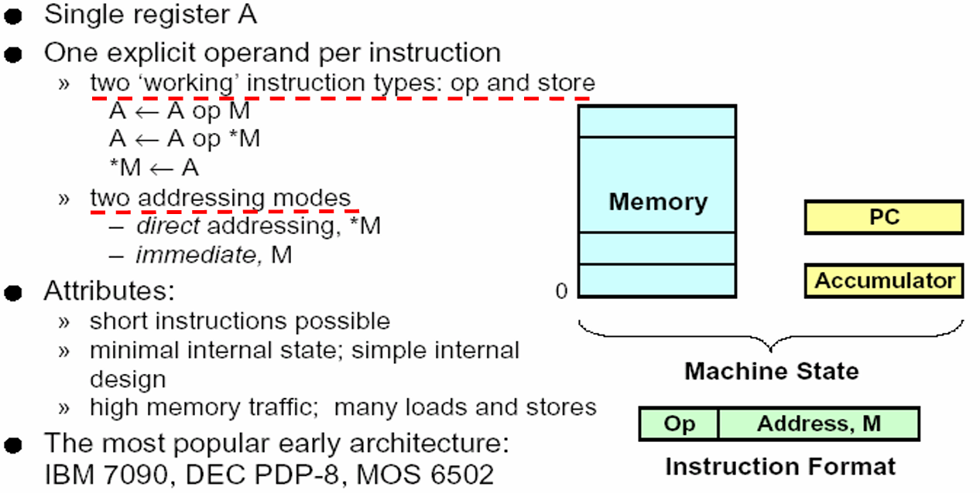
Accumulator Architecture

Slide 5
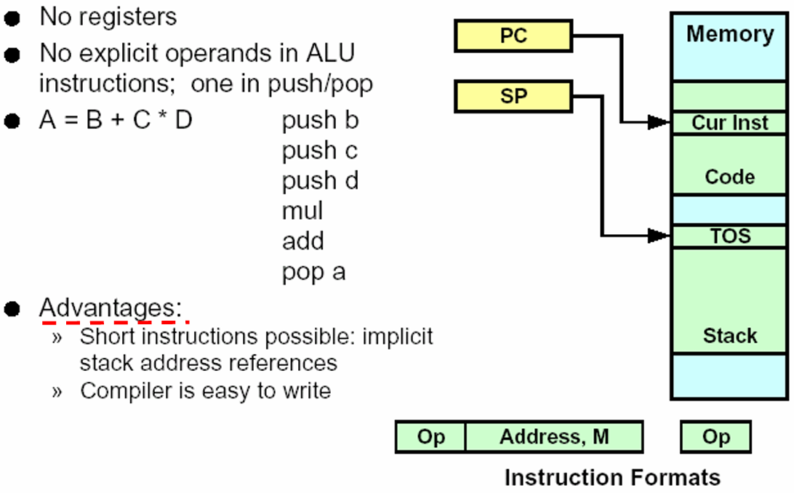
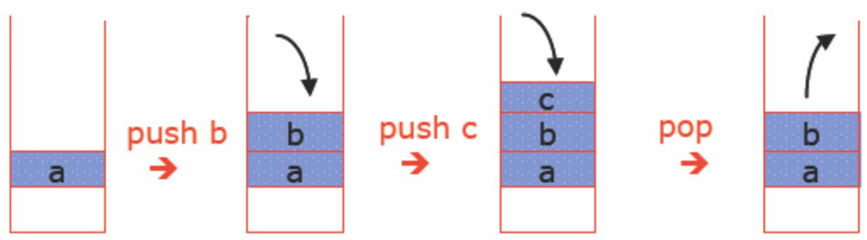
Stack Architecture

Slide 6
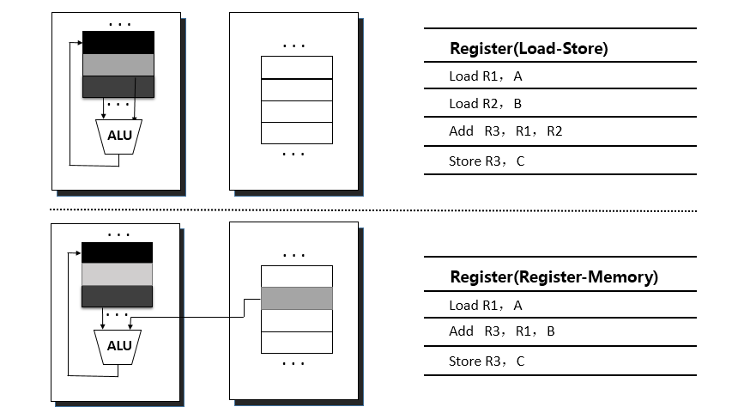
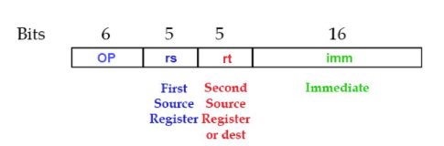
Load Store (General Purpose Register) Architecture
CISC architectures allow complex instructions that can directly access memory, enabling multiple operations within a single instruction
Load-store architecture restricts
memory access operations to
specific load and store instructions,
enhancing execution speed by
limiting direct memory access.
Which type of ld/store instruction sets?

Slide 7
Load Store (General Purpose Register) Architecture
Name | Register | Description
zero | x0 | Constant Value 0
ra | x1 | Return Address
sp | x2 | Stack Pointer
gp | x3 | Global Pointer
tp | x4 | Thread Pointer
t0-t2 | x5-x7 | Temporary Registers
s0/fp | x8 | Saved Register/Frame Pointer
s1 | x9 | Saved Register
a0-a1 | x10-x11 | Function Arguments/Return Value
a2-a7 | x12-x17 | Functions Arguments
s2-s11 | x18-x27 | Saved Registers
t3-t6 | x28-x31 | Temporary Registers
RISC-V features a total of 32 registers, numbered from 0 to 31, each serving a specific purpose. These registers play a crucial role in storing data, addresses, and intermediate results, optimizing the efficiency of program execution.
The zero register always holds the constant value 0. Any value written to this register is discarded, making it useful for operations where a fixed zero value is required.
Storage registers s0–s11 and t0–t6 are primarily used for storing variables during program execution. These registers help preserve data that needs to be accessed frequently without relying on slower memory.

Slide 8
Load Store (General Purpose Register) Architecture
Name | Register | Description
zero | x0 | Constant Value 0
ra | x1 | Return Address
sp | x2 | Stack Pointer
gp | x3 | Global Pointer
tp | x4 | Thread Pointer
t0-t2 | x5-x7 | Temporary Registers
s0/fp | x8 | Saved Register/Frame Pointer
s1 | x9 | Saved Register
a0-a1 | x10-x11 | Function Arguments/Return Value
a2-a7 | x12-x17 | Functions Arguments
s2-s11 | x18-x27 | Saved Registers
t3-t6 | x28-x31 | Temporary Registers
Function Calls: Certain registers in RISC-V are designated for handling function calls. The ra (return address) register stores the address to which the program should return after a function completes. Additionally, registers a0–a7 are used for passing function arguments and storing return values.
Stack Pointer: The stack pointer sp is a register that holds the address of the stack (memory). It typically points to the top of the stack and updates as data is pushed or popped, decreasing when new data is stored and increasing when data is removed. This register primarily utilized in function calls, local variable storage, and managing program execution flow.

Slide 9
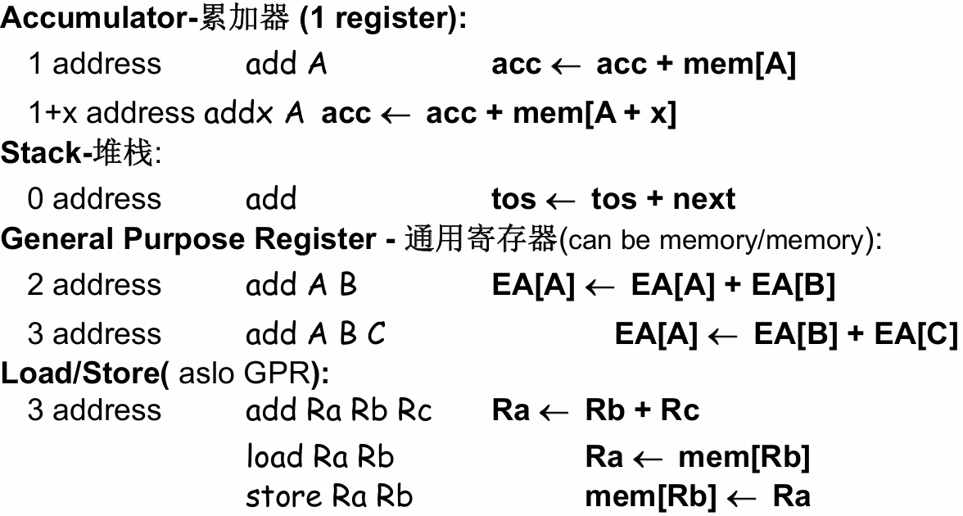
Comparison

Slide 10
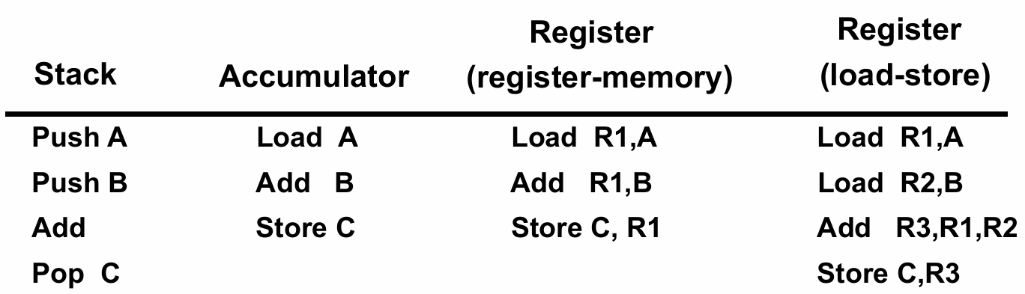
Comparison
Comparison of instruction sequences implementing the same function (C = A + B) using four different instruction sets.

Slide 11
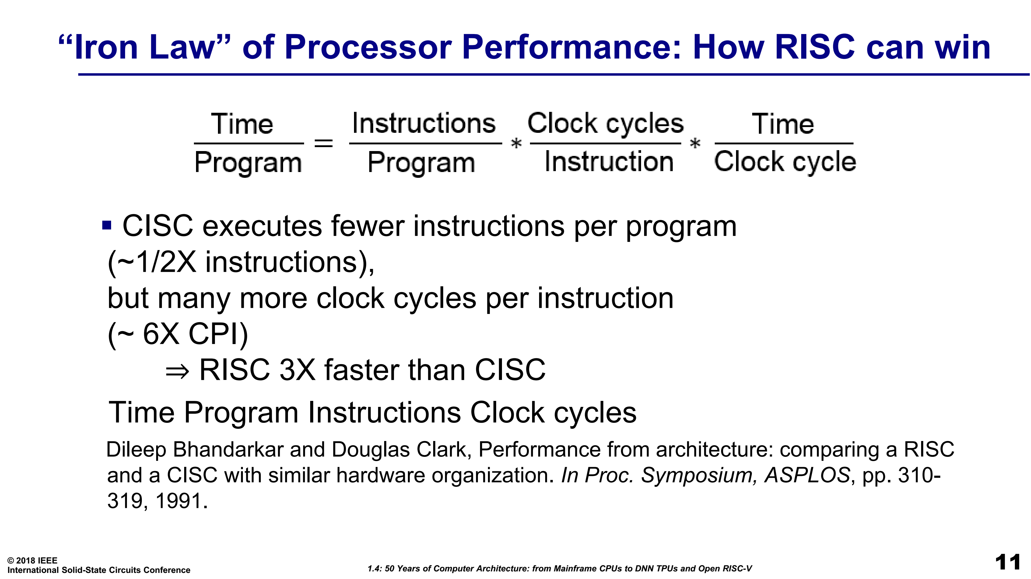
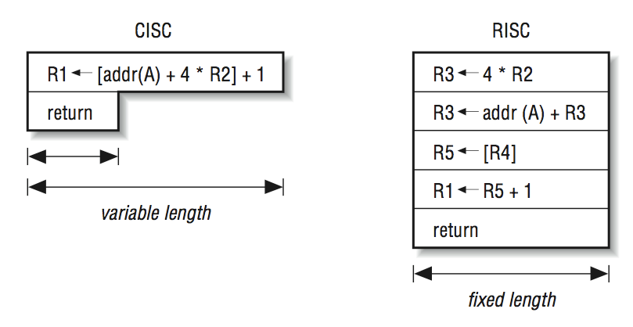
CISC vs RISC
CISC architectures aimed to reduce program size by incorporating a rich set of instructions, with less program size. Example: x86, x86-64bit
RISC emphasizes a smaller set of instructions for rapid execution and efficiency.
How to evaluate?
CISC executes fewer instructions per program (~1/2x instructions), but many more clock cycles per instruction
(~6X CPI)
Overall, RISC is 3x faster than CISC

Slide 12
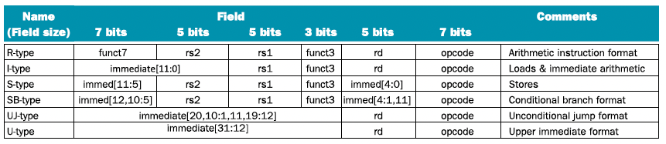
RISC-V Instruction Set
RISC-V is an open-source ISA based on the RISC principles. It is designed for simplicity and scalability, allowing customization for various applications
R-type instructions: register-register operations, where all operands are in registers.
I-type instructions: involve an immediate value, enabling operations where one operand is a constant.
S-type instructions are used for storing data, where rd is replaced by immediate.

Slide 13
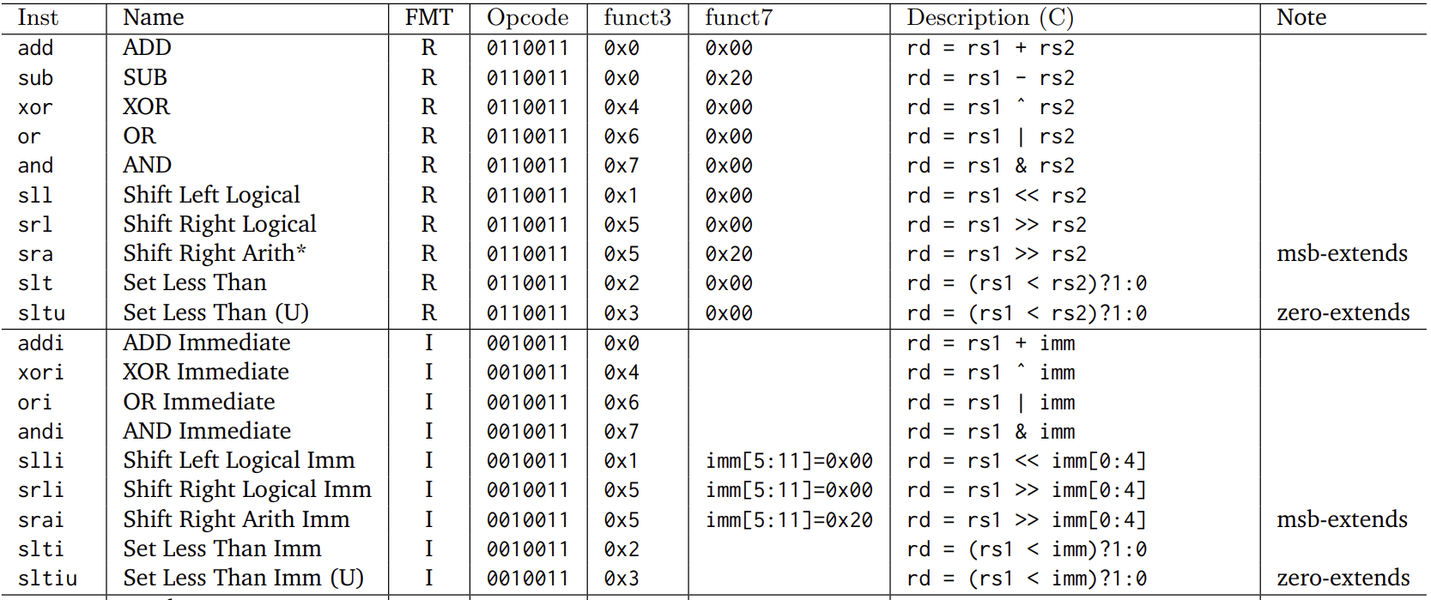
RISC-V Instruction Set

Slide 14
Let’s build a simple ISA
Total instruction length: 16 bit
Register File (RF) index number : 16 entry → register index length?
Opcode length: 3-bit
Operand type: destination / source register, immediate number
R-type
Opcode (3b) | Dest Reg (4b) | Src Reg 1(4b), Src Reg 2(4b) | Funct (1b)
Opcode (3b) | Dest Reg (4b) | Immediate Number (9b)
Opcode (3b) | Dest Reg (4b) | Src Reg (4b) | Immediate Number (5b)
I-type
L-type

Slide 15
Let’s build a simple ISA
Define only 4 instructions to compute MAC / tensor operations in neural network.
Option I: one add, and
one multiply instruction
Option II: one Mult-Acc.
instruction with different
funct flag configuration.
RISC Load-Store Architecture
Opcode | Dest Reg | Src Reg/Imm
Load | rd | rs+imm(5b)
Store | / | rs(addr), rs(data)
Move | rd | imm(9b)
MAC | rd | rs1, rs2, funct=0
 | rd | Rs1, /, fucnt=1

Slide 16
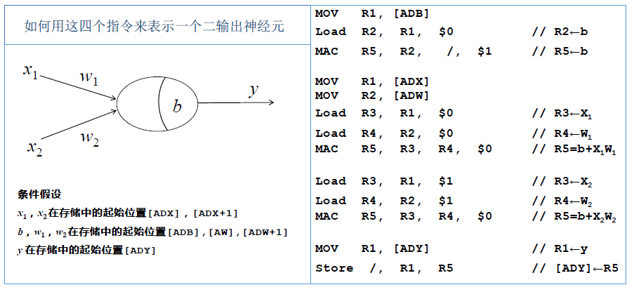
Let’s build a simple ISA
Write an assembly language program based on the ISA to compute a neuron.
Y=x1*w1+x2*w2+b
Assume:
  x1&x2 are stored in mem[ADX], [ADX+1]
  b, w1, w2 are stored in mem[ADB], [ADW], [ADW+1]
  y is stored in mem[ADY]

Slide 17
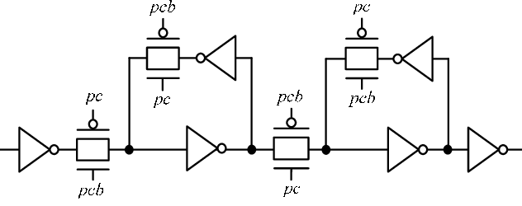
Let’s build a simple AI processor
How to built the simple AI processor according to the simple ISA.
Step 1: Register file module instantiation
module regfile #(
parameter REG_ADDR_WIDTH = 4,
parameter REG_DATA_WIDTH = 16,
parameter REG_NUMBER = 16
)(
input [REG_ADDR_WIDTH-1:0]rs1_addr,
input [REG_ADDR_WIDTH-1:0]rs2_addr,
input [REG_ADDR_WIDTH-1:0]rd_addr,
input [REG_DATA_WIDTH-1:0]rd_data,
input RegWEn,
input clk,rst,
output [REG_DATA_WIDTH-1:0]rs1_data,
output [REG_DATA_WIDTH-1:0]rs2_data
);
reg [REG_DATA_WIDTH-1:0]rf [REG_NUMBER-1:0];
assign rs1_data = rs1_addr==0 ? 0:rf[rs1_addr];
assign rs2_data = rs2_addr==0 ? 0:rf[rs2_addr];
always@(posedge clk or negedge rst) begin
if (!rst) begin
integer i;
for (i=0;i<REG_NUMBER;i=i+1) begin
rf[i] <=0;
end
end
else if (RegWEn&&rd_addr!=0)
rf[rd_addr] <= rd_data;
end
endmodule
rd
A
D
D
R
rs1
rs1
Reg
File
Data
rs2
rs2
D-FF based
RegFile
rd

Slide 18
Let’s build a simple AI processor
Step 2: Data and Instruction memory module instantiation
dataw
module dcmem #(
parameter MEM_ADDR_WIDTH=5,
parameter MEM_DATA_WIDTH=16,
parameter MEM_NUMBER=32
) (
input clk,
input MemWEn,
input [MEM_ADDR_WIDTH-1:0] addr,
input [MEM_DATA_WIDTH-1:0] dataw,
output [MEM_DATA_WIDTH-1:0] datar
);
reg [MEM_DATA_WIDTH-1:0]RAM [MEM_NUMBER-1:0];
always@(posedge clk)begin
if (MemWEn) begin
RAM[addr]<=dataw;
end
end
assign datar = RAM[addr];
endmodule
module icmem #(
parameter PC_WIDTH=16,
parameter ISA_WIDTH=16
) (
input clk,
input rst,
input inst_wen,
input [ISA_WIDTH-1:0] input_inst,
output [ISA_WIDTH-1:0] current_inst
);
reg [PC_WIDTH-1:0] pc;
always@(posedge clk or negedge rst)
if (!rst)
pc<=0;
else
pc<=pc+1;
dcmem inst_mem1(.clk(clk),
.MemWEn(inst_wen),
.addr(pc),
.dataw(input_inst),
.datar(current_inst));
endmodule
A
D
D
R
addr
DCM
DATA
datar
A
D
D
R
WEN
+
pc
ICM
Single/dual port SRAM/DRAM module

Slide 19
Let’s build a simple AI processor
Step 3: Arithmetic module instantiation
rs1
module MAC_ALU #(
parameter REG_DATA_WIDTH=16
) (
input funct, clk
input [REG_DATA_WIDTH-1:0]rs1,rs2,
output [REG_DATA_WIDTH-1:0]rd
);
wire [REG_DATA_WIDTH-1:0] product;
wire [REG_DATA_WIDTH-1:0] addend1,addend2;
reg [REG_DATA_WIDTH-1:0] psum;
assign product = $signed(rs1)*$signed(rs2);
assign addend1 = funct?0:product;
assign addend2 = funct?rs2:psum;
assign rd = addend1+addend2;
always @ (posedge clk)
begin
if (funct)
psum < =0;
else
psum <= rd;
end
endmodule
rd
X
+
0
rs2
（Opcode）
psum
A
（DFF）
B
MUX
module MUX(S,A,B,C,D,Y)
input[1:0]S;
input A,B,C,D;
output Y;
assign Y=(S==2’b00)? A : ( (S==2’b01)? B : (
(S==2’b10)? C : D ))；
endmodule
Y
C
D
S

Slide 20
Let’s build a simple AI processor
Step 4: Top-level instantiation
A
D
D
R
A
D
D
R
A
D
D
R
pc
RF
+
ICM
DATA
DCM
DATA
MAC
module ai_core_top #(
input …
input …
output …
);
…
endmodule

Slide 21

Let’s build a simple AI processor
Step 5: Interconnect
Decode module
+ Instruction memory
Imm Gen
D
E
C
O
D
E
R
rd
A
D
D
R
A
D
D
R
rs1
RF
rs2
DCM
DATA
A
D
D
R
+
pc
ICM
DATA
MAC

Slide 22
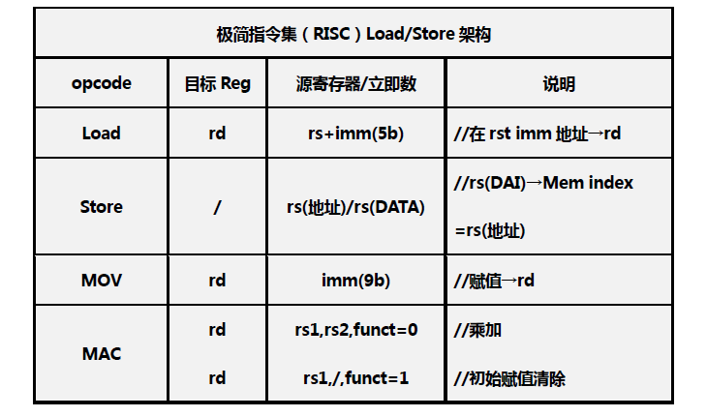
Let’s build a simple AI processor
Step 6: Interconnect
Decode module
+ Register File
+ Load instruction
Imm Gen
5b
D
E
C
O
D
E
R
rd
+
M
U
X
A
D
D
R
A
D
D
R
rs1
rs1
RF
rs2
DCM
DATA
A
D
D
R
+
pc
rd
ICM
DATA
MAC
MUX Ctrl
M
U
X
Notes:
wen

Slide 23
Let’s build a simple AI processor
Step 7: Interconnect
Decode module
+ Register File
+ Store instruction
Imm Gen
5b
D
E
C
O
D
E
R
rd
+
A
D
D
R
A
D
D
R
M
U
X
rs1
rs1
DCM
DATA
RF
rs2
rs2
A
D
D
R
+
pc
rd
ICM
DATA
MAC
MUX Ctrl
M
U
X

Slide 24
Let’s build a simple AI processor
Step 8: Interconnect
Decode module
+ Register File
+ MAC instruction
Imm Gen
5b
D
E
C
O
D
E
R
rd
+
M
U
X
A
D
D
R
A
D
D
R
rs1
rs1
DCM
DATA
RF
rs2
rs2
A
D
D
R
+
pc
rd
ICM
DATA
MAC
MUX Ctrl
M
U
X

Slide 25
Let’s build a simple AI processor
Step 9: Interconnect
Decode module
+ MOV instruction
Question: How to write
the decoder?
9b
Imm Gen
5b
D
E
C
O
D
E
R
rd
+
A
D
D
R
A
D
D
R
M
U
X
rs1
rs1
DCM
DATA
RF
rs2
rs2
A
D
D
R
+
pc
rd
ICM
DATA
MAC
MUX Ctrl
M
U
X

Slide 26
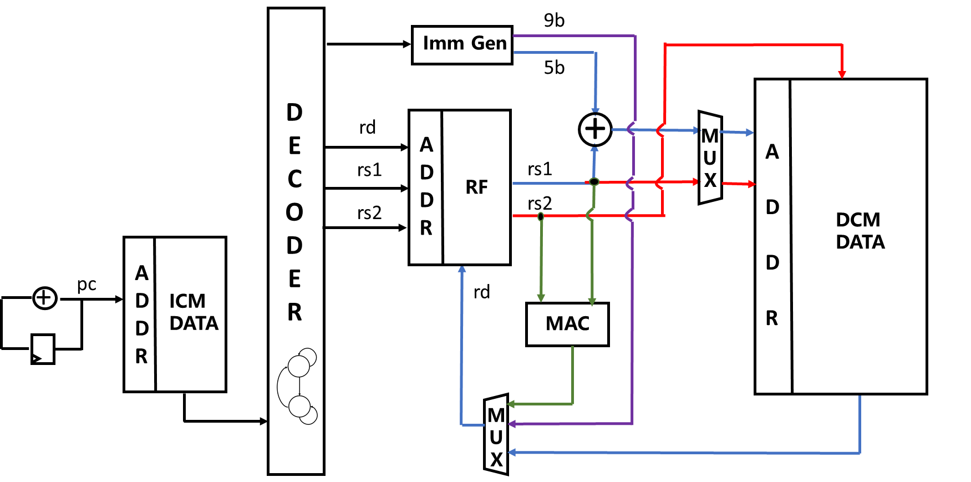
Performance Limit of Single Cycle Implementation
The current architecture is single-cycle implementation, where the clock frequency is limited by the critical path of the entire instruction.
CPU Performance:
NN Compute Performance (TOPS):
Operation #
second
2 MAC #
Instructions
=
Instructions
Clock Cycle
Clock Cycle
Time (1s)
x
x

Slide 27
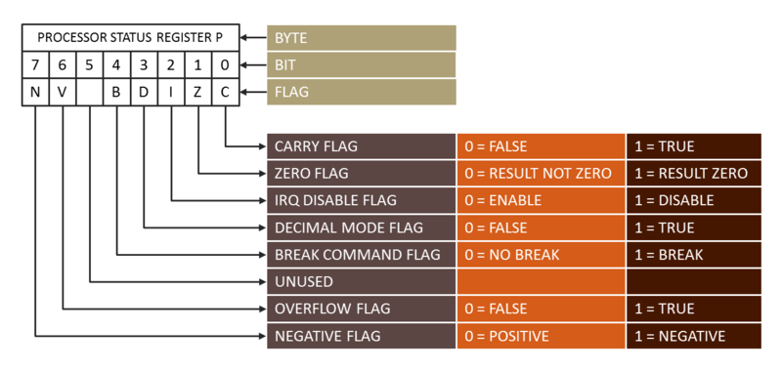
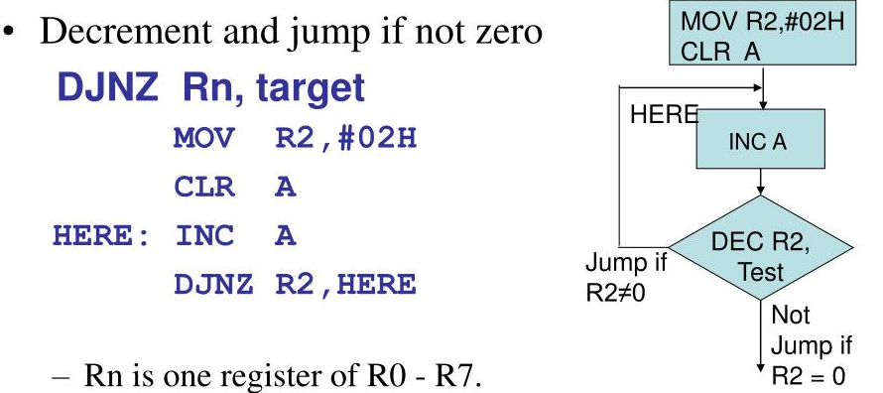
Status Register in RISC
The status register holds flags that reflect the outcomes of arithmetic and logical operations, such as zero, carry, negative, and overflow, facilitating conditional branching and decision-making.
By utilizing status registers, RISC processors can enable efficient execution of conditional branches without the need for complex instruction
Loop Implementation with DJNZ in 8051

