Slide 1
MASTER’S THESIS DEFENCE
Learning to Separate
Neural hit assignment for overlapping electron showers in LDMX
Eliot Montesino Petrén
Lund University · Faculty of Engineering (LTH)
Supervisor: Lene-Kristian Bryngemark · Co-supervisor: Ruth Pöttgen
Notes:
[Timing: 0:00–0:15]
Good morning. My thesis is called ‘Learning to Separate’. The problem is very concrete: when several beam electrons arrive in the same LDMX readout window, their electromagnetic showers overlap. I ask whether set-based neural networks can recover which electron produced each calorimeter hit, and whether a richer model can also identify shared deposits and infer the electron multiplicity. I will begin with the physics motivation, then describe the reconstruction task and models, and spend most of the talk on what succeeds, what fails, and why.
[Sources]
- Thesis title page and abstract: main.tex and sections/00abstract.tex.

Slide 2
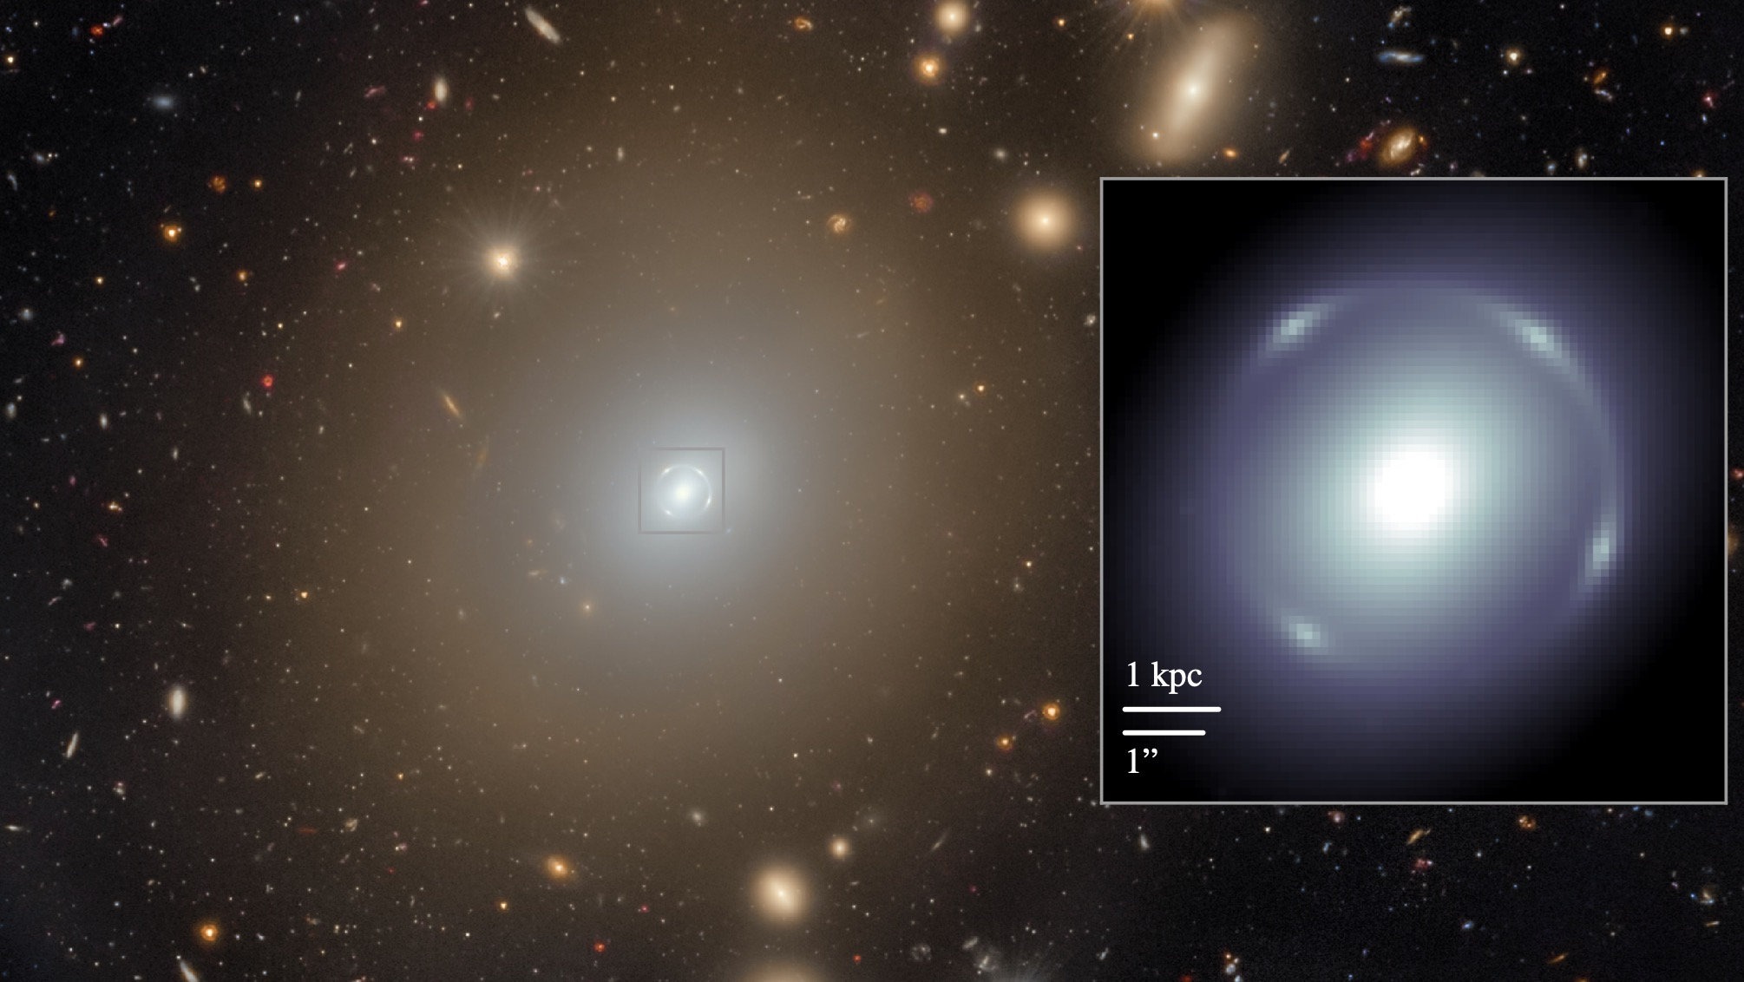
Gravity reveals missing mass—but not its particle identity
≈11%
dark-matter fraction inferred
inside the Einstein radius
Gravity maps unseen mass.
Particle identity: unknown.
Strong lensing constrains total projected mass—not dark matter alone.
Euclid NGC 6505 · O’Riordan et al. (2025) · arXiv:2502.06505
2
Notes:
[Timing: 0:15–1:00]
This Euclid image shows the foreground galaxy NGC 6505 bending light from a more distant galaxy into an almost complete Einstein ring. Lensing constrains the total projected mass; it is not a direct image of dark matter. Combining lensing and spectroscopic modelling, the paper infers a dark-matter fraction of about eleven percent inside the Einstein radius. Across astronomy and cosmology, gravitational effects require far more mass than visible baryons provide, but no dark-matter particle or non-gravitational interaction has been confirmed. That is the gap between knowing that dark matter shapes the Universe and knowing what it is made of. Dark matter shapes the Universe, but its particle identity remains unknown.
[Sources]
- Local image thesis_report/presentation/euclid_dark_matter_einstein_ring.jpg, extracted from Figure 1 of C. M. O’Riordan et al. (Euclid Collaboration), ‘Euclid: A complete Einstein ring in NGC 6505’, Astronomy & Astrophysics 694, A145 (2025), arXiv:2502.06505, DOI 10.1051/0004-6361/202453014.
- Figure data credit: ESA/Euclid/Euclid Consortium/NASA; the paper reports an inferred dark-matter fraction 11.1^{+5.4}_{-3.5}% inside the Einstein radius.
- Thesis sections/2theory.tex, ‘Dark Matter Particle Physics’; bibliography keys cirelli2026-darkmatter and battaglieri2017-cosmic-visions.

Slide 3
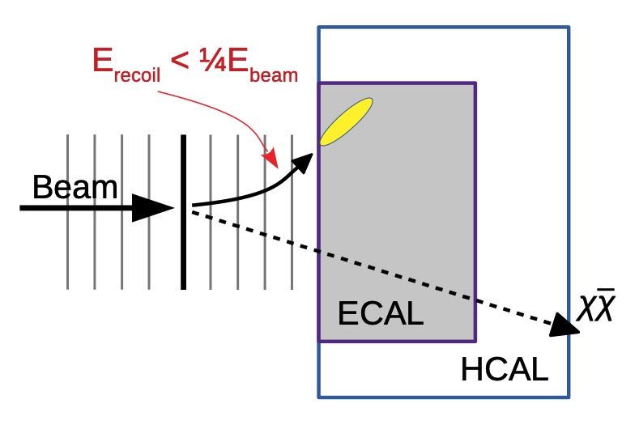
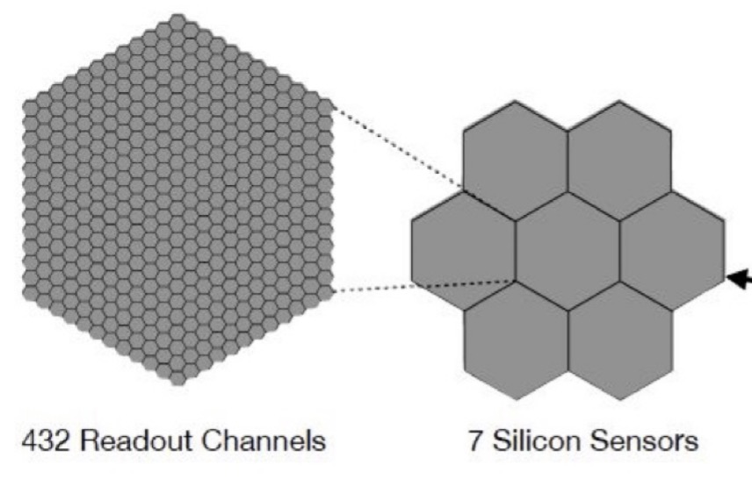
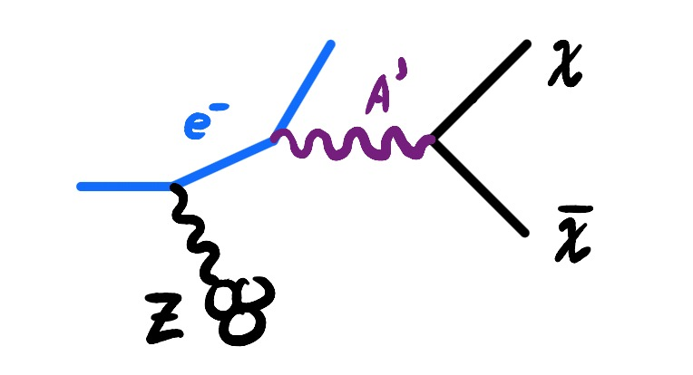
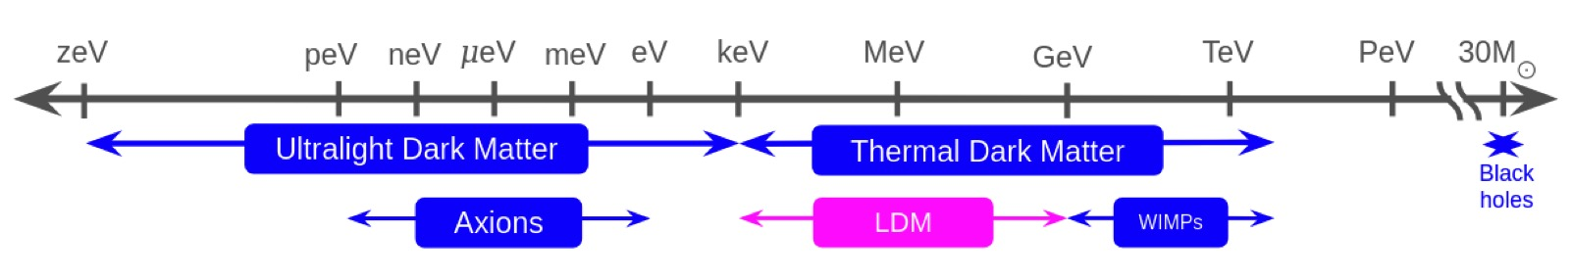
The missing-momentum search opens the sub-GeV frontier
MeV → GeV
Accelerators can produce light dark-sector states where conventional nuclear-recoil searches lose sensitivity—and infer them from momentum imbalance.
Thesis §§2.1–2.2 · active thesis Figure 3 · Battaglieri et al. (2017)
3
Notes:
[Timing: 1:00–2:00]
Below roughly a GeV, nuclear-recoil searches become increasingly limited by kinematics and detector thresholds. Accelerator experiments can instead produce light dark-sector states. The active thesis Figure 3 sketches the benchmark used here: an electron scatters in the target field and radiates a dark photon, A-prime, which decays to an invisible chi–anti-chi pair. The outgoing electron provides the visible recoil needed to infer the imbalance. The mass strip places the LDMX motivation in the MeV-to-GeV range. This dark-photon picture is a concrete benchmark, not a claim that the thesis tests every possible dark-matter model. The thesis itself addresses the reconstruction problem that appears when LDMX operates at useful beam intensity.
[Sources]
- Thesis sections/2theory.tex, ‘Thermal Relics and the Sub-GeV Frontier’ and ‘Dark Photons as Benchmark Mediators’.
- config/fig/dark_bremsstrahlung_feynman.jpg is active-thesis Figure 3; thesis-authored sketch inspired by bibliography key helgstrand2025veto_power.
- config/fig/dm_range.jpeg; thesis provenance: gajdan2025-hcal-thesis, inspired by battaglieri2017-cosmic-visions.
- Physics context: bibliography keys battaglieri2017-cosmic-visions, akesson2018-ldmx and ldmx2025-overview.

Slide 4
LDMX searches for invisible particles through missing momentum
Fine granularity matters
7 silicon modules per sampling plane
432 full-resolution cells per module
32 simulated hit-layer positions
Thesis §2.2 · Åkesson et al. (2018) · LDMX Collaboration (2025)
4
Notes:
[Timing: 2:00–3:05]
LDMX is a fixed-target missing-momentum experiment. An 8 GeV electron is measured before it reaches a thin tungsten target. If it produces invisible particles, the recoil electron carries less energy and a transverse kick, while no visible particle accounts for the imbalance. The tagging and recoil trackers measure the electron, and the electromagnetic and hadronic calorimeters test whether visible activity explains what is missing. The ECal is a high-granularity silicon–tungsten sampling calorimeter. Each sampling plane contains seven hexagonal modules, and each module contains 432 full-resolution silicon cells. In the simulation geometry used for this thesis, reconstructed hits occur at 32 layer positions. That segmentation gives the reconstruction useful three-dimensional structure—but it also means one electron shower becomes a large set of cell measurements rather than one isolated object.
[Sources]
- config/fig/beam_electron_schematic.jpg, from thesis citation akesson2018-ldmx.
- Local crop thesis_report/presentation/ecal_hexagonal_cells.jpg, derived from config/fig/ecal_cells_and_layers.jpg and Figure 3.60 of the LDMX design report, bibliography key ldmx2025-overview.
- Seven modules per plane, 432 cells per module and 32 reconstructed-hit layer positions: thesis sections/2theory.tex, ‘Electromagnetic Calorimeter’.

Slide 5
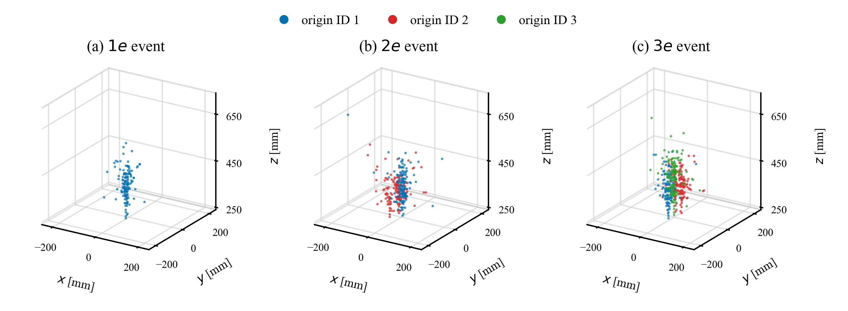
Pile-up converts exposure into overlapping showers
26.4%
of beam buckets contain at least two electrons when μ = 1
P(N=m) = μᵐ exp(−μ) / m!
More electrons per bucket increase usable exposure—but several showers can occupy the same cells.
Truth colours are unavailable to the model
Thesis §§2.2.6, 4.2 · event display uses simulation truth
5
Notes:
[Timing: 3:05–4:05]
At a mean occupancy of one electron per bucket, multi-electron buckets are not rare: 26.4 percent contain at least two electrons. Lowering the occupancy reduces pile-up, but it also reduces electrons on target per unit time. The potential gain is therefore to reconstruct, rather than automatically discard, multi-electron readouts. The right-hand figure shows simulated one-, two-, and three-electron ECal events. Every marker is a selected reconstructed hit, and the colours indicate the truth electron with the largest deposited-energy contribution. Those colours are available only in simulation. In real inference the network sees positions, energies and trigger-pad context. The electromagnetic cascades overlap over many layers, and multiple electrons may contribute energy to the same cell. That makes this an information-losing inverse problem, not simply a matter of drawing a geometric boundary between clean clusters.
[Sources]
- Thesis sections/2theory.tex, ‘Pile-Up and Reconstruction’; Poisson calculation at μ=1.
- Thesis sections/4Methodology.tex, ‘Multi-Electron Event Simulation’.
- Figure asset config/fig/ecal_truth_event_displays.png, thesis-authored from simulated truth.

Slide 6
Reconstruction is an inverse problem with information loss
Forward detector response
Learned reconstruction
Particles become detector objects
Objects become task estimates
Underlying event Y
↓
Detector response S
↓
Observed objects X
Observed objects X
↓
Learned model Rθ
↓
Hit origin · fractions · count
Finite granularity, thresholds, noise and shared cells make the inverse non-unique.
Thesis §§2.2.6, 2.3, 4.2 · inverse-map framing adapted from MLPF
6
Notes:
[Timing: 4:05–4:55]
Let me frame the problem more generally. The detector simulation maps an underlying particle event, Y, to reconstructed detector objects, X. Reconstruction would like to go in the opposite direction—but this is not a literal inverse. Finite cell size, thresholds, noise and overlapping deposits lose information, so several underlying events can be compatible with the same observed response. A learned model therefore approximates a task-specific inverse: from X, it estimates only the quantities needed here. Those are which electron dominates each ECal hit, which electrons share it and with what fractions, and—later in TRACE—whether two or three electron slots are valid. Simulation is useful because it supplies paired X and task targets. The next slide shows how those pairs are constructed while keeping truth out of the model input.
[Sources]
- Thesis sections/2theory.tex, ‘Pile-Up and Reconstruction’ and ‘Learning a Reconstruction Mapping’.
- Thesis sections/4Methodology.tex, ‘Reconstruction Formulation’.
- Inverse-map framing adapted in the thesis from J. Pata et al., ‘MLPF: Efficient machine-learned particle-flow reconstruction using graph neural networks’, EPJC 81 (2021) 381, bibliography key pata2021-mlpf.

Slide 7
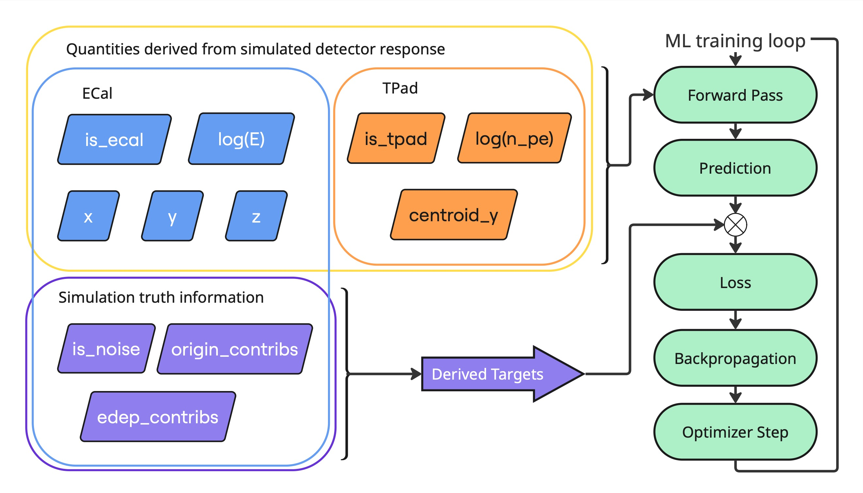
The network sees detector readout—not simulation truth
Input set: ECal (x, y, z, E) + TPad (centroid, photoelectrons) → Targets: dominant origin, contributor set, energy fractions
Thesis §4.3 · reconstructed inputs; truth only defines targets and metrics
7
Notes:
[Timing: 4:55–5:40]
The supervised boundary is important. The model receives only reconstructed detector quantities: for each ECal hit, its cell position and reconstructed energy; for each trigger-pad track, a centroid and photoelectron count. Detector-type flags place both object types in one variable-sized eight-column set. Reconstructed and simulated hits are matched by cell identifier during conversion. Simulation truth then supplies the deposited energy from each overlay origin, which defines the hard dominant-origin label and, for TRACE, the exact contributor subset and continuous fractions. Truth never enters the feature tensor. Trigger-pad tokens have no per-electron target, but they can provide event context; an ECal mask removes their outputs from the loss. The rows remain unordered. This clean separation between detector inputs and truth-derived supervision is also what makes the data-conversion framework reusable for future models.
[Sources]
- Thesis sections/4Methodology.tex, ‘Selected Detector Data and Simulation Truth’, ‘Target Definition’, and ‘Combined Event Tensor’.
- Figure asset config/fig/readout_vs_truth.jpg, thesis-authored.
- Tensor index correction used in notes: continuous columns are 3–8; the prose statement 3–6 is an apparent typo.

Slide 8
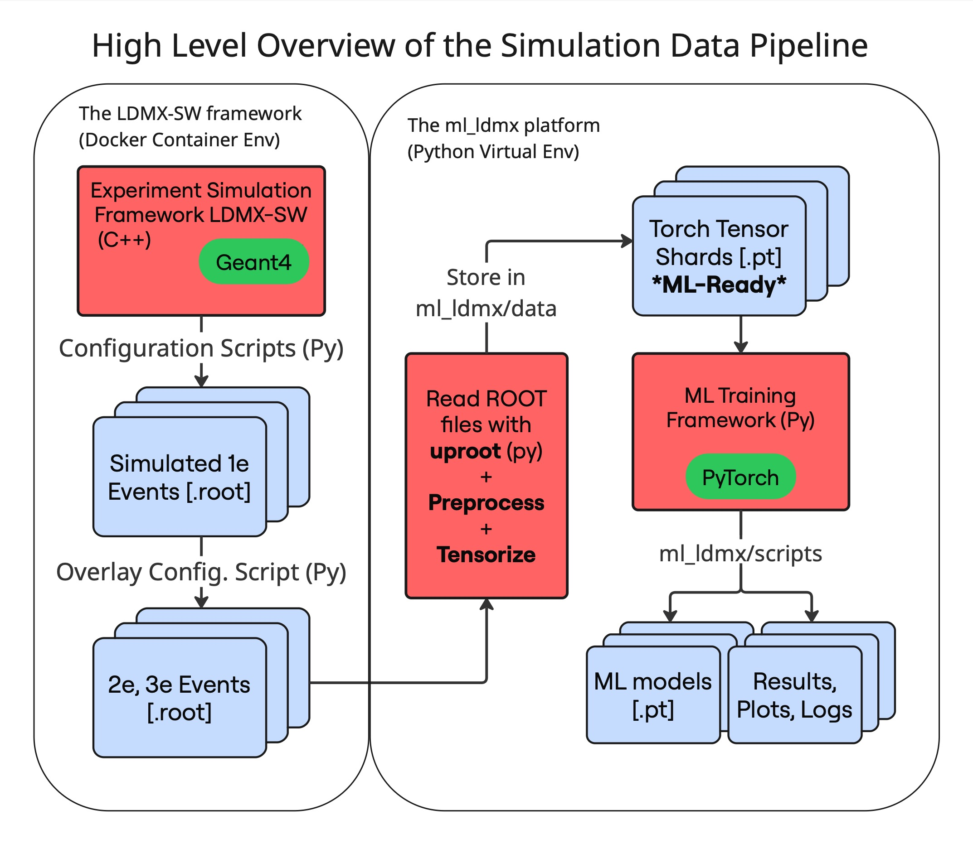
Ten million overlays per multiplicity anchor the study
10⁷
10⁷
two-electron events produced
three-electron events produced
10⁶
80/10/10
events in each final baseline campaign
train / validation / held-out test
Independent 1e histories are overlaid by detector channel before digitisation and reconstruction. No dark-sector signal is injected.
Thesis §§4.1–4.4 · ldmx-sw v4.7.3 · 8 GeV beam
8
Notes:
[Timing: 5:40–6:20]
The samples are built from inclusive, non-signal 8 GeV single-electron simulations. Two-electron events contain one main and one overlaid electron; three-electron events contain one main and two overlays. The particle histories are independent, which is reasonable because direct electron–electron interactions are negligible, but their detector deposits are combined by channel before digitisation and reconstruction. Shared cells and reconstruction effects are therefore treated jointly. Ten million events of each multiplicity were produced, using disjoint source inputs so an electron was not reused. Each reported fixed-multiplicity model uses one million events, split 80, 10 and 10 percent, with the test set held out until the final comparison. This scale supports detailed failure analysis, but it is not a demonstration of the experiment-level background rejection requirement and contains no injected dark-matter signal.
[Sources]
- Thesis sections/4Methodology.tex, ‘Simulation and Data Pipeline Overview’, ‘Single Electron Event Simulations’, and ‘Multi-Electron Event Simulation’.
- Figure asset config/fig/data_pipeline.jpg, thesis-authored.
- Dataset versions and sizes from Tables tab:version_summary and tab:dataset_summary.

Slide 9
Two set encoders test local and global interaction
GravNet
Transformer
Sparse learned neighbourhoods
Global self-attention
• 8 → 128 input projection
• 4 residual GravNet blocks
• learned space dₛ = 4, k = 16
• local propagation after neighbour search
• 0.268 M parameters
• 8 → 128 → 128 projection
• 3 pre-LN encoder blocks
• 4 heads, FFN 128 → 256 → 128
• every valid token can attend to every other
• 0.416 M parameters
Same task: one class per ECal hit · separate 2e and 3e models · TPad tokens provide context only
Thesis §§2.3, 4.5 · Qasim et al. (2019) · Vaswani et al. (2017)
9
Notes:
[Timing: 6:20–7:10]
The controlled baseline comparison uses the same eight input features and the same hit-assignment task. GravNet embeds each detector object and constructs sparse neighbourhoods in a learned coordinate space. Four residual blocks propagate information among sixteen learned neighbours. The Transformer instead applies three pre-layer-normalised encoder blocks with full self-attention, so every valid object can interact with every other object in the event. There is no sequence positional encoding: storage order has no physical meaning, and x, y and z are already features. Both networks are permutation equivariant and emit one class prediction per ECal hit. The fixed-count formulation trains separate two- and three-electron classifiers. The Transformer has more parameters, but this is not a capacity-minimisation study or a universal architecture benchmark. It asks whether sparse learned locality or global attention offers a clear advantage for this simulated reconstruction task.
[Sources]
- Thesis sections/2theory.tex, ‘Graph Neural Networks and GravNet’, ‘Transformer Encoders and Self-Attention’, and ‘GravNet–Transformer Analogy’.
- Thesis sections/4Methodology.tex, ‘GravNet Baseline’ and ‘Transformer Baseline’.
- Architecture references: qasim2019-gravnet and vaswani2017attention.

Slide 10
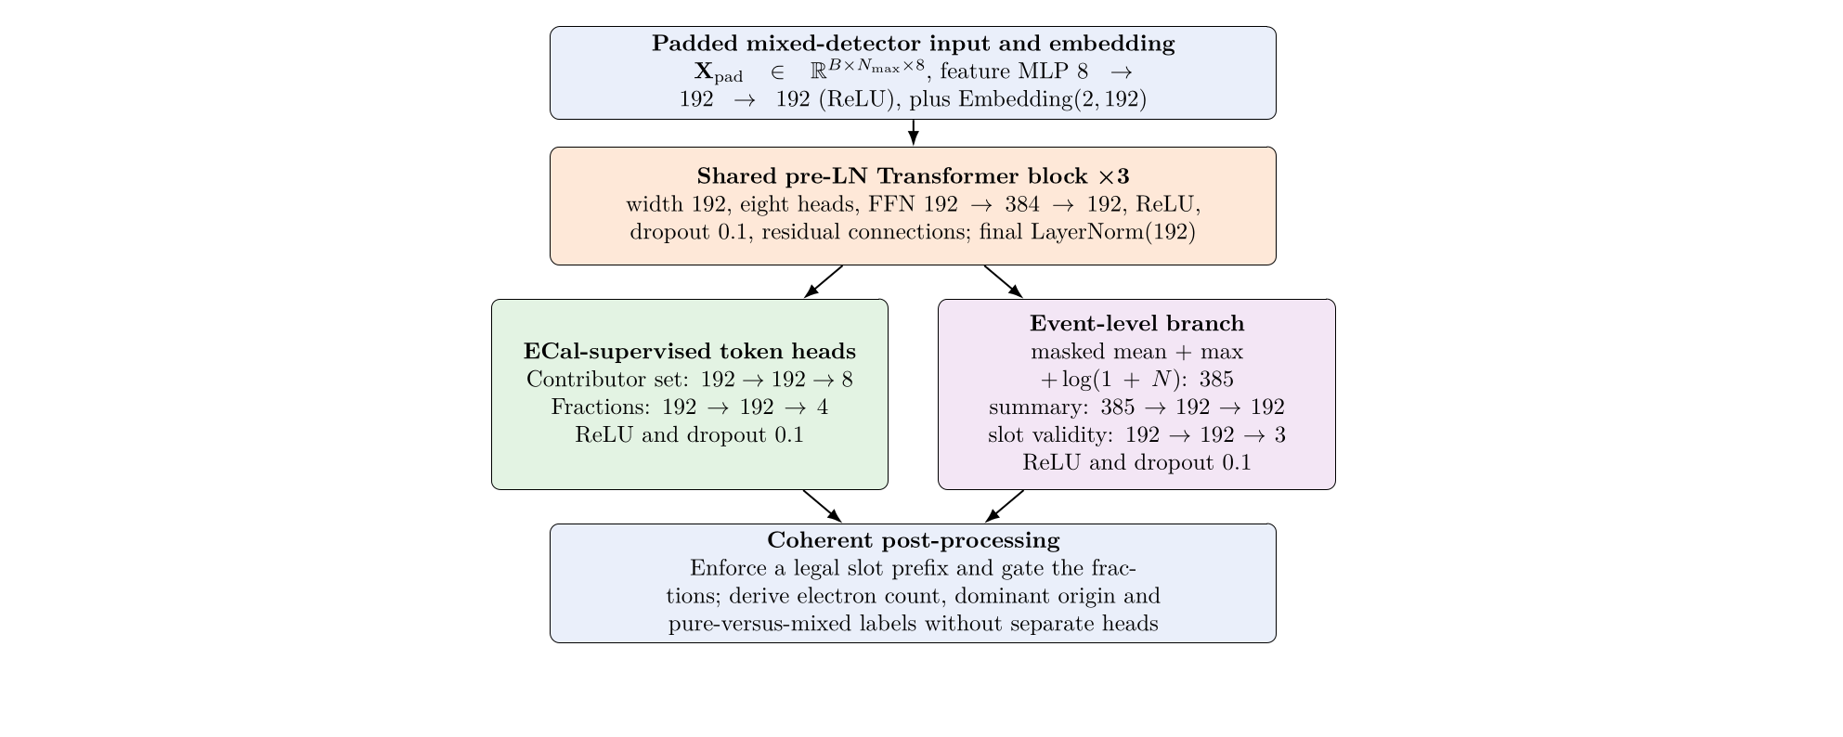
TRACE predicts a coherent 2e/3e event description
Shared Transformer · 1.16 M parameters · width 192 · 3 layers · 8 heads
Contributor subset + energy fractions per hit | valid electron slots per event → count, dominant origin, pure/mixed
Thesis §4.5.3 · MLPF-inspired multi-task reconstruction
10
Notes:
[Timing: 7:10–8:00]
TRACE stands for Transformer for Reconstruction and Attribution of Calorimeter Energy. It removes the assumption that the electron count is known. One shared Transformer is trained on a balanced mixture of two- and three-electron events. At hit level, one head predicts one of the eight possible subsets of three electron slots, including the empty background set, and another predicts four energy fractions: background plus three slots. In parallel, a mask-aware event summary predicts which electron slots are valid. Post-processing enforces a legal slot prefix and gates the fractions, so the electron count, dominant origin and pure-versus-mixed label are derived coherently rather than learned by unrelated heads. The three supervised losses—contributor set, fractions and slot validity—have equal weight. This tests whether richer physical structure can be added without sacrificing the simpler dominant-origin assignment.
[Sources]
- Thesis sections/4Methodology.tex, ‘TRACE: Multi-Task Contributor Reconstruction’ and ‘Training Objectives’.
- Raster asset .tmp_thesis_defense/trace_architecture.png, rendered from thesis TikZ source config/fig/model_architecture_contributor_slot.tex.
- Conceptual reference in thesis: MLPF, bibliography keys pata2021-mlpf and pata2026-mlpf.

Slide 11
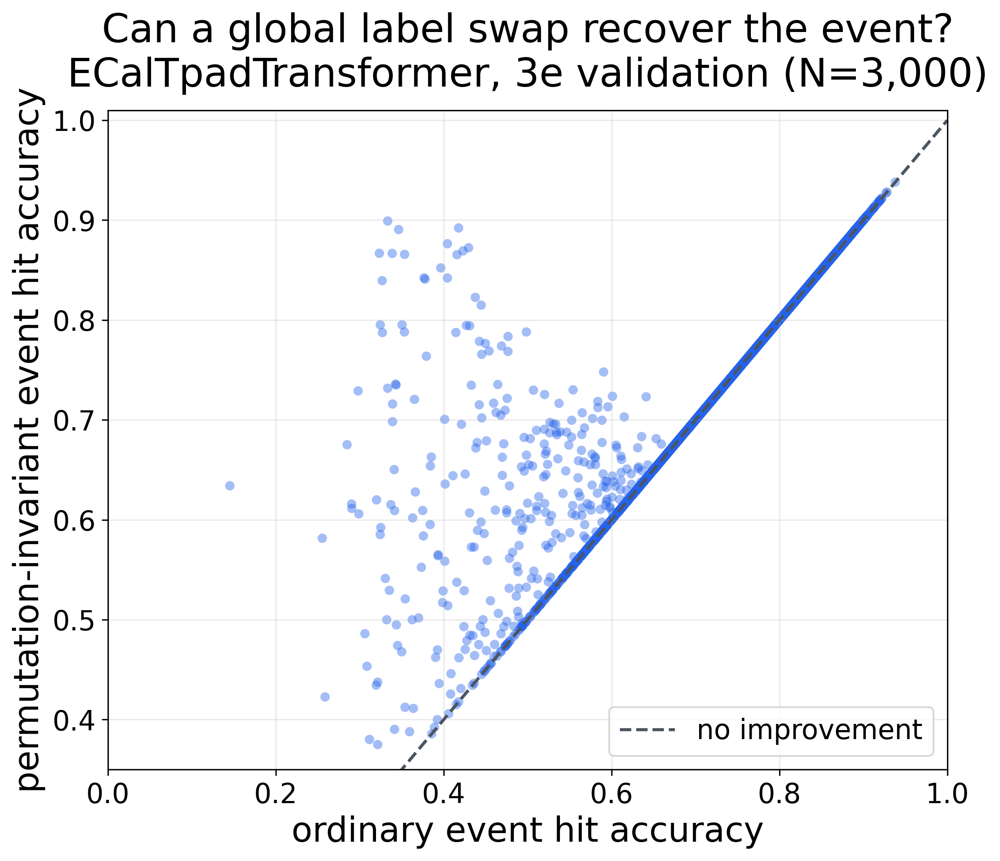
Evaluation must ignore arbitrary shower labels
aligned A = maxπ A(π)
2! mappings for 2e
3! mappings for 3e
One global permutation must apply to every hit. It can repair a complete label swap—but never a local mistake.
9.9% of the illustrated 3e validation scores change after alignment
Thesis §4.7.1 · 3,000-event validation illustration
11
Notes:
[Timing: 8:00–8:45]
Electron slot numbers are a bookkeeping convention, not a physical observable. A model can produce the correct partition of hits while exchanging two complete shower labels. Ordinary class accuracy would count that as wrong. For evaluation, I therefore test every global permutation of the predicted labels—two mappings for two electrons and six for three—and retain the one with the highest event accuracy. The same mapping applies to every hit, so alignment cannot hide individual errors or merge incorrectly separated showers. In this validation illustration, 9.9 percent of three-electron event scores change and the mean increases from 0.722 to 0.737. I report both pooled hit accuracy and event-wise distributions. I also use an energy-weighted accuracy, which weights correct assignment by the raw reconstructed hit energy; it is not a calorimeter energy-resolution metric.
[Sources]
- Thesis sections/4Methodology.tex, ‘Hit-Assignment Accuracy’.
- Figure asset config/fig/results/shower_label_swap_recovery_3e.png, thesis-authored validation diagnostic.
- Formula and 9.9% / 0.722→0.737 values from thesis Figure fig:results_label_swap_recovery.

Slide 12
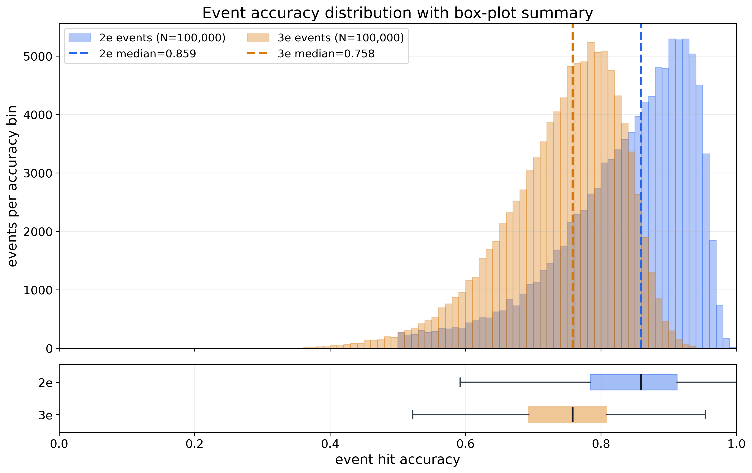
Both baselines recover most of the shower energy
Transformer
84.20%
89.76%
2e pooled hit
2e energy-weighted
74.84%
83.18%
3e pooled hit
3e energy-weighted
GravNet is within 1.05 percentage points on every paired event metric.
Energy weighting lifts accuracy by +5.56 pp (2e) and +8.34 pp (3e): errors carry less energy on average.
Thesis §5.2 · 100,000 held-out events per multiplicity
12
Notes:
[Timing: 8:45–9:45]
These are the headline held-out results. The Transformer reaches 84.20 percent pooled hit accuracy for two-electron events and 74.84 percent for three-electron events. Energy-weighted accuracy is higher—89.76 and 83.18 percent—so the incorrectly assigned hits carry less reconstructed energy on average. GravNet is close. The paired Transformer-minus-GravNet differences range from about 0.42 to 1.05 percentage points and their event-bootstrap intervals exclude zero for these fixed checkpoints. That is a small observed advantage, not evidence that Transformers are universally superior: there is one selected training instance per configuration and the intervals do not include retraining or seed variation. The distributions are broad, which is equally important. Multiplicity shifts the average, but both samples contain easy events and strongly ambiguous tails.
[Sources]
- Thesis sections/5Results.tex, ‘Baseline Architecture and Performance Comparison’ and ‘ECal Hit Assignment Performance’.
- Figure asset config/fig/results/shower_label_swap_recovery_3e.png, thesis-authored.
- Exact values from config/tables/results_baseline_performance.tex and results_baseline_paired.tex.

Slide 13
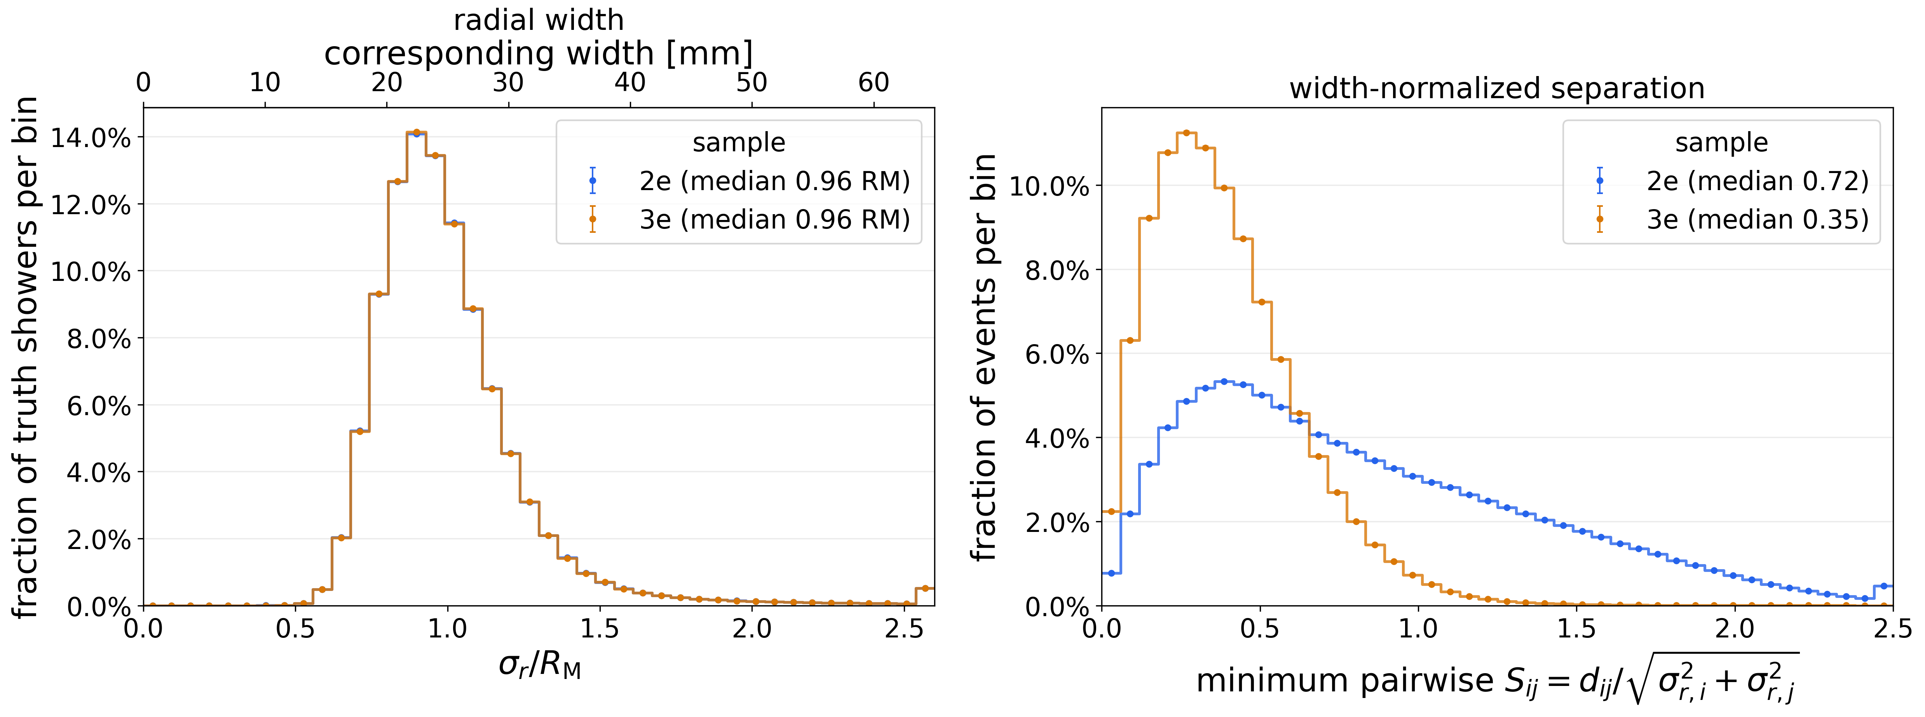
Three-electron events are more crowded—not wider
≈ 0.96 Rₘ
0.724 → 0.353
A 3e event also has three pairs, so the minimum is statistically biased downward; the shift is still physically consistent with stronger overlap.
median radial shower width in both samples
median closest-pair separation / combined width
Thesis §5.1 · truth-assisted geometry · effective Rₘ = 25 mm
13
Notes:
[Timing: 9:45–10:30]
To understand the multiplicity gap, I use simulation truth to project each shower into the transverse plane. For each pair, the centroid distance is divided by the quadrature sum of the shower widths; the event takes the closest pair. Individual shower widths are nearly unchanged between the two samples: the median radial width is about 0.96 Molière radii in both. What changes is crowding. The median closest-pair separation falls from 0.724 combined widths for two electrons to 0.353 for three. That supports overlap, rather than a change in the intrinsic shower size, as the main reason the three-electron task is harder. One nuance is combinatorial: three electrons create three possible pairs, so taking the minimum mechanically shifts the distribution downward. The metric also uses truth energy fractions, so it diagnoses difficulty but is not available on detector data.
[Sources]
- Thesis sections/5Results.tex, ‘Truth-Level Transverse Shower Geometry’ and ‘Implications of the Event Characteristics’.
- Figure asset config/fig/results/shower_widths_and_normalized_separation.png, thesis-authored; slide crops its radial-width and width-normalized-separation panels.
- Definitions from sections/4Methodology.tex, ‘Projected Shower Geometry’.

Slide 14
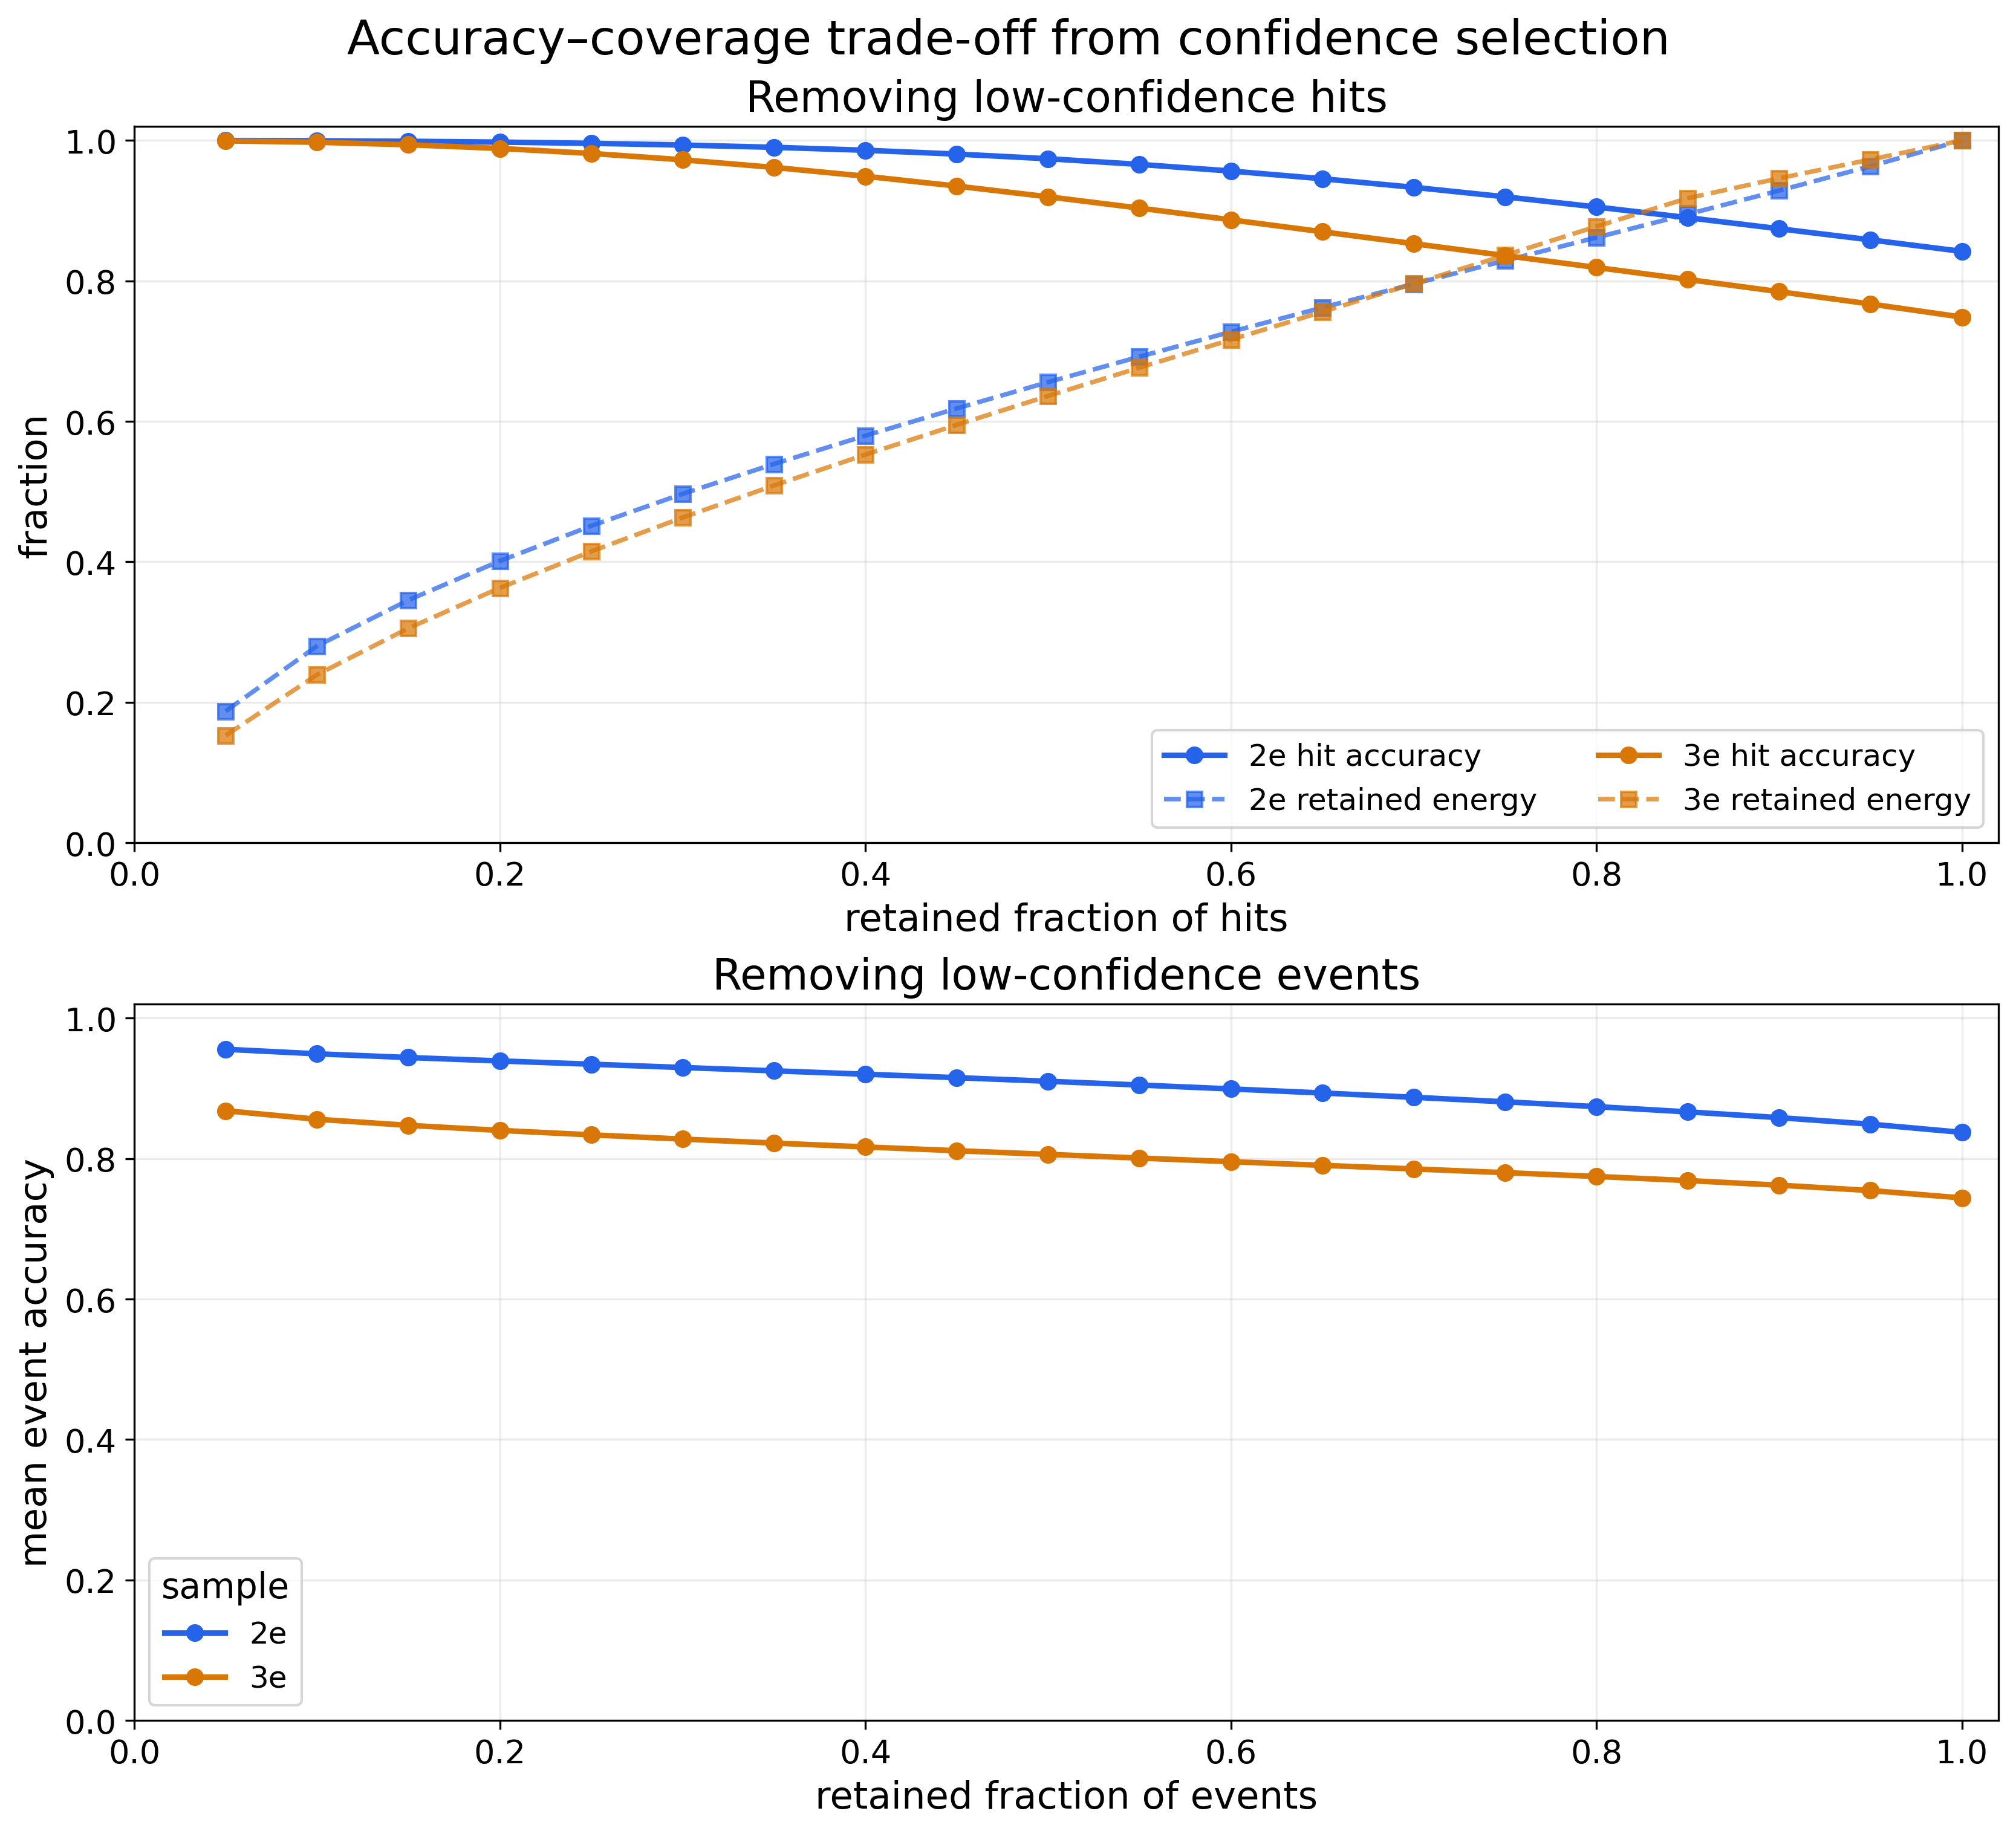
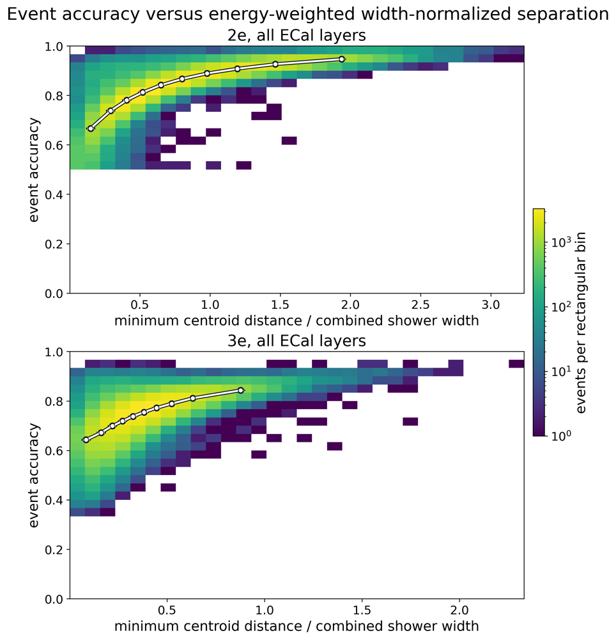
Separation predicts difficulty—but does not determine it
Least → most separated decile
2e 66.6% → 94.6%
3e 64.3% → 84.3%
What it means
• overlap strongly predicts difficulty
• broad spread remains at fixed separation
• truth-assisted diagnostic—not a model input
Thesis §5.2.4 · truth-assisted overlap diagnostic · 10,000 events per decile
14
Notes:
[Timing: 10:30–11:20]
This plot connects physical shower overlap directly to reconstruction performance. The horizontal coordinate is the closest truth-centroid distance divided by the combined radial widths of that shower pair. Events are divided into ten equal-population bins, so each white point summarizes ten thousand test events. From the least- to the most-separated decile, mean accuracy rises from 66.6 to 94.6 percent for two electrons and from 64.3 to 84.3 percent for three. Separation is therefore a strong predictor of difficulty. However, the broad vertical distribution at fixed separation remains important: this single geometric quantity does not completely describe an event. The measure also uses simulated origin fractions and is therefore an interpretation tool, not an inference-time observable. The apparent 50 and 33 percent lower floors arise from choosing the best global label permutation; they are not detector-resolution boundaries.
[Sources]
- Thesis sections/5Results.tex, ‘Performance as a Function of Shower Separation’.
- Figure asset config/fig/results/width_normalized_separation.png, thesis-authored; slide uses the presentation-sized copy .tmp_thesis_defense_v2/width_sep_small.png.
- Definition and truth-dependence from sections/4Methodology.tex, ‘Projected Shower Geometry’; exact decile means cross-checked against the final run-020 analysis outputs.

Slide 15
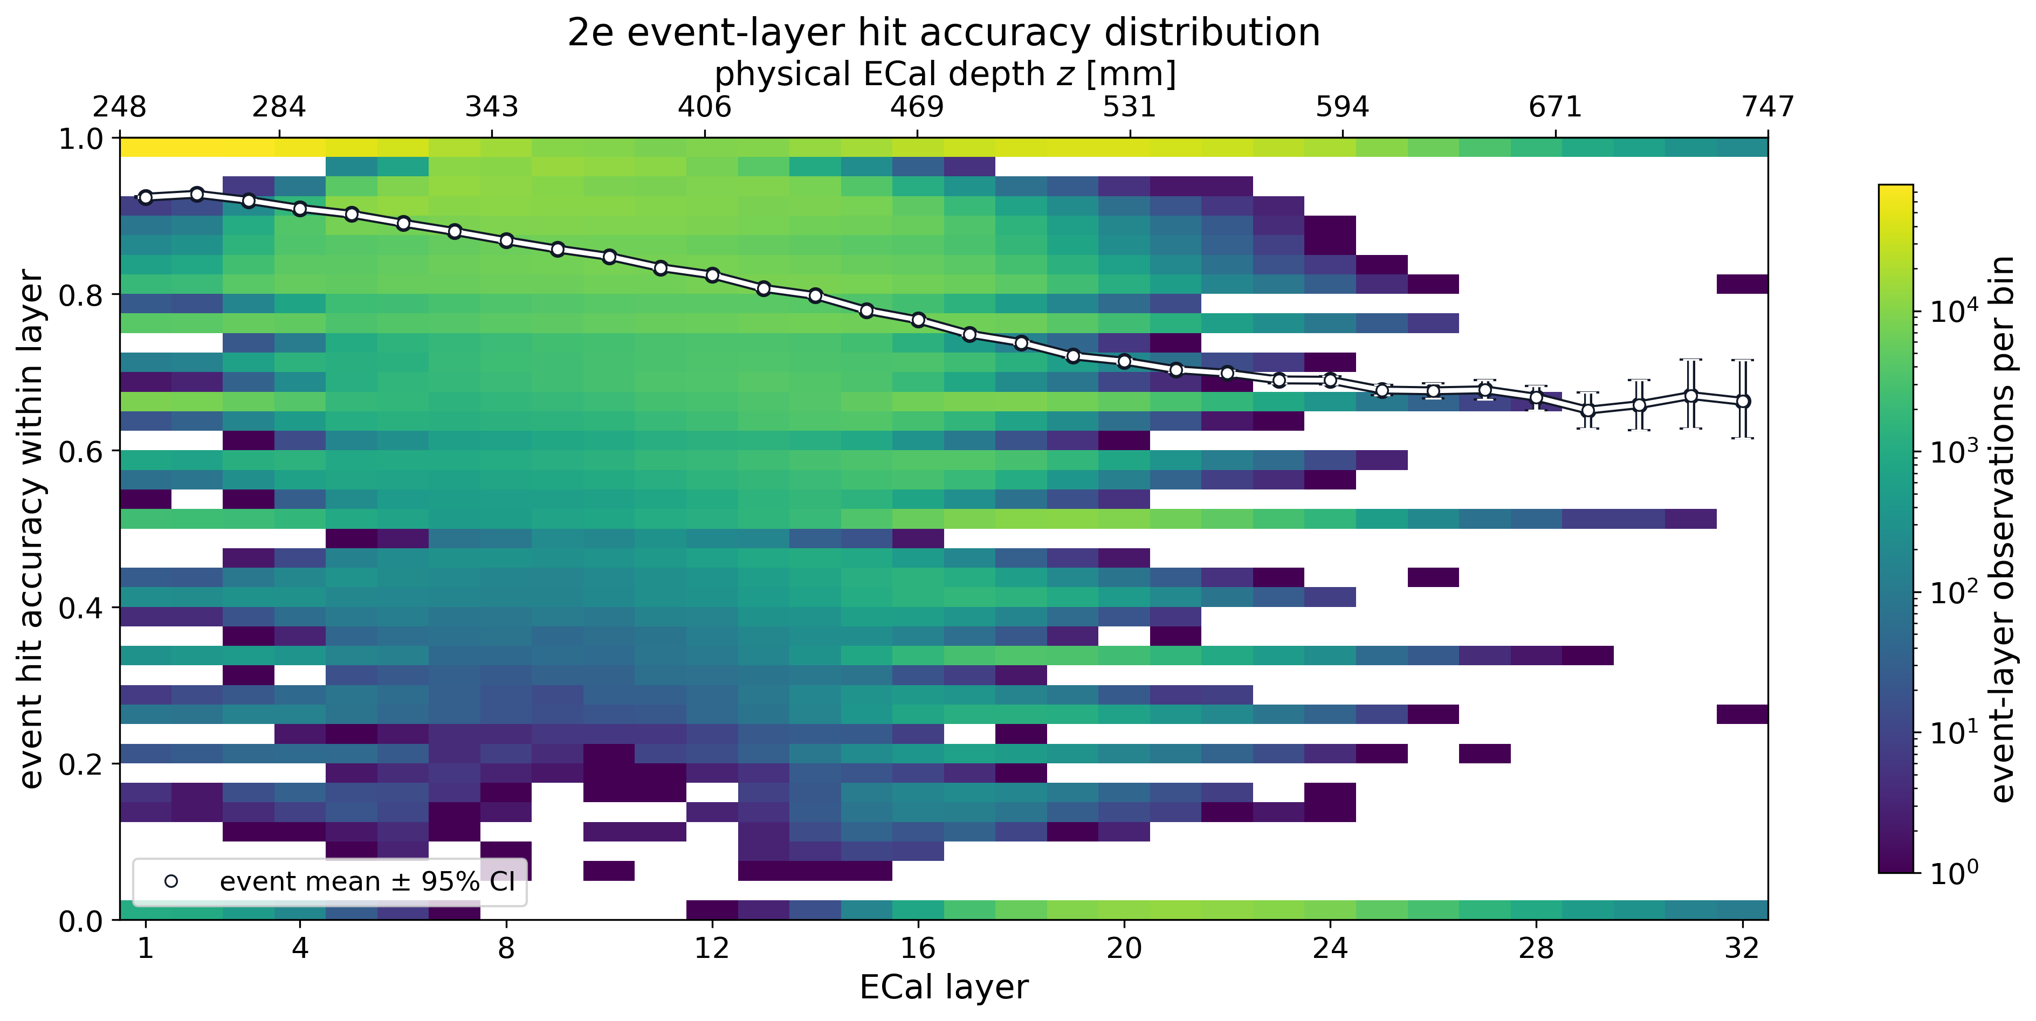
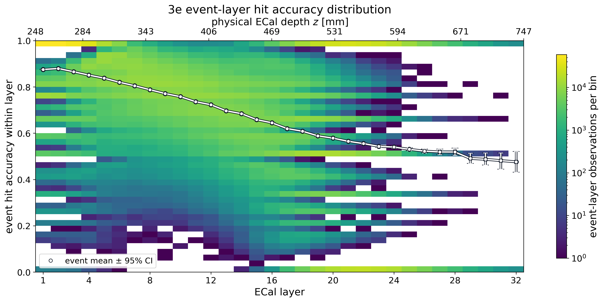
Assignment accuracy falls with ECal depth
92.4 → 71.4%
87.5 → 57.9%
2e mean event accuracy: layer 1 → layer 20
3e mean event accuracy: layer 1 → layer 20
Thesis §5.2.3 · event-balanced means · pooled layers 21–32: 70.5% / 56.5%
15
Notes:
[Timing: 11:20–12:10]
Each white point is an event-balanced mean after applying the same globally optimal event permutation used for the headline metrics. Assignment becomes steadily more difficult through the shower: between layers 1 and 20, the mean falls from 92.4 to 71.4 percent for two electrons and from 87.5 to 57.9 percent for three. Energy weighting improves early-layer accuracy but does not remove the depth dependence. The final twelve layers reach pooled accuracies of 70.5 and 56.5 percent, although they contain only about 1.5 percent of all hits. Their low occupancy also explains the discrete zero, 50, 67 and 100 percent bands and the broader late-layer intervals. This is consistent with later, wider and sparser shower deposits becoming more ambiguous.
[Sources]
- Thesis sections/5Results.tex, ‘Performance Across the Electron Shower Depth’.
- Figure assets config/fig/results/hit_accuracy_by_layer_2e.png and hit_accuracy_by_layer_3e.png, thesis-authored.
- Layer-1-to-layer-20 values and pooled tail values cross-checked against the final run-020 analysis outputs.

Slide 16
Confidence ranks difficult events—but is not calibrated
Retain the most confident predictions
Accuracy increases as low-confidence hits or events are removed.
Interpretation
• useful for ranking and selective reconstruction
• strong correlation with event accuracy
• not yet a calibrated probability
• selection changes acceptance and must be propagated
Thesis §5.2.5 · maximum softmax probability and normalized entropy
16
Notes:
[Timing: 12:10–12:55]
The network’s maximum softmax probability and normalized entropy both track difficulty. This plot orders predictions by confidence and shows the usual accuracy–coverage trade-off: retaining only the most confident fraction raises the accuracy, while adding lower-confidence predictions reduces it. That makes confidence potentially useful for selective reconstruction, quality flags or downstream weighting. But I deliberately call it a ranking signal, not a calibrated probability. No reliability diagram, temperature scaling or detector-level calibration study was performed. Event selection based on confidence would also change acceptance and could bias a physics analysis, so it must be propagated into efficiency and uncertainty studies. The result is therefore diagnostic: the model has useful internal information about its errors, but the conversion from score to trustworthy probability remains future work.
[Sources]
- Thesis sections/5Results.tex, ‘Confidence, Entropy and Selective Performance’.
- Figure asset config/fig/results/accuracy_coverage.png, thesis-authored.
- Confidence terminology corrected in notes: maximum softmax probability, not a raw logit.

Slide 17
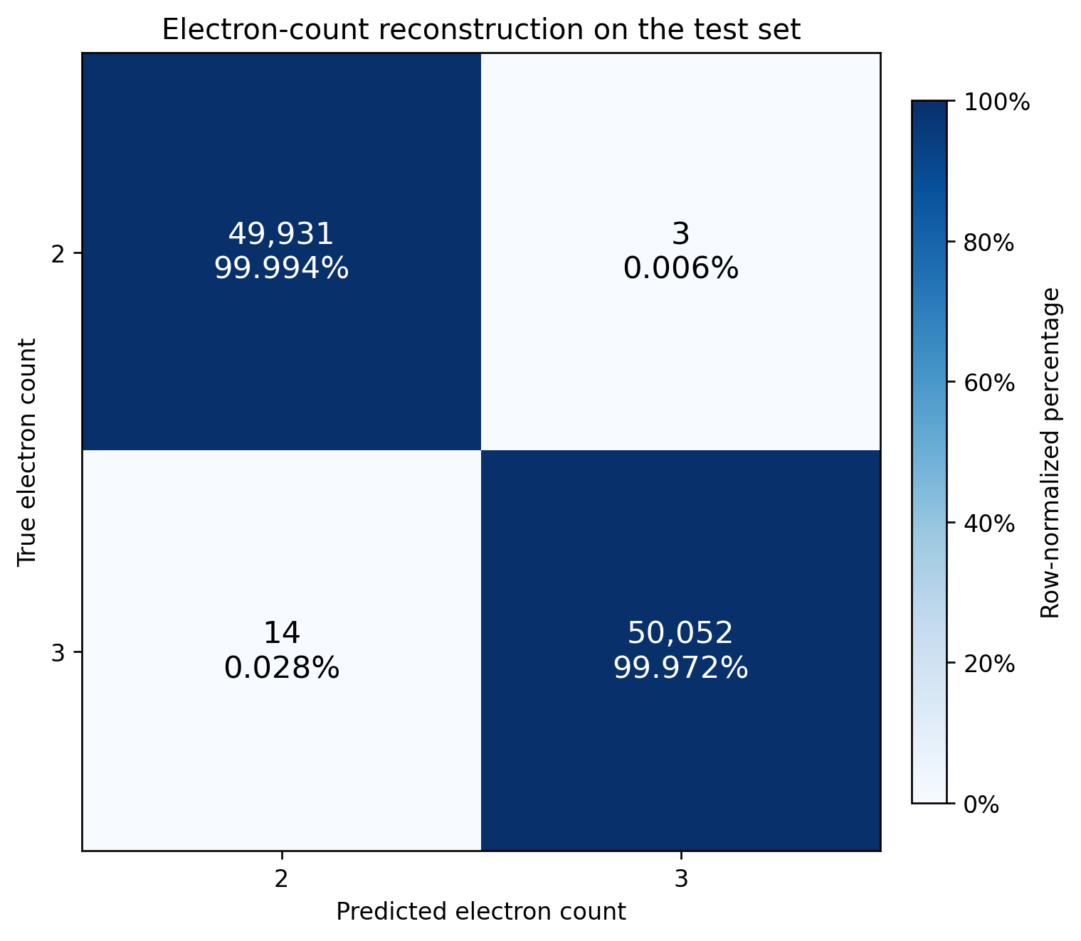
TRACE adds structure with almost no assignment penalty
99.983%
2e-versus-3e count accuracy · 17 errors / 100,000 events
84.13%
74.39%
TRACE 2e pooled assignment
TRACE 3e pooled assignment
Fixed-count Transformer: 84.20% and 74.84%
The count result is a restricted binary distinction in simulation—not general electron counting.
Thesis §5.3 · balanced mixed-multiplicity test set
17
Notes:
[Timing: 12:55–14:00]
TRACE uses one model for both multiplicities. On its balanced 100,000-event test set, it derives the correct electron count in 99.983 percent of events—only seventeen errors. That number needs a strong qualification: the task is the binary distinction between two and three electrons under the same simulated distribution and a three-slot valid-prefix design. It is not unrestricted counting. The more useful comparison is whether the richer model preserves hit assignment. After removing truth-noise hits and applying the same event-wise label alignment, TRACE reaches 84.13 percent for two-electron events and 74.39 percent for three. The fixed-count Transformer reaches 84.20 and 74.84. The penalties are therefore only 0.07 and 0.45 percentage points while TRACE adds contributor subsets, fractions and event-level slot validity. The shared multi-task representation is feasible; the remaining question is which of those richer targets are actually learned well.
[Sources]
- Thesis sections/5Results.tex, ‘TRACE Multi-Task Reconstruction’ and ‘Comparison with Fixed-Multiplicity Hit Assignment’.
- Figure asset config/fig/results/contributor_count_neural_1m.png, thesis-authored.
- Exact values from config/tables/results_contributor_performance.tex and results_contributor_baseline_comparison.tex.

Slide 18
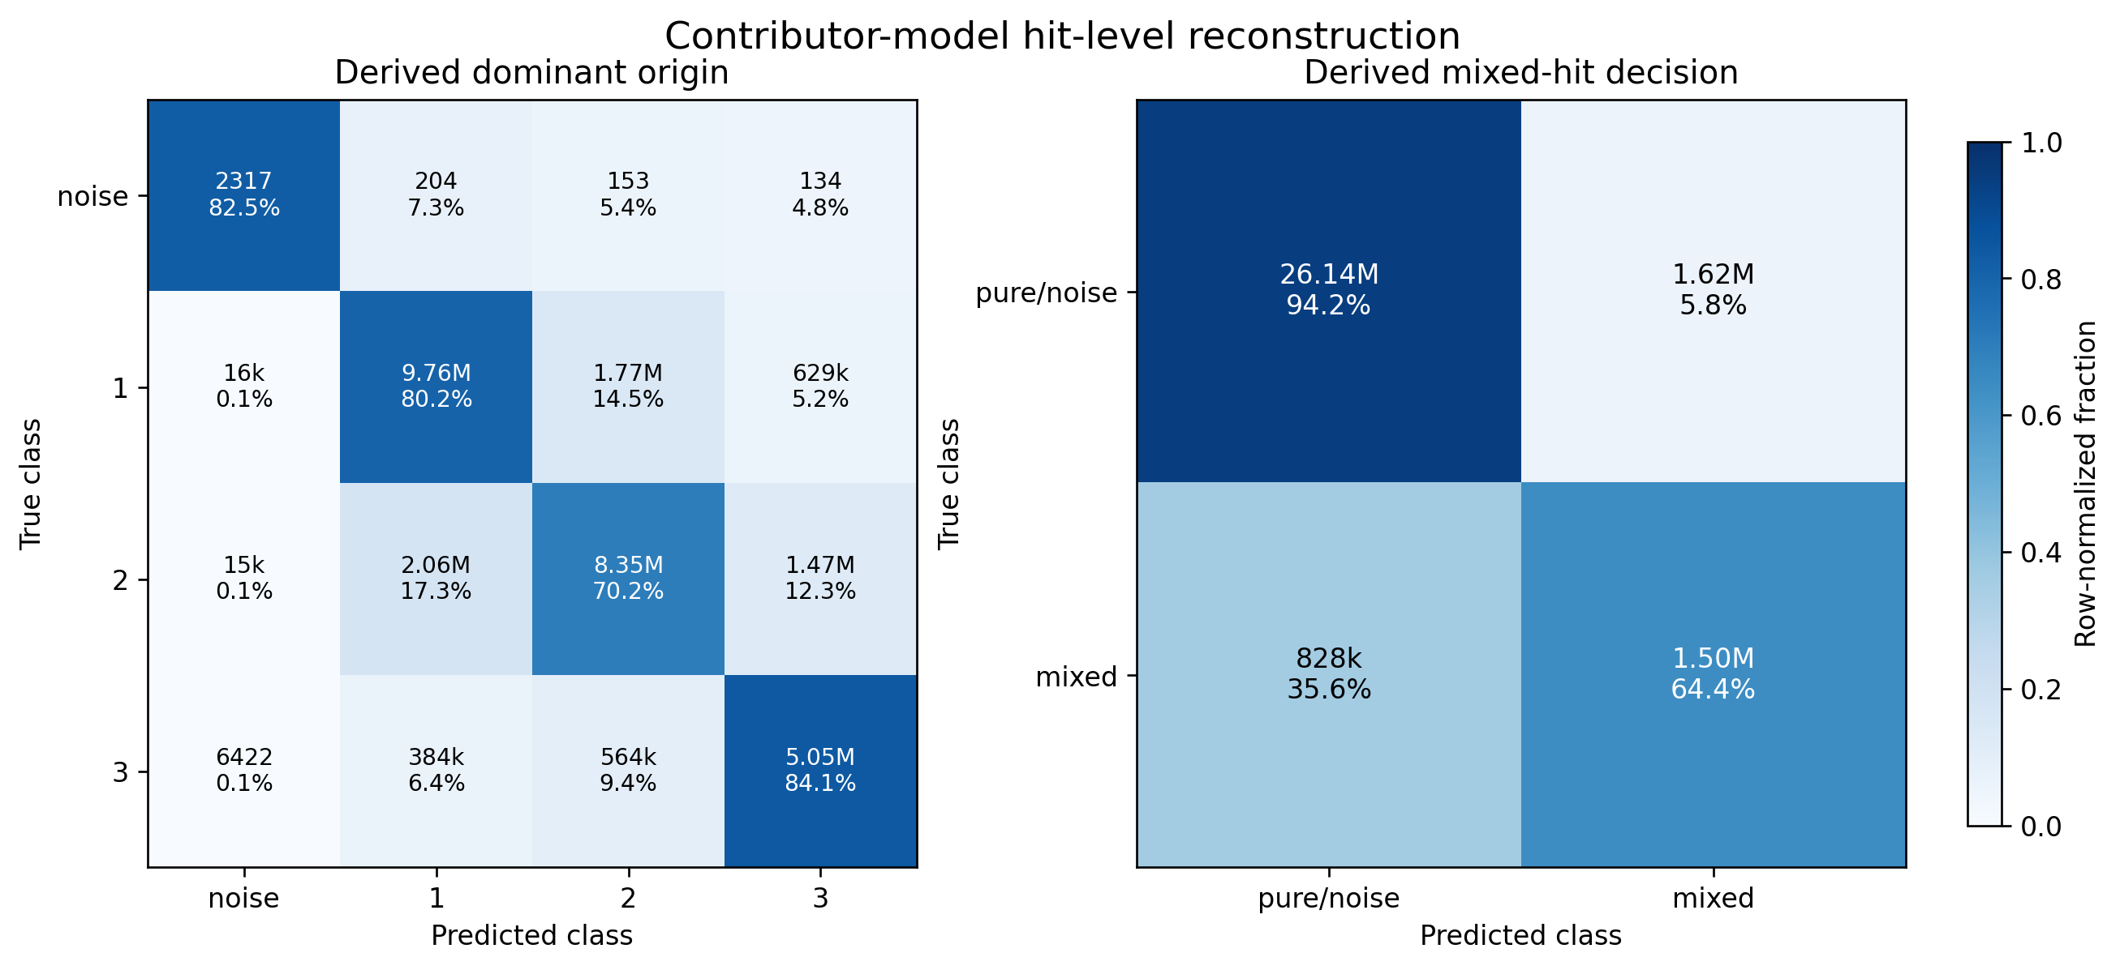
Mixed deposits remain the central reconstruction challenge
72.41%
48.08% / 64.41%
0.115
exact contributor-set accuracy
mixed-hit precision / recall
fraction MAE after invalid-slot masking
Thesis §5.3.1 · final TRACE test set: 30.08 million ECal hits
18
Notes:
[Timing: 14:00–15:05]
Counting is nearly saturated, but sharing one hit among several showers is not. Exact contributor-set accuracy is 72.41 percent. Because pure hits are much more common, that aggregate must be read together with the mixed-hit metrics: precision is 48.08 percent, recall is 64.41 percent and F1 is 0.551. The model finds a majority of true mixed hits, but almost half of its mixed predictions are false positives. For the continuous fractions, the mean absolute error is 0.141 before post-processing and 0.115 after invalid electron slots are masked. That improvement shows useful coupling between event- and hit-level tasks. The remaining ambiguity is physically plausible: if two showers deposit energy in the same readout cell, the measured aggregate may not uniquely encode the separate contributions. This study does not quantify an irreducible lower bound, but mixed cells are clearly the central unsolved target.
[Sources]
- Thesis sections/5Results.tex, ‘Multi-Task Reconstruction Performance’ and ‘Overall Interpretation and Limitations’.
- Figure asset config/fig/results/contributor_hit_task_confusions.png, thesis-authored.
- Exact metrics from config/tables/results_contributor_performance.tex.

Slide 19
Set-based learning is feasible; detector ambiguity is the limit
01
Useful per-electron structure is recoverable
Transformer and GravNet reconstruct most hits—and an even larger share of the energy—in simulated 2e/3e pile-up.
02
Overlap matters more than model family
Three-electron showers are closer, while widths are unchanged; the Transformer edge over GravNet stays around one point or less.
03
Richer reconstruction is possible—but mixed cells remain hard
TRACE nearly preserves assignment and counts 2e/3e events, yet exact contributors and energy sharing remain the open problem.
Next: matched modality retraining · multiple seeds · broader multiplicities · detector/systematic and physics-level validation
Thesis §§5.4, 7 · conclusions and outlook
19
Notes:
[Timing: 15:05–16:05]
I draw three conclusions. First, set-based neural reconstruction is feasible for simulated LDMX pile-up. Both interaction mechanisms recover useful per-electron structure, particularly the energy-carrying hits. Second, the dominant trend is physical ambiguity rather than architecture choice. Three-electron events contain a much closer shower pair, while the shower widths remain essentially unchanged, and the observed Transformer advantage is small. Third, richer reconstruction is possible. TRACE nearly preserves dominant-origin assignment and very accurately distinguishes two from three electrons in its restricted domain, but contributor sets and mixed-cell fractions remain substantially harder. The next experiments should therefore be controlled rather than merely larger: matched ECal-only and multimodal retraining, multiple seeds, permutation-invariant training, broader multiplicities, trigger-cell and latency studies, detector systematic variations, and finally downstream physics metrics. This work establishes a reusable offline simulation platform and a credible starting point—not production reconstruction or a sensitivity result.
[Sources]
- Thesis sections/5Results.tex, ‘Overall Interpretation and Limitations’.
- Thesis sections/7Conclusion.tex, ‘Conclusions’ and ‘Outlook’.
- Headline values and scope also cross-checked against sections/00abstract.tex.

Slide 20
The next step is controlled validation—not a larger network
01
Isolate detector value
Matched ECal-only versus ECal+TPad retraining · identical splits · multiple seeds · separate complete, missing and merged TPad candidates.
02
Make reconstruction permutation-robust
Event-wise slot matching · tune TRACE loss balance · broaden multiplicities, beam conditions and detector systematics.
03
Prove deployability and physics value
Trigger-cell inputs · target-hardware latency and memory · compression only if needed · downstream missing-momentum metrics.
ml_ldmx: reusable ROOT → tensors → training → evaluation workflow
Thesis §7.1 · prioritized outlook · ml_ldmx handover
20
Notes:
[Timing: 16:05–17:25]
The first priority is not to scale the architecture but to remove the largest ambiguity in the present evidence. ECal-only and ECal-plus-TPad models should first be retrained on identical events across several seeds. That separates genuine detector value from the input-distribution shift introduced by removing an entire modality only at inference. Second, TRACE should reduce its dependence on canonical y-ordering through event-wise matching, while its losses and broader multiplicity domain are studied systematically. Only after those controls should the model move to realistic trigger-cell inputs and target hardware, where accuracy, memory and latency can be measured and compression considered. The final test is physics-level value and robustness, not another offline accuracy increment. The ml_ldmx pipeline is the practical handover: it already connects ROOT conversion, tensor building, training and evaluation, so these studies can be added without rebuilding the workflow.
[Sources]
- Thesis sections/7Conclusion.tex, ‘Outlook’.
- Thesis sections/4Methodology.tex, ‘Software and Reproducibility’; repository ml_ldmx workflow.
- TPad causal limitation from sections/5Results.tex, ‘Trigger-Pad Ablation’.

Slide 21
QUESTIONS
Set-based learning can recover useful shower structure from LDMX pile-up.
84.20% 2e hit assignment · 74.84% 3e · 99.983% restricted 2e/3e counting
Eliot Montesino Petrén · Lund University
Notes:
[Timing: 17:25–18:00; retain ≈2 min contingency]
The one-sentence answer to the thesis question is yes: set-based networks can recover useful per-electron shower structure from simulated LDMX pile-up. The main remaining limit is not simply choosing a larger network; it is the ambiguity created by strongly overlapping and genuinely shared detector deposits. Thank you. I am happy to take questions.
[Sources]
- Thesis abstract and sections/7Conclusion.tex.
- Headline values from config/tables/results_baseline_performance.tex and results_contributor_performance.tex.

Slide 22
Backup — TPad carries a small, confounded assignment signal
ECal+TPad minus TPad removed
All three paired intervals exclude zero
Energy-weighted
0.243
The effect is statistically resolved but practically small when the true count is already supplied.
Mean event
0.125
Why the claim is limited
Removing an entire modality only at inference changes the input distribution. A causal detector-value test requires separately trained ECal-only and ECal+TPad models across multiple seeds.
Pooled hit
0.119
paired difference in hit-assignment accuracy (percentage points) · common 0–0.28 scale
Thesis §5.2.6 · paired inference-time ablation · 2,000 event bootstraps
22
Notes:
[Timing: Backup]
Trigger-pad tracks provide upstream position and multiplicity context. In the final fixed-count three-electron Transformer, removing all TPad tokens at inference reduces pooled accuracy by 0.119 percentage points, mean event accuracy by 0.125 and energy-weighted accuracy by 0.243. Paired bootstrap intervals exclude zero, so the trained network is sensitive to the modality. The practical effect is nevertheless small when the correct electron count is already provided. More importantly, this is not a clean causal ablation: the network was trained with TPad tokens, and deleting the whole modality only at inference creates a distribution shift. The correct follow-up is to train matched ECal-only and ECal-plus-TPad models on identical splits, repeat across seeds, and then compare. I show only the paired differences here because the thesis TPad table and headline baseline table contain inconsistent absolute three-electron energy-weighted values.
[Sources]
- Thesis sections/5Results.tex, ‘Trigger-Pad Ablation’.
- Exact paired differences and intervals from config/tables/results_baseline_tpad_ablation.tex.
- Consistency decision: absolute intact energy-weighted value omitted because 83.274% in the ablation table conflicts with 83.18% in the baseline table.

Slide 23
Backup — data, features and training configuration
Item | Configuration
Simulation | ldmx-sw v4.7.3 · ldmx-det-v15-8gev · 8 GeV e⁻
Event input | Variable-size 8-column heterogeneous ECal + TPad set
Final baseline split | 800k train · 100k validation · 100k test, per multiplicity
Optimiser | AdamW · learning rate 3×10⁻⁴ · weight decay 10⁻⁴
Regularisation | Dropout 0.1 · global gradient L2 clip 1.0
Stopping | max 15 epochs · min 5 · patience 3 · Δloss ≥ 10⁻⁴
TRACE objective | contributor-set CE + fraction CE + slot-validity BCE; equal weights
Baseline simplifications: true multiplicity supplied · truth-noise hits removed · hard dominant-origin target
Thesis Chapter 4 and Appendix
23
Notes:
[Timing: Backup]
Use this slide if asked about reproducibility or training. Emphasise that the held-out test set never selected a checkpoint, that all standardisation statistics came from the training split only, and that the baseline task deliberately simplifies the reconstruction problem by supplying multiplicity, removing truth-flagged noise and using a hard dominant-origin label. TRACE relaxes those assumptions only partially: it handles a balanced two-versus-three mixture and retains background, but does not cover arbitrary multiplicity or real detector noise.
[Sources]
- Thesis sections/4Methodology.tex and sections/8Appendix.tex.
- Training values from ‘Optimizer and Regularization’, ‘Early Stopping’, and ‘Training Objectives’.

Slide 24
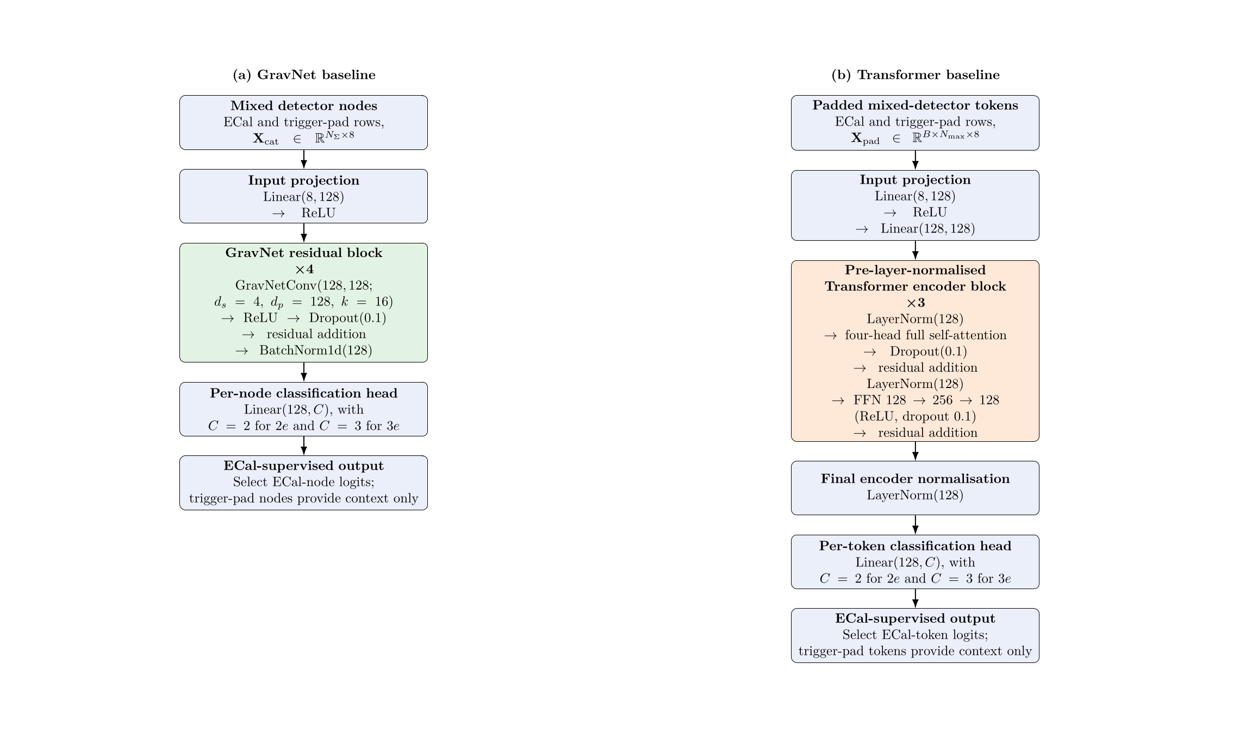
Backup — full baseline architectures
Thesis Figure fig:baseline_architectures
24
Notes:
[Timing: Backup]
The exact configurations are shown here. GravNet uses four residual GravNetConv blocks with learned-space dimension four, propagated width 128 and sixteen neighbours. The Transformer uses three pre-layer-normalised blocks, width 128, four heads and a 256-unit feed-forward layer. Exact parameter counts differ only in the final classifier width: approximately 268 thousand for GravNet and 416 thousand for the Transformer. Trigger-pad nodes or tokens provide context, while only ECal outputs are supervised.
[Sources]
- Raster asset .tmp_thesis_defense/baseline_architecture.png, rendered from thesis TikZ source config/fig/model_architecture_baselines.tex.
- Thesis sections/4Methodology.tex, ‘Model Architectures’.

Slide 25
Backup — exact baseline performance
Multiplicity | Model | Pooled hit | Mean event | Median event | Energy-weighted
2e | Transformer | 84.20 | 83.73 | 85.90 | 89.76
2e | GravNet | 83.79 | 83.32 | 85.77 | 89.26
3e | Transformer | 74.84 | 74.40 | 75.82 | 83.18
3e | GravNet | 74.01 | 73.55 | 75.14 | 82.13
Paired Transformer − GravNet mean-event differences
2e hit +0.417 pp [0.403, 0.431]
2e energy +0.505 pp [0.484, 0.525]
3e hit +0.850 pp [0.834, 0.866]
3e energy +1.048 pp [1.023, 1.072]
Thesis Tables tab:results_baseline_performance and tab:results_baseline_paired
25
Notes:
[Timing: Backup]
This table gives all headline baseline metrics. The paired intervals resample complete held-out events and quantify finite-test-sample uncertainty for fixed trained checkpoints. They do not include training-seed variation, alternative hyperparameters, simulation production uncertainty or detector systematics. The energy-weighted metric uses reconstructed hit energy as a weight for assignment correctness; it is not an energy-response measurement.
[Sources]
- Thesis config/tables/results_baseline_performance.tex.
- Thesis config/tables/results_baseline_paired.tex.

