Slide 1
Digital Logic SNN on FPGA hardware
Bhaskar Vyas - 181EC109
Mohammed Ibrahim Ali - 181EC225

Slide 2
Problem Statement
Reproduce the work done in the research paper by Xiping Ju and Biao Fang, et al.
Use CNN to ‘train’ the SNN
Implement the SNN on Intel Cyclone V FPGA
Analyse the performance and efficiency results of the network

Slide 3
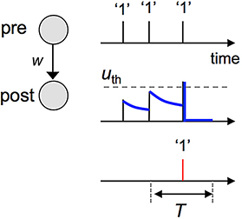
Spiking NN?
Mimics biological neurons
When state exceeds membrane potential, a spike is sent
Neuron state decays over time due to leakage
Notes:
Challenges:
Implementation of SNN in digital logic
Training snn; converting mnist image to spike trains

Slide 4
Research Objectives
Stage 1
Stage 3
Stage 2
Stage 4
Literature review
Theoretical analysis of SNN training process
Verilog design, including testing module
Implementation on FPGA
Build, train CNN
Design and model SNN
Performance analysis
Testing with HPC/automation

Slide 5
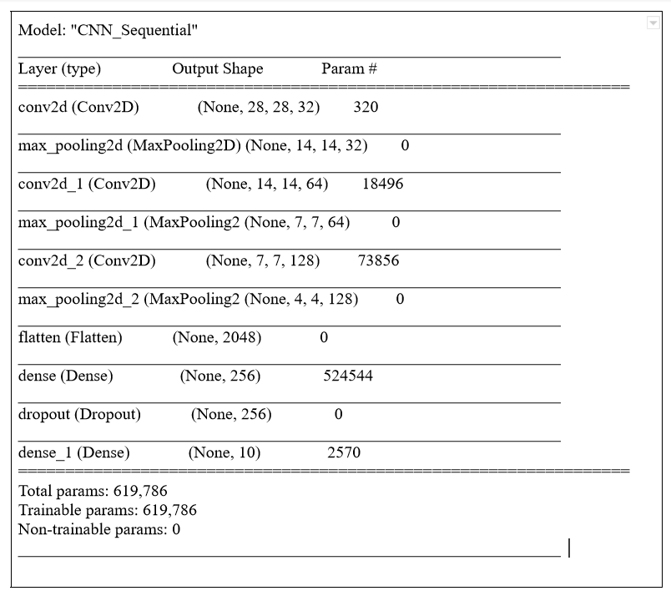

Design Methodology
7 layer CNN model
ReLU as activation function
Max Pooling operation used
Trained on MNIST dataset

Slide 6
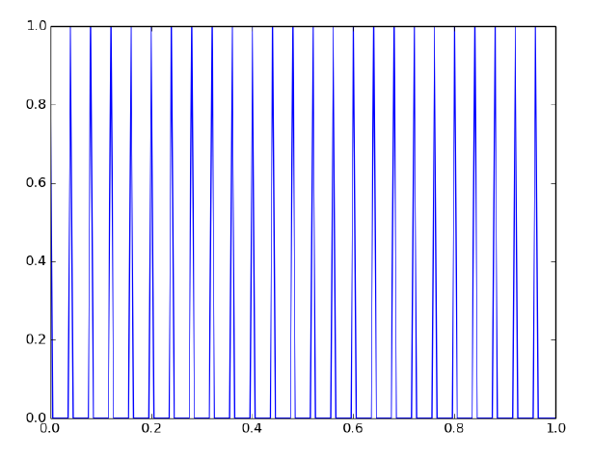

Spike train encoder
Fixed uniform spike trains generation algorithm
Pixel values are normalized between 0 and 1 as firing rate
Compute total spikes fired based on length of time window and firing rate
Spikes uniformly distributed along time window
conversion of information to artificial neuron spikes
rate coding is implemented.
information is carried by the firing rate of the neuron.
Notes:
Explain the process with example:
Length of time 1 sec; 5ms steps -> total spikes = 1/0.005 = 200
Pixel value 32 -> normalized to ~0.125; 200 * 0.125 = 140 spikes;
one spike every 1/0.125 = 8 time steps = 40ms

Slide 7

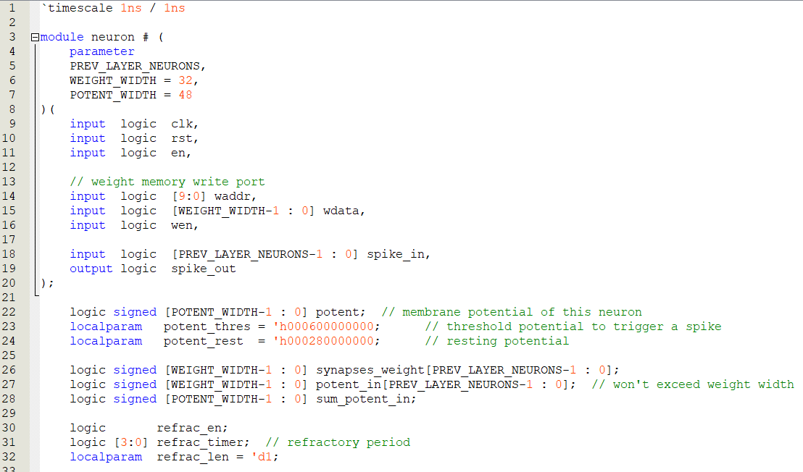
Spike Neuron
Implemented in Verilog
Uses Discrete integral steps based on positive clock edge
No decay

Slide 8
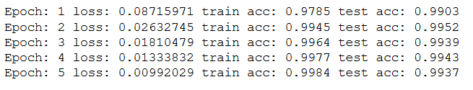
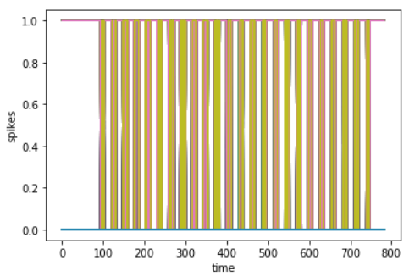
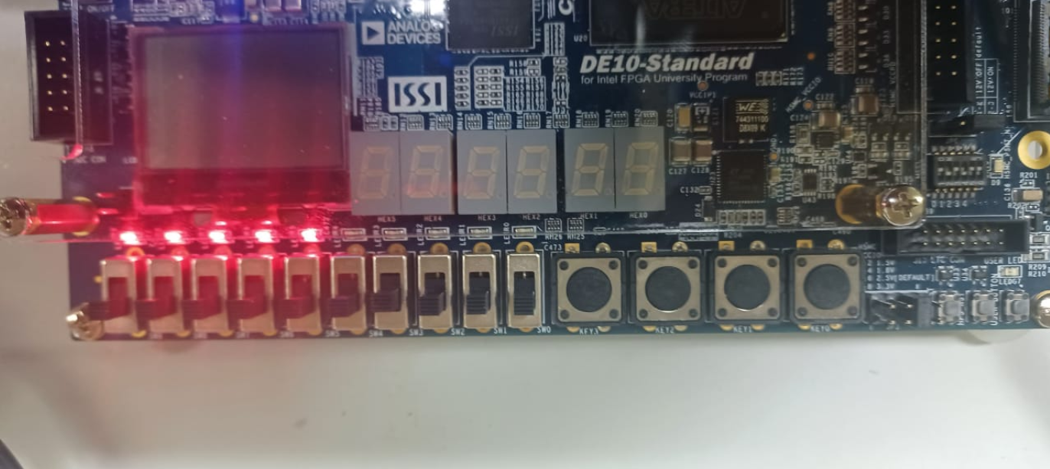
Results

Slide 9
Future Plan
Use HPC to simplify testing on FPGA
Run NN on GPU using MATLAB
Performance and efficiency analysis on FPGA

Slide 10


Questions?

Slide 11
References
https://direct.mit.edu/neco/article-abstract/32/1/182/95561/An -FPGA-Implementation-of-Deep-Spiking-Neural?redirectedFrom=fulltext
A Cost-Efficient High-Speed VLSI Architecture for Spiking Convolutional Neural Network Inference Using Time-Step Binary Spike Maps

