Slide 1
Subreddit relationships
Created By: Carter Nelson
Course: CIS 490
Instructor: Dr. Hsu

Slide 2
Project Goal
Analyze a large collection of reddit comments.
Create a meaningful connection amongst subreddits from the analyzation.
Create a visualization for those subreddit connections.

Slide 3
The Data
The data was retrieved from a post on r/datasets by the user u/Stuck_in_the_matrix.
The dataset had around 54 million comments and was about 32gb in size.
There was a larger set which was 250gb compressed, however I did not have the time or resources to utilize this dataset.
The data was a text file stored in json format.

Slide 4
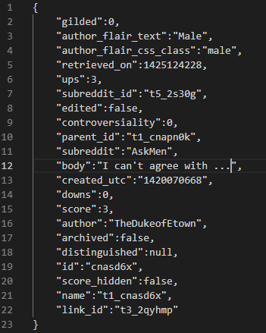
Example

Slide 5
Data Preparation
Used PySpark RDD’s to parallelize data for preparation.
Stored manipulated data in a mongodb collection.
Originally would have taken over 3 days. Redid my parallelization and now it runs in about 15 mins.
Used data in the mongo collection to run more analyzation algorithms on and stored the results in a json file.

Slide 6


Data Preparation
Used the grabbed subreddits to gather their icon images.
Did so using PRAW and Pillow.

Slide 7
Data Visualization
Created a Flask application to host and send data to the frontend.
Used Jinja and jQuery to grab the data being sent by Flask and send it over to the JavaScript.
Placed the subreddit icons in a circle using D3.
Connected the subreddit icons with paths using D3.
Generated on mouse events to highlight paths, show the subreddit text, and enlarge the icons when the mouse is placed over the icon using D3.

Slide 8
Conclusion
The project took a bit longer than anticipated.
In the beginning I overestimated my abilities with PySpark, Mongodb, and D3, but I feel I gained proficiency in each by the end.
The end result turned out better than I pictured, but I still think there are more things that could be added.
While the visualization shows a trend of many subreddits having the same top related subreddits, there are still some interesting results to be seen with the outliers.

