Slide 1



Otree Project Folder
Created with:
otree startproject project_name
settings.py
database [db.sqlite3]
beauty contest
trust
bargaining
public_goods
ultimatum
matching_pennies

Slide 2
App Folder (e.g. trust)
More files and folders
are created but at this
point not important to
you.
Contains a single game or survey
New app is created when you run
otree startapp app_name
  Creates a folder: app_name with the below structure
Subfolder
templates
models.py
views.py
Same name as app
app_name
MyPage.html
Results.html

Slide 3
settings.py
Controls the whole project (language settings, Currency settings, ...)
Contains a list of all available apps (games, surveys) in this otree project
If an otree app is not registered in the settings.py it will not show up in your admin menu!

Slide 4
Registering an app / experiment
In the settings.py find: SESSION_CONFIG = [ and insert:
{
'name': 'matching_pennies', name of experiment
'display_name': "Matching Pennies", name to show in admin menu
'num_demo_participants': 2, number of demo participants
'app_sequence': ['matching_pennies',’survey’], list of apps for experiment
},
(example, “matching pennies”)

Slide 5
database [db.sqlite3/PostgreSQL]
(background knowledge)
Heart of an otree project
Gets created after you run otree resetdb
Contains parameters to control otree
Stores data of app (experiments) in data tables
Only registered apps are connected to the database

Slide 6

What happens
database
settings.py
2. Run: otree resetdb
1. register app
New data tables for your
are created.
app_name_player
app_name_group
app_name
app_name_subsession

Slide 7
Let’s look in the app
app_name
Subfolder
templates
models.py
views.py
MyPage.html
Results.html

Slide 8
models.py
Controls variables in the app
Where functions are defined
Contains 4 main classes
  Constants – constant value (endowments, multipliers, etc.)
  Subsession – functions run before session starts
  Group – group level functions, group variables stored in database
  Player – player level functions, player variables stored in database

Slide 9
Create a variable for database
Class Player(BasePlayer):
sent_amount = models.CurrencyField()
Creates column in data table app_name_player of name sent_amount.
For the creation to work the app has to be registered and you have to
reset the database with otree resetdb
sent_amount
Available field types:
CurrencyField – float values with currency extension (defined in settings.py).
IntegerField – whole number field
FloatField – decimal numbers
CharField – text variables
BooleanField – “Yes / No” (True/False) fields

Slide 10
Options when creating database variables
choices = [1,2,3,4,…] - limits choices for subject; default creates drop down menu in app
blank = True – allows for empty answers by subjects
initial = False – show no starting value
verbose_name = “How much ...” - label shown next to form field to subject
widget = widgets.RadioSelectHorizontal() - horizontal line of radio buttons instead of drop menu for choices (other widgets available)

Slide 11
views.py
Structures the app and makes form fields and variables available to the template files (html) that the user sees
Contains one class per html-template with the identical name of type Page
(e.g. SendResult.html : class SendResult(Page): )
Contains one class per waiting page of type WaitPage
(e.g. class Wait_for_A(WaitPage): )
Contains list page_sequence=[ SendResult, Wait, …] that controls the order of shown templates

Slide 12
Predifined functions in views.py
Outside of template
def vars_for_all_templates(self):
return{
“endowment”:Constants.endowment,
“rounds”:Contstants.num_rounds,
… }
Returns dictionary of variables available in ALL templates. E.g., number of rounds is available in all templates via {{rounds}} .
Inside template
def vars_for_template(self):
return{
“prior”:player.prior,
“random”:player.random(),
… }
Returns dictionary of variables available in THIS template. E.g., random number is available in this template via {{random}} for each player separately.

Slide 13
Predifined functions in views.py II
Inside template
def is_displayed(self):
return self.player.id_in_group == 1
Shows page to player IF THE PLAYER’S ID IS 1.
def before_next_page(self):
self.player.check_minimum()
Do something before next page loads. Here: the player’s minimum offer before next page.
def after_all_players_arrive(self):
self.group.calculate_all_payoff()
Do something after all players have reached this stage. Here: set payoff for all. Mainly used on Waitpages, as these advance automatically if result is TRUE.

Slide 14
Create form fields
In views.py
Class Send(Page):
form_model = models.Group – tells template to which class in models.py the form fields in the list correspond to (here Group; alternatively Player)
form_fields = [‘sent_amount’, …] - list of form fields used in this template
In Send.html (templates/app_name)
{% formfield group.sent_amount with label = “How much ...”%}
Creates a form field in the html website.
If you set verbose_name =”...” in the models.py for this field the part

Slide 15
template page (e.g., Send.html)
Html file with django extensions
{% formfield models_class.field_name with label=”Text next to field” %} - creating form fields; part with label … is unnecessary if verbose_name is defined in models.py
{{var_name}} – access variables form views
{% block title %} … {% endblock %} - title area of page shown to subject
{% block content %} … {% endlock %} - content area
{% block scripts %} … {% endblock %} - area for JavaScripts and CSS
{% next_button %} - create standardized button leading to next page

Slide 16
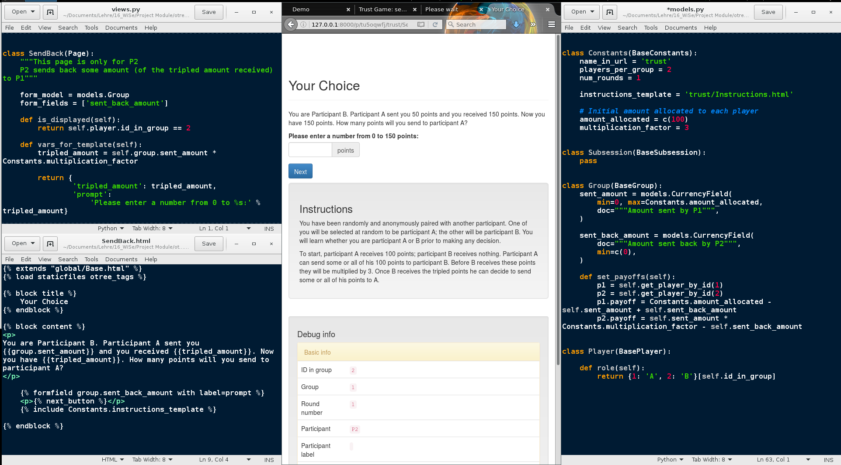
Make available to template
Calls form field
Creates data field
for database, makes
form field available
to app
Creates available form field

Slide 17
Calls upon models.py to get database connection
Writes value stored in database to subject screen

Slide 18
Grabs sent_amount value from database
and multiplier from Contansts class.
Multiplies it and stores in var tripled_amount.
Makes available to template
Shows tripled amount to subject.
!!! tripled amount is NOT stored in
database here!!!

Slide 19

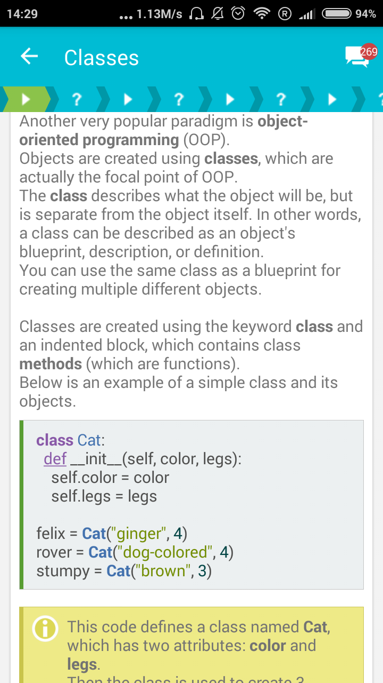
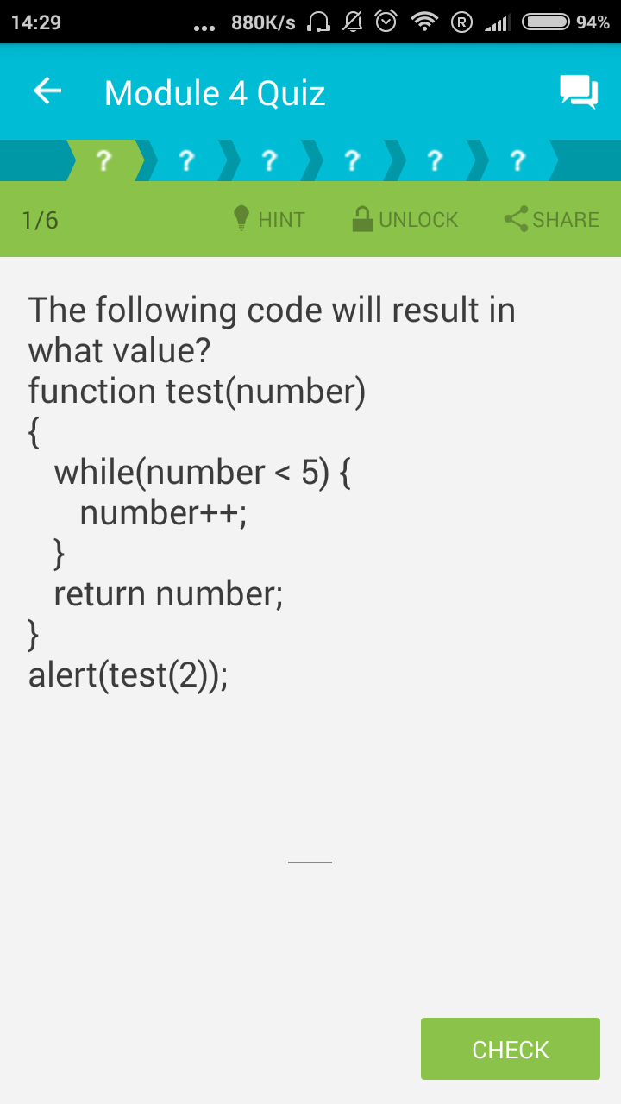
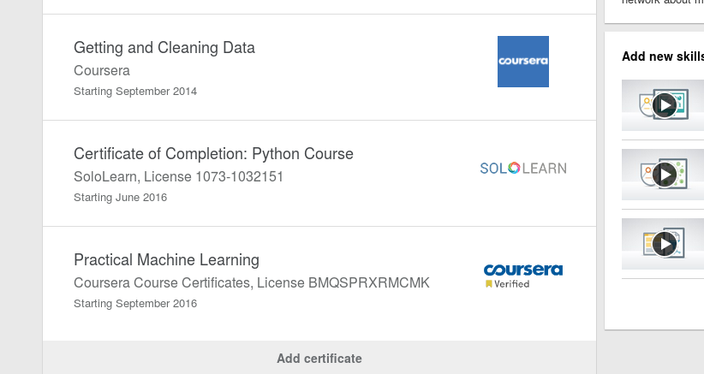
Hints: Learn to program
Python
JavaScript
SoloLearn.com
Free mobile app
Finished courses – certificates for LinkedIn

Slide 20
Programming Editors
Closed Source IDEs
Sublime text , PyCharm , Eclipse , Visual Studio
  Pro: Well maintained, optimized, key-ready
  Con: paid – usually with evaluation duration
Open Source IDEs
Bluefish , Ninja IDE , [Vim , Emacs ]
  Pro: Free, do what you need, highly configurable
  Con: Probably not as powerful as the above one
  [Special case]: extremely powerful with very large user community, BUT very steep learning curve. Need a lot of practice and personal configuration before you are effective.

Slide 21
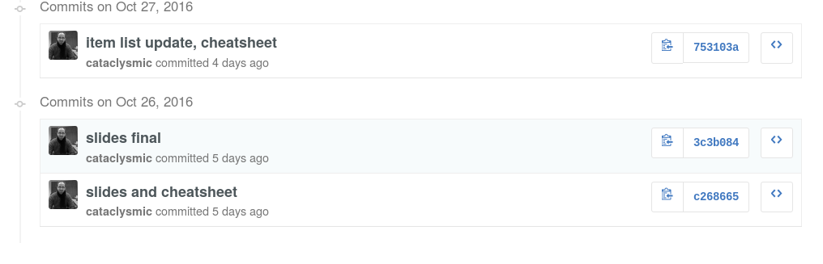
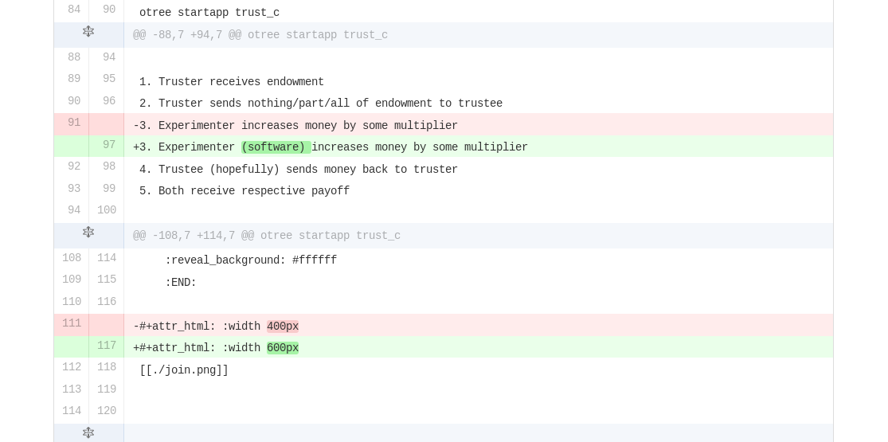
Git
Track your changes and collaborate

Slide 22
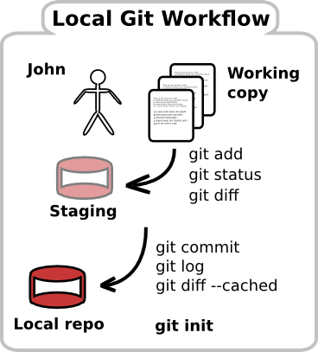
Used for collaborative work
Works for text file based formats
(html, py, css, js, tex, txt, …)
Tracks your changes
Tracks who changes what
Enables parallel working, while ensuring
that nothing get deleted.
Local and online databases ensure data security
and sharing
Youtube channel with great videos jckelley2

Slide 23
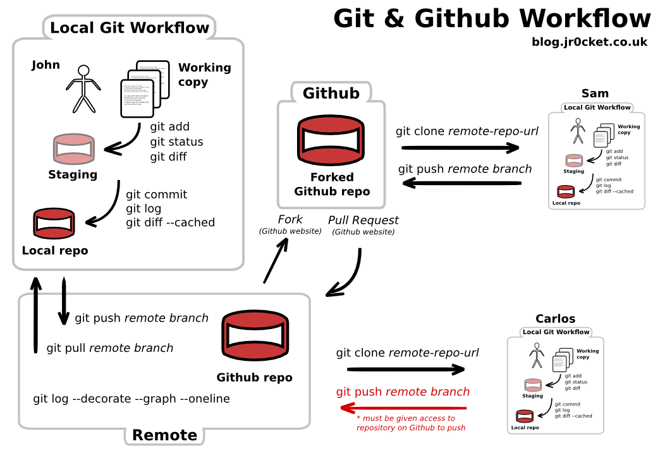
Expert level
Command
Cheatsheet

