Slide 1



Bespoke code
Real World Evidence for Clinical Research
how to cook for myself
6th July 2022
Martí Català

Slide 2
Outline
General instructions
Tasks
Part 0 – Understand commands
Part 1 – Basic commands
Part 2 – Build a cohort
Part 3 – Practice yourself

Slide 3
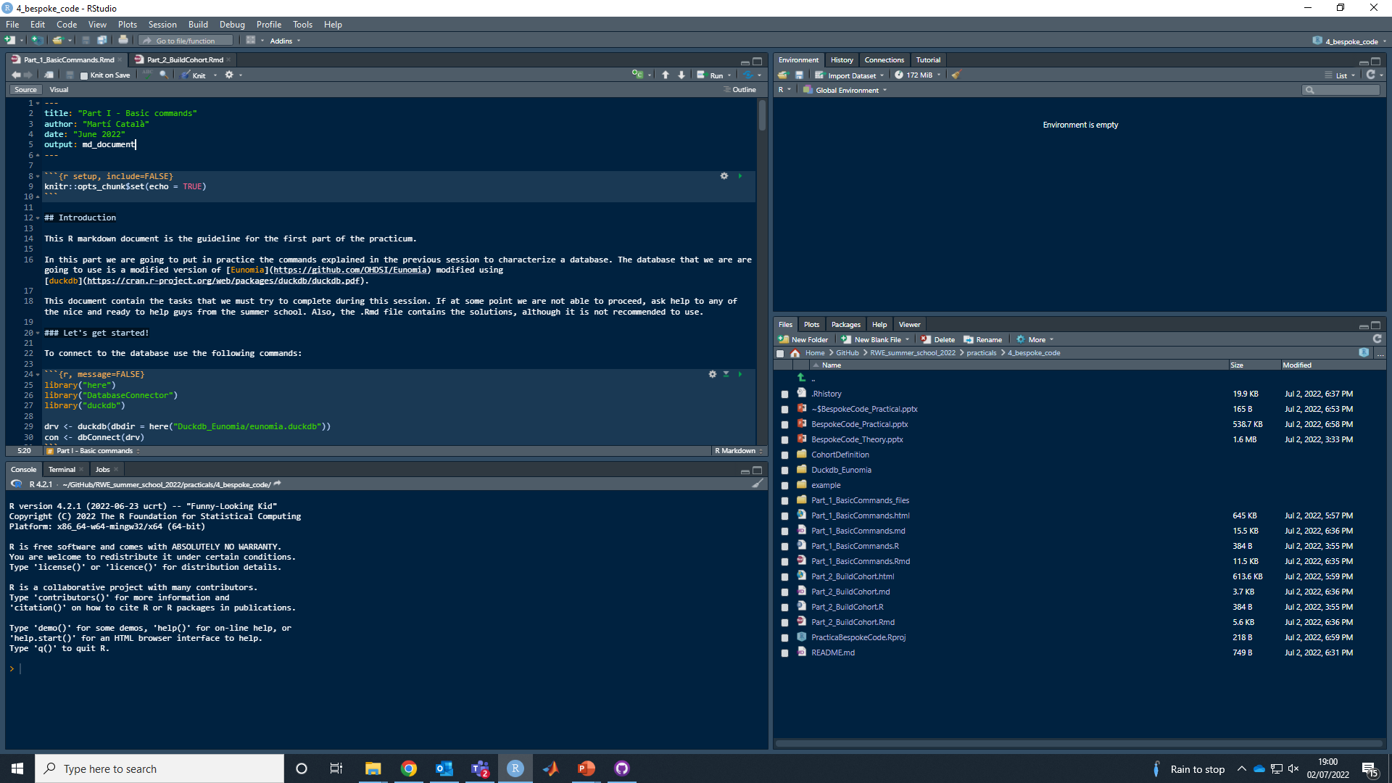
General instructions
Download the documents from Github:
https://github.com/oxford-pharmacoepi/RWE_summer_school_2022/tree/main/practicals/4_bespoke_code
Load the project:

Slide 4
General instructions
We are going to work with eunomia.duckdb that it is a fake database that we modifiedhttps://github.com/OHDSI/Eunomia. The code to connect to this database is contained in Part_1_BasicCommands.R.
For each part we have 3 files:
Part_#_xxxxx.html: tasks to complete, some tips to achieve them and the expected results (only part 1 and 2).
Part_#_xxxxx.R: it contains the code to start completing the tasks.
Part_#_xxxxx.Rmd: it contains the solutions, just look if necessary.

Slide 5
Tasks
Part 0
Understand commands
If you did not understand the commands and this that were explained before the idea is to use Part_0_UndestandCommands.Rmd to try to understand the commands presented and their functionality. NOT RECOMMENDED.
Part 1
Basic Commands
To try to put in practice the explained commands with simple exercises.
You are going to characterize and see the main tables of Eunomia.
RECOMMENDED.
Part 2
Build a cohort
If you want a bigger challenge and start directly trying to build your own cohort using the explained commands.
RECOMMENDED.
Part 3
Practice yourself
If you finish practices 1 and 2, and you have access to your own data you can try to use the same commands in your own data. The problems will increase as bigger the database and you will have to try to optimize the codes or be patient. NOT RECOMMENDED.

Slide 6
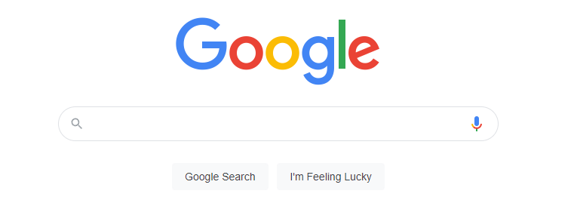
Some links
https://ohdsi.github.io/TheBookOfOhdsi/
https://www.guru99.com/r-dplyr-tutorial.html

