Slide 1
Formally Secure Compilation
of Unsafe Low-level Components
Cătălin Hrițcu
Inria Paris
https://secure-compilation.github.io

Slide 2







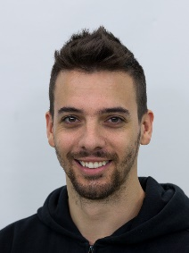




Collaborators
Cătălin
Hrițcu
Marco
Stronati
Guglielmo
Fachini
Arthur
Azevedo
de Amorim
Ana Nora
Evans
Théo
Laurent
Deepak
Garg
Yannis
Juglaret
Marco
Patrignani
Carmine
Abate
Andrew
Tolmach
Benjamin
Pierce
Notes:
Théo Laurent, Ana Nora Evans

Slide 3

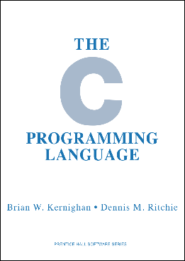

Computers are insecure
devastating low-level vulnerabilities
inherently insecure low-level languages
memory unsafe: any buffer overflow is catastrophic
root cause, but challenging to fix: efficiency, precision, scalability, backwards compatibility, deployment
compartmentalization, a strong practical defense
practically deployed low-level protection mechanisms
process-level privilege separation (all web browsers)
software fault isolation (SFI, Google Native Client)
hardware enclaves (Intel SGX, ARM TrustZone)
Notes:
TODO: metaphor: low-level languages are broken bricks, and higher level languages build up on those bricks

Slide 4
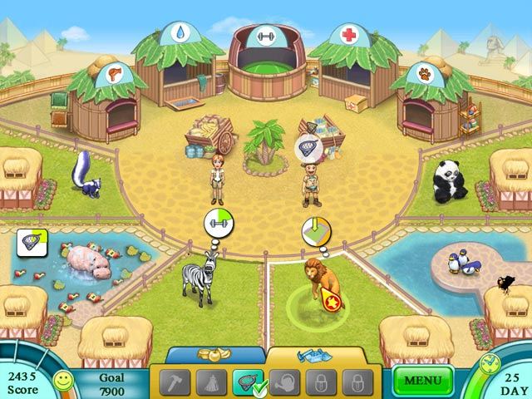
Zoo

Slide 5
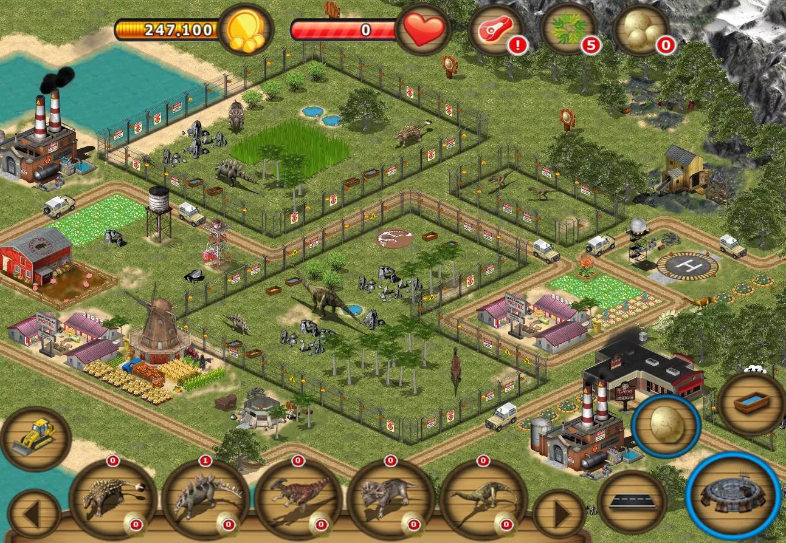
Zoo ... with very dangerous beasts

Slide 6
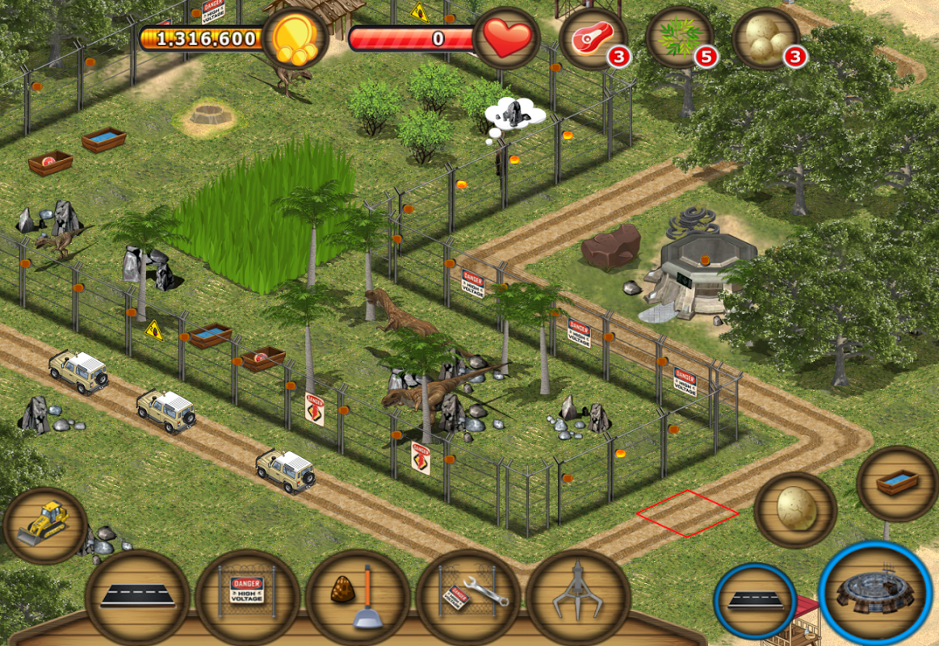

Zoo ... with very dangerous beasts
(source: Jurassic Island: The Dinosaur Zoo)

Slide 7
Compartmentalization for unsafe, low-level languages
Add components to C-like language
interacting only via strictly enforced interfaces
Secure compilation chain
use compartmentalization to efficiently enforce: component separation, call and return discipline, ...
Interesting attacker model
mutual distrust, dynamic compromise, least privilege
each component should be protected from all the others until it becomes compromised (by exhibiting undefined behavior) and starts attacking the remaining uncompromised components
Goal: Build this
Goal: Formalize this

Slide 8

Formally secure compilation
holy grail of preserving security all the way down
high-level attacker
e.g. safe C code
program behavior
source
secure
component
compiler
correctness
(e.g. CompCert)
not
enough
secure
compilation
compiler
low-level attacker
target
program behavior
component
secure
protected
no extra power
e.g. arbitrary machine code
e.g. compromised C code
Benefit: sound security reasoning in the source language forget about compilation chain (linker, loader, runtime)
forget that libraries are written in a lower-level language
Notes:
SAY: First, full abstraction talks not about whole programs but about partial programs interacting with a low-level attacker context.
Full abstraction says that for every low-level attacker context we can find an equivalent high-level attacker context.
This means that the compiled component is protected so that low-level attackers don’t have extra power over it compared to high-level attackers.
If we are able to map contexts back this way, we know that our source component is as secure a target component.
is about mapping
compilation goes in the other direction than correct compilation.
MAYBE: try to further simplify!
MAYBE: security property vs. no low/high-level attacks?
MAYBE: drop “forget ...”, or only soundtrack? – unsure, if I still say it won’t save us time

Slide 9
Fully abstract compilation
(preservation of observational equivalence)
∃
high-level attacker
high-level attacker
high-level attacker
≁
.
1st high-level component
2nd high-level component
⇒
compiler
compiler
low-level attacker
low-level attacker
∃
1st compiled component
≁
2nd compiled component
low-level attacker
.
Issues: (1) hard to realistically and efficiently achieve (2) challenging to prove at scale
(3) not intuitive to most security people
(4) doesn't quite work for unsafe languages
Notes:
(hopeless against timing side channels; more realistic: preservation of noninterference)

Slide 10
Our new target: Robust compilation
∀(bad, attack) trace t
high-level attacker
robust trace property preservation (robust = in adversarial context)
gives up on confidentiality (relational/hyper properties)
intuition:
stronger than compiler correctness
seems weaker than full abstraction + compiler correctness
less extensional than FA
∃
high-level attacker
causing t
high-level component
.
⇒
compiler
low-level attacker
∃
compiled component
low-level attacker causing t
.
Advantages: easier to realistically achieve and prove
useful: preservation of invariants and other integrity properties
works for unsafe languages (supporting dynamic compromise)

Slide 11
Mutually distrustful components
∀compromise scenarios. ∀ (bad, attack) traces t.
∃ high-level attack from some fully defined A₂, A₄, A₅
i₁
i₂
i₃
i₄
i₅
C₁
A₂
C₃
A₄
A₅
⇓ t
Limitation: static compromise
C₁ and C₃ fully defined
∃ low-level attack from compromised C₂↓, C₄↓, C₅↓
i₁
i₂
i₃
i₄
i₅
C₁
C₂
C₃
C₄
C₅
⇓ t
↓
↯
↓
↓
↯
↓
↯
↓
C₁ and C₃ can get guarantees only if they are perfectly secure
(i.e. fully defined = do not exhibit undefined behavior in any context)
This is the most we were able to do for full abstraction!
[Beyond Good and Evil - Juglaret, Hrițcu, et al, CSF’16]
Notes:
TODO: might make sense to give the crypto + cats example here!

Slide 12
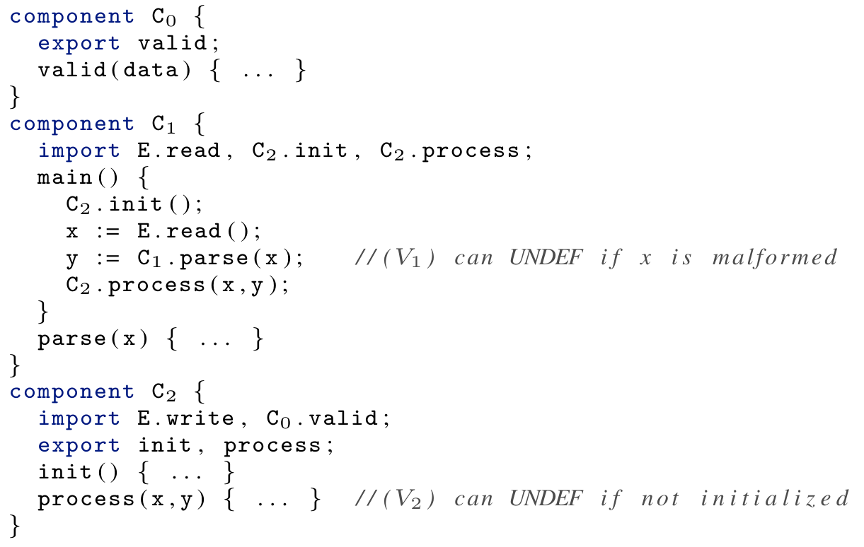
Static compromise not good enough
neither C₁ not C₂ are fully defined
yet C₁ is protected until calling C₁.parse
and C₂ can't actually be compromised

Slide 13
Dynamic compromise
i₁
i₂
i₃
C₀
C₁
C₂
⇓ t
↓
↓
↓
∃ a dynamic compromise scenario explaining t in source language
for instance ∃[A₁,A₂] leading to the following compromise sequence:
i₁
i₂
i₃
(0)
C₀
C₁
C₂
⇓ m₁;Undef(C₁)
↯
≤
i₁
i₂
i₃
(1)
C₀
A₁
C₂
⇓ m₂;Undef(C₂)
↯
≤
Trace is very helpful
- detect undefined behavior
- rewind execution
i₁
i₂
i₃
(2)
C₀
A₁
A₂
⇓ t
[When Good Components Go Bad - Fachini, Stronati, Hrițcu, et al]

Slide 14
Now we know what these words mean!
(at least in the setting of compartmentalization for unsafe, low-level languages)
Mutual distrust
Dynamic compromise
Least privilege
C₁
A₂
C₃
A₄
A₅
C₀
A₁
C₂
⇓ m₂; Undef(C₂)
↯
i₁
i₂
i₃
C₀
A₁
C₂

Slide 15
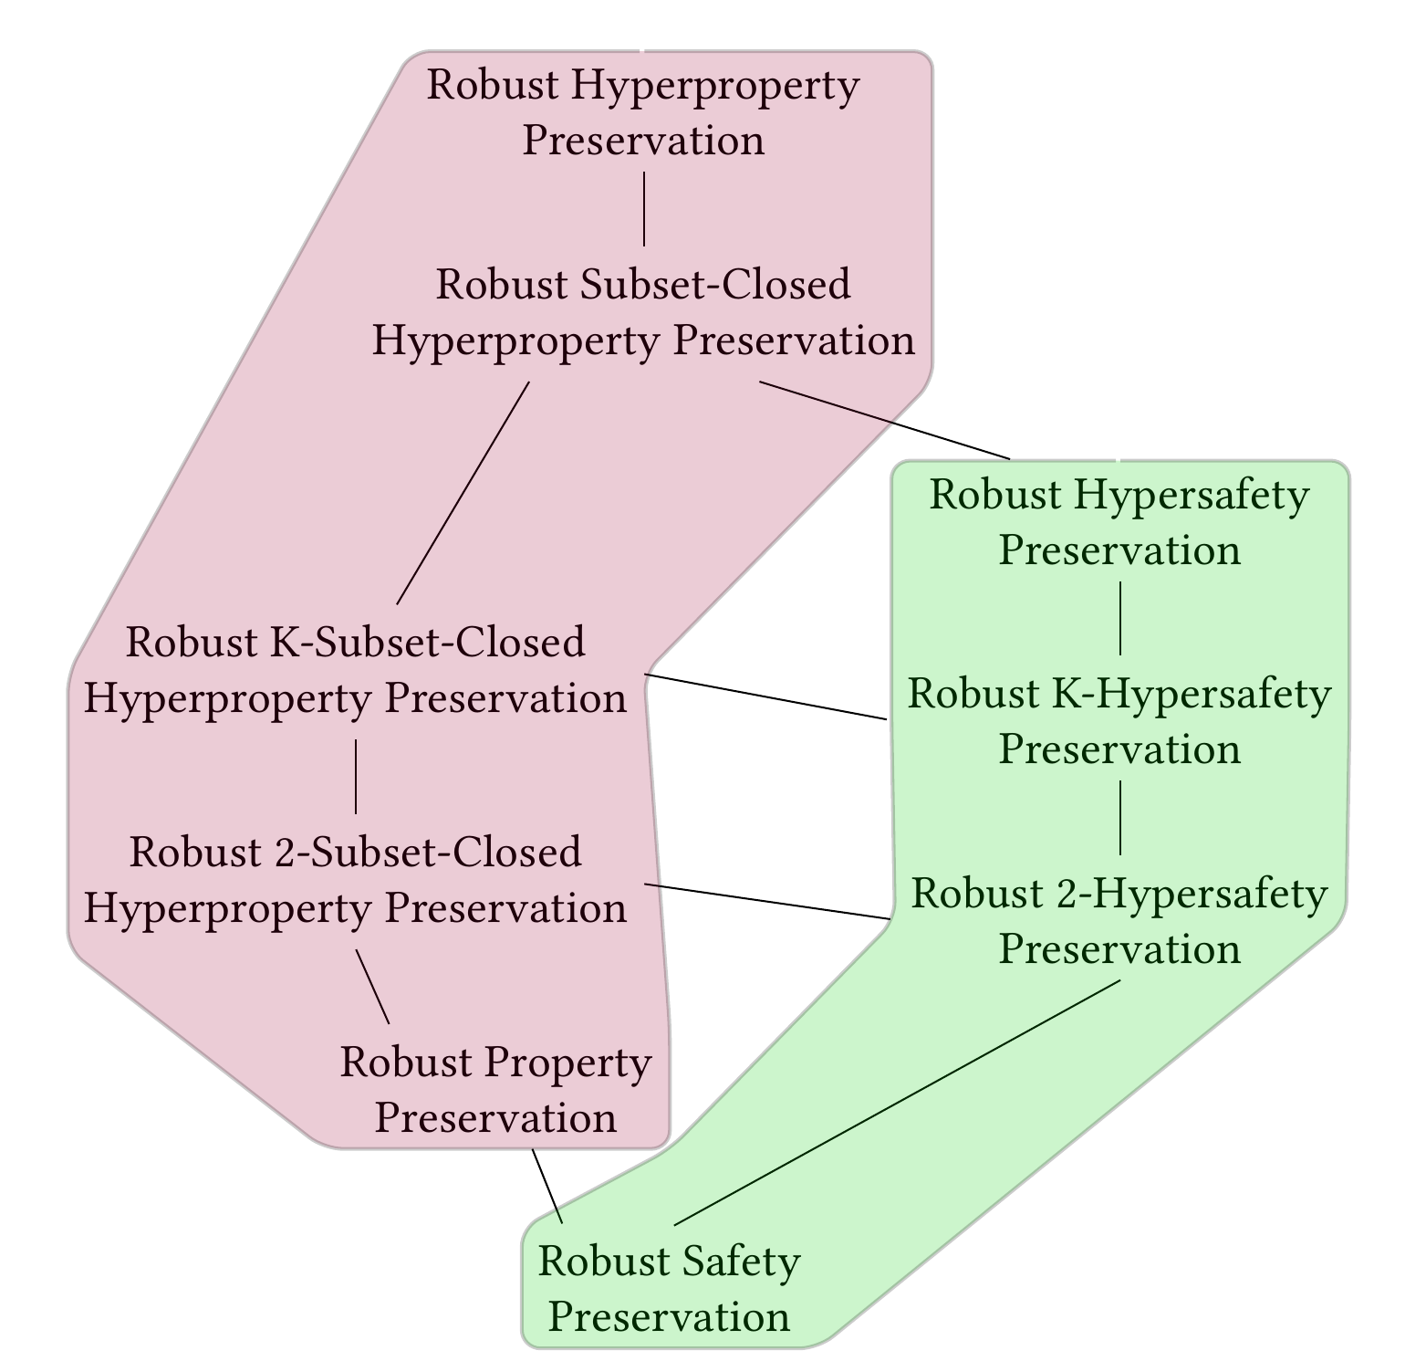

Beyond trace properties
Legend (Trace) property = set of traces
Hyperproperty = set of sets of traces
back-translating contexts
∀P∀C_{t}∃C_{s}∀t...
back-translating
finite trace prefixes
∀P∀C_{t}∀t∃C_{s}...
full abstraction lives around here (if we move ∀P after ∃C_{s}
i.e. preserving relational 2-hypersafety)
[Robust Hyperproperty Preservation for Secure Compilation - Garg, Hrițcu, et al]

Slide 16
Building and verifying realistic secure compartmentalizing compilation chains
Vision for ...
(i.e. mostly vaporware at this point)

Slide 17

Goal: achieving secure compilation at scale
protecting higher-level abstractions
Low* language
(safe C subset in F*)
miTLS*
KremSec
C language
+ components
+ memory safety
memory safe C component
legacy C component
CompSec⁺
CompSec
ASM language
(RISC-V + micro-policies)
ASM component
protecting component boundaries
Notes:
SAY (beginning): The goal for SECOMP is to achieve full abstraction at scale for realistic programming languages
SAY (end): Pause at the end, the goal of this project is to build all of this.

Slide 18
Protecting component boundaries
Add mutually distrustful components to C
interacting only via strictly enforced interfaces
CompCert-based compilation chain
propagate interface information to produced binary
Micro-policy simultaneously enforcing
component separation
type-safe procedure call and return discipline
Software fault isolation fallback
when tagged hardware support not available
Good progress on this but in much simplified setting
Notes:
SAY (end, quickly if needed): One fundamental challenge is defining the proper attacker model for this, and we will present a preliminary result on this at CSF this year.
NOT ADDED: might add that undefined behavior is restricted to the component that caused it; this could be an answer to the “unsafe source” point which I’m anyway not making.

Slide 19



Protecting higher-level abstractions
Low*: enforcing specifications in C
some can be turned into contracts, checked dynamically; micro-policies can speed this up too
Limits of purely-dynamic enforcement
functional purity, termination, relational reasoning
push these limits further and combine with static analysis
Notes:
- TODO: This slide starts being a bit empty
Removed:
- Low* have more interesting abstractions
security of Low* to C compiler trivial for C interfaces (because F* allows and tracks effects, as opposed to Coq)
+ No longer true since Low* is just a subset of C
Removed:
ML abstractions we want to enforce with micro-policies
types, value immutability, opaqueness of closures, parametricity (dynamic sealing), GC vs malloc/free, ...

Slide 20
backup slides

Slide 21
Broad view on secure compilation
Different security goals / attacker models
Fully abstract compilation and variants, robust compilation, noninterference preservation, ...
Different enforcement mechanisms
reference monitors, secure hardware, static analysis, software rewriting, randomization, ...
Different proof techniques
(bi)simulation, logical relations, multi-language semantics, embedded interpreters, ...

