Slide 1
Formally Secure Compilation
of Unsafe Low-level Components
Cătălin Hrițcu
Inria Paris
https://secure-compilation.github.io

Slide 2
Parcurs profesional
2001 - 2005 - Infoiași - student la licență
2005 - 2011 - Saarland University - MSc & PhD
2011 - 2013 - U. of Pennsylvania - PostDoc with Benjamin Pierce, DARPA CRASH/SAFE
2013 - acum - Inria Paris - Cercetător
2017 - 2021 - ERC Starting Grant SECOMP - PI
2017 - 2020 - DARPA SSITH/HOPE - coPI

Slide 3

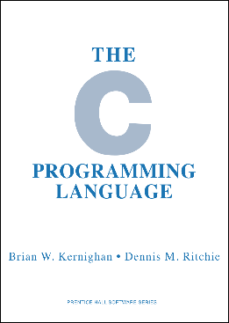
Computers are insecure
devastating low-level vulnerabilities
teasing out 2 important security problems:
1. inherently insecure low-level languages
memory unsafe: any buffer overflow can be catastrophic allowing remote attackers to gain complete control
2. unsafe interaction with unsafe code
even code written in safer languages has to interoperate with unsafe code
unsafe interaction: safety guarantees lost
Notes:
TODO: metaphor: low-level languages are broken bricks, and higher level languages build up on those bricks

Slide 4
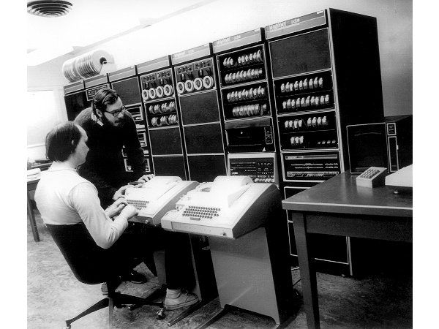
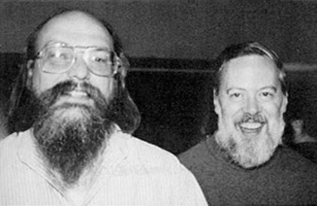
How did we get here?
programming languages, compilers, and hardware architectures
designed in an era of scarce hardware resources
too often trade off security for efficiency
the world has changed (2017 vs 1972*)
security matters, hardware resources abundant
time to revisit some tradeoffs
* “...the number of UNIX installations has grown to 10, with more expected...”
-- Dennis Ritchie and Ken Thompson, June 1972
Notes:
TODO: metaphor: hippies (Unix pioneers) vs emos (holding mobile devices)?

Slide 5

Key enabler: Micro-Policies
software-defined, hardware-accelerated, tag-based monitoring
pc
tpc
tpc
mem[0]
tm0
r0
tr0
tr0
“store r0 r1”
tm1
tm1
r1
tr1
tr1
mem[2]
tm2
mem[3]
tm3
tm3
tm3
≠
tpc
tr0
tr1
=
tm3
tm3
tm1
store
monitor
allow
policy violation stopped!
(e.g. out of bounds write)
tpc’
tpc’
tm3’
tm3’
disallow
software monitor’s decision is hardware cached
Notes:
SAY (start): They key enabler for this project is a software-hardware protection mechanism called micro-policies, on which I’ve been working in the past 4 years.
SAY (end): ... of course the software monitor can also disallow any instruction if it causes a violation of the enforce policy, for instance the monitor can disallow a write out of the bounds of an array if the color of the pointer doesn’t match the color of the memory location.
(JPB): add enthusiasm, this is a really cool mechanism: efficient, fine-grained, expressive, adaptable, secure, formally verified, real – would need time to say it!
(JPB): practice end, decide level of detail in advance
MAYBE: make micro-policies logo faster?

Slide 6






Micro-policies are cool!
low level + fine grained: unbounded per-word metadata, checked & propagated on each instruction
flexible: tags and monitor defined by software
efficient: software decisions hardware cached
expressive: complex policies for secure compilation
secure and simple enough to verify security in Coq
real: FPGA implementation on top of RISC-V

Slide 7
Expressiveness
Way beyond MPX, SGX, SSM, etc
information flow control (IFC)
monitor self-protection
protected compartments
dynamic sealing
heap memory safety
code-data separation
control-flow integrity (CFI)
taint tracking
...
[POPL’14]
Verified
(in Coq)
[Oakland’15]
Evaluated
(<10% runtime overhead)
[ASPLOS’15]
Notes:
Remember: I’ve lead this verification effort. I’ve had the idea of bringing this beyond IFC (and CRASH/SAFE)

Slide 8
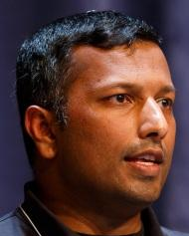



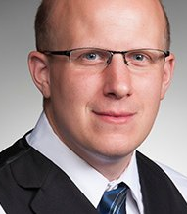
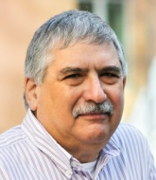
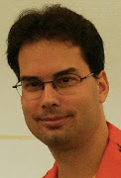



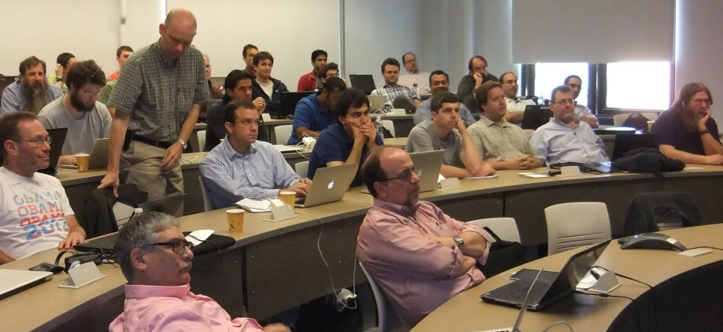
Micro-Policies Project
Formal methods & architecture & systems
Previous: DARPA CRASH/SAFE (2011-2014)
Current: DARPA SSITH/HOPE (2017-2020)
PIs:
Draper Labs: Arun Thomas, Chris Casinghino
Dover Microsystems: Greg Sullivan
DornerWorks: Nathan Studer, David Johnson
UPenn: André DeHon, Benjamin Pierce
Inria Paris: Cătălin Hrițcu
Portland State: Andrew Tolmach
MIT: Howie Shrobe
Notes:
TODO: ERC SECOMP, 2 x DARPA
TODO: Add Guglielmo and Theo

Slide 9
ERC SECOMP Grand Challenge
(2017-2021)
Use micro-policies to build the first efficient formally secure compilers for realistic programming languages
Provide secure semantics for low-level languages
C with protected components and memory safety
Enforce secure interoperability with unsafe code
ASM, C, and Low* [= safe C subset embedded in F* for verification]
Notes:
SAY: SECOMP is about taking this very expressive protection mechanism to a whole new level. The goal of SECOMP is to use micro-policies to ...
SAY: Where by secure compilers I mean compilers that prevent all low-level attacks on compiled code by 1. providing ... and 2. enforcing ...

Slide 10
Goal: achieving secure compilation at scale
Low* language
(safe C subset in F*)
miTLS*
KremSec
C language
+ components
+ memory safety
memory safe C component
legacy C component
CompSec⁺
CompSec
ASM language
(RISC-V + micro-policies)
ASM component
protecting component boundaries
Notes:
SAY (beginning): The goal for SECOMP is to achieve full abstraction at scale for realistic programming languages
SAY (end): Pause at the end, the goal of this project is to build all of this.

Slide 11
Formally Secure Compilation of Unsafe Low-level Components

Slide 12







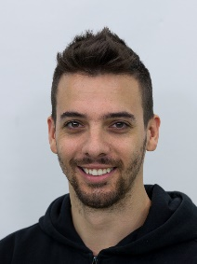


Collaborators
Cătălin
Hrițcu
Marco
Stronati
Guglielmo
Fachini
Arthur
Azevedo
de Amorim
Ana Nora
Evans
Théo
Laurent
Deepak
Garg
Yannis
Juglaret
Marco
Patrignani
Carmine
Abate
Andrew
Tolmach
Benjamin
Pierce
Inria Paris CMU U. Virginia ENS Paris UPenn Portland State MPI-SWS U. Trento

Slide 13

Compartmentalization for unsafe, low-level languages
Add components to C-like language
interacting only via strictly enforced interfaces
Secure compilation chain
use low-level security mechanisms to efficiently enforce: component separation, call and return discipline, ...
Interesting attacker model
mutual distrust, dynamic compromise, least privilege
e.g. dynamic compromise = "each component should be protected from all the others until it becomes compromised and starts attacking the remaining uncompromised components"
Goal: Build this
Goal: Formalize this

Slide 14

Formally secure compilation
holy grail of preserving security all the way down
high-level attacker
e.g. safe C code
program behavior
source
secure
component
compiler
correctness
(e.g. CompCert)
not
enough
secure
compilation
compiler
low-level attacker
target
program behavior
component
secure
protected
no extra power
e.g. arbitrary machine code
e.g. compromised C code
Benefit: sound security reasoning in the source language forget about compilation chain (linker, loader, runtime)
forget that libraries are written in a lower-level language
Notes:
SAY: First, full abstraction talks not about whole programs but about partial programs interacting with a low-level attacker context.
Full abstraction says that for every low-level attacker context we can find an equivalent high-level attacker context.
This means that the compiled component is protected so that low-level attackers don’t have extra power over it compared to high-level attackers.
If we are able to map contexts back this way, we know that our source component is as secure a target component.
is about mapping
compilation goes in the other direction than correct compilation.
MAYBE: try to further simplify!
MAYBE: security property vs. no low/high-level attacks?
MAYBE: drop “forget ...”, or only soundtrack? – unsure, if I still say it won’t save us time

Slide 15
Fully abstract compilation
preservation of observational equivalence
∃
high-level attacker
high-level attacker
high-level attacker
≁
.
1st high-level component
2nd high-level component
compiler
compiler
low-level attacker
low-level attacker
∃
1st compiled component
≁
2nd compiled component
low-level attacker
.
Notes:
(hopeless against timing side channels; more realistic: preservation of noninterference)

Slide 16
Undefined behavior
#include <string.h>
int main (int argc, char **argv)
{
char c[12];
strcpy(c, argv[1]);
return 0;
}
Buffer overflow
$ gcc target.c -fno-stack-protector
$ ./a.out haha
$ ./a.out hahahahahahahahahaha
zsh: segmentation fault (core dumped)

Slide 17
Source reasoning vs undefined behavior
Source reasoning
We want to reason formally about security with respect to source language semantics
Undefined behavior
can't be expressed at all by source language semantics!
Observational equivalence doesn't work with undefined behavior!?
int buf[5]; buf[42] ~ int buf[5]; buf[43]?
Can we somehow avoid undefined behavior?

Slide 18
Full abstraction with mutually distrustful components
∀compromise scenarios.
∃ high-level attack from some fully defined A₂, A₄, A₅
i₁
i₂
i₃
i₄
i₅
≁
i₁
i₂
i₃
i₄
i₅
C₁
A₂
C₃
A₄
A₅
D₁
A₂
D₃
A₄
A₅
if C₁, C₃, D₁, D₃ fully defined and
∃ low-level attack from compromised C₂↓, C₄↓, C₅↓
i₁
i₂
i₃
i₄
i₅
≁
i₁
i₂
i₃
i₄
i₅
C₁
C₂
C₃
C₄
C₅
D₁
C₂
D₃
C₄
C₅
↓
↓
↓
↓
↓
↓
↓
↓
↓
↓
Limitation: static compromise model: C₁, C₃, D₁, D₃ get guarantees only if perfectly safe
(i.e. fully defined = do not exhibit undefined behavior in any context)
This is the most we were able to achieve for full abstraction!
[Beyond Good and Evil - Juglaret, Hrițcu, et al, CSF’16]
Notes:
TODO: might make sense to give the crypto + cats example here!

Slide 19
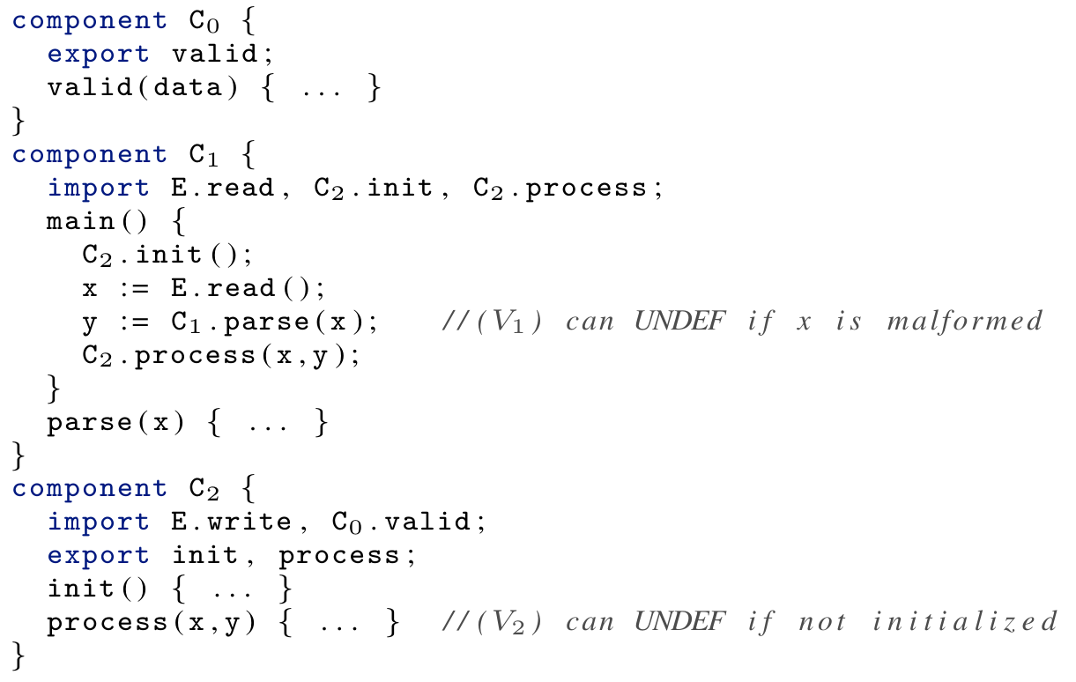
Static compromise not good enough
neither C₁ not C₂ are fully defined
yet C₁ is protected until calling C₁.parse
and C₂ can't actually be compromised

Slide 20
New secure compilation criterion: Robust Compilation
∀(bad, attack) trace t
robust trace property preservation (robust = in adversarial context)
intuition:
stronger than compiler correctness
seems weaker than full abstraction + compiler correctness
less extensional than full abstraction
∃
high-level attacker
high-level attacker
causing t
high-level component
.
⇒
compiler
low-level attacker
∃
compiled component
low-level attacker causing t
.
Advantages: easier to realistically achieve and prove at scale
useful: preservation of invariants and other integrity properties
more intuitive to security people (generalizes to hyperproperties!)
extends to unsafe languages (supporting dynamic compromise)

Slide 21
Dynamic compromise
i₁
i₂
i₃
C₀
C₁
C₂
⇓ t
↓
↓
↓
∃ a dynamic compromise scenario explaining t in source language
for instance ∃[A₁,A₂] leading to the following compromise sequence:
i₁
i₂
i₃
(0)
C₀
C₁
C₂
⇓ m₁;Undef(C₁)
↯
≤
i₁
i₂
i₃
(1)
C₀
A₁
C₂
⇓ m₂;Undef(C₂)
↯
≤
Trace is very helpful
- detect undefined behavior
- rewind execution
i₁
i₂
i₃
(2)
C₀
A₁
A₂
⇓ t
[When Good Components Go Bad - Fachini, Stronati, Hrițcu, et al]

Slide 22
Now we know what these words mean!
(at least in the setting of compartmentalization for unsafe low-level languages)
Mutual distrust
Dynamic compromise
Least privilege
C₁
A₂
C₃
A₄
A₅
C₀
A₁
C₂
⇓ m₂; Undef(C₂)
↯
i₁
i₂
i₃
C₀
A₁
C₂
[When Good Components Go Bad - Fachini, Stronati, Hrițcu, et al]

Slide 23
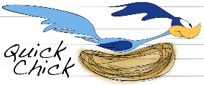
Simple Secure Compilation Chain
Verified
(in Coq)
Compartmentalized unsafe source
Buffers, procedures, components
interacting via strictly enforced interfaces
Compartmentalized abstract machine
Simple RISC abstract machine with
build-in compartmentalization
software fault isolation
Micro-policy machine
Standard
machine
fallback
Tag-based reference monitor enforcing:
- component separation
- procedure call and return discipline
Inline reference monitor enforcing:
- component separation
- procedure call and return discipline
Systematically tested (with QuickChick)

Slide 24
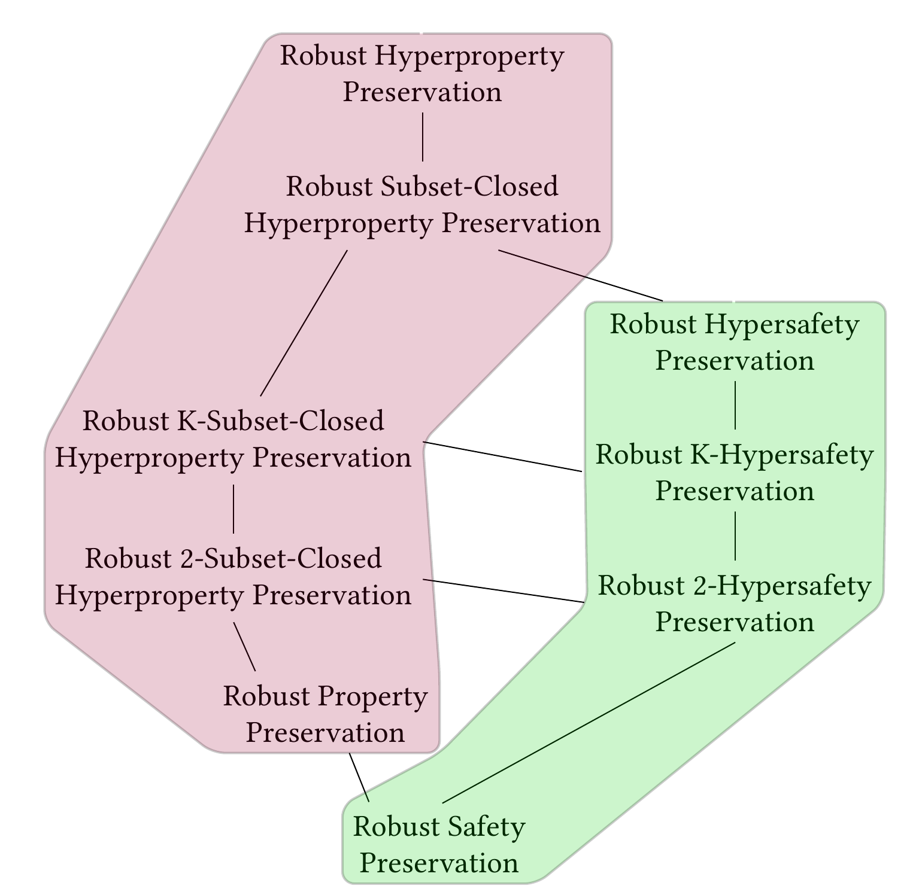
Beyond trace properties
Legend (Trace) property = set of traces
Hyperproperty = set of sets of traces
back-translating contexts
∀P∀C_{t}∃C_{s}∀t...
back-translating
finite trace prefixes
∀P∀C_{t}∀t∃C_{s}...
full abstraction lives around here (if we move ∀P after ∃C_{s}
i.e. preserving relational 2-hypersafety)
[Robust Hyperproperty Preservation for Secure Compilation - Garg, Hrițcu, et al]

Slide 25
Compartmentalization mechanisms
practically deployed ones
process-level privilege separation (all web browsers)
software fault isolation (SFI, Google Native Client)
hardware enclaves (Intel SGX, ARM TrustZone)
and more on drawing boards:
WebAssembly (WASM)
capability machines (CHERI)
tagged architectures (micro-policies)

