Slide 1


Devastating low-level vulnerabilities
Inherently insecure C/C++-like languages
memory (and type) unsafe: any buffer overflow is catastrophic
root cause, but challenging to fix:
efficiency
precision
scalability
backwards compatibility
deployment

Slide 2

Practical mitigation: compartmentalization
Main idea:
break up security-critical C applications into mutually distrustful components running with least privilege & interacting via strictly enforced interfaces
Strong security guarantees & interesting attacker model
"a vulnerability in one component should not immediately destroy the security of the whole application"
"components can be compromised by buffer overflows"
"each component should be protected from all the others"
Goal 1: Formalize this

Slide 3
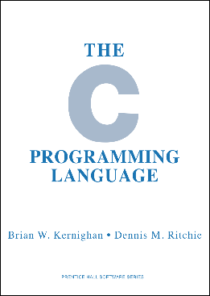
Goal 2: Build secure compilation chains
Add components to C
interacting only via strictly enforced interfaces
Enforce "component C" abstractions:
component separation, call-return discipline, ...
Secure compilation chain:
compiler, linker, loader, runtime, system, hardware
Use efficient enforcement mechanisms:
OS processes (all web browsers) — WebAssembly (web browsers)
software fault isolation (SFI) — capability machines
hardware enclaves (SGX) — tagged architectures
Practical need for this (e.g. crypto library/protocol)

Slide 4
Source reasoning vs undefined behavior
Source reasoning
We want to reason formally about security with respect to source language semantics
Undefined behavior
can't be expressed at all by source language semantics!

Slide 5
Dynamic compromise
i₁
i₂
i₃
C₀
C₁
C₂
⇓ t
↓
↓
↓
∃ a dynamic compromise scenario explaining t in source language
for instance leading to the following compromise sequence:
i₁
i₂
i₃
(0)
C₀
C₁
C₂
⇓ m₁;Undef(C₁)
↯
≤
i₁
i₂
i₃
(1)
∃A₁.
C₀
A₁
C₂
⇓ m₂;Undef(C₂)
↯
≤
Trace is very helpful
- detect undefined behavior
- rewind execution
i₁
i₂
i₃
(2)
∃A₂.
C₀
A₁
A₂
⇓ t
[When Good Components Go Bad - Fachini, Stronati, Hrițcu, et al]

Slide 6
Restricting undefined behavior
Mutually-distrustful components
restrict spatial scope of undefined behavior
Dynamic compromise
restrict temporal scope of undefined behavior
undefined behavior = observable trace event
effects of undefined behavior shouldn't percolate before earlier observable events
careful with code motion, backwards static analysis, ...
CompCert already offers this saner model
GCC and LLVM currently violate this model

Slide 7
Now we know what these words mean!
(at least in the setting of compartmentalization for unsafe low-level languages)
Mutual distrust
Dynamic compromise
Static privilege
C₁
A₂
C₃
A₄
A₅
C₀
A₁
C₂
⇓ m₂; Undef(C₂)
↯
i₁
i₂
i₃
C₀
A₁
C₂

Slide 8


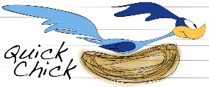
Towards Secure Compilation Chain
(mostly) Verified
(in Coq)
Compartmentalized unsafe source
Buffers, procedures, components
interacting via strictly enforced interfaces
Compartmentalized abstract machine
Simple RISC abstract machine with
build-in compartmentalization
software fault isolation
Micro-policy machine
Bare-bone
machine
Tag-based reference monitor enforcing:
- component separation
- procedure call and return discipline
(linear capabilities / linear entry points)
Inline reference monitor enforcing:
- component separation
- procedure call and return discipline
(program rewriting, shadow call stack)
Systematically tested (with QuickChick)

