Slide 1








Journey Beyond Full Abstraction: Exploring Robust Property Preservation for Secure Compilation
Carmine
Abate
Rob Blanco
Deepak
Garg
Cătălin
Hrițcu
Jérémy Thibault
Marco
Patrignani
Inria Paris
Inria Paris
MPI-SWS
Inria Paris
Inria Paris
Stanford
& CISPA

Slide 2
Good programming languages provide helpful abstractions for writing more secure code
structured control flow, procedures, modules, interfaces, correctness and security specifications, ...
abstractions not enforced when compiling and linking with adversarial low-level code
all source-level security guarantees are lost
Notes:
End: Such abstractions are crucial for making the effort required to reason about the correctness and security properties of realistic code tractable in practice.

Slide 3

HACL* verified cryptographic library, in practice
, in practice
~100.000 LOC in F*
16.000.000+ LOC in C/C++
160x
HACL* library
Firefox web browser
KreMLin
+ CompCert
GCC
ASM
ASM
Insecure interoperability: linked code can read and write
data and code, jump to arbitrary instructions, smash the stack, ...
Notes:
End: compromised (or malicious) application linking in miTLS can easily read and write miTLS’s data and code, jump to arbitrary instructions, smash the stack, ...

Slide 4
We need secure compilation chains
Protect source-level abstractions even against linked adversarial low-level code
various enforcement mechanisms: processes, SFI, ...
shared responsibility: compiler, linker, loader, OS, HW
Goal: enable source-level security reasoning
linked adversarial target code cannot break the security of compiled program any more than some linked source code
no "low-level" attacks

Slide 5
Robustly preserving security
∀
source context
source context
source
secure
program
⇒
compiler
∀
target
context
target context
compiled
secure
program
protected
no extra power
But what should "secure" mean?
Notes:
End: if source program is secure against all source contexts
- then compiled program is secure against all target contexts
- but what should "is secure" mean?

Slide 6

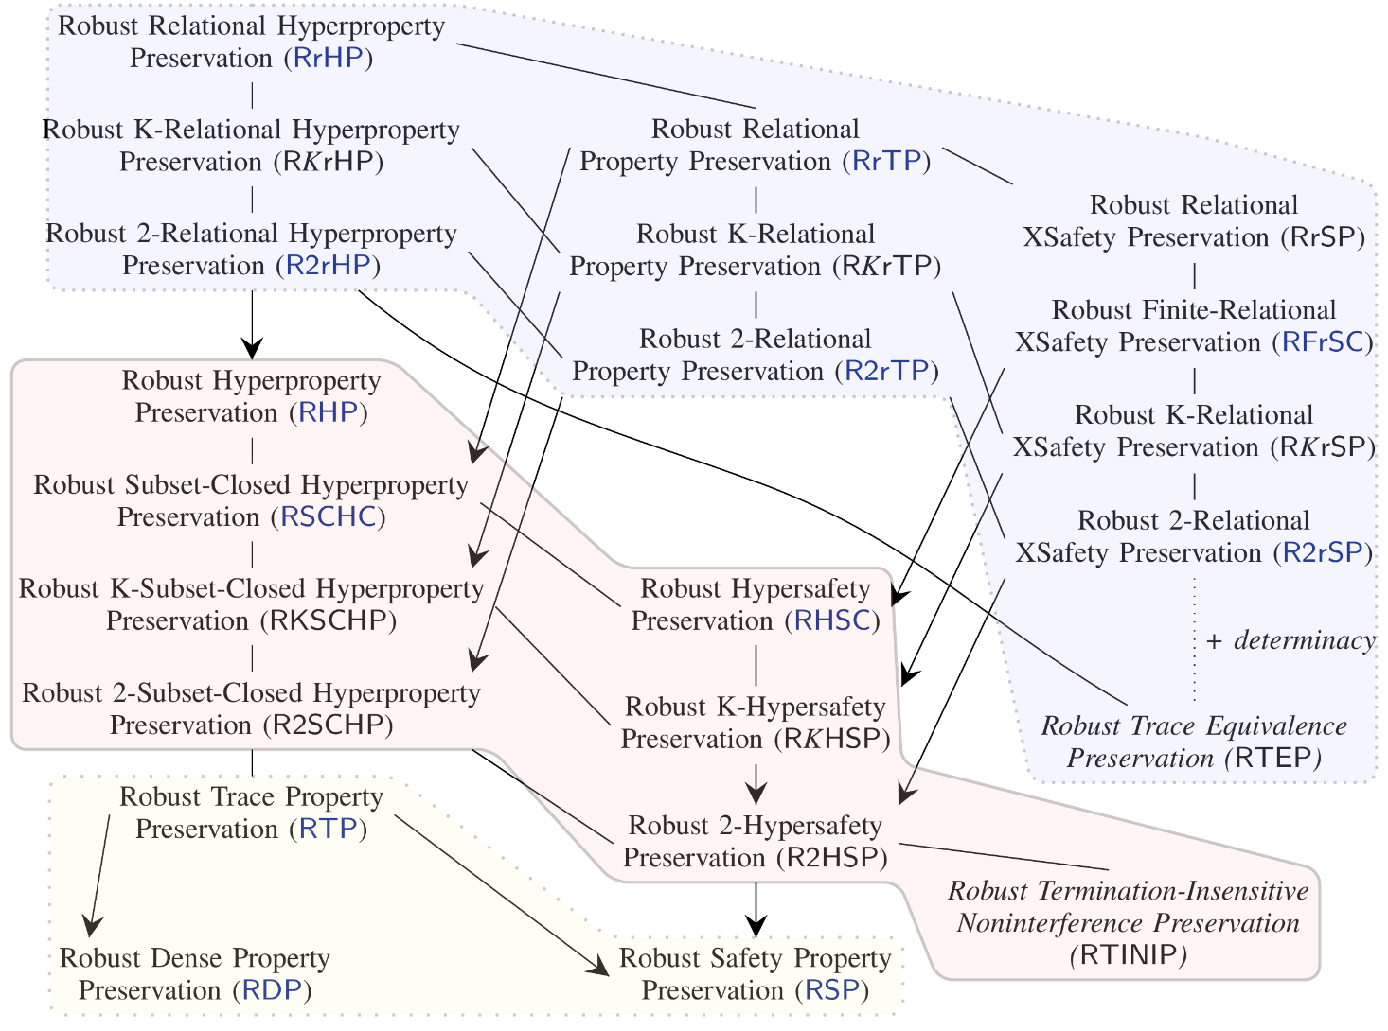
What properties should we robustly preserve?
No one-size-fits-all security criterion
relational
hyperproperties
(trace equivalence)
More secure
+ code confidentiality
hyperproperties
(noninterference)
+ data confidentiality
More efficient
to enforce
Easier to prove
trace properties
(safety & liveness)
only integrity

Slide 7
Robust Trace Property Preservation
property-based characterization
property-free characterization
∀source programs.
∀π trace property.
∀source programs.
∀(bad/attack) trace t.
∀
source context
trace t
source context
source context
∃
.
source program
⇝t ⇒ t∈π
source context
source program
⇝t
.
⇔
⇒
⇒
compiler
compiler
back- translation
target context
target context
∀
target context trace t
compiled program
∃
compiled program
⇝t ⇒ t∈π
target context
⇝t
.
.
what one might want to achieve
how one can prove it

Slide 8
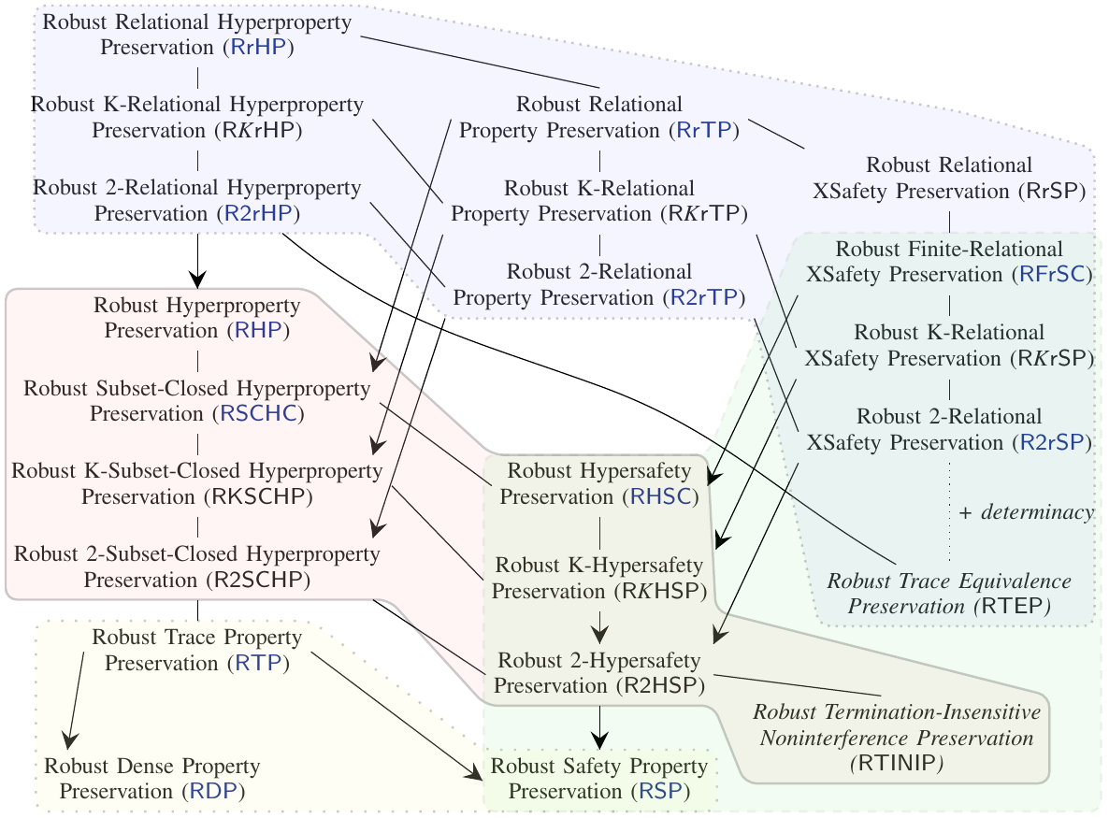
Some of the proof difficulty is manifest in
property-free characterization
back-translating context
∀C_{T}∃C_{S}∀P∀t...
back-translating
finite set of
finite trace prefixes
∀k∀P₁..P_{k}∀C_{T} ∀m₁..m_{k} ∃C_{S}...
back-translating
prog & context ∀P∀C_{T}∃C_{S}∀t...
back-translating
finite trace prefix
∀P∀C_{T}∀m≤t∃C_{S}...
back-translating
prog & context & trace
∀P∀C_{T}∀t∃C_{S}...
Notes:
Note: back-translating trace vs execution ... intuition vs. precision

Slide 9

Journey Beyond Full Abstraction
First to explore space of secure compilation criteria based on robust property preservation
Carefully studied the criteria and their relations
Property-free characterizations
implications, collapses, separations results
Introduced relational (hyper)properties (new classes!)
Clarified relation to full abstraction ...
Embraced and extended proof techniques ...
https://github.com/secure-compilation/exploring-robust-property-preservation

Slide 10

Where is Full Abstraction?
(i.e. robust behavioral equivalence preservation)
without internal nondeterminism,
full abstraction is here
doesn't imply any other criterion

Slide 11

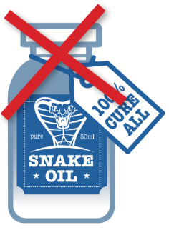
Full abstraction does not imply any other criterion in our diagram
Intuitive counterexample adapted from Marco&Deepak [CSF'17]
When context passes in bad input value (e.g. ill-typed):
lunch the missiles - breaks Robust Safety Preservation
or loop forever - breaks Robust Liveness Preservation
or leak secret inputs - breaks Robust NI Preservation
Yet this doesn't break full abstraction or compiler correctness!
Full abstraction only ensures code confidentiality
no integrity, no safety, no data confidentiality, ...

Slide 12
Embraced and extended™ proof techniques
strongest
criterion
achievable
for simple translation from statically to dynamically typed language with first-order functions and I/O
back-translating context
∀C_{T}∃C_{S}∀P∀t...
[New et al,ICFP'16]
generic technique
applicable
back-translating
finite set of
finite trace prefixes
∀k∀P₁..P_{k}∀C_{T} ∀m₁..m_{k} ∃C_{S}...
[Jeffrey & Rathke, ESOP'05] [Patrignani et al,TOPLAS'15]
Notes:
TODO: reference [New et al]

Slide 13
Some open problems
Practically achieving secure interoperability with lower-level code
more realistic languages and compilation chains
Verifying robust satisfaction for source programs
program logics, logical relations, partial semantics, ...
Different traces for source and target semantics
connected by some arbitrary relation
mappings between source and target properties
interesting even for correct compilation

Slide 14


My dream: secure compilation at scale
language
HACL*
C language
+ components
+ memory safety
memory safe C component
legacy C component
ASM language
(RISC-V + micro-policies)
ASM component
Notes:
TODO: this repeats point 3 from previous slide
SAY (beginning): The goal for SECOMP is to achieve full abstraction at scale for realistic programming languages
SAY (end): Pause at the end, the goal of this project is to build all of this.

Slide 15
Journey Beyond Full Abstraction
First to explore space of secure compilation criteria based on robust property preservation
Carefully studied the criteria and their relations
Property-free characterizations
implications, collapses, separations results
Introduced relational (hyper)properties (new classes!)
Clarified relation to full abstraction ...
Embraced and extended proof techniques ...
https://github.com/secure-compilation/exploring-robust-property-preservation

