Slide 1


Efficient Formally Secure Compilers to a Tagged Architecture
Cătălin Hrițcu
Inria Paris
Prosecco Reading Group - Friday, November 29, 2013
TexPoint fonts used in EMF.
Read the TexPoint manual before you delete this box.: AAAA

Slide 2

Computers are insecure
devastating low-level vulnerabilities
programming languages, compilers, and hardware architectures
designed in an era of scarce hardware resources
too often trade off security for efficiency
the world has changed (2016 vs 1972)
security matters, hardware resources abundant
time to revisit some tradeoffs

Slide 3


Hardware architectures
Today’s processors are mindless bureaucrats
“write past the end of this buffer” ... yes boss!
“jump to this untrusted integer” ... right boss!
“return into the middle of this instruction” ... sure boss!
Software bears most of the burden for security
Manufacturers have started looking for solutions
2015: Intel Memory Protection Extensions (MPX) and Intel Software Guard Extensions (SGX)
2016: Oracle Silicon Secured Memory (SSM)
“Spending silicon to improve security”
Notes:
Guess what: this situation is starting to change. Intel released new chips last year that ...
End: I will return to MPX and SSM later in the talk. At this point, this illustrates the fact that hardware manufacturers are actively looking for ways to spend silicon to increase security. So proposing better solutions that involve “spending silicon” is not far fetched.

Slide 4

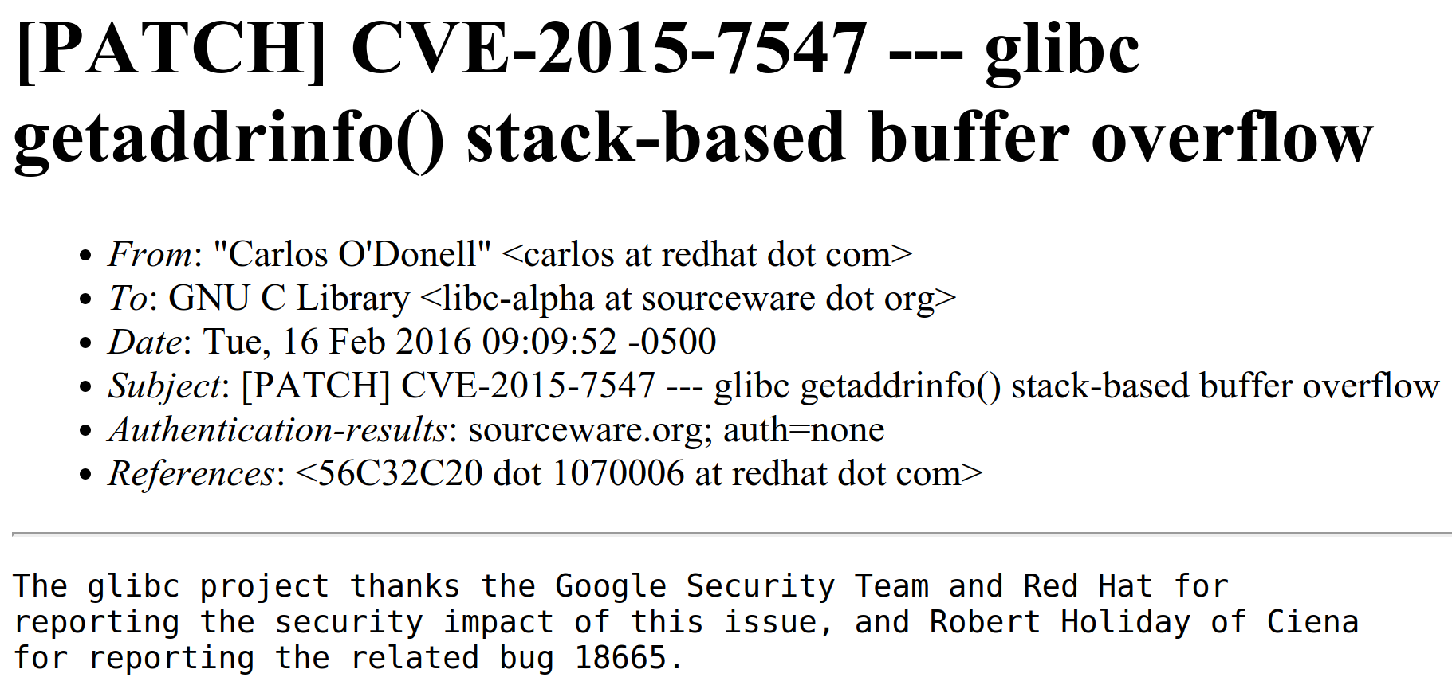
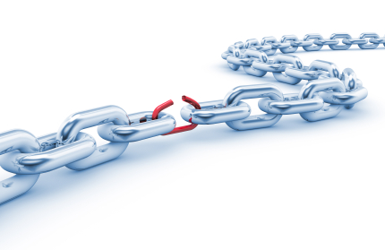



Unsafe low-level languages
C (1972) and C++ undefined behavior
including buffer overflows, checks too expensive
compilers optimize aggressively assuming undefined behavior will simply not happen
Programmers bear the burden for security
just write secure code ... all of it
DNS queries
vulnerable since May 2008
Notes:
http://arstechnica.com/security/2016/02/extremely-severe-bug-leaves-dizzying-number-of-apps-and-devices-vulnerable/
https://googleonlinesecurity.blogspot.fr/2016/02/cve-2015-7547-glibc-getaddrinfo-stack.html
https://sourceware.org/ml/libc-alpha/2016-02/msg00416.html
Rust trying to fix some of this
Rust: that’s great, but it will take a while ...
https://github.com/rust-lang/rfcs/blob/master/text/0560-integer-overflow.md
do I really want to break the flow with RUST -- NO

Slide 5





Safer high-level languages
F#
memory safe (at a cost)
useful abstractions for writing secure code:
GC, type abstraction, modules, immutability, ...
not immune to low-level attacks
large runtime systems, in C++ for efficiency
unsafe interoperability with low-level code
libraries often have large parts written in C/C++
enforcing abstractions all the way down too expensive

Slide 6


Slide 7


Slide 8
Efficient
Secure Compilation
to Micro-Policies
2nd part of this talk (more speculative)
Secure semantics for low-level languages
Secure interoperability with lower-level code
Formally: fully abstract compilation
holy grail, enforcing abstractions all the way down
currently this would be way too expensive
Key enabling technology: micro-policies
hardware-accelerated tag-based monitoring
1st part of this talk
Notes:
Unsure about: a bit of duplication with slide 6: “enforcing abstractions all the way down would be too expensive”

Slide 9
Micro-Policies

Slide 10

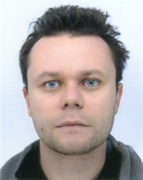










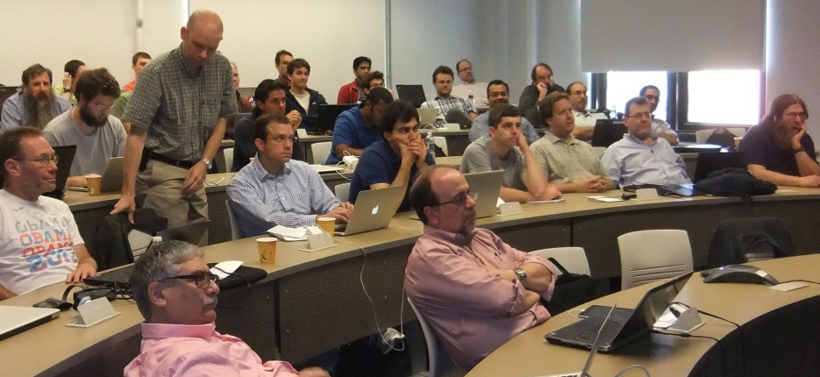
Micro-Policies team
Formal methods & architecture & systems
Current team:
Inria: Cătălin Hrițcu, Yannis Juglaret
UPenn: Arthur Azevedo de Amorim, André DeHon, Benjamin Pierce, Nick Roessler, Antal Spector-Zabusky
Portland State: Andrew Tolmach
MIT: Howard E. Shrobe, Stelios Sidiroglou-Douskos
Industry: Draper Labs, Bluespec Inc
Spinoff of past project: DARPA CRASH/SAFE (2011-2014)

Slide 11

Micro-policies
add large tag to each machine word
words in memory and registers are all tagged
unbounded metadata
word
tag
tag[0]
tag[1]
tag[2]
(not addressable)
(protected meta-data space)
pc
tag
mem[0]
tag
r0
tag
mem[1]
tag
r1
tag
mem[2]
tag
r2
tag
mem[3]
tag
*Conceptual model, our hardware implements this efficiently

Slide 12
Tag-based instruction-level monitoring
pc
tpc
tpc
mem[0]
tm0
pc
r0
tr0
tr0
mem[1]
tm1
tm1
r1
tr1
tr1
mem[2]
tm2
r2
tr2
tr2
mem[3]
tm3
decode(mem[1]) = add r0 r1 r2
tpc
tr0
tr1
tr2
tm1
add
monitor
tpc’
tpc’
tr0’
tr0’
allow

Slide 13
Tag-based instruction-level monitoring
pc
tpc
mem[0]
tm0
r0
tr0
mem[1]
tm1
pc
r1
tr1
mem[2]
tm2
r0
r2
tr2
mem[3]
tm3
decode(mem[1]) = store r0 r1
tpc
tr0
tr1
tm3
tm2
store
monitor
bad action stopped!
disallow

Slide 14

Micro-policies are cool!
low level + fine grained: unbounded per-word metadata, checked & propagated on each instruction
expressive: can enforce large number of policies
flexible: tags and monitor defined by software
efficient: accelerated using hardware caching
secure: simple enough to formally verify security
real: FPGA implementation on top of RISC-V CPU

Slide 15


Expressiveness
information flow control (IFC)
monitor self-protection
compartmentalization
dynamic sealing
heap memory safety
code-data separation
control-flow integrity (CFI)
taint tracking
...
[Oakland’13, POPL’14]
Verified
(in Coq)
[Oakland’15]
Evaluated
(<10% runtime overhead)
[ASPLOS’15]
Notes:
Remember: I’ve lead this verification effort. I’ve had the idea of bringing this beyond IFC (and CRASH/SAFE)

Slide 16

Flexibility (by example)
Heap memory safety micro-policy prevents
spatial violations: reading/writing out of bounds
temporal violations: use after free, invalid free
for heap-allocated data
Pointers become unforgeable capabilities
can only obtain a valid pointer to a heap region
by allocating that region or
by copying/offsetting an existing pointer to that region
Notes:
for simplicity only for heap-allocated data and excluding unpacked C structs

Slide 17
Memory safety micro-policy
p←malloc k
0
1
k-1
k
0
7
0@M(c,i)
0@M(c,i)
...
0@M(c,i)
7@M(c’,i)
fresh c
(e.g. ++c)
q ← p + k
q ← p + 1
p = A8F0
@ptr(c)
A8F1@ptr(c) = q
1
K
!p ← 7
c = c
!q ← 42
c != c’
color of region
out of bounds
free p
T_{v} ::= i | ptr(c) tags on values
T_{m} ::= M(c,T_{v}) | F tags on memory
color of region
tag of content
Notes:
TODO: this can be further simplified without losing much! For instance showing colors only by their color, maybe even dropping the tag structure completely.
Warning: Our malloc allocate words, while the C one allocates bytes!

Slide 18
Memory safety micro-policy
0
1
k-1
k
7@F
7
0@F
...
0@F
7@M(c’,i)
q ← p + k
p = A8F0
@ptr(c)
A8F1@ptr(c) = q
K
!q ← 42
c != c’
out of bounds
free p
x ← !p
T_{v} ::= i | ptr(c) tags on values
T_{m} ::= M(c,T_{v}) | F tags on memory
use after free
Oracle Silicon Secured Memory (2016) similar, but with only 16 colors
Intel MPX cannot detect this
Notes:
Oracle Silicon Secured Memory (2016) can do this for 16 colors, Intel MPX can’t detect the use after free!
good intentions, but solutions limited and not adaptable to new threats
... but, not very principled, comprehensive, long-sighted

Slide 19
Efficiently executing micro-policies
op
tpc
t1
t2
t3
tci
lookup
zero overhead hits!
found
op
tpc
t1
t2
t3
tci
tpc’
tr
tpc’
tr
op
tpc
t1
t2
t3
tci
tpc’
tr
op
tpc
t1
t2
t3
tci
tpc’
tr
op
tpc
t1
t2
t3
tci
tpc’
tr
hardware cache

Slide 20
Efficiently executing micro-policies
op
op
tpc
tpc
t1
t1
t2
t2
t3
t3
tci
tci
tpc’
tpc’
tr
tr
misses trap to software
lookup
produced “rule” cached
op
tpc
t1
t2
t3
tci
tpc’
tr
op
tpc
t1
t2
t3
tci
tpc’
tr
op
tpc
t1
t2
t3
tci
tpc’
tr
op
tpc
t1
t2
t3
tci
tpc’
tr
hardware cache

Slide 21
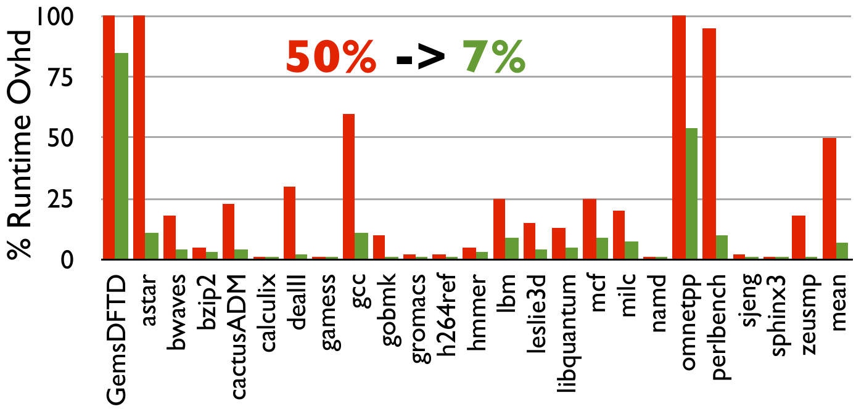
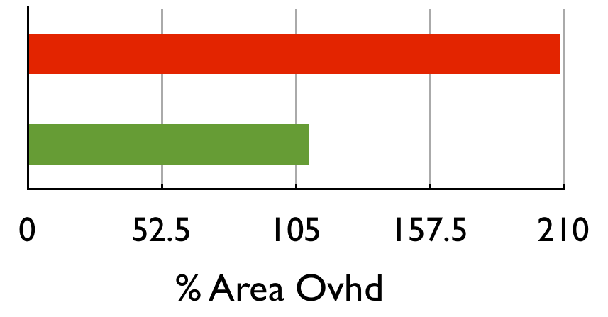
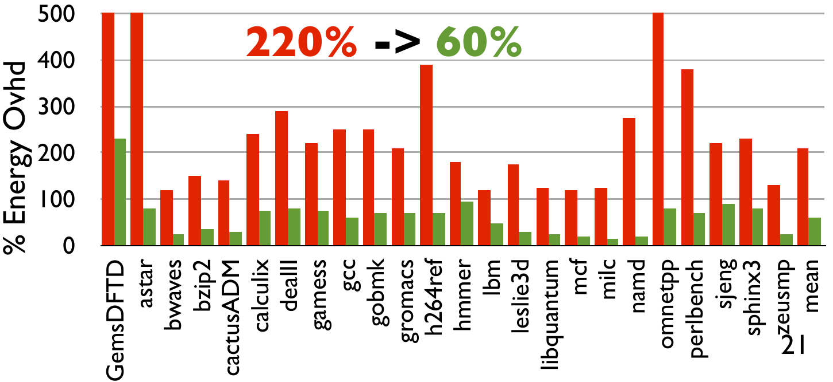
Experimental evaluation (simulations)
heap memory safety + code-data separation + taint tracking + control-flow integrity
simple RISC processor: single-core 5-stage in-order Alpha (pre RISC-V transition)
spending silicon
2006
(40% now)
More details
[ASPLOS’15]
Notes:
End: So we are providing a good way to spend silicon that goes beyond adding more and more core nobody knows how to use. But does this improve security? We’ve proved formally that it does.
Q from MSR audience: have we looked at the outliers and see what they are doing; unfortunately I don’t think we did, right?

Slide 22
Formal verification in Coq
Memory safe abstract machine
[POPL’14, Oakland’15]
correctly implements
Symbolic machine
Micro-policy
memory safety
micro-policy
correctly implements
correctly
implements*
Concrete
machine
Monitor
Rule cache
memory safety
monitor
ASM
Generic Framework
*only proved for IFC (verified DSL compiler)

Slide 23
Is this secure?
P in {IFC,CFI}
Abstract machine for P
secure
(e.g. noninterference)
correctly implements
Symbolic machine
Micro-policy
P
correctly implements
Concrete
machine
Monitor
Rule cache
secure
monitor for P
* Working on extrinsic definition of memory safety [Alpha is for address, Azevedo de Amorim et al, draft 2015]
Notes:
End: reasoning principles and separation logic

Slide 24

Secure Compilation
Joint work with Yannis Juglaret
Notes:
Working on this with Yannis Juglaret, my PhD student in Paris. Recently started project, less than a year ago.

Slide 25
Secure compilation
Goal: to build the first efficient secure compilers for realistic programming languages
Secure semantics for low-level languages
C with memory safety and compartmentalization
Secure interoperability with lower-level code
ASM, C, ML, and F* (verification system for ML)
problems are quite different at different levels
Formally: fully abstract compilation
enforcing abstractions all the way down
Notes:
Probably fine now: maybe remove some of the duplication in the details? Removed some things from slide 8 (or so) ... only duplication now is in the last 2 bullets

Slide 26
Fully abstract compilation, intuition
high-level attacker
high-level code
compiler
full abstraction
low-level attacker
compiled code
Benefits: can reason about security in the source language;
forget about compiler, linker, loader, runtime system,
and (to some extent) low-level libraries
Notes:
Say: Fully abstract compilation goes in the other direction than correct compilation. Mapping contexts back up.

Slide 27
Very long term vision
F*
F* component
SecF*
ML
ML component
SecML
SecML
C variants
safe C component
legacy C component
memory
safe
CompSec⁺
CompSec⁺
CompSec⁺
CompSec
ASM
(RISC-V+μP)
compiled F* component
compiled ML component
compiled safe C component
compiled legacy C comp
ASM component
compartmentalization boundaries

Slide 28



Low-level compartmentalization
Break up software into mutually distrustful components running with minimal privileges & interacting only via well-defined interfaces
Limit the damage of control hijacking attacks to just the C or ASM components where they occur
Not a new idea, already deployed in practice:
process-level privilege separation
software-fault isolation
Micro-policies can give us better interaction model
We also aim to show security formally
Notes:
more natural and efficient communication model

Slide 29
Compartmentalized C
Want to add components with typed interfaces to C
Compiler (e.g. CompCert), linker, loader propagate interface information to low-level memory tags
each component’s memory tagged with unique color
procedure entry points tagged with procedure’s type
Micro-policy enforcing:
component isolation
procedure call discipline (entry points)
stack discipline for returns (linear return capabilities)
type safety on cross-component interaction
[Towards a Fully Abstract Compiler Using Micro-Policies, Juglaret et al, TR 2015]
Notes:
register cleaning – compiler or micropolicy?
runtime: malloc and free respect components

Slide 30
Compartmentalization micro-policy
memory
registers
invariant:
at most one
return capability
per call stack level
Jal r
@n
pc
...
r
stack level
linear return capability
C₁
...
current color
@Ret n
@Ret n
cross-component call
only allowed at EntryPoint
...
changed color
...@EntryPoint
@(n+1)
pc
r_{a}
...
increment
@(n+1)
Store r_{a} → ⋆r_{m}
cross-component
return only allowed
via return capability
pc
r_{a}
r_{m}
...
@(n+1)
pc
r_{a}
r_{m}
C₂
Load ⋆r_{m} → r_{a}
Jump r_{a}
@(n+1)
pc
r_{a}
r_{m}
loads and stores to the same
component always allowed

Slide 31
Secure compartmentalization property
∀compromise scenarios.
i₁
i₂
i₃
i₄
i₅
≁
i₁
i₂
i₃
i₄
i₅
C₁
A₂
C₃
A₄
A₅
H
D₁
A₂
D₃
A₄
A₅
∀ low-level attack from compromised C₂↓, C₄↓, C₅↓
∃ high-level attack from some fully defined A₂, A₄, A₅
i₁
i₂
i₃
i₄
i₅
≁
i₁
i₂
i₃
i₄
i₅
C₁
C₂
C₃
C₄
C₅
D₁
C₂
D₃
C₄
C₅
↓
↯
↓
↓
↯
↓
↯
↓
L
↓
↯
↓
↓
↯
↓
↓
↯
follows from “structured full abstraction
for unsafe languages” + “separate compilation”
[Beyond full abstraction, Juglaret, Hritcu, et al, draft’16]

Slide 32


Protecting higher-level abstractions
ML abstractions we want to enforce with micro-policies
types, value immutability, opaqueness of closures, parametricity (dynamic sealing), GC vs malloc/free, ...
F*: enforcing full specifications using micro-policies
some can be turned into contracts, checked dynamically
fully abstract compilation of F* to ML trivial for ML interfaces (because F* allows and tracks effects, as opposed to Coq)
Limits of purely-dynamic enforcement
functional purity, termination, relational reasoning
push these limits further and combine with static analysis
Notes:
ML and F* have more interesting abstractions
interaction with ML: safe interaction between manual and automatic memory management
Gradual typing

Slide 33
Composing compilers and higher-level micro-policies
To compose compilers need
higher-level micro-policies
composing micro-policies
F*
F* component
SecF*
ML+μP
SecF* μPolicy
SecML
SecML μPolicy
C+μP
CompSec⁺
ASM
(RISC-V+μP)
CompSec⁺ μPolicy
compiled F* component
Notes:
This is already enough to also allow user-specified policies for ML and C.
Allowing ML and C programmers to write micro-policies is great.

Slide 34
User-specified higher-level policies
By composing more micro-policies we can allow user-specified micro-policies for ML and C
Good news: micro-policy composition is easy since tags can be tuples
But how do we ensure programmers won’t break security?
Bad news: secure micro-policy composition is hard!
ML+μP
C+μP
ASM
(RISC-V+μP)
Notes:
This is already enough to also allow user-specified policies for ML and C.
Allowing ML and C programmers to write micro-policies is great.

Slide 35
Secure micro-policy composition
securely composing reference monitors is easy
... as long as they can only stop execution
micro-policies have richer interaction model:
monitor services: malloc, free, classify, declassify, ...
recoverable errors are similar
composing micro-policies can break them
e.g. composing anything with IFC can leak
memory safety + compartmentalization

Slide 36

Secure compilation
Solving conceptual challenges
Secure micro-policy composition
Higher-level micro-policies (for C and ML)
Formalizing security properties (i.e. attacker models)
Building the first efficient secure compilers for realistic programming languages
C (CompCert): memory safety & compartmentalization
ML and F*: protecting higher-level abstractions
Measuring & lowering the cost of secure compilation
Showing that these compilers are indeed secure
Better verification and testing techniques
Notes:
Maybe some more images

Slide 37




Redesigned ML verification system [POPL’16]
functional programming language with effects (like OCaml, F#, Standard ML, Haskell)
deductive verification system based on SMT solvers (like FramaC, Why3, Dafny, Boogie, VCC, ESC/Java2)
interactive proof assistant based on dependent types (like Coq, Lean, Agda)
Working on language design, formal foundations, logical aspects, proof assistant, self-certification
Main practical application:
verified reference implementation of upcoming TLS 1.3
Notes:
using and improving the proof assistant size

Slide 38

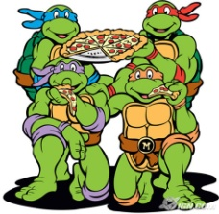
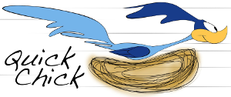


Dependable property-based testing
QuickCheck effective at finding bugs
reducing the testing effort
language for property-based generators
obtaining stronger confidence
polarized mutation testing
providing stronger formal foundations
verified testing, generator synthesis(?)
integrating testing in proof assistants
reducing the cost of interactive verification
Luck
Notes:
Luck: domain-specific language
beyond just finding bugs
verified testing: only makes sense for very tricky or highly reusable code, generator synthesis could be much more useful in general
End: reducing the cost of formal verification in Coq and F*

Slide 39

Conclusion
There is a pressing practical need for ...
more secure languages providing strong abstractions
more secure compiler chains protecting these abstractions
more secure hardware making the cost of all this acceptable
clear attacker models & strong formal security guarantees
Building the first efficient secure compilers for realistic programming languages (C, ML, F*)
Targeting micro-policies = new mechanism for hardware-accelerated tag-based monitors
Thank you!

Slide 40
backup slides

Slide 41
About my research
Formal methods, broadly
programming languages
type systems
deductive verification
proof assistants
formal metatheory
certified tools
property-based testing
Solving security problems
formal attacker models
designing and building more secure systems
stopping low-level attacks
dynamic monitoring
integrity, information flow
security protocols
Useful tools, choose one that’s well-suited for the problem
Build and release open source software based on research
Notes:
Very bad start, should improve or drop – went for drop
Is it always security problems? No, but it would dilute the story?
Phrases at the end too long?

Slide 42
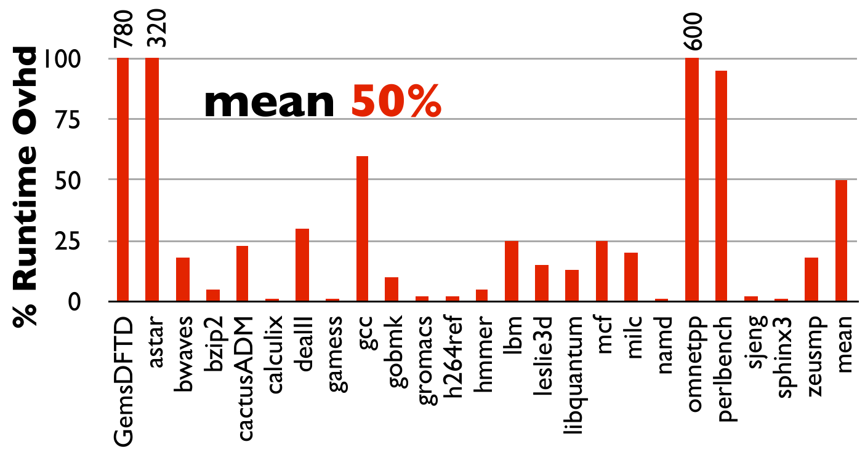
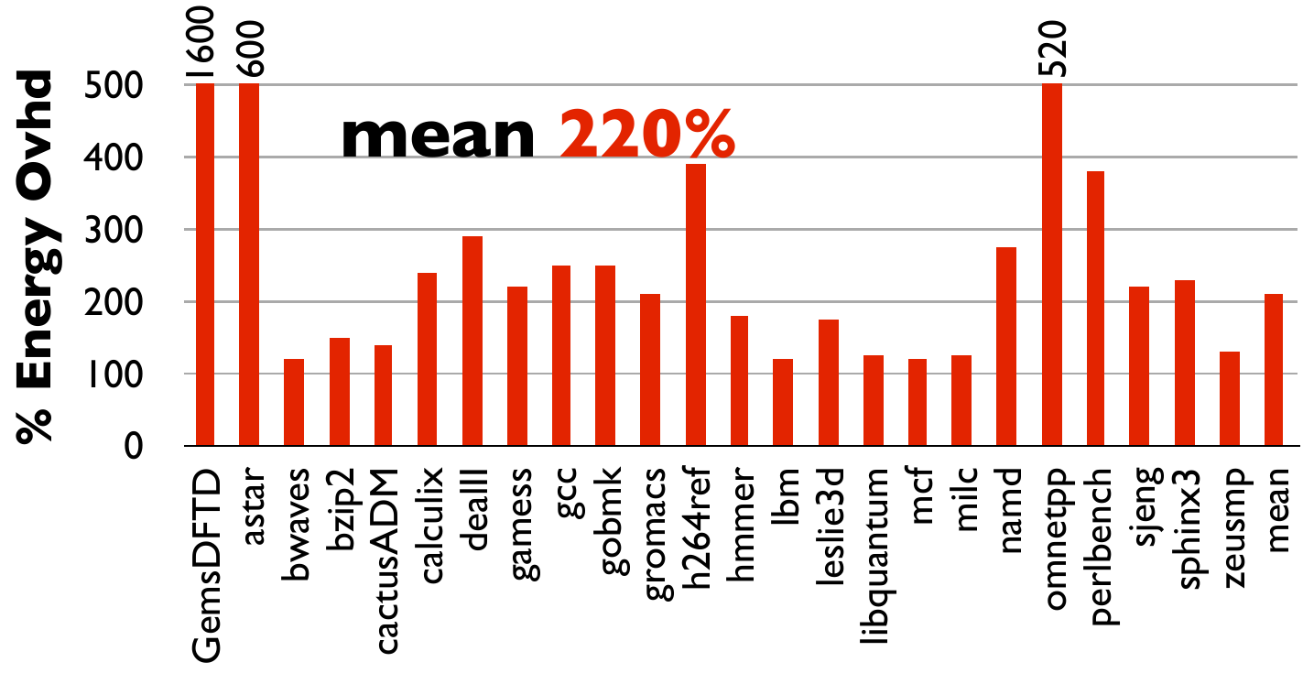
Simulations for naive implementation
memory safety + code-data separation + taint tracking + control-flow integrity
simple RISC processor: single-core 5-stage in-order Alpha
simulation numbers;
but this naive version also
implemented on FPGA
(part of SAFE machine)
[FPGA ’13, TRETS ‘15]

Slide 43
Targeted [micro-]architectural optimizations
[ASPLOS’15]
grouping opcodes and ignoring unused tags
increases effective rule cache capacity
transferring only unique tags to/from DRAM
reduces runtime and energy overhead
using much shorter tags for on-chip data caches
reduces runtime, energy, and area overhead
caching composite policies separately
makes rule cache misses much cheaper
Notes:
in Rennes discussed quite a bit about this without slide support;
at PLAS made this backup slide since I though there won’t be HW experts in the room; but then I still needed to present it

Slide 44
Expressiveness
Micro-policy mechanism can efficiently enforce:
heap memory safety
code-data separation
control-flow integrity
compartment isolation
taint tracking
information flow control
monitor self-protection
dynamic sealing
... and a lot more!
Notes:
TODO: merge with next slide

Slide 45
Memory safety micro-policy
1. Sets of tags
T_{v} ::= i | ptr(c)
T_{m} ::= M(c,T_{v}) | F
T_{pc} ::= T_{v}
2. Transfer function
Record IVec := { op:opcode ; t_{pc}:T_{pc} ; t_{i}:T_{m} ; ts: ... }
Record OVec (op:opcode) := { t_{rpc} : T_{pc} ; t_{r} : ... }
transfer : (iv:IVec) -> option (OVec (op iv))
tpc
ti
t1
t2
t3
add
monitor
tpc’
trpc
tr0’
tr
allow
disallow
bad action stopped!

Slide 46
Memory safety micro-policy
1. Sets of tags
T_{v} ::= i | ptr(c)
T_{m} ::= M(c,T_{v}) | F
T_{pc} ::= T_{v}
2. Transfer function
Record IVec := { op:opcode ; t_{pc}:T_{pc} ; t_{i}:T_{m} ; ts: ... }
Record OVec (op:opcode) := { t_{rpc} : T_{pc} ; t_{r} : ... }
transfer : (iv:IVec) -> option (OVec (op iv))
Definition transfer iv :=
match iv with
| {op=Load; t_{pc}=ptr(c_{pc}); t_{i}=M(c_{pc},i); ts=[ptr(c); M(c,T_{v})]}
=> {t_{rpc}=ptr(c_{pc}); t_{r}=T_{v}}
| {op=Store; t_{pc}=ptr(c_{pc}); t_{i}=M(c_{pc},i); ts=[ptr(c); T_{v}; M(c,T_{v}’)]}
=> {t_{rpc}=ptr(c_{pc}); t_{r}=M(c,T_{v})}
...

Slide 47
Memory safety micro-policy
1. Sets of tags
T_{v} ::= i | ptr(c)
T_{m} ::= M(c,T_{v}) | F
T_{pc} ::= T_{v}
2. Transfer function
Record IVec := { op:opcode ; t_{pc}:T_{pc} ; t_{i}:T_{m} ; ts: ... }
Record OVec (op:opcode) := { t_{rpc} : T_{pc} ; t_{r} : ... }
transfer : (iv:IVec) -> option (OVec (op iv))
3. Monitor services
Record service := { addr : word; sem : state -> option state; ... }
Definition mem_safety_services : list service :=
[malloc; free; base; size; eq].
*This takes us beyond “noninterferent” reference monitors (more soon)
Notes:
We go beyond “noninterferent” monitors
Rennes: quite a bit of talking on the side about this being more than reference monitoring and thus composition being difficult, could try to add a separate slide about that after open problems?

Slide 48
Open problems
Interaction with PL, compiler, loader, linker, OS
Secure micro-policy composition
Verified optimizing compiler for micro-policies
Reduced/more adaptive energy usage
More realistic processor (our-of-order execution, even multi-core)
Cache side channels

Slide 49
Take away
Micro-policies, novel security mechanism
low level, fine grained, expressive, flexible, efficient, formally secure, real
cool research direction with many interesting open problems for us and others to solve
other projects:
F*: formal verification of ML programs
QuickChick: property-based testing for Coq
Thank you!

Slide 50
Fully abstract compilation, definition
∃
high-level attacker
high-level attacker
high-level attacker
≁
.
1st high-level component
2nd high-level component
⇔
compiler
compiler
low-level attacker
low-level attacker
∃
1st compiled component
≁
2nd compiled component
low-level attacker
.
Notes:
TODO: could bring in secrecy intuitions ... could also drop though in favor of secure compartmentalization

Slide 51
Memory safety for C
starting point: heap memory safety policy
additional complications:
unboxed structs, stack allocation, byte addressing, unaligned memory accesses, custom allocators, ...
different attacker model / security property (not full abstraction)
absence of (spatial&temporal) memory safety violations
high-level reasoning principles enabled by memory safety [Alpha is for Address, draft’15]
Notes:
TODO: talking a lot in the air about reasoning principles and separation logic
Further ideas:
- dynamically enforcing the compcert memory model
- static + dynamic analysis
- didn't sort this out part yet
- static optimizations should speed things up
- secure optimizations! don't assume absence of undefined behaviors
- compatibility with existing non-standard idioms is a big problem
- while memory safety is Plan A, we need a plan B
- in any case we need interoperability with memory unsafe ASM

