Slide 1

This course
1. Logic and proofs
2. Functional programming
3. Program verification
Using the Coq proof assistant
Curry-Howard correspondence
proofs = purely functional programs
bridge between logic and computer science

Slide 2
Next steps
Software Foundations and other Coq books
More about the Curry-Howard correspondence
More about functional programming
Verifying programs with side-effects in F*

Slide 3
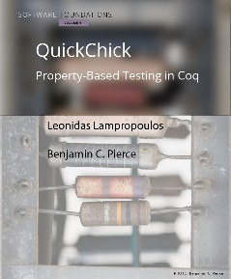
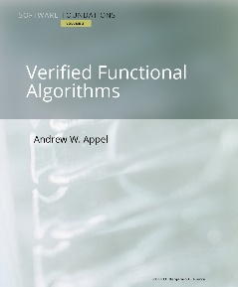
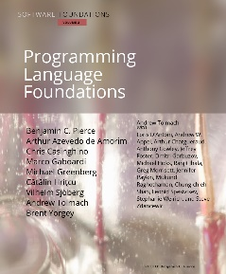
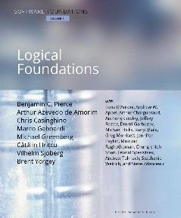
Software Foundations
Volume 1: Logical Foundations
More exercises: advanced, optional
More chapters: Regular expressions, While programs, Lexing and Parsing, More automation, Extracting ML from Coq
Volume 2: Programming Language Foundations
Volume 3: Verified Functional Algorithms
Volume 4: QuickChick: Property-Based Testing in Coq
https://softwarefoundations.cis.upenn.edu

Slide 4
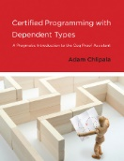
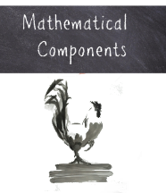
Other Coq books, more advanced
Adam Chlipala (MIT):
Certified Programming with Dependent Types
Formal Reasoning About Programs
Ilya Sergey (Yale-NUS College):
Programs and Proofs -- Mechanizing Mathematics with Dependent Types
Assia Mahboubi and Enrico Tassi (Inria)
Mathematical Components book

Slide 5


More about the Curry-Howard correspondence
Phil Wadler's Propositions as Types paper
various talks available online too
Xavier Leroy's College de France course
Programmer = démontrer ? La correspondance de Curry-Howard aujourd'hui

Slide 6
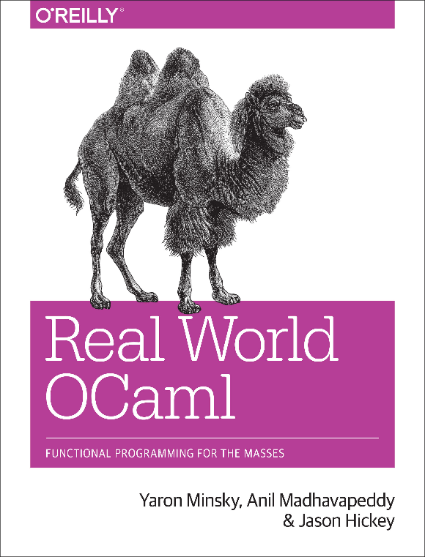
More about functional programming
OCaml MOOC -- Classes Start: 22 September 2019
Book: Real World OCaml, Functional Programming for the Masses

Slide 7
Verifying programs with side-effects in F*
Functional programming language with effects
like OCaml, Haskell, F#, ...
Semi-automated verification system using SMT
like Dafny, FramaC, Why3, …
Expressive core based on dependent type theory
like Coq, Agda, Lean, …
https://fstar-lang.org

