Slide 1

CI/CD
Intro to pipelines and app deployment
Catalina Dumitru and Madalin Giurca
May 2022

Slide 2
Agenda
What is CI/CD?
Tools for CI/CD
DevOps Lifecycle
What is Azure DevOps?
Intro to GitHub Actions
Let’s write some code!

Slide 3
What is CI/CD
Continuous integration (CI) and continuous delivery (CD) are the processes that are used to:
Build
Package
Deploy
… your application.
Notes:
In principiu, practice pentru a scrie codul mai bine, mai safe si mai repede.
Ci => integreaza codul intr-un singur repo, usor de accesat si de manageuit
Cd => drumul codului din repo in production

Slide 4
Continuous Integration
CI = development practice that helps ensure that software components work together and allows you to continuously integrate code into a single shared and easy to access repository.
Developers practicing CI to merge their changes in the master branch as often as possible.
For CI we need:
Version Control
Build automation
Test automation
Often commits
Build on change

Slide 5
Why CI/CD matter
Smaller code changes
Bug early discovery
Automatic app deployment
Transparent health monitoring
Test pipeline customization
Faster release rate
Faster Mean Time To Resolution (MTTR)
Notes:
SCC = intergam cate o bucata mica de cod pe rand, nu big chunks
Bug discovery - avand parti mici de cod modificate, care trec printr un PR inainte de merge in master exista sanse mai mari sa vedem bugs
Auto app deployment – e mai usor sa duci schimbarile in prod
Transparent health monitoring – datorita testelor automate ai un feedback rapid al starii sistemului
Pipeline customization – putem sa decidem ce teste sa se ruleze si cum
FRR = avand in vedere ca problemele sunt detectata si fix-uite mai repede, putems a facem si release-uri mai frecvente
MTTR = timpul de la momentul cand detectam problema pana cand o rezolvam => CI/CD reduce aceasta bucata de timp

Slide 6
Bug early discovery helped by merge requests
For merging changes into the main branch you need to open a Merge Request / Pull Request.
Benefits:
Highlights differences between main and your branch – the changes you made
Easier to be reviewed by colleagues
Most common policies for MR/PR:
Minimum 2 approvals
Build is successful
Tests run successfully
No comments unresolved

Slide 7
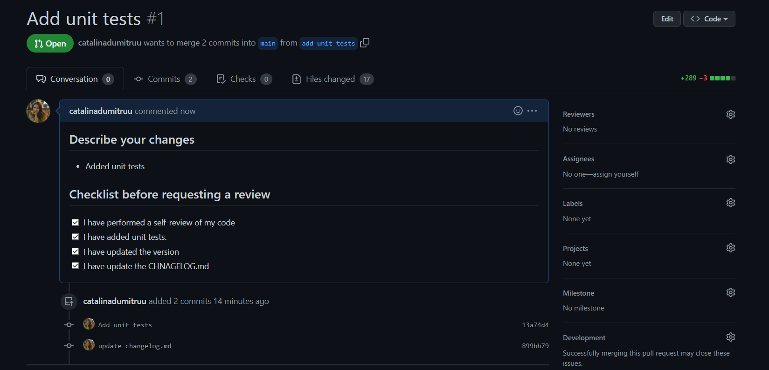
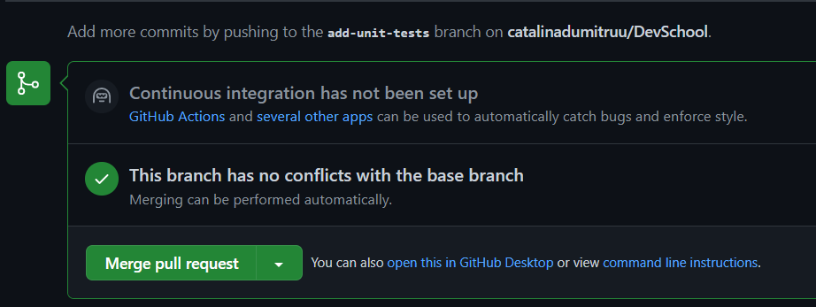
Customize your merge requests
You can customize policies for merge requests:
Require a number of approvals
Require all comments resolved
Add a merge request template (a description – steps - that must be completed)

Slide 8
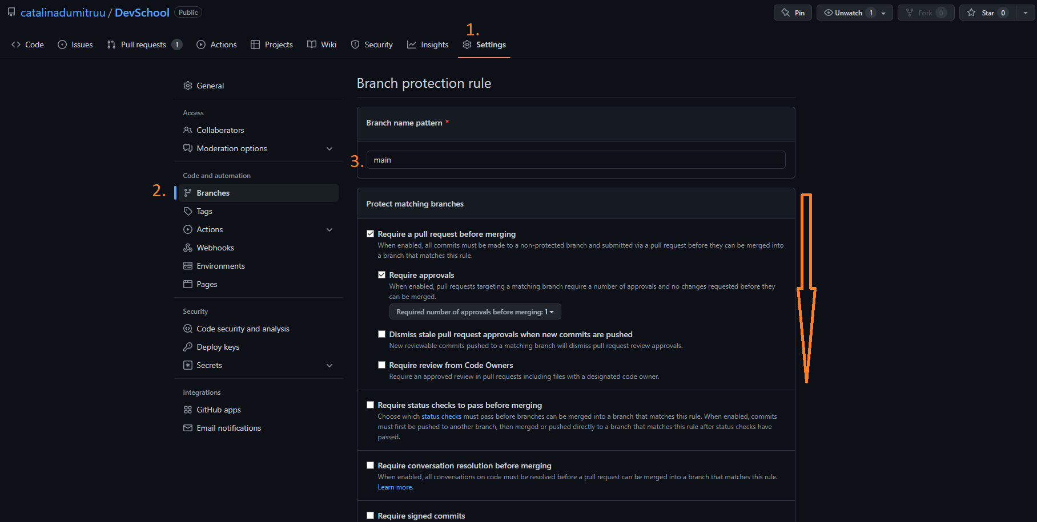
Branch policies

Slide 9
CD - #TODO

Slide 10
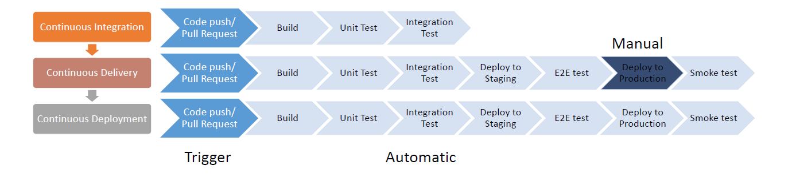
From integration to deployment

Slide 11
Tool for CI/CD
The most used systems are:
Jenkins
GitLab
TeamCity (JetBrains)
Travis
Azure DevOps
CodeShip
GoCD

Slide 12
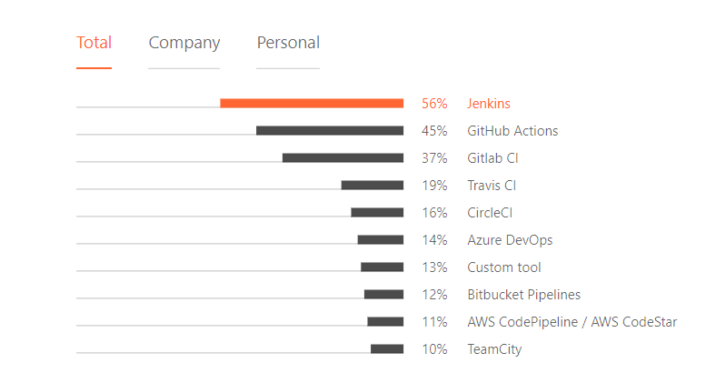
Most used tools for CI in 2021
*https://www.jetbrains.com/lp/devecosystem-2021/team-tools/

Slide 13
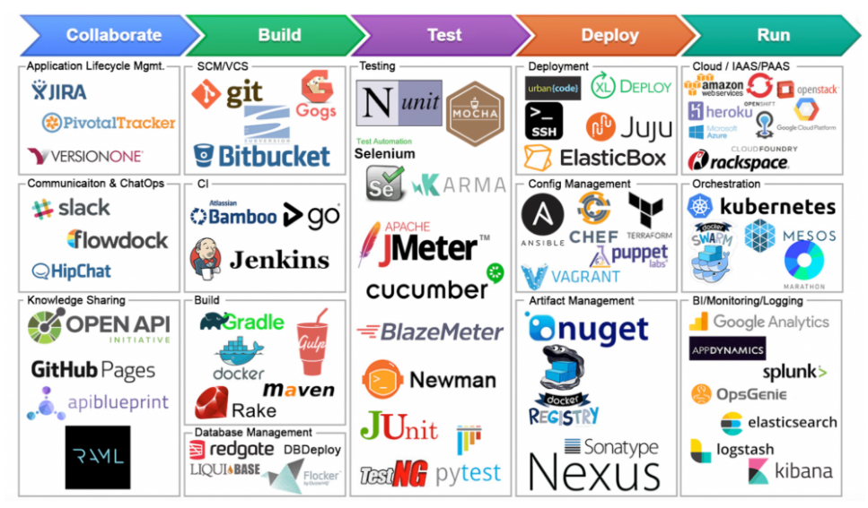
But there is not single tool that does it all …

Slide 14
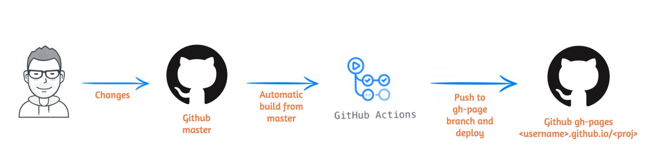
GitHub Actions
GitHub Actions help us to automate the CI/CD flows.
Using GitHub actions you can create YAML pipelines that help you automatically build and run tests at push on a branch.

Slide 15
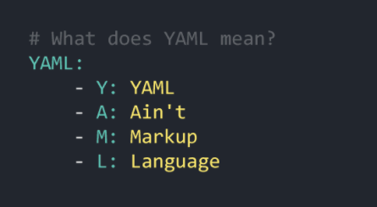
GitHub Actions – YAML files
YAML is a data-serialization language used often for config files
YAML is friendly and easy to be read
YAML documents are basically a collection of key-value pairs where the value can be as simple as a string or as complex as a tree

Slide 16
Let’s do some CI/CD!
Branch: course-14

Slide 17
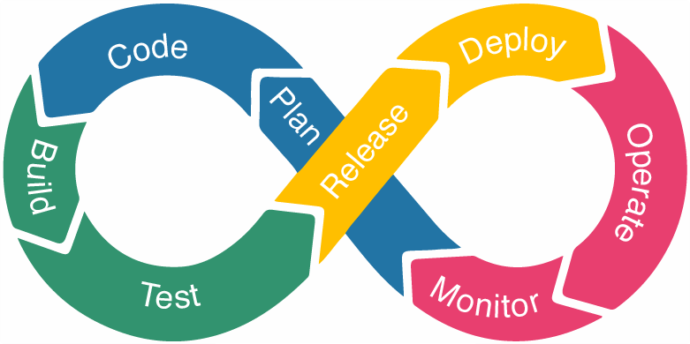
DevOps Lifecycle
Notes:
Development = planning + coding (decidem cum va arata proiectul, nu avem tool-uri pentru planning, dar e obligatoriu sa folosim version control atunci cand scriem codul Git, JIRA, SVN etc.
Urmeaza partea de Build => se foloesc tooluri ca Maven pentru a buildui aplicatia si pentru a avea un executabil ca input pentru urmatoarele faze
Testing => tool-uri ca Selenium,TestNG, Junit sunt folosit de catre QAs pentru a testa in parallel parti specific din cod
INTEGRATION = inima ciclului de DevOps => devii merge-uiesc featureuri noi mai des, ele sunt testat in mod continuu. In general se foloseste Jenkins care detecteaza o schimbare in repo si pregateste un nou bild cu schimbarea in forma unui jar
DEPLOYMENT = codul este deploaiat in serverele de production cu tooluri ca chef, ansible etc.
Monitoring = aici de inregistreaza info vitale despre starea aplicatiei in serverele de prod si se reia ciclul pentru bug fix-uri etc.

Slide 18
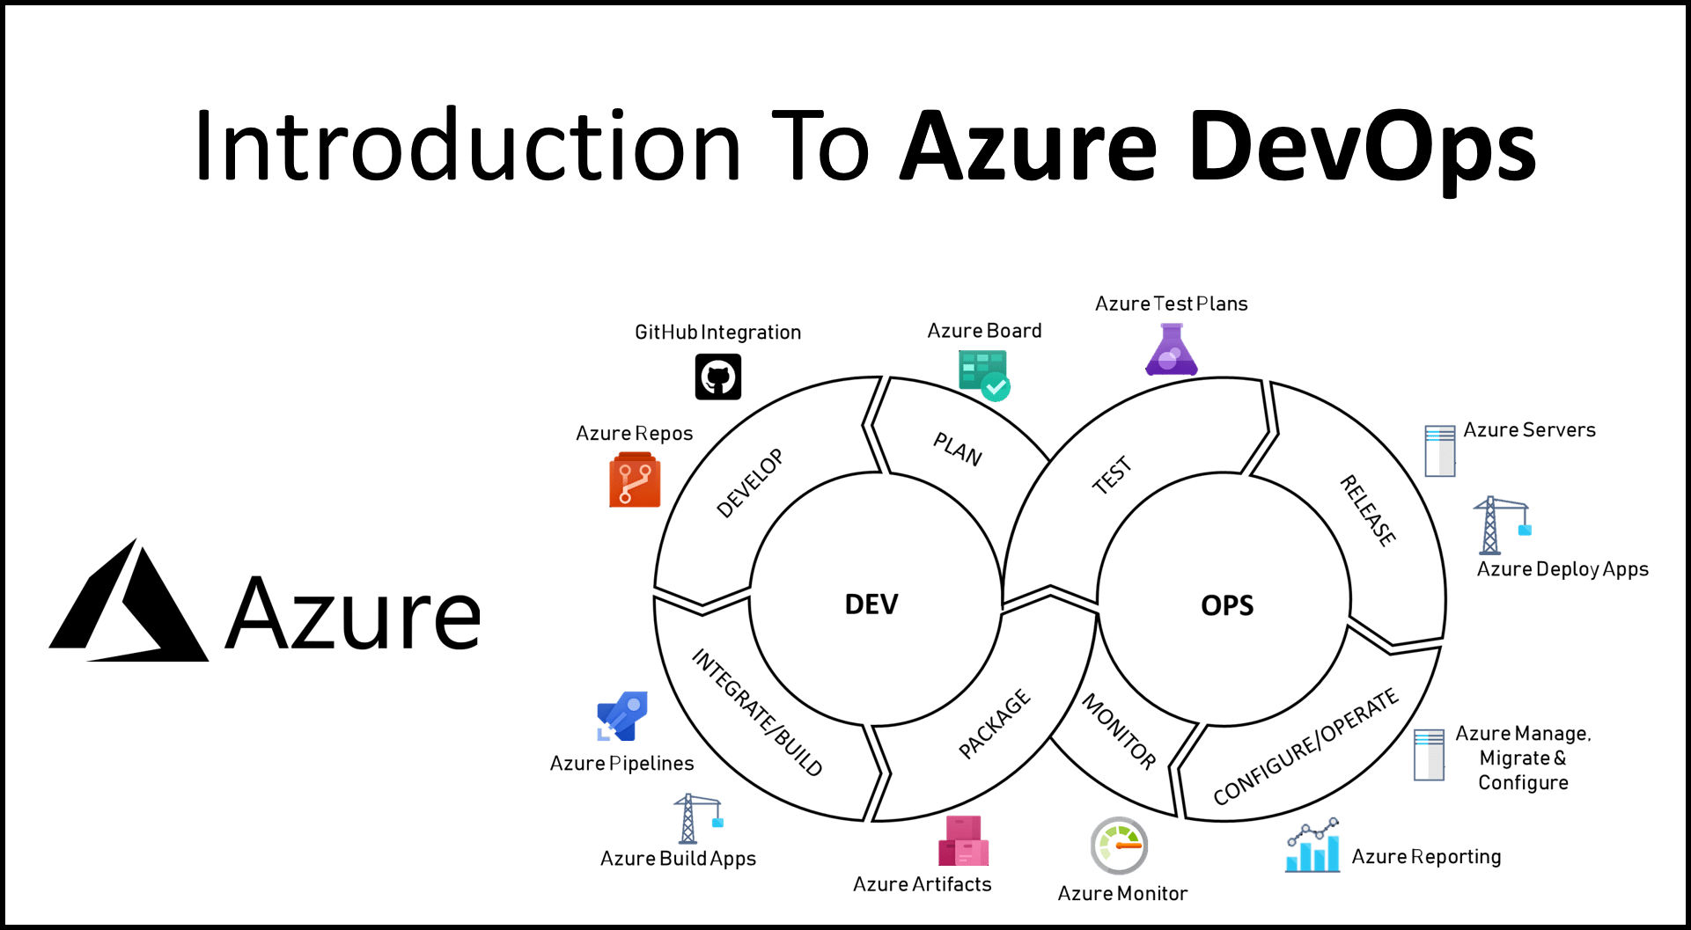
What is Azure DevOps?
Azure DevOps contains all you need to assemble your product from start to finish.
Notes:
Tests – adaugi teste: configurari, use case-uri, parametrii etc.
Configure + Monitor = analiza apliatiei, a pod-urilor, a vm-urilor oriunde ai facut deploy
Kubernetes = un tool prin care manageuim clusterele pe care ruleaza containere
Pod = cea mai mica unitate care se poate deploaia pe care o putem creea in Kubernetes.

Slide 19
Monitoring – Micrometer/Prometheus

Slide 20








Thank you!
ing.com
@ING_News
LinkedIn.com/company/ING
SlideShare.net/ING
Medium.com/ing-blog
ingwb.com
Facebook.com/ING
YouTube.com/ING
Flickr.com/INGGroup

