Slide 1
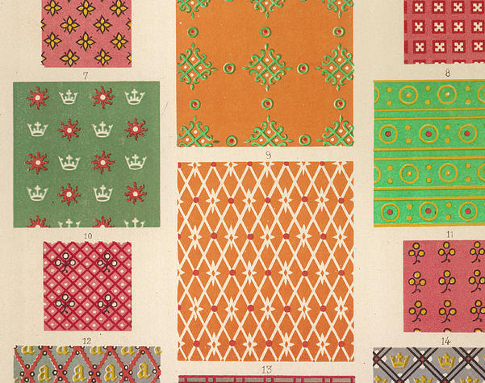
Fabric Content Classification Using Textural Properties
By: Catalina Murray

Slide 2

The Problem Under Study
Fiber content affects several properties about clothing including its appearance, structure, and durability
It is required by law to include any fiber content greater than 1% on each label
Testing is expensive and costly
A hurdle for both manufacturers and designers
Lab Testing for Fiber Content
(1)
Notes:
Fiber content cot is a major contributor to the appearance, comfort, durability, costs, and care characteristics of fabrics. Fibers present in percentages above 1% must be labeled by percentage as a required component of your product's label. The current process can cost upwards of tens of thousands of dollars for manufactuerers. It can also takes weeks at a time.

Slide 3
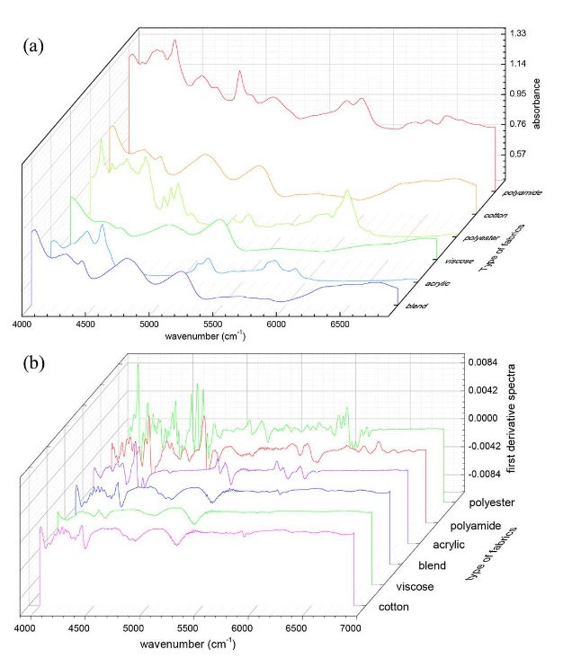

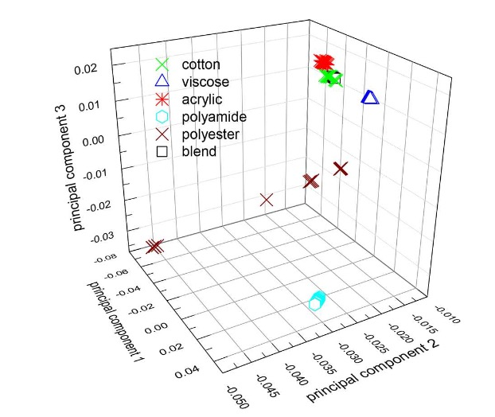
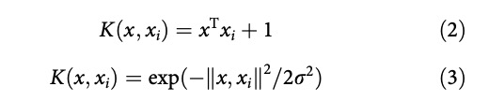
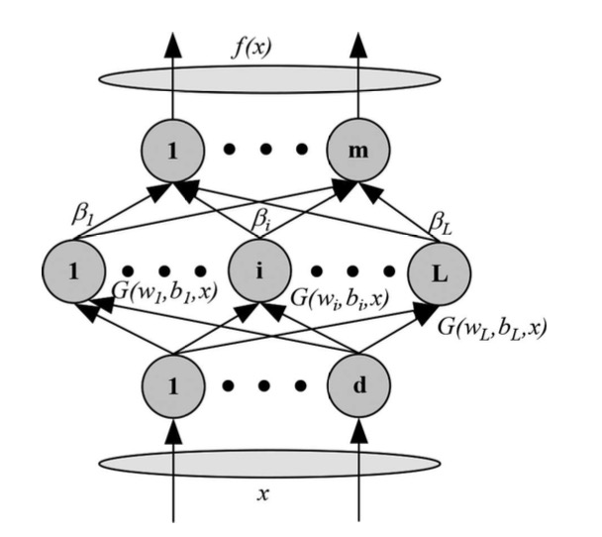
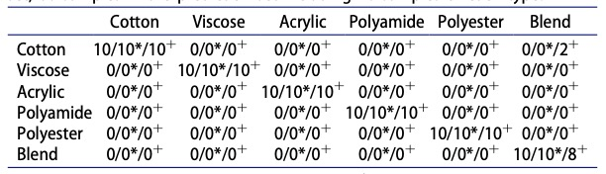
Existing Approaches
Spectroscopy
NIR spectroscopy
LS-SVM
PCA
Linear (2) , RBF (3)
ELM
Results
LS-SVM, ELM *, SIMCA +

Slide 4
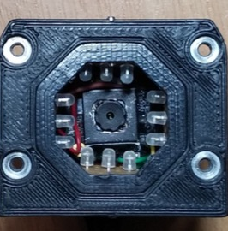
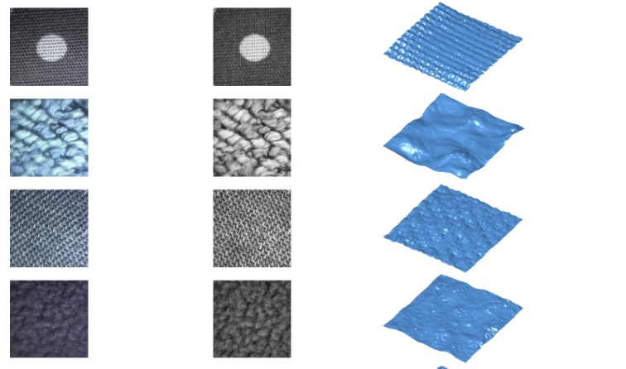
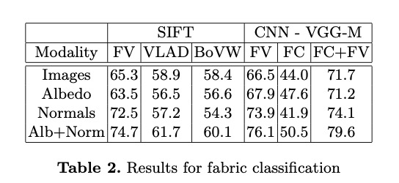
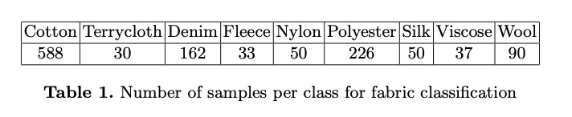
Existing Approaches
Miro-geometry and reflectance
Photometric Stereo
Example images: (original, albedo, 3D shape)
Feature extraction:
Dense SIFT features,
VGG-M pre-trained neural network (8 layers)
Original images in different lights,
Albedo
Normals
Fusing normal and albedo,
Feature encoding:
BoVW
VLAD
FV

Slide 5
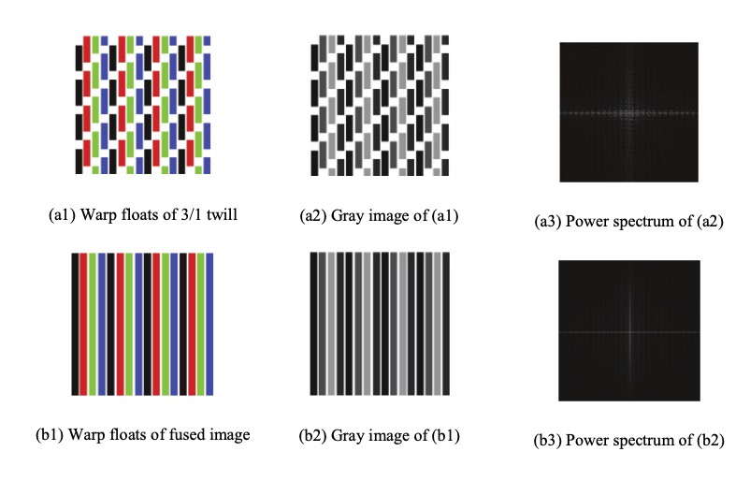
Existing Approaches
Other
Weave type
Clustering methods
CNN
Fabric defect detection
Histogram-based approaches
LBP
GLCM
Gabor filters
Color-based approaches
Dictionary-based approaches

Slide 6
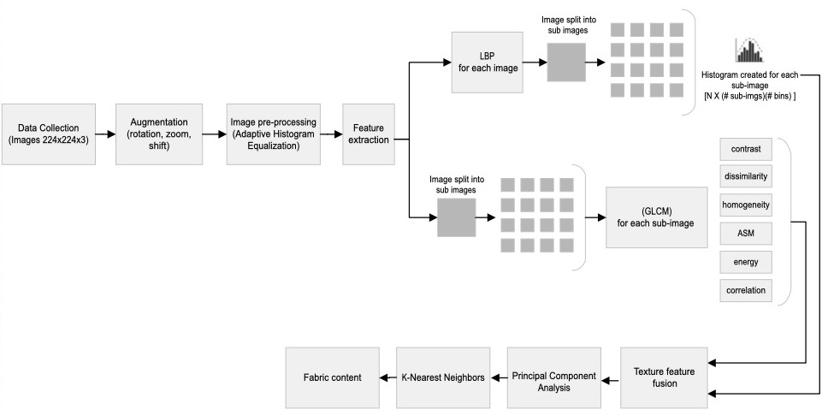
Proposed Approach

Slide 7
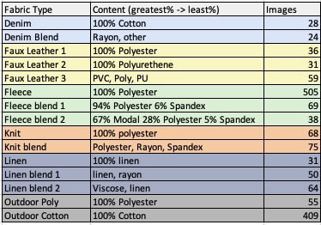
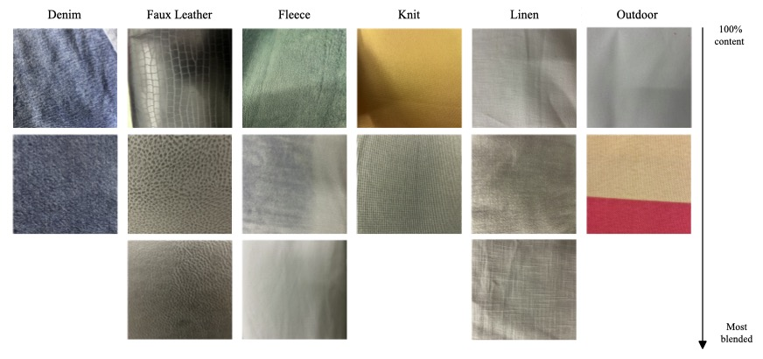
Experimental Design
Data Collection
I-bug data set
TILDA data set

Slide 8
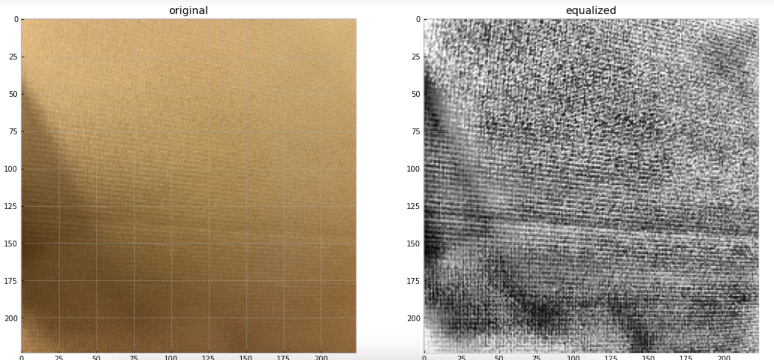
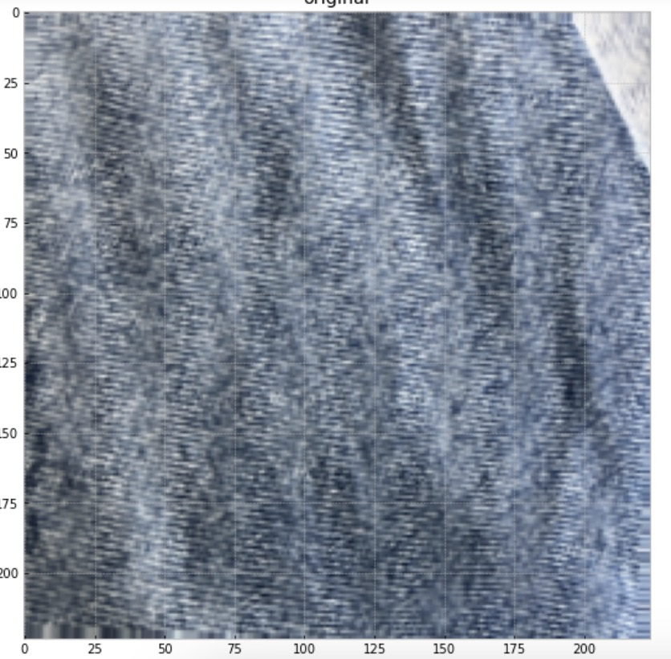
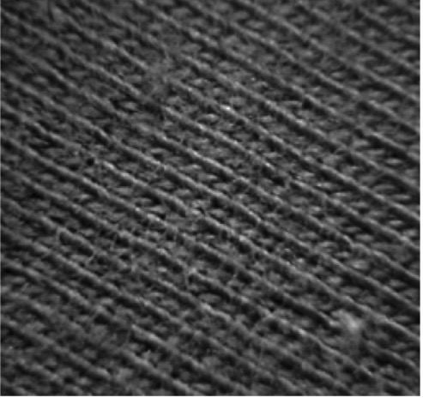
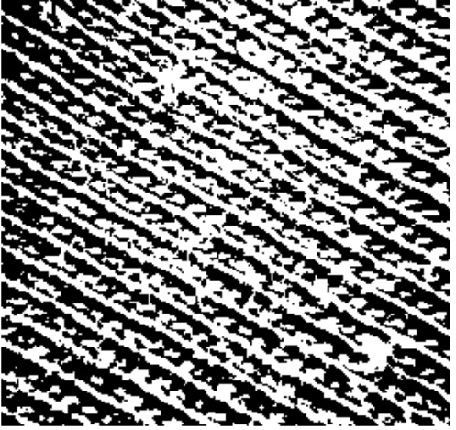
Experimental Design
Image pre-processing
Other characteristics:
Image size and color
224x224x3
Adaptive Histogram equalization
Augmentation
Binarization with Otsu’s Thresholding

Slide 9
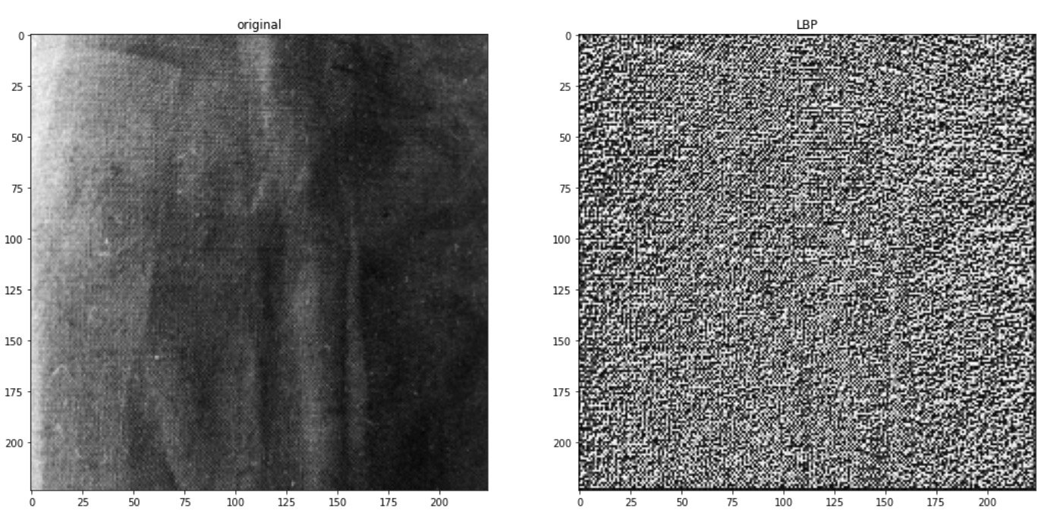
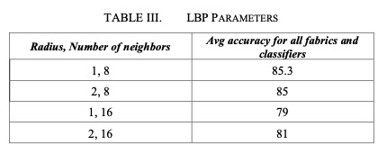
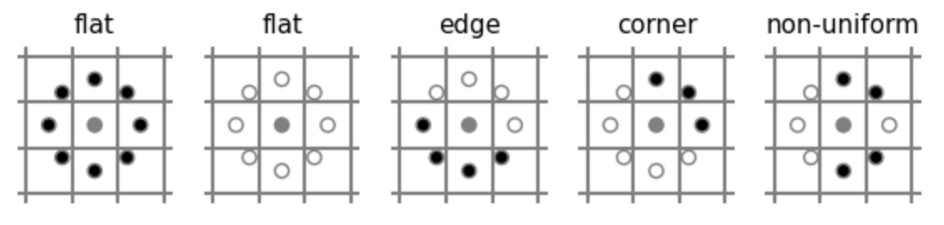

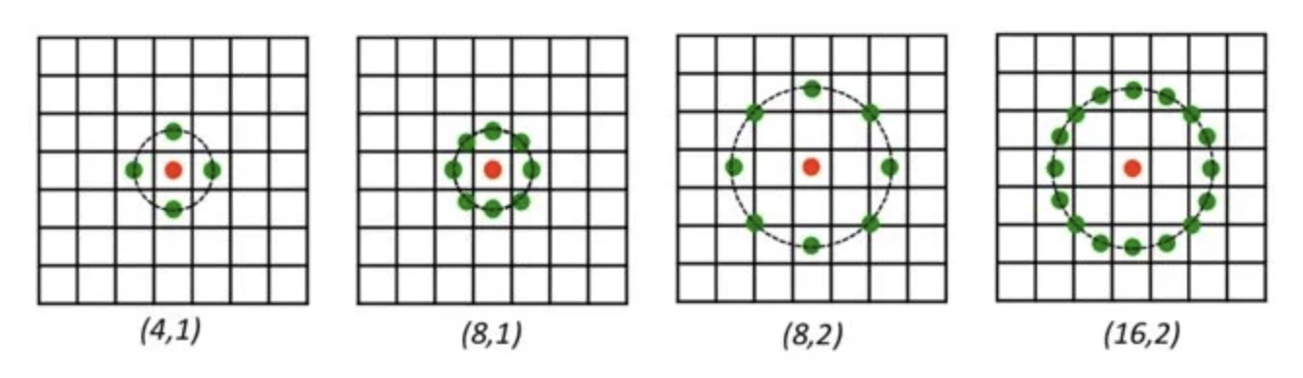
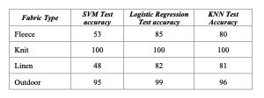
Experimental Design
Feature Extraction
Local Binary Pattern
Different radius and neighboring points

Slide 10
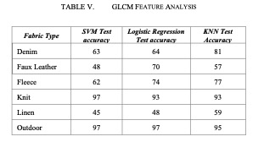
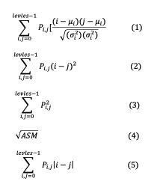
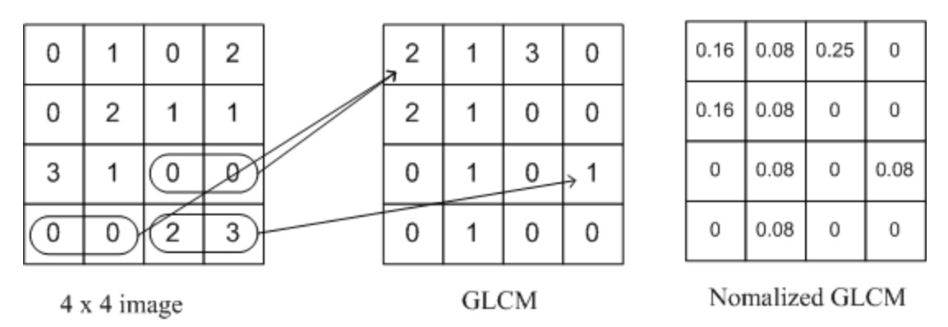


Experimental Design
Feature Extraction
Gray Level Co-occurrence Matrix

Slide 11
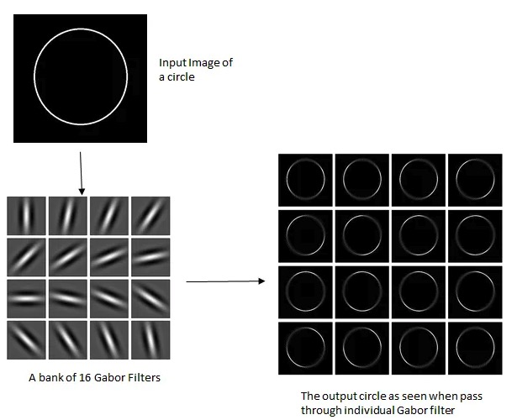
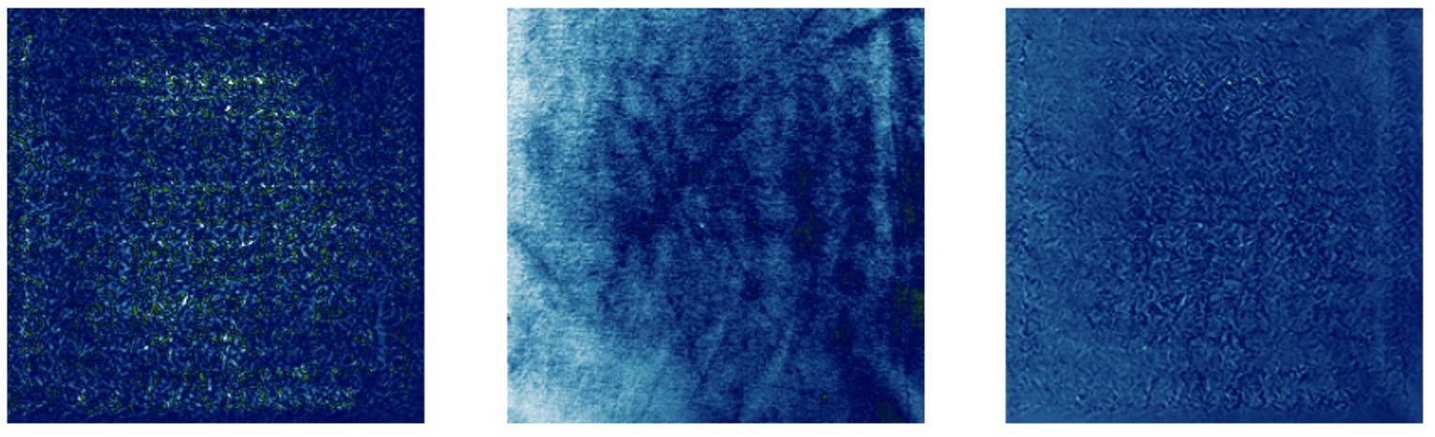
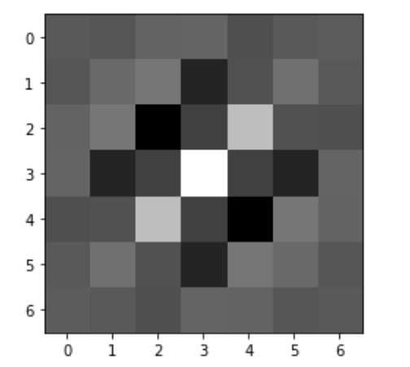
Saliency, Gabor Filters
Feature Extraction
Gabor Filters
(1)
Saliency map
Original image
Overlayed image

Slide 12
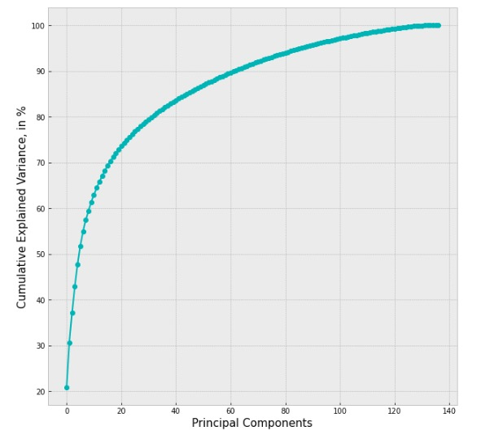
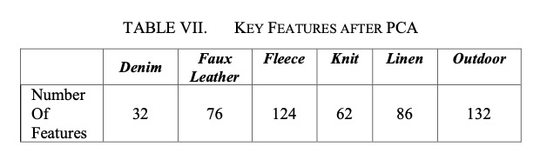
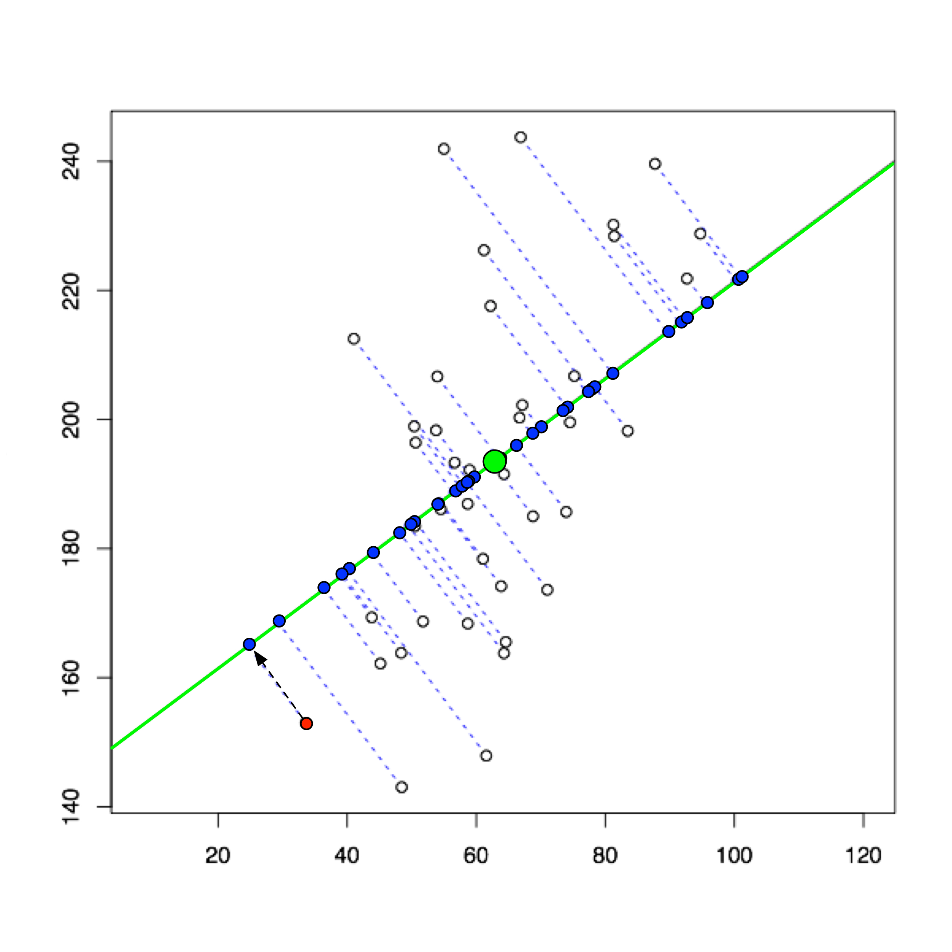

PCA
Principle Component Analysis:
Dimensionality reduction technique
Reduce overfitting
Limited by the number of images per class
$$Total Number of features=\left(64 bins ∗16 sub imgs\right)+\left(16 sub imgs ∗6\right)$$
Principal Component Analysis (3)

Slide 13
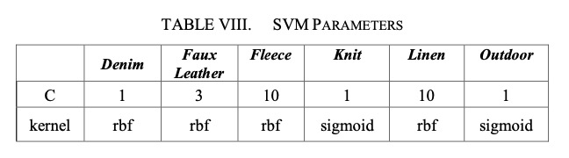
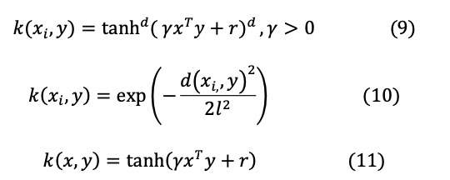
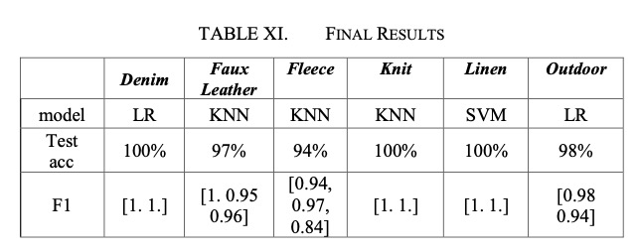
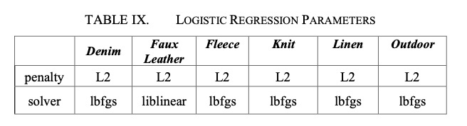
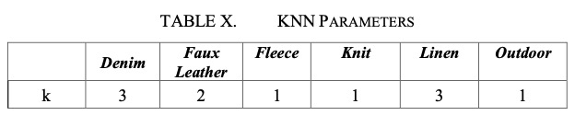
Model Evaluation
SVM:
C: inversely proportional to the penalty term (squared L2)
Kernel: linear, polynomial(9), RBF(10), sigmoid(11)
Logistic Regression:
solver: L-BFGS, liblinear, newton-cg, saga
penalty: no penalty, L1, L2
KNN:
K: number of neighboring points

Slide 14
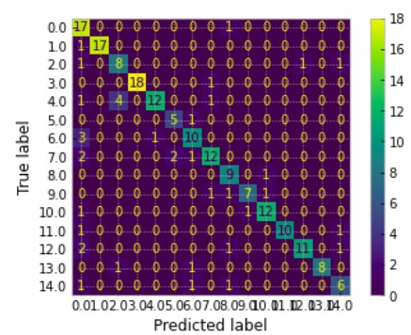
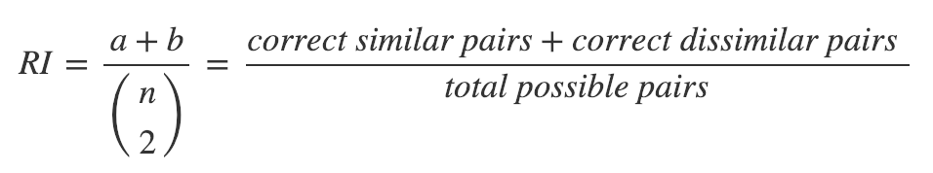
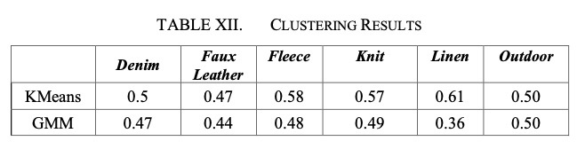
Other evaluations
Combined classes:
Test accuracy
KNN: 80%
SVM: 76%
Logistic Regression: 77%
CNN:
Resnet 18
Resnet 50
MobileNetV2
Highest test accuracy around 82%
Clustering:
Rand index

Slide 15
Conclusion
Proposed model:
Accuracy rates between 94-100%
15 different content makeups in 6 different fabric groups
Limitations:
Tedious labeling process
Limited data and variance
Future Work:
Clustering
CNN architecture for more complex fabric samples
combining methods

