Slide 1
Air Quality Monitor

Slide 2
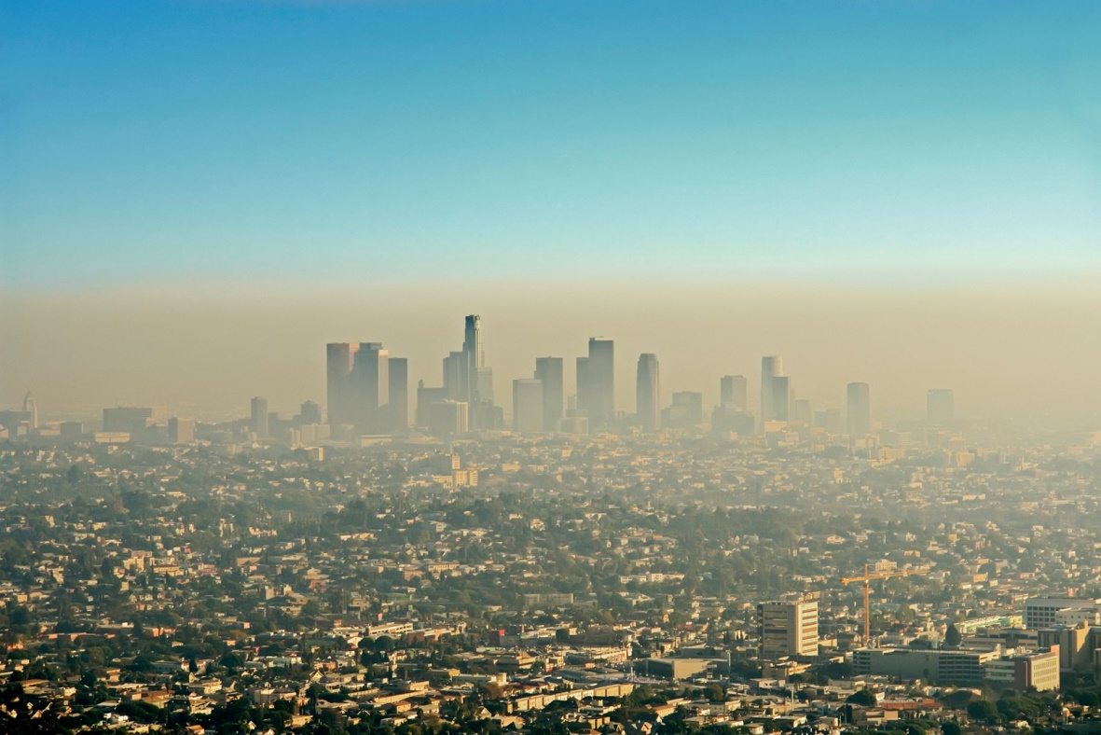
Air pollution – a big threat
A poor air quality has a major role in the development of severe health problems, especially on long exposure times. In 2012, one in eight deaths was reported as a result of air pollution exposure.

Slide 3
Sensing air pollution
We breathe an average of 15 kilograms of air per day, and during exercise, this number almost doubles. With the air quality monitor, you can always check the level of pollution in your area.

Slide 4
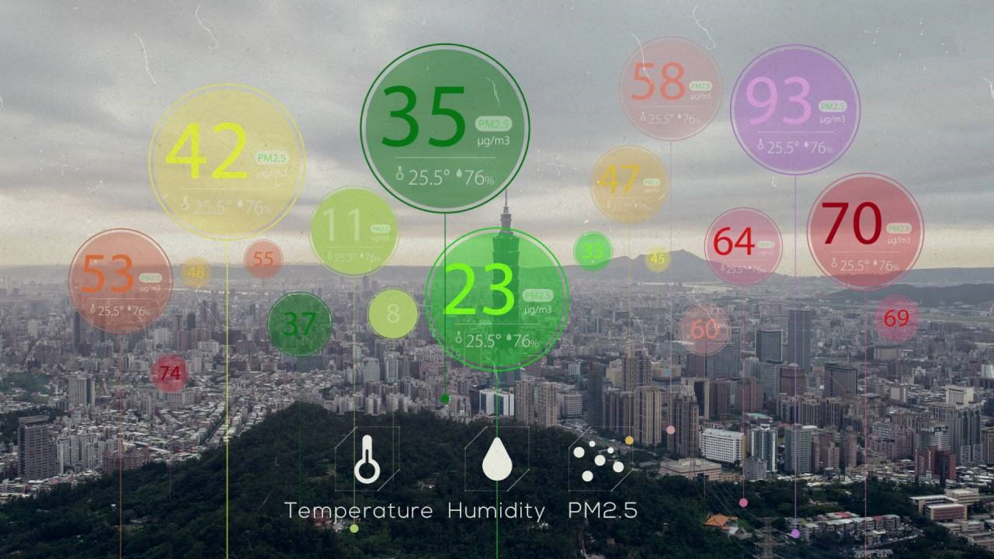
Air pollution assessment
Air quality monitor measures air parameters and calculates the index of air quality, helping you find new ways to reduce the impact of pollution in today’s urban micro-climate.

Slide 5
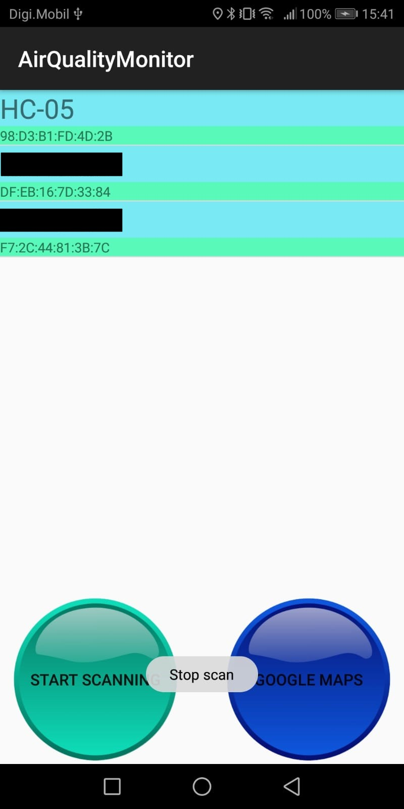
Air Quality Monitor
Air Quality Monitor is a set of devices that, together with an Android application helps you monitor the air quality in your town.
It is built to be easy to use, fast, and always up to date.
You just have to connect to a device in your area and it will automatically update the cloud database with new information about air parameters

Slide 6
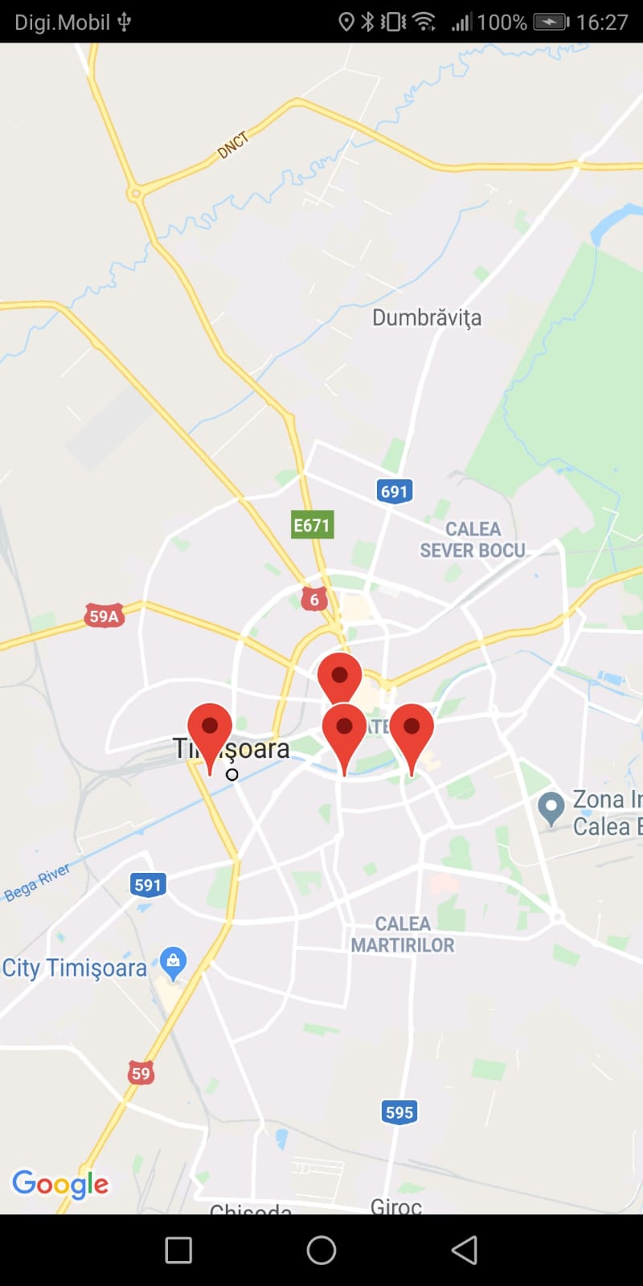
Air Quality Monitor
All the available devices in your area can be seen in the Google Map Activity.

Slide 7
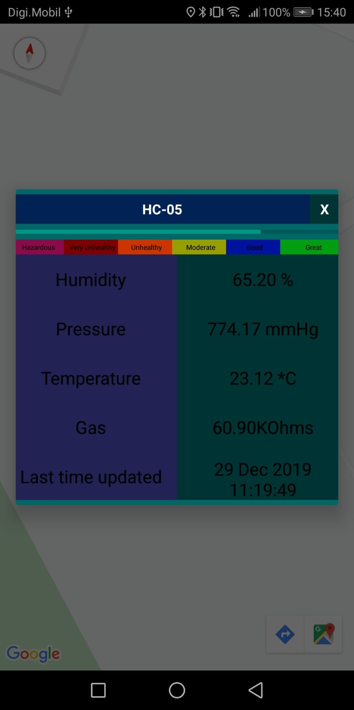
Air Quality Monitor
By clicking on one of these devices, you can see a more detailed view of all air parameters and the date and time this information was acquired

Slide 8
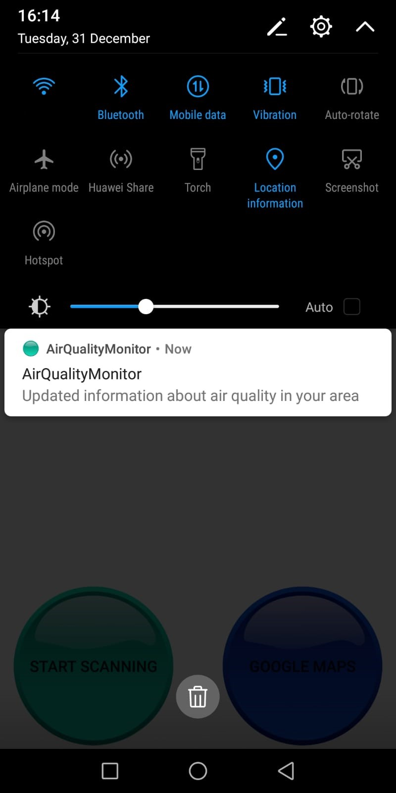
Air Quality Monitor
Whenever someone connects to a device and updates acquired parameters of that area, all users will be notified.
By selecting the notification, you can navigate back to the main activity and view the changes.

Slide 9
Thank you

