Slide 1
MEMENTO
Android Application

Slide 2
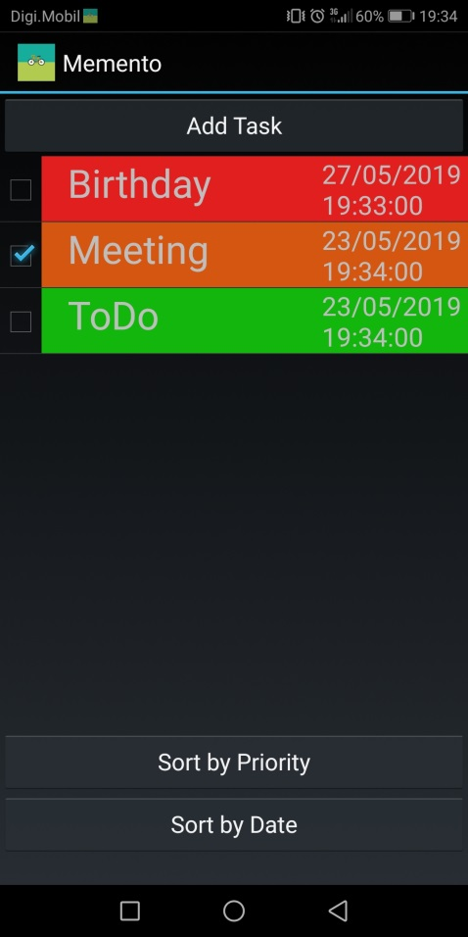
Is it difficult to remind every task and date with detail?
Do you have an Android Smartphone?
We have a solution to make your life easier…
Memento : An Android Application

Slide 3


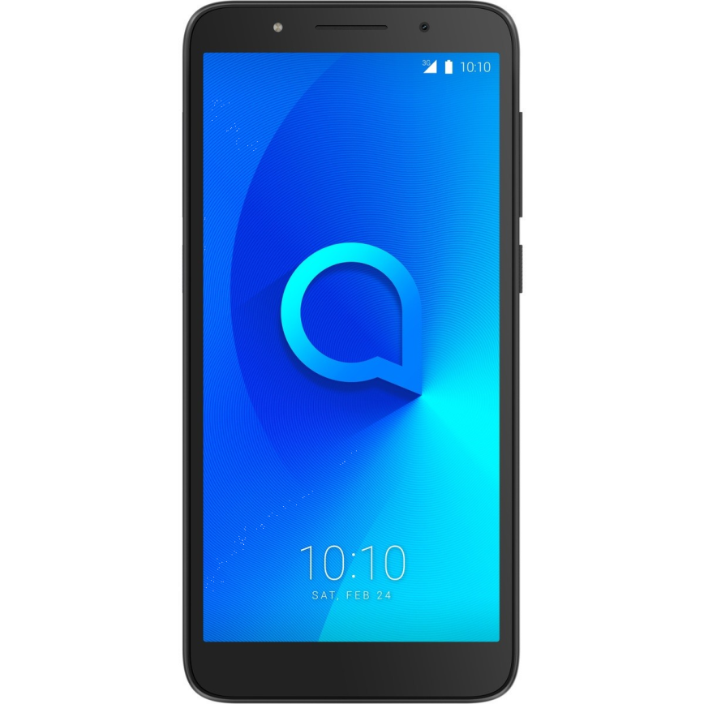


Slide 4
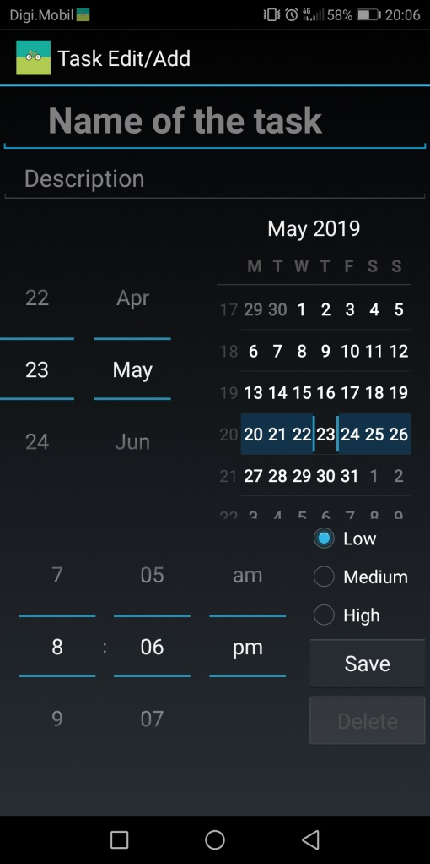
Memento is an Application that lets the user manage his tasks.
It is built to ease appointment management and to be convenient and easy to use
It is based on a database where you can add all your appointments and you will be notified when the deadline arrives
Above all, it provides a confortable user experience and efficiency.

Slide 5
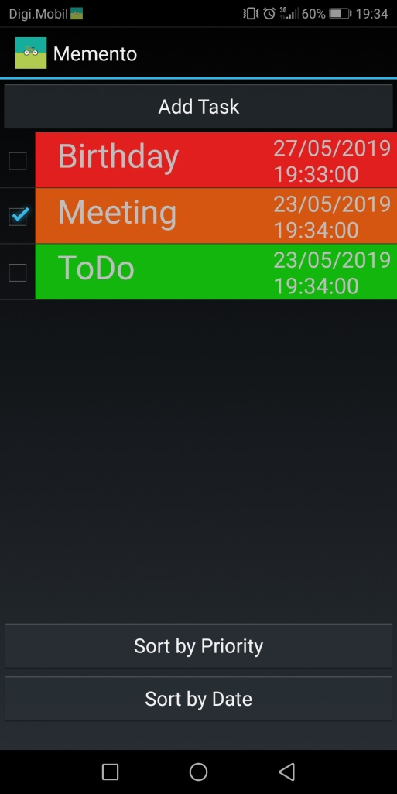
You can easily add your task by clicking the Add Task button
Each task has a priority
You can also sort your appointments by priority and date

Slide 6
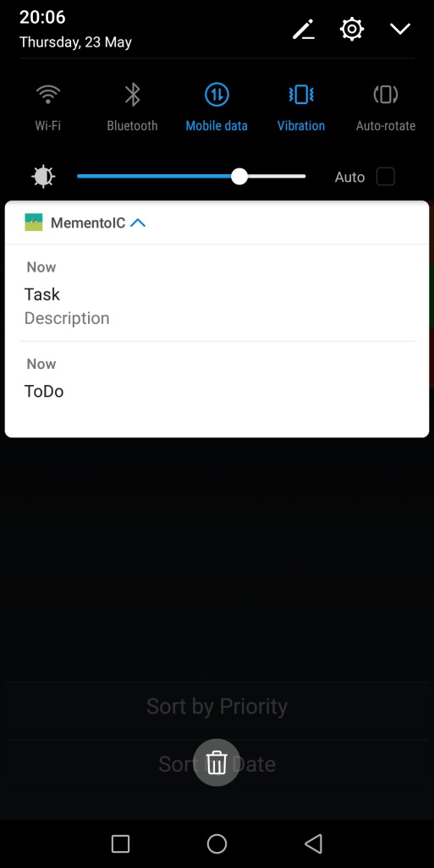
When the deadline is met, you will be notified immediately
By selecting the notification, you can navigate to the main activity where you can delete the task or mark it as done

Slide 7
Thank you for your time

