Slide 1

Test Automation Framework – Java & Selenium
Cătălan Cătălin

Slide 2
Agenda
App presentation
Tools used
Functionalities tested
Main packages and structure
Challenges

Slide 3
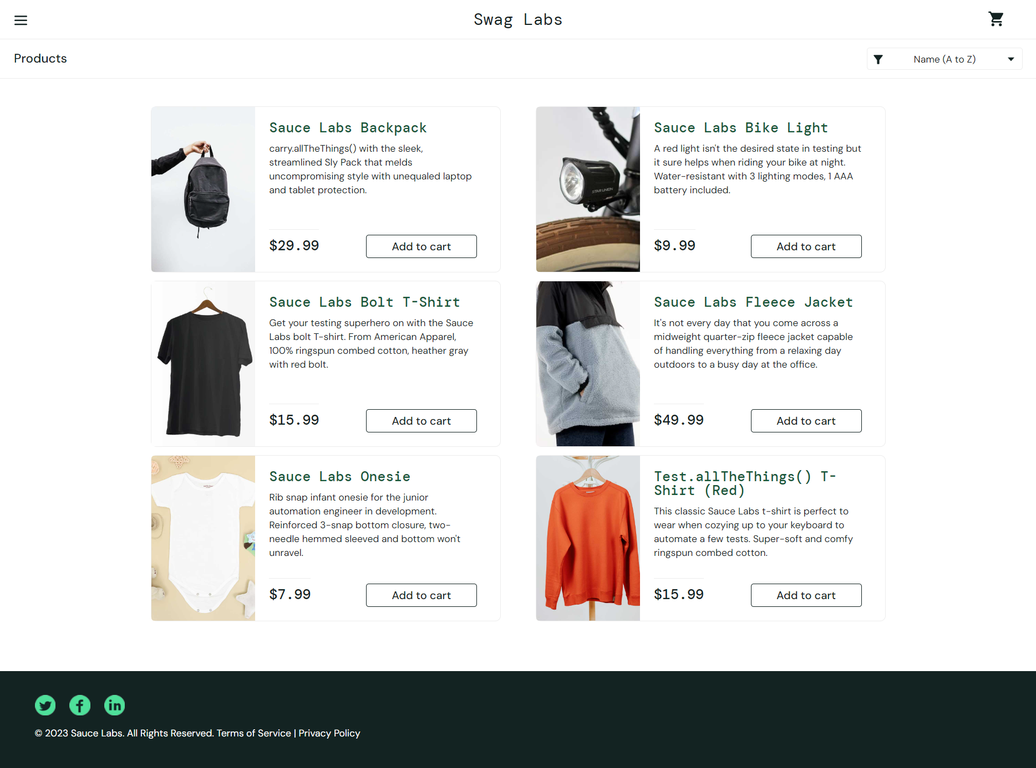
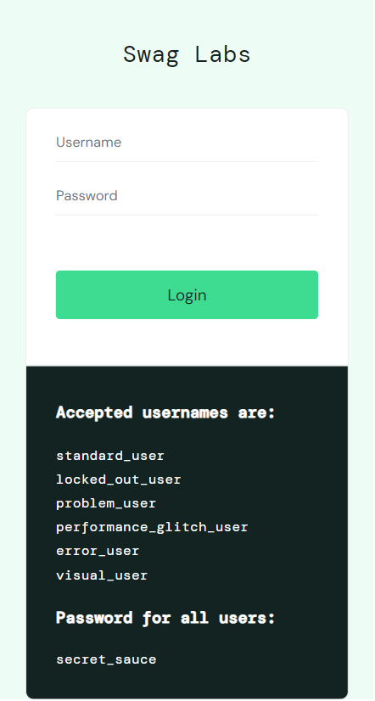
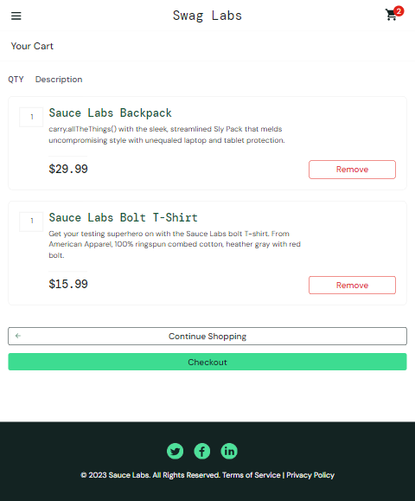
App presentation
The app being tested is an online store.
It has several pages:
Login page;
Inventory page (Home page);
Cart page;
Product details page;
Checkout page.

Slide 4




Tools used
Java
JUnit
an object-oriented programming language
a framework used to write and execute automated test cases
Eclipse IDE
Selenium
an integrated development environment used in computer programming
an automated testing tool used to test web applications

Slide 5
Functionalities tested
Login in the app with a invalid user
Create a booking for one product
Login in the app with a valid user
Login in the app with a locked user
Add and remove a product from the cart

Slide 6
Main packages and structure

Slide 7
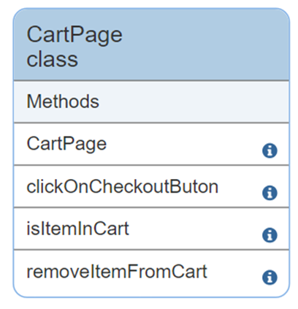
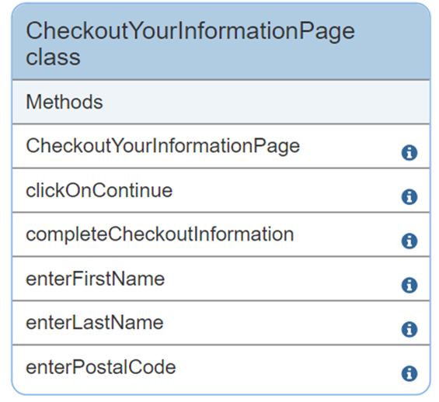
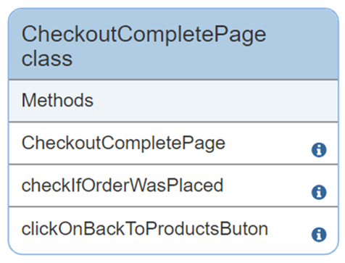
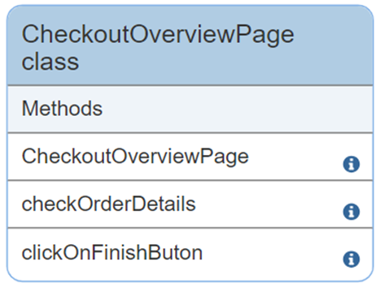
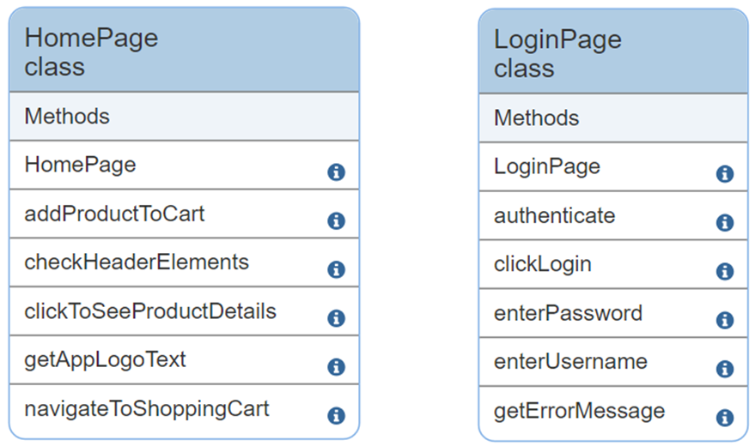
Page package

Slide 8
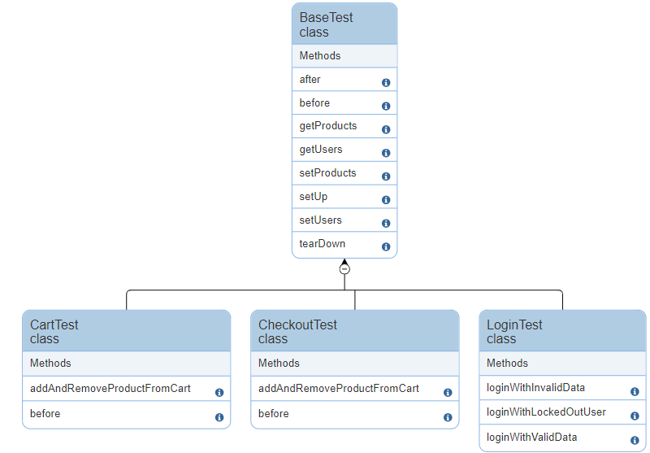
Tests package

Slide 9


Challenges
Identifying certain selectors
Some selectors were difficult to identify, but I learned how to use XPath axes (ancestor, descendant, preceding, etc.).
Reading data from JSON files
Although I haven't worked much with reading data from files so far and had some difficulties at first, I found it to be an excellent practice in testing applications.
Keeping test data in JSON files separate from the source code helps keep the code clean and organized.
Data stored in JSON files can easily be reused in different tests or even in different projects.

Slide 10
Thank you for your attention!
Cătălan Cătălin
catalin_catalan@yahoo.com

