Slide 1
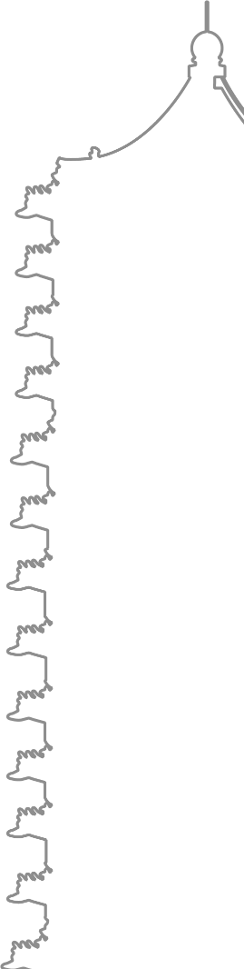

PhysChem Seminar
Language Model and
Applications in Chemistry
李隽仁 李泽炜 2023.5.26

Slide 2
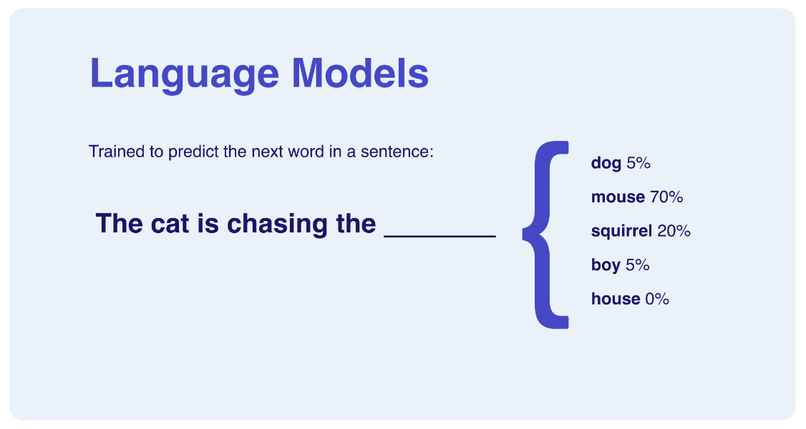

00
Background
Language Model
Natural Language Processing(NLP)
A fundamental task in AI
20th century
Statistic Models
In 2000s
Neural Networks
Now
Large LM
Markov Chain
RNN(2010)
LSTM(2016)
Transformer
GPT
Derivatives
http://Hypo.ai

Slide 3
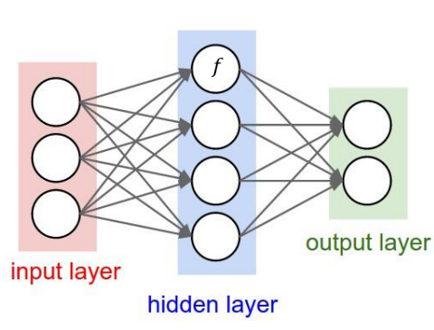
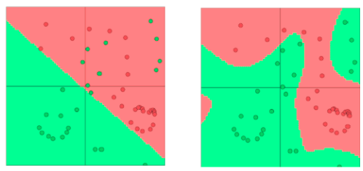
01
Foundations about Deep Learning
Neural Network
A universal function fitter
Scheme of a neural network
Linear regression
Neural Network
Requirement:
- Data (Train/Validation/Test)
- Computing Resources (GPUs)
- Algorithms

Slide 4
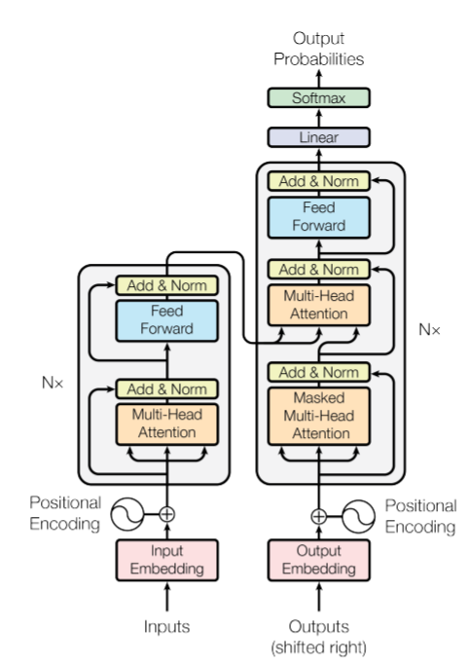
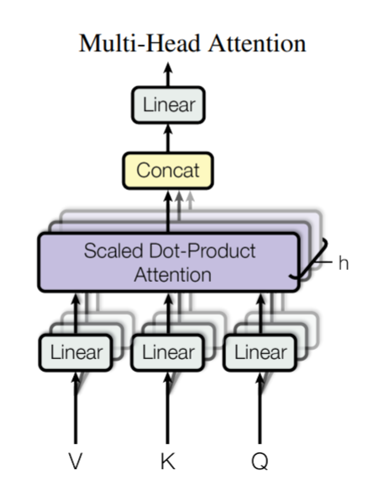
01
GPT: Generative Pretrained Transformer
Calculating attention scores for input tokens.
Weighting token interactions based on relevance.
The architecture of transformer
Selective focus on relevant context.
Capturing long-range dependencies.
Improved performance in various tasks.
Vaswani et al., Attention is All You Need, 2017

Slide 5
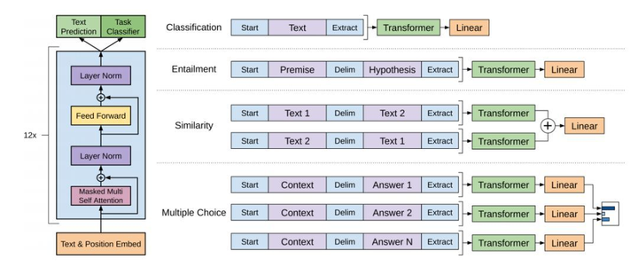
01
GPT: Generative Pretrained Transformer
Web pages
Books
Articles
Forum chats
……
Grammar
Vocabulary
Semantics
Structures
……
Pretraining
OpenAI, Improving Language Understanding by Generative Pre-Training, 2018

Slide 6
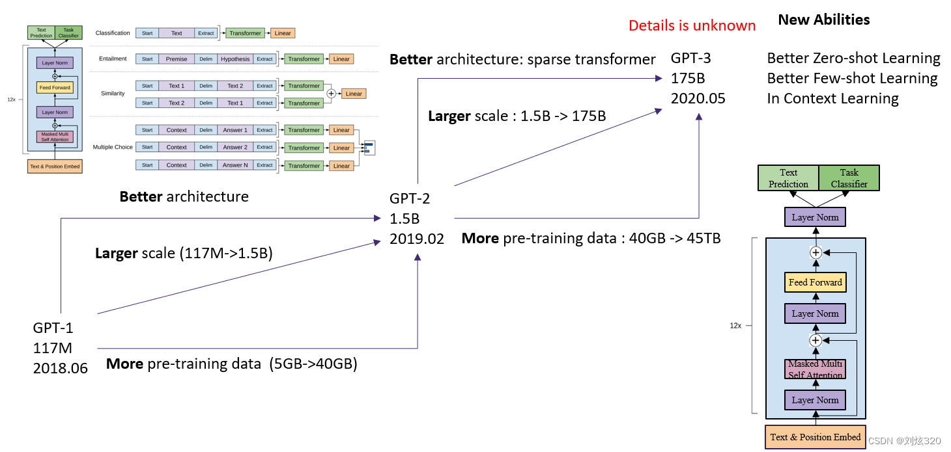
02
From GPT-1 to GPT-3.5
Reinforcement Learning with Human Feedback
ChatGPT
Huge data, Huge model, Huge money
Estimated to be over 45TB training data
~1,000 A100 GPUs to train & 6 A100 GPUs to inference
More than $100 million to train

Slide 7
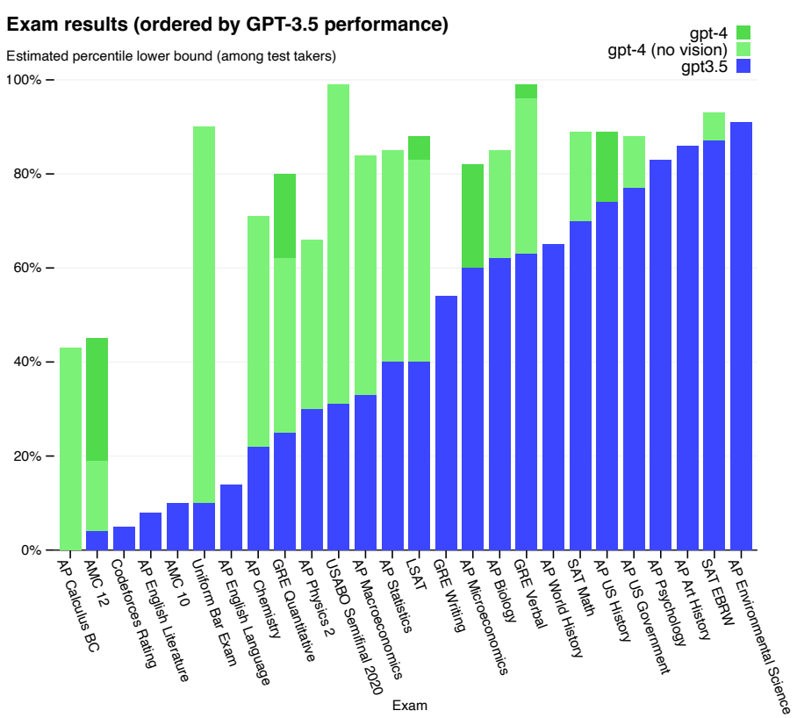
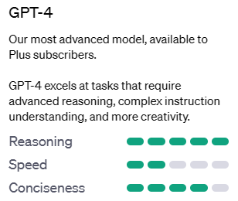
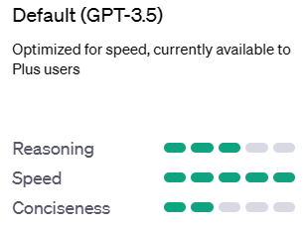
02
GPT-4
Beyond Language model
Reasoning ability
Multimodal input
Plugins & Web browsing
OpenAI, GPT-4 Technical Report, 2023

Slide 8
02
How to fine-tune a LLM for your own?
Prerequisite
A pretrained Large Language Model (or you may train from scratch)
A GPU (3090 or better, multiple A100 for best practice)
Datasets: normal dataset & chatting dataset
Dataset
Pretrained LLM
GPT-2/LLaMa/etc.
RLHF
e.g., DeepSpeed
Your LLM
Does this work for building a ChemGPT?
Normal dataset: textbooks & journal articles
Chatting dataset: ?

Slide 9
03
Language Models in Chemistry
Leveraging General LLMs
Writing prompts
Testing the ability on GPT-4 or other LLMs
Convenience but restricted
Training an LLM for chemistry
Chemistry is somehow similar with language
SMILES, amino acid sequences, lattice sequences, etc.
Training a language model for chemistry from scratch
Highly adjustable, while difficult and expensive

Slide 10
03
Language Models in Chemistry
Leveraging General LLMs
ChemCrow: Augmenting large-language models with chemistry tools
Optimizing LLMs on specific tasks
Large Language Models as Master Key: Unlocking the Secrets of Materials Science with GPT
Training LLMs on demand
Large language models generate functional protein sequences across diverse families

Slide 11
04
ChemCrow: Adding Chemistry Tools
Leveraging General LLMs
ChemCrow: Augmenting large-language models with chemistry tools

Slide 12
05

Slide 13
06
PROGEN: Designing Proteins

Slide 14
05
Conclusion and Future

Slide 15
06
Acknowledgement

