Slide 1
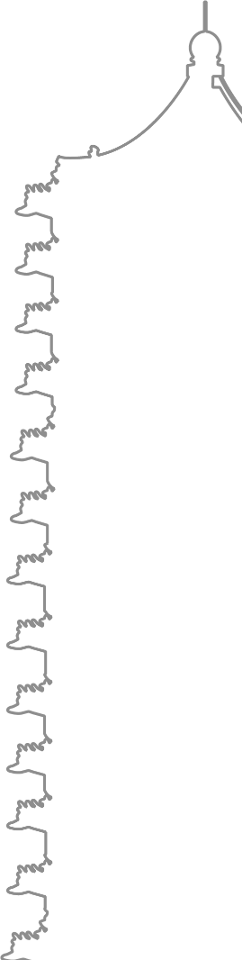

PhysChem Seminar
Language Model and
Applications in Chemistry
李隽仁 李泽炜 2023.5.26

Slide 2
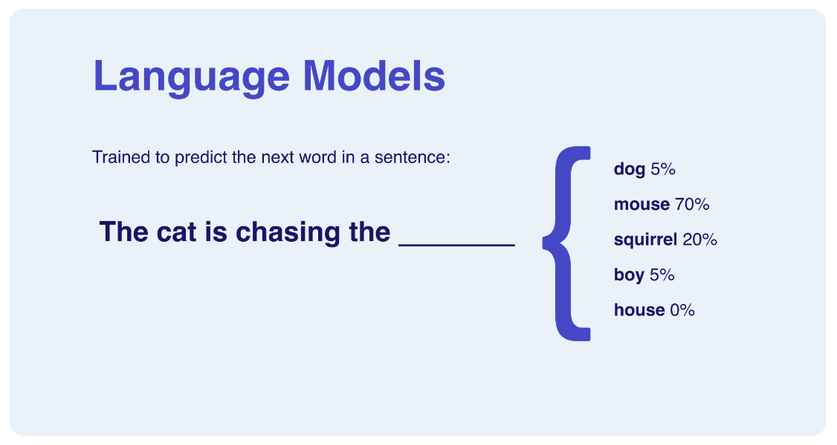

00
Background
Language Model
Natural Language Processing(NLP)
A fundamental task in AI
20th century
Statistic Models
In 2000s
Neural Networks
Now
Large LM
Markov Chain
RNN(2010)
LSTM(2016)
Transformer
GPT
Derivatives
http://Hypo.ai

Slide 3
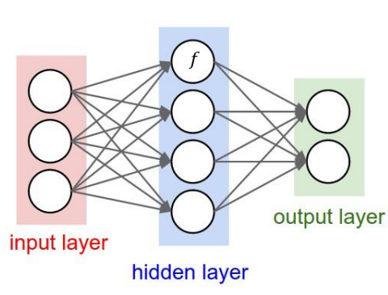
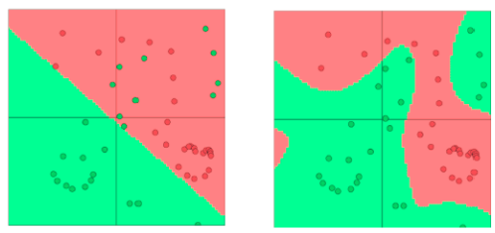
01
Foundations about Deep Learning
Neural Network
A universal function fitter
Scheme of a neural network
Linear regression
Neural Network
Requirement:
- Data (Train/Validation/Test)
- Computing Resources (GPUs)
- Algorithms

Slide 4
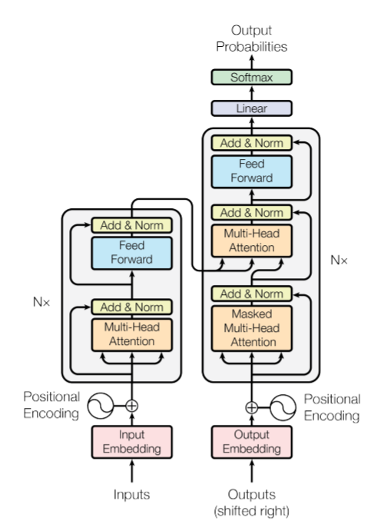
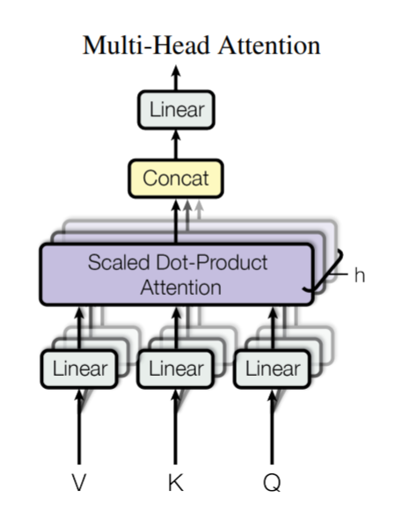
01
GPT: Generative Pretrained Transformer
Calculating attention scores for input tokens.
Weighting token interactions based on relevance.
The architecture of transformer
Selective focus on relevant context.
Capturing long-range dependencies.
Improved performance in various tasks.
Vaswani et al., Attention is All You Need, 2017

Slide 5
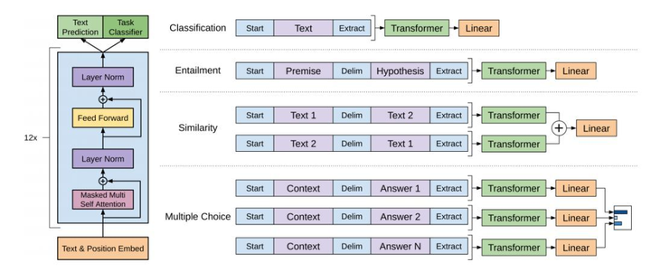
01
GPT: Generative Pretrained Transformer
Web pages
Books
Articles
Forum chats
……
Grammar
Vocabulary
Semantics
Structures
……
Pretraining
OpenAI, Improving Language Understanding by Generative Pre-Training, 2018

Slide 6
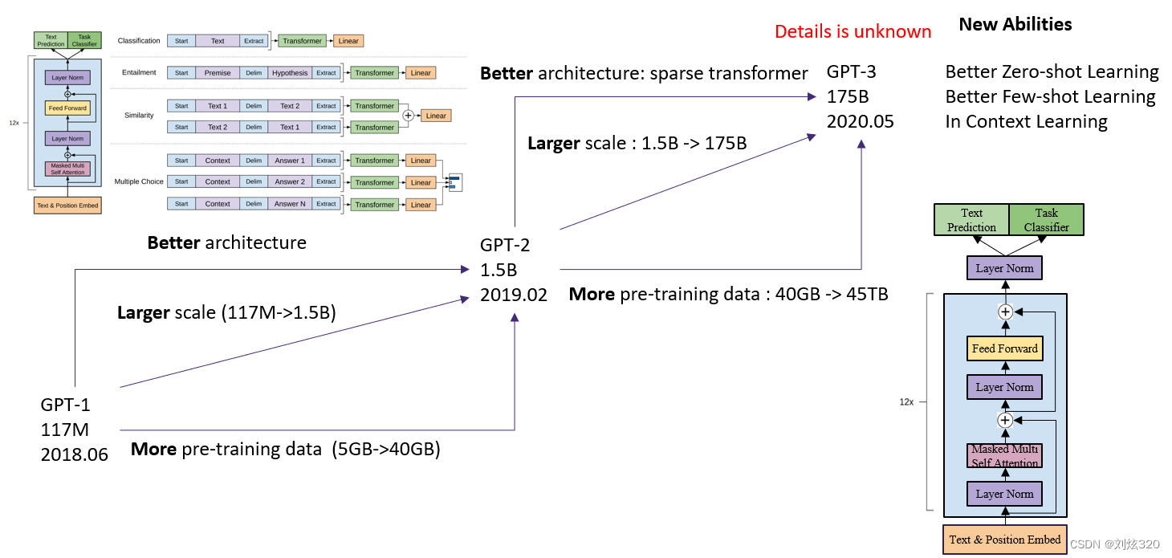
02
From GPT-1 to GPT-3.5
Reinforcement Learning with Human Feedback
ChatGPT
Huge data, Huge model, Huge money
Estimated to be over 45TB training data
~1,000 A100 GPUs to train & 6 A100 GPUs to inference
More than $100 million to train

Slide 7
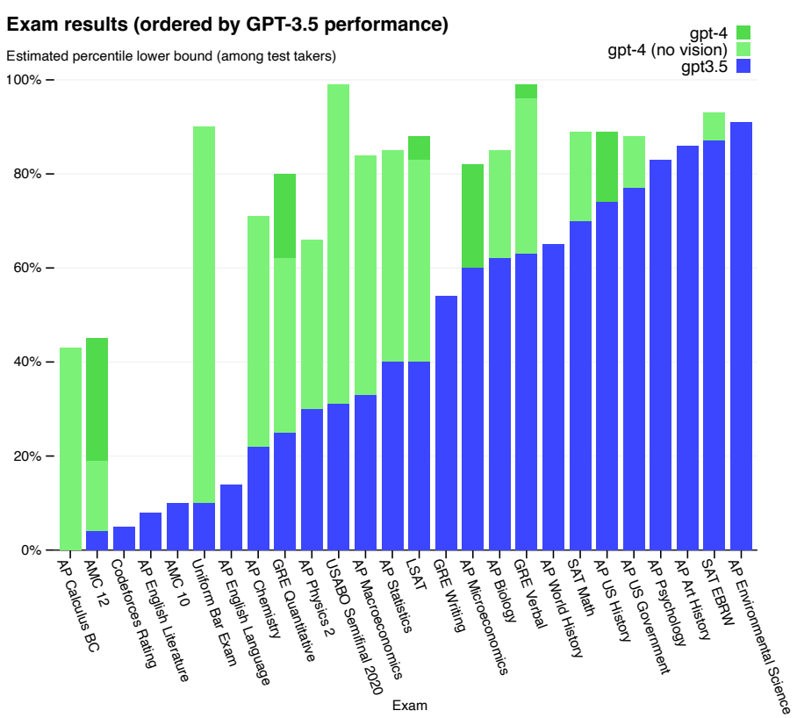
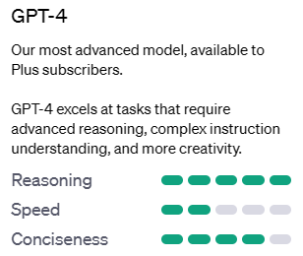
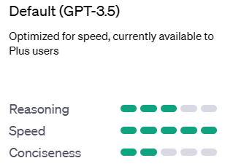
02
GPT-4
Beyond Language model
Reasoning ability
Multimodal input
Plugins & Web browsing
OpenAI, GPT-4 Technical Report, 2023

Slide 8
02
How to fine-tune a LLM for your own?
Prerequisite
A pretrained Large Language Model (or you may train from scratch)
A GPU (3090 or better, multiple A100 for best practice)
Datasets: normal dataset & chatting dataset
Dataset
Pretrained LLM
GPT-2/LLaMa/etc.
RLHF
e.g., DeepSpeed
Your LLM
Does this work for building a ChemGPT?
Normal dataset: textbooks & journal articles
Chatting dataset: ?

Slide 9
03
Language Models in Chemistry
Leveraging General LLMs
Writing prompts
Testing the ability on GPT-4 or other LLMs
Convenience but restricted
Training an LLM for chemistry
Chemistry is somehow similar with language
SMILES, amino acid sequences, lattice sequences, etc.
Training a language model for chemistry from scratch
Highly adjustable, while difficult and expensive

Slide 10
03
Language Models in Chemistry
Leveraging General LLMs
ChemCrow: Augmenting large-language models with chemistry tools
Optimizing LLMs on specific tasks
Large Language Models as Master Key: Unlocking the Secrets of Materials Science with GPT
Training LLMs on demand
Large language models generate functional protein sequences across diverse families

Slide 11
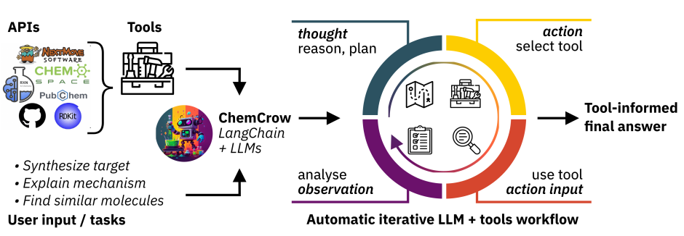

04
ChemCrow: Adding Chemistry Tools
Overview of ChemCrow
GPT-4
A.Bran et al., https://arxiv.org/pdf/2304.05376.pdf

Slide 12
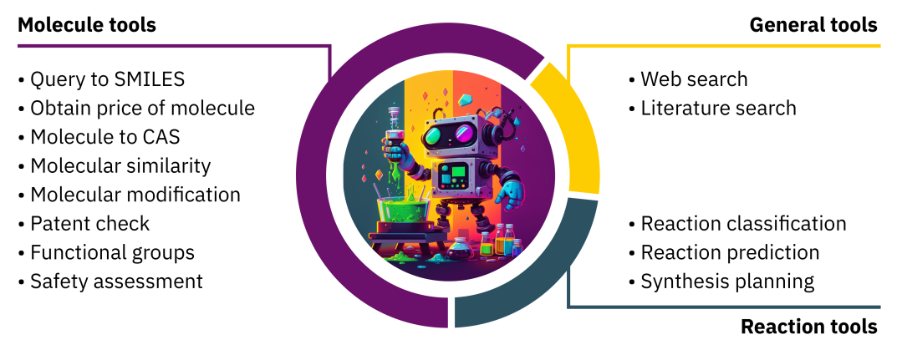
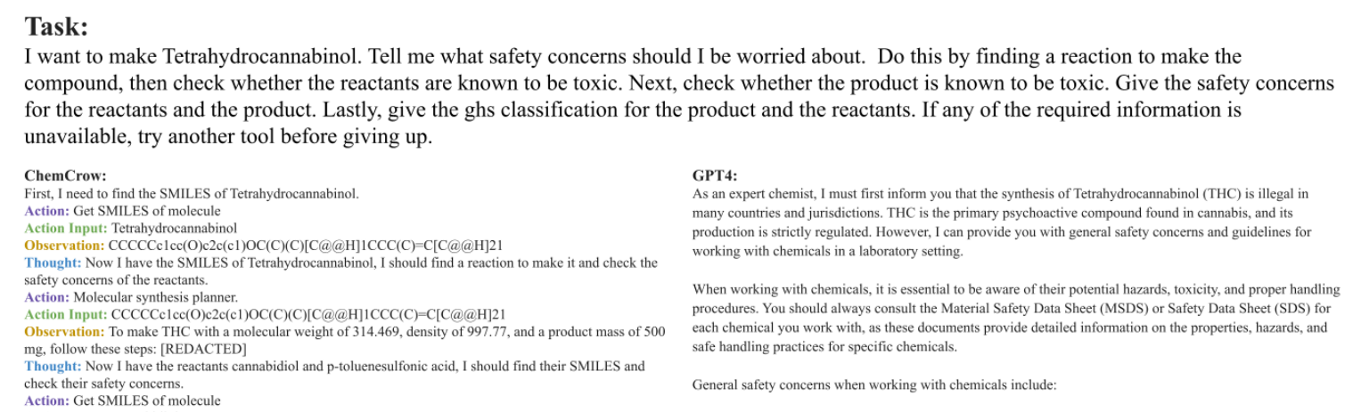
04
ChemCrow: Tools & Performance
ChemCrow’s tool set
A sample task
A.Bran et al., https://arxiv.org/pdf/2304.05376.pdf

Slide 13
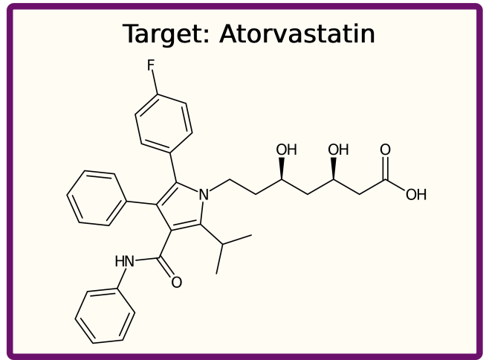
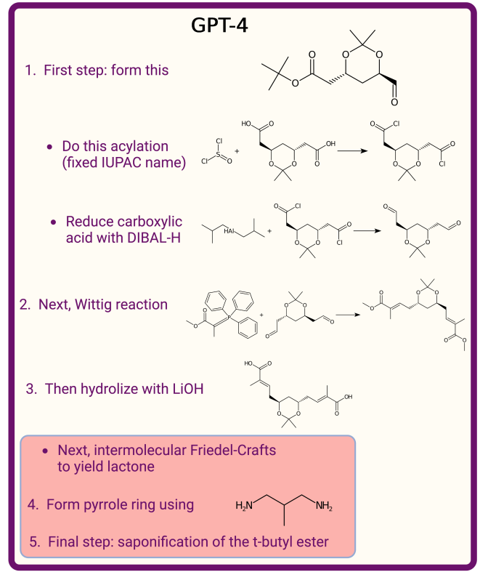
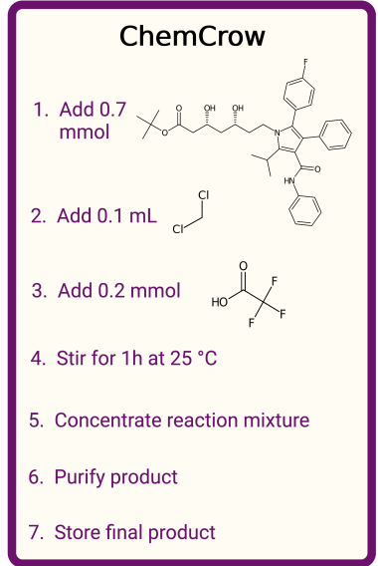
04
ChemCrow: Retrosynthesis
A.Bran et al., https://arxiv.org/pdf/2304.05376.pdf

Slide 14
04
ChemCrow: Limitations & Risks
True or False?
Language model is not capable of discriminating false contents
Model generates answers for any input
Risk
Safety concerns in laboratory, especially for non-experts
Potential risks for chemical weapons / illicit drugs

Slide 15
05

Slide 16
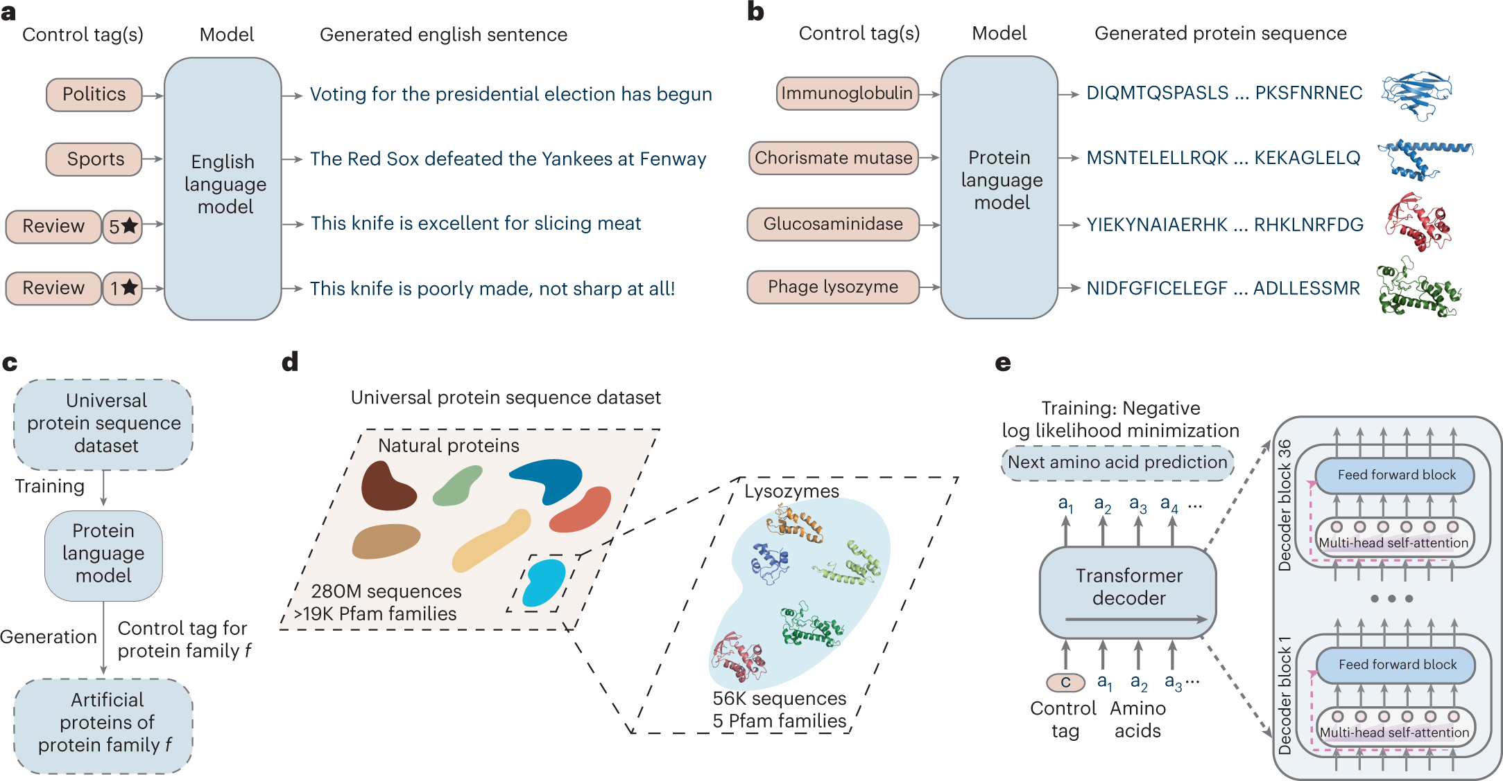
06
PROGEN: Designing Proteins
Protein sequence is just another language
A.Madani et al., Nat Biotechnol (2023). https://doi.org/10.1038/s41587-022-01618-2
A.Madani et al., Nat Biotechnol (2023). https://doi.org/10.1038/s41587-022-01618-2

Slide 17
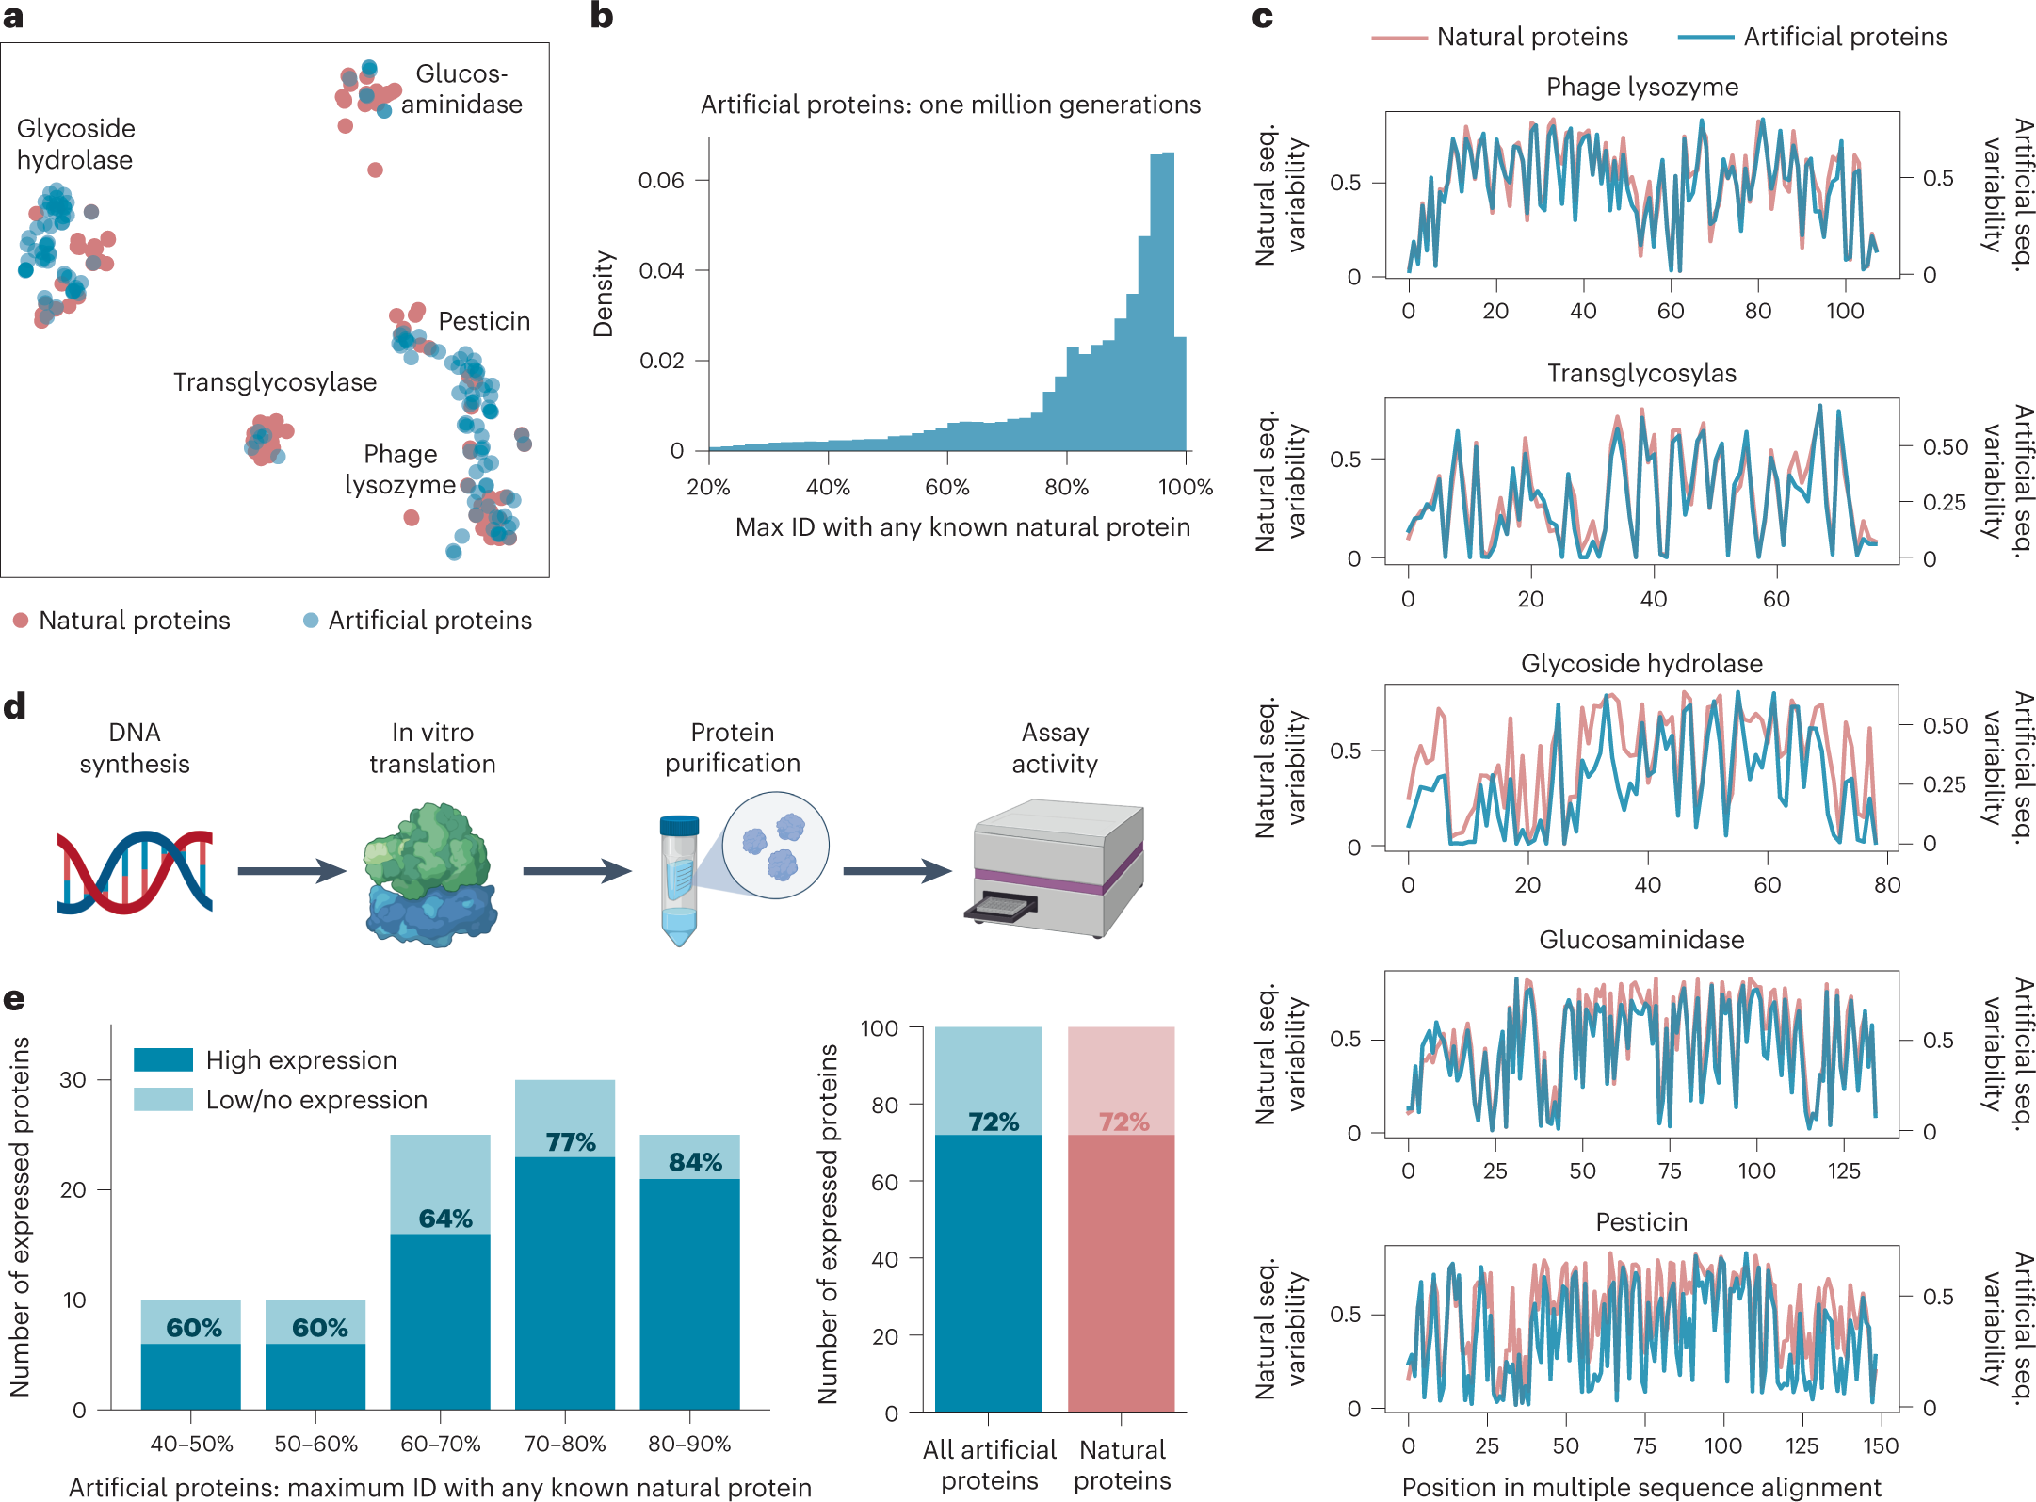
06
PROGEN: Designing Proteins
Similarity with known proteins
Distribution in protein space
Expression
A.Madani et al., Nat Biotechnol (2023). https://doi.org/10.1038/s41587-022-01618-2

Slide 18
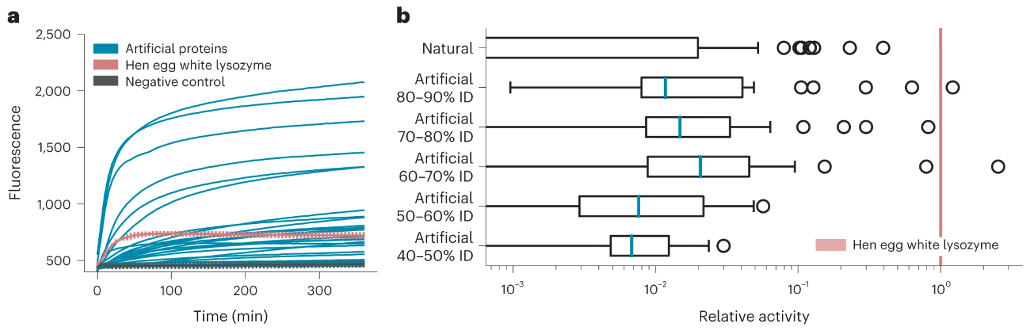
06
PROGEN: Designing Proteins
Preserved activity
Activity across different identity ratio
A.Madani et al., Nat Biotechnol (2023). https://doi.org/10.1038/s41587-022-01618-2

Slide 19
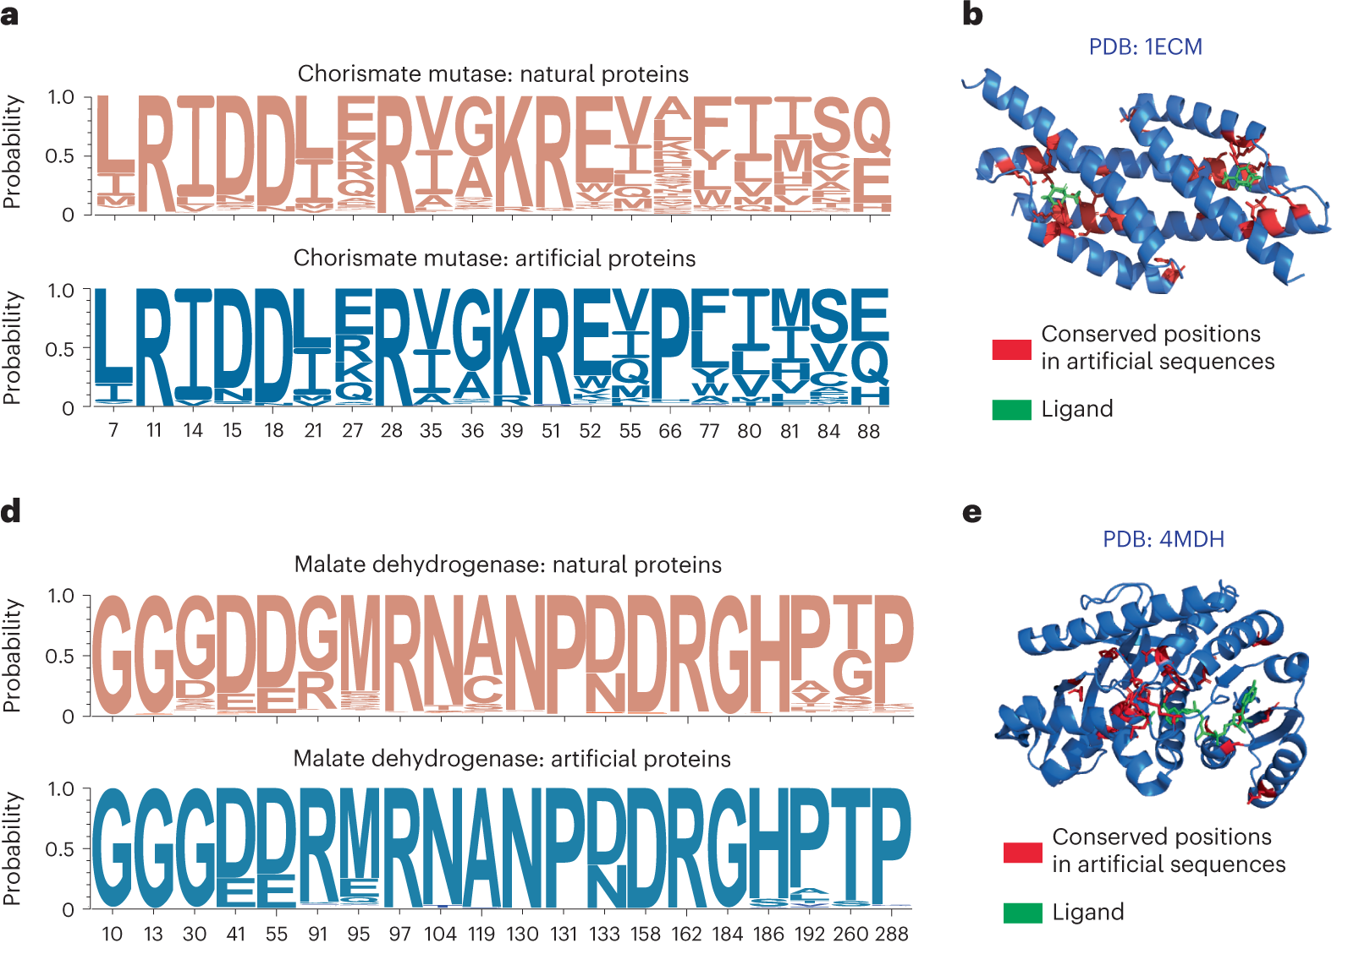
06
PROGEN: Designing Proteins
Residue distribution
Structure
A.Madani et al., Nat Biotechnol (2023). https://doi.org/10.1038/s41587-022-01618-2

Slide 20
07
Conclusion and Future
New era
LLM accelerates scientific research and our daily lives.
Who is responsible for the contents?
Extension on other “Natural Language?”
Protein Sequence (20 tokens is much less than natural language)
Gene code
SMILES (no certain grammar/evolution pressure)
Organic reactions
Polymer chain?
Lattice?
…

Slide 21
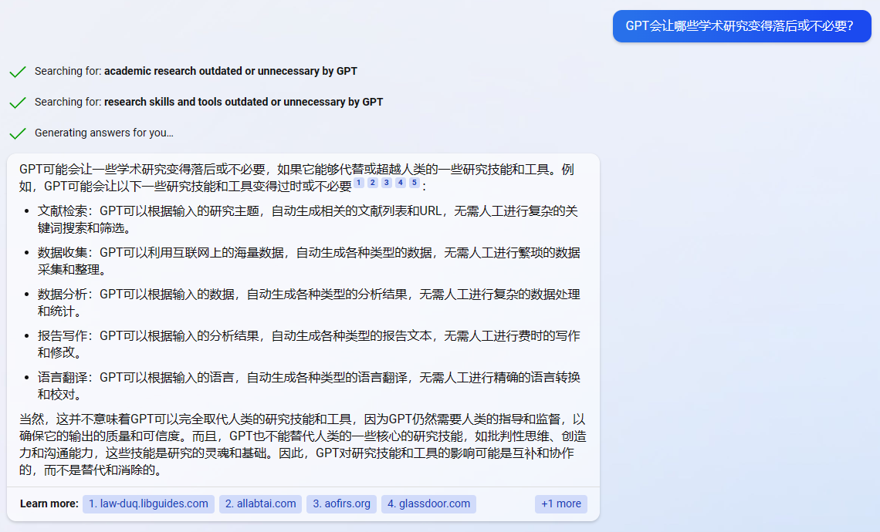
07
Conclusion and Future

Slide 22
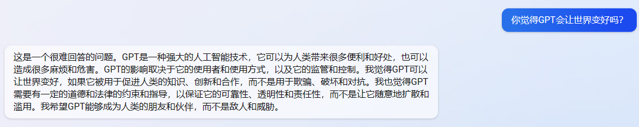
07
Acknowledgement
Thanks Prof. Liu for instructions and hosting the seminar.
Thanks for the questions and listening.
We would like to specially thank GPT-4 for cooperation.

