Slide 1
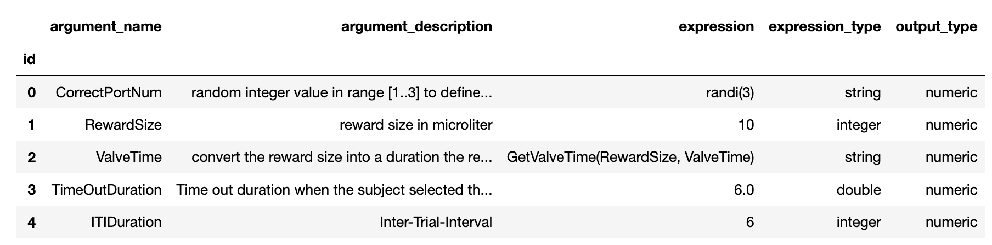
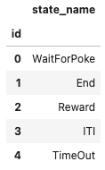
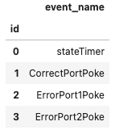
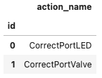
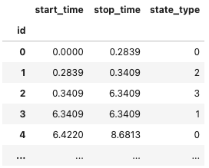
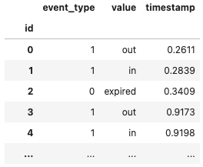
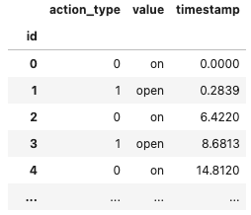
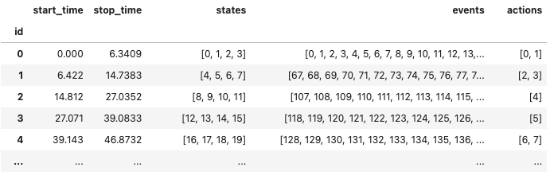
/general
Task
TaskArgumentTable
StateTypesTable
BEADLTaskProgram
EventTypesTable
BEADLTaskSchema
ActionTypesTable
/acquisition
StatesTable
EventsTable
ActionsTable
/intervals
TrialsTable (TimeIntervals)

Slide 2
/general
Task
TaskArgumentTable
StateTypesTable
EventTypesTable
ActionTypesTable
BEADLTaskProgram
BEADLTaskSchema
/acquisition
/intervals
StatesTable
EventsTable
ActionsTable
TrialsTable (TimeIntervals)

