Slide 1

Collaborative Platform for Analysis of Software Systems
Catarina Isabel Carvalho Santana
Thesis to obtain the Master of Science Degree in
Information Systems and Computer Engineering
Advisor: Prof. António Manuel Ferreira Rito da Silva
30th October 2015

Slide 2
Outline
The Problem
Thesis Objectives
State-of-the-Art
Solution
Domain Model
Features
Evaluation

Slide 3
The problem
Software Architectures Course
Correlation theory-practice
  Not easy
  Long documents
  Students have different learning rhythms
  Information is not available consistently
Notes:
In SA theoretical classes students are taught the most important concepts in the field of software architectures, and in the practical classes and group assignments articles describing real software systems are analyzed, in order to create a correlation between the theory and practice.
However, doing this correlation is not easy, as software description articles are fairly long documents. Also, the information is not available consistently for all students. Students have different personalities, and understand things at their own rhythm

Slide 4
Thesis Objectives
Create a Collaborative Platform
Create the Correlation Theory-Practice
  Annotate text;
  Build a structured representation
Social Elements
  Boost collaboration and motivation
Notes:
The goal of this thesis is to develop a collaborative platform, where this correlation between theoretical concepts and the software descriptions can be done collaboratively among students.
The most important feature of this platform is to provide ways to annotate the case descriptions text, in order to create structured representation which synthesizes the article analyzed.
The use of social software elements will increase collaboration and motivation.

Slide 5
State of the Art
Social Software
Knowledge Structuring
Notes:
I'm going to present the state of the art in the two major fields related to this thesis: Social software, which regards features to promote socialization in systems, and Knowledge Structuring, which regards extracting and structuring information from various sources

Slide 6
Social Software
Field | Relation with this thesis
Honeycomb Framework | Identification, Groups, Conversation, Reputation, Sharing, Relationships
Persuasive Software | Social Learning and Facilitation: Visualizing people's contributions; Competition: Reputation System; Cooperation: Discussion Forums; Recognition: Spotlight
Roles in Social Networks | Two roles: Student and Teacher
Reputation Systems | Motivational tool; Positive ratings; Simple aggregation algorithm; Discriminate user behavior;
Notes:
Regarding Social Software, I analyzed the state of the art in the Honeycomb framework, Persuasive Software, Roles in social software and reputation systems.

Slide 7
Social Software
Field | Relation with this thesis
Honeycomb Framework | Identification, Groups, Conversation, Reputation, Sharing, Relationships
Persuasive Software | Social Learning and Facilitation: Visualizing people's contributions; Competition: Reputation System; Cooperation: Discussion Forums; Recognition: Spotlight
Roles in Social Networks | Two roles: Student and Teacher
Reputation Systems | Motivational tool; Positive ratings; Simple aggregation algorithm; Discriminate user behaviour;
Notes:
The Honeycomb framework identifies the major elements of social software. From these, Identification (unique identification in the platform), Groups (existence of work groups), Conversation (asynchronous in discussion forums, for example), Reputation (assigning a reputation for motivational purposes), Sharing (allowing to share other media), and Relationships (there are relations student-student and teacher-student) are useful in this context.

Slide 8
Social Software
Field | Relation with this thesis
Honeycomb Framework | Identification, Groups, Conversation, Reputation, Sharing, Relationships
Persuasive Software | Social Learning and Facilitation: Visualizing people's contributions; Competition: Reputation System; Cooperation: Discussion Forums; Recognition: Spotlight
Roles in Social Networks | Two roles: Student and Teacher
Reputation Systems | Motivational tool; Positive ratings; Simple aggregation algorithm; Discriminate user behavior;
Notes:
Regarding Persuasive software, there are design patterns in order to promote Social learning and facilitation (motivate people by showing other people pursuing the same goals), Competition, Cooperation and Recognition. Visualizing people's contributions, adding reputation system, providing a discussion forum and a spotlight with the higher reputation scores would promote these four persuasive features.

Slide 9
Social Software
Field | Relation with this thesis
Honeycomb Framework | Identification, Groups, Conversation, Reputation, Sharing, Relationships
Persuasive Software | Social Learning and Facilitation: Visualizing people's contributions; Competition: Reputation System; Cooperation: Discussion Forums; Recognition: Spotlight
Roles in Social Networks | Two roles: Student and Teacher
Reputation Systems | Motivational tool; Positive ratings; Simple aggregation algorithm; Discriminate user behavior;
Notes:
Regarding Roles, there are methods to infer roles from analysis of a social network, but in this context these are explicit and easily identifiable: There are Students, who are the major contributors to the platform, and teachers, who have less contributions but of major importance.

Slide 10
Social Software
Field | Relation with this thesis
Honeycomb Framework | Identification, Groups, Conversation, Reputation, Sharing, Relationships
Persuasive Software | Social Learning and Facilitation: Visualizing people's contributions; Competition: Reputation System; Cooperation: Discussion Forums; Recognition: Spotlight
Roles in Social Networks | Two roles: Student and Teacher
Reputation Systems | Motivational tool; Positive ratings; Simple aggregation algorithm; Discriminate user behavior;
Notes:
Regarding Reputation systems, they have shown to be a powerful motivational tool, and that could be applied to this platform. User contributions could be rated in a positive scale and aggregated with a simple algorithm such as a weighted average, in order to produce a reputation score. The rating scale and reputation score should discriminate all kinds of user behavior, and these values should not be modifiable. Reputation information is calculated as soon as ratings are assigned.

Slide 11
Knowledge Structuring
Field | Relation with this Thesis
Collaborative Tagging | Associate tags with software description text;
Semi-Structured Content | Creation of a semi-structure from the software description text;
Ontology Learning | Extracting the Software Architectures concepts from the software description text;
Notes:
Regarding Knowledge Structuring, I will present the state of the art in collaborative tagging, semi-structured contents and ontology learning.

Slide 12
Knowledge Structuring
Field | Relation with this Thesis
Collaborative Tagging | Associate tags with software description text;
Semi-Structured Content | Creation of a semi-structure from the software description text;
Ontology Learning | Extracting the Software Architectures concepts from the software description text;
Notes:
Regarding Collaborative Tagging, it is the idea of freely attaching keywords, or tags, to content, in order to describe it or the category in which it falls.
In this platform, tags can be used to identify the different concepts of Software Architectures in the description text.

Slide 13
Knowledge Structuring
Field | Relation with this Thesis
Collaborative Tagging | Associate tags with software description text;
Semi-Structured Content | Creation of a semi-structure from the software description text;
Ontology Learning | Extracting the Software Architectures concepts from the software description text;
Notes:
The idea of Semi structured content is to create a middle term between structured knowledge such as taxonomies and ontologies and unstructured knowledge, such as plain text. One example of semi-structured content is Wikipedia, where pages follow a certain template, but text is freely inserted in the template.
The existence of templates to represent the Software Architectures concepts extracted from the text in a semi-structured way would greatly benefit this platform.

Slide 14
Knowledge Structuring
Field | Relation with this Thesis
Collaborative Tagging | Associate tags with software description text;
Semi-Structured Content | Creation of a semi-structure from the software description text;
Ontology Learning | Extracting the Software Architectures concepts from the software description text;
Notes:
The idea of Ontology Learning is to use Artificial Intelligence techniques to extract concepts and their relations from text.
This idea applies to the platform in the sense that the Software Architectures concepts can be extracted from the text by having students tagging them accordingly. By extracting these concepts and eliciting the relations between them, the semi-structure referred previously is built.

Slide 15
Solution
Web Application
  Authentication System
  Add/Remove Documents
  View Documents
  Create Annotations
  Templates
Notes:
To solve the problems stated earlier, and considering the state of the art analyzed, a web application was developed to be used by both teachers and students, in or out of the classroom. The developed application features:
- An authentication system, where users login with their unique credentials. There are two types of users, students and teachers.
-A document management tool where teachers can add or remove the documents to analyze,
-Parsing of documents into a view, allowing text selection and tag assignment to that text
-Templates for Software Architectures concepts, which will contain the highlighted and tagged text and make it easier to correlate the theory and practice

Slide 16
Software Architectures Concepts
Scenario
  Quality Requirement: Availability, Interoperability, Testability, Performance, Security, Modifiability, Usability;
  Source of Stimulus, Stimulus, Artifact, Environment, Response, Response Measure;
  Tactics;
Notes:
I will now explain the software architectures domain model, which will make it easier to understand the architectural and implementation decisions.
First I will start by presenting the concepts from the Software Architectures classes.
The Scenario is used to capture and express quality requirements, which can be availability, interoperability, modifiability, performance, security, testability and usability. A scenario is composed by a source of stimulus (entity that generates a stimulus), a stimulus (condition that arrives at the system), environment (system condition), artifact (what is stimulated), response (the response to the stimulus) and the response measure (how the response is measured). Each scenario uses a set of tactics, which are design decisions specific to achieve a certain quality attribute

Slide 17
Software Architectures Concepts
View
  Set of system elements;
  Three viewtypes: Module, Component & Connector, Allocation;
  Viewtypes refine into styles;
Notes:
A view is a representation of a set of system elements, and relations between them. A view can fall into one of three viewtype categories: Module Viewtype, where the elements are the Modules, unit of implementation, the Component and Connector Viewtype, where the elements are Components (processing units), and Connectors (pathways of interaction between components), and Allocation Viewtype, where the elements are the Software Elements (Modules, Components, Connectors) and the Environmental elements.
Viewtypes refine into styles, which are specializations of the elements and relation types

Slide 18
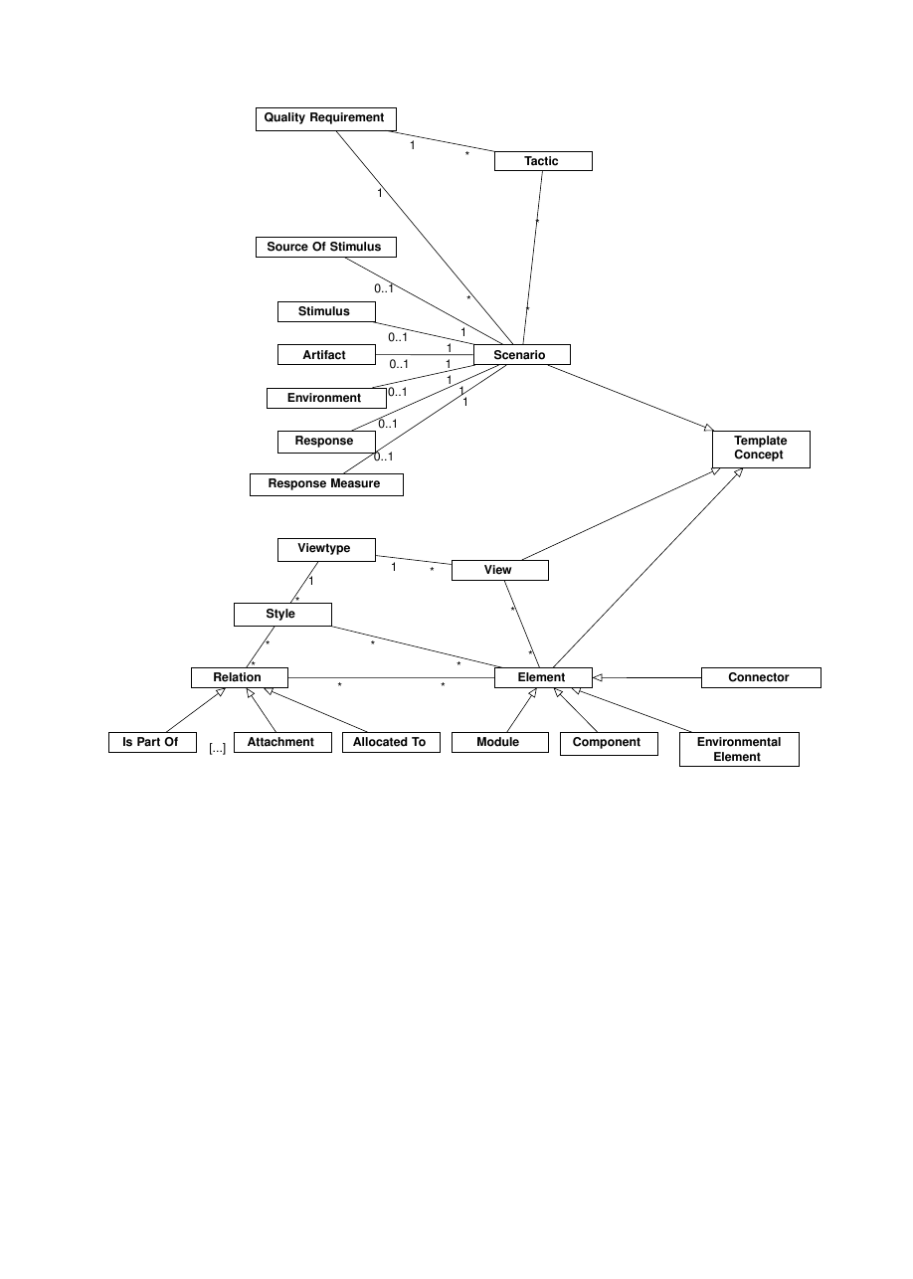
Abstract Domain Model
Notes:
This is an abstract domain model, showing the concepts presented.
The Scenario has its elements, which belong to only a single scenario. It also has a quality requirement and a set of tactics, which are specific for that quality requirement
A view belongs to a certain viewtype, which refines into a set of styles. A view has a set of elements, which are related to each others.
The Scenario, View, and Element are the main concepts, and have dedicated templates. In these templates, the relations with other elements are shown.

Slide 19
Template Schema
<html>
<body>
<div id="ScenarioIdentification">
<span>Scenario Name</span>
<span>Scenario Quality Requirement</span>
</div>
<div id="ScenarioDetails">
<span>Scenario Description</span>
<div id="Scenario Elements">
<div id="Source of Stimulus">Description</div>
<div id="Stimulus">Description</div>
<div id="Artifact">Description</div>
<div id="Environment">Description</div>
<div id="Response">Description</div>
<div id="Response Measure">Description</div>
<div id="Tactics">
<div>Tactic1 Description</div>
<div>Tactic2 Description</div>
</div>
</div>
</div>
</body>
</html>
Notes:
This is a possible schema for a Scenario. The scenario description is added to it, and their elements are shown inside the template.

Slide 20
Application's Features
Notes:
I will now give a more detailed description of the applications features

Slide 21

Application's Features
Document
  Adding and removing documents
  Parsing into a view
Notes:
Adding and removing documents allows adding documents to analyze
By being able to parse the documents in a view, students can read and analyze the text.

Slide 22
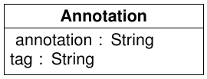
Application's Features
Annotation
  Select text
  Assign a tag from a closed set
Notes:
Inside the document view, it is possible to select parts of text and tag them with one of the concepts from the Software Architectures course, thus creating an Annotation.
Annotations help organizing the knowledge, and creating the correlation between the theoretical concepts and the practical examples

Slide 23
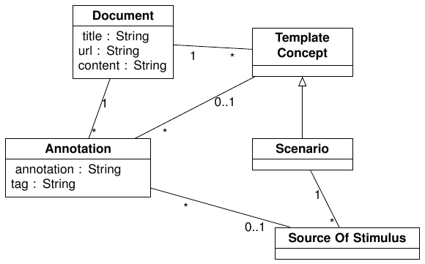
Application's Features
Annotation
  Associate with templates
    According to the tag
Templates
  Can be created
  Show associated annotations
Notes:
These annotations can be associated with templates, accordingly with the tag given. For example, annotations with tag “Scenario”, “Source Of Stimulus”, etc., can only be associated with Scenario templates.
Templates can be created for a certain annotation.
Inside the template, it is possible to see all the associated annotations.
This not only improves understanding the theory-practice correlation, but also allows to see how the different concepts are related.

Slide 24
Application's Features
Templates
  Add more information than annotations
    Scenario Tactics, Module relations, etc.
  Add user text
    To improve the descriptions
Notes:
Inside the templates, it is also possible to add more information.
In the case of Scenarios, it is possible to add specific tactics, accordingly with the quality requirement.
In the case of Modules, it is possible to add relations with other Modules
In the case of components and connectors, it is possible to add ports and roles, and attachment relations between ports and roles.
In the case of the views, it is possible to add elements, accordingly with the selected viewtype.
In all templates, it is possible to add user text to help describing the concepts.

Slide 25
Application's Features
Structured Representation
  Aggregates all templates
  Overview of the whole document
Notes:
Finally, inside the document view it is possible to navigate to the structured representation of the document.
This structured representation aggregates all the templates associated with the document in a single view, allowing the students to see how a real software system relates with the concepts learnt in the classes.
It is also a good study helper, as it provides an overview of the important parts of a document.

Slide 26
Demonstration
Notes:
Mostrar a aplicação a funcionar...

Slide 27
Evaluation
Evaluate usability and usefulness
Volunteers enrolled in Software Architectures Course
8 Volunteers
  From which 5 answered the Survey
Results indicative, not conclusive
Notes:
To assess the usability and usefulness of the platform, students enrolled in the Software Architectures class were proposed to volunteer to test the platform in terms of creating annotations and associating them with Scenarios, and then register their opinions in a small survey.
Unfortunately, only eight students volunteered to test the application, and from these eight, only five answered the survey.
Therefore, the results I am going to present are merely indicative, but not conclusive.

Slide 28
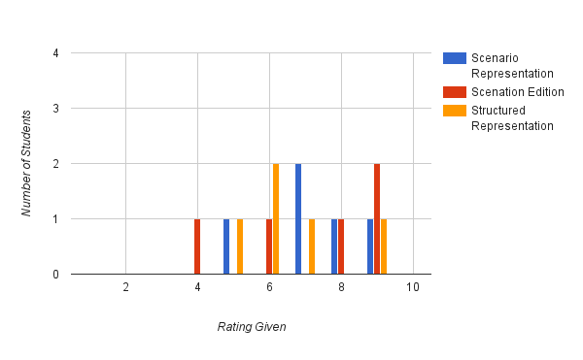
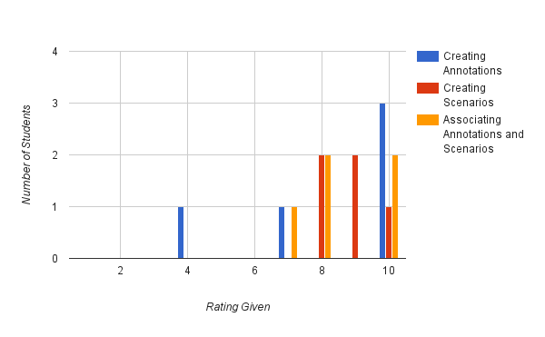
Evaluation
Usability
Notes:
The Students were asked to rate several aspects of the usability of the platform in a scale from 1 to 10. These aspects include creating annotations, creating, viewing and editing scenarios, associating annotations and viewing the structured representation of a document.
Overall students found the application easy to use, although there were complaints related to the AnnotatorJS interface.

Slide 29
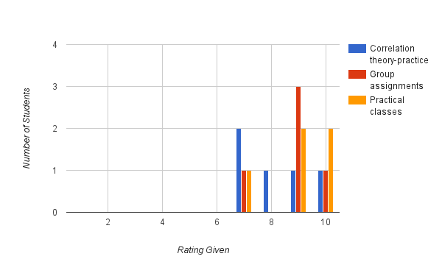
Evaluation
Usefulness
Notes:
The students were also asked to rate the usefulness of this platform in the sense of how much it helps in correlating theory with practice, and how useful it could be in group assignments and practical classes.
Despite still needing some improvements, students found the platform useful, specially for their group assignments and practical classes.

Slide 30
Future Work
Allocation Viewtype
Graphical Representations
Social Elements
  Groups
  Discussions
  Reputation System
Notes:
Developing a fully social platform that provides knowledge structuring was a very ambitious goal, and the solution developed focused on having a way to create a co-relation between the software description text and the Software Architectures concepts.
For future development, the platform should include the Allocation Viewtype views and elements, which are less used but important nonetheless.
Views are easier to understand if they are represented graphically, and should be available
And finally, the inclusion of social elements, such as a reputation system, discussion forums and the existence of groups

Slide 31
Collaborative Platform for Analysis of Software Systems
Catarina Isabel Carvalho Santana
Thesis to obtain the Master of Science Degree in
Information Systems and Computer Engineering
Advisor: Prof. António Manuel Ferreira Rito da Silva
30th October 2015

